Slide 1
DIGITAL FTE
PERFORMANCE INDEX – QUALITY DIMENSION
Answer Quality, Trustworthiness, LLM Evaluation & Runtime Quality Scoring
Presented to: Executive Briefing: CEO, Ranga ( group managers ), Phanindra Sir ( Team Lead)
Status: Development Complete Production Quality Pending (Regeneron AWS/RDS + Approved Benchmark Dataset)

Slide 2
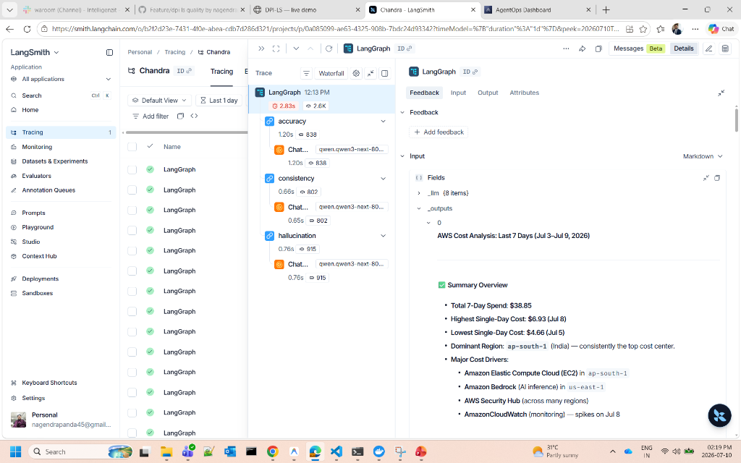
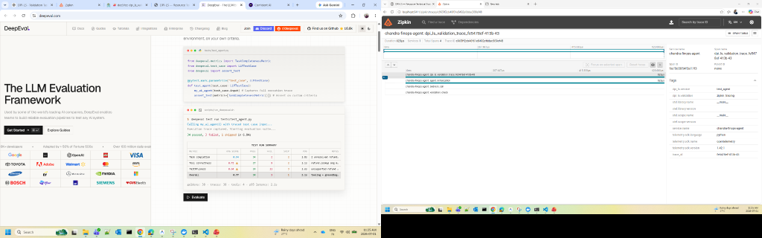
DPI-LS PERFORMANCE INDEX
What is DPI-LS Quality & How It Works
Digital FTE Quality Index
• Quality (Q) measures whether an AI Agent produces accurate, relevant, trustworthy and consistent answers during runtime.
• Quality combines three runtime evaluation resources: • AgentOps • LangSmith • Ragas
• Together they evaluate: • LLM answer quality • Prompt execution • Agent workflow Runtime observability • Retrieval quality AI reasoning consistency
• Quality ensures every AI execution can be evaluated before production deployment.
• Runtime telemetry is collected from AgentOps, LangSmith, and Ragas using real OpenTelemetry traces in the development environment.

Slide 3
DPI-LS PERFORMANCE INDEX
Quality (Q) Dimension & Telemetry Sources
AgentOps Runtime Observability Session Replay Token Usage Cost Execution Timeline | LangSmith Execution Traces Prompt Flow LangGraph Datasets Experiments | Ragas Answer Relevancy Faithfulness Context Precision Context Recall Correctness
No | Parameter | What It Measures | Source System | URL / Where Data Comes From
1 | LLM Runtime Observability | • Prompt Tokens • Completion Tokens • Total Tokens • LLM Calls • Session Replay • Agent Actions • Runtime Duration • Cost Tracking • Execution Timeline | AgentOps SDK | https://app.agentops.ai
2 | LLM Execution Tracing | • Prompt Flow • Chain Execution • LangGraph Nodes • Dataset Runs • Trace Hierarchy • Span Execution • Prompt Versions • Experiment Tracking | LangSmith | https://smith.langchain.com
3 | LLM Quality Evaluation | • Answer Relevancy • Faithfulness • Context Precision • Context Recall • Answer Correctness • Semantic Similarity • Response Groundedness | Ragas | https://docs.ragas.io

Slide 4
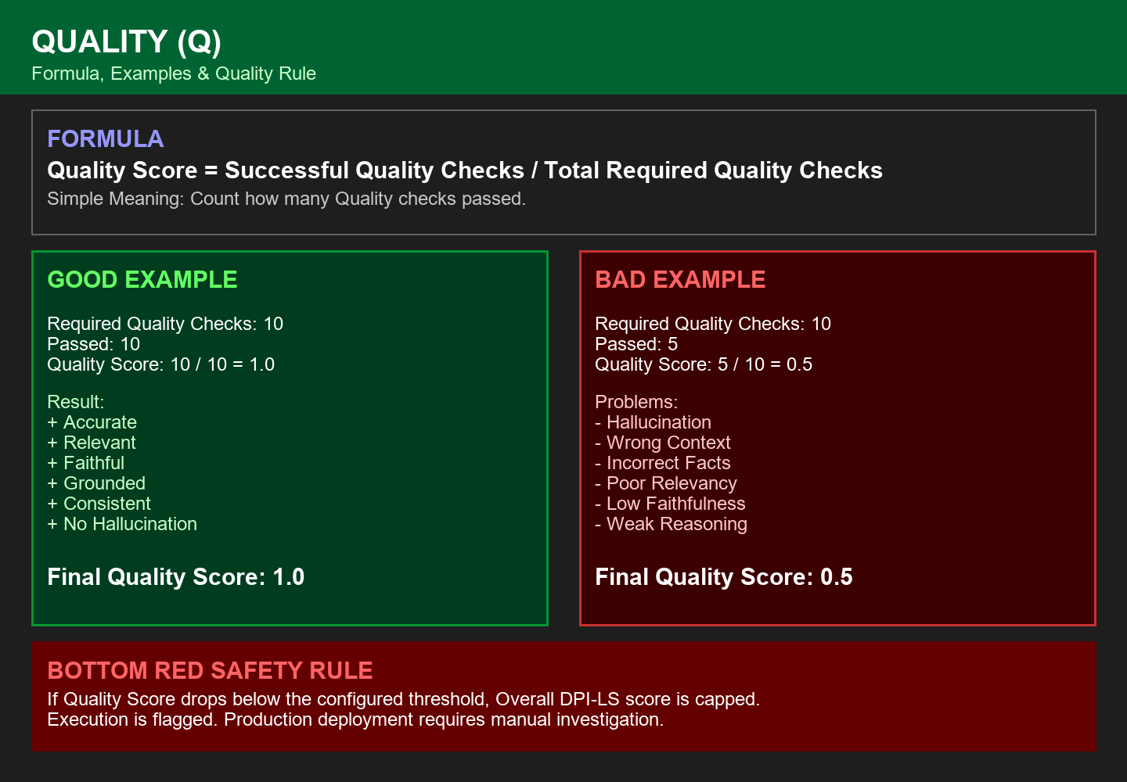
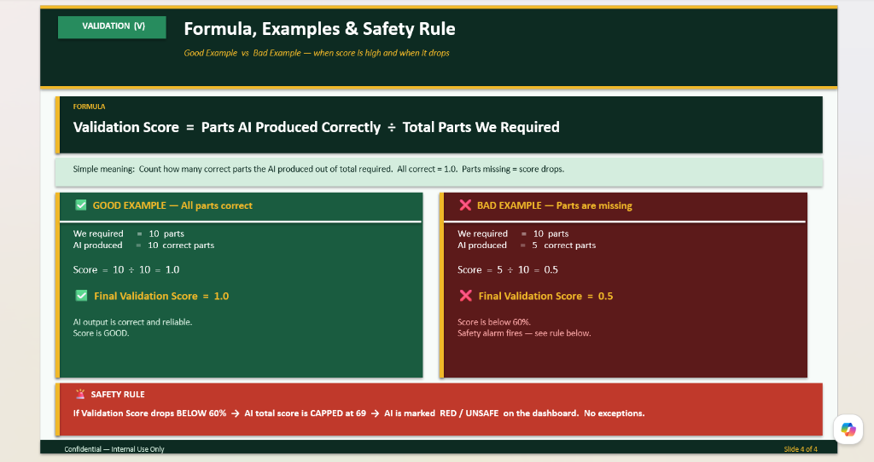
DPI-LS PERFORMANCE INDEX
Formula, Examples & Quality Rule
Key Logic Highlights
• Formula: Quality Score = Successful Quality Checks ÷ Total Required Quality Checks
• The validation score represents how many required validation checks passed successfully.
• If all validation checks pass, Quality Score = 1.0
• If several checks fail, Quality Score decreases accordingly.
• Good Example: Passed = 10 / Required = 10 Score = 1.0 (Runtime successfully validated)
• Bad Example: Passed = 5 / Required = 10 Score = 0.5 (Quality confidence decreases)
• Safety Rule: If Quality Score drops below the configured threshold, the overall DPI-LS score is reduced and the dashboard flags the execution for investigation.

Slide 5
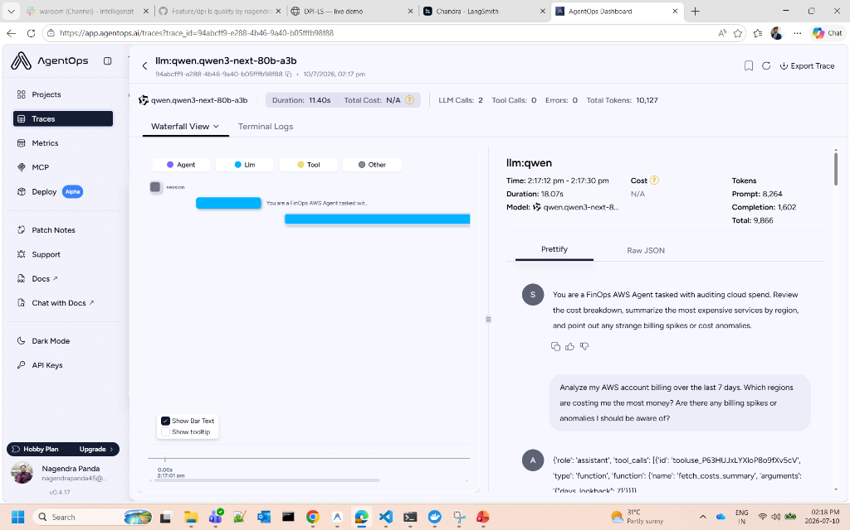
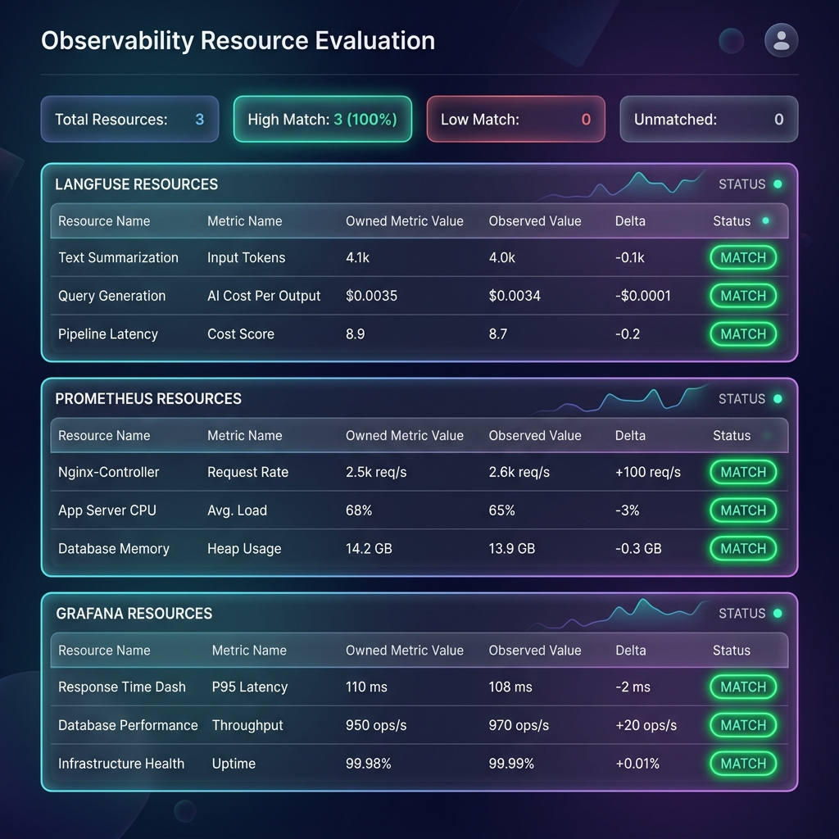
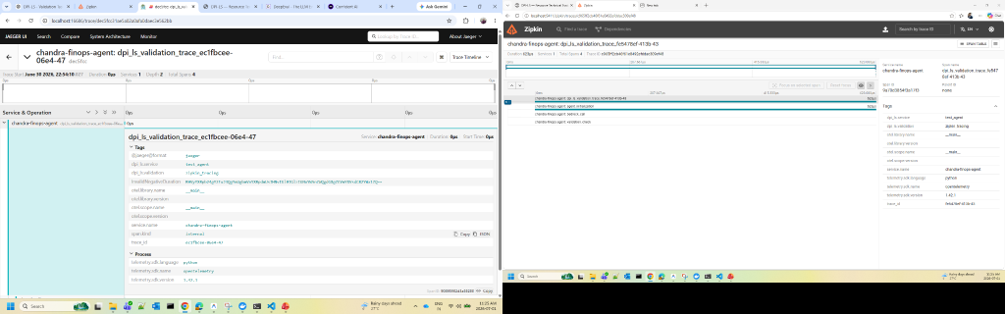
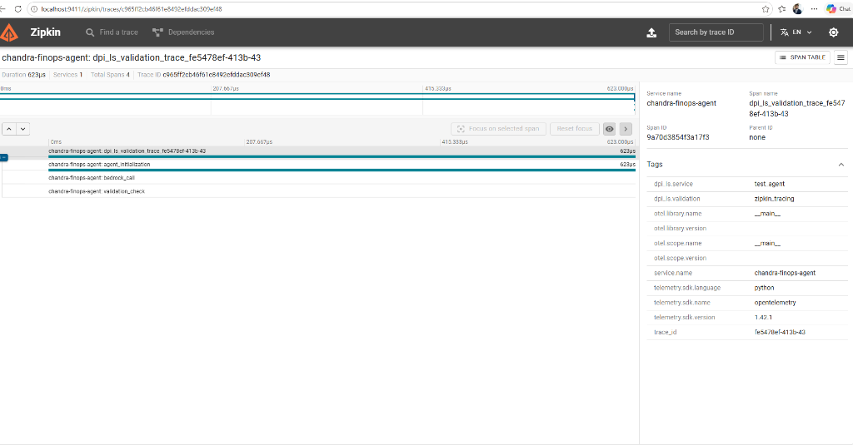
DPI-LS PERFORMANCE INDEX
DPI-LS Quality Dashboards & Runtime Evidence
LLM Evaluation Metrics
Distributed Runtime Tracing
Trace Timeline Visualization
Quality Resource Evaluation Dashboard
Quality dashboards showing real runtime evaluation and distributed observability. Evidence is collected from AgentOps, LangSmith and Ragas during development using OpenTelemetry.

Slide 6
DPI-LS PERFORMANCE INDEX
Production Quality Execution Workflow
■ Step 1: Start LangSmith
Docker container (Port 16686)
■ Step 2: Start Ragas
Docker container (Port 9411)
■ Step 3: Start Backend uv run uvicorn api.app:app --host 127.0.0.1 --port 8000 --reload uv run uvicorn api.app:app --host 127.0.0.1 --port 8000 --reload
uv run uvicorn api.app:app --host 127.0.0.1 --port 8000 --reload
■ Step 4: Run Quality Agent
uv run python examples/test_agent.py
■ Step 5: Execute Quality
AgentOps evaluation, LangSmith tracing, Ragas tracing
■ Step 6: Verify Results
Quality Dashboard, AgentOps Metrics, LangSmith Trace, Ragas Timeline, Resources Dashboard
Expected Results: AgentOps → SUCCESS LangSmith → SUCCESS Ragas → SUCCESS Resources Dashboard → SUCCESS Live Runtime Metrics Displayed

Slide 7
DPI-LS PERFORMANCE INDEX
Quality Dimension Summary
✅ AgentOps integrated
✅ LangSmith integrated
✅ Ragas integrated
✅ OpenTelemetry implemented
✅ Quality Resources Dashboard
✅ Live Runtime Metrics
✅ FastAPI Backend
✅ SQLite Integration
✅ Development Testing Completed
Next Steps:
• Regeneron AWS validation
• Regeneron RDS
• Approved Benchmark Dataset
• Production Recall Measurement
• M6 Quality

