Slide 1
DIGITAL FTE
PERFORMANCE INDEX – VALIDATION DIMENSION
Cost Traceability, Real-Time Telemetry & Core Scoring Validation
Presented to: Executive Briefing: CEO, Ranga ( group managers ), Phanindra Sir ( Team Lead)
Status: Development Complete Production Validation Pending (Regeneron AWS/RDS + Approved Benchmark Dataset)

Slide 2
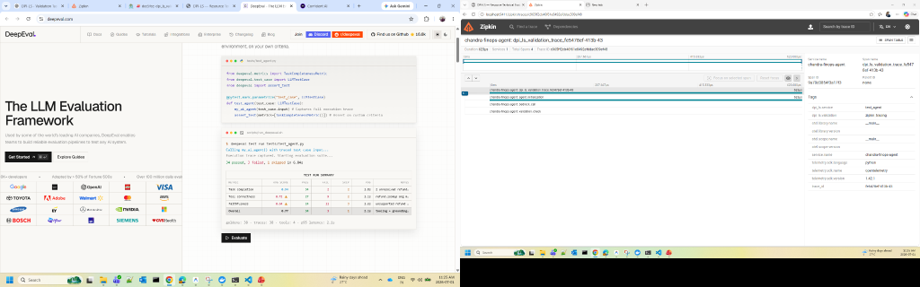
DPI-LS PERFORMANCE INDEX
What is DPI-LS Validation & How It Works
Digital FTE Validation Index
• Validation (V) measures whether an AI agent produces trustworthy, accurate, observable and verifiable outputs during runtime.
• The Validation dimension combines three runtime validation resources: • DeepEval • Jaeger • Zipkin
• Together they evaluate: • AI answer quality • Runtime correctness • Distributed execution tracing • End-to-end observability
• Validation ensures every AI execution can be evaluated, traced and verified before production deployment.
• Runtime telemetry is collected from DeepEval, Jaeger, and Zipkin using real OpenTelemetry traces in the development environment.

Slide 3
DPI-LS PERFORMANCE INDEX
Validation (V) Dimension & Telemetry Sources
Runtime Metrics
DeepEval: Answer Relevancy, Faithfulness, Hallucination, Correctness | Jaeger: Trace ID, Span Count, Latency, Dependencies | Zipkin: Trace Timeline, Execution Timeline, Service Calls, Trace Latency
No | Parameter | What It Measures | Source System | URL / Where Data Comes From
1 | LLM Quality Evaluation | Evaluates Answer Relevancy, Faithfulness, Hallucination and Correctness. | DeepEval SDK | https://deepeval.com
2 | Distributed Trace Monitoring | Captures runtime spans, latency, service dependencies and execution flow. | Jaeger | http://localhost:16686
3 | Execution Timeline Visualization | Captures request timeline, trace visualization, service execution path and runtime analysis. | Zipkin | http://localhost:9411

Slide 4
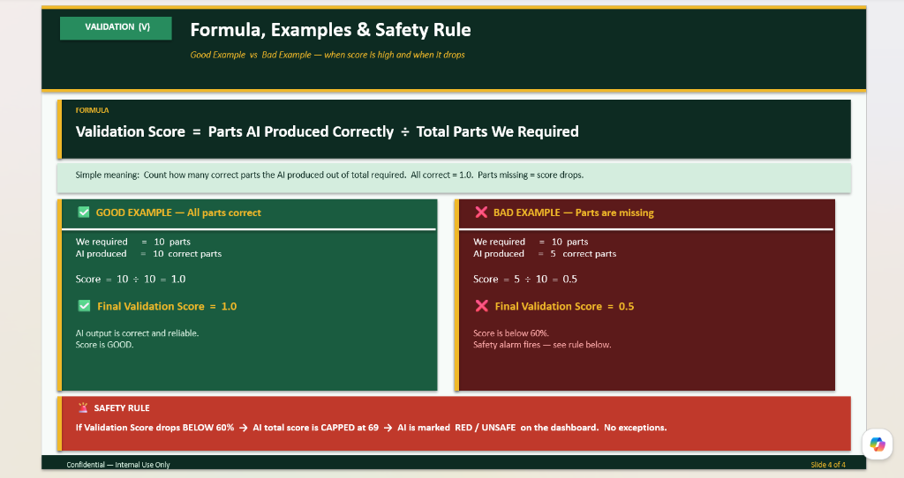
DPI-LS PERFORMANCE INDEX
Formula, Examples & Validation Rule
Key Logic Highlights
• Formula: Validation Score = Correct Validation Checks ÷ Total Validation Checks
• The validation score represents how many required validation checks passed successfully.
• If all validation checks pass, Validation Score = 1.0
• If several checks fail, Validation Score decreases accordingly.
• Good Example: Passed = 10 / Required = 10 Score = 1.0 (Runtime successfully validated)
• Bad Example: Passed = 5 / Required = 10 Score = 0.5 (Validation confidence decreases)
• Safety Rule: If Validation Score drops below the configured threshold, the overall DPI-LS score is reduced and the dashboard flags the execution for investigation.

Slide 5
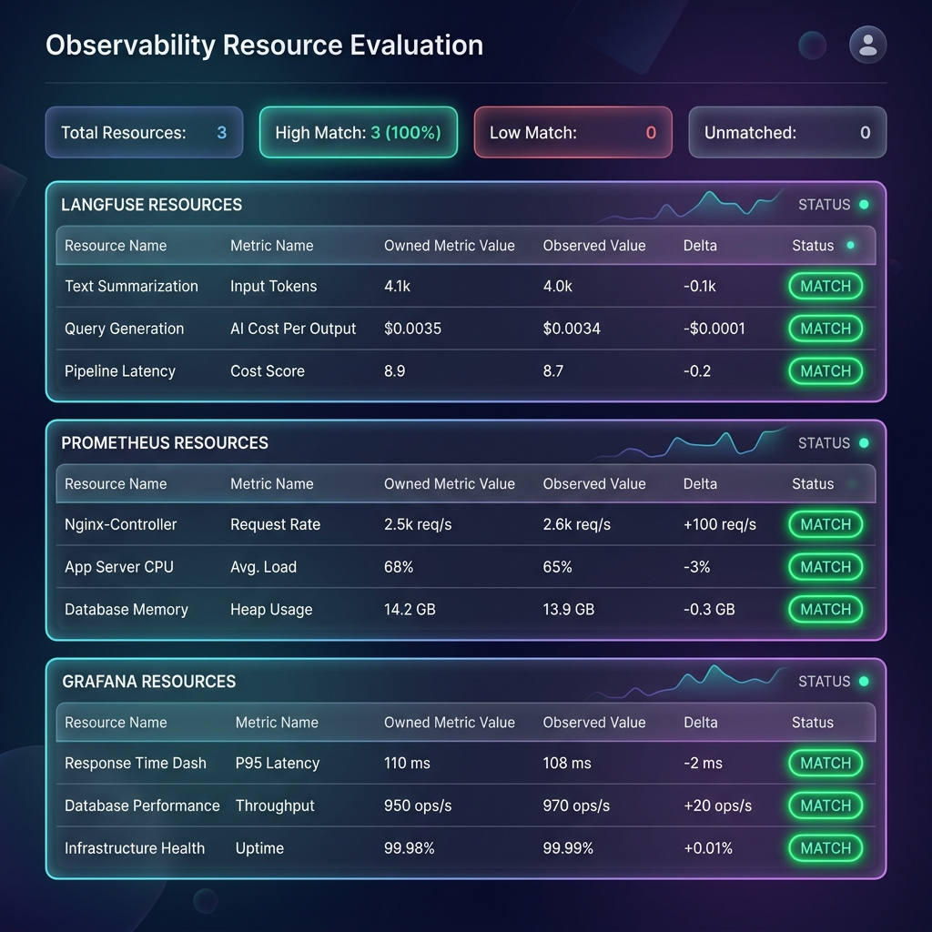
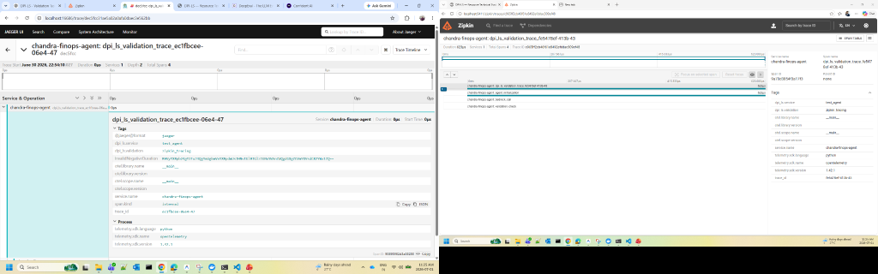
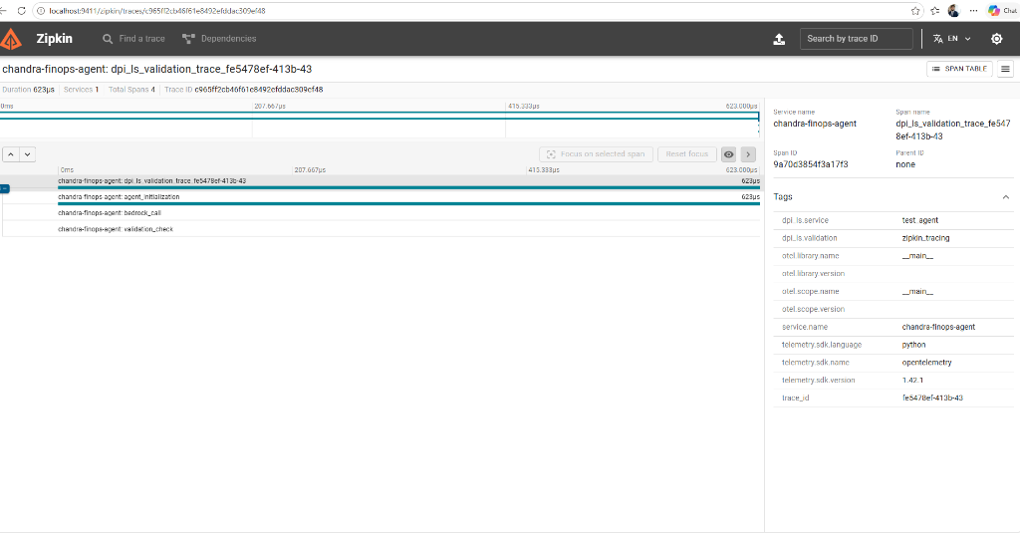
DPI-LS PERFORMANCE INDEX
DPI-LS Validation Dashboards & Runtime Evidence
LLM Evaluation Metrics
Distributed Runtime Tracing
Trace Timeline Visualization
Validation Resource Evaluation Dashboard
Validation dashboards showing real runtime evaluation and distributed observability. Evidence shown is from live runtime telemetry captured in the development environment using OpenTelemetry.

Slide 6
DPI-LS PERFORMANCE INDEX
Production Validation Execution Workflow
■ Step 1: Start Jaeger
Docker container (Port 16686)
■ Step 2: Start Zipkin
Docker container (Port 9411)
■ Step 3: Start Backend
uv run uvicorn api.app:app --host 127.0.0.1 --port 8000 --reload
■ Step 4: Run Validation Agent
uv run python examples/test_agent.py
■ Step 5: Execute Validation
DeepEval evaluation, Jaeger tracing, Zipkin tracing
■ Step 6: Verify Results
Validation Dashboard, DeepEval Metrics, Jaeger Trace, Zipkin Timeline, Resources Dashboard
Expected Results: DeepEval → SUCCESS Jaeger → SUCCESS Zipkin → SUCCESS Resources Dashboard → SUCCESS Live Runtime Metrics Displayed

Slide 7
DPI-LS PERFORMANCE INDEX
Validation Dimension Summary
✅ DeepEval integrated
✅ Jaeger integrated
✅ Zipkin integrated
✅ OpenTelemetry implemented
✅ Validation Resources Dashboard
✅ Live Runtime Metrics
✅ FastAPI Backend
✅ SQLite Integration
✅ Development Testing Completed
Next Steps:
• Regeneron AWS validation
• Regeneron RDS
• Approved Benchmark Dataset
• Production Recall Measurement
• M6 Validation

