Slide 1
DPI-LS: Digital Performance Index
Life Science AI Governance & Observability Platform
Sales & Marketing Presentation

Slide 2
What is DPI-LS & Why Did We Build It?
DPI-LS is an enterprise-grade AI governance and scoring platform.
Aggregates telemetry from 20+ observability tools into a single pane of glass.
Built for Life Sciences to enforce strict regulatory compliance (FDA/HIPAA).
Acts as a strict gatekeeper to prevent AI hallucinations and security vulnerabilities.

Slide 3
Benefits, Advantages & Features
Mitigates Enterprise Risk: Stops prompt injections and PII leaks.
Empowers Business Owners: SMEs set custom success baselines.
Single Pane of Glass: Replaces 20 dashboards with one simple grade.
Cost Tracking: Ensures your AI digital workforce is ROI-positive.

Slide 4
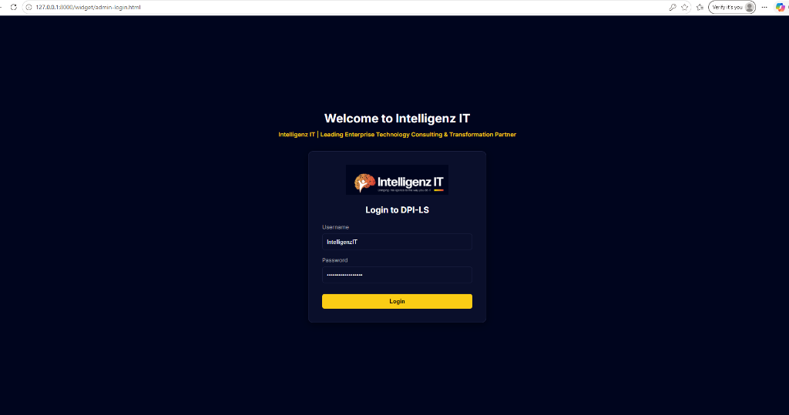
1. Secure Login
Administrators securely authenticate to access the DPI-LS enterprise governance platform.

Slide 5
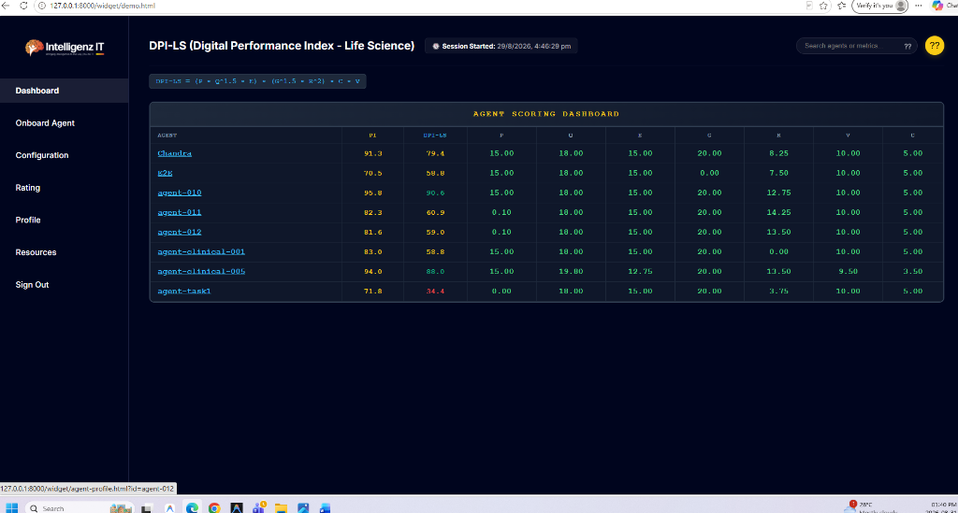
2. Global Dashboard
A unified view of all active agents and their performance scores across the 7 critical telemetry dimensions.

Slide 6
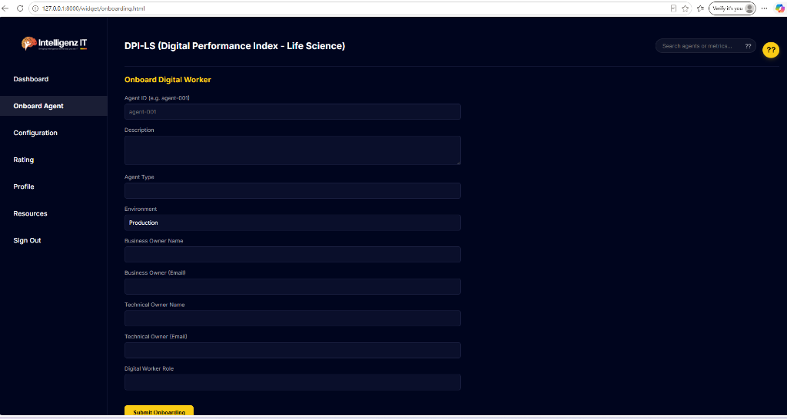
3. Agent Onboarding
Register new digital workers by defining their environment, scope, and technical/business ownership.

Slide 7
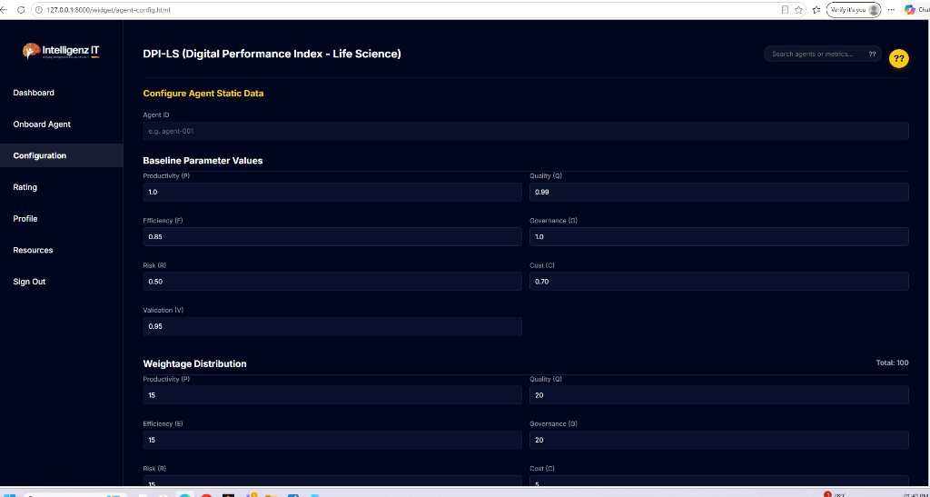
4. Business Configurations
SMEs dictate AI success by dynamically setting baseline targets and distributing 100% weight across the 7 metrics.

Slide 8
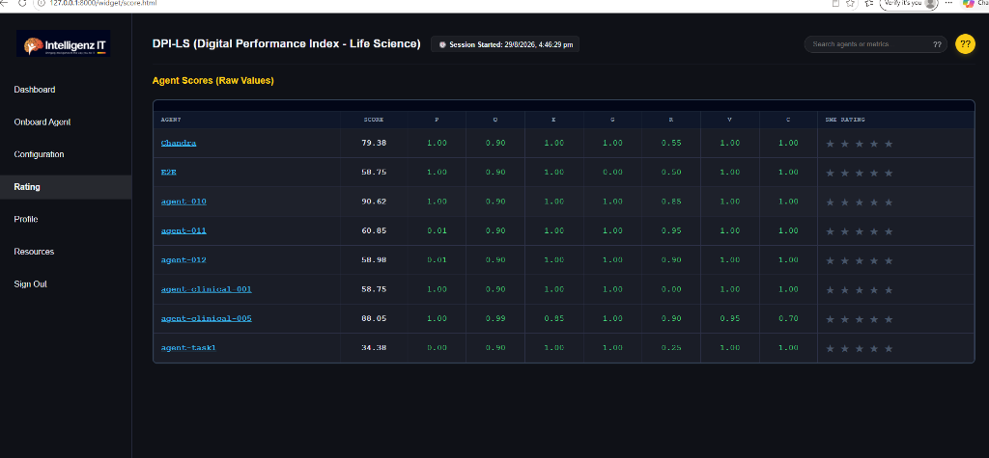
5. Manager Ratings
Business owners submit manual star-ratings to ensure empirical scores align with real-world human expectations.

Slide 9
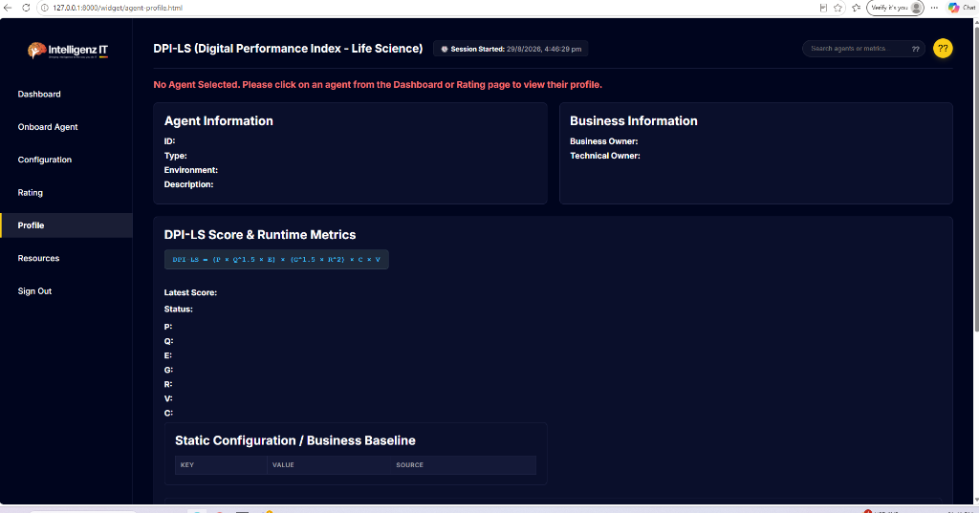
6. Agent Profile & Auditing
A deep-dive verifiable audit trail for individual agents to track parameters and reject unsafe models.

Slide 10
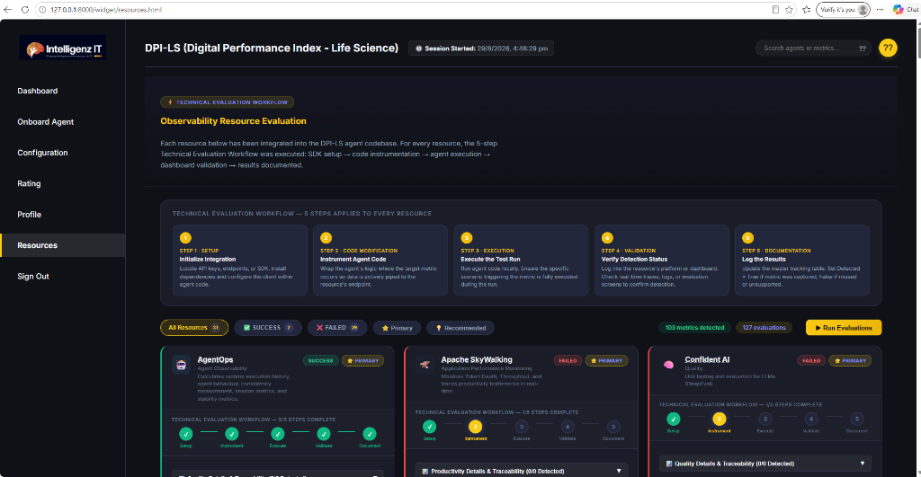
7. Telemetry Resources
Monitor the real-time operational status of 20+ integrated external observability tools like AgentOps and Langfuse.

Slide 11
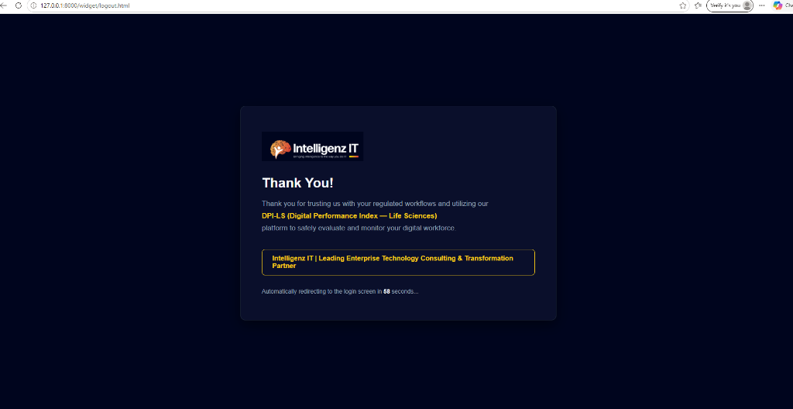
8. Secure Logout
Strict session expiration automatically terminates access and securely redirects users back to the login screen.

