Slide 1
DIGITAL FTE
PERFORMANCE INDEX – LIFE SCIENCES

Slide 2
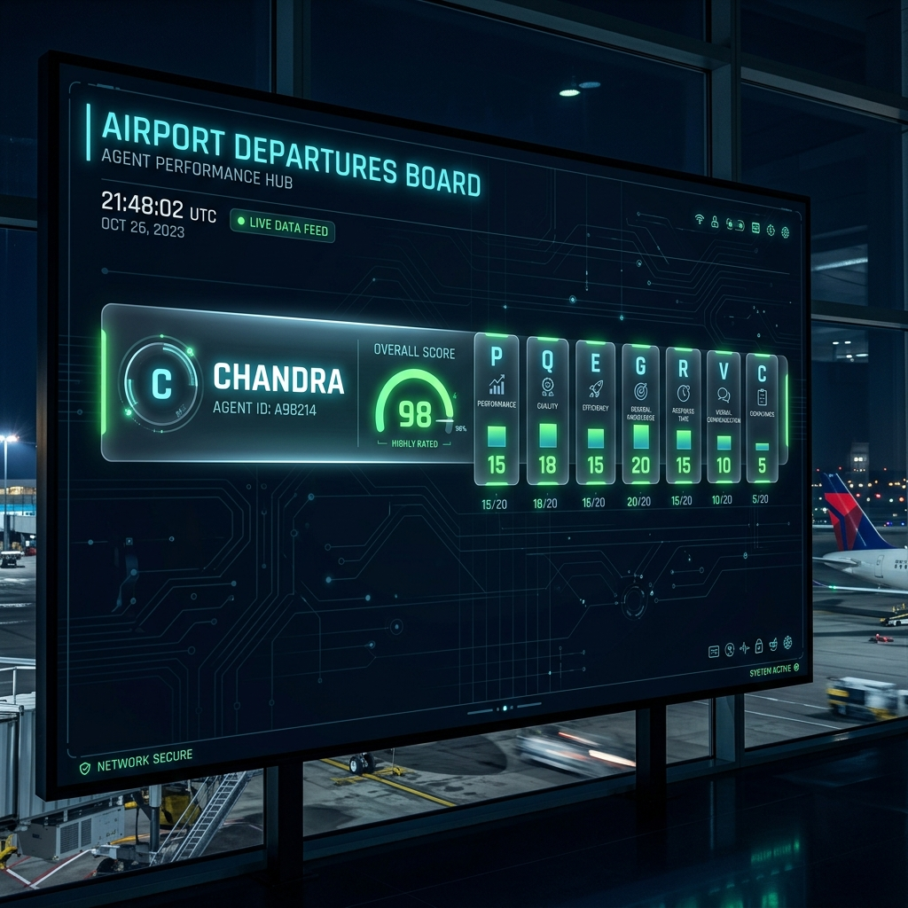
DPI-LS PERFORMANCE INDEX
What is DPI-LS & How It Works
Digital FTE Performance Index
• DPI-LS is a comprehensive, risk-weighted KPI framework designed specifically for Life Sciences AI deployments.
• It continuously measures agent performance across 7 Dimensions: Productivity (P), Quality (Q), Execution (E), Governance (G), Risk (R), Validation (V), and Cost (C).
• It prevents unchecked runtime executions and provides full trace logging for compliance.
• Composite Formula: DPI-LS = (P × Q^1.5 × E) × (G^1.5 × R^2) × C × V

Slide 3
DPI-LS PERFORMANCE INDEX
Cost (C) Dimension & Telemetry Sources
Defining the Cost (C) Dimension
The Cost score measures how economically viable the AI agent is relative to a human operator. Data is collected across three live telemetry tools: Langfuse (token cost tracking), Prometheus (aggregation metrics), and Grafana (dashboard visualization).
No | Parameter | What It Measures | Source System | URL / Where Data Comes From
1 | Token Spends & API Latency | Counts raw input/output tokens and cost in USD. | Langfuse Cloud | https://cloud.langfuse.com (Secure API Keys)
2 | Live Metrics (e.g. TCO, score) | Aggregates utilization, input/output tokens, and model costs. | Prometheus exporter | http://localhost:9090 (Port 9090 - Live query)
3 | Efficiency Ratios & Visuals | Tracks cost performance curves, raw values, and weighted indexes. | Grafana Dashboard | http://localhost:3000 (Port 3000 - Live UI)

Slide 4
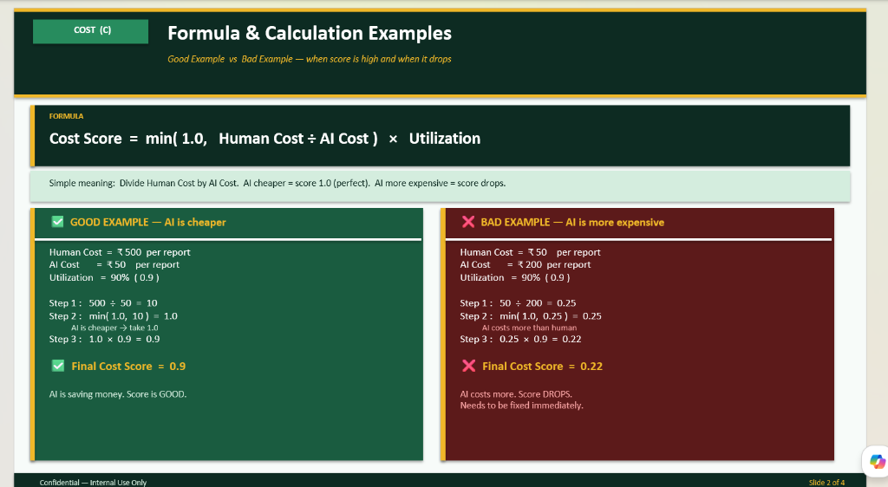
DPI-LS PERFORMANCE INDEX
Formula & Calculation Examples
Key Logic Highlights
• Formula: C = min(1.0, Human Cost / AI Cost) * Utilization
• If AI is cheaper, the ratio is capped at 1.0 (maximum raw performance score).
• If AI is more expensive than human, the ratio is inverted, causing the score to drop rapidly.
• Utilization factor scales the score linearly to ensure idle/wasteful agents are penalized.
• USD Formats: Live metrics are fully formatted in USD ($) across the entire UI/telemetry stack.

Slide 5
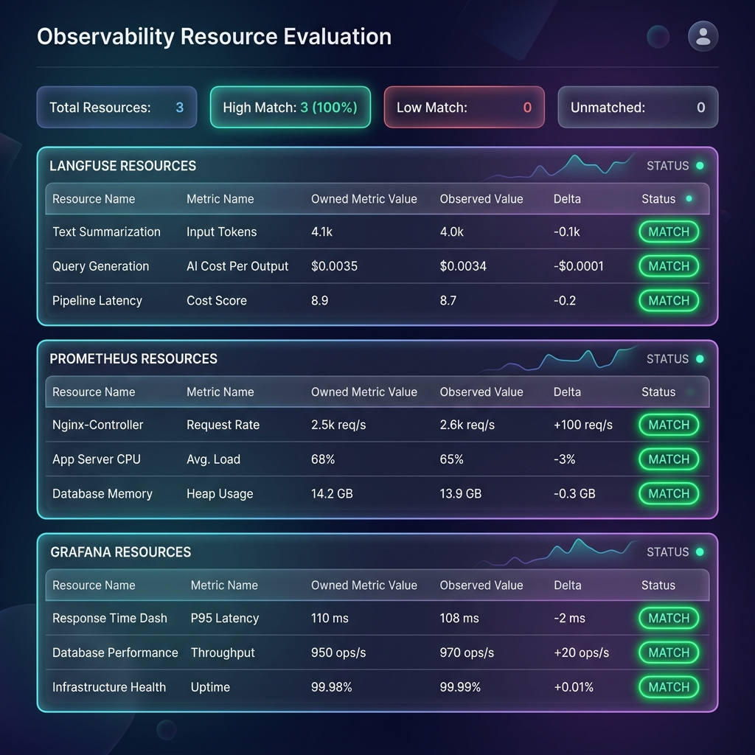
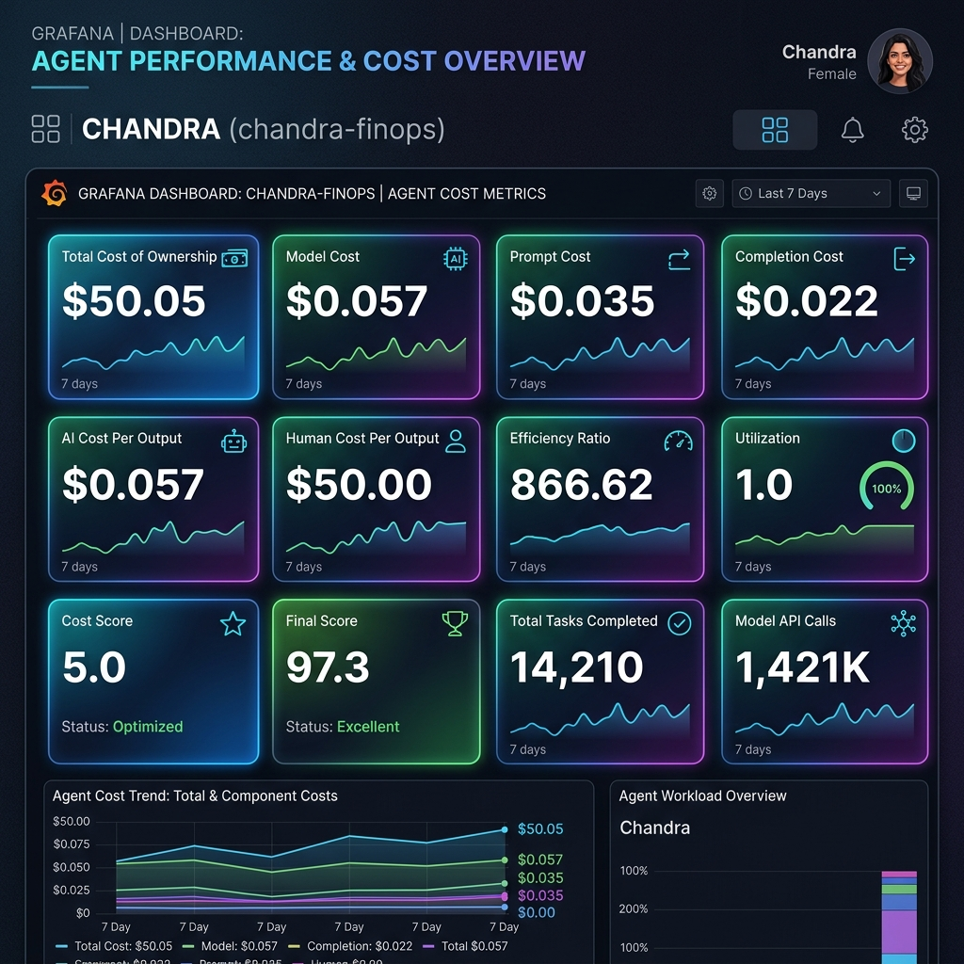
DPI-LS PERFORMANCE INDEX
DPI-LS Production Dashboards & UI
Resources Page: Expanded default cards showing live USD costs per agent run
Grafana Dashboard: Real-time telemetry monitoring Chandra FinOps agent

Slide 6
DPI-LS PERFORMANCE INDEX
Production Command Execution Workflow
Run each service in a separate PowerShell terminal to start the live dashboard:
■ 1. Launch Prometheus (Port 9090)
cd 'C:\Users\User\Downloads\prometheus-3.12.0.windows-amd64\prometheus-3.12.0.windows-amd64' .\prometheus.exe --config.file=prometheus.yml --web.listen-address=127.0.0.1:9090
■ 2. Launch Grafana Server (Port 3000)
cd 'C:\Users\User\Downloads\grafana_13.0.2_26816849631_windows_amd64\grafana-13.0.2\bin' .\grafana.exe server --homepath '..'
■ 3. Start the API Backend Server (Port 8000)
cd 'd:\Projects\widget\widget' uv run uvicorn api.app:app --host 127.0.0.1 --port 8000
■ 4. Execute AI Agent Run (Pipes traces to Langfuse & exports telemetry metrics)
cd 'd:\Projects\widget\widget' uv run python examples/test_agent.py

