Slide 1

Toronto Crime Data Exploration and Prediction Model
Phanindra kumar Tirumalasetty
DATA - 602 Intro to Data Analysis and Machine Learning (Devin Fensterheim)

Slide 2
Project Approach: CRISP-DM
Business Understanding
Data Understanding
Data Preparation
Modeling
Evaluation
Deployment
Notes:
Neta

Slide 3
Introduction
Background information on Toronto Crime Data Exploration
The Toronto Crime Data Exploration and Prediction Model is a project that aims to analyze and predict major crimes reported in the city of Toronto, Canada. The project uses the "Major Crime Indicators Open Data" dataset provided by the Toronto Police Service, which contains information on crimes reported from 2014 to 2022.
Objectives of the project
The main objectives of this project are to explore the patterns and trends of major crimes in Toronto, identify the most common types of crimes and their locations, and develop a predictive model to forecast future crime occurrences.

Slide 4

Data
The dataset used in this project is the "Major Crime Indicators Open Data" provided by the Toronto Police Service. It includes information on the type of crime, the date and time it occurred, the location, and other relevant details such as the status of the case and any arrests made. The project is developed in a Jupyter notebook in includes exploratory data analysis (EDA) and a logistic regression prediction model.

Slide 5
About the Dataset
The dataset includes information on crimes such as homicide, sexual assault, assault with a weapon, robbery, break and enter, and auto theft.
323,397 Observations, The dataset has 29 columns
Unique event id, Offence
Crime Occurrence year, month, day and time.
Reported date, time and year.
Longitude, Latitude positions(X,Y)
Location, neighborhood and address.
Features : Latitudes, Longitudes, Crime occurrence date, time and month to find the type of Offence.

Slide 6
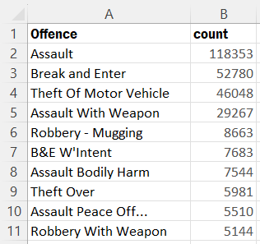
Top 10 most frequently occurring crimes
Data Analysis
Assault, break and enter, and theft-related offenses are the most common criminal offenses reported.
Assault, with the highest count, is a cause for concern as it indicates a high level of physical violence and harm to individuals.
Break and enter offenses may indicate inadequate security measures in buildings and properties, leading to increased incidents of theft and burglary.
Theft of motor vehicle offenses may point towards a lack of proper safety measures to safeguard vehicles
the data can assist in creating awareness and educating people on safety measures to protect themselves and their property from such criminal offenses.

Slide 7
Most common offence, crime location and month
Data Analysis
The most common offence is 'Assault' with 118353 occurrences.
The most common crime location is Apartment (Rooming House, Condo) with 77032 occurrences.
The most common month for crime is October with 28973 occurrences.

Slide 8
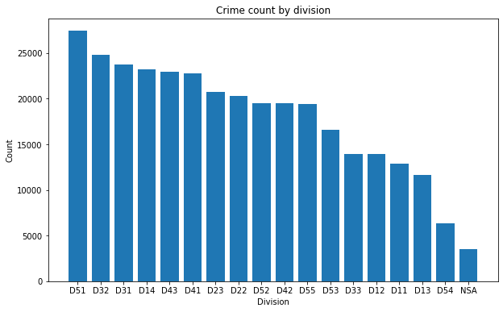
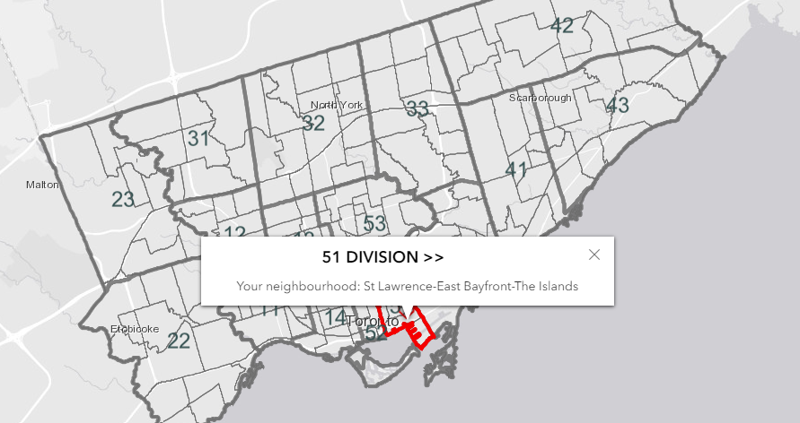
Visualize the crime count by Division
Data Visualization

Slide 9
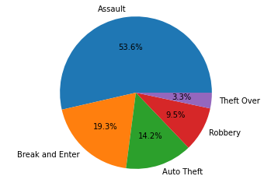
The most common Crime (OFFENCE)
Data Visualization

Slide 10
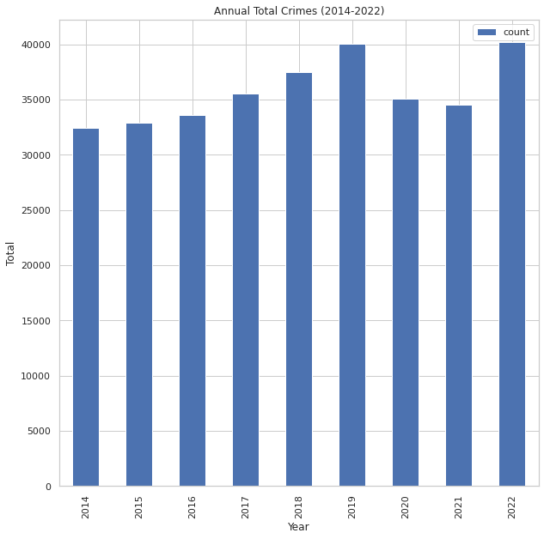
Annual Total Crimes
Data Visualization
Based on the given table, we can conclude that the total number of crimes reported has been increasing over the years in the given area.
This upward trend in the number of crimes reported over the years is a cause for concern and needs to be addressed by law enforcement agencies and policymakers.
The fluctuation in the trend, such as a decrease in 2020 and 2021, could be due to various factors, including social and economic conditions, changes in law enforcement policies, or other external factors

Slide 11
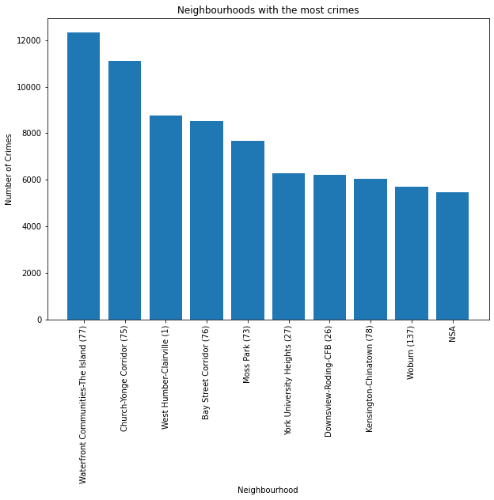
Neighborhoods with the most crimes
Data Visualization
Some neighborhoods have higher crime rates than others, with Waterfront Communities-The Island and Church-Yonge Corridor having the highest number of reported crimes.
On the other hand, some neighborhoods, such as Woburn and NSA, have relatively lower crime rates.
The variation in crime rates can be attributed to several factors, including population density, socioeconomic conditions, and law enforcement efforts.

Slide 12
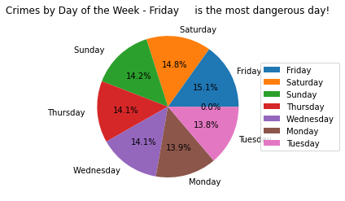
Crimes by Day of the Week - to find the most dangerous day
Data Visualization
The higher percentage of crime reported on weekends, including Friday and Saturday, could be due to increased social activities, such as parties and events, leading to more opportunities for criminal activity.
The lower percentage of crime reported on Monday and Tuesday could be due to fewer social activities and less crowded public spaces.

Slide 13
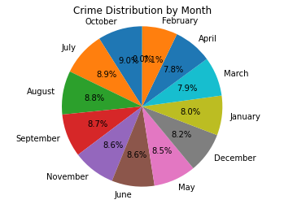
Crime Distribution by Month
Data Visualization
October has the highest percentage of crimes reported at 9.0%
May, June, July, August, September, and October have relatively high percentages of crimes reported, while February has the lowest percentage of crimes reported
Factors responsible for the variation in crime rates across different months, such as seasonal changes, holidays, or other external factors.

Slide 14
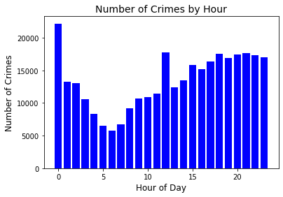
Number of Crimes by Hour
Data Visualization
Based on the bar chart, the number of crimes reported is highest at midnight, and it gradually decreases as the night progresses.
From 6 AM, there is a steady increase in the number of crimes reported, which continues till noon.

Slide 15
Prediction using Logistic regression
Modeling
Logistic regression is a statistical model used for predicting a binary outcome, such as whether or not a crime will occur. In this project, a logistic regression model is used to predict the likelihood of a crime occurring based on the given features in the dataset. The model is trained on a subset of the data and then tested on a separate subset to evaluate its performance.

Slide 16
Prediction using Logistic regression
Modeling
Selects specific columns (latitude, longitude, date, day, hour, and offense) from a dataframe and drops any rows that have null values.
Extracts day and hour from the date column and drops the original date column.
Encodes the offense column using StringIndexer and drops the original offense column.
Assembles the features into a vector column.
Splits the data into 70% training and 30% testing sets.
Trains a logistic regression model on the training data.
Uses the trained model to generate predictions for the test data.
Evaluates the performance of the model by calculating the accuracy of the predictions.

Slide 17
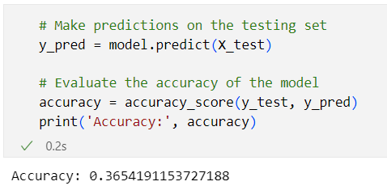
Prediction using Logistic regression
Modeling
The results of the logistic regression model are evaluated using metrics such as accuracy
The output shows that the accuracy of the model is 0.365, which means that the model correctly predicted the criminal offense category for about 36.5% of the test data.

Slide 18
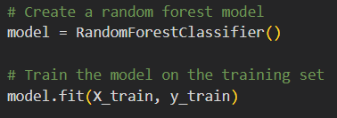
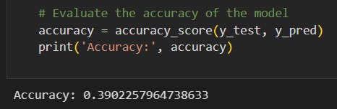
Modeling
Prediction using Decision tree Classifier with an accuracy of 39%
Prediction using Random Forest Classifier with an accuracy of 36.7%

Slide 19
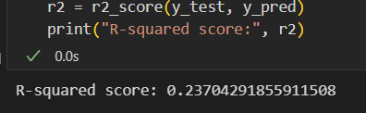
Prediction using XGBRegressor with an R-squared score of the model is only 23.7%
Prediction using LGBMRegressor with an R-squared score of the model is only 19 %
Prediction using Gradient boosting with an R-squared score of the model is only 27 %

Slide 20
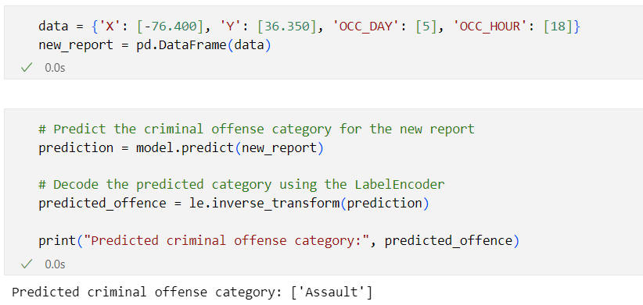
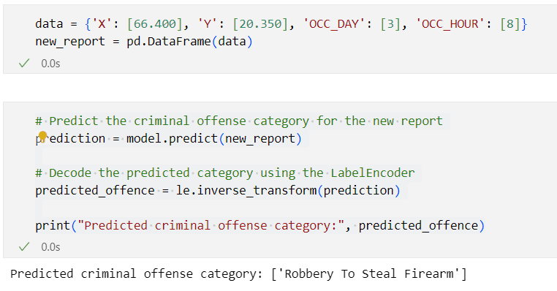
Prediction
Prediction
Based on the input values of 'X', 'Y', 'OCC_DAY', and 'OCC_HOUR', the model predicted that the criminal offense category for this report is 'Assault'.
Based on the input values of 'X', 'Y', 'OCC_DAY', and 'OCC_HOUR', the model predicted that the criminal offense category for this report is ‘Robbery To Steal Firearm’.

Slide 21
Summary of the findings
Through the exploration and analysis of the Toronto Crime Data, I have identified the top 10 most frequently occurring crimes, the most common crime location, the most common month for crime, and other key insights. I have also developed a logistic regression model to predict the likelihood of a crime occurring based on various features in the dataset. The model has shown promising results in identifying factors that contribute to the likelihood of a crime occurring.
Future directions and potential applications of the model
The prediction model developed in this project can be further refined and optimized to improve its performance. The model can also be applied in various real-world scenarios, such as crime prevention, resource allocation, and policy-making. For example, law enforcement agencies can use the model to identify high-risk areas and allocate resources accordingly, while policymakers can use the insights gained from the model to develop evidence-based policies to improve public safety.

Slide 22
References
Toronto Police Service Major Crime Indicators Open Data: https://data.torontopolice.on.ca/datasets/TorontoPS::major-crime-indicators-open-data/explore?location=20.749938%2C-82.020079%2C3.51
Logistic Regression: https://en.wikipedia.org/wiki/Logistic_regression
Python: https://www.python.org/
Visualization libraries: Matplotlib, Seaborn
Thank you

