Slide 1
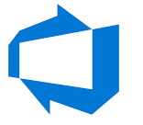

Kubernetes

Slide 2

Kubernetes (Pods)
Container
Container
Container
Container
Side Car- Container
Pod
Pod
Pod
Host
Node
Smallest unit of k8s
Abstraction over container
Usually 1 application per pods
Can have side car container per pod

Slide 3
Kubernetes (Services)
App
App
IP
Service
Permanent IP address
Lifecycle of Pod and Service are Not Connected
Pod
IP Changes with every restart
Pod
DB
DB
IP
Service
Pod
Pod
Node
Node

Slide 4

Kubernetes (Ingress)
App
Service
Pod
Ingress
DB
Service
Ingress is similar to web server in on premise deployment
Pod
Node

Slide 5
Kubernetes (ConfigMap & Secret)
DB_URL
ConfigMap
DB_Username
DB_Password
Base64 encoded
Can store passwords, certificates
Secret
App
Service
Pod
Ingress
DB
Service
Pod
Node

Slide 6

Kubernetes (Volume Mounts)
App
Service
Pod
Ingress
DB
Service
Pod
Local Storage
Node
Remote Storage

Slide 7
Kubernetes (Replicas)
Service acts like load balancer for multiple pods
App
App
Service
Pod
Pod
Ingress
DB
DB
Service
Pod
Pod
Node 2
Node 1

Slide 8
Kubernetes (Deployment)
Abstraction of pods is deployment
App
App
Service
Pod
Pod
Ingress
DB
DB
Service
Pod
Pod
Node 2
Node 1

Slide 9
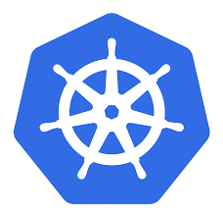
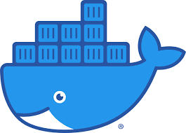
Kubernetes Components
Kubelet interacts with both- the container & node for assigning resources
App
APP Service
App
Pod
Pod
DB Service
Kube Proxy makes sure request is sent to destination such that network overhead is avoided
DB
DB
Pod
Pod
Kube
Proxy
Kube
Proxy
Docker (Container Runtime)
Kubelet
Kubelet
Docker (Container Runtime)
Worker Node
Worker Node

Slide 10
Kubernetes Components
Client
App
APP Service
App
Requests are executed after authentication
Pod
Pod
DB Service
API Service
DB
DB
Pod
Pod
Scheduler
Control Manager
Docker (Container Runtime)
Kube
Proxy
Kube
Proxy
Docker (Container Runtime)
Kubelet
Brain of K8S
etcd
Kubelet
CPU:30% used
CPU:90% used
Key Value Store
Worker Node
Worker Node
Master Node

Slide 11
Kubernetes Components
Client
App
APP Service
API is load balanced
Etcd is distributed
App
Pod
Pod
DB Service
API Service
API Service
DB
DB
Pod
Pod
Scheduler
Scheduler
Control Manager
Control Manager
Docker (Container Runtime)
Kube
Proxy
Kube
Proxy
Docker (Container Runtime)
Kubelet
etcd
etcd
Kubelet
CPU:30% used
CPU:90% used
Worker Node
Worker Node
Master Node
Master Node

Slide 12
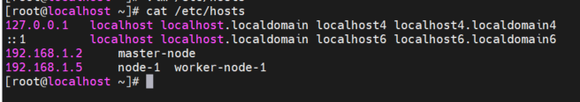
Kubernetes Installation (All Nodes)
Master node should have 2 vCPUs
Install docker
setenforce 0
service firewalld stop
swapoff –a
hostnamectl set-hostname <Node Name>
cat /etc/hosts
127.0.0.1 localhost localhost.localdomain localhost4 localhost4.localdomain4
::1 localhost localhost.localdomain localhost6 localhost6.localdomain6
192.168.1.2 master-node
192.168.1.5 node-1 worker-node-1

Slide 13
Kubernetes Installation (All Nodes Cont.)
cat /etc/yum.repos.d/kubernetes.repo
[kubernetes]
name=Kubernetes
baseurl=https://packages.cloud.google.com/yum/repos/kubernetes-el7-x86_64
enabled=1
gpgcheck=1
repo_gpgcheck=1
gpgkey=https://packages.cloud.google.com/yum/doc/yum-key.gpg https://packages.cloud.google.com/yum/doc/rpm-package-key.gpg
yum install kubeadm -y
Comment disabled_plugins = ["cri"] line in /etc/containerd/config.toml
systemctl restart containerd
systemctl enable kubelet
systemctl start kubelet
Reference - https://www.tecmint.com/install-a-kubernetes-cluster-on-centos-8/

Slide 14
Kubernetes Installation (Master Node)
kubeadm init
mkdir -p $HOME/.kube
cp -i /etc/kubernetes/admin.conf $HOME/.kube/config
chown $(id -u):$(id -g) $HOME/.kube/config
export kubever=$(kubectl version | base64 | tr -d '\n')
kubectl apply -f "https://cloud.weave.works/k8s/net?k8s-version=$kubever"
If nodes are restarted run the following commands
Join New Worker Nodes long after kubeadm init
swapoff –a
disable firewall if firewall rules are not added
service kubelet restart
kubeadm token list
kubeadm token create –print-join-command

Slide 15
Kubernetes Basic Commands
kubectl get nodes
kubectl get pods
kubectl logs –f <pod name>
kubectl describe pods <pod name>
kubectl create deployment nginx-deployment --image=nginx
kubectl scale --replicas=3 deployment/nginx-deployment
kubectl get replicaset
kubectl describe nodes
kubectl taint nodes master-node node-role.kubernetes.io/control-plane-
echo -n 'abc123' | base64
Login to docker hub with you creds and create private registry
docker login
kubectl create secret generic regcred \
--from-file=.dockerconfigjson=/root/.docker/config.json \
--type=kubernetes.io/dockerconfigjson

Slide 16
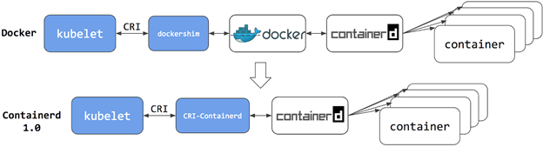
Kubernetes Architecture- version 1.24

Slide 17
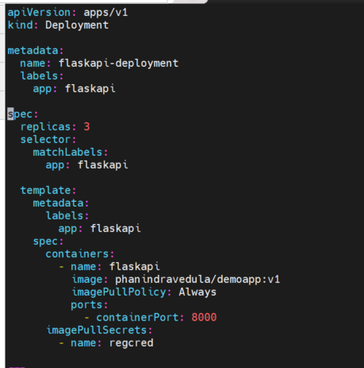
Kubernetes YAML
Kind of component and API version it is using
Metadata of the component
Spec of deployment
Metadata and Spec of pod

Slide 18
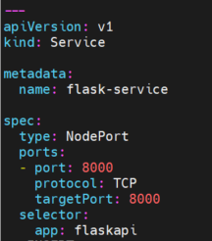
Kubernetes YAML
Type of component
Metadata of component
Spec of component

Slide 19
Kubernetes Basic Implementation
https://github.com/phanindravedula/K8s-Deployment
docker build –t <privateRepoUserName>/demoapp:v1 .
docker push <privateRepoUserName>/demoapp:v1
kubectl apply -f flask-configMap.yaml
kubectl apply -f flask-secret.yaml
kubectl apply -f flask-deployment.yaml
kubectl delete -f flask-deployment.yaml
Types of Services in Kubernetes Reference
https://devopsdice.com/different-types-of-services-in-kubernetes/

Slide 20
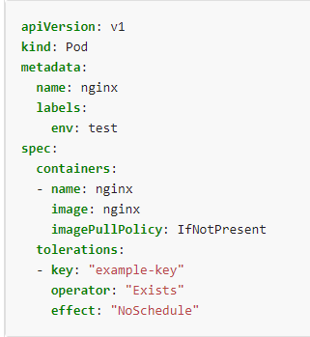
Kubernetes Taints & Tolerations
Taints allow a node to repel a set of pods.
Tolerations are applied to pods. Tolerations allow the scheduler to schedule pods with matching taints. Tolerations allow scheduling but don't guarantee scheduling: the scheduler also evaluates other parameters as part of its function.
kubectl taint nodes master-node key1=value1:NoSchedule
You specify a toleration for a pod in the PodSpec. Both of the following tolerations "match" the taint created by the kubectl taint line above, and thus a pod with either toleration would be able to schedule onto node1

Slide 21
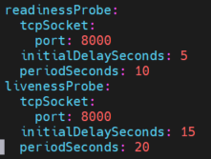
Kubernetes Liveliness Probe & Readiness Probe
Liveliness probe
The periodSeconds field specifies that the kubelet should perform a liveness probe every 20 seconds. The initialDelaySeconds field tells the kubelet that it should wait 15 seconds before performing the first probe
Readiness Probe
Sometimes, applications are temporarily unable to serve traffic. For example, an application might need to load large data or configuration files during startup, or depend on external services after startup. In such cases, you don't want to kill the application, but you don't want to send it requests either. Kubernetes provides readiness probes to detect and mitigate these situations. A pod with containers reporting that they are not ready does not receive traffic through Kubernetes Services.
Readiness probes runs on the container during its whole lifecycle.

Slide 22
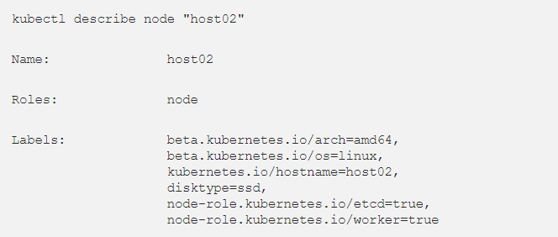
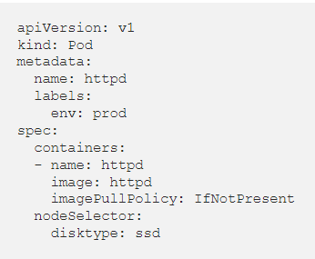
Node Labels & Selector
Node labels
Like many other Kubernetes objects, nodes have labels. You can attach labels manually. Kubernetes also populates a standard set of labels on all nodes in a cluster
Node isolation/restriction
Adding labels to nodes allows you to target Pods for scheduling on specific nodes or groups of nodes. You can use this functionality to ensure that specific Pods only run on nodes with certain isolation, security, or regulatory properties.
nodeSelector
nodeSelector is the simplest recommended form of node selection constraint. You can add the nodeSelector field to your Pod specification and specify the node labels you want the target node to have. Kubernetes only schedules the Pod onto nodes that have each of the labels you specify.

Slide 23
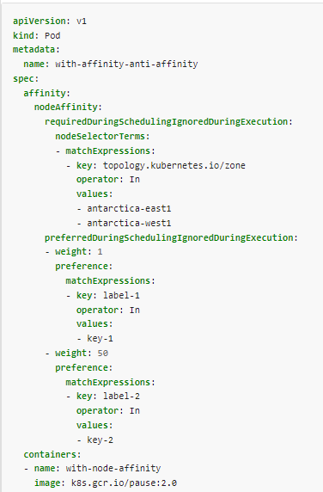
Node Affinity
requiredDuringSchedulingIgnoredDuringExecution: The scheduler can't schedule the Pod unless the rule is met. This functions like nodeSelector, but with a more expressive syntax.
preferredDuringSchedulingIgnoredDuringExecution: The scheduler tries to find a node that meets the rule. If a matching node is not available, the scheduler still schedules the Pod.
You can use the operator field to specify a logical operator for Kubernetes to use when interpreting the rules. You can use In, NotIn, Exists, DoesNotExist, Gt and Lt

Slide 24
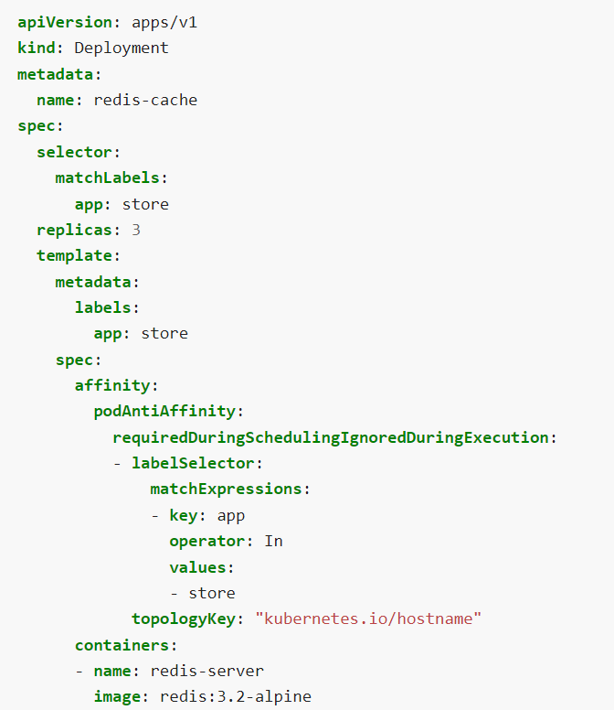
Pod Anti-Affinity
In the following example Deployment for the redis cache, the replicas get the label app=store. The podAntiAffinity rule tells the scheduler to avoid placing multiple replicas with the app=store label on a single node. This creates each cache in a separate node.
Hostname=Node-1
Pod 1
With label app=store
Pod 2
With label app=store
Hostname=Node-2

Slide 25
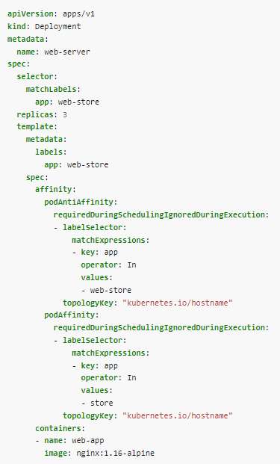
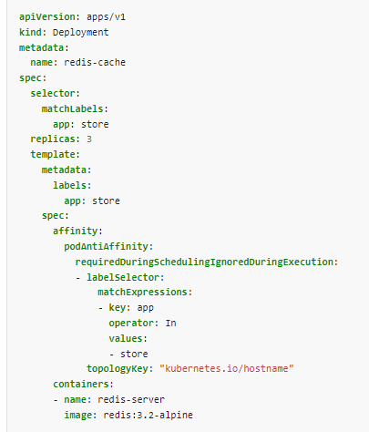
Pod Affinity & Anti-Affinity
redis-cache
App:store
redis-cache
Web-server
App:store
Node-1
App:web-store
Web-server
App:web-store
redis-cache
App:store
Node-2
Web-server
App:web-store
redis-cache
App:store
Web-server
Node-3
App:web-store
https://kubernetes.io/docs/concepts/scheduling-eviction/assign-pod-node/

Slide 26
Kubernetes Namespaces
Virtual Cluster in k8s cluster
APP1 Service
App1
DB1
App1
Namespace
App1
DB1
Pod
Pod
DB1 Service
Pod
Pod
App2
DB2
APP2 Service
App2
DB2
App2
Namespace
Pod
Pod
DB2 Service
Pod
Pod
Kube-system namespace
Docker (Container Runtime)
Kubelet
Kube Proxy
Kube Proxy
Kubelet
Docker (Container Runtime)
Worker Node 1
Worker Node 2

Slide 27
Kubernetes Namespaces
Why Namespaces ?
Logically grouping resources in k8s cluster
Avoiding conflicts if multiple teams are using the same cluster
Multiple environments can be maintained in one k8s cluster
Access and resource limits on namespaces
Access Across Namespaces
Most of the resources from one namespace cannot be accessed from another namespace
Services can be accessed from another namespace using inter dns
Volumes cannot be segregated using namespaces
Change default namespace
kubectl config set-context --current --namespace=flask-app

Slide 28
Kubernetes Ingress
K8S Cluster
Load Balancer
Service 1
Service 2
Service 3
Ingress Resource-1
Ingress Resource-2
Ingress Resource-3
Ingress Controller
Ingress Controller
Ingress Controller
POD1
POD2
POD5
POD6
POD9
POD10
POD3
POD4
POD7
POD8

Slide 29
Kubernetes Ingress
DaemonSets manage groups of replicated Pods. However, DaemonSets attempt to adhere to a one-Pod-per-node model, either across the entire cluster or a subset of nodes. A Daemonset will not run more than one replica per node. Another advantage of using a Daemonset is that, if you add a node to the cluster, then the Daemonset will automatically spawn a pod on that node, which a deployment will not do
git clone https://github.com/nginxinc/kubernetes-ingress
git clone https://github.com/phanindravedula/K8s-Deployment
yum install haproxy
Modify /etc/haproxy/haproxy.cfg as per K8s-Deployment/Ingress/haproxy.cfg
Service haproxy restart
kubectl apply -f kubernetes-ingress/deployments/common/ns-and-sa.yaml
kubectl apply -f kubernetes-ingress/deployments/rbac/rbac.yaml
kubectl apply -f kubernetes-ingress/deployments/common/default-server-secret.yaml
kubectl apply -f kubernetes-ingress/deployments/common/nginx-config.yaml
kubectl apply -f kubernetes-ingress/deployments/common/ingress-class.yaml
kubectl apply -f K8s-Deployment/Ingress/nginx-ingress.yaml
kubectl apply -f K8s-Deployment/Ingress/ flask-ingress.yaml
kubectl apply -f K8s-Deployment/Ingress/ flask-deployment.yaml
cat /etc/hosts
192.168.1.3 demoapp.example.com

Slide 30
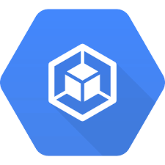

Kubernetes Volumes- Option 1
K8s Cluster
App1 Pod1
App1 Pod2
App2 Pod1
App2 Pod2
App1 Pod 3
Worker Node-2
Worker Node-3
Worker Node-1

Slide 31
Kubernetes Volumes- Option 2
K8s Cluster
App1 Pod1
App1 Pod2
App1 Pod3
Replicated
Replicated
Worker Node-1
Worker Node-2
Worker Node-3

Slide 32
Kubernetes Volumes- Option 3
K8s Cluster
NFS or Cloud Storage
App Pod1
App Pod2
App Pod 3
Worker Node-1
Worker Node-2
Worker Node-3

Slide 33
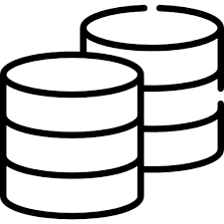
Storage Class, Persistent Volume, PV Claims
Actual Storage
K8s Cluster
10 GB
Persistent Volume
5GB
Persistent Volume
Storage Class
Persistent Volume Claim
Persistent Volume Claim
Persistent Volume Claim
/var/lib
/var/lib
/var/log
App1 Pod1
App1 Pod2
App2 Pod 1
Worker Node-1
Worker Node-2
Worker Node-3

Slide 34
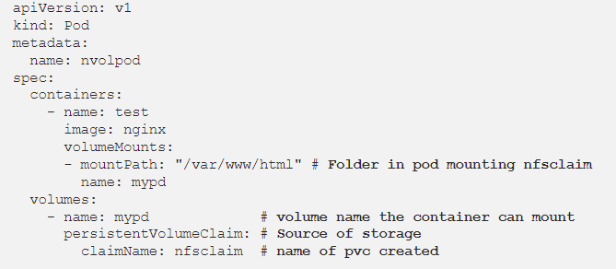
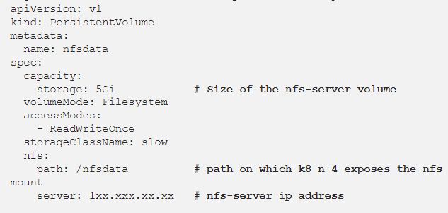
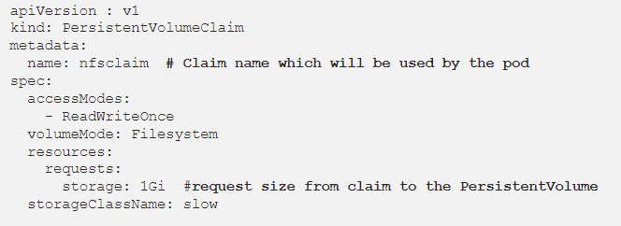
NFS PV,PVC
DevOps
Storage Admin

Slide 35
PV Provisioner
Actual Storage
K8s Cluster
10 GB
Persistent Volume
5GB
Persistent Volume
Storage Class with provisioner
Persistent Volume Claim
Persistent Volume Claim
Persistent Volume Claim
/var/lib
/var/lib
/var/log
App1 Pod1
App1 Pod2
App2 Pod 1
Worker Node-1
Worker Node-2
Worker Node-3

Slide 36
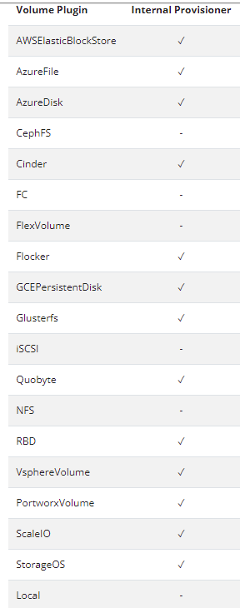
Provisioners

Slide 37
NFS-Provisioner Using Helm
systemctl start nfs-server.service
mkdir /nfs
chown -R nobody: /nfs
chmod 777 /nfs
cat /etc/exposts
/nfs *(rw,no_subtree_check,no_root_squash,no_all_squash,insecure)
git clone https://github.com/phanindravedula/K8s-Deployment
curl -fsSL -o get_helm.sh https://raw.githubusercontent.com/helm/helm/main/scripts/get-helm-3
chmod 700 get_helm.sh
./get_helm.sh
helm repo add nfs-subdir-external-provisioner https://kubernetes-sigs.github.io/nfs-subdir-external-provisioner/
helm list
helm install nfs-subdir-external-provisioner nfs-subdir-external-provisioner/nfs-subdir-external-provisioner \
--set nfs.server=192.168.1.3 \
--set nfs.path=/nfs
kubectl apply -f K8s-Deployment/nfs-provisioner/pvc-nfs.yaml
kubectl apply -f K8s-Deployment/nfs-provisioner/flask-pvc-deployment.yaml
https://github.com/kubernetes-sigs/nfs-subdir-external-provisioner

Slide 38
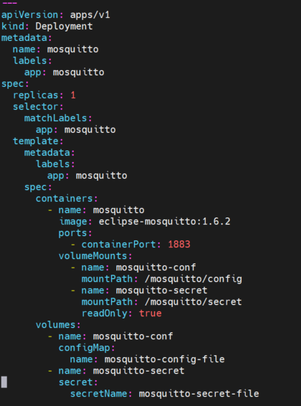
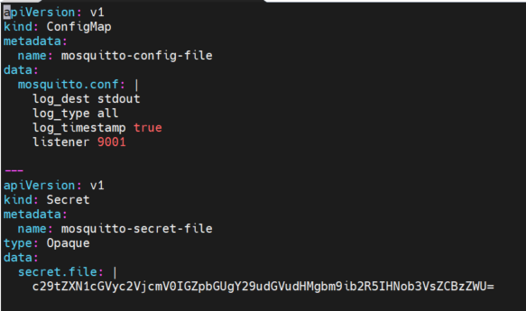
ConfigMaps & Secrets as Persistent Volumes

Slide 39

StatefulSets
Stateless Application
All microservices like applications & APIs which does not depend on previous data
Deployed using deployment & replicasets
Created in random order, deleted in random order and are all identical
Can have 1 service to load balance
Stateful Application
All databases, whose state must be preserved which depends on previous data
Deployed using statefulset
Sticky identity for each pod
Created from same specification, but not interchangeable
Persistent identifier across any re-scheduling
In statefulSet, next pod will not be create if the previous pod is not up & running
StatefulSets are deleted in reverse order
App-pod-xasbh
App-pod-edscf
App-pod-wertr
DB-pod-0
DB-pod-01
DB-pod-02

Slide 40
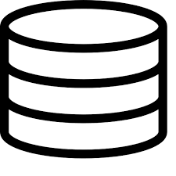

Scaling Database
Master
Worker-1
Worker-2
DB-pod-0
DB-pod-01
DB-pod-02
Writing
Reading
Writing
Reading
Reading
Data Clone
Data Clone
Data Inconsistency
PV1
Continuous Sync
PV2
Continuous Sync
PV3

Slide 41
StatefulSet
Stateful Application
StatefulSets have individual service names so that even if pod restarts, the new pod can be accesses the same old service name
svc1
DB-pod-0
DB-pod-01
DB-pod-02
Mysql-pod-0.svc2
Mysql-pod-1.svc2
Mysql-pod-2.svc2

Slide 42
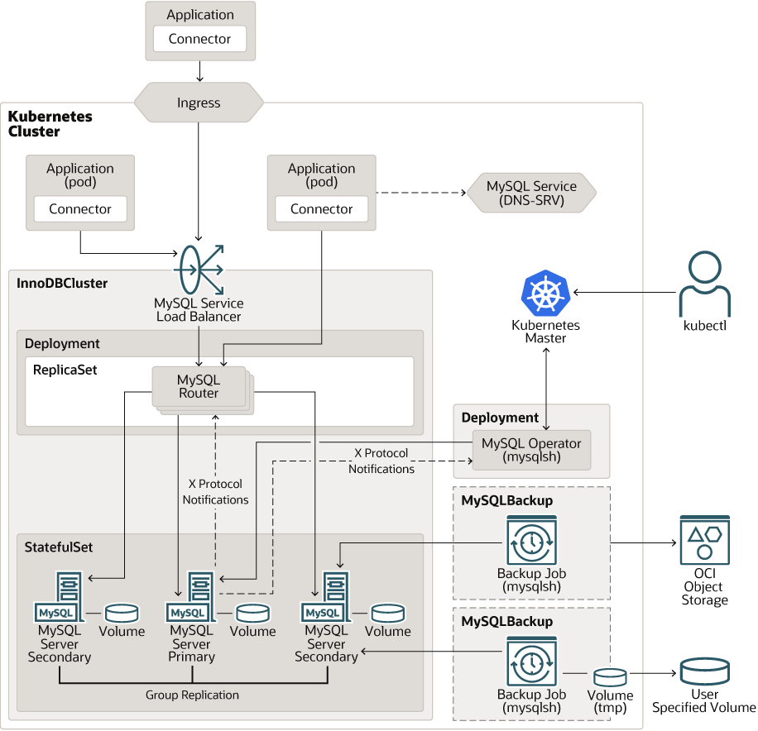
Mysql Kubernetes Operator
These operators are build using
Custom Resource Definitions (CRDs)
https://dev.mysql.com/doc/mysql-operator/en/mysql-operator-introduction.html
https://www.youtube.com/watch?v=Vf6lTP3mUO4

Slide 43
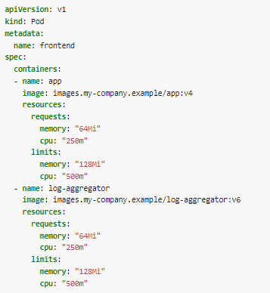
Resource Management
Limit
150Mb Memory
1.0 CPU
Requests
100Mb Memory
0.5 CPU
CPU is compressible resource, if pod starts hitting CPU limits Kubernetes will start to throttle container i.e CPU will be artificially restricted, making app performance worse, but it wont be terminated or evicted
Memory is not compressible resource, if pod starts to use more memory it will be terminated immediately

Slide 44
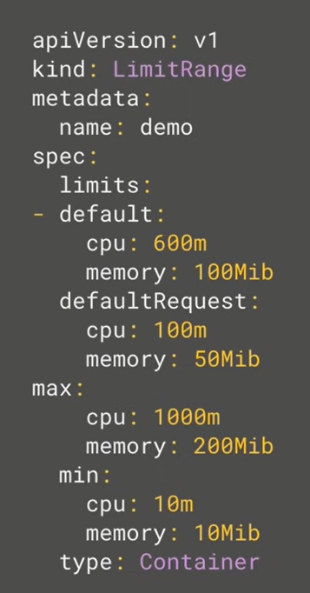
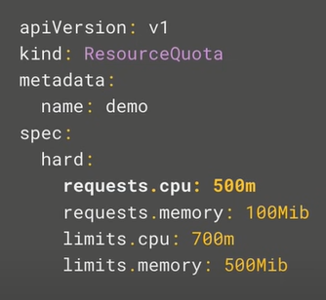
Resource Management
Resource Quota for namespace
Any containers that does not have the default value will be assigned these values
Any containers that does not have the default requests value will be assigned these values
Max a container can set in the namespace
Kubernetes scheduler uses round robin for scheduling while checking for requested resources
In overcommitment state, Kubernetes will look for resources that are using more resources than they requested and terminate based on priority
If Max section is set and default section is not set then default value becomes the max value
Min a container can set in the namespace
https://kubernetes.io/docs/concepts/policy/resource-quotas/

Slide 45
Vertical & Horizontal Pod Auto Scaling
Vertical Pod Auto Scaling
Before Scaling
CPU:1000m
Mem:500mi
Pod1
Pod2
Pod3
Pod4
After Scaling
Pod1
Pod2
Pod3
Pod4
Horizontal Pod Auto Scaling
CPU:2000m
Mem:1000mi
Before Scaling
Pod1
Pod2
Pod3
Pod4
CPU:1000m
Mem:500mi
After Scaling
Cloud providers give an option to auto scale nodes
Pod1
Pod2
Pod3
Pod4
Pod1
Pod2
Pod3
Pod4
CPU:1000m
Mem:500mi
https://www.youtube.com/watch?v=jcHQ5SKKTLM
https://www.youtube.com/watch?v=FfDI08sgrYY

Slide 46
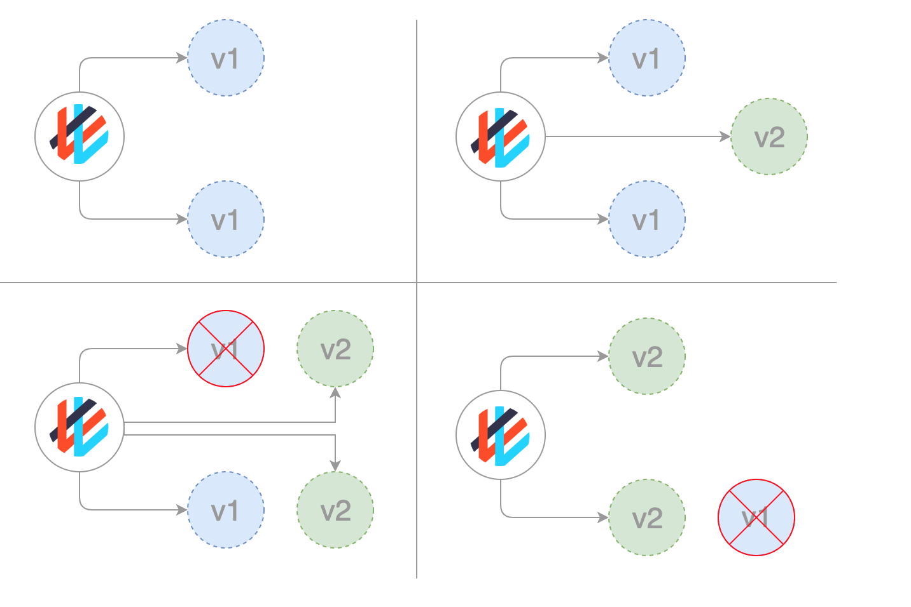
Deployment Strategies: Rolling Updates
The rolling deployment is the standard default deployment to Kubernetes. It works by slowly, one by one, replacing pods of the previous version of your application with pods of the new version without any cluster downtime.

Slide 47
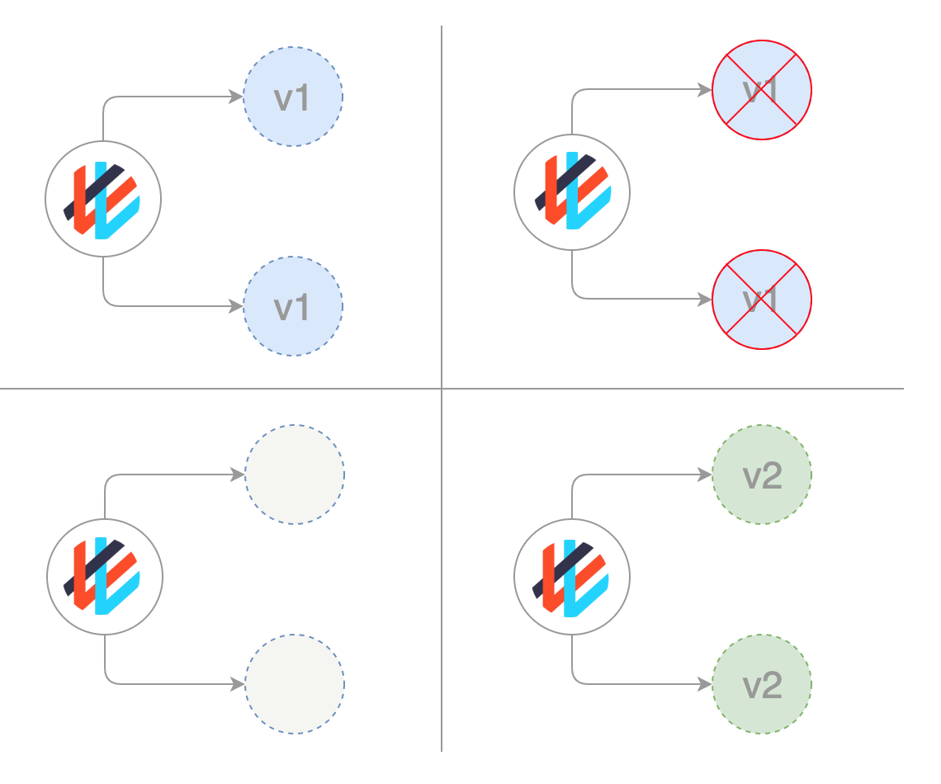
Deployment Strategies: Recreate
In this type of very simple deployment, all of the old pods are killed all at once and get replaced all at once with the new ones.

Slide 48
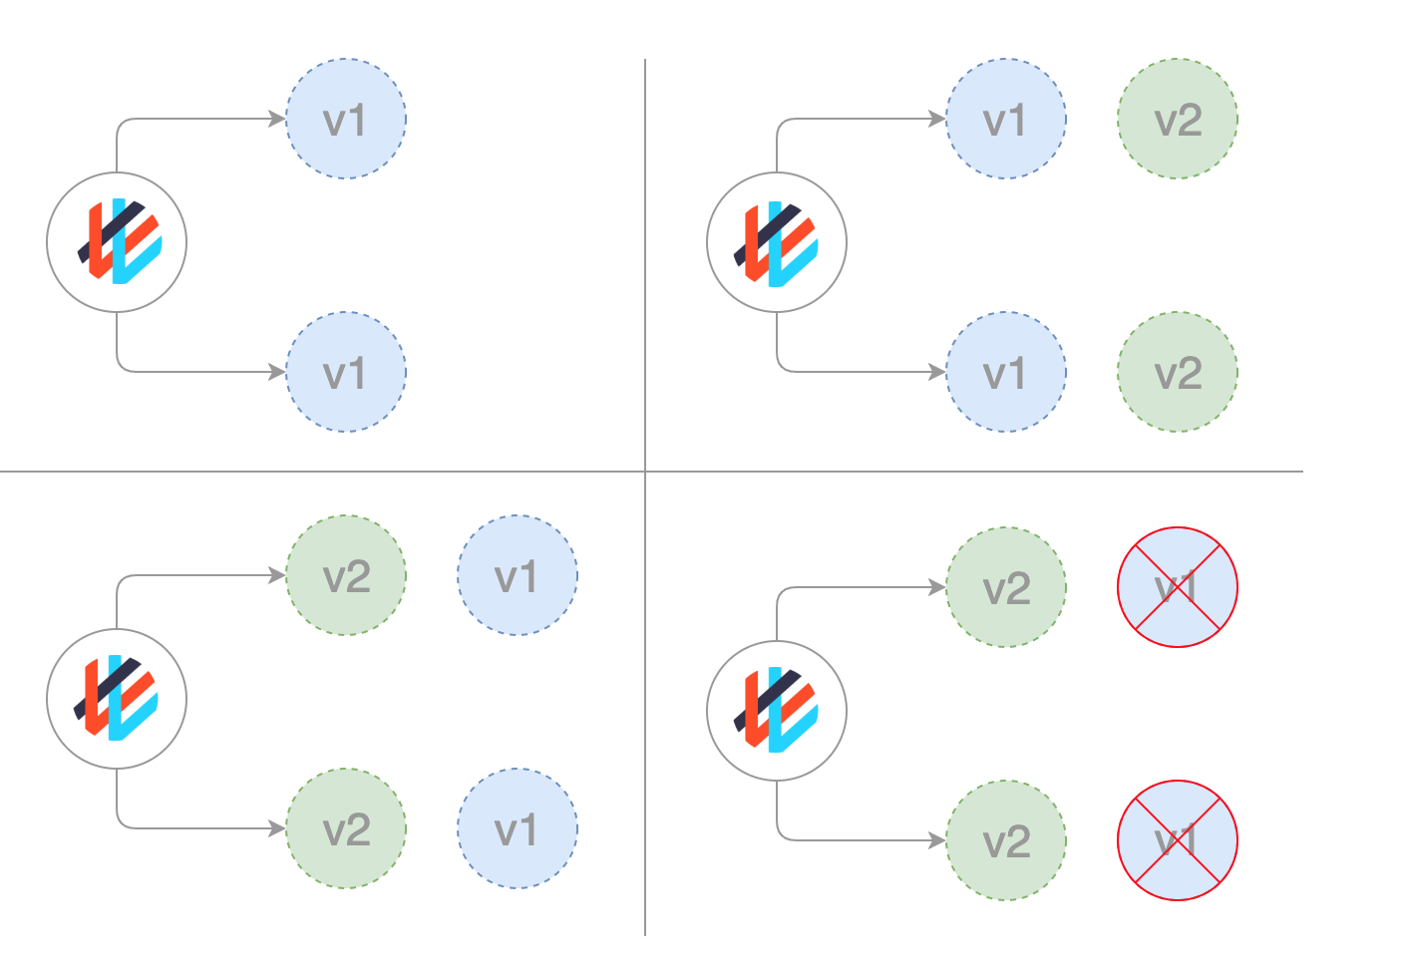
Deployment Strategies: Blue/ Green or (Red/Black )
In a blue/green deployment strategy (sometimes referred to as red/black) the old version of the application (green) and the new version (blue) get deployed at the same time. When both of these are deployed, users only have access to the green; whereas, the blue is available to your QA team for test automation on a separate service or via direct port-forwarding.

Slide 49
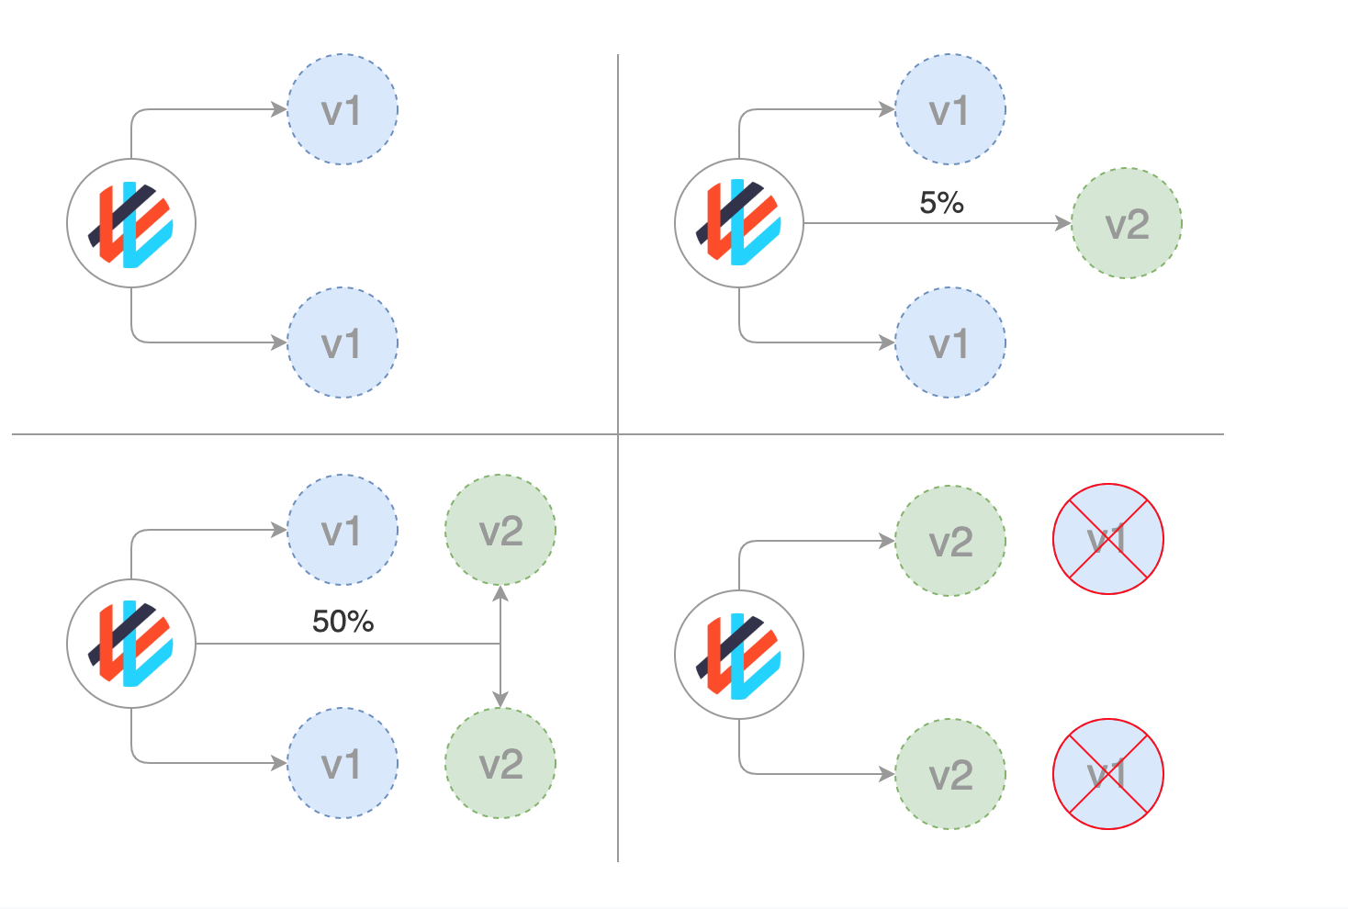
Deployment Strategies: Canary
Canary deployments are a bit like blue/green deployments, but are more controlled and use a more ‘progressive delivery’ phased-in approach. There are a number of strategies that fall under the umbrella of canary including: dark launches, or A/B testing.
https://www.weave.works/blog/kubernetes-deployment-strategies

Slide 50
Service Mesh: ISTIO
Istio is a service mesh—a modernized service networking layer that provides a transparent and language-independent way to flexibly and easily automate application network functions
Features:
Traffic Management- for Canary and blue green deployment
Observability- Comes with Prometheus, Grafana, kiali & jaeger
Security- Provide security on pod level using different methods
https://istio.io/latest/docs/setup/getting-started/

Slide 51
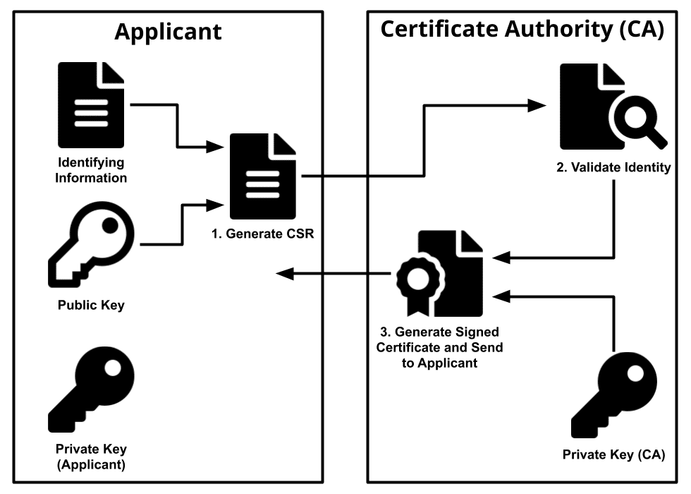
Certificates

Slide 52
Kubernetes RBAC
Rules
Api Groups
Core api group
Extensions
Apps
networking
Resources
Pods
Deployments
replicasets
Verbs
Get
List
Watch
Update
Create
delete
Default
Finance
Kube-System
Role
Role Binding
User/Group

Slide 53
Kubernetes RBAC
Remote Cli
Master Node
Kubernetes
CA Authority
/etc/Kubernetes/pxi
Generate username.key
Private Key
Ca.key
Ca.crt
Private Key
Certificate
Generate
username.csr
And send it to CA
Certificate Signing
Request
Certificate Signing
Request
Generate Kube Config File
Certificate
Generate Certificate
username.crt
Certificate
username.crt

Slide 54
Kubernetes RBAC
Remote Cli
Master Node
Kubernetes
CA Authority
/etc/Kubernetes/pki
Generate username.key
Private Key
Ca.key
Ca.crt
openssl genrsa -out john.key 2048
Private Key
Certificate
Generate
username.csr
And send it to CA
Certificate Signing
Request
openssl req -new -key john.key -out john.csr -subj "/CN=john/O=finance"
openssl x509 -req -in john.csr -CA ca.crt -CAkey ca.key -CAcreateserial -out john.crt -days 365
Certificate Signing
Request
Certificate
Generate Certificate
username.crt
Certificate
username.crt

Slide 55
Kubernetes RBAC Commands
Generate Kube Config File
cp /root/.kube/config .
cat john.crt | base64 -w0
cat john.key | base64 -w0
Replace client-certificate-data & client-key-data with user data and modify the config according to the user
Copy the config file to /home/username/.kube/config
chown –R username:username /home/username/.kube
Chmod 770 –R /home/username/.kube
Apply Role & RoleBinding
Kubectl apply –f role.yaml
Kubectl apply –f rolebinding.yaml

