Slide 1
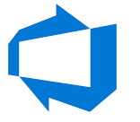

Azure Backup

Slide 2

VM Backup
Azure Backup
For backing up Azure VMs running production workloads, use Azure Backup. Azure Backup supports application-consistent backups for both Windows and Linux VMs. Azure Backup creates recovery points that are stored in geo-redundant recovery vaults. When you restore from a recovery point, you can restore the whole VM or just specific files.
Azure Site Recovery
Azure Site Recovery protects your VMs from a major disaster scenario when a whole region experiences an outage due to major natural disaster or widespread service interruption. You can configure Azure Site Recovery for your VMs so that you can recover your application with a single click in matter of minutes. You can replicate to an Azure region of your choice.
Managed disk snapshots
In development and test environments, snapshots provide a quick and simple option for backing up VMs that use Managed Disks. A managed disk snapshot is a read-only full copy of a managed disk that is stored as a standard managed disk by default. With snapshots, you can back up your managed disks at any point in time. These snapshots exist independent of the source disk and can be used to create new managed disks. They are billed based on the used size. For example, if you create a snapshot of a managed disk with provisioned capacity of 64 GiB and actual used data size of 10 GiB, that snapshot is billed only for the used data size of 10 GiB.

Slide 3
VM Backup
Images
Managed disks also support creating a managed custom image. You can create an image from your custom VHD in a storage account or directly from a generalized (sysprepped) VM. This process captures a single image. This image contains all managed disks associated with a VM, including both the OS and data disks. This managed custom image enables creating hundreds of VMs using your custom image without the need to copy or manage any storage accounts.
Images versus snapshots
It's important to understand the difference between images and snapshots. With managed disks, you can take an image of a generalized VM that has been deallocated. This image includes all of the disks attached to the VM. You can use this image to create a VM, and it includes all of the disks.
A snapshot is a copy of a disk at the point in time the snapshot is taken. It applies only to one disk. If you have a VM that has one disk (the OS disk), you can take a snapshot or an image of it and create a VM from either the snapshot or the image.
A snapshot doesn't have awareness of any disk except the one it contains. This makes it problematic to use in scenarios that require the coordination of multiple disks, such as striping. Snapshots would need to be able to coordinate with each other and this is currently not supported.

Slide 4
Azure Backup Advantages
Offload on-premises backup. Azure Backup offers a simple solution for backing up your on-premises resources to the cloud. Get short and long-term backup without the need to deploy complex on-premises backup solutions.
Back up Azure IaaS VMs. Azure Backup provides independent and isolated backups to guard against accidental destruction of original data. Backups are stored in a Recovery Services vault with built-in management of recovery points. Configuration and scalability is simple, backups are optimized, and you can easily restore as needed.
Get unlimited data transfer. Azure Backup does not limit the amount of inbound or outbound data you transfer, or charge for the data that is transferred. Outbound data refers to data transferred from a Recovery Services vault during a restore operation. If you perform an offline initial backup using the Azure Import/Export service to import large amounts of data, there is a cost associated with inbound data.
Keep data secure. Data encryption allows for secure transmission and storage of your data in the public cloud. You store the encryption passphrase locally, and it is never transmitted or stored in Azure. If it is necessary to restore any of the data, only you have encryption passphrase, or key.

Slide 5
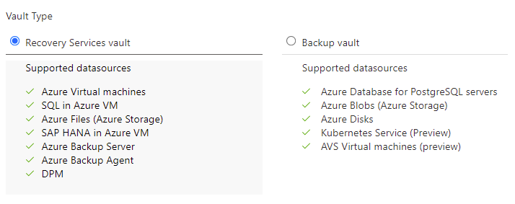
Azure Backup Vaults

Slide 6
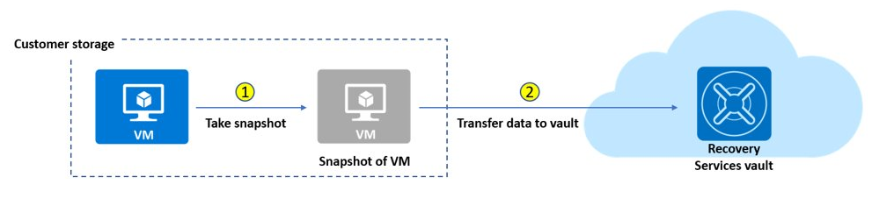
VM Backup

Slide 7
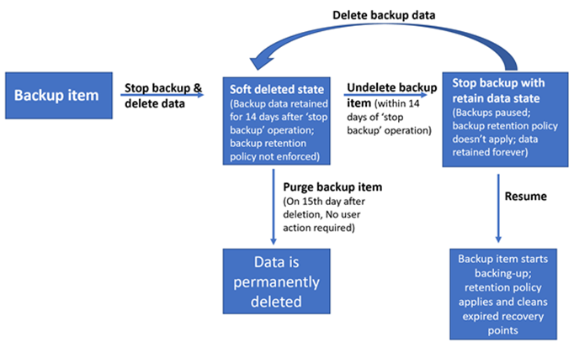
Soft Delete for Backups

Slide 8
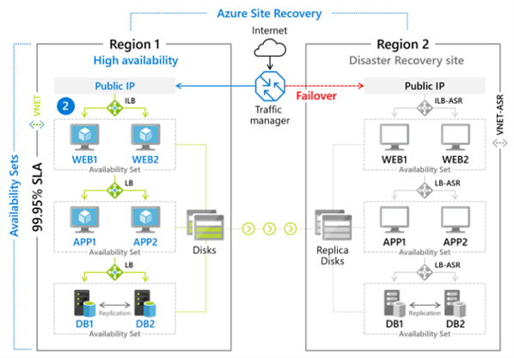
Azure Site Recovery

Slide 9
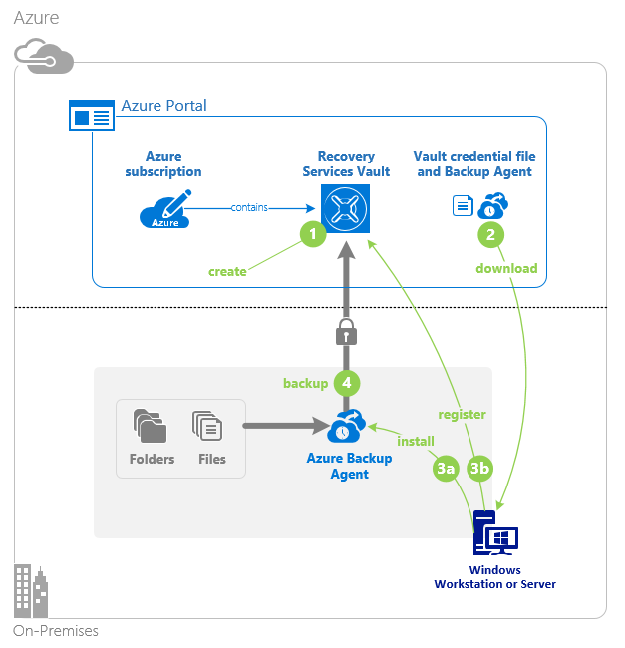
Azure Backup on-premise to cloud (MARS)
Create the recovery services vault. Within your Azure subscription, you will need to create a recovery services vault for the backups.
Download the agent and credential file. The recovery services vault provides a link to download the Azure Backup Agent. The Backup Agent will be installed on the local machine. There is also a credentials file that is required during the installation of the agent. You must have the latest version of the agent. Versions of the agent below 2.0.9083.0 must be upgraded by uninstalling and reinstalling the agent.
Install and register agent. The installer provides a wizard to configure the installation location, proxy server, and passphrase information. The downloaded credential file will be used to register the agent.
Configure the backup. Use the agent to create a backup policy including when to backup, what to backup, how long to retain items, and settings like network throttling.

Slide 10

Microsoft Azure Backup Server (MABS)
Another method of backing up virtual machines is using a Data Protection Manager (DPM) or Microsoft Azure Backup Server (MABS) server. This method can be used for specialized workloads, virtual machines, or files, folders, and volumes. Specialized workloads can include SharePoint, Exchange, and SQL Server

Slide 11
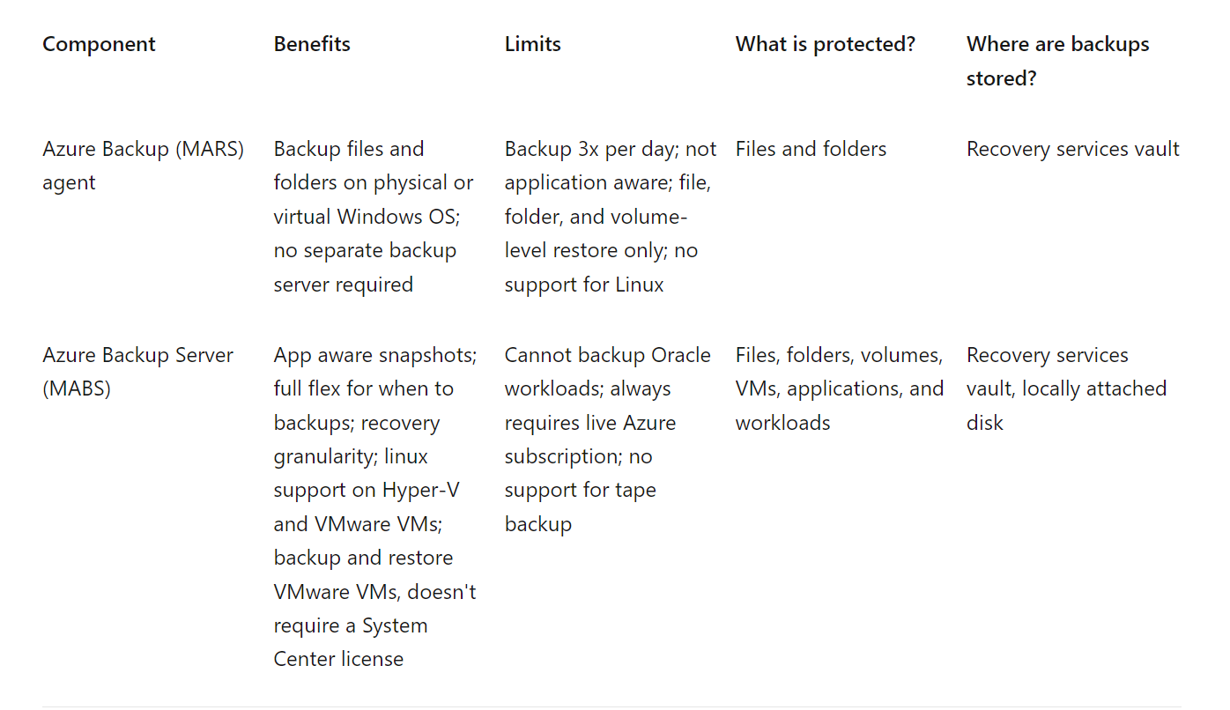
MARS vs MABS

Slide 12
Azure Monitoring

Slide 13
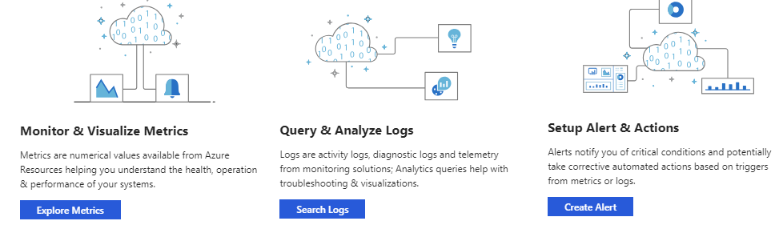
Azure Monitoring

Slide 14
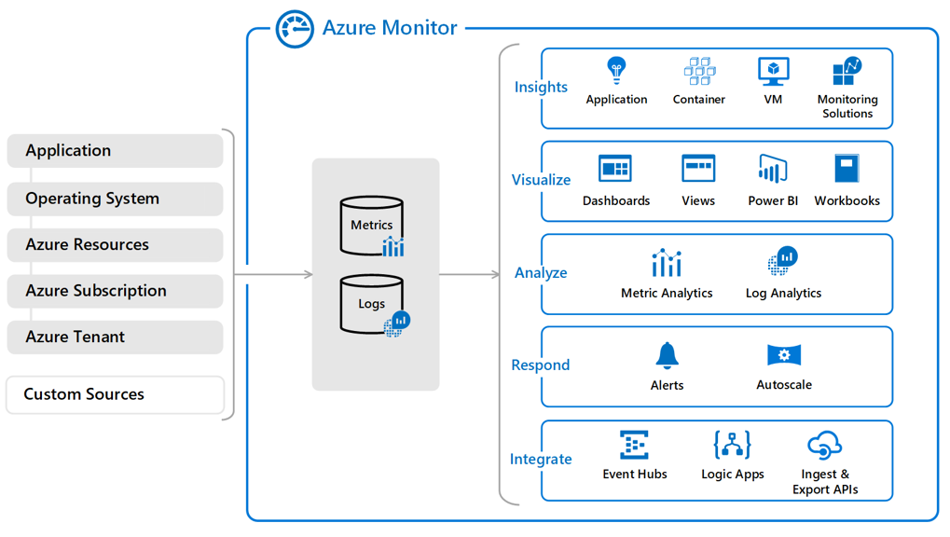
Azure Monitoring
Metrics are numerical values that describe some aspect of a system at a particular point in time. They are lightweight and capable of supporting near real-time scenarios.
Logs contain different kinds of data organized into records with different sets of properties for each type. Data such as events and traces are stored as logs in addition to performance data so that it can all be combined for analysis.

Slide 15
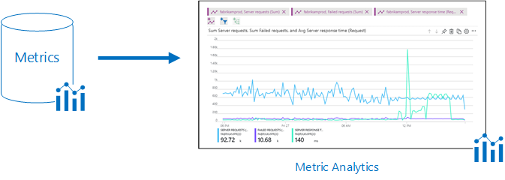
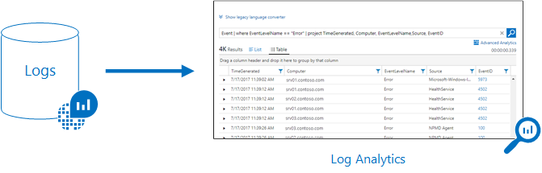
Azure Monitoring

Slide 16
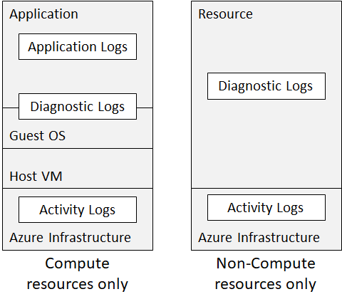
Azure Monitoring
Azure Monitor collects data from each of the following tiers:
Application monitoring data: Data about the performance and functionality of the code you have written, regardless of its platform.
Guest OS monitoring data: Data about the operating system on which your application is running. The application could be running in Azure, another cloud, or on-premises.
Azure resource monitoring data: Data about the operation of an Azure resource.
Azure subscription monitoring data: Data about the operation and management of an Azure subscription, as well as data about the health and operation of Azure itself.
Azure tenant monitoring data: Data about the operation of tenant-level Azure services, such as Azure Active Directory.

Slide 17
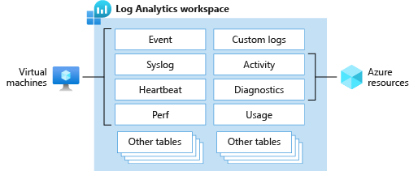
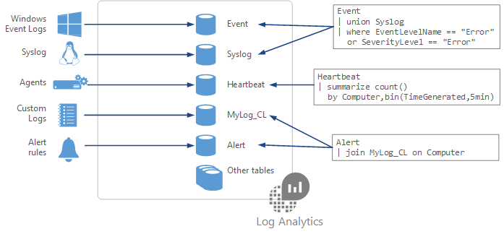
Azure Log Analytics
Features for Log Analytics Workspace
Access mode | Involves how users access a Log Analytics workspace, plus defines data scope
Access control mode | Defines how permissions work for any given Log Analytics workspace
Table-level RBAC | Provides a mechanism to define more granular data control inside a Log Analytics workspace with other permissions listed in the table

Slide 18
Azure Agents
Agent | Description
Azure Monitor Agent | Collects monitoring data from guest operating systems on VMs and delivers data to Azure Monitor logs and/or metrics
Log Analytics agent | Collects logs and performance data for virtual machines in Azure, other clouds, or on-premises
Azure diagnostics extension | Enables customers to receive extra data from guest operating systems and workloads living on compute resources
Dependency agent | Collects discovered data about certain processes running on virtual machines

Slide 19
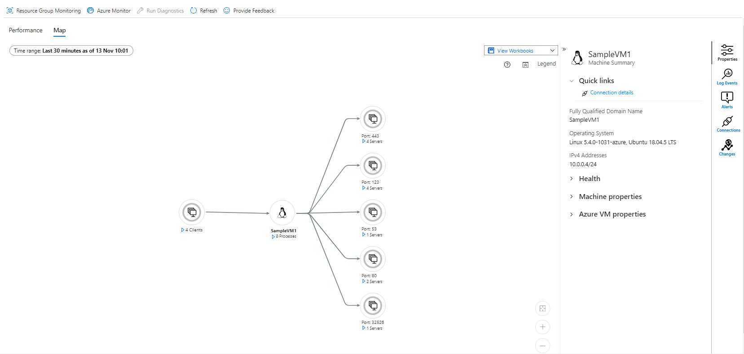
Azure Monitor Insights

Slide 20
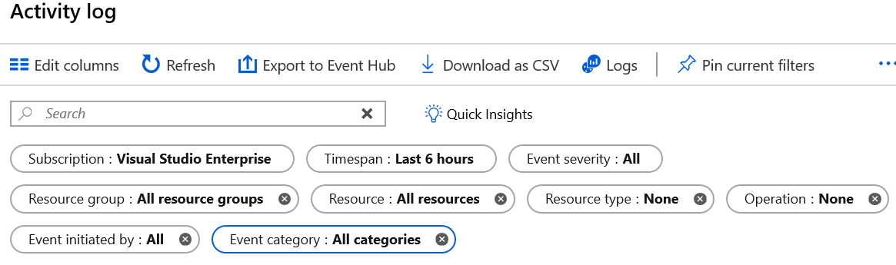
Azure Monitoring
Activity logs are kept for 90 days. You can query for any range of dates, as long as the starting date isn't more than 90 days in the past. You can retrieve events from your Activity Log using the Azure portal, CLI, PowerShell cmdlets, and Azure Monitor REST API.

Slide 21
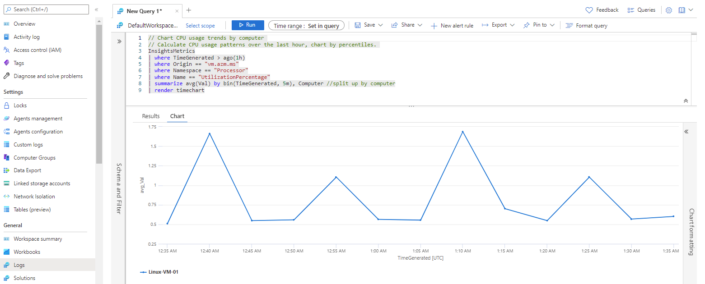
Azure Logs
https://docs.microsoft.com/en-gb/azure/azure-monitor/logs/log-analytics-tutorial#time-range

Slide 22
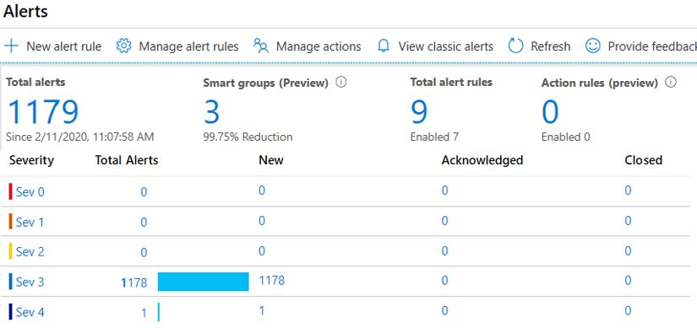
Azure Alerts
The Monitor Alerts experience has many benefits.
Better notification system. All newer alerts use action groups, which are named groups of notifications and actions that can be reused in multiple alerts.
A unified authoring experience. All alert creation for metrics, logs and activity log across Azure Monitor, Log Analytics, and Application Insights is in one place.
View Log Analytics alerts in Azure portal. You can now also observe Log Analytics alerts in your subscription. Previously these were in a separate portal.
Separation of Fired Alerts and Alert Rules. Alert Rules (the definition of the condition that triggers an alert), and Fired Alerts (an instance of the alert rule firing) are differentiated, so the operational and configuration views are separated.
Better workflow. The new alerts authoring experience guides the user along the process of configuring an alert rule, which makes it simpler to discover the right things to get alerted on.

