Slide 1
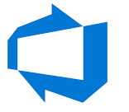




Azure vNets
Use unique IP Range across all the ENTIRE environment
192.168.1.4
DHCP
Subnet-1
Subnet-2
Subnet-3
Subnet-4
DNS-168.63.129.16
.0 N/W
.1- GW
.2- DNS
.3- DNS
.255- Broadcast
RFC-1918
https://datatracker.ietf.org/doc/html/rfc1918

Slide 2
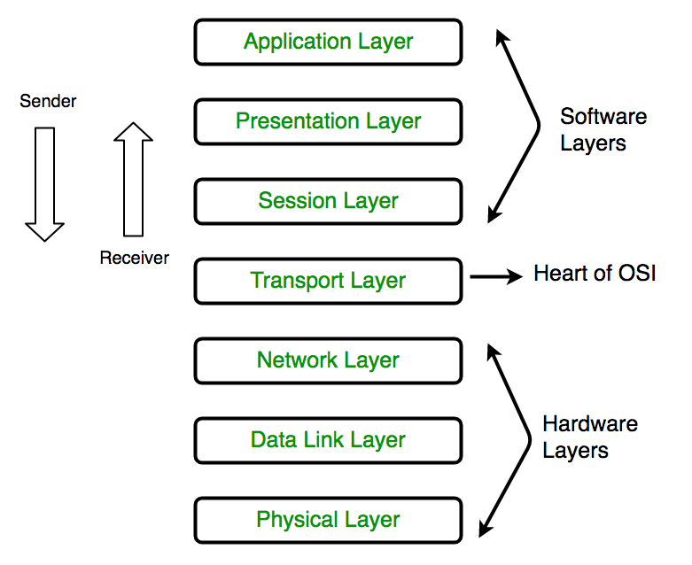
OSI Model
OSI stands for Open Systems Interconnection. It has been developed by ISO – ‘International Organization for Standardization‘, in the year 1984. It is a 7 layer architecture with each layer having specific functionality to perform. All these 7 layers work collaboratively to transmit the data from one person to another across the globe.

Slide 3
OSI Model
Browser, messaging System
Browser, messaging System
Translation
Encryption
Compression
Decryption
Session establishment,
maintenance & termination
Session establishment,
maintenance & termination
Segmentation
Port Addressing
Reassembling
Port Addressing
Routing
Logical Addressing
Routing
Logical Addressing
Framing
Physical Addressing
Bit Synchronization
Bit Rate Control
Bit Synchronization
Bit Rate Control

Slide 4
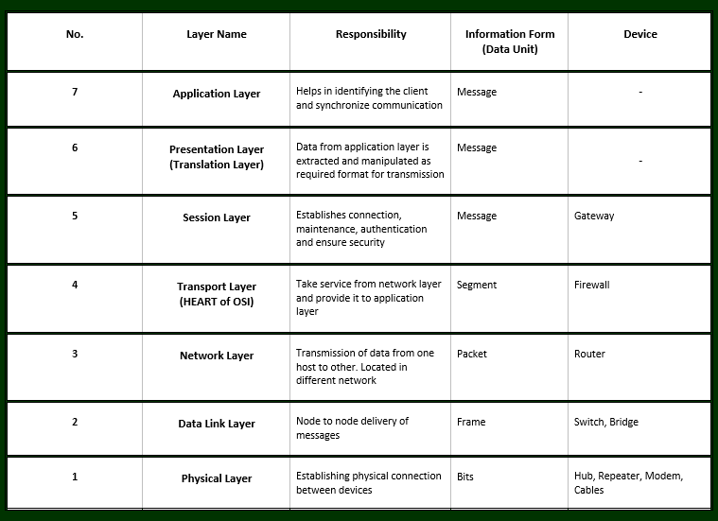
OSI Model
https://www.geeksforgeeks.org/layers-of-osi-model/

Slide 5
Azure NSGs
InBound
Outbound
192.168.1.4/26
NSG
192.168.1.5/26
NSG
NSG
NSG
NSG
Subnet-1
Subnet-2
Subnet-3
Subnet-4
vNet-1

Slide 6
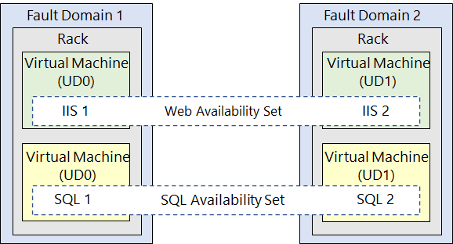
Virtual Machine Availability Sets
You can create a virtual machine and an Availability Set at the same time. A VM can only be added to an Availability Set when it is created. To change the Availability Set, you need to delete and then recreate the virtual machine.
VM Series- https://azure.microsoft.com/en-in/pricing/details/virtual-machines/series/

Slide 7
Virtual Machine Availability Sets
Virtual machine availability sets
Virtual machine availability sets are another tool to help you build a more resilient, highly available environment. Availability sets are designed to ensure that VMs stagger updates and have varied power and network connectivity, preventing you from losing all your VMs with a single network or power failure.
Availability sets do this by grouping VMs in two ways: update domain and fault domain.
Update domain: The update domain groups VMs that can be rebooted at the same time. This allows you to apply updates while knowing that only one update domain grouping will be offline at a time. All of the machines in one update domain will be updated. An update group going through the update process is given a 30-minute time to recover before maintenance on the next update domain starts.
Fault domain: The fault domain groups your VMs by common power source and network switch. By default, an availability set will split your VMs across up to three fault domains. This helps protect against a physical power or networking failure by having VMs in different fault domains (thus being connected to different power and networking resources).
Best of all, there’s no additional cost for configuring an availability set. You only pay for the VM instances you create.

Slide 8
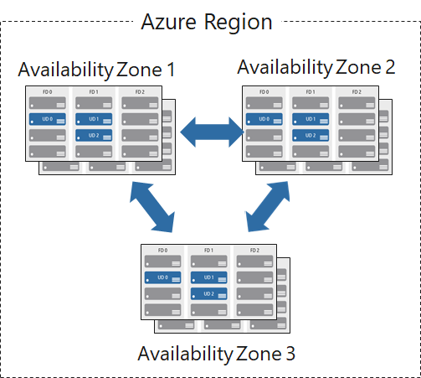
Virtual Machine Availability Zones
Cloud-init script examples- https://docs.microsoft.com/en-us/azure/virtual-machines/linux/tutorial-automate-vm-deployment
https://github.com/uglide/azure-content/blob/master/articles/virtual-machines/virtual-machines-linux-using-cloud-init.md
With Availability Zones, Azure offers industry best 99.99% VM uptime SLA.

Slide 9
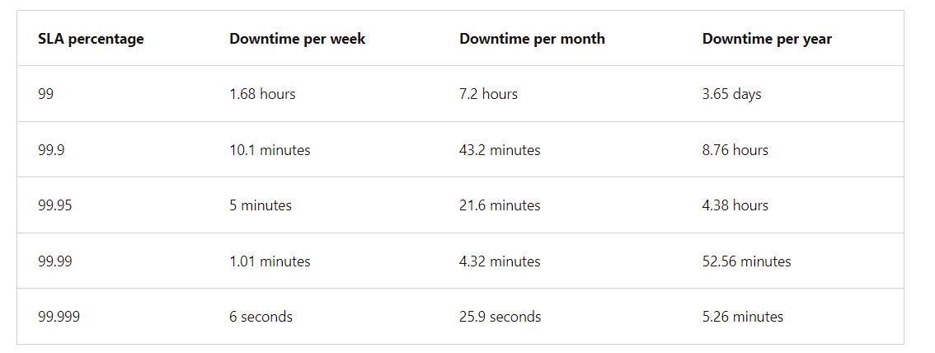
SLA
These amounts are cumulative, which means that the duration of multiple different service outages would be combined, or added together.

Slide 10
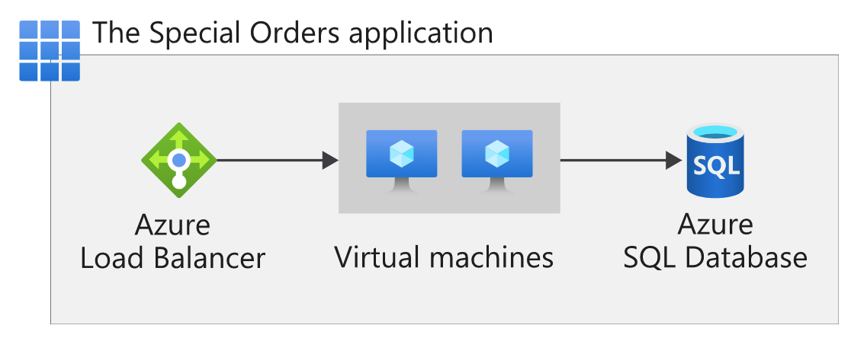
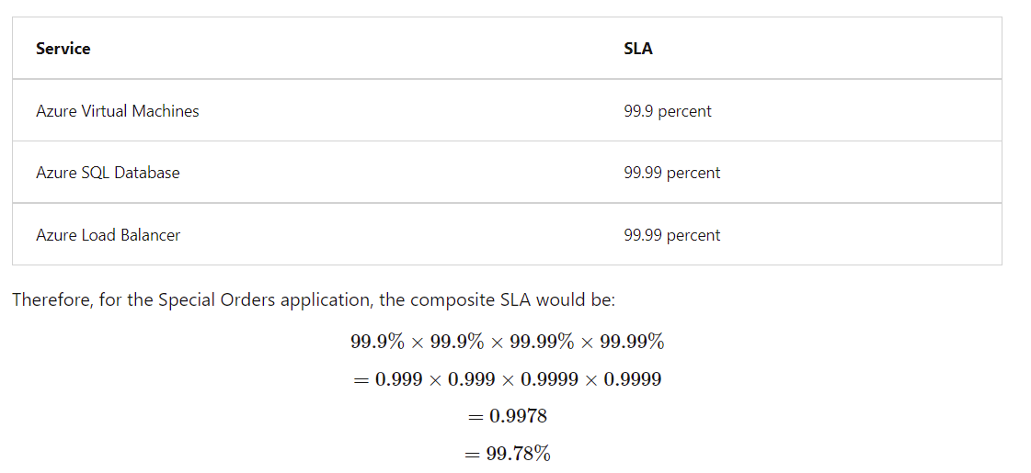
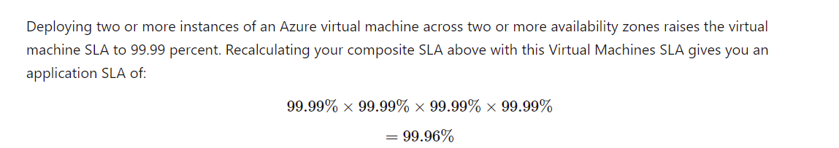
SLA

Slide 11
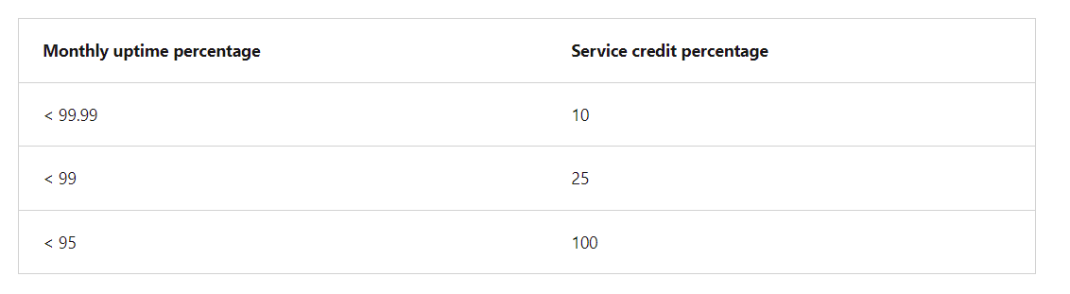
SLA
A service credit is the percentage of the fees you paid that are credited back to you according to the claim approval process.
An SLA describes how Microsoft responds when an Azure service fails to perform to its specification. For example, you might receive a discount on your Azure bill as compensation when a service fails to perform according to its SLA.
Credits typically increase as uptime decreases. Here's how credits are applied for Azure Database for MySQL according to uptime:

Slide 12
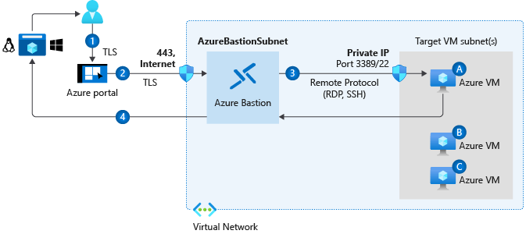
Azure Virtual Machines- Bastion
Bastion should be deployed in a separate subnet
Bastion must be present in the same network as that of the VM or in the network which is accessible from the VM Network

Slide 13
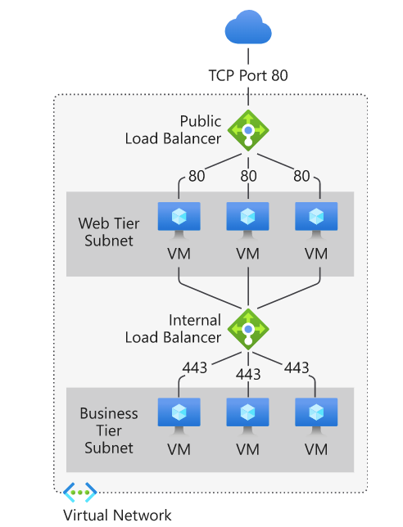
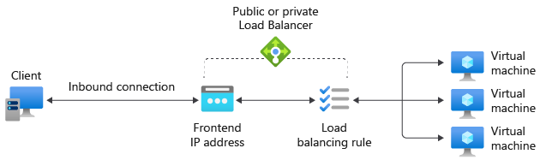
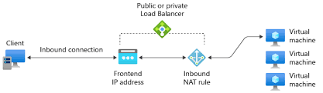
Load Balancer
FrontEnd IP
Backend Pool

Slide 14
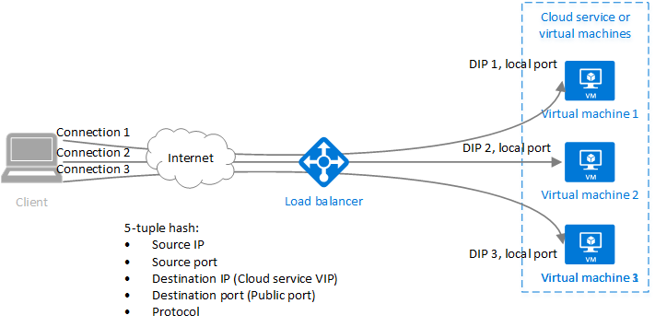
Load Balancer
Session persistence specifies how traffic from a client should be handled. The default behavior (None) is that successive requests from a client may be handled by any virtual machine. You can change this behavior.
None (default) specifies any virtual machine can handle the request.
Client IP (2-tuple hash) specifies that successive requests from the same client IP address will be handled by the same virtual machine.
Client IP and protocol (5-tuple hash) specifies that successive requests from the same client IP address and protocol combination will be handled by the same virtual machine.

Slide 15
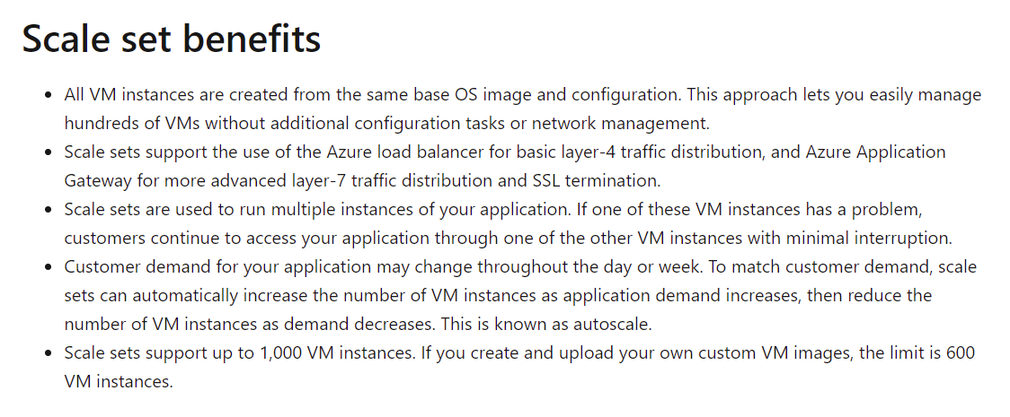
VM Scale Sets
Virtual machine scale sets are an Azure Compute resource you can use to deploy and manage a set of identical VMs

Slide 16
Azure Migrate
Azure Migrate
Azure Migrate is a service that helps you migrate from an on-premises environment to the cloud. Azure Migrate functions as a hub to help you manage the assessment and migration of your on-premises datacenter to Azure.
It provides the following:
Unified migration platform: A single portal to start, run, and track your migration to Azure.
Range of tools: A range of tools for assessment and migration. Azure Migrate tools include Azure Migrate: Discovery and assessment and Azure Migrate: Server Migration. Azure Migrate also integrates with other Azure services and tools, and with independent software vendor (ISV) offerings.
Assessment and migration: In the Azure Migrate hub, you can assess and migrate your on-premises infrastructure to Azure.

Slide 17
Azure Arc
Managing hybrid and multi-cloud environments can rapidly get complicated. Azure provides a host of tools to provision, configure, and monitor Azure resources.
Azure Arc provides a centralized, unified way to:
Manage your entire environment together by projecting your existing non-Azure resources into ARM.
Manage multi-cloud and hybrid virtual machines, Kubernetes clusters, and databases as if they are running in Azure.
Use familiar Azure services and management capabilities, regardless of where they live.
Continue using traditional ITOps while introducing DevOps practices to support new cloud and native patterns in your environment.
Configure custom locations as an abstraction layer on top of Azure Arc-enabled Kubernetes clusters and cluster extensions.
Currently, Azure Arc allows you to manage the following resource types hosted outside of Azure:
Servers
Kubernetes clusters
Azure data services
SQL Server
Virtual machines (preview)

Slide 18
Azure VM Reservation
Azure Reservations help you save money by committing to one-year or three-year plans for multiple products. Committing allows you to get a discount on the resources you use. Reservations can significantly reduce your resource costs by up to 72% from pay-as-you-go prices. Reservations provide a billing discount and don't affect the runtime state of your resources. After you purchase a reservation, the discount automatically applies to matching resources.
You can pay for a reservation up front or monthly. The total cost of up-front and monthly reservations is the same and you don't pay any extra fees when you choose to pay monthly. Monthly payment is available for Azure reservations, not third-party products.

Slide 19
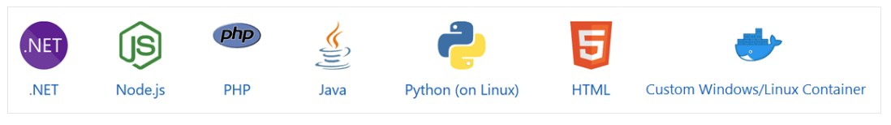
App Service
Azure App Service brings together everything you need to create websites, mobile backends, and web APIs for any platform or device. Applications run and scale with ease on both Windows and Linux-based environments. There are many deployment choices.

Slide 20
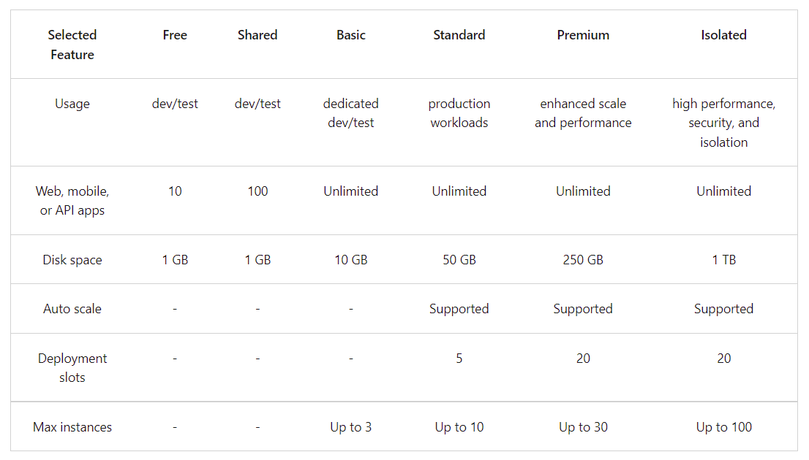
App Service Plans

Slide 21
App Service
Reasons to use App Services
Multiple languages and frameworks. App Service has first-class support for ASP.NET, Java, Ruby, Node.js, PHP, or Python. You can also run PowerShell and other scripts or executables as background services.
DevOps optimization. Set up continuous integration and deployment with Azure DevOps, GitHub, BitBucket, Docker Hub, or Azure Container Registry. Promote updates through test and staging environments. Manage your apps in App Service by using Azure PowerShell or the cross-platform command-line interface (CLI).
Global scale with high availability. Scale up or out manually or automatically. Host your apps anywhere in Microsoft's global datacenter infrastructure, and the App Service SLA promises high availability.
Connections to SaaS platforms and on-premises data. Choose from more than 50 connectors for enterprise systems (such as SAP), SaaS services (such as Salesforce), and internet services (such as Facebook). Access on-premises data using Hybrid Connections and Azure Virtual Networks.
Security and compliance. App Service is ISO, SOC, and PCI compliant. Authenticate users with Azure Active Directory or with social login (Google, Facebook, Twitter, and Microsoft). Create IP address restrictions and manage service identities.
Application templates. Choose from an extensive list of application templates in the Azure Marketplace, such as WordPress, Joomla, and Drupal.
Visual Studio integration. Dedicated tools in Visual Studio streamline the work of creating, deploying, and debugging.
API and mobile features. App Service provides turn-key CORS support for RESTful API scenarios, and simplifies mobile app scenarios by enabling authentication, offline data sync, push notifications, and more.
Serverless code. Run a code snippet or script on-demand without having to explicitly provision or manage infrastructure and pay only for the compute time your code actually uses.

Slide 22
App Service Deployment
git clone https://github.com/phanindravedula/appServices
cd appServices
python3 -m venv .venv
source .venv/bin/activate
pip install -r requirements.txt
Deactivate
az webapp up --runtime PYTHON:3.8 --sku F1 --location australiacentral --resource-group DEV-Resource-Rroup
https://docs.microsoft.com/en-us/azure/app-service/quickstart-python?tabs=flask%2Cmac-linux%2Cazure-cli%2Cazure-cli-deploy%2Cdeploy-instructions-azportal%2Cterminal-bash%2Cdeploy-instructions-zip-azcli

Slide 23
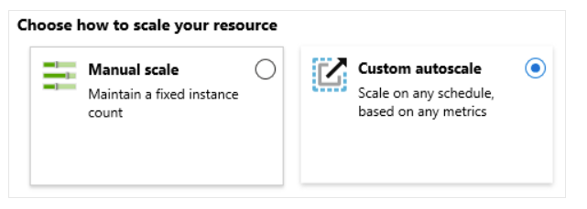
App Service Scaling
Scale up. Get more CPU, memory, disk space, and extra features like dedicated virtual machines (VMs), custom domains and certificates, staging slots, autoscaling, and more. You scale up by changing the pricing tier of the App Service plan that your app belongs to.
Scale out: Increase the number of VM instances that run your app. You can scale out to as many as 30 instances, depending on your pricing tier. App Service Environments in Isolated tier further increases your scale-out count to 100 instances. The scale instance count can be configured manually or automatically (autoscale). Autoscale is based on predefined rules and schedules.

Slide 24
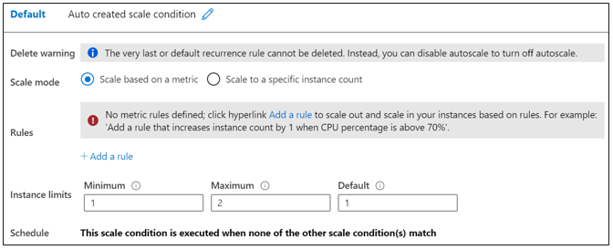
App Service Scaling
Rules include a trigger and a scale action (in or out). The trigger can be metric-based or time-based.
Metric-based. Metric-based rules measure application load and add or remove VMs based on that load. For example, do this action when CPU usage is above 50%. Examples of metrics are CPU time, Average response time, and Requests.
Time-based. Time-based (schedule-based) rules allow you to scale when you see time patterns in your load and want to scale before a possible load increase or decrease occurs. For example, trigger a webhook every 8am on Saturday in a given time zone.

Slide 25
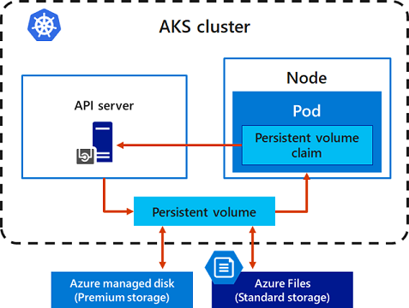
AKS

Slide 26
AKS- Max Pods per Node to Subnet Relation
If Max Pods per nodes = 110
Number of Ips required = 110 Ips for pods + 1 IP for node = 111 Ips in subnet
If subnet is /24 then we have 256 Ips
Maximum nodes we can have in the subnet = 2 nodes because for 3 nodes we need 111*3 Ips i.e. 333 Ips
If subnet is /22 then we have 1024 Ips
Maximum nodes we can have in the subnet = 9 because for 10 nodes we need 111*10 i.e. 1110 Ips
If Max number of pods per nodes = 30
So number of Ips required for 1 nodes will be 30 + 1 = 31 Ips
If subnet is /24 then we have 256 Ips
Maximum nodes we can have in the subnet = 8 because for 9 node we need 279 Ips

Slide 27
AKS Setup
Az Cli installation in centos 8.5
sudo rpm --import https://packages.microsoft.com/keys/microsoft.asc
sudo dnf install -y https://packages.microsoft.com/config/rhel/8/packages-microsoft-prod.rpm
echo -e "[azure-cli]
name=Azure CLI
baseurl=https://packages.microsoft.com/yumrepos/azure-cli
enabled=1
gpgcheck=1
gpgkey=https://packages.microsoft.com/keys/microsoft.asc" | sudo tee /etc/yum.repos.d/azure-cli.repo
sudo dnf install azure-cli
az login (make sure the VM time and your laptop time are in same timezone)
az acr login --name <Container Registry name>
az aks get-credentials --resource-group Phanindra_AKS_RG --name aks-cluster-01
kubectl create secret docker-registry azcrsecret --namespace default --docker-server=phanindraregistry.azurecr.io --docker-username=phanindraregistry --docker-password=xiMpD16FOGKO/+o+ANaPxKbllL1V9/GG

Slide 28
AKS Setup
Configure ACR integration for existing AKS clusters (if not done during AKS installation)
az aks update -n myAKSCluster -g myResourceGroup --attach-acr <acr-name>
Build the docker image with the registry path
docker build -t phanindraregistry.azurecr.io/demoapp:v1 .
docker push phanindraregistry.azurecr.io/demoapp:v1
Helm Installation
curl -fsSL -o get_helm.sh https://raw.githubusercontent.com/helm/helm/main/scripts/get-helm-3
chmod 700 get_helm.sh
./get_helm.sh
Nginx Installation
NAMESPACE=ingress-basic
helm repo add ingress-nginx https://kubernetes.github.io/ingress-nginx
helm repo update
helm install ingress-nginx ingress-nginx/ingress-nginx \
--create-namespace \
--namespace $NAMESPACE \
--set controller.service.annotations."service\.beta\.kubernetes\.io/azure-load-balancer-health-probe-request-path"=/healthz

Slide 29
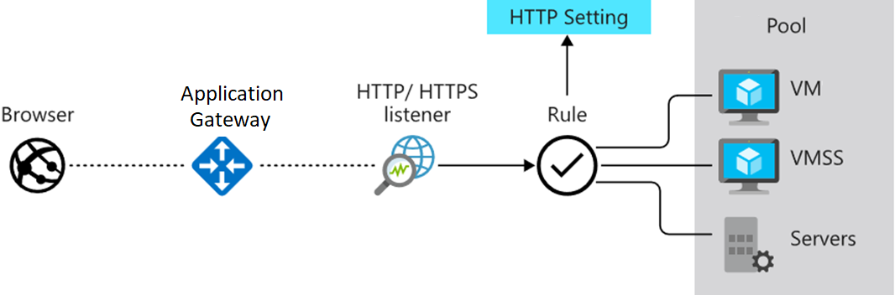
Azure Application Gateway

Slide 30
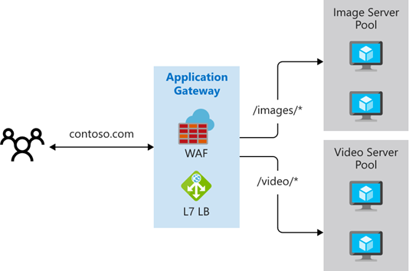
Azure Application Gateway Path Based Routing

Slide 31
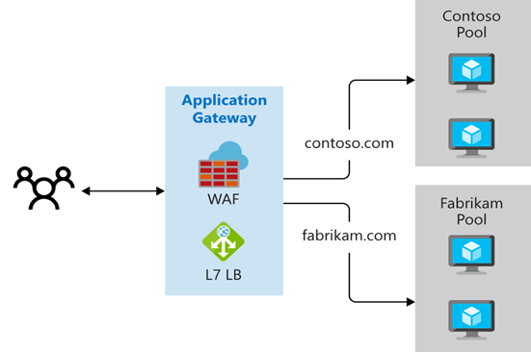
Azure Application Gateway Multi Site Routing

Slide 32
Azure Application Gateway Other Features
Redirection. Redirection can be used to another site, or from HTTP to HTTPS.
Rewrite HTTP headers. HTTP headers allow the client and server to pass parameter information with the request or the response.
Custom error pages. Application Gateway allows you to create custom error pages instead of displaying default error pages. You can use your own branding and layout using a custom error page.

Slide 33
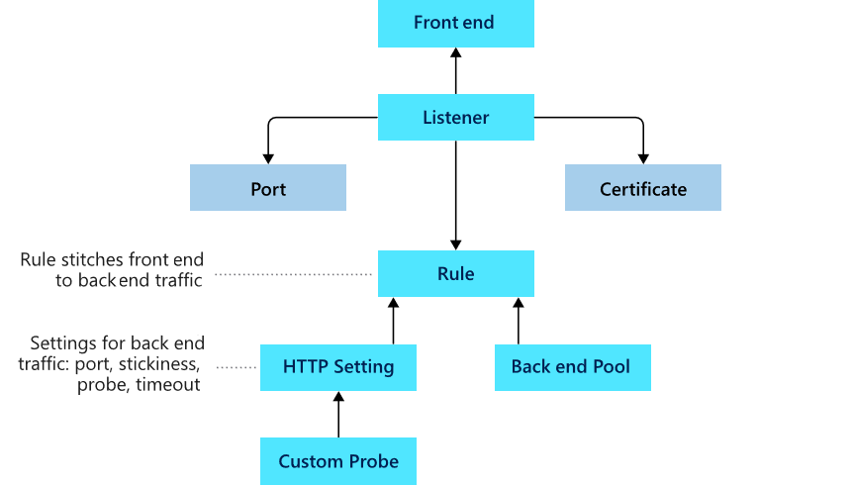
Azure Application Gateway Setup

Slide 34
AKS Storage Classes
An Azure Disks can only be mounted with Access mode type ReadWriteOnce, which makes it available to one node in AKS. If you need to share a persistent volume across multiple nodes, use Azure Files.
Create Storage Account and file share
Create the following secret in AKS
kubectl create secret generic azurefileshare-secret --from-literal=azurestorageaccountname=aksstorage17082022 --from-literal=azurestorageaccountkey=kwc7OI/p3LdeVPebBuE3kIIRdy7S0SWdlD/sScnyWM3rbvftsWvPRGoSngbDDQf9rnEEHs8Xvh8y+ASto+eHhg==
https://github.com/phanindravedula/AKS-Deployment
https://docs.microsoft.com/en-us/azure/aks/azure-disk-volume

Slide 35
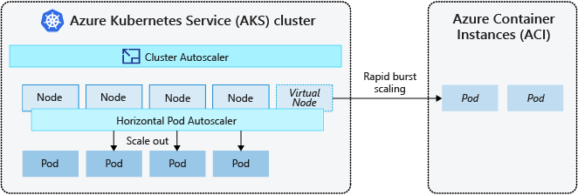
Azure Container Instances
https://cloud.netapp.com/blog/azure-cvo-blg-azure-kubernetes-service-tutorial-integrate-aks-with-aci

