Slide 1
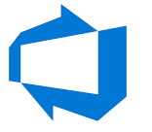
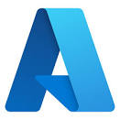
Azure

Slide 2

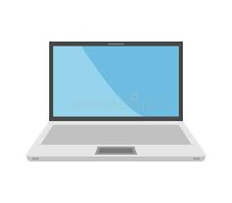

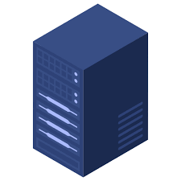
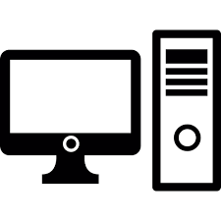
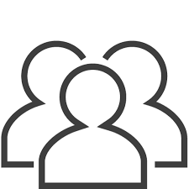
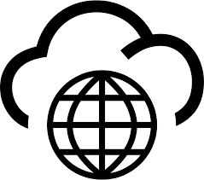
On Premise Active Directory
Region-1
192.168.1.0/24
192.168.2.0/24
Region-3
192.168.3.0/24
Region-2
Printer-04
PC-10
PC-01
PC-02
PC-03
PC-08
PC-09
PC-11
Active Directory Domain Services
DNS-01
DNS-02
PC-04
PC-05
PC-06
PC-07
DC-03
Server-03
Server-01
Server-02
DC-01
DC-02
Domain Join
Printer-01
Printer-02
Printer-03

Slide 3
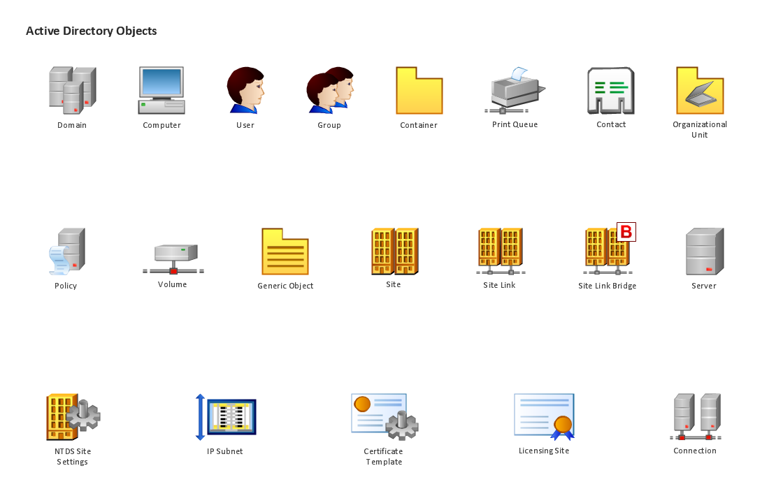
On Premise Active Directory

Slide 4
On Premise Active Directory
abc.com
ROOT Domain
AD Tree
us.abc.com
uk.abc.com
in.abc.com
Sub Domains
sales.us.abc.com
devops.us.abc.com
OU1
Delegate Permissions to Objects in OU Level
Group Policy
Cloud OU
Objects

Slide 5
On Premise Active Directory
ROOT Domain
Forest
ROOT Domain
abc.com
pqr.com
AD Tree
us.abc.com
uk.abc.com
in.abc.com
us.pqr.com
uk.pqr.com
Sub Domains
sales.us.abc.com
devops.us.abc.com
sales.us.pqr.com
devops.us.pqr.com
OU1
Delegate Permissions to Objects in OU Level
Group Policy
Cloud OU
Cloud OU
Objects
Objects

Slide 6
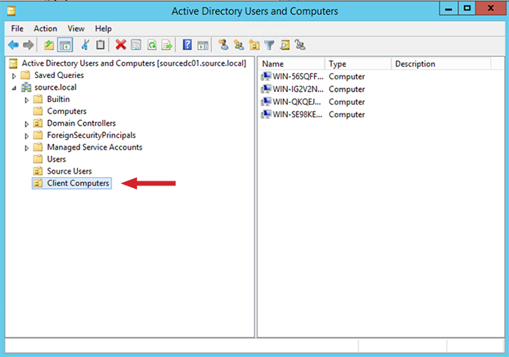
On Premise Active Directory

Slide 7

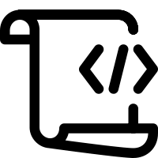
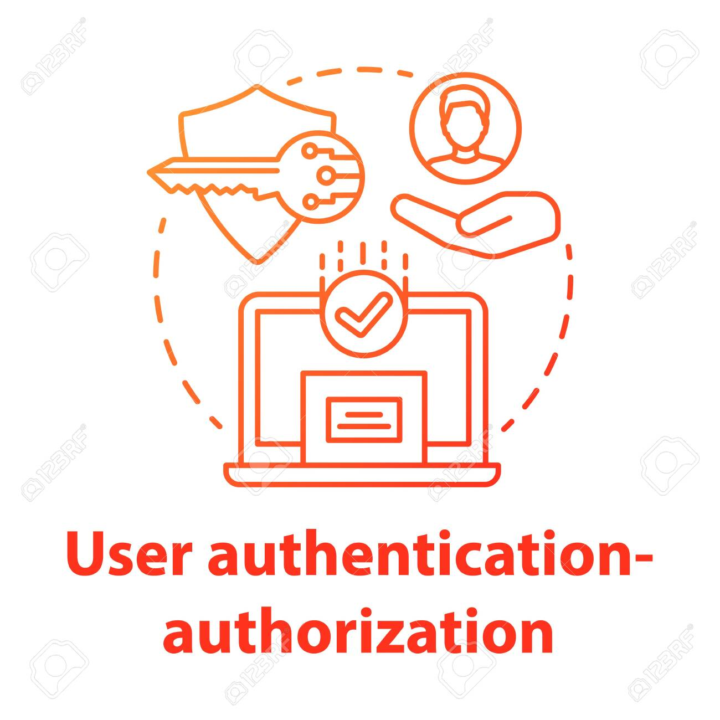
Single-Sign-On
AT1
App1
RT1
AT2
App2
Everytime client send refresh token again, authorization is performed and new access token is generated

Slide 8
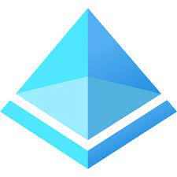
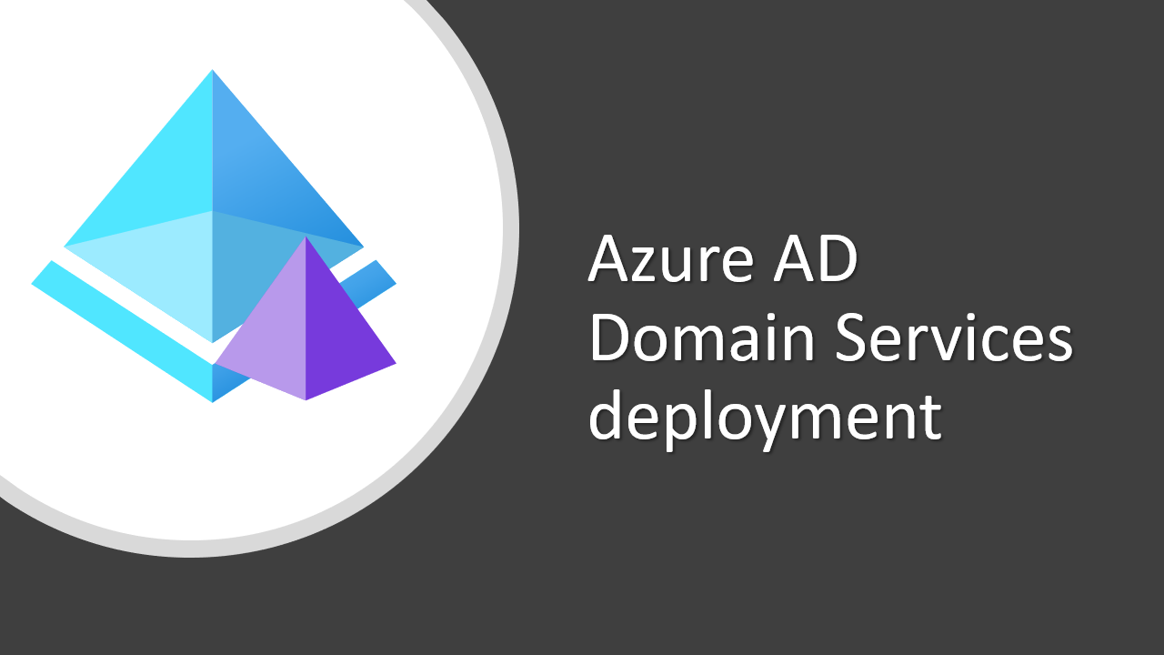
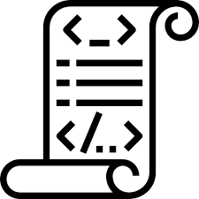
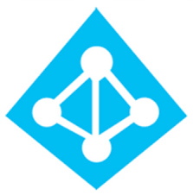
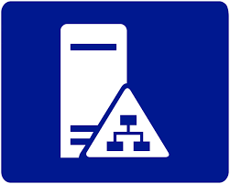
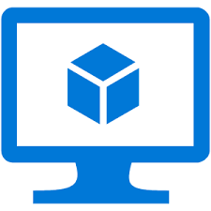
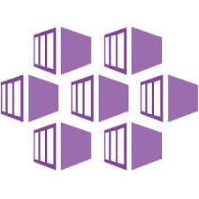
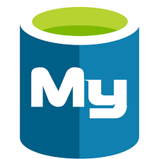
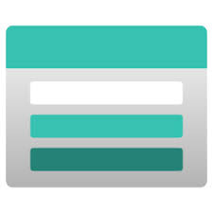
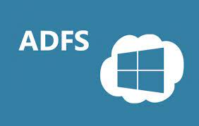
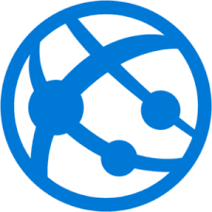

Azure Active Directory
Conditional Access
MFA
JIT (Just in Time Access)
Partners
AAD
SAML
OTP
Azure AD is not AD in Azure
Subscriptions trust Azure AD
Azure B2C is a separate service
AADDS is for scenarios like AVD
OAUTH2
OIDC
SAML
B2B
Cloud Apps
PAAS
Like Workday
Enterprise
Apps
Subscription-1
Root Management Group
SAML
Azure AD
Subscription-2
Customers
Gmail
Facebook
Github
B2C
Azure AD Connect
Subscription-3
Management Group-1
Management Group-2
Azure AD App Proxy
Subscription-4
APP
Resource Group-03
Resource Group-02
Resource Group-01
MSAL (Microsoft Authentication Library)
APP
Kerberos
NTLM
LDAP
Subnet-02
Subnet-01
SAML
vNet-4/Region-3
vNet-2/Region-2
vNet-3/Region-2
vNet-1/Region-1
If user is working remotely then user must use VPN
https://infrastructuremap.microsoft.com/

Slide 9
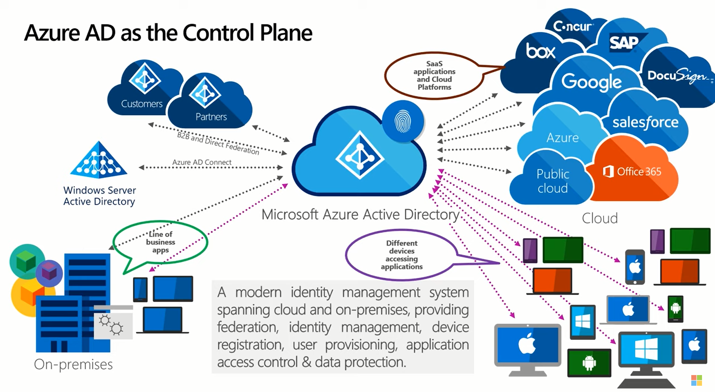
Azure Active Directory

Slide 10
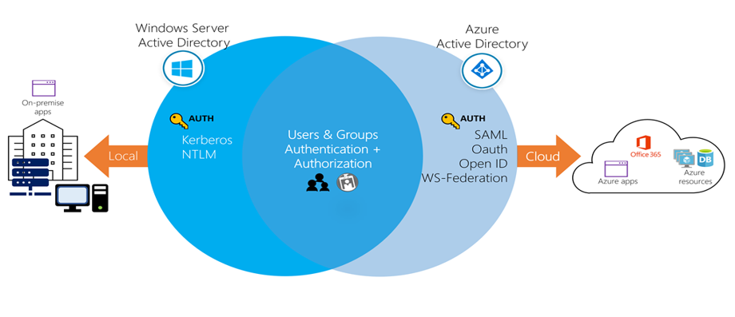
Azure Active Directory

Slide 11
Cloud Computing
What is cloud computing ?
Cloud computing is the delivery of computing services over the internet. Computing services include common IT infrastructure such as virtual machines, storage, databases, and networking. Cloud services also expand the traditional IT offerings to include things like Internet of Things (IoT), machine learning (ML), and artificial intelligence (AI).
What is shared responsibility model ?
Start with a traditional corporate datacenter. The company is responsible for maintaining the physical space, ensuring security, and maintaining or replacing the servers if anything happens. The IT department is responsible for maintaining all the infrastructure and software needed to keep the datacenter up and running. They’re also likely to be responsible for keeping all systems patched and on the correct version.
With the shared responsibility model, these responsibilities get shared between the cloud provider and the consumer. Physical security, power, cooling, and network connectivity are the responsibility of the cloud provider. The consumer isn’t collocated with the datacenter, so it wouldn’t make sense for the consumer to have any of those responsibilities.

Slide 12
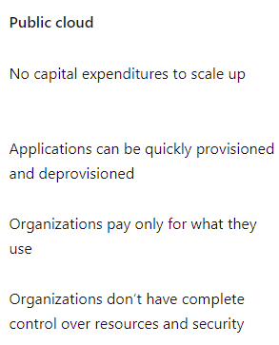
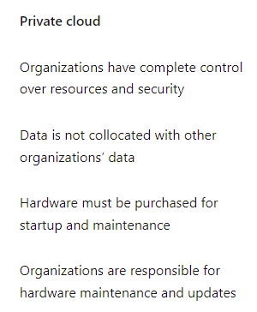
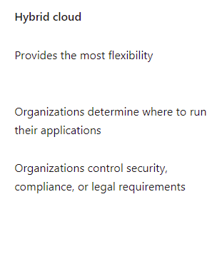
Clouds Models

Slide 13
Cloud Models
Multi-cloud
A fourth, and increasingly likely scenario is a multi-cloud scenario. In a multi-cloud scenario, you use multiple public cloud providers. Maybe you use different features from different cloud providers. Or maybe you started your cloud journey with one provider and are in the process of migrating to a different provider. Regardless, in a multi-cloud environment you deal with two (or more) public cloud providers and manage resources and security in both environments.
Azure Arc
Azure Arc is a set of technologies that helps manage your cloud environment. Azure Arc can help manage your cloud public cloud solely on Azure, a private cloud in your datacenter, a hybrid configuration, or even a multi-cloud environment running on multiple cloud providers at once.
Azure VMware Solution
What if you’re already established with VMware in a private cloud environment but want to migrate to a public or hybrid cloud? Azure VMware Solution lets you run your VMware workloads in Azure with seamless integration and scalability.

Slide 14
Azure Pricing
When comparing IT infrastructure models, there are two types of expenses to consider. Capital expenditure (CapEx) and operational expenditure (OpEx).
Cloud computing falls under OpEx because cloud computing operates on a consumption-based model.
This consumption-based model has many benefits, including:
No upfront costs.
No need to purchase and manage costly infrastructure that users might not use to its fullest potential.
The ability to pay for more resources when they're needed.
The ability to stop paying for resources that are no longer needed.

Slide 15
Benefits of Cloud
Security & Governance
Reliability
Reliability is the ability of a system to recover from failures and continue to function. It's also one of the pillars of the Microsoft Azure Well-Architected Framework.
Predictability
Predictability in the cloud lets you move forward with confidence. Predictability can be focused on performance predictability or cost predictability.
Performance
Performance predictability focuses on predicting the resources need to deliver a positive experience for your customers. Autoscaling, load balancing, and high availability are just some of the cloud concepts that support performance predictability.
Cost
Cost predictability is focused on predicting or forecasting the cost of the cloud spend. With the cloud, you can track your resource use in real time,

Slide 16
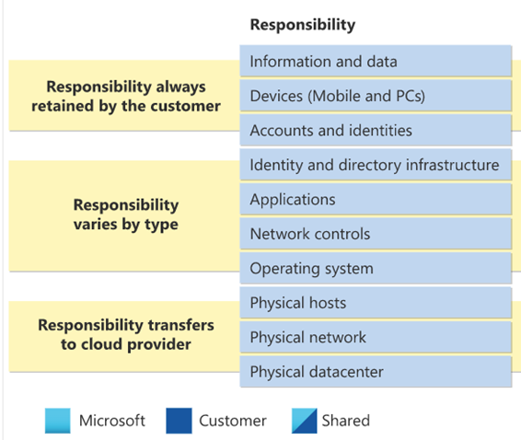




Cloud Services Models

Slide 17
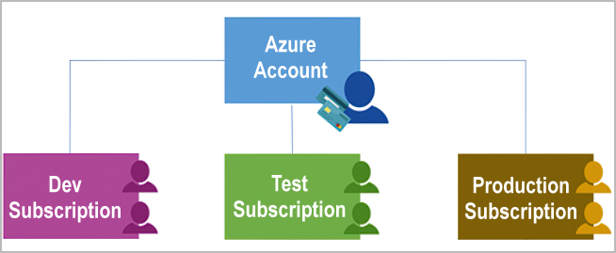
Azure Management Groups & Subscriptions
Important facts about management groups:
10,000 management groups can be supported in a single directory.
A management group tree can support up to six levels of depth. This limit doesn't include the root level or the subscription level.
Each management group and subscription can support only one parent.

Slide 18
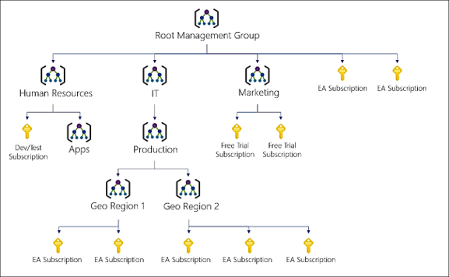
Azure Management Groups

Slide 19
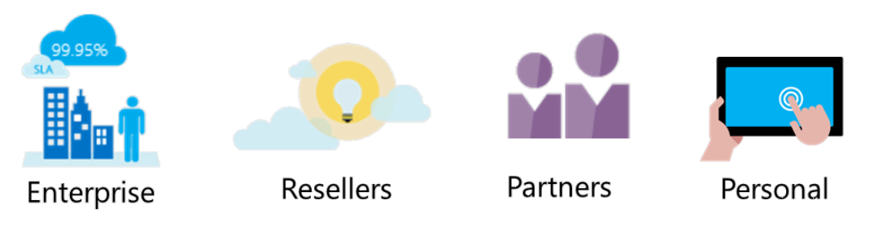
Options to buy subscriptions
Enterprise agreements
Any Enterprise Agreement customer can add Azure to their agreement by making an upfront monetary commitment to Azure. That commitment is consumed throughout the year by using any combination of the wide variety of cloud services Azure offers. Enterprise agreements have a 99.95% monthly SLA.
Reseller
Buy Azure through the Open Licensing program, which provides a simple, flexible way to purchase cloud services from your Microsoft reseller. If you already purchased an Azure in Open license key, activate a new subscription or add more credits now.
Partners
Find a Microsoft partner who can design and implement your Azure cloud solution. These partners have the business and technology expertise to recommend solutions that meet the unique needs of your business.
Personal free account
With a free trial account, you can get started using Azure right away and you won’t be charged until you choose to upgrade.
Azure offers free and paid subscription options to suit different needs and requirements. The most commonly used subscriptions are:
Free
Pay-As-You-Go
Enterprise Agreement
Student

Slide 20
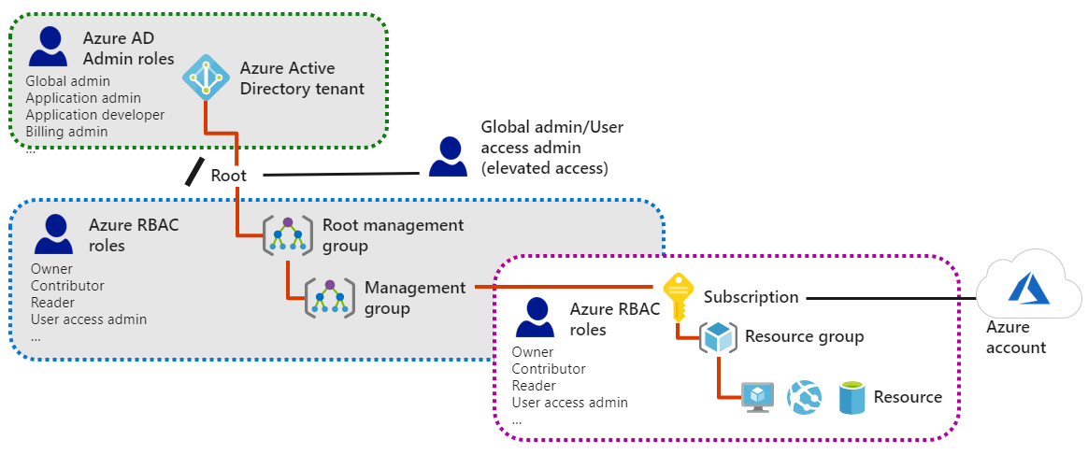
Azure RBAC Roles vs AD Roles

Slide 21
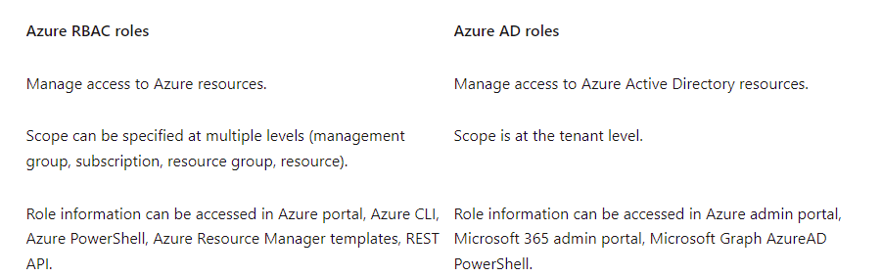
Azure RBAC Roles vs AD Roles

Slide 22
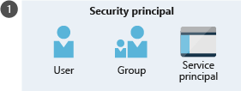
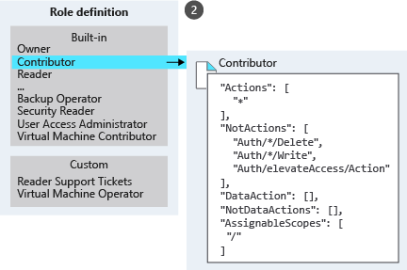
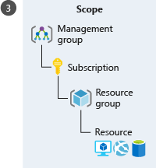
Azure RBAC
Security principal (who)
A security principal is just a fancy name for a user, group, or application that you want to grant access to.
Role definition (what you can do)
A role definition is a collection of permissions. It's sometimes just called a role. A role definition lists the permissions that can be performed, such as read, write, and delete. Roles can be high-level, like Owner, or specific, like Virtual Machine Contributor.
Scope (where)
Scope is where the access applies to. This is helpful if you want to make someone a Website Contributor, but only for one resource group.

Slide 23
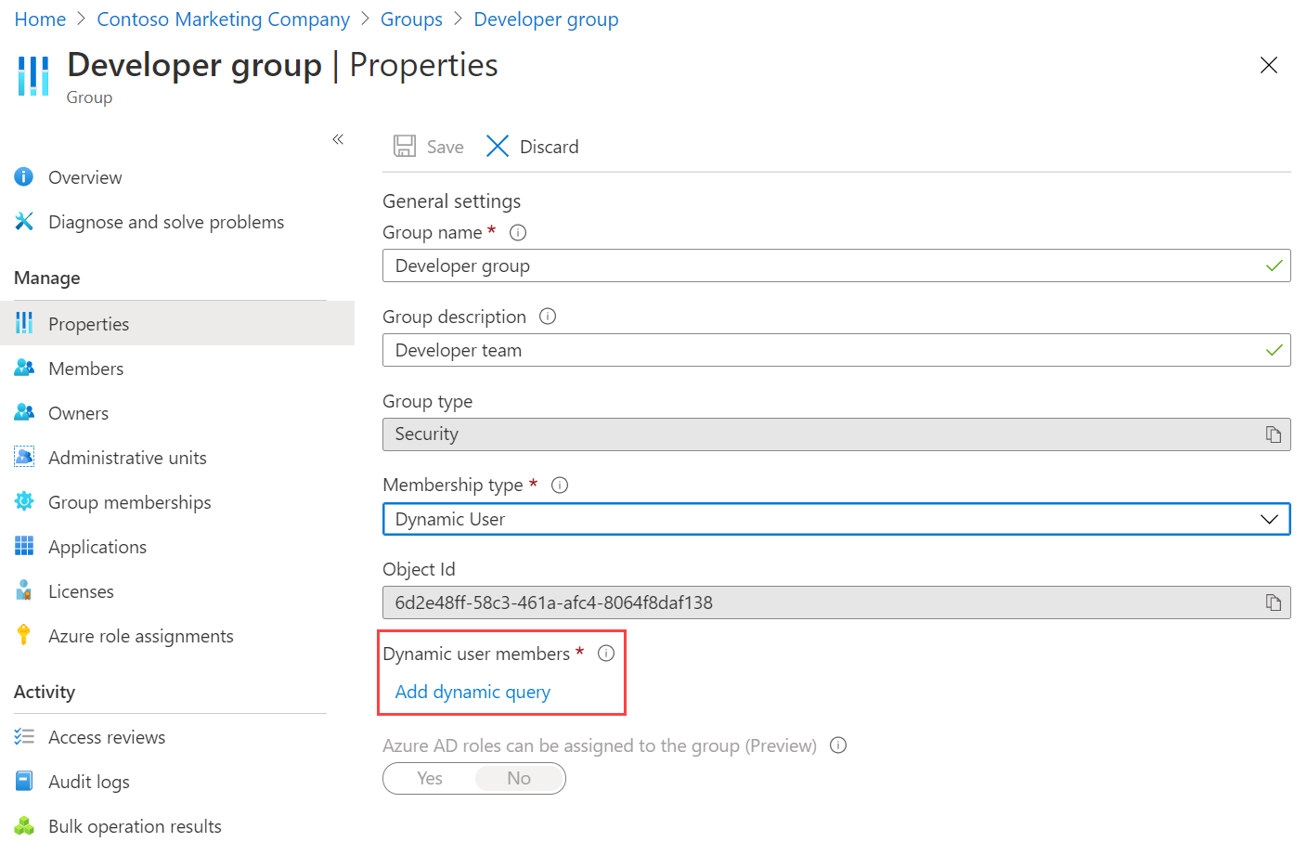
Azure Groups ( Dynamic User Addition)

Slide 24
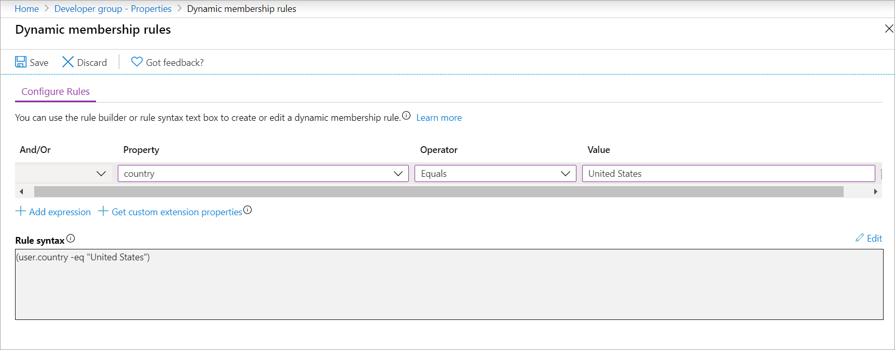
Azure Groups ( Dynamic User Addition)

Slide 25
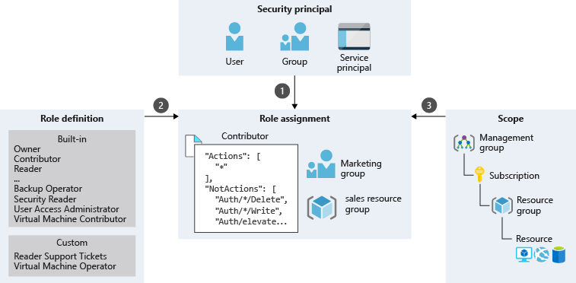
Azure RBAC
Role assignment
Once you have determined the who, what, and where, you can combine those elements to grant access. A role assignment is the process of binding a role to a security principal at a particular scope, for the purpose of granting access. To grant access, you create a role assignment. To revoke access, you remove a role assignment.

Slide 26
Azure SSPR
Any user who is signed in can change their password, regardless of the edition of Azure AD.
If you're not signed in and you've forgotten your password or your password has expired, you can use SSPR in Azure AD Premium P1 or P2. It's also available with Microsoft 365 Apps for business or Microsoft 365.
In a hybrid situation, where you have Active Directory on-premises and Azure AD in the cloud, any password change in the cloud must be written back to the on-premises directory. This writeback support is available in Azure AD Premium P1 or P2. It's also available with Microsoft 365 Apps for business.
A user is considered registered for SSPR when they've registered at least the number of methods that you've required to reset a password. You can set this number in the Azure portal.

Slide 27
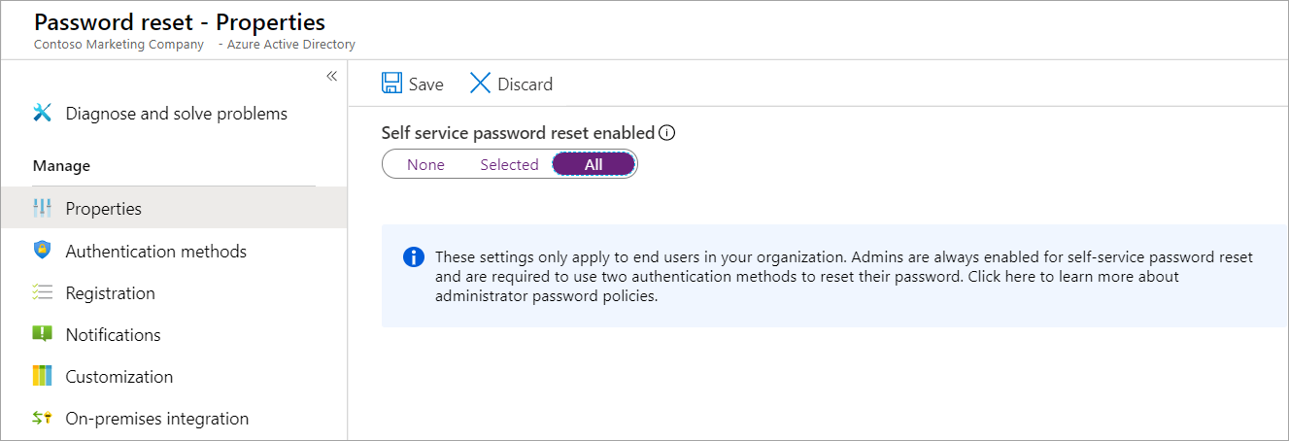
Azure SSPR

Slide 28
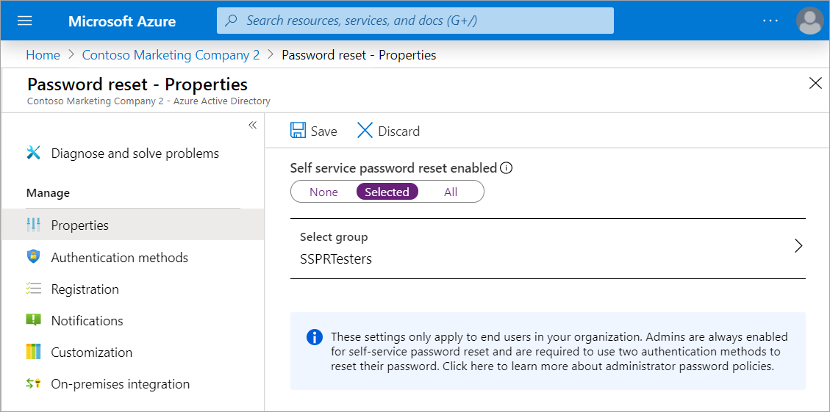
Azure SSPR

Slide 29
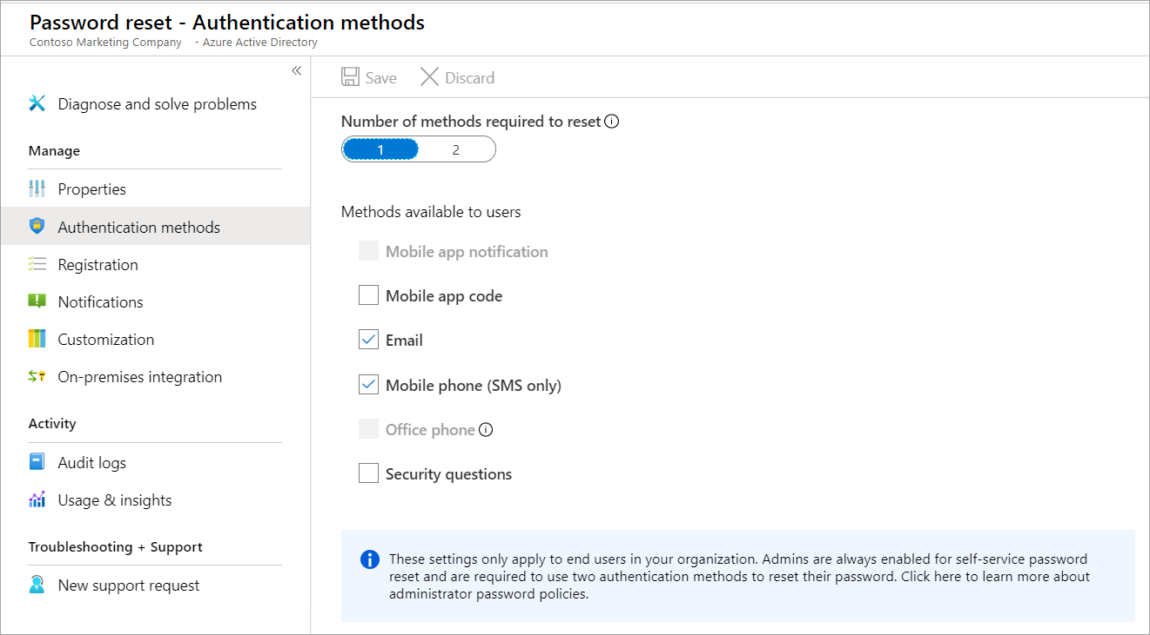
Azure SSPR

Slide 30
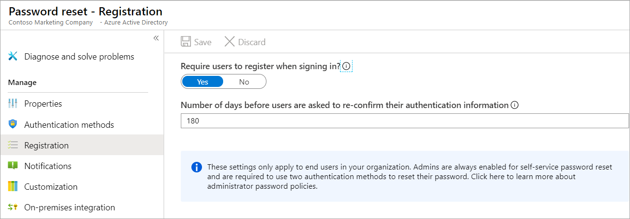
Azure SSPR

Slide 31
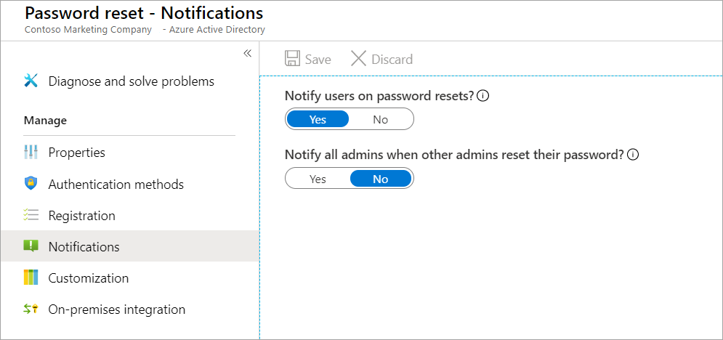
Azure SSPR

Slide 32
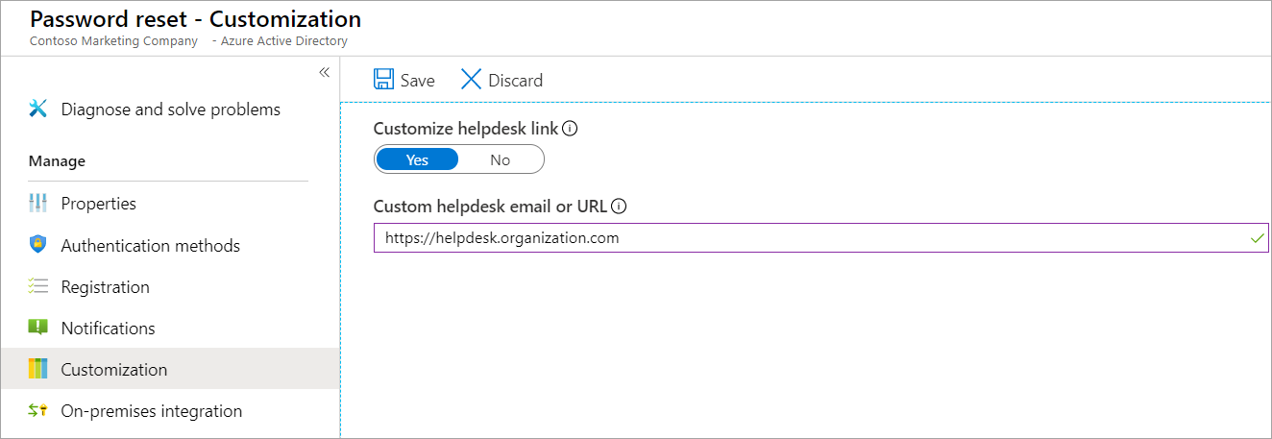
Azure SSPR

Slide 33
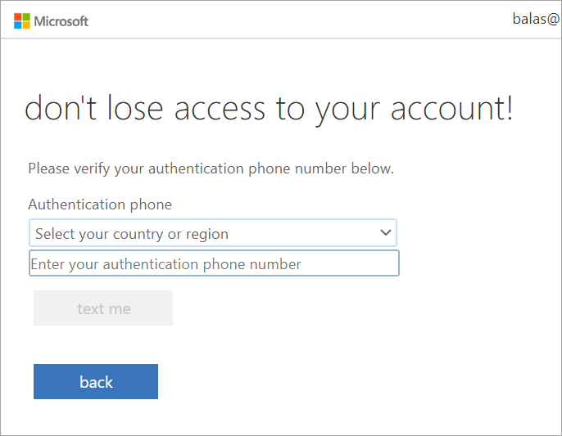
Azure SSPR

Slide 34
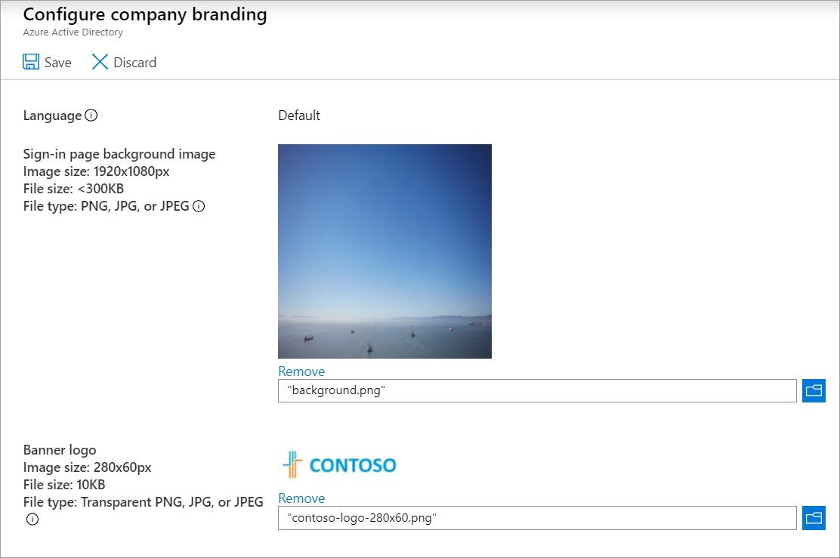
Azure Company Branding

Slide 35
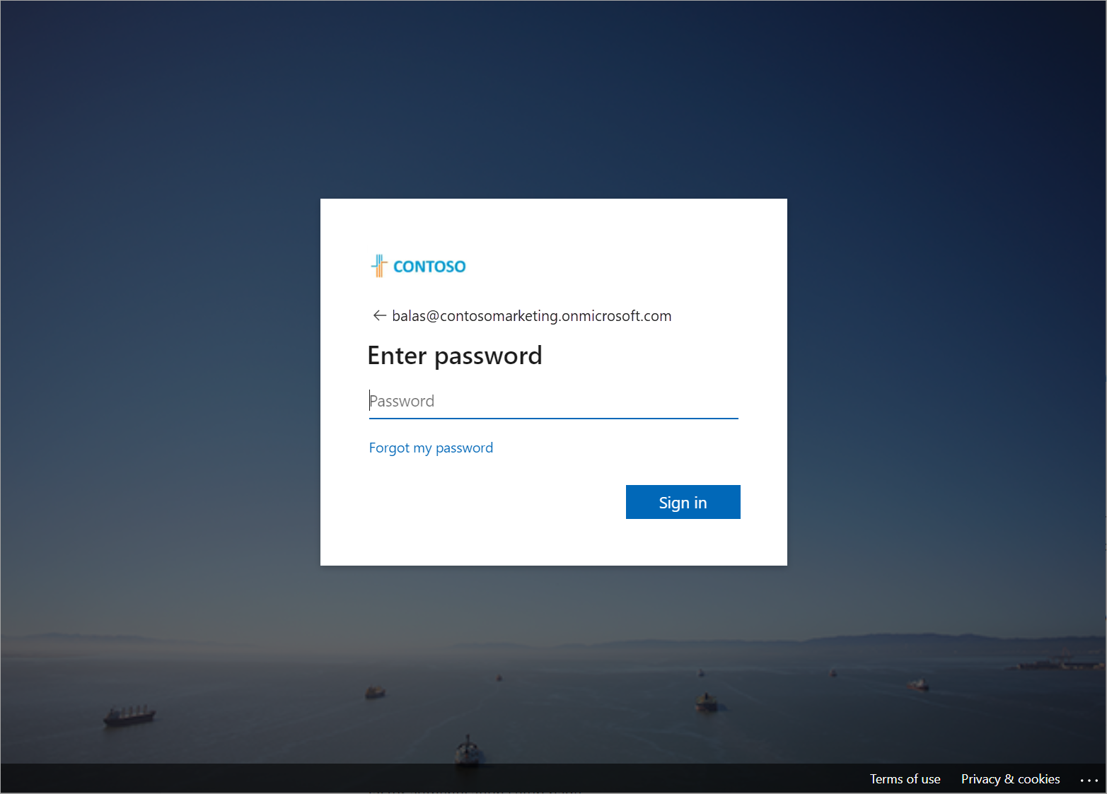
Azure Company Branding

Slide 36
Azure Policy
Use cases
Specify the resource types that your organization can deploy.
Specify a set of virtual machine SKUs (Stock Keeping Units) that your organization can deploy.
Restrict the locations your organization can specify when deploying resources.
Enforce a required tag and its value.
Audit if Azure Backup service is enabled for all Virtual machines.

Slide 37
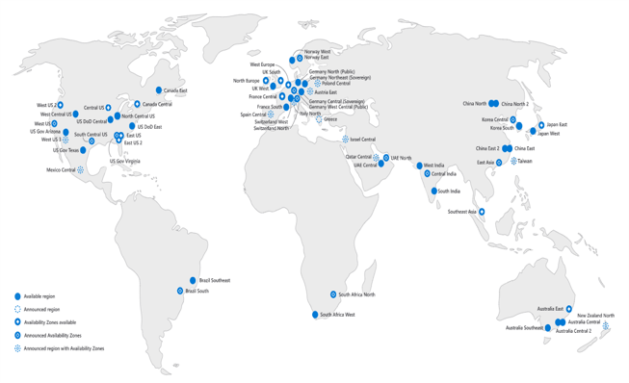
Azure Regions

Slide 38
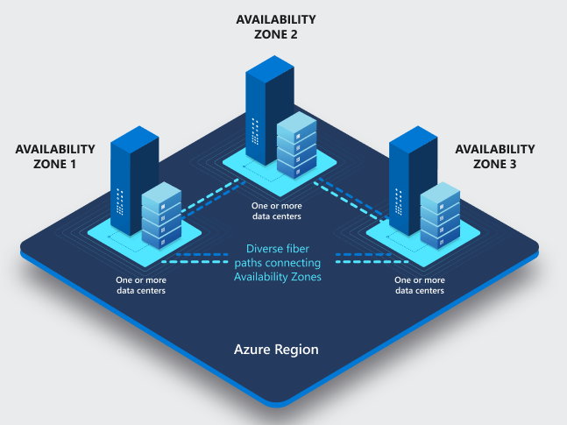
Azure Availability Zones
https://docs.microsoft.com/en-us/azure/availability-zones/az-overview

Slide 39

Azure Availability Zones

Slide 40

Azure Paired Regions
https://docs.microsoft.com/en-us/azure/availability-zones/cross-region-replication-azure

Slide 41
Azure Paired Regions
Sovereign Regions
In addition to regular regions, Azure also has sovereign regions. Sovereign regions are instances of Azure that are isolated from the main instance of Azure. You may need to use a sovereign region for compliance or legal purposes.
Azure sovereign regions include:
US DoD Central, US Gov Virginia, US Gov Iowa and more: These regions are physical and logical network-isolated instances of Azure for U.S. government agencies and partners. These datacenters are operated by screened U.S. personnel and include additional compliance certifications.
China East, China North, and more: These regions are available through a unique partnership between Microsoft and 21Vianet, whereby Microsoft doesn't directly maintain the datacenters.

Slide 42

Azure Clouds

