Slide 1


Docker

Slide 2




Current Environment
Libs
Deps
Linux VM OS
Hardware

Slide 3
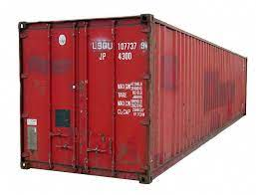
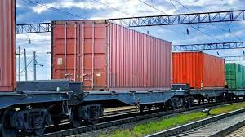
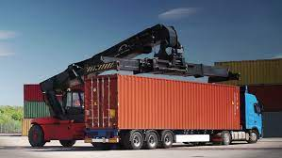

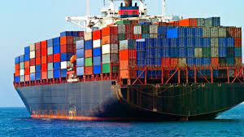
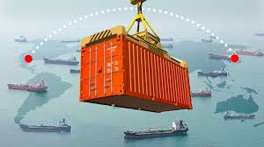
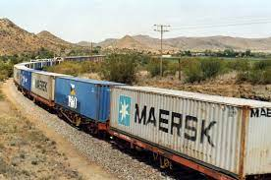
Containers

Slide 4
Why Containers
Compatibility with underlying OS
Compatibility with lib & dependencies
(as different service requires different versions )
3. Env setup will be same across users
Libs
Deps
OS
Hardware

Slide 5

Docker
Network
Network
Network
Processes
Processes
Processes
Mounts
Mounts
Mounts
Libs
Deps
Libs
Deps
Libs
Deps
Docker
OS
Hardware

Slide 6




Docker (Sharing the kernel)
Centos
Ubuntu
Fedora
Suse
Software
Software
Software
Software
OS Kernel

Slide 7
Docker (Sharing the kernel)
Centos
Ubuntu
Fedora
Suse
Software
Software
Software
Software
Docker
OS- Centos

Slide 8
Docker vs VMs
Lower Utilization
of resources
More Utilization
of resources
Network
Network
Less Disk Space
Processes
Processes
Higher Disk Space
Mounts
Mounts
Libs
Deps
Libs
Deps
Libs
Deps
Libs
Deps
Less Time to Boot
More Time to Boot
OS
OS
Docker
Hypervisor
OS
Hardware
Hardware

Slide 9
Docker & VMs
Network
Network
Network
Network
Processes
Processes
Processes
Processes
Mounts
Mounts
Mounts
Mounts
Libs
Deps
Libs
Deps
Libs
Deps
Libs
Deps
Docker
Docker
OS
OS
Hypervisor
Hardware

Slide 10
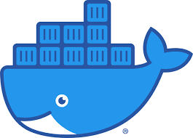
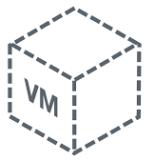
Docker Registry
docker run nginx
docker run gunicorn
docker run flask
docker run mysql
docker run gunicorn
docker run gunicorn
Docker hub (Public Docker Registry)
VM

Slide 11
Image vs Container
Container 1
Container 2
Docker Image
Container 3
Package
Template
Plan
Container 4

Slide 12
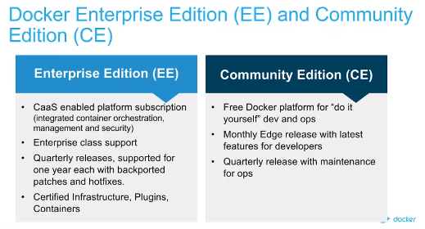
Docker

Slide 13

Docker Port Mapping
80
8000
192.168.1.4:80
5000
5000
docker run –p 80:5000 <Image name>
Flask Container
Flask Container 2
172.17.0.2
192.168.1.4
Docker Host (VM)

Slide 14

Docker Volume Mapping
3306
3306
Docker run –v /opt/datadir:/var/lib/mysql mysql
MySql Container
/var/lib/mysql
172.17.0.2
/opt/datadir
192.168.1.4
Docker Host (VM)

Slide 15
Docker- Networking
Bridge
None
Host
docker run ubuntu –network=none
docker run ubuntu –network=host
80
5000
5000
8000
5000
5000
Bridge
Flask Container
Flask Container
Flask Container
172.17.0.2
172.17.0.3
192.168.1.5
Docker Host (VM)
192.168.1.4
Docker Host (VM)
192.168.1.4
Docker Host (VM)
192.168.1.4
docker network create –driver bridge –subnet 192.168.2.0/24 <name of network>
Notes:
Different container can be in different networks
docker inspect to check network
Docker has embedded DNS

Slide 16
Docker
Docker Engine
Remote Host
Docker CLI
REST API
Docker CLI
Docker Daemon
Docker –H=<remote engine ip>:2375

Slide 17
Docker Installation
cd /etc/yum.repos.d/ && sed -i 's/mirrorlist/#mirrorlist/g' /etc/yum.repos.d/CentOS-*
cd /etc/yum.repos.d/ && sed -i 's|#baseurl=http://mirror.centos.org|baseurl=http://vault.centos.org|g' /etc/yum.repos.d/CentOS-*
yum install yum-utils -y
dnf config-manager --add-repo https://download.docker.com/linux/centos/docker-ce.repo
yum install docker-ce --allowerasing -y
systemctl start docker
systemctl enable docker
curl -L "https://github.com/docker/compose/releases/download/1.23.2/docker-compose-$(uname -s)-$(uname -m)" -o /usr/local/bin/docker-compose
chmod +x /usr/local/bin/docker-compose
git clone https://github.com/phanindravedula/Docker-Deployment.git
chmod 777 /Docker-Deployment/db/init.sql
cd Docker-Deployment && docker-compose up

Slide 18
Docker Commands
docker run docker/whalesay cowsay Hello-World
docker ps
docker ps –a
docker stop <container ID>
docker rm <container ID>
docker images
docker rmi <image name>
docker pull
docker run ubuntu
(docker container is killed if there are no processes to run)
Docker run ubuntu sleep 5
docker exec <container id> <command>
docker run –d <image>
docker logs <container id>
docker attach <docker id>
docker run image:tag
docker exec –it <container id> /bin/bash
docker inspect <container id>

Slide 19
Docker Commands
Private registry
Environment Variable
docker run -d -p 5000:5000 --name demoRegistry registry
Docker image tag my-image localhost:5000/my-image
Docker push localhost:5000/my-image
Docker pull localhost:5000/my-image
----------------------------------------
For pulling image from other nodes
cat /etc/default/docker
DOCKER_OPTS="--config-file=/etc/docker/daemon.json“
cat /etc/docker/daemon.json
{"insecure-registries":["192.168.1.2:5000"]}
Service docker restart
Docker pull 192.168.1.2:5000/my-image
docker run –e <var>=value <container id
docker inspect <container id>
(to get the env variables for containers)
Entrypoint vs CMD
Docker build –t ubuntu-sleeper .
Docker run ubuntu-sleeper sleep 10
ENTRYPOINT- cmd line arguments will get appended
CMD- Command line arguments will get replaced
Both can be used to specify default values
Scaling
Image Rebuilding
docker-compose up –build
docker-compose up –scale <service name>=<number>
https://www.guguweb.com/2019/02/07/how-to-move-docker-data-directory-to-another-location-on-ubuntu/

