Slide 1


Introduction to IT

Slide 2


What is Client?
Client-Server Architecture
Client Requesting Server
Server Responding to Client
Client
Server
A client is any computer hardware or software device that requests access to a service provided by a server.
In a client-server architecture, clients interact with servers by making requests for data or resources that the client is not capable of providing.

Slide 3
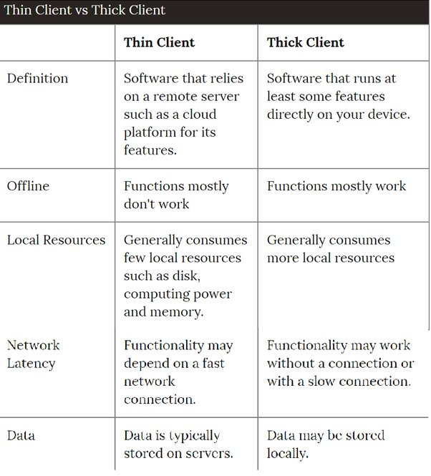
Types of Clients & differences

Slide 4
What is Server?
Client-Server Architecture
Client Requesting Server over http
Server Responding to Client over http
Types of Servers
Application server
Web server
Database server
Domain name service
File server
Mail server
Print server
Proxy server
Client
Server
A server is a computer program or device that provides a service to another computer program and its user, also known as the client

Slide 5
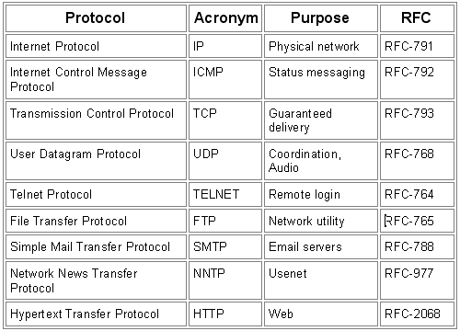
Types of Protocols

Slide 6
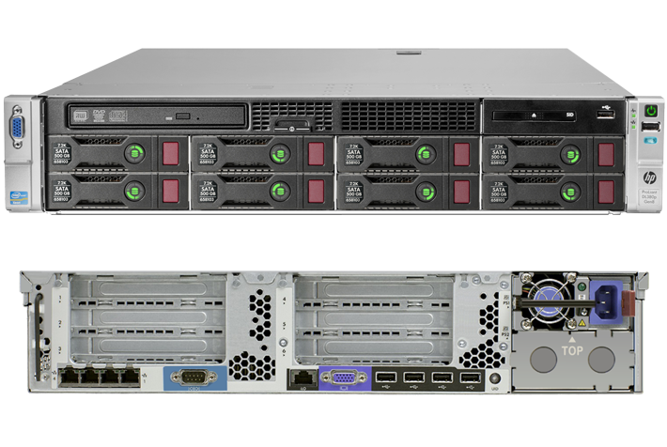
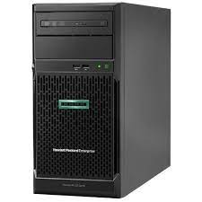
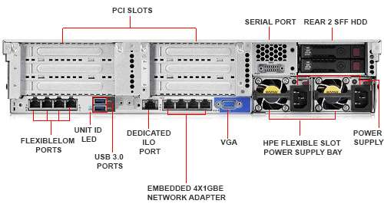
What is On Premise ?
CPU
Bare Metal Server
https://www.electronicshub.org/types-of-computer-ports/

Slide 7
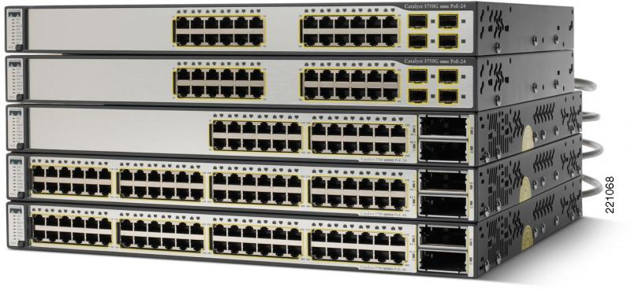
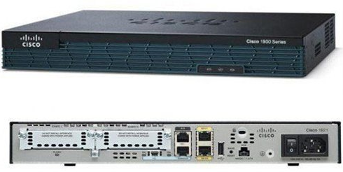
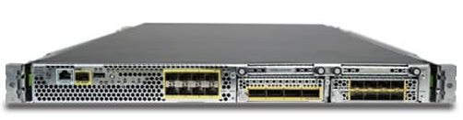
What is On Premise ?
Switch
Router
Firewall

Slide 8
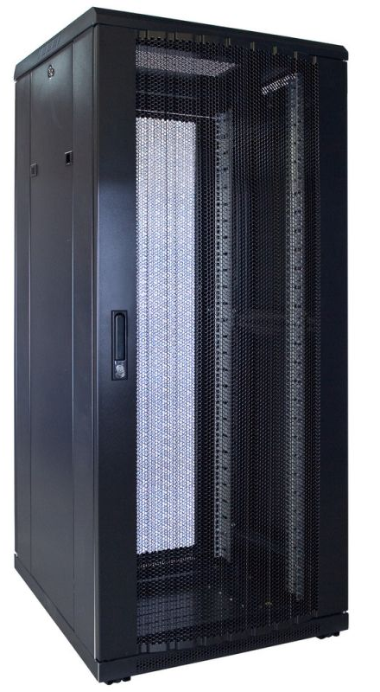
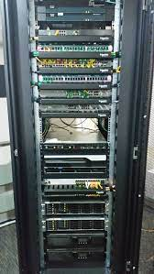

What is On Premise ?

Slide 9
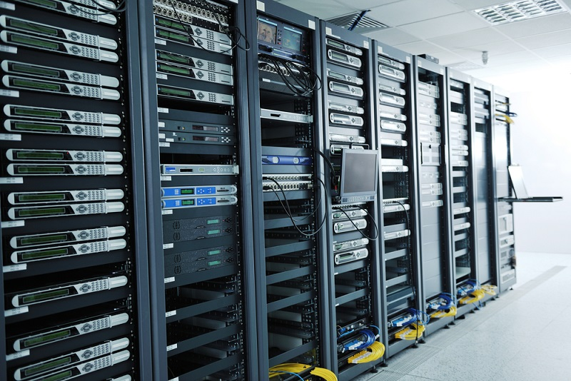
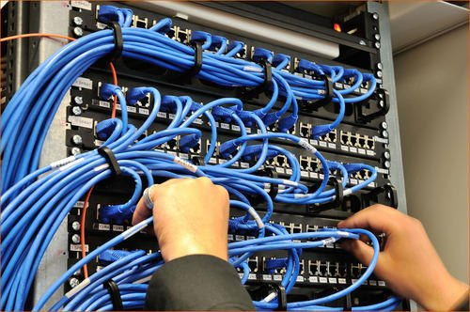
What is On Premise ?

Slide 10

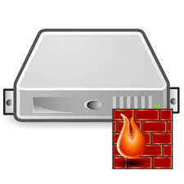


What is On Premise ?
IRCTC Data Centre
https://www.irctc.co.in/

Slide 11
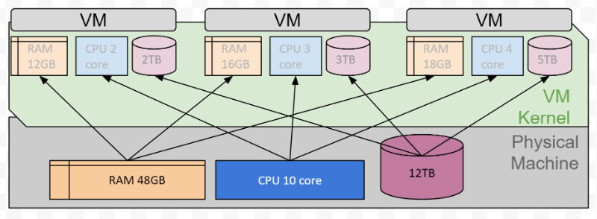




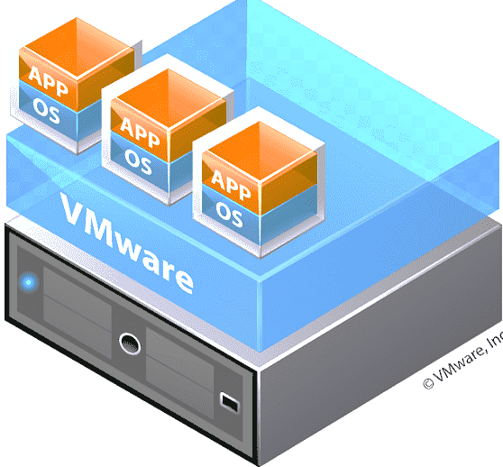
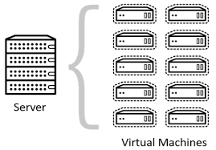
What is Virtual ?
Hypervisor

Slide 12
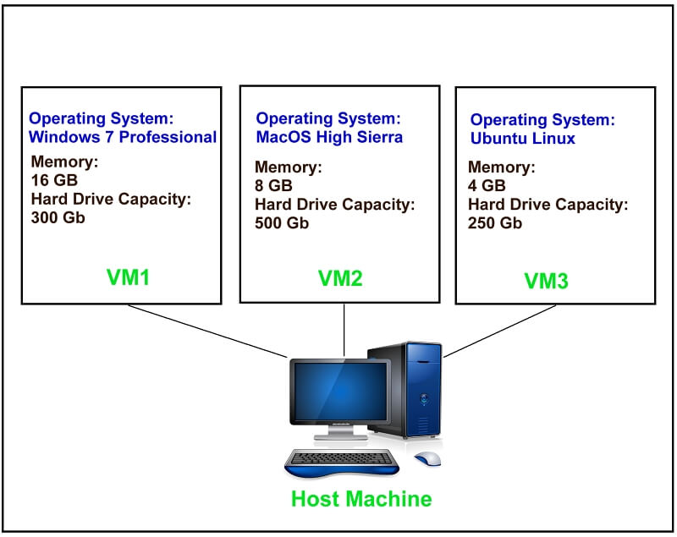
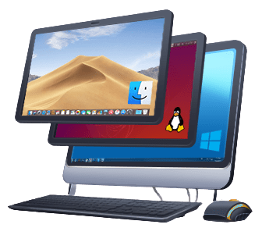
What is Virtual ?
A virtual machine (VM) is a virtual environment that functions as a virtual computer system with its own CPU, memory, network interface, and storage, created on a physical hardware system
Software called a hypervisor separates the machine’s resources from the hardware and provisions them appropriately so they can be used by the VM
The hypervisor treats compute resources—like CPU, memory, and storage—as a pool of resources that can easily be relocated between existing guests or to new virtual machines.

Slide 13
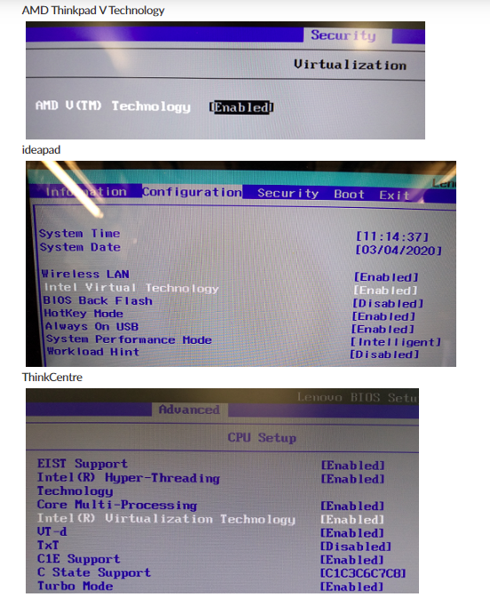
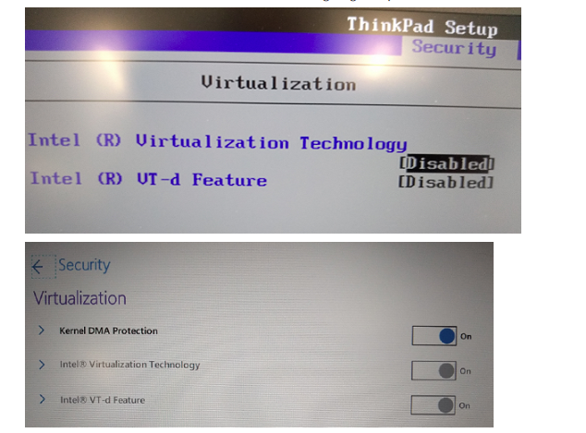
Enabling Virtualization in Laptop
How to enable virtualization in BIOS for <your laptop model name> ?
Download the following Centos OS image – 10GB- http://ftp.iij.ad.jp/pub/linux/centos-vault/8.5.2111/isos/x86_64/

Slide 14
Linux Fundamentals

Slide 15
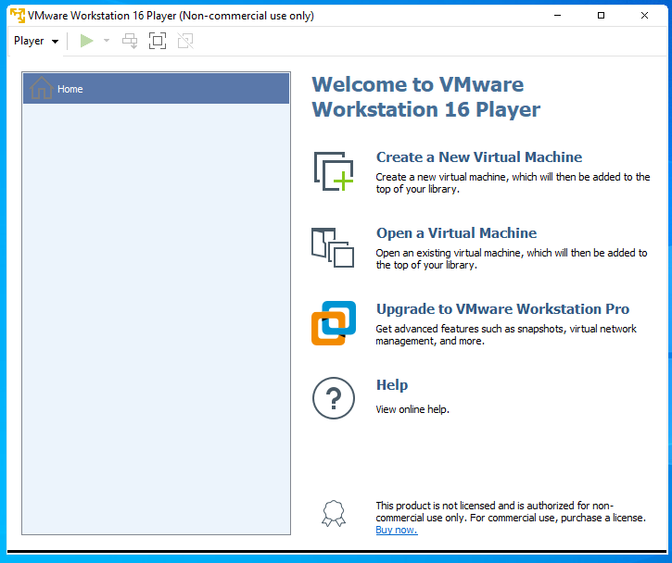

Linux Booting
Download the following Centos OS image – 10GB-
http://ftp.iij.ad.jp/pub/linux/centos-vault/8.5.2111/isos/x86_64/
Download VMWare workstation for windows-
https://www.vmware.com/in/products/workstation-player/workstation-player-evaluation.html
STEP-1
Click on Create a New Virtual Machine

Slide 16
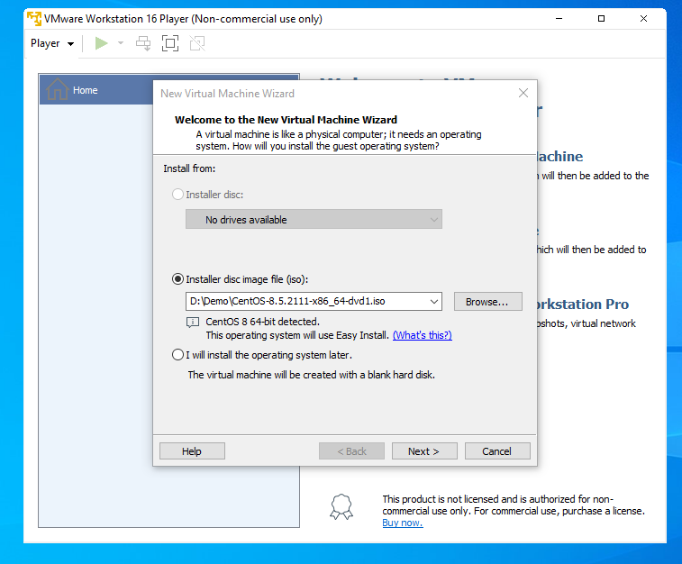
Linux Booting
STEP-2
Browse and select the ISO image that you downloaded and click on next

Slide 17
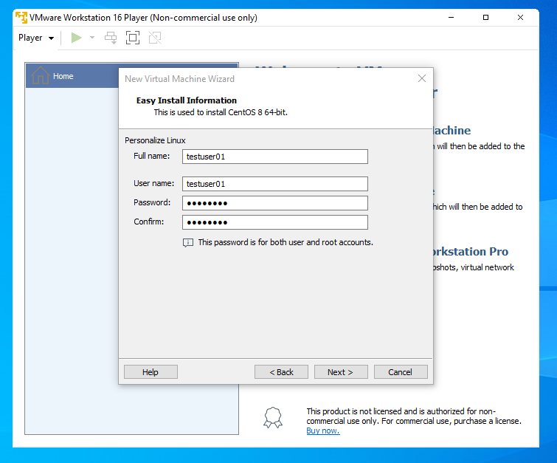
Linux Booting
STEP-3
Give some username and password, this password is going to be same as root password.

Slide 18
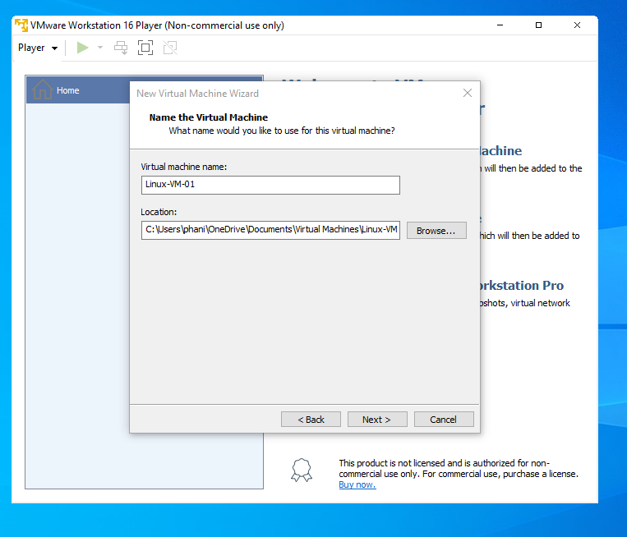
Linux Booting
STEP-4
Give some name for the VM, and choose the location for VM

Slide 19
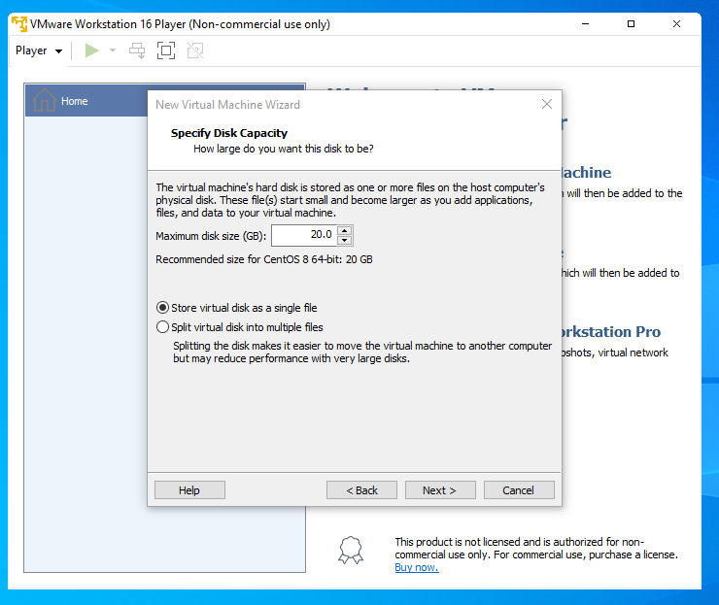
Linux Booting
STEP-5
Select store virtual disk as single file

Slide 20
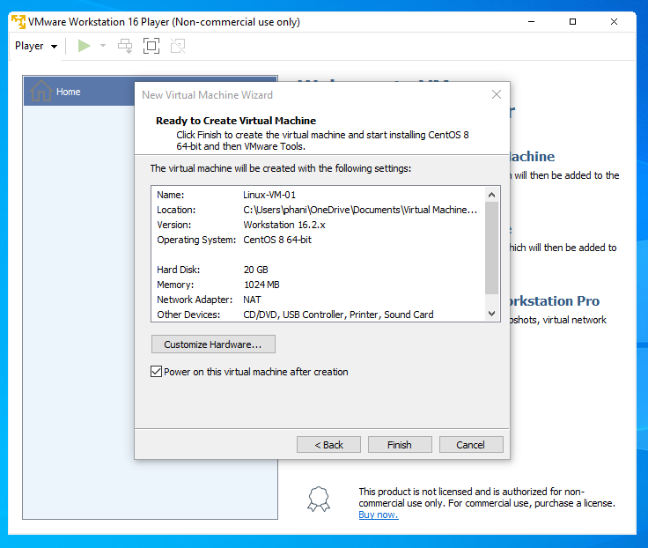
Linux Booting
STEP-6
Click on Finish

Slide 21
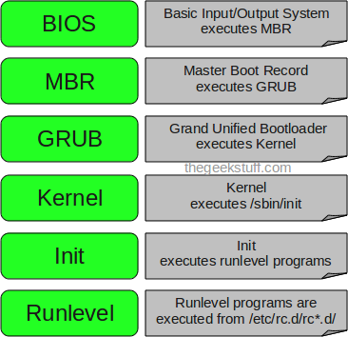
Linux Booting

Slide 22
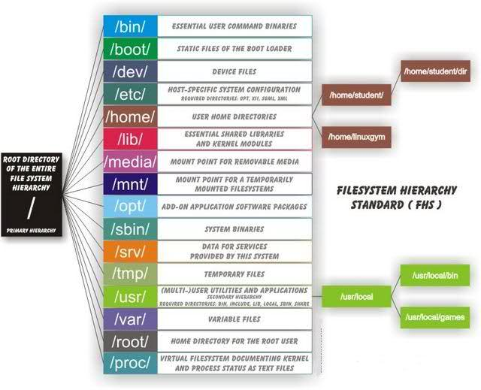
Linux Directory Structure

Slide 23
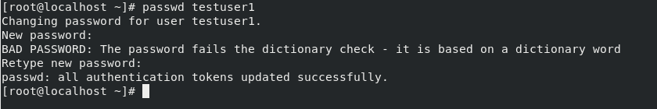

Linux Basic Commands
https://www.hostinger.in/tutorials/linux-commands

Slide 24
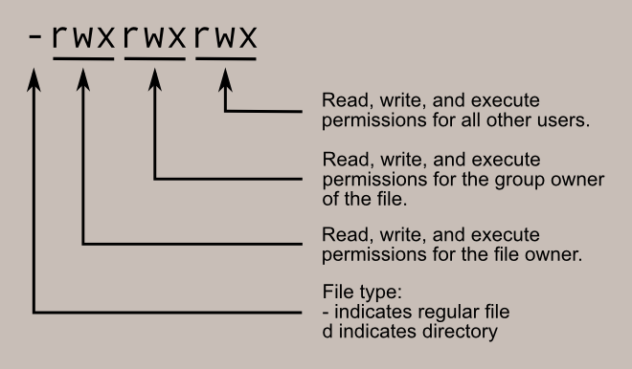
Linux Permissions

Slide 25
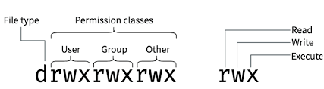
Linux Permissions

Slide 26
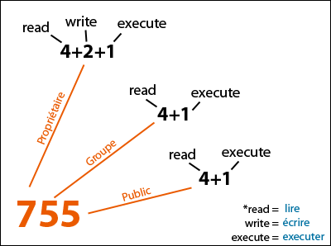
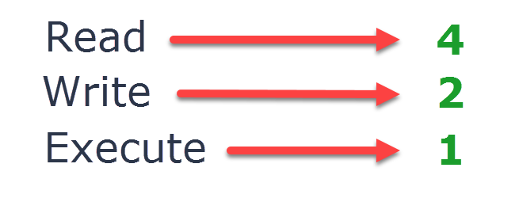
Linux Permissions

Slide 27
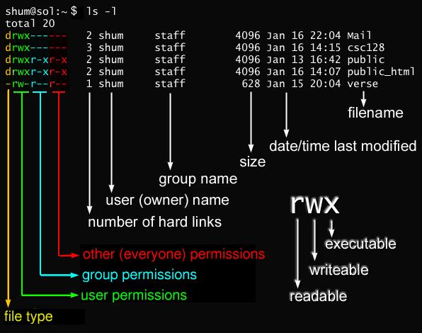
Linux Permissions

Slide 28




Linux Permissions
UseCase: Create a file in home directory of demouser01 and give read access to only testuser01
Approach:
If we have to give access to specific users, in this case testuser01 and demouser01, we must assign permissions to a group of users rather than for other users.
Since the file is in home directory of demouser01 we cannot expose the home directory of demouser01 to all users.
So we must have a group with demouser01 and testuser01.
We can create a separate group only for this scenario or we can add testuser01 to demouser01 group as every user will have a group created.
1. Add testuser01 to demouser01 group
2. Verify if testuser01 is added to demouser01
3. Verify top level permissions, i.e /home, no changes required at this level
4 Assign read and execute permissions for group for /home/demouser01 folder
Chmod 750 /home/demouser01
5 Assign read permissions for group for /home/demouser01/abc.txt file
Chmod 740 /home/demouser01/abc.txt
5 testuer01 should now be able to read the file

Slide 29
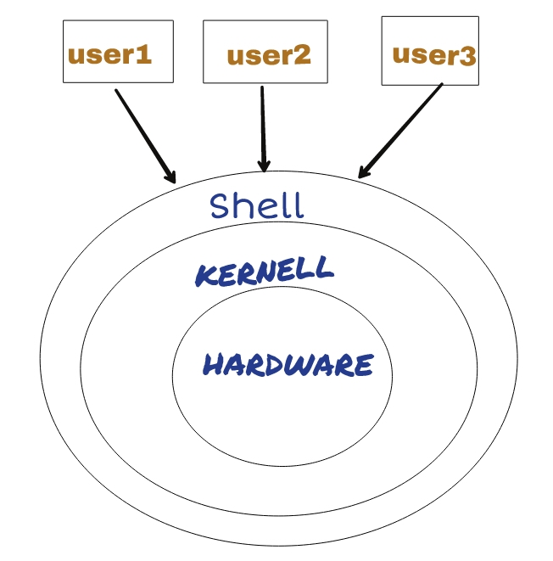
Shell
Types of Shells
Bash
Tcsh
Ksh
Zsh
Fish

Slide 30
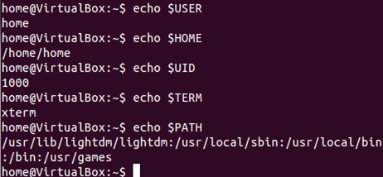
Environment Variables

