Slide 1


Networking

Slide 2

What is Network ?
A computer network or data network is a telecommunications network which allows nodes to communicate and share resources.

Slide 3
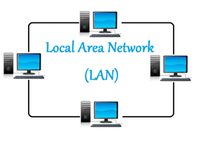
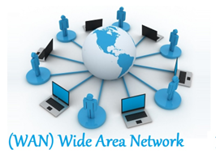
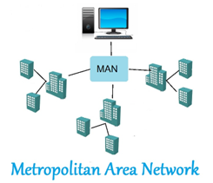
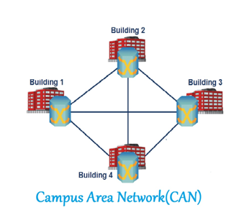
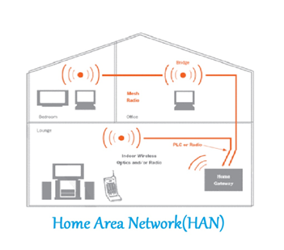
Types of Networks

Slide 4
Mac Address & IP Address
MAC Address:
It is the unique machine address given to your device. It will never change.
IP Address:
An IP address or Internet Protocol address is the address assigned to your mobile, printer or computer by the network that uses Internet protocol for communication.

Slide 5
IP Address
11000000.10101000.00000001.00000010/
1111111.11111111.11111111.00000000
192.168.1.2
/24
255.255.255.0
IP Address
Subnet Mask
A subnet mask is a 32-bit number created by setting host bits to all 0s and setting network bits to all 1s. In this way, the subnet mask separates the IP address into the network and host addresses.
1111111.11111111.11111111.00000000=255.255.255.0
Number of IP in Range = 2^(32-Subnet Mask)

Slide 6
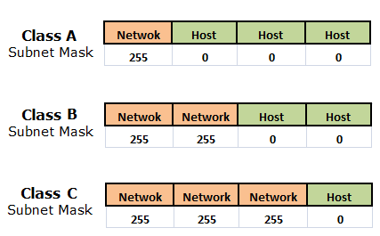
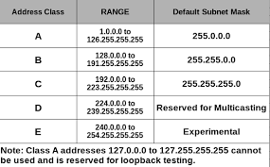
Classes of IP Address
Class D IP addresses ( it is 32-bit network addresses and they don’t have hostID.) are used for multicasting. And in case, you are wondering what multicasting is -
Multicast means sending some information to some predefined group of users/networks (Intended ones, as they want to receive).
Don’t let yourself confuse between Multicast (type: ONE TO MANY) & Broadcast (type: ONE TO ALL), in broadcast, they send the information to the whole network irrespective of their wish to receive or not.
Class E IP addresses have been defined (first four bits are 1 1 1 1) but still not used on the internet due to restrictions of The IETF (Internet Engineering Task Force). They have reserved this for their own research purpose. No Class E Address has been released for public use till now.

Slide 7
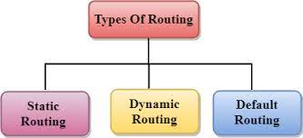
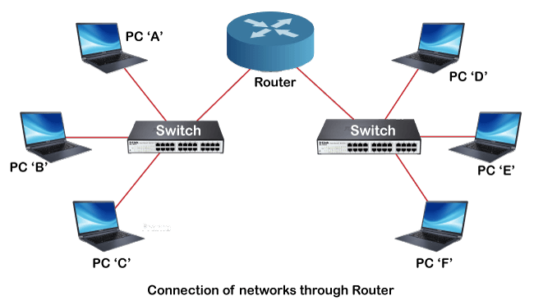
Routing
192.168.2.0/24
192.168.1.0/24

Slide 8
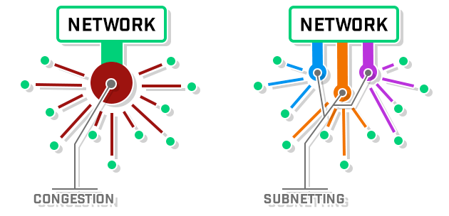
Subnetting
Subnetting is the strategy used to partition a single physical network into more than one smaller logical sub-networks (subnets)

Slide 9
Subnetting
192.168.1.0/24
Number of Ips = 2^(32-24)=256
Subnet Mask = 24 1’s & 8 0’s = 255.255.255.0
192.168.1.0/25
192.168.1.128/25
Number of Ips = 2^(32-25) = 128
Number of Ips = 2^(32-25) = 128
Subnet Mask = 25 1s & 7 0’s = 255.255.255.128
Subnet Mask = 25 1s & 7 0’s = 255.255.255.128
Network IP = 192.168.1.0
Network IP = 192.168.1.128
Broadcast IP = 192.168.1.127
Broadcast IP = 192.168.1.255

Slide 10
Subnetting
192.168.1.0/26
192.168.1.128/26
Number of Ips = 2^(32-26) = 64
Number of Ips = 2^(32-26) = 64
Subnet Mask = 26 1s & 6 0’s = 255.255.255.192
Subnet Mask = 26 1s & 6 0’s = 255.255.255.192
Network IP = 192.168.1.0
Network IP = 192.168.1.128
Broadcast IP = 192.168.1.63
Broadcast IP = 192.168.1.191
192.168.1.64/26
192.168.1.192/26
Number of Ips = 2^(32-25) = 64
Number of Ips = 2^(32-26) = 64
Subnet Mask = 26 1s & 60’s = 255.255.255.192
Subnet Mask = 26 1s & 6 0’s = 255.255.255.192
Network IP = 192.168.1.64
Network IP = 192.168.1.192
Broadcast IP = 192.168.1.127
Broadcast IP = 192.168.1.255

Slide 11
Subnetting
192.168.1.224/27
Security
Management
Performance
192.168.1.192/27
192.168.1.0/27
192.168.1.160/27
HR
R
Finance
192.168.1.128/27
192.168.1.32/27
IT
192.168.1.64/27
192.168.1.96/27

Slide 12
CIDR (Classless Inter-Domain Routing or supernetting)
192.168.1.0/24
172.168.0.0/16
Number of Hosts = 2^(32-16)=65536
192.168.1.2/23
Binary Subnet Mask= 11111111.11111111.11111110.00000000
172.168.0.0/16
172.168.0.0/24
172.168.1.0/24
Network Address | Usable Host Range | Broadcast Address:
192.168.0.0 | 192.168.0.1 - 192.168.1.254 | 192.168.1.255
172.168.2.0/24
172.168.255.0/24

Slide 13
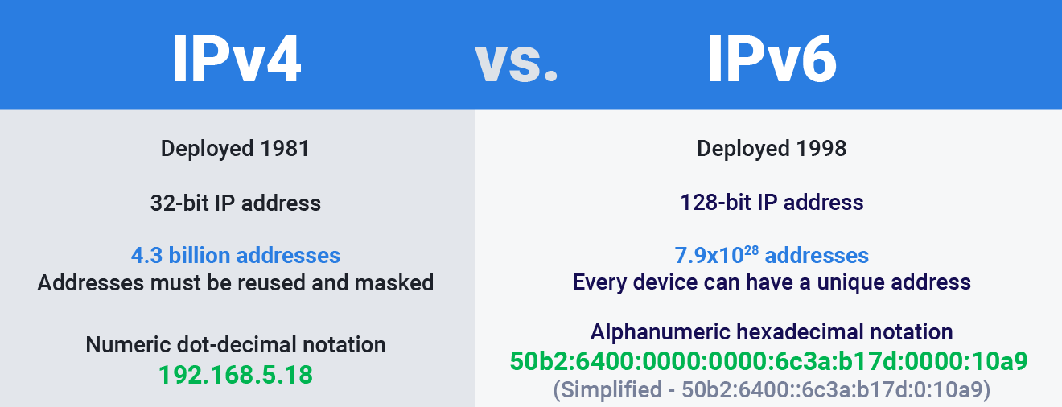
IP Address

Slide 14
Network Services

Slide 15
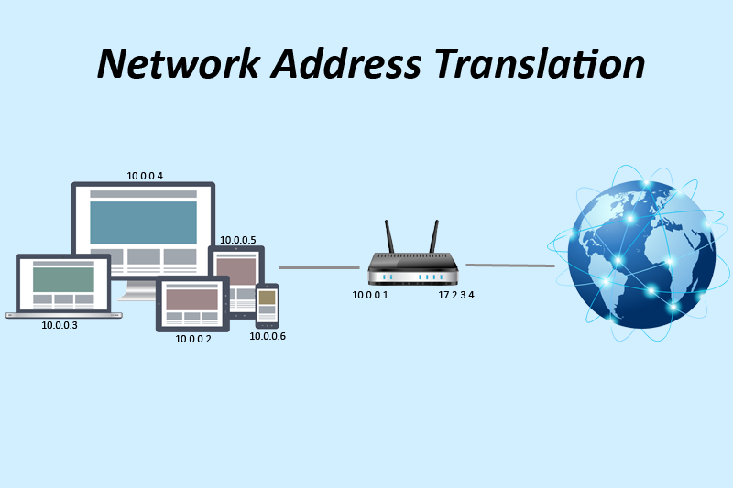
NAT

Slide 16
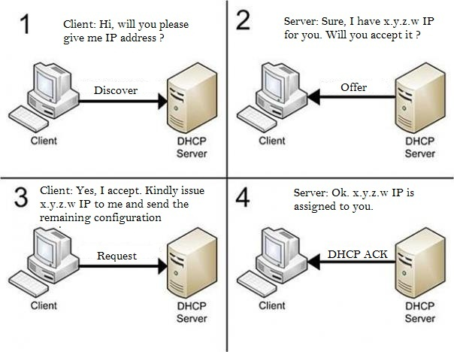
DHCP
Reference Link for DHCP configuration on Windows Server-
https://newhelptech.wordpress.com/2017/06/21/step-by-step-deploy-dhcp-services-in-windows-server-2016/

Slide 17




DNS
Local DNS Resolver
Or
Recursive DNS Resolver
Root Name Server
Iterative Query
Address of TLD i.e .com
Check its cache
Update Cache
TLD(Top Level Domain) Server
Recursive Query
example.com
www.example.com
Check its own cache
Update Cache
Authoritative DNS Server
www.example.com
Check Systems DNS Resolver
Update Cache
Check Cache
www.example.com

Slide 18
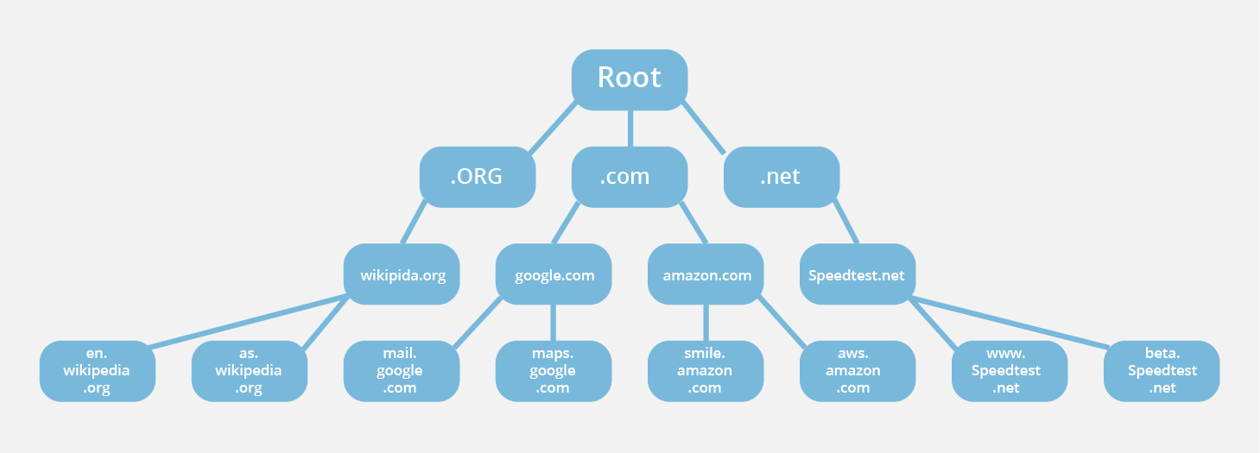
DNS

Slide 19
DNS
Address Mapping record (A Record)—also known as a DNS host record, stores a hostname and its corresponding IPv4 address.
IP Version 6 Address record (AAAA Record)—stores a hostname and its corresponding IPv6 address.
Canonical Name record (CNAME Record)—can be used to alias a hostname to another hostname. When a DNS client requests a record that contains a CNAME, which points to another hostname, the DNS resolution process is repeated with the new hostname.
Mail exchanger record (MX Record)—specifies an SMTP email server for the domain, used to route outgoing emails to an email server.
Name Server records (NS Record)—specifies that a DNS Zone, such as “example.com” is delegated to a specific Authoritative Name Server, and provides the address of the name server.
Reverse-lookup Pointer records (PTR Record)—allows a DNS resolver to provide an IP address and receive a hostname (reverse DNS lookup).
Start of Authority (SOA Record)—this record appears at the beginning of a DNS zone file, and indicates the Authoritative Name Server for the current DNS zone, contact details for the domain administrator, domain serial number, and information on how frequently DNS information for this zone should be refreshed.
Reference Link for DNS configuration on Windows Server- https://www.itechguides.com/how-to-install-and-configure-dns-on-windows-server-2016/

Slide 20
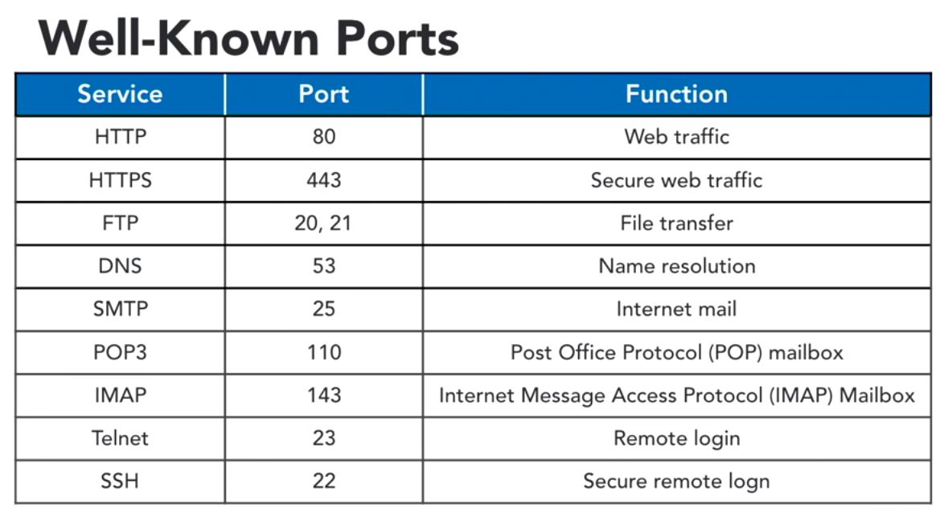
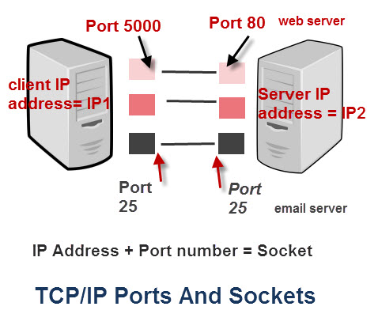
Ports

Slide 21
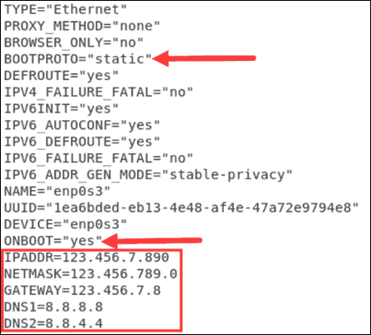
Network Configuration Demo

Slide 22
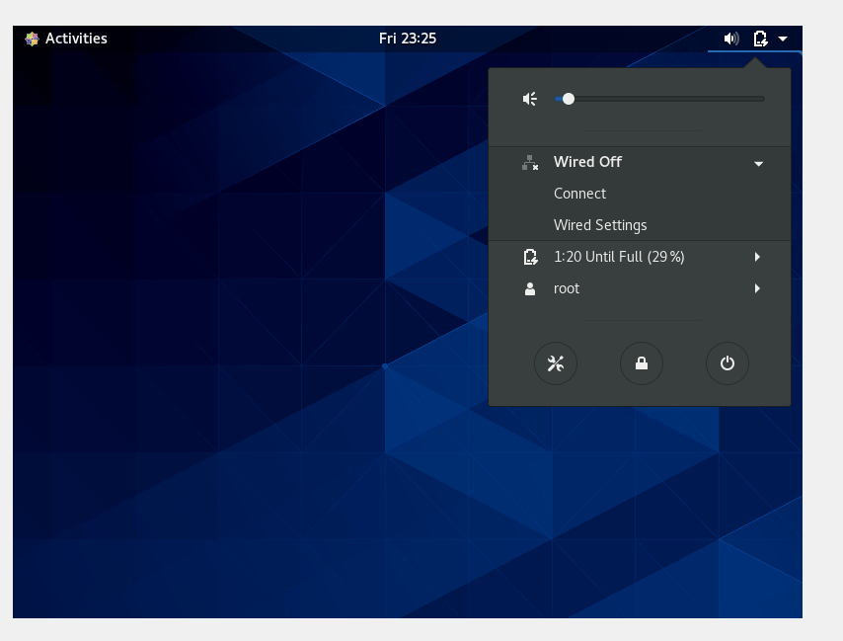
Accessing VMs over Putty
Click on Top right drop down in your VM
Select Wired Off
Select Wired Settings

Slide 23
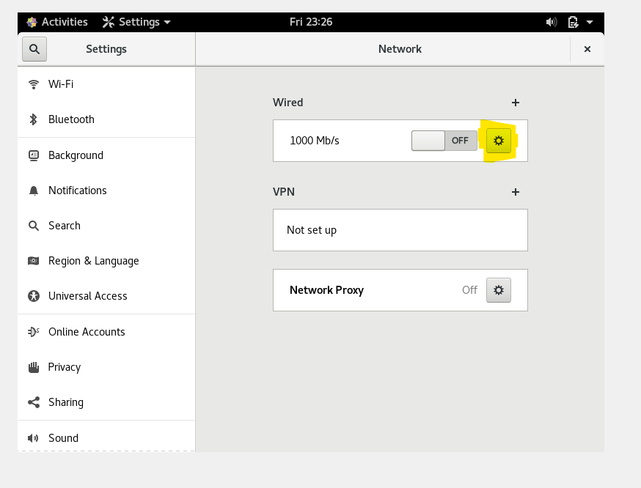
Accessing VMs over Putty
Click on Settings Symbol next to Wired (Highlighted in the image)

Slide 24
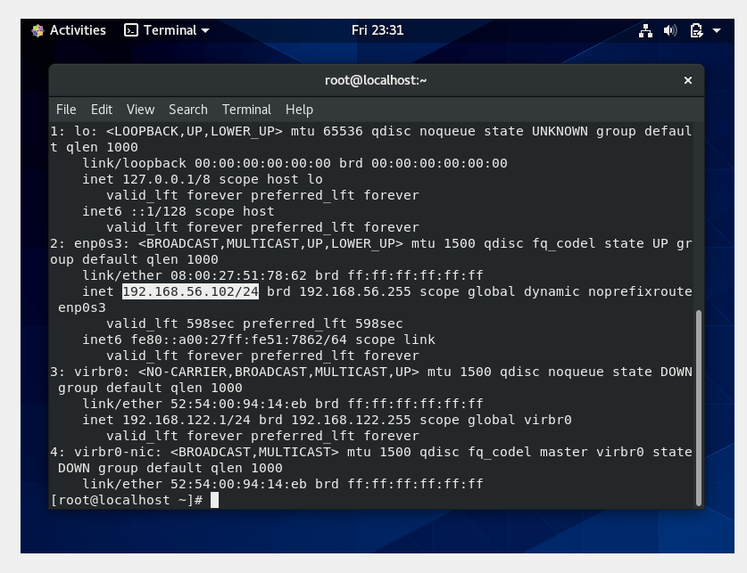
Accessing VMs over Putty
Open terminal and type “ip a”, you will receive the IP address on the system
(Highlighted in the image)

Slide 25
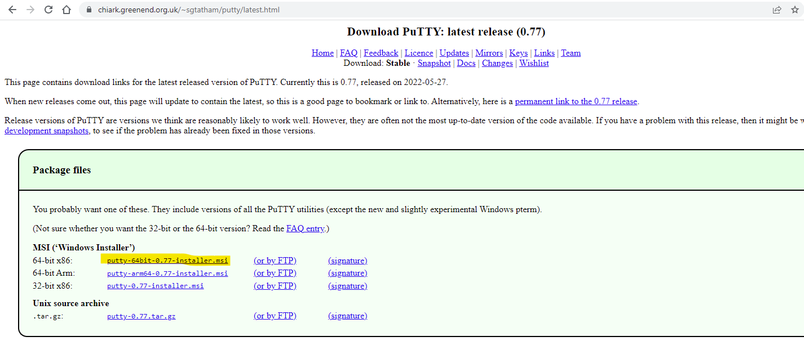
Accessing VMs over Putty
Download Putty from the below link by clicking on he highlighted version
Install the putty
https://www.chiark.greenend.org.uk/~sgtatham/putty/latest.html

Slide 26
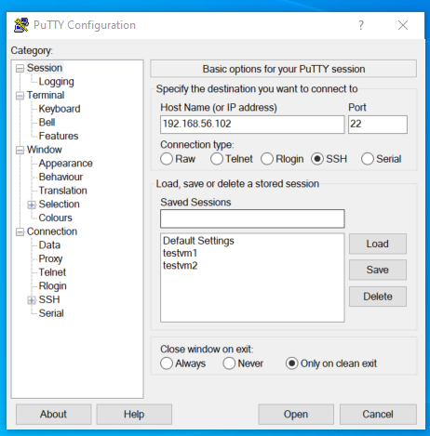
Accessing VMs over Putty
Enter IP address of the VM in Putty & Connect to your VM

