Slide 1


On Premise Deployments

Slide 2
RPM
RPM (RPM Package Manager)
RPM is a popular package management tool in Red Hat Enterprise Linux-based distros. Using RPM, you can install, uninstall, and query individual software packages. Still, it cannot manage dependency resolution like YUM. RPM does provide you useful output, including a list of required packages. An RPM package consists of an archive of files and metadata. Metadata includes helper scripts, file attributes, and information about packages.

Slide 3
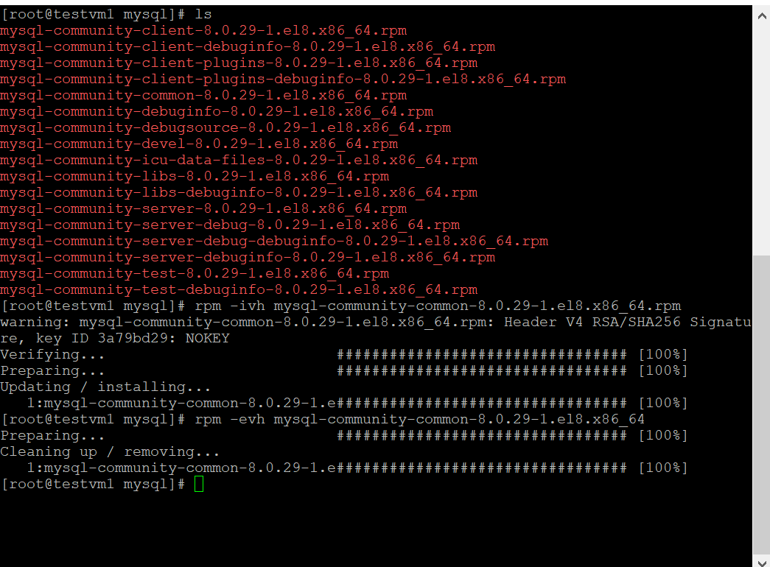
RPM installation & uninstallation
RPM installation-
rpm -ivh mysql-community-common-8.0.29-1.el8.x86_64.rpm
RPM uninstallation-
rpm -evh mysql-community-common-8.0.29-1.el8.x86_64

Slide 4
Repos
Yellow Dog Updater, Modified (YUM)
YUM is the primary package management tool for installing, updating, removing, and managing software packages in Red Hat Enterprise Linux. YUM performs dependency resolution when installing, updating, and removing software packages.

Slide 5
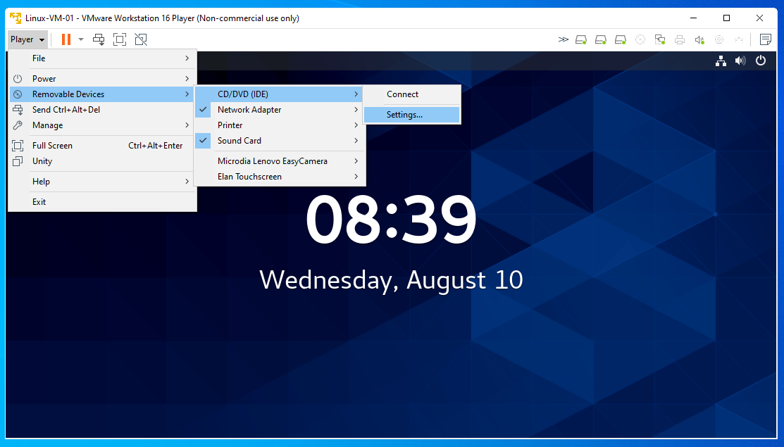
YUM Local Repo

Slide 6
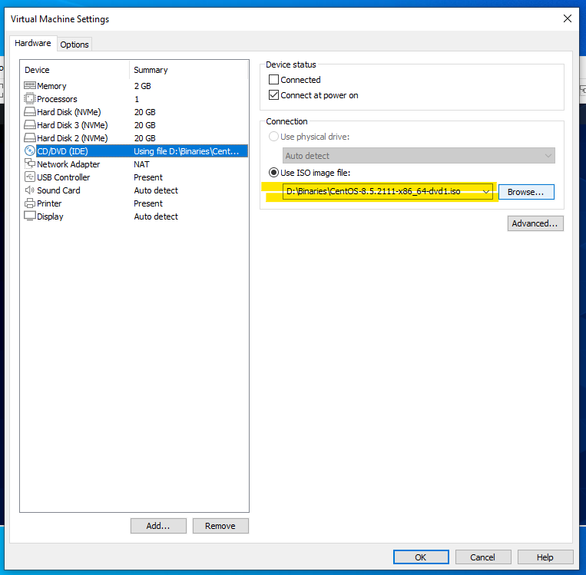
YUM Local Repo
Select the centos 8.5 iso image and click ok

Slide 7
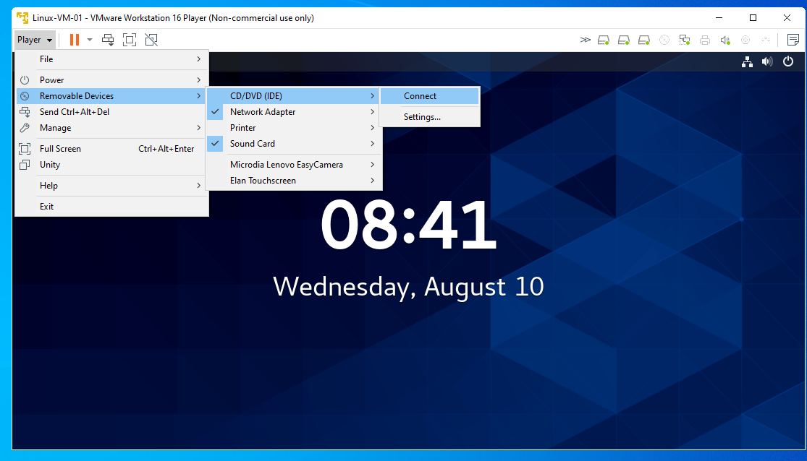
YUM Local Repo
Click on Connect

Slide 8
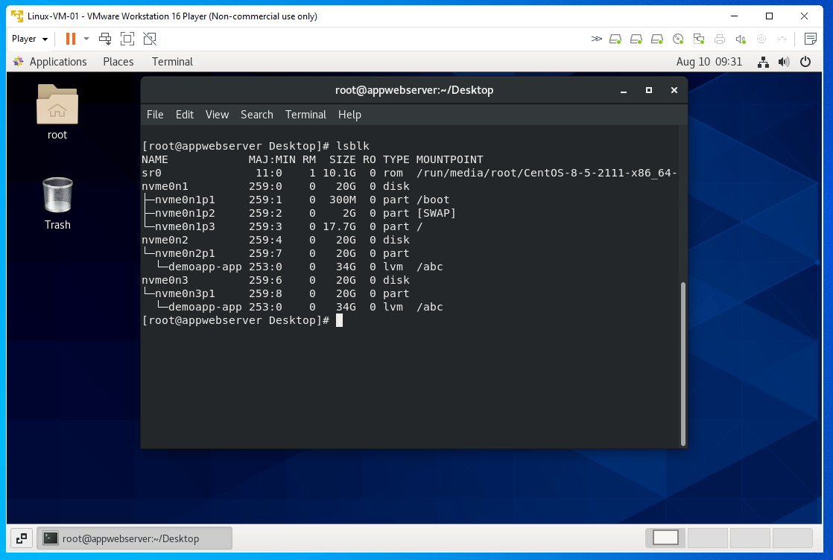
YUM Local Repo
vim /etc/yum.repos.d/local.repo & add the below lines
[InstallMedia-BaseOS]
name=CentOS Linux 8 - BaseOS
metadata_expire=-1
gpgcheck=1
enabled=1
baseurl=file:////run/media/root/CentOS-8-5-2111-x86_64-dvd/BaseOS/
gpgkey=file:///etc/pki/rpm-gpg/RPM-GPG-KEY-centosofficial
[InstallMedia-AppStream]
name=CentOS Linux 8 - AppStream
metadata_expire=-1
gpgcheck=1
enabled=1
baseurl=file:////run/media/root/CentOS-8-5-2111-x86_64-dvd/AppStream/
gpgkey=file:///etc/pki/rpm-gpg/RPM-GPG-KEY-centosofficial

Slide 9
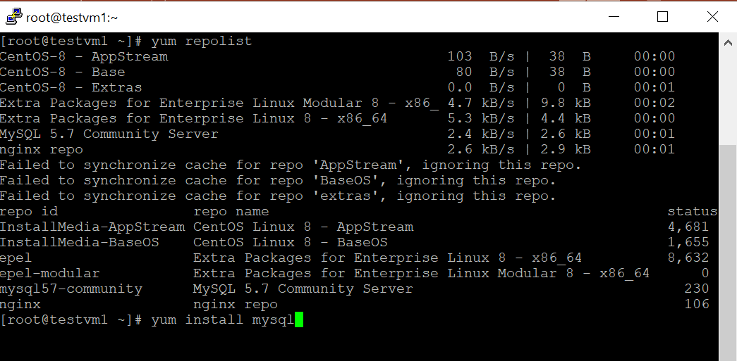
YUM Remote Repo
The below is an example to add mysql repo for mysql installation
vim /etc/yum.repos.d/mysql.repo & add the following lines
[mysql57-community]
name=MySQL 5.7 Community Server
baseurl=http://repo.mysql.com/yum/mysql-5.7-community/el/6/$basearch/
enabled=1
gpgcheck=1
gpgkey=file:///etc/pki/rpm-gpg/RPM-GPG-KEY-mysql-2022
“yum repolist” to check active repos

Slide 10

NFS (Network File Share)
NFS-Client
NFS-Server
/nfsClient01
/nfsShare
NFS-Client
/nfsClient02

Slide 11
NFS
NFS-Server
NFS-Client
/nfsShare
/nfsClient
yum install nfs-utils
mkdir /nfsClient
mount -t nfs <IP Address of Server>:/nfsServer/ /nfsClient
yum install nfs-utils
systemctl start nfs-server.service
mkdir /nfsShare
chown -R nobody: /nfsShare/
chmod 777 /nfsShare/
Add the following entry to /etc/exports- /nfsShare <client ip Address>(rw)
systemctl restart nfs-utils.service
exportfs –arv
showmount -e <IP Address of Server>
firewall-cmd --permanent --add-service=nfs
firewall-cmd --permanent --add-service=rpc-bind
firewall-cmd --permanent --add-service=mountd
firewall-cmd --reload

Slide 12
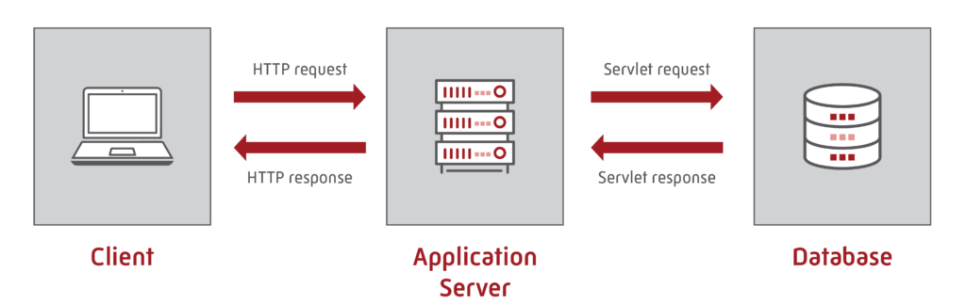
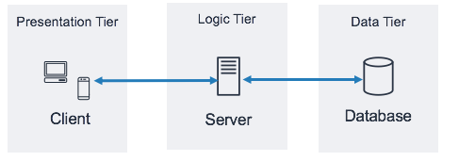
On Premise Application Deployment

Slide 13



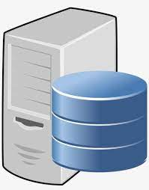
On Premise Application Deployment
App1-Server
App1 Running
Web Server
DB-Server
Web Server
Running
DB Running
App2-Server
App2 Running

Slide 14
On Premise Application Deployment
VM1
App1-Server
DB-Server
App1 Running
DB Running
Web Server
App2-Server
Web Server
Running
App2 Running
VM2

Slide 15
On Premise Application Deployment
App1-Server
yum install mariadb-devel gcc* redhat-rpm-config python3-devel
mkdir /app1
touch main.py
pip3 install virtualenv
virtualenv app1env
source app1env/bin/activate
pip3 install flask gunicorn flask_mysqldb
touch wsgi.py
Chmod 750 wsgi.py
Chmod 750 main.py
Exit from virtualenv- deactivate
touch /etc/systemd/system/app1.service
setenforce 0
service app2 restart
firewall-cmd --zone=public --add-port=<flask_port>/tcp --permanent
Reference-
https://www.digitalocean.com/community/tutorials/how-to-serve-flask-applications-with-gunicorn-and-nginx-on-centos-7
SeLinux Custom Policy Creation
https://access.redhat.com/documentation/en-us/red_hat_enterprise_linux/8/html/using_selinux/writing-a-custom-selinux-policy_using-selinux
yum install git
git clone https://github.com/phanindravedula/On-Premise-Deployment

Slide 16
On Premise Application Deployment
App2-Server
yum install mariadb-devel gcc* redhat-rpm-config python3-devel
mkdir /app2
touch main.py
pip3 install virtualenv
virtualenv app2env
source app2env/bin/activate
pip3 install flask gunicorn flask_mysqldb
touch wsgi.py
Chmod 750 wsgi.py
Chmod 750 main.py
Exit from virtualenv - deactivate
touch /etc/systemd/system/app2.service
setenforce 0
service app2 restart
firewall-cmd --zone=public --add-port=<flask_port>/tcp --permanent

Slide 17
On Premise Application Deployment
Nginx
yum install nginx
Make changes in /etc/nginx/nginx.conf as per github
Mysql
yum install mysql-server
service mysqld start
mysql_secure_installation
Create some root password
Enter No for all other questions

