Slide 1


Storage

Slide 2
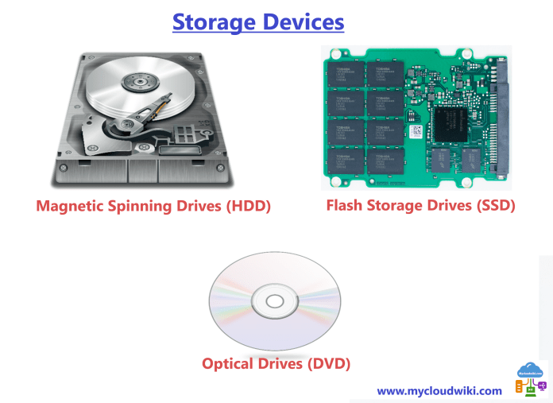
Types of Storage Devices

Slide 3
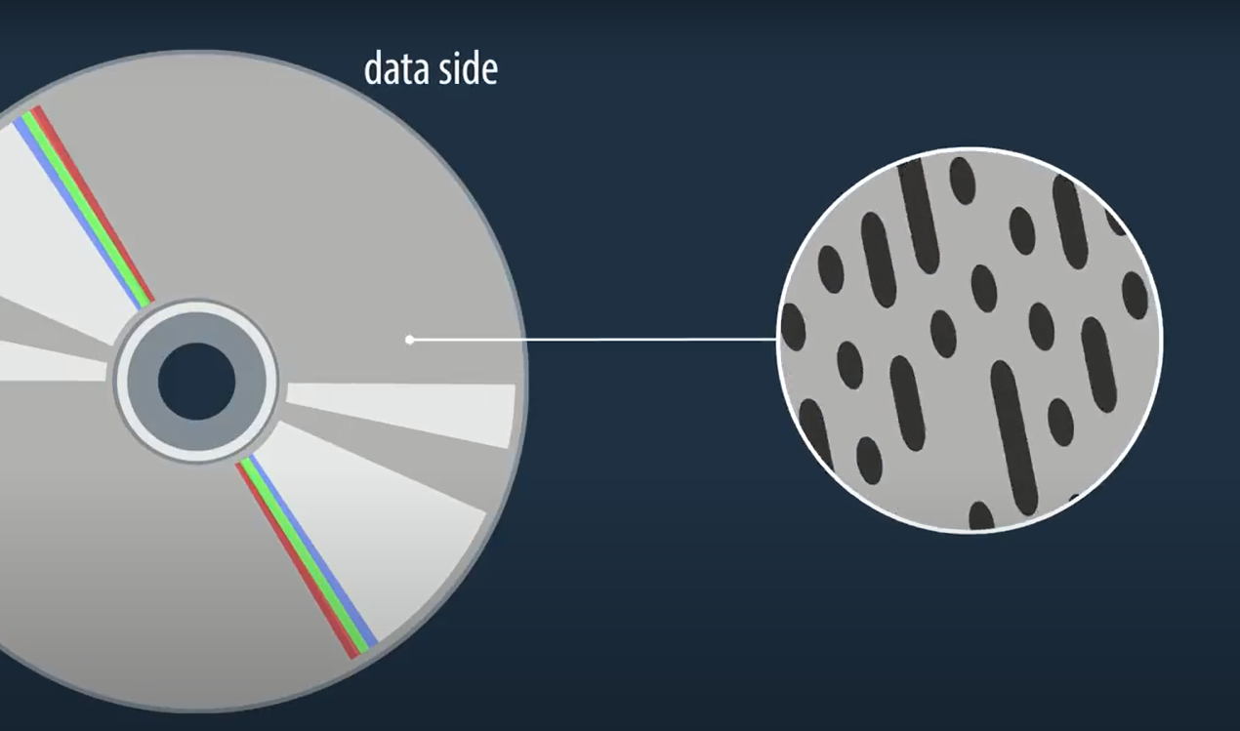
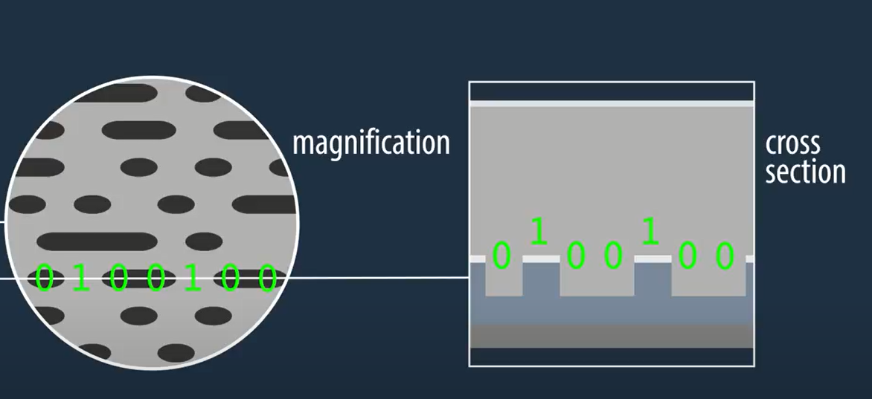
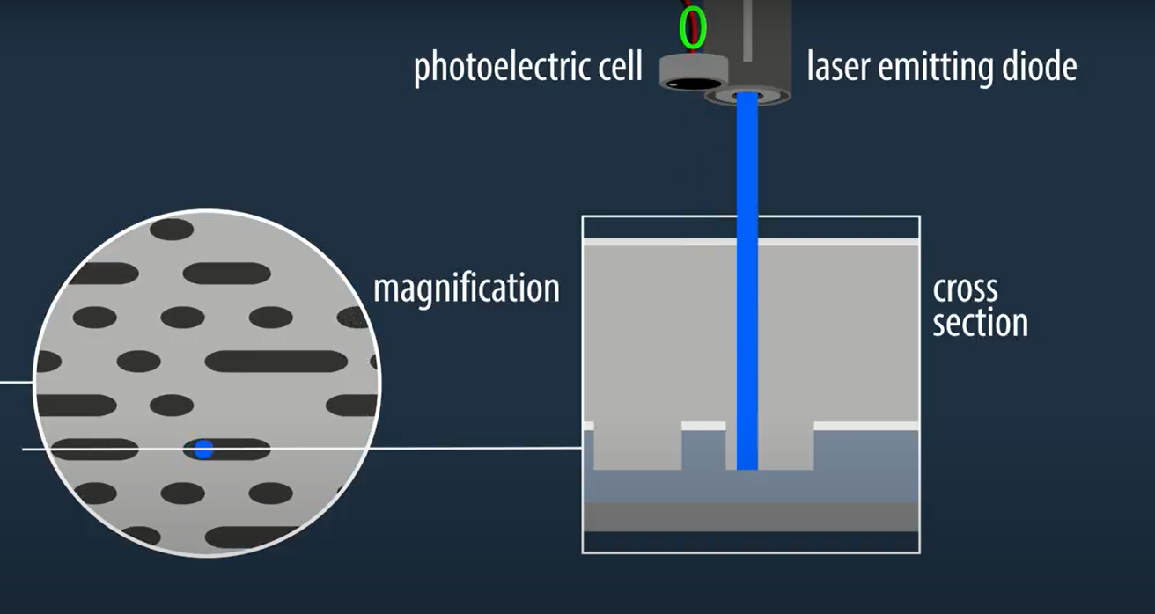
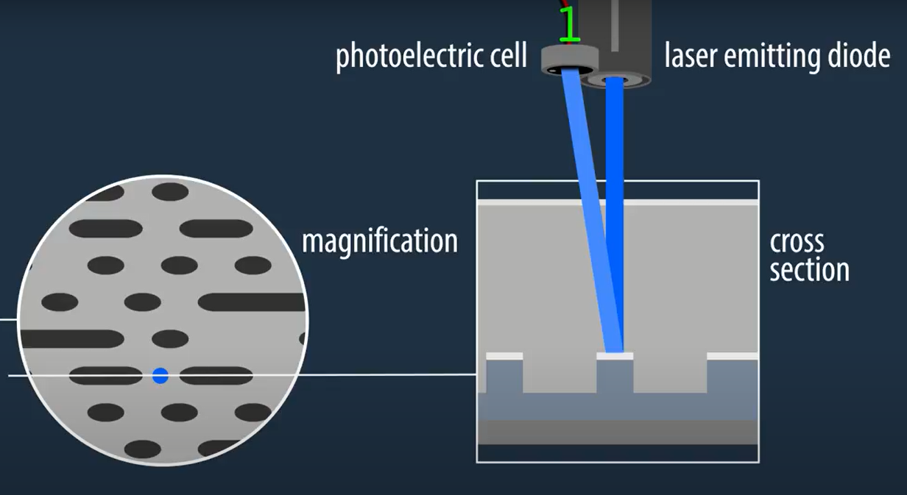
CD

Slide 4
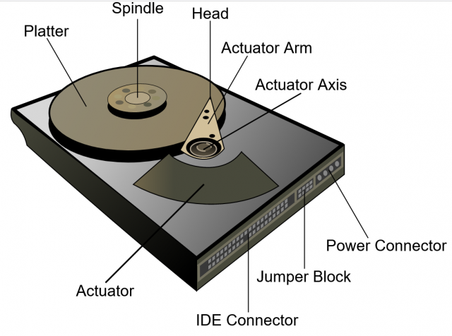
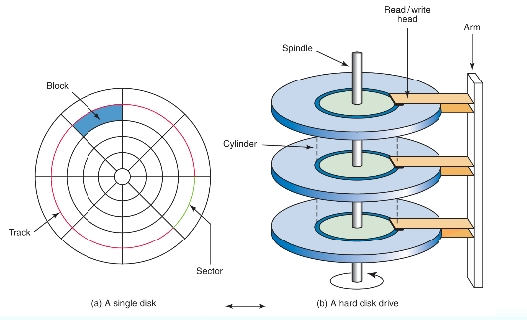
HDD

Slide 5
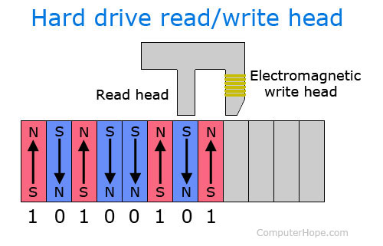
HDD

Slide 6
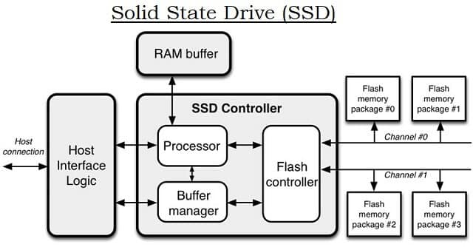
SSD
Solid State Drive (SSD) memory chips are often compared to RAM (Random Access Memory). However, unlike the RAM, the files are saved on the NAND flash grid which can store anywhere between 256KB to 4 MB. The store device has the exact route to the file destination, which gives the controller instant access to the address of the required file as and when the request is made. In order to prevent volatility, the devices are designed with the Floating Gate Transistors (FGRs) to hold electrical charge.

Slide 7
SSD
The disadvantages of SSD include:
Cost – SSDs are more expensive than the HDD even after having similar storage capacity.
Data Recovery – The data can be completely destroyed and can not be recovered if one of the memory flash is destroyed.
Storage – SSD faces a major problem regarding the storage. The data can be written on empty blocks. However, when the blocks get filled, overwriting becomes an issue. Reading the data is not affected by this. To avoid this issue, one has to transfer the data into another memory drive and erase the SSD to reload the data.

Slide 8
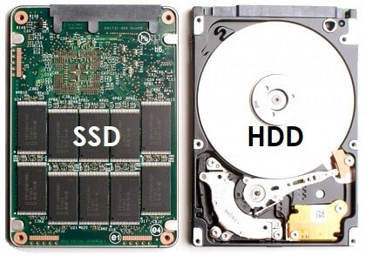
SSD vs HDD

Slide 9
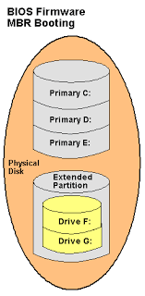
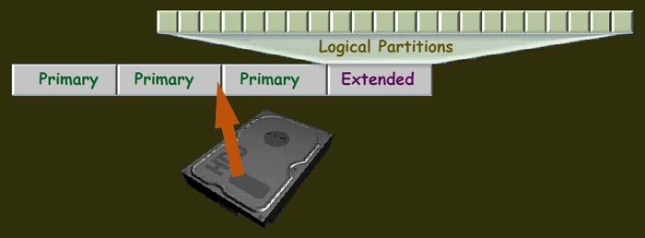
Disk Management

Slide 10
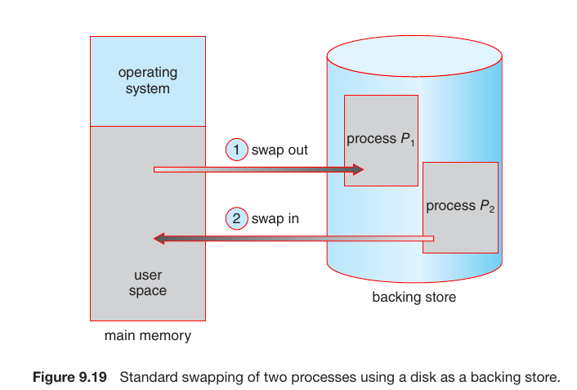
Swapping
Swapping is the process whereby a page of memory is copied to the preconfigured space on the hard disk, called swap space, to free up that page of memory. The combined sizes of the physical memory and the swap space is the amount of virtual memory available.

Slide 11
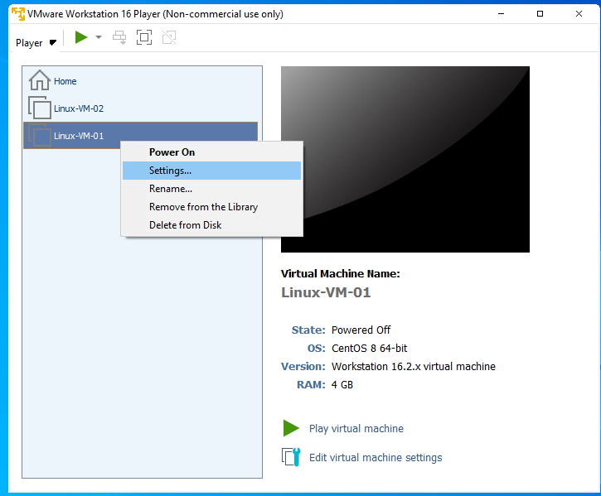
Attaching a Disk in VMWare
Go to VM Settings

Slide 12
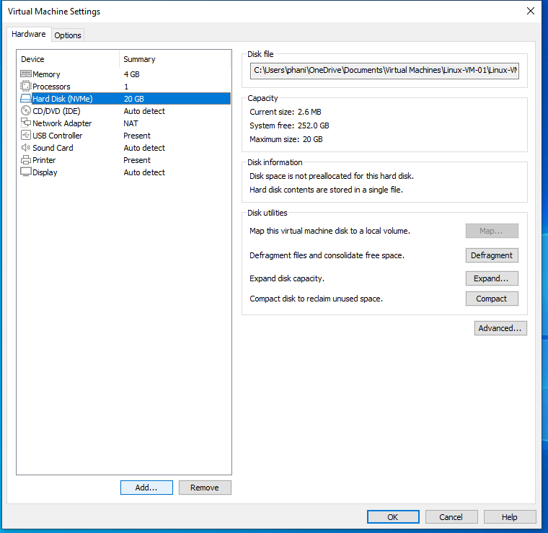
Attaching a Disk in VMWare
Click on Add

Slide 13
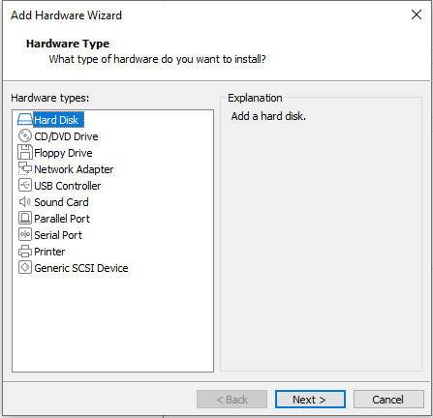
Attaching a Disk in VMWare
Select Hard Disk and click on Next

Slide 14
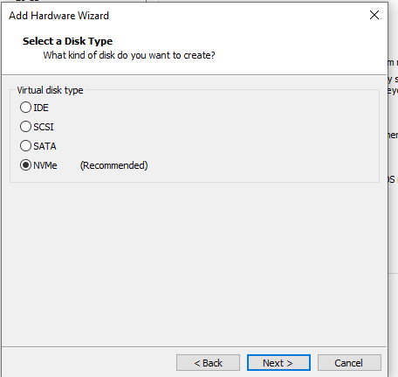
Attaching a Disk in VMWare
Select NvMe and click Next

Slide 15
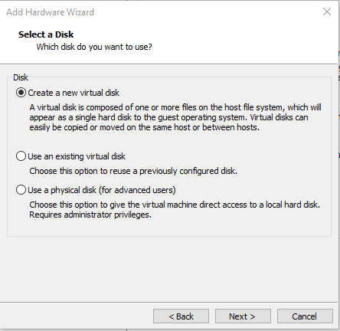
Attaching a Disk in VMWare
Select Create a new virtual disk and click Next

Slide 16
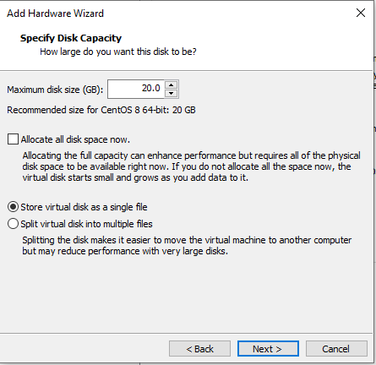
Attaching a Disk in VMWare
Select Store virtual disk as a single file and click Next

Slide 17
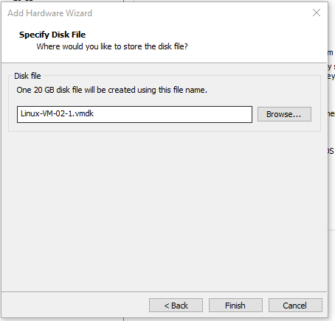
Attaching a Disk in VMWare
Click on Finish

Slide 18
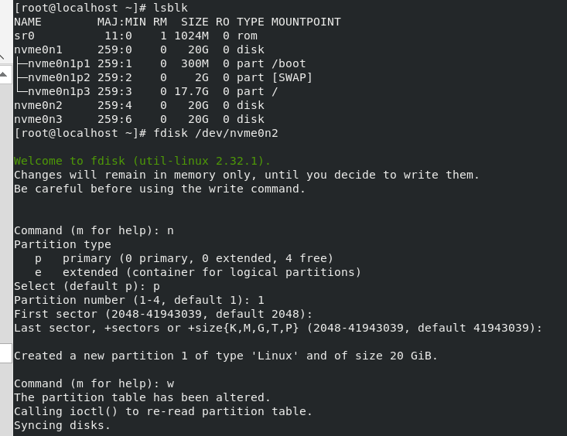
Creating Partitions on New Disk

Slide 19
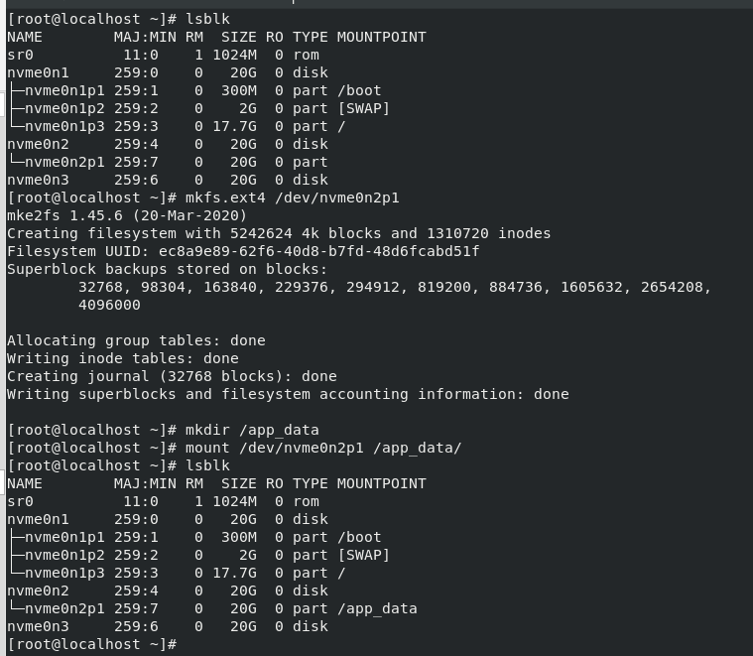
Formatting with File System

Slide 20
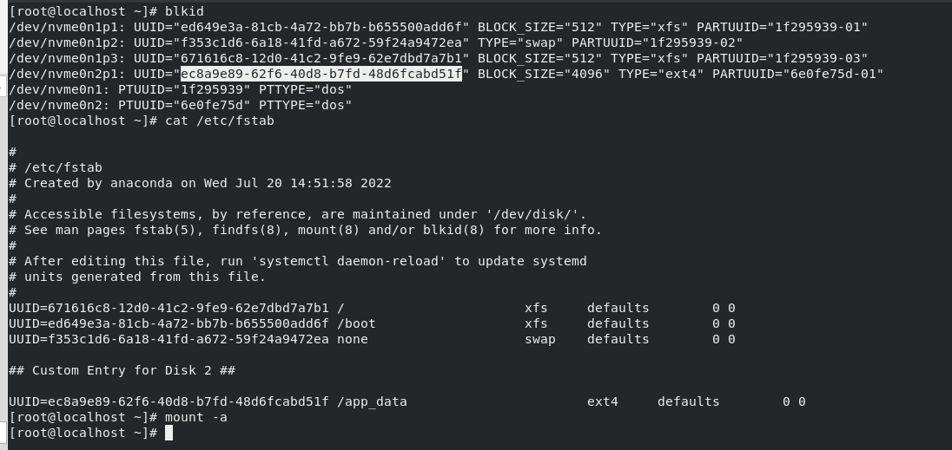
fstab Entry

Slide 21
LVM
Logical Volume- app
32GB
Logical Volume- database
4GB
2GB
2GB
20GB
Volume Group – app_data
40GB
Physical Volume- /dev/nvme0n2p1
Physical Volume- /dev/nvme0n3p1
20GB
Disk- nvme0n2
Disk- nvme0n3
20GB
20GB

Slide 22
LVM Commands
Create Partitions of LVM type (fdisk /dev/<disk name> )
Create Physical Volume Group- pvcreate /dev/<partition name> /dev/<partition name>
Create Volume Group- vgcreate <vg name> /dev/<partition name> /dev/< partition name>
Create Logical Volume- lvcreate -L <size> -n <name of the group> <name of vg>
Format the LV with filesystem
Mount the LV to folder (/etc/fstab)

Slide 23
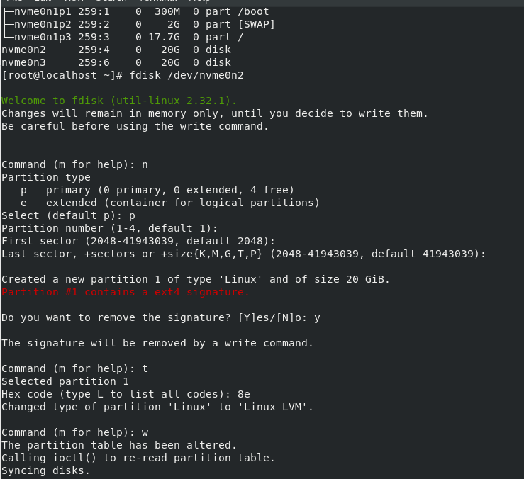
LVM
Attach 2 hard disks
Format nvme0n2 with LVM type of partition

Slide 24
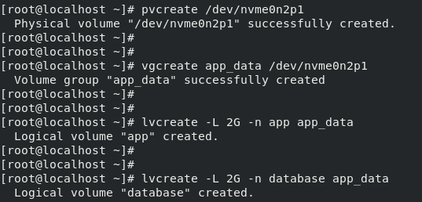
LVM
Create PV
Create VG
Create LV

Slide 25
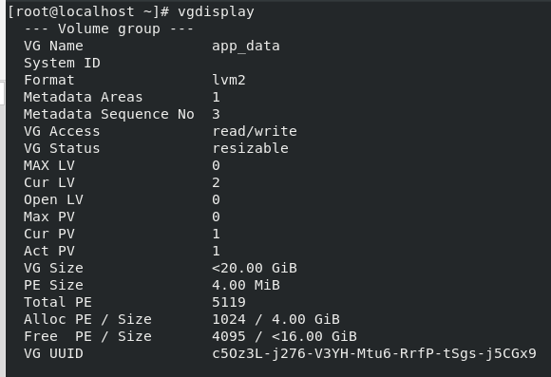
LVM
Display Physical Volume
Display Volume Group

Slide 26
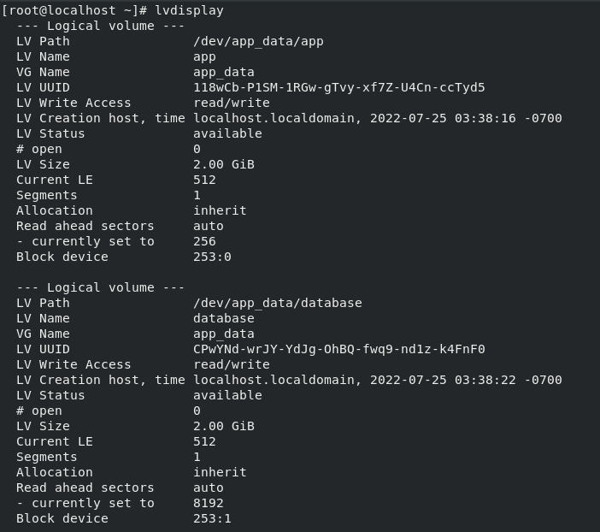
LVM
Display Logical Volume

Slide 27
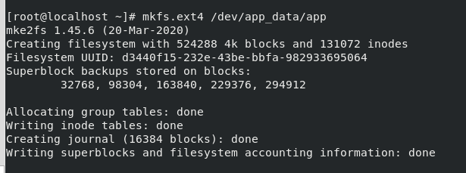
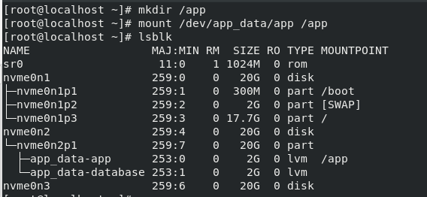
LVM
Format app LV with ext4 type of filesystem
Mount app lv to /app folder

Slide 28
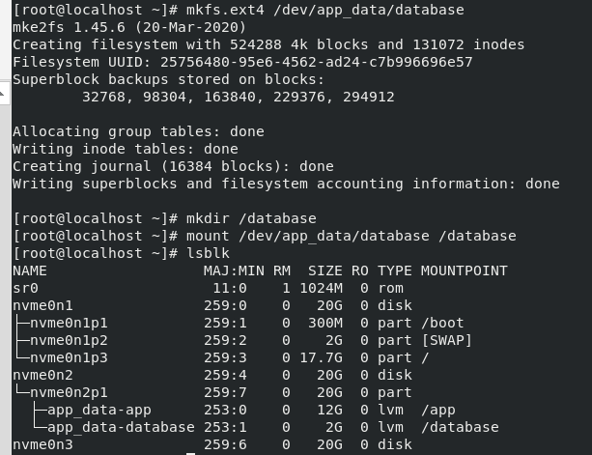
LVM
Format database LV with ext4 type of filesystem
Mount database lv to /database folder

Slide 29
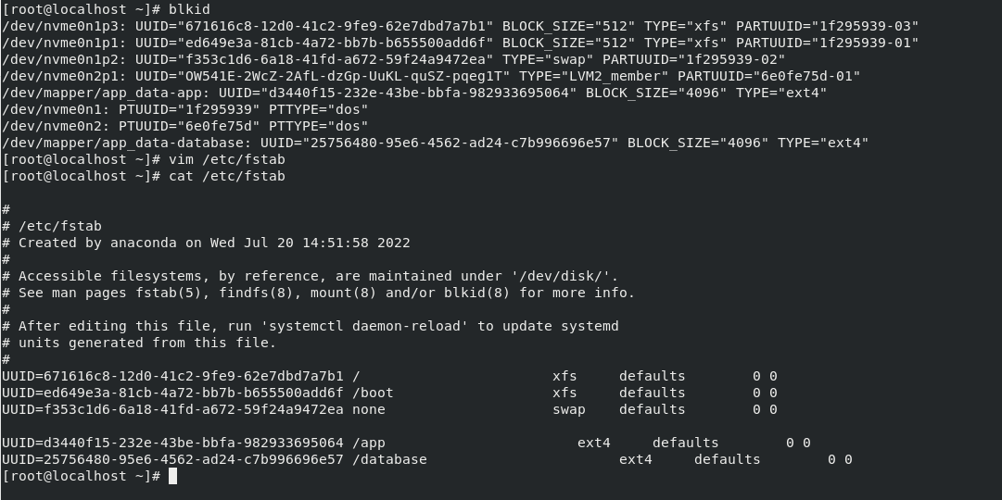
LVM
Add fstab Entry

Slide 30
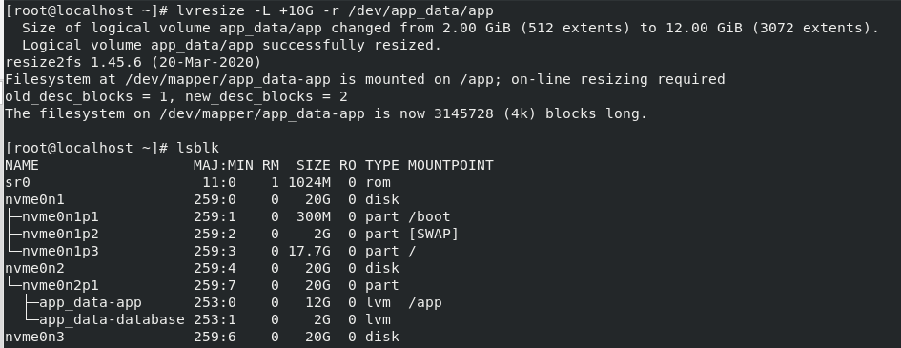
LVM
Resize LV to increase the folder size of /app

Slide 31
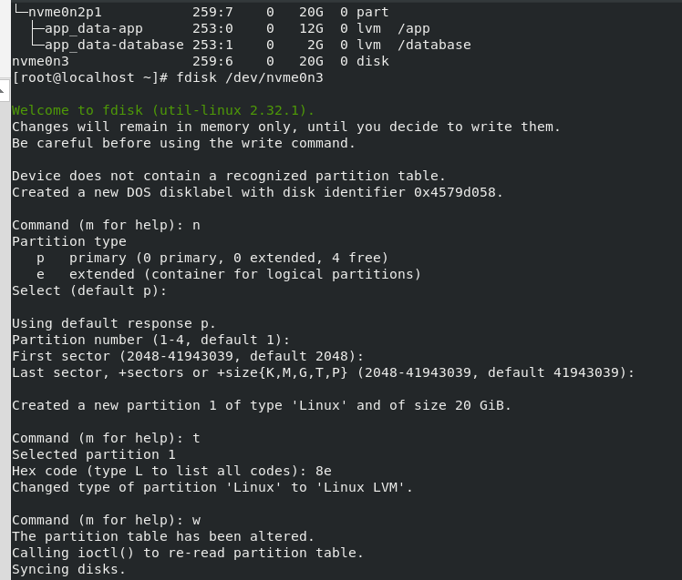
LVM- Adding Physical Volume
Format nvme0n3 with LVM type of partition

Slide 32

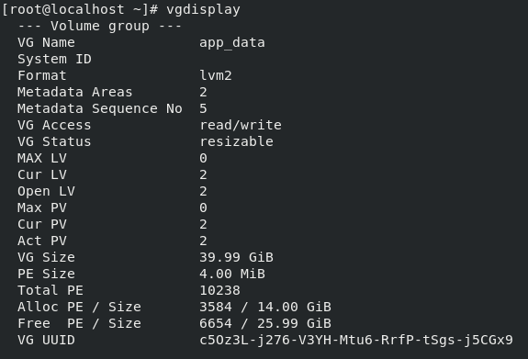
LVM
PV Create for nvme0n3p1
Extend VG with nvme0n3p1
Display VG

Slide 33
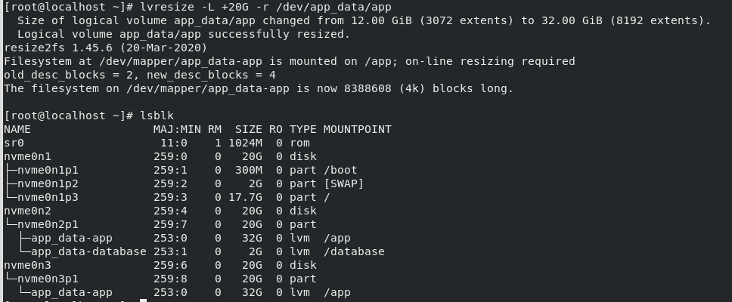
LVM
Resize lv to increase space

