Slide 1
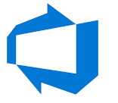

Azure Network Services

Slide 2

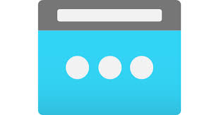

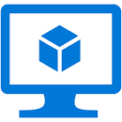
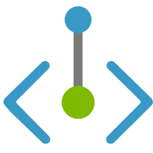

Azure Private Endpoint
Subscription-1
Region-1
Public IP
Storage Account PAAS Service
Jump-VM
192.168.1.5
Private Endpoint
192.168.1.4
Compute Subnet
Subnet- 2
Subnet- 3
Subnet-4
vNet-1

Slide 3
Azure Private Endpoint
Azure Private Link provides private connectivity from a virtual network to Azure platform as a service (PaaS), customer-owned, or Microsoft partner services. It simplifies the network architecture and secures the connection between endpoints in Azure by eliminating data exposure to the public internet.
Private connectivity to services on Azure. Traffic remains on the Microsoft network, with no public internet access. Connect privately to services running in other Azure regions. Private Link is global and has no regional restrictions.
Integration with on-premises and peered networks. Access private endpoints over private peering or VPN tunnels from on-premises or peered virtual networks. Microsoft hosts the traffic, so you don’t need to set up public peering or use the internet to migrate your workloads to the cloud.
Protection against data exfiltration for Azure resources. Use Private Link to map private endpoints to Azure PaaS resources. When there is a security incident within your network, only the mapped resource would be accessible, eliminating the threat of data exfiltration.
Services delivered directly to your customers’ virtual networks. Privately consume Azure PaaS, Microsoft partner, and your own services in your virtual networks on Azure. Private Link works across Azure Active Directory (Azure AD) tenants to help unify your experience across services. Send, approve, or reject requests directly, without permissions or role-based access controls.

Slide 4
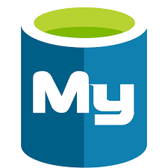
Azure Service Endpoint
Subscription-1
Region-1
Public IP
Mysql PAAS Service
Jump-VM
192.168.1.5
Service Endpoint
Compute Subnet
Mysql Subnet
Subnet- 3
Subnet-4
vNet-1

Slide 5
Azure Service Endpoint
Why use a service endpoint?
Improved security for your Azure service resources. VNet private address spaces can be overlapping and so, cannot be used to uniquely identify traffic originating from your VNet. Service endpoints secure Azure service resources to your virtual network by extending VNet identity to the service. When service endpoints are enabled in your virtual network, you secure Azure service resources to your virtual network by adding a virtual network rule. The rule improves security by fully removing public Internet access to resources, and allowing traffic only from your virtual network.
Optimal routing for Azure service traffic from your virtual network. Today, any routes in your virtual network that force Internet traffic to your premises and/or virtual appliances, known as forced-tunneling, also force Azure service traffic to take the same route as the Internet traffic. Service endpoints provide optimal routing for Azure traffic.
Endpoints always take service traffic directly from your virtual network to the service on the Microsoft Azure backbone network. Keeping traffic on the Azure backbone network allows you to continue auditing and monitoring outbound Internet traffic from your virtual networks, through forced-tunneling, without impacting service traffic. Learn more about user-defined routes and forced-tunneling.
Simple to set up with less management overhead. You no longer need reserved, public IP addresses in your virtual networks to secure Azure resources through IP firewall. There are no NAT or gateway devices required to set up the service endpoints. Service endpoints are configured through the subnet. There is no additional overhead to maintaining the endpoints.

Slide 6
Azure vNet Peering
Subscription-1
Region-1
Subscription-2
Region-2
192.168.2.0/24
Vm-01
Vm-02
192.168.1.4/26
192.168.2.8/26
vNet-2
Subnet-1
Subnet-2
Subnet-3
Subnet-4
192.168.3.0/24
vNet-1
Vm-03
vNet peering is not transitive- i.e If vNet-1 is peered to vNet-2 and vNet-3 then vNet-2 is Cannot Communicate with vNet-3
192.168.3.14/26
vNet-3

Slide 7
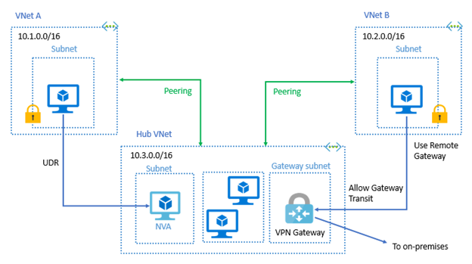
Azure vNet Peering
When you Allow Gateway Transit the virtual network can communicate to resources outside the peering. For example, the subnet gateway could:
Use a site-to-site VPN to connect to an on-premises network.
Use a VNet-to-VNet connection to another virtual network.
Use a point-to-site VPN to connect to a client.
In these scenarios, gateway transit allows peered virtual networks to share the gateway and get access to resources. This means you do not need to deploy a VPN gateway in the peer virtual network.

Slide 8
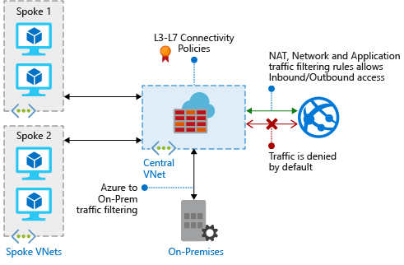
Azure Firewall

Slide 9
Azure Firewall
Azure Firewall features
Built-in high availability. High availability is built in, so additional load balancers aren't required. There's nothing you need to configure.
Availability Zones. Azure Firewall can be configured during deployment to span multiple Availability Zones for increased availability.
Unrestricted cloud scalability. Azure Firewall can scale up as much as you need to accommodate changing network traffic flows, so you don't need to budget for your peak traffic.
Application FQDN filtering rules. You can limit outbound HTTP/S traffic or Azure SQL traffic to a specified list of fully qualified domain names (FQDN) including wild cards.
Network traffic filtering rules. You can centrally create allow or deny network filtering rules by source and destination IP address, port, and protocol. Azure Firewall is fully stateful, so it can distinguish legitimate packets for different types of connections. Rules are enforced and logged across multiple subscriptions and virtual networks.
Threat intelligence. Threat intelligence-based filtering can be enabled for your firewall to alert and deny traffic from/to known malicious IP addresses and domains. The IP addresses and domains are sourced from the Microsoft Threat Intelligence feed.
Multiple public IP addresses. You can associate multiple public IP addresses with your firewall.

Slide 10
Azure Firewall
NAT rules
You can configure Azure Firewall Destination Network Address Translation (DNAT) to translate and filter inbound traffic to your subnets. Each rule in the NAT rule collection is used to translate your firewall public IP and port to a private IP and port. Scenarios where NAT rules might be helpful are publishing SSH, RDP, or non-HTTP/S applications to the Internet. A NAT rule that routes traffic must be accompanied by a matching network rule to allow the traffic. Configuration settings include:
Name: A label for the rule.
Protocol: TCP or UDP.
Source Address: * (Internet), a specific Internet address, or a CIDR block.
Destination Address: The external address of the firewall that the rule will inspect.
Destination Ports: The TCP or UDP ports that the rule will listen to on the external IP address of the firewall.
Translated Address: The IP address of the service (virtual machine, internal load balancer, and so on) that privately hosts or presents the service.
Translated Port: The port that the inbound traffic will be routed to by the Azure Firewall.
Network rules
Any non-HTTP/S traffic that will be allowed to flow through the firewall must have a network rule. For example, if resources in one subnet must communicate with resources in another subnet, then you would configure a network rule from the source to the destination. Configuration settings include:
Name: A friendly label for the rule.
Protocol: TCP, UDP, ICMP (ping and traceroute) or Any.
Source Address: The address or CIDR block of the source.
Destination Addresses: The addresses or CIDR blocks of the destination(s).
Destination Ports: The destination port of the traffic.

Slide 11
Azure Firewall
Application rules
Application rules define fully qualified domain names (FQDNs) that can be accessed from a subnet. For example, specify the Windows Update network traffic through the firewall. Configuration settings include:
Name: A friendly label for the rule.
Source Addresses: The IP address of the source.
Protocol:Port: HTTP/HTTPS and the port that the web server is listening on.
Target FQDNs: The domain name of the service, such as www.contoso.com. Wildcards can be used. An FQDN tag represents a group of FQDNs associated with well known Microsoft services. Example FQDN tags include Windows Update, App Service Environment, and Azure Backup.
Rule processing
When a packet is being inspected to determine if it is allowed or not, the rules are processed in this order:
Network Rules
Application Rules (network and application)
Once a rule is found that allows the traffic through, no more rules are checked.

Slide 12
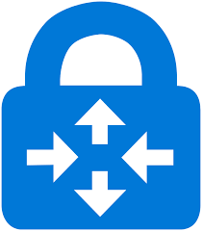
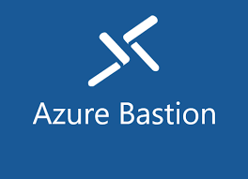
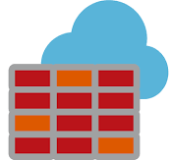
Azure Firewall
Subscription-1
Region-1
Subscription-2
Region-2
192.168.1.0/24
Route Table
NAT-DNAT Rules
Network-L4
Application-L7
192.168.2.0/24
/26 subnet for firewall
NSG
NSG
NSG
Subnet-3
Subnet-2
vNet-02
Subnet-1
vNet peering is not transitive- i.e If vNet-1 (hub vnet) is peered to vNet-3 and vNet-2 then vNet-2 is Cannot Communicate with vNet-3
Vnet-01-Hub-vNet
Route Table
192.168.3.0/24
Using Firewall we can route traffic from vNet-02 to vNet-03
Subscription-3
Region-3
vNet-03

Slide 13
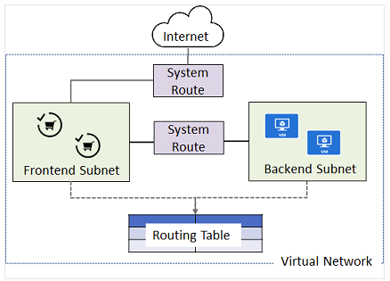
Azure System Routes
Azure uses system routes to direct network traffic between virtual machines, on-premises networks, and the Internet. The following situations are managed by these system routes:
Traffic between VMs in the same subnet.
Between VMs in different subnets in the same virtual network.
Data flow from VMs to the Internet.
Information about the system routes is recorded in a route table. A route table contains a set of rules, called routes, that specifies how packets should be routed in a virtual network. Routing tables are associated to subnets, and each packet leaving a subnet is handled based on the associated route table. Packets are matched to routes using the destination. The destination can be an IP address, a virtual network gateway, a virtual appliance, or the internet. If a matching route can't be found, then the packet is dropped.

Slide 14
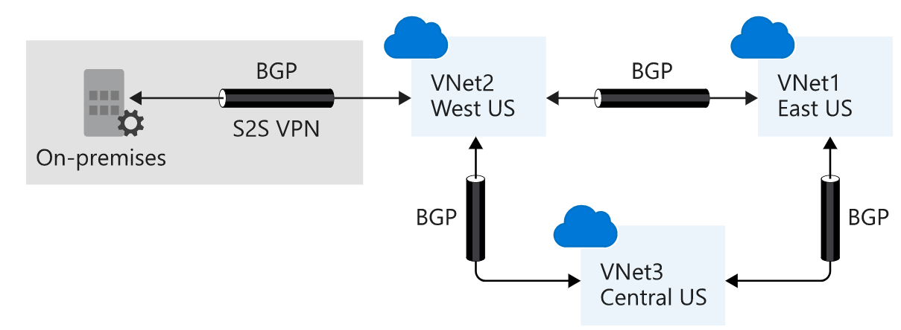
Border Gateway Protocol

Slide 15
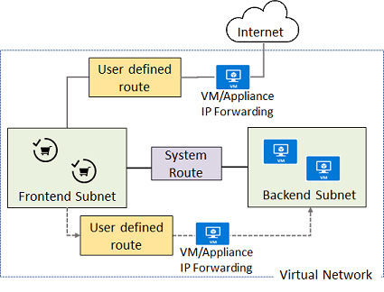
Azure User Defined Routes
Azure automatically handles all network traffic routing. But, what if you want to do something different? For example, you may have a VM that performs a network function, such as routing, firewalling, or WAN optimization. You may want certain subnet traffic to be directed to this virtual appliance. For example, you might place an appliance between subnets or a subnet and the internet.

Slide 16
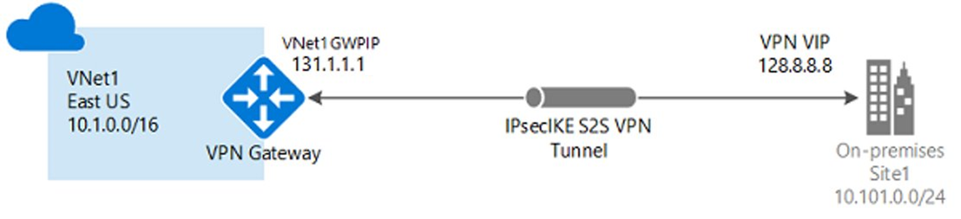
Azure VPN Gateway
Site-to-site connections connect on-premises datacenters to Azure virtual networks
Point-to-site (User VPN) connections connect individual devices to Azure virtual networks
Route-based VPNs. Route-based VPNs use routes in the IP forwarding or routing table to direct packets into their corresponding tunnel interfaces. The tunnel interfaces then encrypt or decrypt the packets in and out of the tunnels. The policy (or traffic selector) for Route-based VPNs are configured as any-to-any (or wild cards).
Policy-based VPNs. Policy-based VPNs encrypt and direct packets through IPsec tunnels based on the IPsec policies configured with the combinations of address prefixes between your on-premises network and the Azure VNet. The policy (or traffic selector) is defined as an access list in the VPN device configuration. When using a Policy-based VPN, keep in mind the following limitations:
Policy-Based VPNs can only be used on the Basic gateway SKU and is not compatible with other gateway SKUs.
You can have only one tunnel when using a Policy-based VPN.
You can only use Policy-based VPNs for S2S connections, and only for certain configurations. Most VPN Gateway configurations require a Route-based VPN.

Slide 17
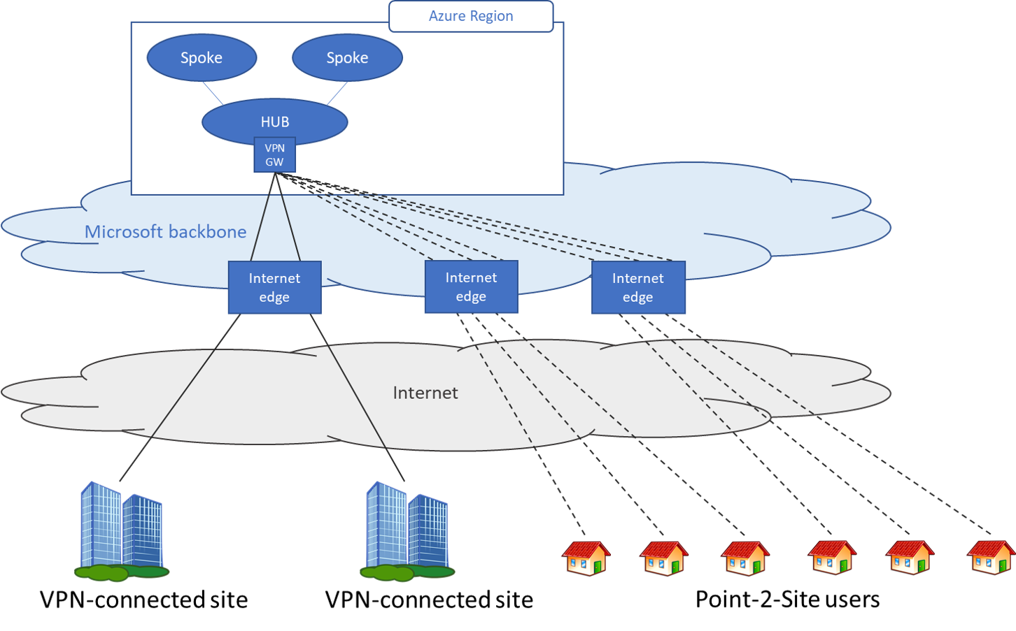
Azure VPN Gateway

Slide 18
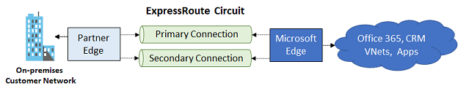
Azure ExpressRoute
Azure ExpressRoute lets you extend your on-premises networks into the Microsoft cloud. The connection is facilitated by a connectivity provider. With ExpressRoute, you can establish connections to Microsoft cloud services, such as Microsoft Azure, Microsoft 365, and CRM Online.
Features of ExpressRoute
Make your connections fast, reliable, and private
Use a virtual private cloud for storage, backup, and recovery
Extend and connect your datacenters
Build hybrid applications
Advantages of ExpressRoute
Layer 3 connectivity
Redundancy
Connectivity to Microsoft cloud services
Connectivity to all regions within a geopolitical region
Global connectivity with ExpressRoute premium add-on
Across on-premises connectivity with ExpressRoute Global Reach
Bandwidth options
Flexible billing models

Slide 19
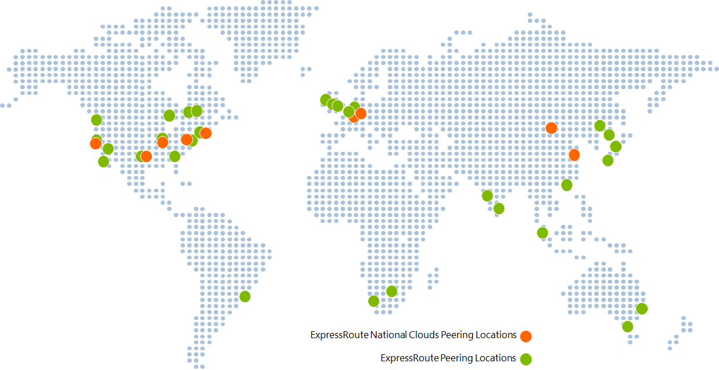
Azure ExpressRoute
ExpressRoute is supported across all Azure regions and locations. This map provides a list of Azure regions and ExpressRoute locations. ExpressRoute locations are where Microsoft peers with several service providers. When you connected to at least one ExpressRoute location within the geopolitical region, you will access Azure services across all regions within a geopolitical region.

Slide 20
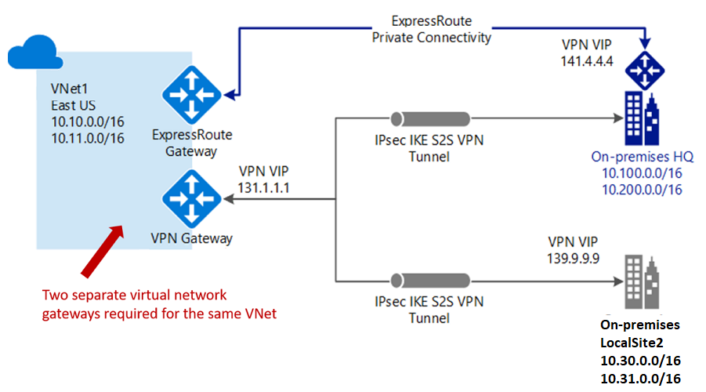
Azure ExpressRoute
You configure a Site-to-Site VPN as a secure failover path for ExpressRoute or use Site-to-Site VPNs to connect to sites that are not part of your network, but that are connected through ExpressRoute. Notice this configuration requires two virtual network gateways for the same virtual network, one using the gateway type VPN, and the other using the gateway type ExpressRoute.

Slide 21
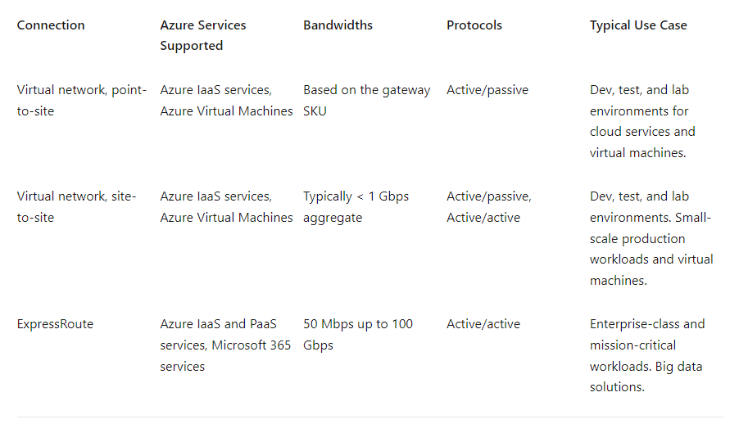
Azure ExpressRoute

Slide 22
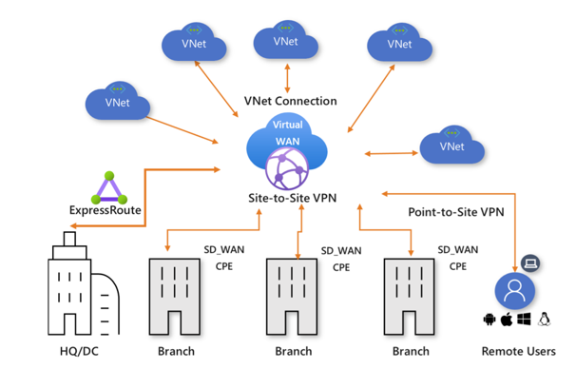
Azure Virtual WAN
Azure Virtual WAN is a networking service that provides optimized and automated branch connectivity to, and through, Azure. Azure regions serve as hubs that you can choose to connect your branches to. You use the Azure backbone to connect branches and enjoy branch-to-VNet connectivity. There is a list of partners that support connectivity automation with Azure Virtual WAN VPN.
Azure Virtual WAN brings together many Azure cloud connectivity services such as site-to-site VPN, User VPN (point-to-site), and ExpressRoute into a single operational interface. Connectivity to Azure VNets is established by using virtual network connections. The global transit network architecture based on a hub-and-spoke connectivity model. The cloud hosted network 'hub' enables transitive connectivity between endpoints that may be distributed across different types of 'spokes'.

Slide 23
Automation in Azure

Slide 24
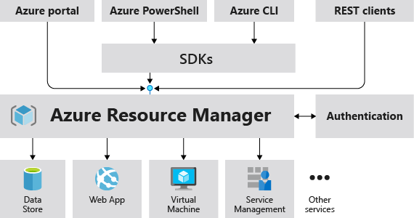
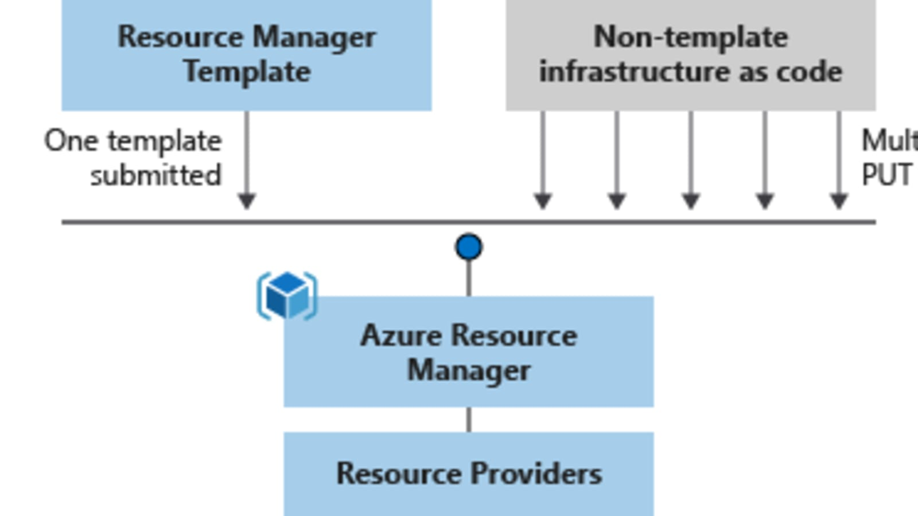
ARM Templates

Slide 25
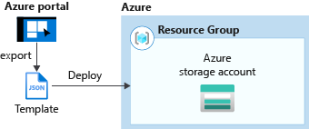
ARM Templates
{ "$schema": "http://schema.management.azure.com/schemas/2015-01-01/deploymentTemplate.json#", "contentVersion": "", "parameters": { }, "variables": { }, "resources": [ ], "outputs": { } }
$schema: The location of the JSON schema file that describes the version of the template language.
contentVersion: The version of the template (such as 1.0.0.0).
parameters: The optional values that are provided when deployment is executed to customise resource deployment.
variables: The values that are used as JSON fragments in the template to simplify template language expressions.
resources: A manageable item that is available through Azure. Some common resources are a virtual machine, storage account, web app, database, and virtual network, but there are many more.
outputs: The values that are returned after deployment.
az group deployment create –name testdeployment –g DEV-RG –template-file deploy.json –parameters parameters.json

Slide 26
ARM Templates
ARM templates provide many benefits when planning for deploying Azure resources. Some of those benefits include:
Declarative syntax: ARM templates allow you to create and deploy an entire Azure infrastructure declaratively. Declarative syntax means you declare what you want to deploy but don’t need to write the actual programming commands and sequence to deploy the resources.
Repeatable results: Repeatedly deploy your infrastructure throughout the development lifecycle and have confidence your resources are deployed in a consistent manner. You can use the same ARM template to deploy multiple dev/test environments, knowing that all the environments are the same.
Orchestration: You don't have to worry about the complexities of ordering operations. Azure Resource Manager orchestrates the deployment of interdependent resources, so they're created in the correct order. When possible, Azure Resource Manager deploys resources in parallel, so your deployments finish faster than serial deployments. You deploy the template through one command, rather than through multiple imperative commands.
Modular files: You can break your templates into smaller, reusable components and link them together at deployment time. You can also nest one template inside another template. For example, you could create a template for a VM stack, and then nest that template inside of templates that deploy entire environments, and that VM stack will consistently be deployed in each of the environment templates.
Extensibility: With deployment scripts, you can add PowerShell or Bash scripts to your templates. The deployment scripts extend your ability to set up resources during deployment. A script can be included in the template or stored in an external source and referenced in the template. Deployment scripts give you the ability to complete your end-to-end environment setup in a single ARM template.

Slide 27
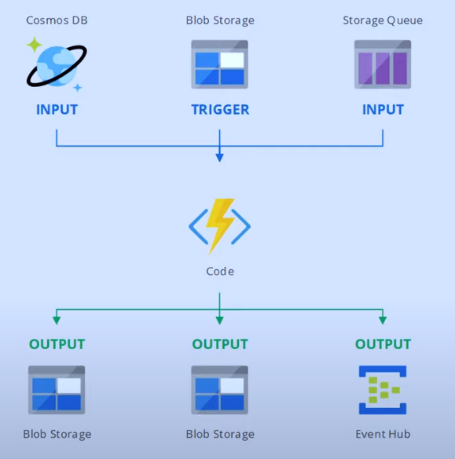
Azure Functions
Azure Functions is an event-driven, serverless compute option that doesn’t require maintaining virtual machines or containers.

Slide 28
Azure Functions
Benefits of Azure Functions
Using Azure Functions is ideal when you're only concerned about the code running your service and not about the underlying platform or infrastructure. Functions are commonly used when you need to perform work in response to an event (often via a REST request), timer, or message from another Azure service, and when that work can be completed quickly, within seconds or less.
Functions scale automatically based on demand, so they may be a good choice when demand is variable.
Azure Functions runs your code when it's triggered and automatically deallocates resources when the function is finished. In this model, you're only charged for the CPU time used while your function runs.
Functions can be either stateless or stateful. When they're stateless (the default), they behave as if they're restarted every time they respond to an event. When they're stateful (called Durable Functions), a context is passed through the function to track prior activity.
Functions are a key component of serverless computing. They're also a general compute platform for running any type of code. If the needs of the developer's app change, you can deploy the project in an environment that isn't serverless. This flexibility allows you to manage scaling, run on virtual networks, and even completely isolate the functions.

Slide 29
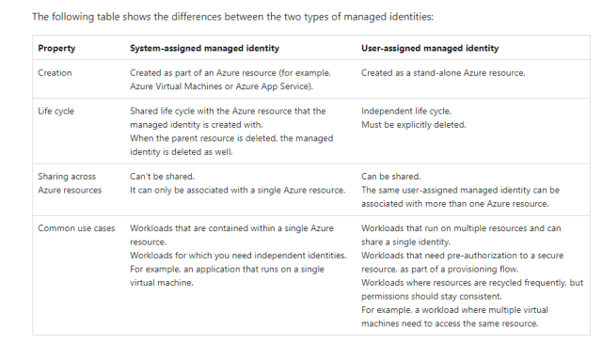
System Assigned vs User Assigned Managed Identities

Slide 30
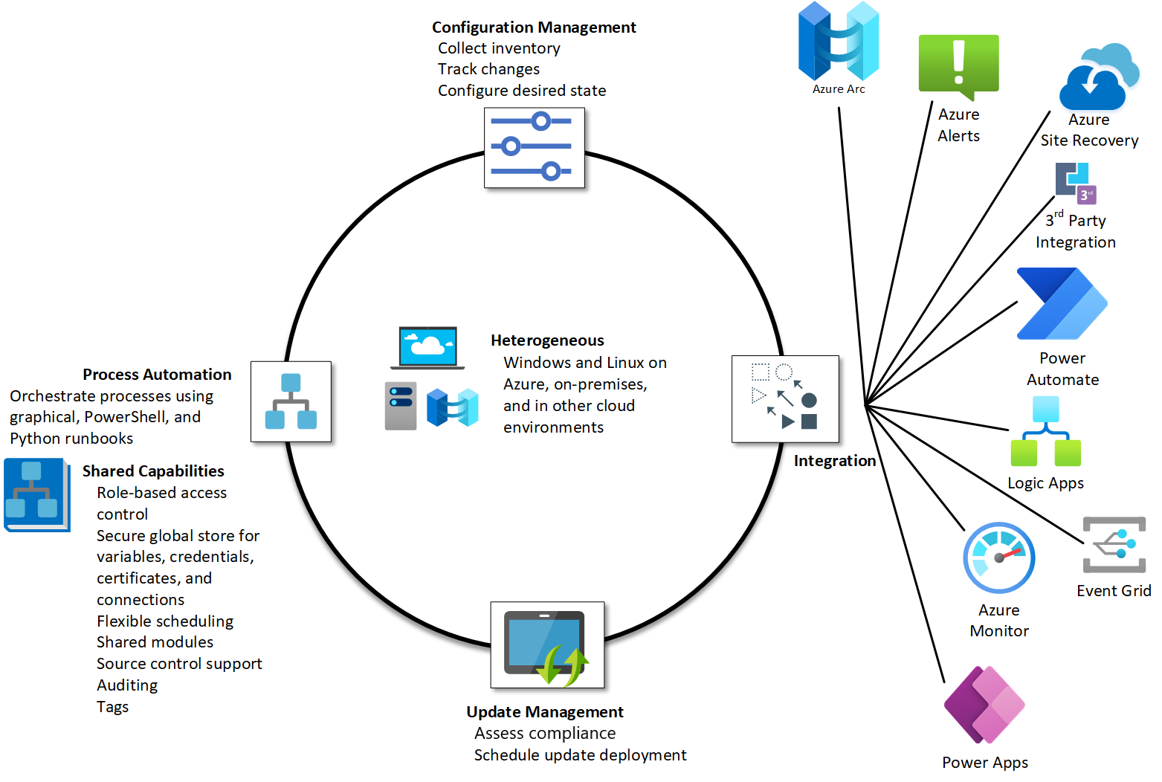
Azure Automation Accounts

Slide 31
Azure Desired State Configuration
Manually maintaining a correct and consistent configuration for the servers that run your services can be difficult and error prone. Azure Automation State Configuration uses PowerShell DSC to help address these challenges. It centrally manages your DSC artifacts and the DSC process.
Azure Automation State Configuration has a built-in pull server. You can target nodes to automatically receive configurations from this pull server, conform to the desired state, and report back on their compliance. You can target virtual or physical Windows or Linux machines, in the cloud or on-premises.
You can use Azure Monitor logs to review the compliance of your nodes by configuring Azure Automation State Configuration to send this data.
# Create a file share
New-SmbShare -Name MyFileShare -Path C:\Shared -FullAccess User1 -ReadAccess User2
This approach isn't idempotent. Idempotence describes an operation that has the same effect whether you run it once or 10,001 times. To achieve idempotence in PowerShell, you need to add logic and error handling. If the file share doesn't exist, you create it. If the share does exist, there's no need to create it. If User2 exists but doesn't have read access, you add read access.

Slide 32
Azure Desired State Configuration
$shareExists = $false
$smbShare = Get-SmbShare -Name $Name -ErrorAction SilentlyContinue
if($smbShare -ne $null)
{
Write-Verbose -Message "Share with name $Name exists"
$shareExists = $true
}
if ($shareExists -eq $false)
{
Write-Verbose "Creating share $Name to ensure it is Present"
New-SmbShare @psboundparameters
}
else
{
# Need to call either Set-SmbShare or *ShareAccess cmdlets
if ($psboundparameters.ContainsKey("ChangeAccess"))
{
#...etc., etc., etc
}
}
Configuration Create_Share
{
Import-DscResource -Module xSmbShare
# A node describes the VM to be configured
Node $NodeName
{
# A node definition contains one or more resource blocks
# A resource block describes the resource to be configured on the node
xSmbShare MySMBShare
{
Ensure = "Present"
Name = "MyFileShare"
Path = "C:\Shared"
ReadAccess = "User1"
FullAccess = "User2"
Description = "This is an updated description for this share"
}
}
}

Slide 33
Azure Desired State Configuration
The local configuration manager (LCM) is a component of the Windows Management Framework (WMF) on a Windows operating system. The LCM is responsible for updating the state of a node, like a VM, to match the desired state. Every time the LCM runs, it completes the following steps:
Get: Get the current state of the node.
Test: Compare the current state of a node against the desired state by using a compiled DSC script (.mof file).
Set: Update the node to match the desired state described in the .mof file.
The LCM on each node can operate in two modes.
Push mode: An administrator manually sends, or pushes, the configurations to one or more nodes. The LCM makes sure that the state on each node matches what the configuration specifies.
Pull mode: A pull server holds the configuration information. The LCM on each node polls the pull server at regular intervals, by default every 15 minutes, to get the latest configuration details. These requests are denoted as step 1 in the following diagram. In step 2, the pull server sends the details about any configuration changes back to each node.
Both modes have advantages:
Push mode is easy to set up. It doesn't need its own dedicated infrastructure, and it can run on a laptop. Push mode is helpful to test the functionality of DSC. You could also use push mode to get a newly imaged machine to the baseline desired state.
Pull mode is useful in an enterprise deployment that spans a large number of machines. The LCM regularly polls the pull server and makes sure the nodes are in the desired state. If an external tool or team applies hotfixes that result in configuration drift on individual machines, those machines are quickly brought back in line with the configuration you've set. This process can help you achieve a state of continuous compliance for your security and regulatory obligations.

Slide 34
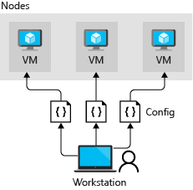
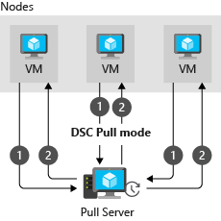
Azure Desired State Configuration
Push Mode
Pull Mode

Slide 35
Logic Apps
Azure Logic Apps is a cloud-based platform for creating and running automated workflows that integrate your apps, data, services, and systems. With this platform, you can quickly develop highly scalable integration solutions for your enterprise and business-to-business (B2B) scenarios. As a member of Azure Integration Services, Azure Logic Apps simplifies the way that you connect legacy, modern, and cutting-edge systems across cloud, on premises, and hybrid environments.
The following list describes just a few example tasks, business processes, and workloads that you can automate using the Azure Logic Apps service:
Schedule and send email notifications using Office 365 when a specific event happens, for example, a new file is uploaded.
Route and process customer orders across on-premises systems and cloud services.
Move uploaded files from an SFTP or FTP server to Azure Storage.
Monitor tweets, analyze the sentiment, and create alerts or tasks for items that need review.

