Slide 1
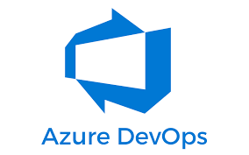

Azure DevOps

Slide 2








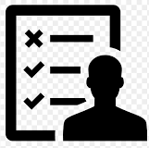
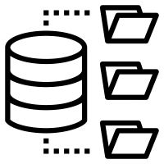


DevOps Lifecycle
Customer comes with requirements
Business analysts/product owner translates requirements into smaller units called backlogs
Developers picks up backlog items/bugs and starts development
Engineering team/SCRUM master does the capacity planning and sprint planning
Once developers finish the code, they
Build and test in their local
Get it reviewed
Commits the code to central repo
Business users test UAT environment
If they find any expectation mismatch then report it to product owner
Testing team does test planning
Testing team tests the deployments and logs defects
Once testing team is satisfied they promote the deployment to UAT
Central
Repo
Once business team is satisfied they promote the deployment to PROD
PROD
VMs
Kubernetes
PAAS Services
UAT
VMs
Kubernetes
PAAS Services
DEV
VMs
Kubernetes
PAAS Services
Deployment Environments
Build and test in central place with the entire code
Save the build output in central place
Stage wise deploy

Slide 3
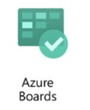
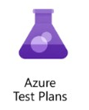
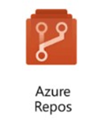
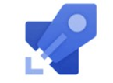
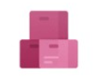
DevOps Lifecycle
Customer comes with requirements
Business analysts/product owner translates requirements into smaller units called backlogs
Developers picks up backlog items/bugs and starts development
Azure Boards
Engineering team/SCRUM master does the capacity planning and sprint planning
Once developers finish the code, they
Build and test in their local
Get it reviewed
Commits the code to central repo
Business users test UAT environment
If they find any expectation mismatch then report it to product owner
Testing team does test planning
Testing team tests the deployments and logs defects
Once testing team is satisfied they promote the deployment to UAT
Azure
Repo
Azure Test Plans
Once business team is satisfied they promote the deployment to PROD
PROD
VMs
Kubernetes
PAAS Services
UAT
VMs
Kubernetes
PAAS Services
DEV
VMs
Kubernetes
PAAS Services
Azure
Build
Pipelines
Deployment Environments
Build and test in central place with the entire code
Save the build output in central place
Stage wise deploy
Azure Release Pipelines
Azure Artifacts

Slide 4
Features of Azure DevOps
Azure Boards delivers a suite of Agile tools to support planning and tracking work, code defects, and issues using Kanban and Scrum methods
Azure Repos provides Git repositories or Team Foundation Version Control (TFVC) for source control of your code.
Azure Pipelines provides build and release services to support continuous integration and delivery of your apps.
Azure Artifacts allows teams to share Maven, npm, and NuGet packages from public and private sources and integrate package sharing into your CI/CD pipelines.
Azure Test Plans provides several tools to test your apps, including manual/exploratory testing and continuous testing.

Slide 5
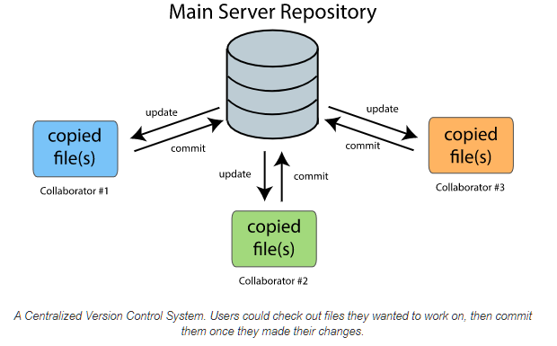
Centralized version control (TFVC)

Slide 6
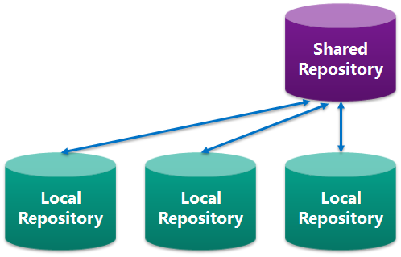
Distributed version control (git)

Slide 7
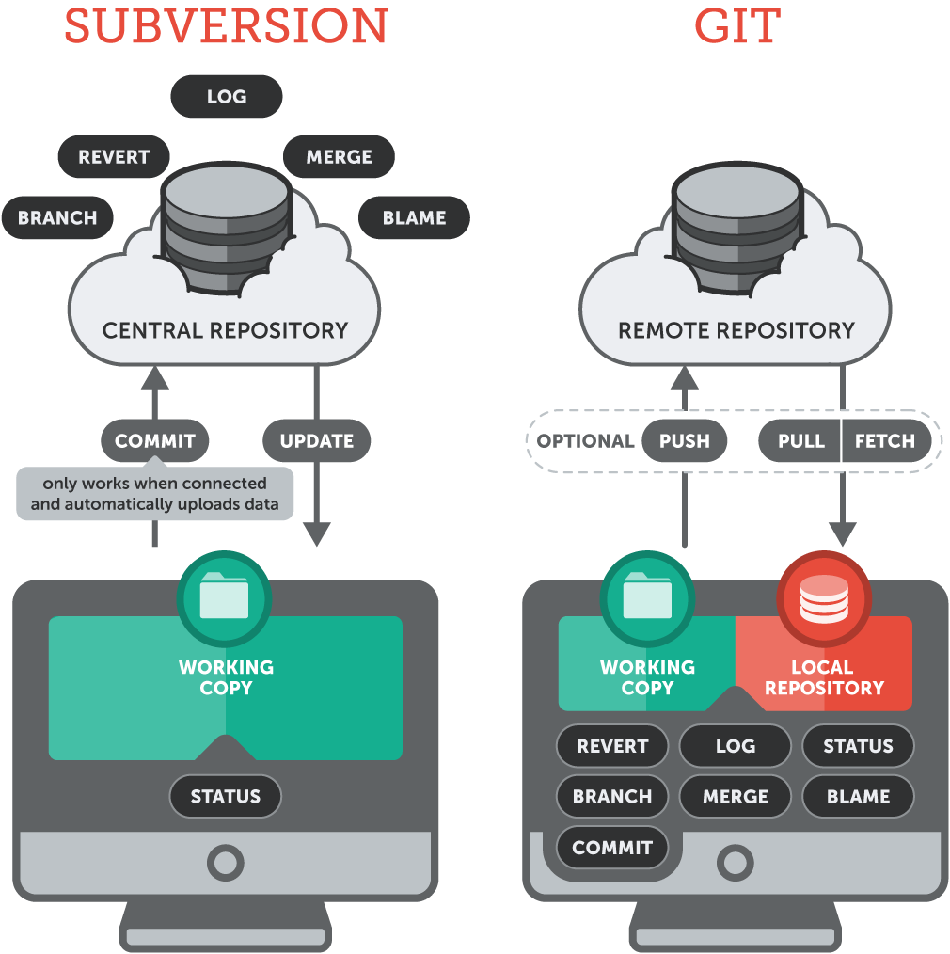
TFVC vs GIT

Slide 8
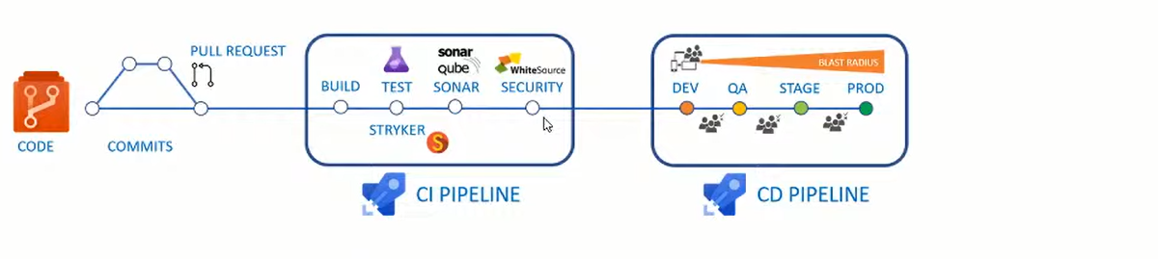
CI/CD Overview

Slide 9
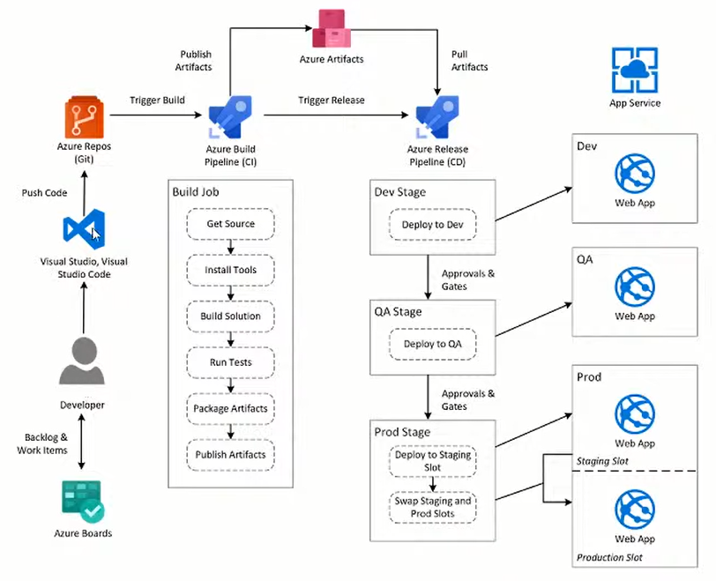
CI/CD Lifecycle

Slide 10
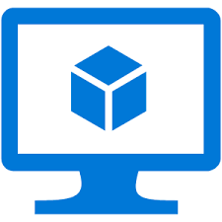

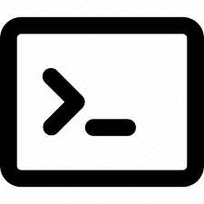
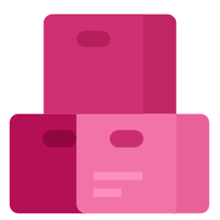

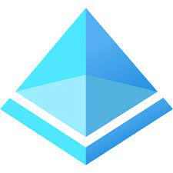

Azure DevOps Agent Architecture
Run CI Code
Agent
Pulls
CI Code when CI is triggered
Push the build output to artifact
Stores artifacts in backend secure storage/databases
Pulls CD Code when CD is triggered
Pulls artifacts form the build
AD Authentication using service Connection
Run CD Code
Same or different Agent
Deploy the artifact

Slide 11
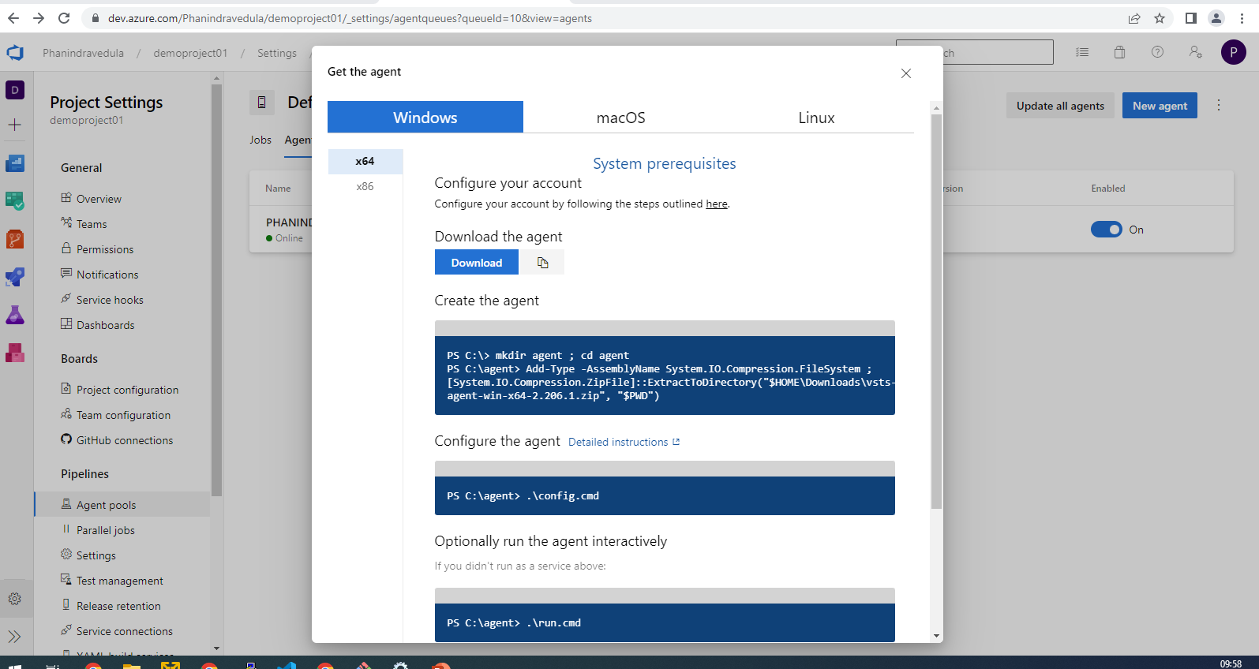
Self-Hosted Agent Installation
Go to project Settings > Agent pools > add new agent

Slide 12
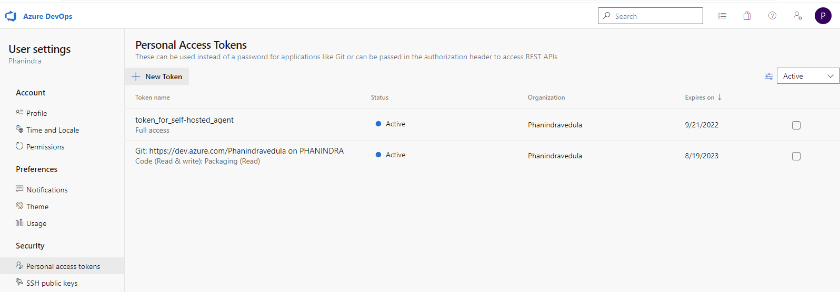
Self-Hosted Agent Installation
Go to user Settings on top right corner > Personal Access Tokens > add new tokens

Slide 13
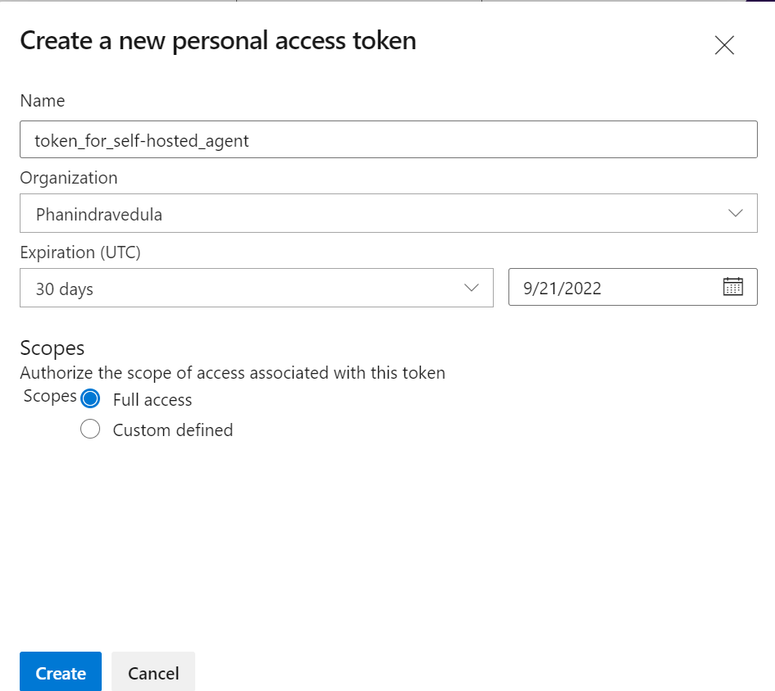
Self-Hosted Agent Installation
Give name and appropriate permissions

Slide 14
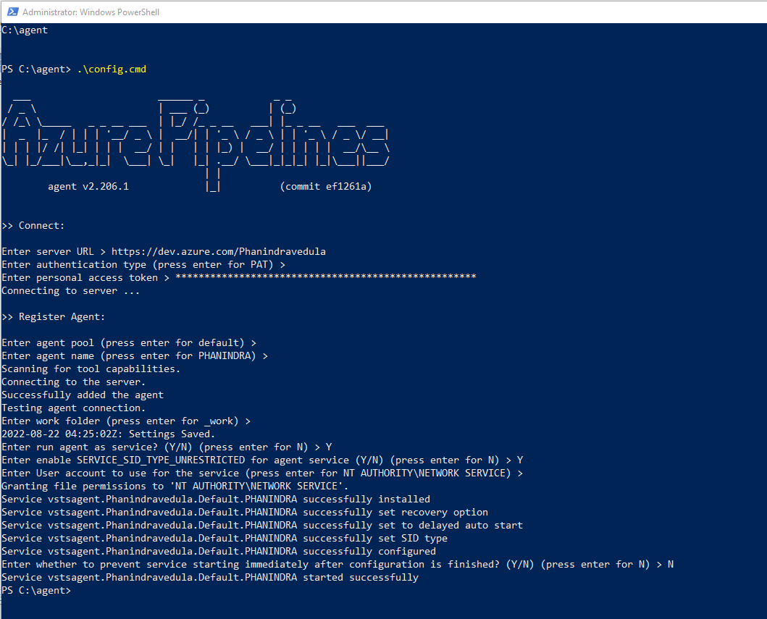
Self-Hosted Agent Installation- Windows
Download and extract the agent file
Cd to the agent directory and follow the steps

Slide 15
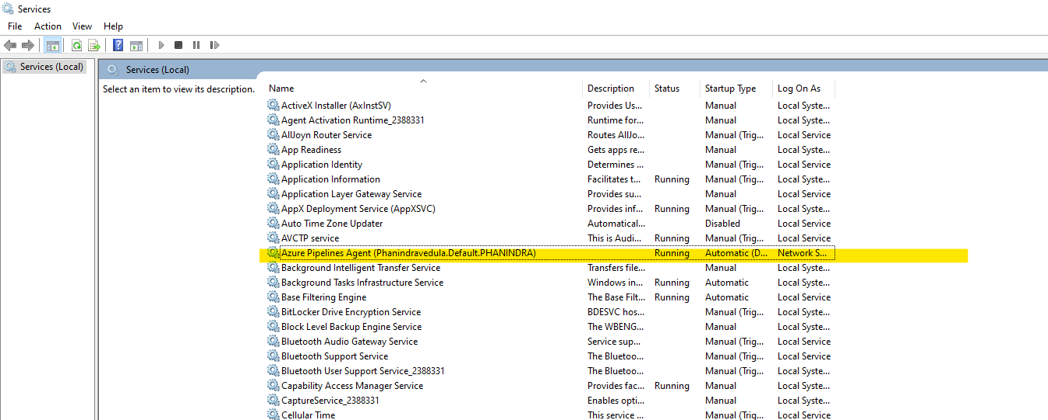
Self-Hosted Agent Installation- Windows
Search for services and check if Pipeline service is running

Slide 16
Self-Hosted Agent Installation- Linux
useradd linuxagentuser01
passwd linuxagentuser01
su linuxagentuser01
cd ~
mkdir devops-agent
wget https://vstsagentpackage.azureedge.net/agent/2.206.1/vsts-agent-linux-x64-2.206.1.tar.gz
tar -xvzf vsts-agent-linux-x64-2.206.1.tar.gz

Slide 17
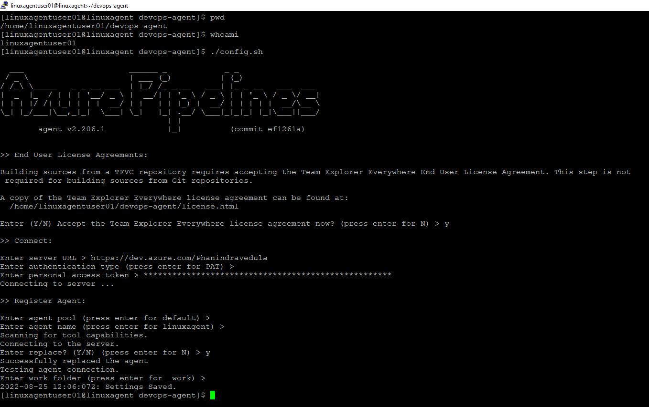
Self-Hosted Agent Installation- Linux

Slide 18
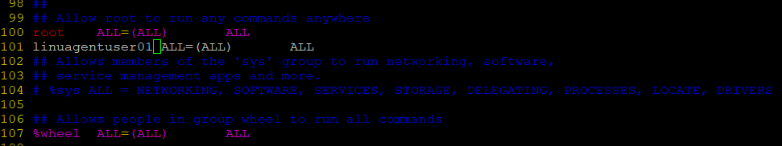
Self-Hosted Agent Installation- Linux
Switch as root & add agent user to docker group
usermod -a linuxagentuser01 -G docker
Switch as root & add agent user to sudo users by adding the line number 101 to /etc/sudoers file

Slide 19
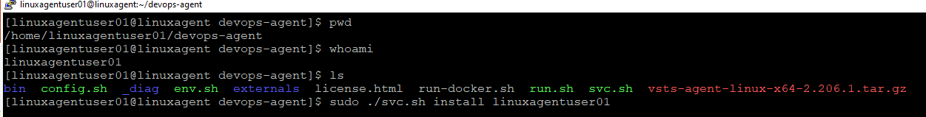
Self-Hosted Agent Installation- Linux
sudo ./svc.sh start
sudo ./svc.sh stop

Slide 20
Git Setup in local Machine
git init
git add .
git commit –m “commit message”
git remote add origin https://Phanindravedula@dev.azure.com/Phanindravedula/demoproject01/_git/demoproject01
git push -u origin --all
https://git-scm.com/download/win

Slide 21
Dotnet Project Setup
dotnet new sln -o demoapp
cd demoapp
dotnet new mvc -n demoapp.web
dotnet sln demoapp.sln add demoapp.web\demoapp.web.csproj
dotnet restore
dotnet build --configuration release
cd demoapp.web
dotnet bin\Release\net6.0\demoapp.web.dll
dotnet publish --no-build --configuration release
https://dotnet.microsoft.com/en-us/download

Slide 22
Terraform Commands
az ad sp create-for-rbac --role reader --scopes /subscriptions/{subscription_id} –name “terraform sp”
terraform fmt
terraform init
terraform apply main.tfplan
terraform plan -out main.tfplan
https://code.visualstudio.com/docs/?dv=win64

