Slide 1


Multi-Windows
Wind River Solution Accelerators for Android
| © 2013 Wind River. All Rights Reserved.

Slide 2
Legal Disclaimer
Copyright © 2013 Wind River Systems, Inc. No part of this material may be reproduced without the explicit written agreement of Wind River Systems, Inc. Wind River Systems, Inc. makes no guarantee about the accuracy of the information contained in this document. It is intended for information purposes only, and shall not be incorporated into any contract. It is not a commitment to deliver any material, code or functionality, and should not be relied upon in making purchasing decisions. The development, release and timing of any features or functionality described for Wind River products remains at the sole discretion of Wind River. Linux is a trademark of Linus Torvalds and other trademarks and logos used in this document are the properties of their respective owners.
| © 2013 Wind River. All Rights Reserved.

Slide 3
Agenda
Product Overview
Multi-Windowing Product Highlights
Use Case Examples
Compatibility with 3rd Party Application
Miscellaneous
| © 2013 Wind River. All Rights Reserved.

Slide 4
Problem Statement
Android does not support multiple application windows open at the same time
The problem limits productivity of the user on devices, especially those on a larger screen (like a tablet)
Samsung and LG both have multiple application solutions which users are generally favorable towards, however, they are limited in their functionality
| © 2013 Wind River. All Rights Reserved.

Slide 5
Definition of the Product
Wind River designed a multi-window UI for Android that improves multitasking and running of several applications in parallel
The Solution Accelerator allows the user to enjoy the increased productivity with easier device control
This concept is valid across most vertical markets and users
The solution is scalable from handsets to tablets to desktop to large screen displays
The Multi-Windowing Solution Accelerator provides highly innovative user experience
| © 2013 Wind River. All Rights Reserved.

Slide 6
Benefits of the Product
Product Lifecycle with Solution Accelerators
Solid line: with SA
Dot line: without SA (traditional)
Engineering Resources
Reduced
Resources
Reduced Time to Market
development phase
start-up phase
maintenance phase
Time
| © 2013 Wind River. All Rights Reserved.

Slide 7
Product Features
Ability to create 1, 2, 3, 4, 5… windows
Resize windows (horizontally, vertically, both)
Move windows anywhere on screen, including partially off screen
Maximize to full size (and then restore)
Minimize off screen (and then restore)
Task Manager for minimized restore
| © 2013 Wind River. All Rights Reserved.

Slide 8
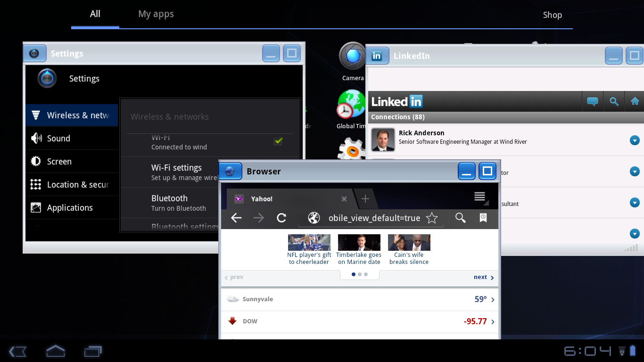
Product Features
Support for portrait and landscape applications
Ability to customize parts of the solution
  Icons
  Border size, color, texture
  Default window size (currently 560x680)
Marketplace applications on multi-windowing environment: LinkedIn
| © 2013 Wind River. All Rights Reserved.

Slide 9
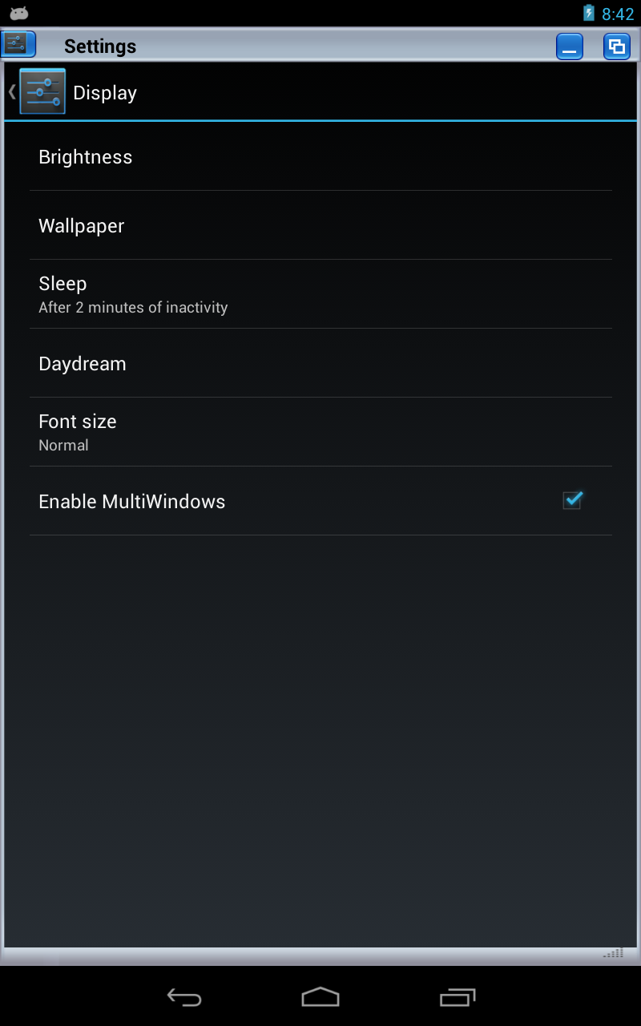
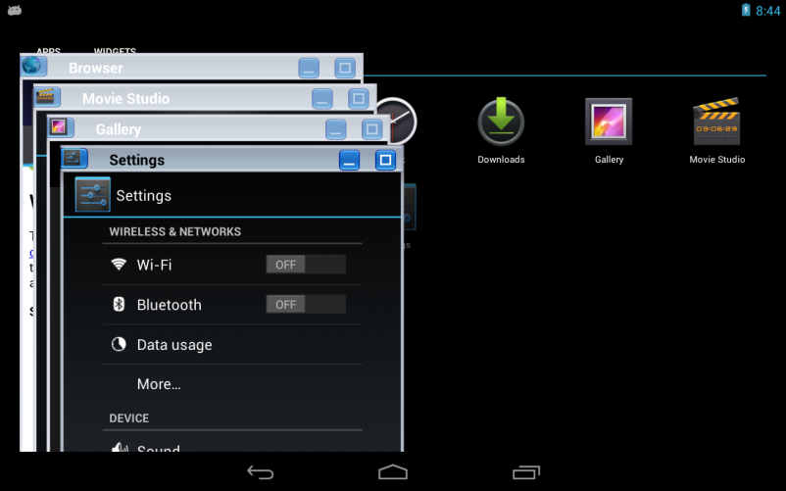
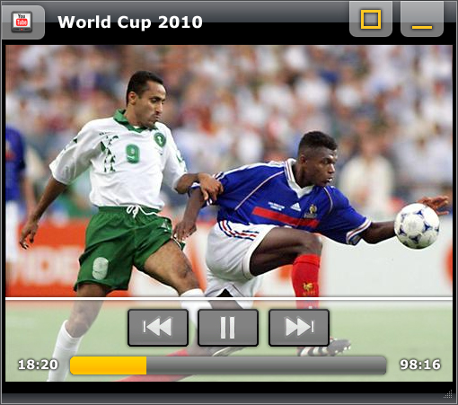
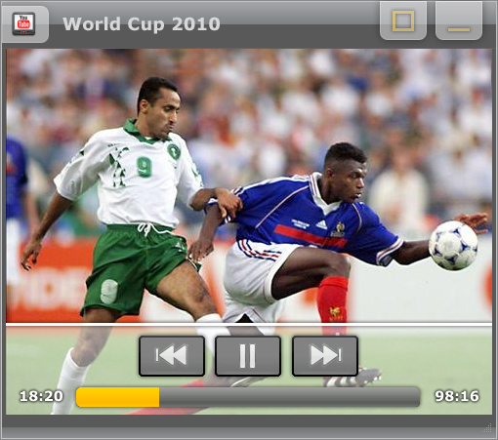
Product Features
Ability to turn Multi-Windows on and off
Support for new window tiling
Window focus indication
| © 2013 Wind River. All Rights Reserved.

Slide 10
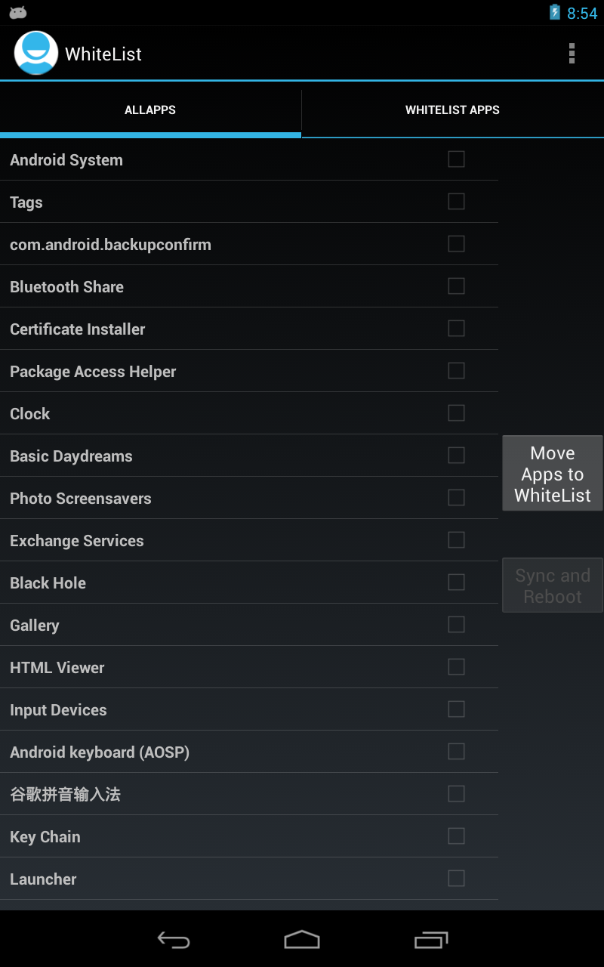
Product Features
WhiteList feature controls which applications can run in Multi-Windows
  Hides applications which are not well written for smaller window sizes
  Allows Google’s Compatibility Test Suite (CTS) to pass
    All non-white listed apk’s work just like standard Android expects
  WhiteList.apk provides simple UI to control this
    Might or might not be given to user
| © 2013 Wind River. All Rights Reserved.

Slide 11
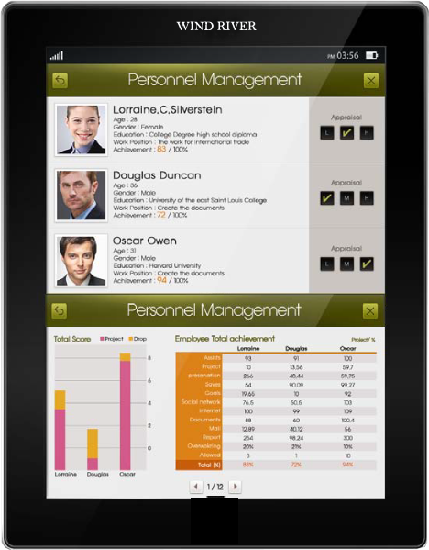
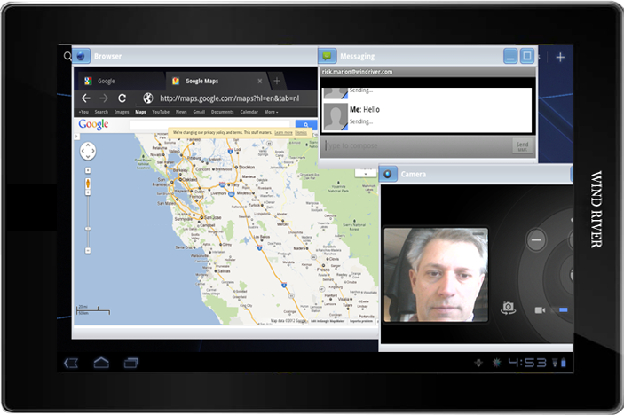
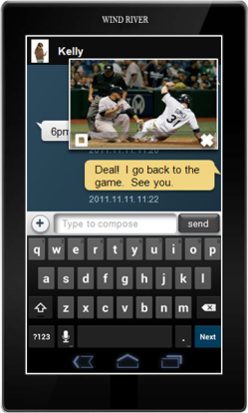
Support for Multiple Use Cases
Examples:
  Automotive (side-by-side, Navigation + user controlled)
  Industrial (four fixed, equal sized windows)
“Skins” used to restrict features, customize the solution
Split-Screen use case
Finger touch
<10” display
Typical Window UI style & use case
Mouse/Keyboard driven
>11” tablet or netbook device
PIP use case
Finger touch
<5” display
| © 2013 Wind River. All Rights Reserved.

Slide 12
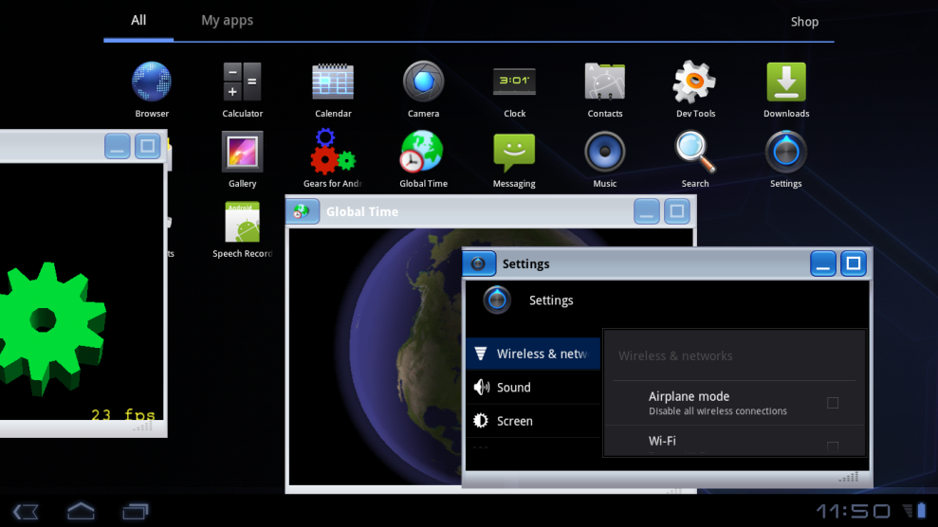
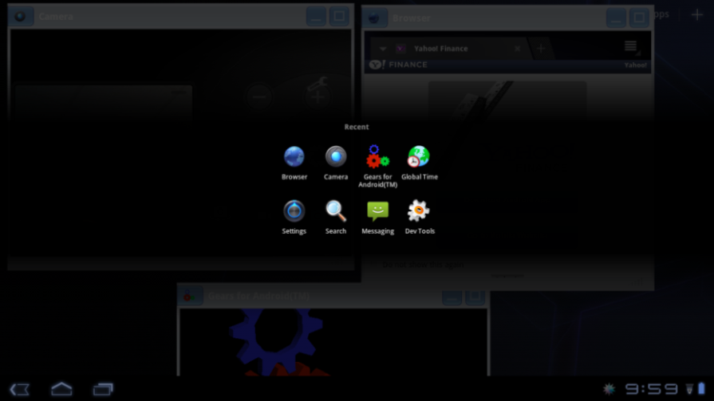
Use Case: PC-like Window Control
Provides “unlimited” windows as long as hardware supports
Provides typical windowing features such as move, resize, minimize, maximize, restore, overlap, partial off-screen
HOME and BACK key continue to work as expected
Two 3D applications are running at same time
Off screen mode
The launcher stays on the screen for quick launch of other applications
Long pressing home button will bring up task manager to restore minimized windows running in the background
Windows will return to their last position on the screen
User can activate/deactivate the feature in real-time
Windows Resize
Windows Overlapping (Full/Partial)
| © 2013 Wind River. All Rights Reserved.

Slide 13
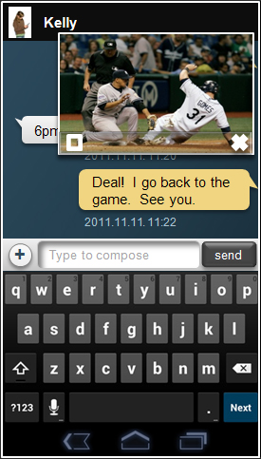
Use Case: Picture-in-Picture
No application frame to expand background application view (alpha-blending is also feasible)
The use case is applicable for devices with small screens (smartphones)
The example shown on the right hand side of the screen illustrates a multi-window use case on a 5-inch smart phone
The use case is about responding to a SMS message while continuing to watch a mobile TV video
Simple Control:
L: Resume to full screen
R: Quit
Graphic image on right-hand side is illustration purpose only
| © 2013 Wind River. All Rights Reserved.

Slide 14
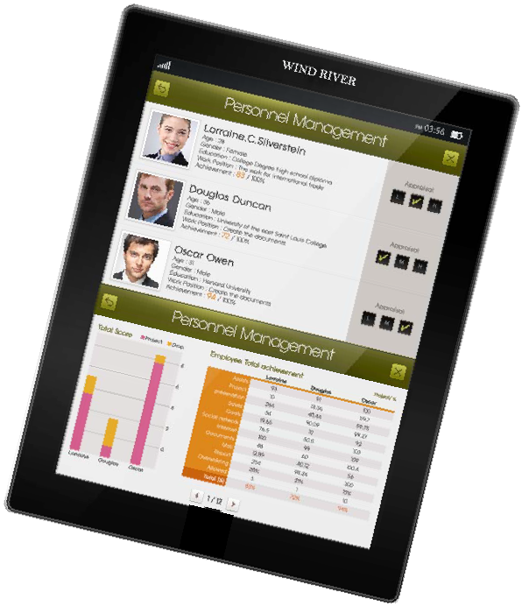
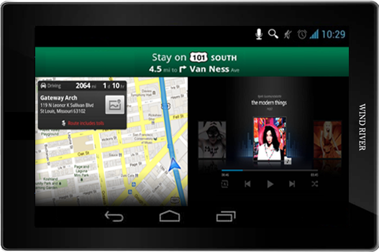
Use Case: Split-Screen
The use case is applicable for smartphone, tablet or automotive
Split-screen is a technique commonly used to allow the simultaneous presentation of different information on a single display
Graphic image on right-hand side is illustration purpose only
| © 2013 Wind River. All Rights Reserved.

Slide 15
Compatibility for 3rd Party Applications
Not all applications work well in Multi-Windows
Main issues we see:
  Fonts which don’t scale when displayed in smaller window (so window content is scrunched up)
  Part of screen is hidden unless you maximize the window (when applications write directly to the screen buffers)
  Applications which do not define Layout Properties correctly could cause display window to overlap with window borders (ex: Flipboard)
  Some applications are written exclusively for landscape or portrait mode (this issue, of course, requires a turn of the device just like a device without Multi-Windows, ex: Angry Birds)
| © 2013 Wind River. All Rights Reserved.

Slide 16
Most Installed Android Apps (over 100M)
Tools
Travel
Comm.
Games
Misc
Google Play
Maps
Gmail
Angry Birds
G. P. Books
Google Search
Street View
Skype
Fruit Ninja
Dropbox
Adobe Flash
WhatsApp
SubwaySurfers
Adobe Reader
Voice Search
Facebook
Candy Crush
Go Launcher
Tiny Flashlight
Viber
Talking Tom Cat
G. Translate
Samsung Push
Media
Social
LINE
Chrome
YouTube
Facebook
Hangouts
G. Play Music
Twitter
ChatOn
Apps ok in small window
G. Play Movies
Google+
Pandora
Instagram
AntiVirus

Slide 17
Google Mobile Services
Chrome
Tag Google
Calendar
Google+
Gmail
Hangouts
Misc
News
Play Magazine
Gears
Gallery
Music
Global Time
Play Games
Store
Genl Runner
Setup Wizard
Play Games
Play Services
Voice Search
Maps
Talk Back
Messenger

Slide 18
Compatibility for Android CTS
Multi-Windows passes the Compatibility Test Suite when used with the White List feature or when it is turned off
  Solution can be turned on and off via SETTINGS menu option
If you are running Multi-Windows and let every app open in smaller window, this will fail CTS
  Example: One failing test case opens an .apk and counts the # of graphical items (widgets) on the screen; MW adds widgets in the window frame and minimize/maximize icons, so the test counts three more widgets and fails
  Samsung and LG have the same problem
  They limit which .apks can run in the smaller windows
For some verticals (Medical, Auto, Industrial), GMS approval is not required/desired
| © 2013 Wind River. All Rights Reserved.

Slide 19
Android Limitations
Android does not allow the user to open two windows of the same application at the same time
  Consequently multi-windowing does not allow users to play two videos at the same time even when there are two video player installed on the same system. For example, you cannot open two browser windows and this is a limitation of AOSP
  However two applications that use similar resource is possible to run at same time. Screenshot that contains ‘Android Gears’ and ‘World Clock’ is an example where both applications run with OpenGL
  In most cases, two videos / audio streams will work at the same time, although we have seen one hardware platform that limited this functionality
| © 2012 Wind River. All Rights Reserved.

Slide 20
Code Porting
MW is very dependent on the Android Open Source Project (AOSP) code
  So every new release of Android might require some porting work to support
  We heavily modify the ActivityManager , WindowsManager, and PhoneWindowManager code
MW is not dependent on the hardware, so its easy to port to new hardware platforms
| © 2012 Wind River. All Rights Reserved.

Slide 21
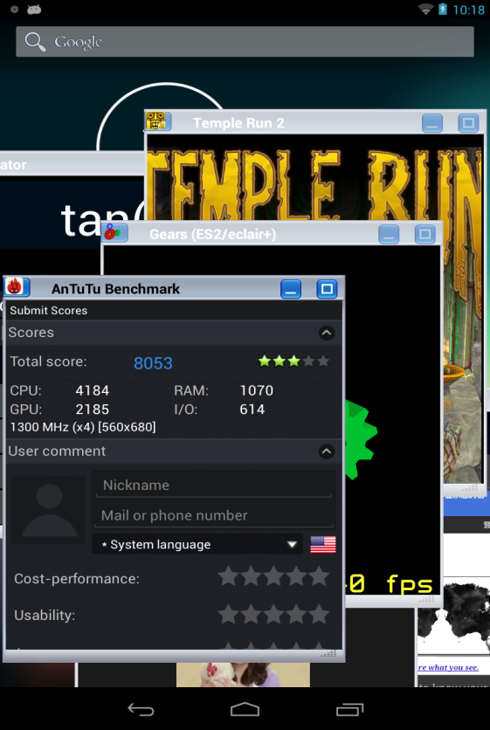
Performance
MW was implemented to work in harmony with Android
Performance does not suffer much when multiple windows are open in a properly architected system
Nexus 7 shows some slowing of highly resource dependent .apks after about six applications
  Video playing
  Music playing
  Graphic intensive game
  Browser
  Etc.
MW: ON | Scenario 1 Only Test Tool | Scenario 2 Tool + 1 App | Scenario 3 Tool + 2 Apps | Scenario 4 Tool + 3 Apps | Scenario 5 Tool + 6 Apps
Running Apps | Antutu | Antutu Temple Run | Antutu Temple Run Gallery | Antutu Temple Run Gallery TED | Antutu Temple Run Gallery TED Music Gears Browser
Total | 12808 | 9356 | 8705 | 7944 | 6289
CPU | 5841 | 4823 | 4552 | 4184 | 3288
Memory (RAM) | 1875 | 1207 | 1097 | 979 | 810
GPU | 4211 | 2603 | 2449 | 2336 | 1786
I/O | 881 | 723 | 607 | 445 | 405
| © 2012 Wind River. All Rights Reserved.

Slide 22
Current Demo Status
Primary ARM-based demo platform is the Nexus 7 tablet (nVIDIA Tegra 3 w/ 1 GB RAM) with Jelly Bean Maintenance Release 1 (Android v4.2.2)
Can also show on Intel x86 (Atom) Red Ridge 10” tablet running Ice Cream Sandwich
Demo is moved to new versions of Android as they become available and customer demand warrants
| © 2013 Wind River. All Rights Reserved.

Slide 23
Product Delivery
A GPG encrypted archive on FTP with packaged changes to Android, kernel and boot loader
Documentation (Developers Guide)
Source code patches
Technical Support
Customization services available via Wind River Professional Services
| © 2013 Wind River. All Rights Reserved.

Slide 24
Additional Information
Datasheets
Recorded Demos (Videos)
Live Demos
| © 2013 Wind River. All Rights Reserved.

Slide 25
Business Model
Typically we use an Enterprise Licensing Model
  Yearly subscription
Flexible business model
  Royalties or per unit fees can be entertained
Various short and long term support packages available
Customization or porting available
| © 2013 Wind River. All Rights Reserved.

Slide 26
Contacts
Wind River Android Product Management
  Darshan Patel (darshan.patel@windriver.com) / Mktg Director
Wind River Solution Technology Center
  Rick Anderson (rick.anderson@windriver.com) / Eng. Director
| © 2013 Wind River. All Rights Reserved.

Slide 27
| © 2013 Wind River. All Rights Reserved.

