Slide 1


OpenStack and EC2 API教學
國立交通大學 資訊技術服務中心
蘇俊憲
2013/06/04
Notes:
整體執行成果
<number>
<number>

Slide 2
資訊技術服務中心
Outline
OpenStack API Client Architecture
Install the OpenStack Clients
Command List for nova Client
Nova API Client
Glance API Client

Slide 3
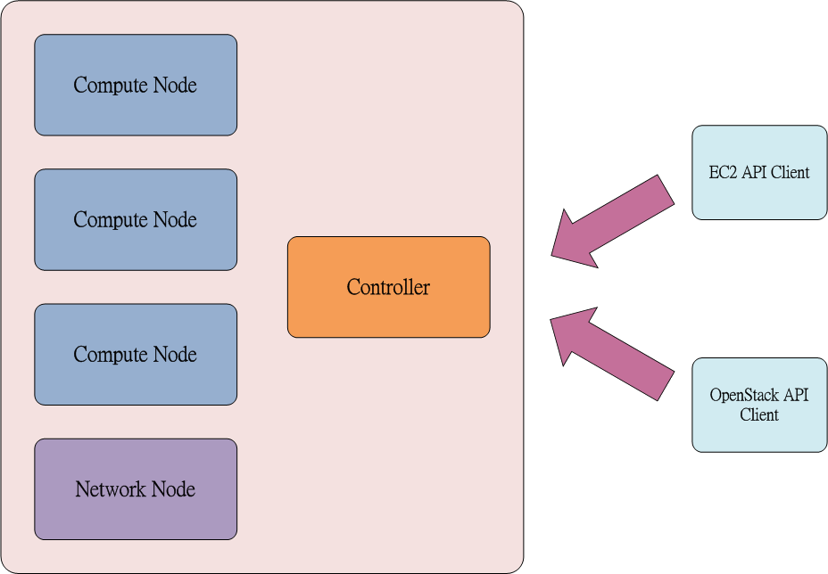
資訊技術服務中心
OpenStack API Client Architecture
140.113.98.2

Slide 4
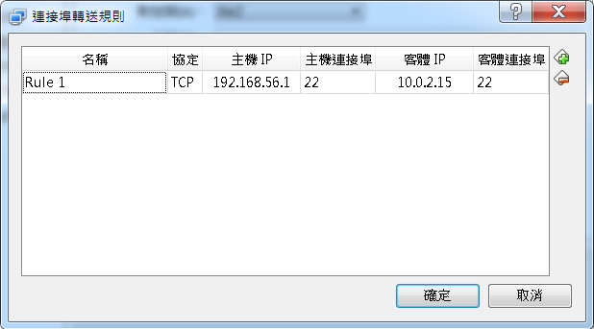
資訊技術服務中心
Install the OpenStack Clients
Virtual Box
Import Ubuntu 12.04 Image from Hard Disk
Check PC Room PC IP address
Config Port Forwarding

Slide 5
資訊技術服務中心
Install the OpenStack Clients
Install ssh in API Client
#sudo api-get install ssh
Use ssh connect to API client by 22 port
openstacklab / nctuopenstack
Install aptitude
#sudo apt-get install aptitude
Install pip(Python Package Index)
#sudo aptitude install python-pip
Install Nova-API Client
#sudo pip install python-novaclient

Slide 6
資訊技術服務中心
Install the OpenStack Clients
Install or update the client packages
sudo pip install [--update] python-<project>client
nova -> Compute API
quantum ->Networking API
keystone -> Identity service API
glance -> Image service API
swift -> Object storage API
cinder -> Block storage API
Install,upgrade,uninstall Nova-API Client
#sudo pip install python-novaclient
#sudo pip install --upgrade python-novaclient
#sudo pip uninstall python-novaclient

Slide 7
資訊技術服務中心
Install the OpenStack Clients
下載OpenStack RC file
上傳RC file到API Client
變更檔案執行權限
#sudo chmod +x rc_filename.sh
載入環境變數
#sudo source rc_filename.sh
輸入密碼
測試
#nova image-list

Slide 8
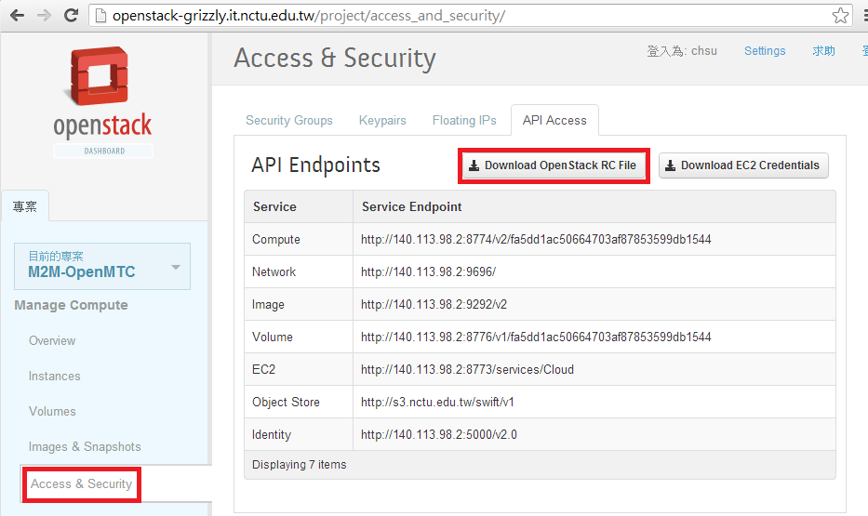
資訊技術服務中心
Install the OpenStack Clients
下載OpenStack RC file

Slide 9
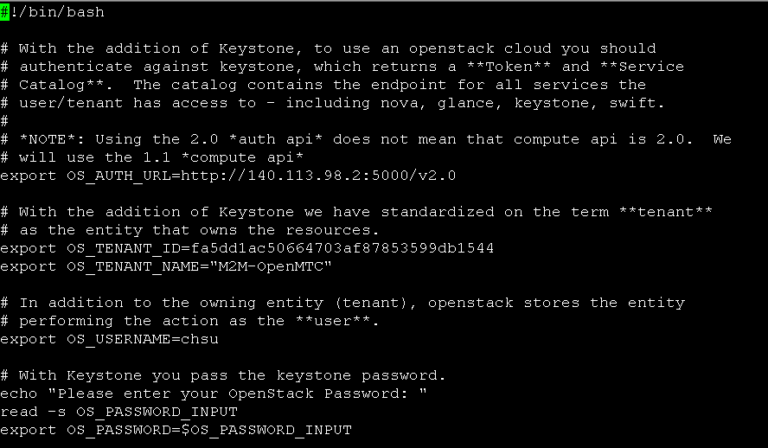
資訊技術服務中心
Install the OpenStack Clients

Slide 10
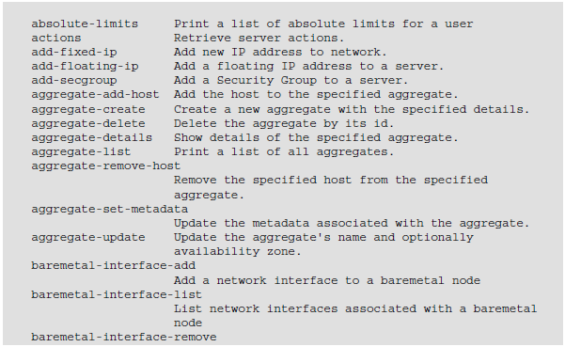
資訊技術服務中心
Command List for nova Client
#nova help
#nova help <subcommand>

Slide 11
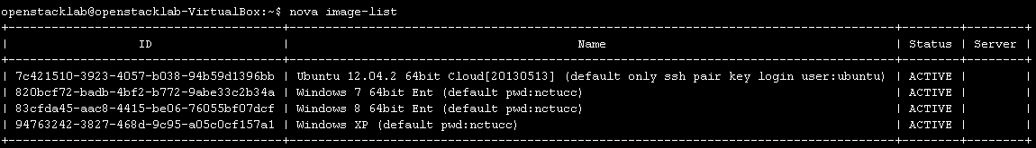
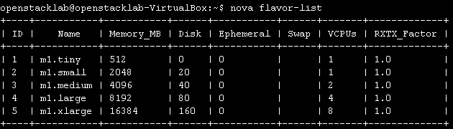
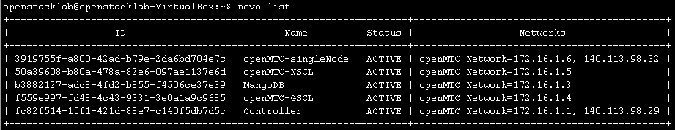
資訊技術服務中心
NOVA API Client
List Instances, Images, and Flavors
#nova image-list
#nova flavor-list
#nova list

Slide 12
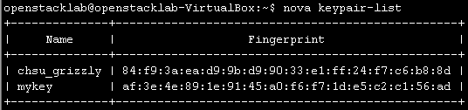
資訊技術服務中心
NOVA API Client – Key Pair
Creating New Keys
#nova keypair-add mykey > mykey.pem
List Key Pair
#nova keypair-list

Slide 13
Security Group

Slide 14
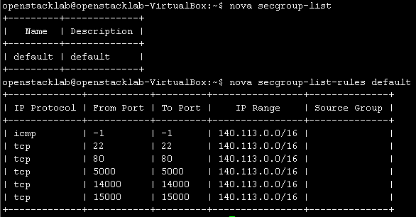
資訊技術服務中心
NOVA API Client – Security Group
Manage Security Groups
#nova secgroup-list
#nova secgroup-list-rules default

Slide 15
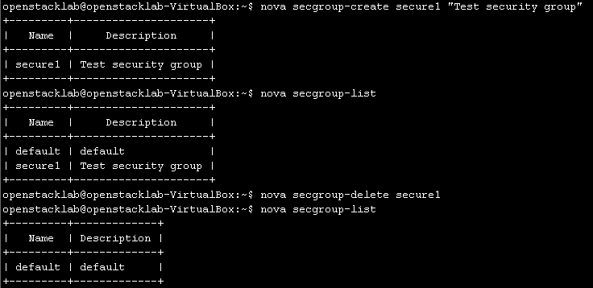
資訊技術服務中心
NOVA API Client – Security Group
Add or delete a security group
#nova secgroup-create secure1 "Test security group"
#nova secgroup-delete secure1

Slide 16
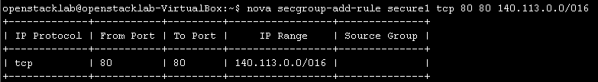
資訊技術服務中心
NOVA API Client – Security Group
Modify security group rules
#nova secgroup-add-rule secure1 tcp 80 80 140.113.0.0/16
#nova secgroup-add-rule secure1 icmp -1 -1 140.113.0.0/16
#nova secgroup-delete-rule secure1 tcp 80 80 140.113.0.0/16

Slide 17
資訊技術服務中心
NOVA API Client – Security Group
Add security group to instances
nova add-secgroup testapi secure1

Slide 18
Instances

Slide 19
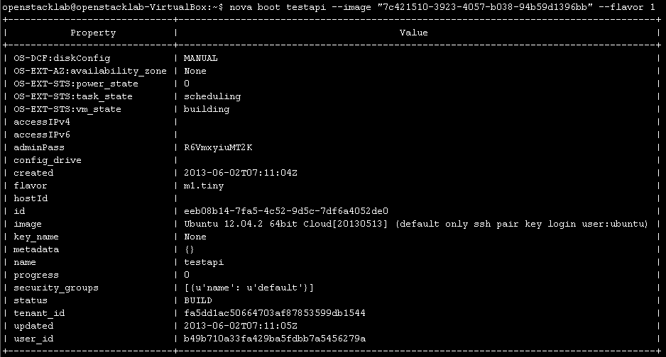
資訊技術服務中心
NOVA API Client - Launch an Instance
Launch an Instance – without ssh-key
#nova boot testapi --image "7c421510-3923-4057-b038-94b59d1396bb" --flavor 1

Slide 20
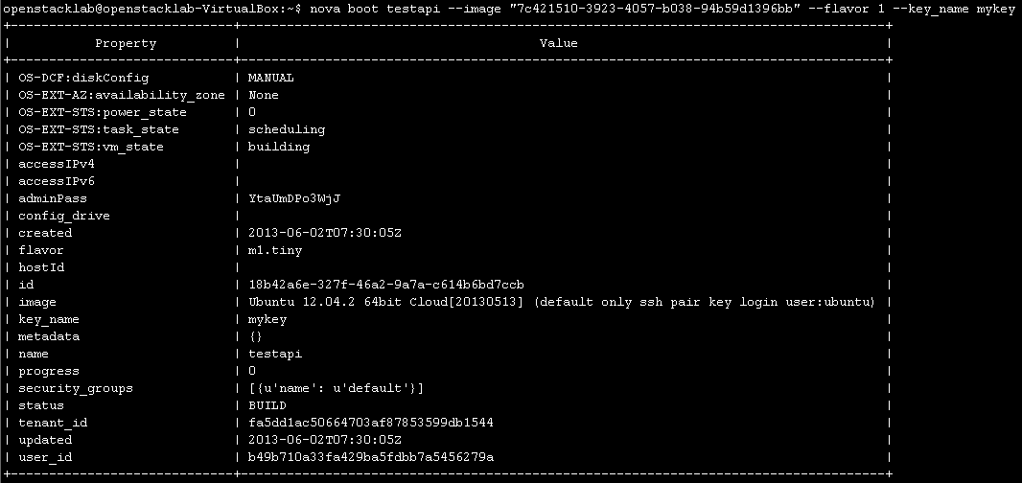
資訊技術服務中心
NOVA API Client - Launch an Instance
Launch an Instance – with ssh-key
#nova boot testapi --image "7c421510-3923-4057-b038-94b59d1396bb" --flavor 1 --key_name mykey

Slide 21
資訊技術服務中心
NOVA API Client - Launch an Instance
Launch an Instance with security group
#nova boot testapi --image "7c421510-3923-4057-b038-94b59d1396bb" --flavor 1
--key_name mykey --security-groups secure1

Slide 22
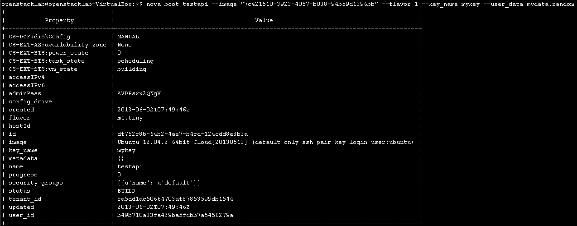
資訊技術服務中心
NOVA API Client - Launch an Instance
Launch an Instance – with user_data
#nova boot testapi --image "7c421510-3923-4057-b038-94b59d1396bb" --flavor 1 --key_name mykey
--user_data mydata.random

Slide 23
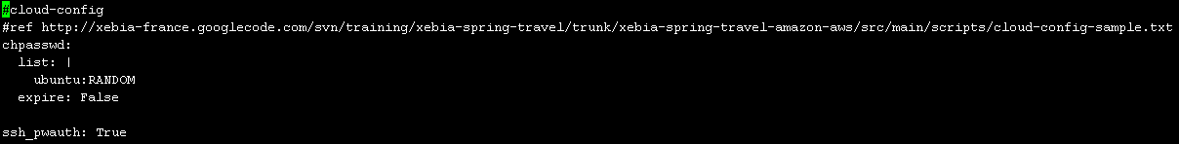
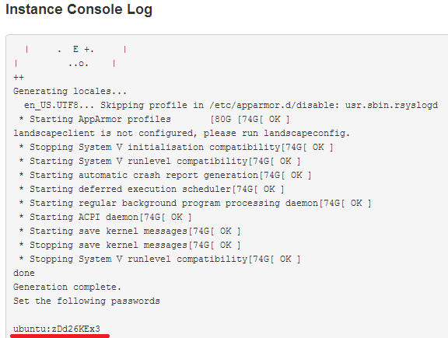
資訊技術服務中心
NOVA API Client – User_Data
mydata.random

Slide 24
資訊技術服務中心
NOVA API Client – Instance
Stop and Start an Instance
#nova pause / nova unpause <instance Name or ID>
#nova suspend / nova resume <instance Name or ID>

Slide 25
資訊技術服務中心
NOVA API Client - Instance
Reboot 、Terminate an Instance
#nova reboot <instance Name or ID>
#nova delete <instance Name or ID>

Slide 26
Floating IPs

Slide 27
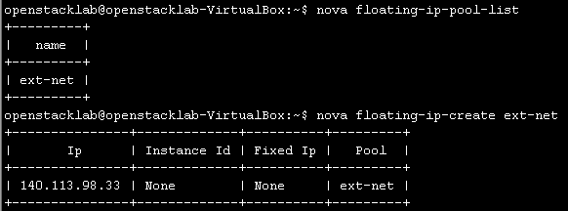
資訊技術服務中心
NOVA API Client
Manage Floating IP Addresses
#nova floating-ip-pool-list
#nova floating-ip-create ext-net
# nova floating-ip-delete 140.113.98.33

Slide 28
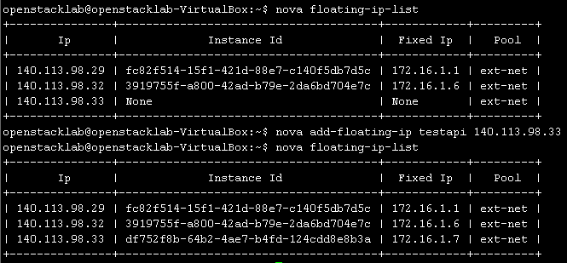
資訊技術服務中心
NOVA API Client
Manage Floating IP Addresses
#nova add-floating-ip testapi 140.113.98.33
#nova floating-ip-list
#nova remove-floating-ip <server> <address>
Notes:
<number>

Slide 29
Usage Statistics

Slide 30
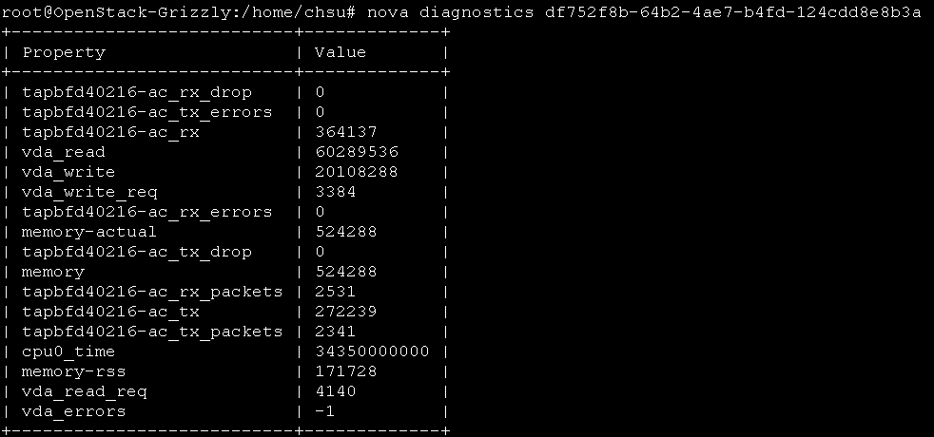
資訊技術服務中心
NOVA API Client – Instance Usage
# nova diagnostics <server Name or ID>
Notes:
<number>

Slide 31
Glance API Client

Slide 32
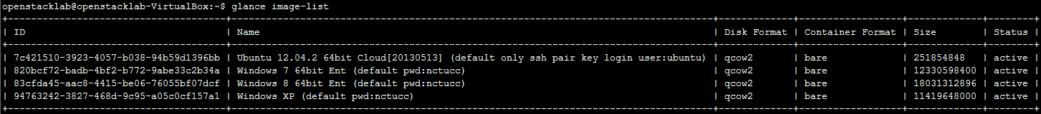
資訊技術服務中心
Glance API Client - List Images
Install Glance API Client
# sudo pip install python-glanceclient
List Images
#glance image-list

Slide 33
資訊技術服務中心
Glance API Client - Add a New Image
Download the test image
http://cloud-images.ubuntu.com/precise/current/precise-server-cloudimg-amd64-disk1.img
Upload an image to glance
#glance image-create --name StudentID-image --disk-format=qcow2 --container-format=bare --is-public=True --file precise-server-cloudimg-amd64-disk1.img
#glance image-create --name StudentID-image --disk-format=qcow2 --container-format=bare --is-public=True --copy-from http://cloud-images.ubuntu.com/precise/current/precise-server-cloudimg-amd64-disk1.img

Slide 34
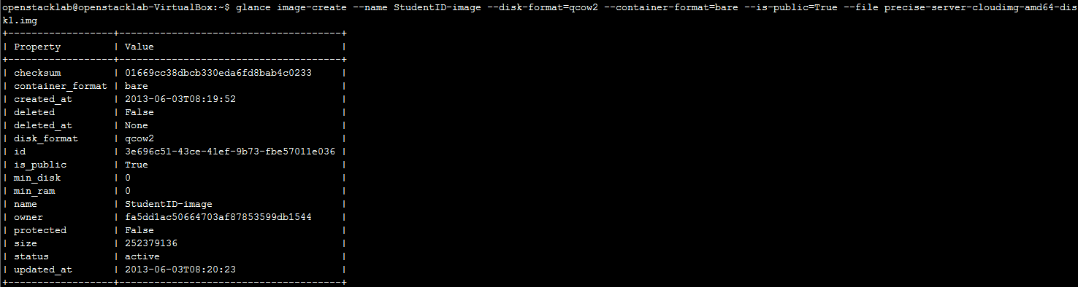
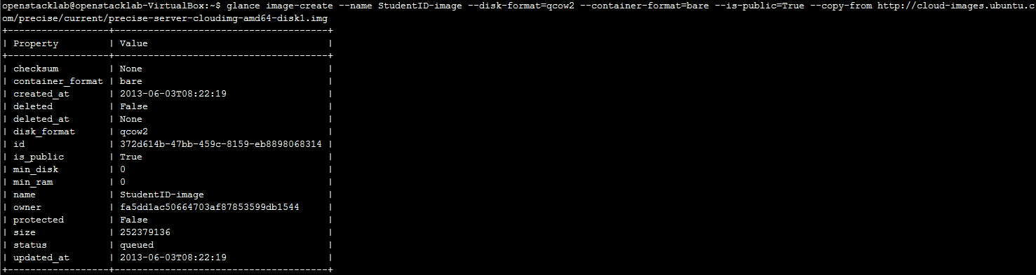
資訊技術服務中心
Glance API Client - Add a New Image
Image is a local file
Image from Internet

Slide 35
資訊技術服務中心
Glance API Client - Add a New Image
Download the test image
http://cloud-images.ubuntu.com/precise/current/precise-server-cloudimg-amd64-disk1.img
Upload an image to glance
#glance image-create --name StudentID-image --disk-format=qcow2 --container-format=bare --is-public=True --file precise-server-cloudimg-amd64-disk1.img
#glance image-create --name StudentID-image --disk-format=qcow2 --container-format=bare --is-public=True --copy-from http://cloud-images.ubuntu.com/precise/current/precise-server-cloudimg-amd64-disk1.img

Slide 36
http://docs.openstack.org/cli/quick-start/content/authenticate.html

