Slide 1
Cassandra

Slide 2
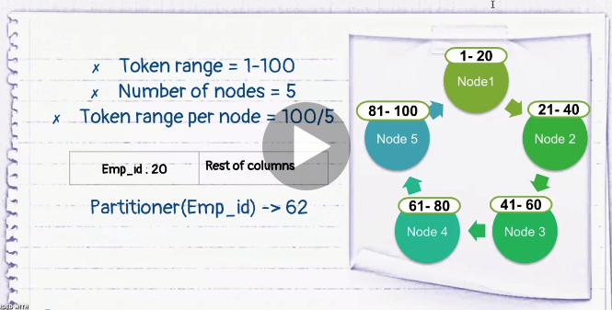

Slide 3
