Slide 1
OBE Implementation
Module-1:University Setting
Submitted By
TEAM VIRTUAL THINKERS
Lokeshwar Reddy Otikunda [AP23110011150]
Sri Akshaya Kodali [AP23110011163 ]
Sumana Sree Karani [AP23110011203 ]
Mehrosh Sultana [AP23110011212 ]
Phani Sree Ramidi [AP23110011213]
CSE-Q | III | BTECH

Slide 2
Introduction to Project
For SRM-AP's OBE implementation, We are assigned a task “University Setting” that uses efficient sorting and searching algorithms. In this project we will implement a fast sorting algorithm like Merge Sort and compare it with Quick Sort. We will use Linear Search for data searching and compare it with Binary search. By analyzing and displaying the time complexity of both sets of algorithms, we will demonstrate how the custom algorithms offer better performance.

Slide 3
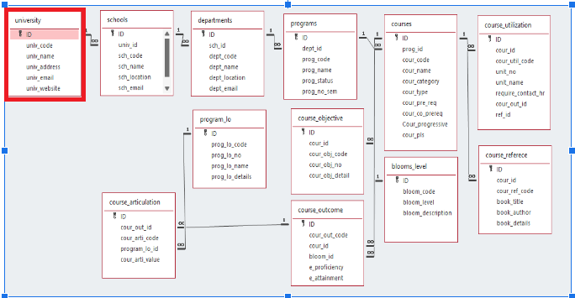
Architecture Diagram[*highlight your module as shown]

Slide 4
Module Description : University Setting
In this Module , users are allowed to create, update, retrieve, delete, sort, and search university records.
It stores university details (id,code, name, address, email, website) in a text file for persistence.
This module supports searching and sorting based on university code,name and email
Simple file-based operations ensure easy management of university information.
Additionally we provide the pseudo codes and time complexity analysis of sorting and searching algorithms, comparison of those algorithms with existing algorithms.

Slide 5
University Setting:Field/table details
Field Name | Data type
id | integer
univ_code | String
univ_name | String
univ_address | String
univ_email | String
univ_website | String

Slide 6
University Setting:Programming Details
File name:OBE_VirtualThinkers_university_PhaniSree
Function/method name
Create:VirtualThinkers_university_create
Update:VirtualThinkers_university_update
Retrieve:VirtualThinkers_university_retrive
Delete:VirtualThinkers_university_delete
Sorting:VirtualThinkers_university_MergeSort
Searching:VirtualThinkers_university_LinearSearch
Storing:VirtualThinkers_university_storing

Slide 7
University Setting:Programming Details
Comparison(both searching and Sorting):
For Searching- VirtualThinkers_university_Compare_Search
For Sorting- VirtualThinkers_university_Compare_sorting
Time Complexity(both searching and Sorting):
For Searching-VirtualThinkers_university_complexity_Search
For Sorting-VirtualThinkers_university_compexity_Sorting

Slide 8
University Setting:Programming Details
Algorithm Details(pseudocode or steps)(both searching and Sorting):
For Searching-VirtualThinkers_university_Search_details
For Sorting- VirtualThinkers_university_Sort_details
File name(for storing the details)
File name to be used is:-university_setting .txt

Slide 9
University : Sorting Algorithm used
Sorting Algorithm Name:Merge Sort It recursively divides an array into two halves, sorts each half, and then merges the sorted sub arrays into a single sorted array. Merge Sort follows Divide and Conquer method
Steps: 1. Divide the array into two halves. 2. Sort each half recursively. 3. Merge the two sorted sub arrays into a sorted whole.
Algorithm: Input: An unsorted list of data
Output: A sorted list of data in ascending order

Slide 10
University : Comparison of Sorting Algorithm
Sorting Algorithm Name:Quick Sort It follows Divide and Conquer method.It works by recursively partitioning an array around a pivot, placing elements smaller than the pivot on its left and elements greater than the pivot on its right.
Steps:
1.Choose a Pivot.
2. Partition the array around the pivot, placing smaller elements to its left and larger elements to its right.
3. Recursively Sort the left and right partitions.
Algorithm: Input: An unsorted list of data
Output: A sorted list of data in ascending order

Slide 11
University : Time Complexity of Sorting Algorithm
Sl.No | Algorithm Name | Time Complexity Compared Algorithm Time Complexity
1. | Merge sort | 1.Best case:O(nlog n) Quick sort 1.Best case:O(nlog n) 2.Average case:O(nlog n) 2.Average case:O(nlog n) 3.Worst case:O(nlog n) 3.Worst case:O(n^2)

Slide 12
University : Searching Algorithm used
Algorithm Name: Linear search
Linear Search follows an iterative approach. It iterates through the whole list of data and check whether our required element is there in list or not
Steps:
1.Compares if the current element equals the search element
2. If matches, it return position or index of the element.
3. Otherwise if not found in list returns (-1)NULL to show element not found
Algorithm: Input: List of data, search element Output: index or position of search element if found else (-1) for not found---:

Slide 13
University : Comparison of Searching Algorithm
Algorithm used for comparison:Binary search
It works recursively or Iteratively by getting a sorted list as input.It then finds the mid element and check whether our required element is there in list or not
Steps:
1.It then finds the mid element and compares with the element to search and
2. if equal returns the index or position of mid.
3.Other wise checks if search element is greater or less than mid and if greater it performs binary search for 2nd half of list.
4.If less than mid it performs binary search on 1st half of list
Algorithm:
Input: sorted list of data, search element Output: index or position of search element if found else (-1) for not found---:

Slide 14
University : Time Complexity of Searching Algorithm
Sl.No | Algorithm Name | Time Complexity Compared Algorithm Time Complexity
1. | Linear search | 1.Best case:O(1) Binary search 1.Best case:O(1) 2.Average case:O(n) 2.Average case:O(logn) 3.Worst case:O(n) 3.Worst case:O(logn)

Slide 15
Sample Source Code
#include <stdio.h>
#include <string.h>
#include <stdlib.h>
#define MAX_UNIVERSITIES 100
// Structure to handle University details
struct University {
int ID;
char univ_code;
char univ_name[10];
char univ_address[10];
char univ_email[15];
char univ_website[20];
};
//Function Declarations
void VirtualThinkers_university_create(struct University u[], int *count);
void VirtualThinkers_university_update(struct University u[], int count);
void VirtualThinkers_university_retrieve(struct University u[], int *count);
void VirtualThinkers_university_delete(struct University u[], int *count);
void VirtualThinkers_university_MergeSort(struct University u[], int left, int right, int sort_by);
void merge(struct University arr[], int left, int right, int sort_by);
void VirtualThinkers_university_storing(struct University u[], int *count, int mode, int univ_code);
void VirtualThinkers_university_displayMenu();
void VirtualThinkers_university_LinearSearch(struct University u[], int count);

Slide 16
// Function to handle all file operations
void VirtualThinkers_university_storing(struct University u[], int *count, int mode, int ID) {
FILE *file = NULL;
// Writing new university details into the file (create or update)
if (mode == 1) {
file = fopen("university_setting.txt", "w");
if (file == NULL) {
printf("File cannot be opened for writing.\n");
return;
}
for (int i = 0; i < *count; i++) {
fprintf(file, "%d\n%s\n%s\n%s\n%s\n%s\n", u[i].ID,u[i].univ_code, u[i].univ_name,
u[i].univ_address, u[i].univ_email, u[i].univ_website);
}
fclose(file);
printf("University data is saved successfully into the file!\n");
}
// Deleting selected university from the file
else if (mode == 3) {
file = fopen("university_setting.txt", "r");
if (file == NULL) {
printf("The file cannot be opened for reading.\n");
return;
}
struct University temp_u[MAX_UNIVERSITIES];
int temp_count = 0;
int found = 0;

Slide 17
// Reading all universities into a temporary array
while (fscanf(file, "%d\n", &temp_u[temp_count].ID) == 1) {
fscanf(file, “%[^\n]\n”.temp_u[temp_count].univ_code);
fscanf(file, "%[^\n]\n", temp_u[temp_count].univ_name);
fscanf(file, "%[^\n]\n", temp_u[temp_count].univ_address);
fscanf(file, "%[^\n]\n", temp_u[temp_count].univ_email);
fscanf(file, "%[^\n]\n", temp_u[temp_count].univ_website);
if (temp_u[temp_count].ID== ID) {
found = 1; // if university found, mark it as 1
continue;
}
temp_count++;
}
fclose(file);
if (!found) {
printf("University with ID %d is not found.\n", ID);
return;
}
// Updating the list of universities back into the file after deleting a university
*count = temp_count; // Updating count after deletion
file = fopen("university_setting.txt", "w");
if (file == NULL) {
printf("The file cannot be opened for writing.\n");
return;
}

Slide 18
for (int i = 0; i < *count; i++) {
fprintf(file, "%d\n%s\n%s\n%s\n%s\n%s\n",temp_u[i].ID, temp_u[i].univ_code,
temp_u[i].univ_name,temp_u[i].univ_address, temp_u[i].univ_email, temp_u[i].univ_website);
}
fclose(file);
printf("University with ID %d has been deleted successfully.\n", ID);
}
}
// Create new university
void VirtualThinkers_university_create(struct University u[], int *count) {
if (*count >= MAX_UNIVERSITIES) {
printf("Maximum Count Reached! It is not possible to add any more universities.\n");
return;
}
printf("Enter the University ID: ");
scanf("%d", &u[*count].univ_ID);
// Checking for same university ID
for (int i = 0; i < *count; i++) {
if (u[i].ID == u[*count].ID) {
printf("Error: University with ID %d already exists. Please enter a different ID.\n", u[*count].ID);
printf("Enter a unique University ID: ");
scanf("%d", &u[*count].ID);
i = -1;
}
}

Slide 19
printf(“Enter the University Code:”);
Scanf(“%s”,u[*count].univ_code);
printf("Enter the University Name (3-6 characters): ");
while (1) {
scanf(" %[^\n]", u[*count].univ_name);
int len = strlen(u[*count].univ_name);
if (len >= 3 && len <= 6) break;
else printf("Error: The name of the university must consist of 3-6 characters. Please enter again: ");
}
printf("Enter the University Address (3-6 characters): ");
while (1) {
scanf(" %[^\n]", u[*count].univ_address);
int len = strlen(u[*count].univ_address);
if (len >= 3 && len <= 6) break;
else printf("Error: The address of the university must consist of 3-6 characters. Please enter again: ");
}
printf("Enter the University Email (12-13 characters): ");
while (1) {
scanf("%s", u[*count].univ_email);
int len = strlen(u[*count].univ_email);
if (len >= 12 && len <= 13) break;
else printf("Error: The email of the university must consist of 12-13 characters. Please enter again: ");
}
printf("Enter the University Website: ");
scanf("%s", u[*count].univ_website);
(*count)++;
// Storing the new university details into the file (mode 1 for writing)
VirtualThinkers_university_storing(u, count, 1, 0);
printf("University is added and saved successfully!\n");
}

Slide 20
// Update existing university details
void VirtualThinkers_university_update(struct University u[], int count) {
int univ_ID;
int found = 0;
if (count == 0) {
printf("There are no universities available to update.\n");
return;
}
printf("Enter the University ID to update: ");
scanf("%d", &univ_ID);
for (int i = 0; i < count; i++) {
if (u[i].ID== ID) {
found = 1;
printf("Updating the University Details\n");
printf("Enter the New University Code : ");
scanf(" %[^\n]", u[i].univ_code);
printf("Enter the New University Name (3-5 characters): ");
while (1) {
scanf(" %[^\n]", u[i].univ_name);
int len = strlen(u[i].univ_name);
if (len >= 3 && len <= 6) break;
else printf("Error: The name of the university must consist of 3 to 6 characters. Please enter again: ");
}
printf("Enter the New University Address (3-6 characters): ");
while (1) {
scanf(" %[^\n]", u[i].univ_address);
int len = strlen(u[i].univ_address);
if (len >= 3 && len <= 6) break;
else printf("Error: The address of the university must consist of 3 to 6 characters. Please enter again: ");
}
printf("Enter the New University Email (12-13 characters): ");

Slide 21
while (1) {
scanf(" %[^\n]", u[i].univ_email);
int len = strlen(u[i].univ_email);
if (len >= 12 && len <= 13) break;
else printf("Error: The email of the university must consist of 12 to 13 characters. Please enter again: ");
}
printf("Enter the New University Website: ");
scanf(" %[^\n]", u[i].univ_website);
// Storing the updated university details into the file
VirtualThinkers_university_storing(u, &count, 1, 0);
printf("University details are updated and saved successfully!\n");
break;
}
}
if (!found) {
printf("University with ID %d is not found.\n", univ_code);
}
}
// Delete university
void VirtualThinkers_university_delete(struct University u[], int *count) {
int ID;
if (*count == 0) {
printf("There are no universities available to delete.\n");
return;
}
printf("Enter the ID of the university you need to delete: ");
scanf("%d", &ID);

Slide 22
// Loop through to find and delete university
int found = 0;
for (int i = 0; i < *count; i++) {
if (u[i].ID == ID) {
found = 1;
for (int j = i; j < *count - 1; j++) {
u[j] = u[j + 1];
}
(*count)--; // Decrease the count after deletion
break;
}
}
if (!found) {
printf("University with ID %d is not found.\n", ID);
return;
}
// Storing the updated list of universities after deletion
VirtualThinkers_university_storing(u, count, 1, 0);
printf("University with ID %d has been deleted successfully.\n", ID);
}
// Merge Sort function to sort universities based on different criteria
void merge(struct University arr[], int left, int right, int sort_by) {
if (left >= right) return;

Slide 23
int mid = left + (right - left) / 2;
merge(arr, left, mid, sort_by);
merge(arr, mid + 1, right, sort_by);
int n1 = mid - left + 1;
int n2 = right - mid;
struct University L[n1], R[n2];
for (int i = 0; i < n1; i++) L[i] = arr[left + i];
for (int j = 0; j < n2; j++) R[j] = arr[mid + 1 + j];
int i = 0, j = 0, k = left;
while (i < n1 && j < n2) {
int compare = 0;
if (sort_by == 1)
compare = L[i].univ_code - R[j].univ_code;
else if (sort_by == 2)
compare = strcmp(L[i].univ_name, R[j].univ_name);
else if (sort_by == 3)
compare = strcmp(L[i].univ_email, R[j].univ_email);
if (compare <= 0) {
arr[k++] = L[i++];
} else {
arr[k++] = R[j++];
}
}
while (i < n1) arr[k++] = L[i++];
while (j < n2) arr[k++] = R[j++];
}

Slide 24
void VirtualThinkers_university_MergeSort(struct University u[], int left, int right, int sort_by) {
if (left >= right) return;
int mid = left + (right - left) / 2;
VirtualThinkers_university_MergeSort(u, left, mid, sort_by);
VirtualThinkers_university_MergeSort(u, mid + 1, right, sort_by);
merge(u, left, right, sort_by);
}
void VirtualThinkers_university_display(struct University u[], int count) {
if (count == 0) {
printf("No universities available to display.\n");
return;
}
printf("\n\t\t\t\tList of Universities (Sorted)\n\n");
printf("--------------------------------------------------------------------------------------------------\n");
printf("\tCode\t\tName\t\tAddress\t\tEmail\t\tWebsite\n");
printf("--------------------------------------------------------------------------------------------------\n");
for (int i = 0; i < count; i++) {
printf("\t%s\t\t%s\t\t%s\t\t%s\t%s\n", u[i].univ_code, u[i].univ_name, u[i].univ_address, u[i].univ_email, u[i].univ_website);
}
printf("\n");
}
void VirtualThinkers_university_LinearSearch(struct University u[], int count) {
if (count == 0) {
printf("No universities available to search.\n");
return;
}

Slide 25
int search_by;
printf("Select search criteria:\n");
printf("1. Search by Code\n");
printf("2. Search by Name\n");
printf("3. Search by Email\n");
printf("Enter your choice: ");
scanf("%d", &search_by);
int found = 0;
if (search_by == 1) {
char code_to_search[10];
printf("Enter the code of the university to search: ");
scanf(" %[^\n]", code_to_search);
for (int i = 0; i < count; i++) {
if (strcmp(u[i].univ_code, code_to_search) == 0) {
printf("\nUniversity found:\n");
printf("CODE: %s\n", u[i].univ_code);
printf("NAME: %s\n", u[i].univ_name);
printf("ADDRESS: %s\n", u[i].univ_address);
printf("EMAIL: %s\n", u[i].univ_email);
printf("WEBSITE: %s\n", u[i].univ_website);
found = 1;
break;
}
}
} else if (search_by == 2) {
char name_to_search[10];
printf("Enter the name of the university to search: ");
scanf(" %[^\n]", name_to_search);

Slide 26
for (int i = 0; i < count; i++) {
if (strcmp(u[i].univ_name, name_to_search) == 0) {
printf("\nUniversity found:\n");
printf("CODE: %s\n", u[i].univ_code);
printf("NAME: %s\n", u[i].univ_name);
printf("ADDRESS: %s\n", u[i].univ_address);
printf("EMAIL: %s\n", u[i].univ_email);
printf("WEBSITE: %s\n", u[i].univ_website);
found = 1;
break;
}
}
} else if (search_by == 3) {
char email_to_search[15];
printf("Enter the email of the university to search: ");
scanf(" %[^\n]", email_to_search);
for (int i = 0; i < count; i++) {
if (strcmp(u[i].univ_email, email_to_search) == 0) {
printf("\nUniversity found:\n");
printf("CODE: %s\n", u[i].univ_code);
printf("NAME: %s\n", u[i].univ_name);
printf("ADDRESS: %s\n", u[i].univ_address);
printf("EMAIL: %s\n", u[i].univ_email);
printf("WEBSITE: %s\n", u[i].univ_website);
found = 1;
break; } } }
if (!found) {
printf("\nUniversity not found.\n");
}
}

Slide 27
void VirtualThinkers_university_retrieve(struct University u[], int *count) {
FILE *file = fopen("university_setting.txt", "r");
if (file == NULL) {
printf("There are no universities available.\n");
return;
}
*count = 0; // Resetting university count
while (fscanf(file, "%d\n", &u[*count].univ_ID) == 1) {
fscanf(file, "%[^\n]\n", u[*count].univ_name);
fscanf(file, "%[^\n]\n", u[*count].univ_address);
fscanf(file, "%[^\n]\n", u[*count].univ_email);
fscanf(file, "%[^\n]\n", u[*count].univ_website);
(*count)++;
}
fclose(file);
if (*count == 0) {
printf("There are no universities available to display.\n");
return;
}
printf("\n\t\t\t\tList of Universities\n\n");
printf("--------------------------------------------------------------------------------------------------\n");
printf("\tCode\t\tName\t\tAddress\t\tEmail\t\tWebsite\n");
printf("--------------------------------------------------------------------------------------------------\n");
for (int i = 0; i < *count; i++) {
printf("\t%s\t\t%s\t\t%s\t\t%s\t%s\n",u[i].univ_code,u[i].univ_name,u[i].univ_address,u[i].univ_email,u[i].univ_website);
}
printf("\n");
}

Slide 28
void VirtualThinkers_university_Compare_Sorting(){
printf("\nComparision of Merge and Quick Sort\n");
printf("\nMerge Sort\n");
printf("1. Merge sort also follows the divide & conquer approach. it finds a mid element and divides the data continuously into 2 parts till each array has 1 element Then it sorts those sub arrays and merges back into a single array and returns the sorted array.\n");
printf("2. It is a stable sorting algorithm.\n");
printf("3. It works faster in execution due to its recursive calls, there are multiple calls and list is sorted very fast.\n");
printf("4. Space complexity of Merge sort is O(n).\n");
printf("5. Works well on any size of data.\n");
printf("6. It sorts externally.\n");
printf("\n\tQuick Sort\n");
printf("1. QuickSort follows the divide & conquer approach that selects an element as pivot element and divides/ partitions the array / list around the picked pivot element by placing the pivot element in its correct position in the sorted array. The partition or array does not follow any ration only follows the position of pivot element in sorted array.\n");
printf("2. It is an unstable sorting algorithm.\n");
printf("3. Slow in execution due to iterative calls.\n");
printf("4. The space complexity of quicksort is O(log(n)) in the average case, and O(n) in the worst case.\n");
printf("5. It is not efficient for larger set of data.\n");
printf("6. Sorting is done internally.\n\n");
}
void VirtualThinkers_university_Compare_Search(){
printf("\nComparision of Linear and binary Search\n");
printf("\n\tBinary Search\n");
printf("1. needs sorted data as input.\n");
printf("2. Only single dimension arrays/ lists can be used due to divide and conquer approach.\n");

Slide 29
printf("3. Binary Search follows the divide and conquer approach. It divides the array / list into 2 halves from the mid element, then
compares if the mid element is equal to the search element, if yes then return the mid index or position value. Else not equal, it checks if
search element is smaller or greater than mid element. If smaller than mid, then this process is repeated on first half or array / list.
Else the search value greater than mid element, then same process repeated on second half of list / array.\n");
printf("4. Binary search is more efficient for large, ordered lists.\n");
printf("5. Faster in execution as only half of the data is to be checked and only 1 element is checked if same or not.\n");
printf("6. Space complexity of the binary search is O(1).\n");
printf("\n\tLinear Search\n");
printf("1. works the same for sorted and unsorted data.(ie. order of data does not affect the working of algorithm)\n");
printf("2. Multidimensional array can be used as it uses an iterative approach.\n");
printf("3. Linear search also called as the Sequential search follows an iterative approach. It iterates through each element of the list and compares it with the element to be searched. If the search element is found, it returns the position or index of the element. Else not found it returns a value (-1) NULL to show the element is not found.\n");
printf("4. Linear search is better for smaller lists or unordered data.\n");
printf("5. Slower in execution as iteration is done on every element by comparing each element every iteration.\n");
printf("6. Space complexity of the linear search is O(1).\n\n");
}
void VirtualThinkers_university_compexity_Sorting(){
printf("Time Complexity of Sort Algorithms:\n");
printf("\n1. Quick Sort:");
printf("\nBest Case: O(n*log(n))");
printf("\nAverage Case: O(n*log(n))");
printf("\nWorst Case: O(n^2)");
printf("\n2. Merge Sort:");
printf("\nBest Case: O(n log n)");
printf("\nAverage Case: O(n log n)");
printf("\nWorst Case: O(n log n)\n");
}

Slide 30
void VirtualThinkers_university_compexity_Search(){
printf("Time Complexity of Search Algorithms:\n");
printf("\n1. Linear Search:");
printf("\nBest Case: O(1)");
printf("\nAverage Case: O(n)");
printf("\nWorst Case: O(n)");
printf("\n2. Binary Search:");
printf("\nBest Case: O(1)");
printf("\nAverage Case: O(log n)");
printf("\nWorst Case: O(log n)\n");
}
void VirtualThinkers_university_Sort_details() {
printf("\nMerge Sort Algorithm \nDivide and Conquer:\n");
printf("---------------------------------\n");
printf("Merge Sort is a divide and conquer algorithm that recursively divides an array into two halves, sorts each half, and then merges the sorted halves into a single sorted array.");
printf("\nBase Case:\n\tThe array has only 1 or no elements, the array is already sorted. The algorithm stops dividing when it reaches this condition.");
printf("\nRecursive Division:\n");
printf("For an array segment arr[left...right]:\n");
printf("\nFind the middle index: mid = (left + right) / 2.");
printf("\nRecursively apply Merge Sort to the first half: MergeSort(arr, left, mid).");
printf("\nRecursively apply Merge Sort to the second half: MergeSort(arr, mid + 1, right).");
printf("\n\tMerge Step:");
printf("\nAfter both halves are sorted, merge them back together in sorted order:");
printf("\nCreate Temporary Arrays:");
printf("\nCreate two temporary arrays to hold the elements of the left and right halves.");
printf("\nL[] holds elements from arr[left] to arr[mid].");
printf("\nR[] holds elements from arr[mid + 1] to arr[right].");
printf("\nInitialize Pointers:");
printf("\ni will track the current index in L[].");
printf("\nj will track the current index in R[].");
printf("\nk will track the position in the original array where the smallest element should go.");
printf("\nMerge Elements in Sorted Order:");
printf("\nWhile there are elements in both L[] and R[], compare L[i] with R[j]:");

Slide 31
printf("\nIf L[i] is smaller, place L[i] in arr[k] and increment i and k.");
printf("\nIf R[j] is smaller, place R[j] in arr[k] and increment j and k.");
printf("\nCopy Remaining Elements:");
printf("\nIf there are any remaining elements in L[], copy them to arr[k].");
printf("\nIf there are any remaining elements in R[], copy them to arr[k].");
printf("\n\tEnd of Recursive Calls:");
printf("\nThe recursive calls continue until all array segments have been sorted and merged, resulting in a fully sorted array.");
printf("\nSummary of steps:\nDivide the array into two halves.");
printf("\nSort each half recursively.\nMerge the two sorted halves into a sorted whole.");
printf("---------------------------------\n");
printf("\nQuick Sort Algorithm Algorithm\nDivide and Conquer:");
printf("----------------------------------\n");
printf("\nQuick Sort is a divide and conquer algorithm, which recursively partitions an array around a pivot, placing elements smaller than the pivot on its left and elements greater than the pivot on its right");
printf("\nBase Case:\nIf the array segment has zero or one element, it is already sorted. Quick Sort stops dividing when it reaches this base case.");
printf("\nPartition Step:");
printf("\nFor an array segment arr[left...right]:\nChoose a Pivot:");
printf("\nSelect a pivot element from the array. Common choices include:\nThe first element (arr[left]).\nThe last element (arr[right]).\nThe middle element (arr[(left + right) / 2]).");
printf("\nHere, let's assume the pivot is arr[right] (the last element in the segment).");
printf("\nReorder Elements:");
printf("\nInitialize two pointers:\ni starts at left - 1 (just before the first element).\nj traverses from left to right - 1.");
printf("\nFor each element arr[j]:");
printf("\nIf arr[j] is less than or equal to the pivot, increment i and swap arr[i] with arr[j] to move smaller elements to the left of the pivot.");
printf("\n\tPlace the Pivot:");
printf("\nAfter the loop, place the pivot at its correct position by swapping arr[i + 1] with arr[right].");
printf("\nThe pivot is now at index i + 1, with all smaller elements on the left and all greater elements on the right.");
printf("\n\tRecursive Sort:");

Slide 32
printf("\nRecursively apply Quick Sort on the left and right partitions:");
printf("\nQuickSort(arr, left, i) sorts the elements on the left of the pivot.\nQuickSort(arr, i + 2, right) sorts the elements on the right of the pivot.");
printf("\n\tEnd of Recursive Calls:");
printf("\nThe recursive calls continue until all segments have been sorted, resulting in a fully sorted array.");
printf("\nSummary of Steps:");
printf("\nChoose a Pivot.\nPartition the array around the pivot, placing smaller elements to its left and larger elements to its right.");
printf("\nRecursively Sort the left and right partitions.");
printf("----------------------------------\n");
}
void VirtualThinkers_university_Search_details(){
printf("\nLinear Search Algorithm Pseudocode:\n");
printf("-----------------------------------\n");
printf("\nfunction linearSearch(arr, target):");
printf("\n for each element in arr:");
printf("\n if element == target:");
printf("\n return the index of element");
printf("\n return -1 (if target is not found)\n");
printf("-----------------------------------\n\n");
printf("\nBinary Search Algorithm Pseudocode:\n");
printf("------------------------------------\n");
printf("\nfunction binarySearch(arr, target):");
printf("\n low = 0");
printf("\n high = length of arr - 1");
printf("\n while low <= high:");
printf("\n mid = (low + high) / 2");
printf("\n if arr[mid] == target:");
printf("\n return mid");
printf("\n else if arr[mid] < target:");
printf("\n low = mid + 1");
printf("\n else:");
printf("\n high = mid - 1\n");
printf("\n return -1 (if target is not found)\n");
printf("-----------------------------------\n\n");
}

Slide 33
void VirtualThinkers_university_displayMenu() {
printf("**** University Module ********\n");
printf("1. Create New University\n");
printf("2. Update University\n");
printf("3. Retrieve University Details\n");
printf("4. Delete University Details\n");
printf("5. Sort University Details\n");
printf("6. Search University Details\n");
printf("7. Compare Sort Algorithms\n");
printf("8. Compare Search Algorithms\n");
printf("9. Display Time Complexity of Sorting Algorithm\n");
printf("10. Display Time Complexity of Searching Algorithm\n");
printf("11. Display Sort Algorithm Details\n");
printf("12. Display Search Algorithm Details\n");
printf("13. Exit Application\n");
}
int main() {
struct University uni[MAX_UNIVERSITIES];
int count = 0;
int option,sort_by;
do {
VirtualThinkers_university_displayMenu();
printf("Please select an option: ");
scanf("%d", &option);
getchar();
switch (option) {
case 1:
VirtualThinkers_university_create(uni, &count);
break;
case 2:
VirtualThinkers_university_update(uni, count);
break;
case 3:
VirtualThinkers_university_retrieve(uni, &count);
break;

Slide 34
case 4:
VirtualThinkers_university_delete(uni, &count);
break;
case 5:
printf("Choose sort criteria:\n1. Sort by Code\n2. Sort by Name\n3. Sort by Email\n");
scanf("%d", &sort_by);
VirtualThinkers_university_MergeSort(uni, 0, count - 1, sort_by);
printf("Universities sorted successfully.\n");
VirtualThinkers_university_display(uni, count); // Display sorted list
break;
case 6:
VirtualThinkers_university_LinearSearch(uni, count);
break;
case 7:
VirtualThinkers_university_Compare_Sorting( );
break;
case 8:
VirtualThinkers_university_Compare_Search( );
break;
case 9:
VirtualThinkers_university_compexity_Sorting();
break;
case 10:
VirtualThinkers_university_compexity_Search();
break;
case 11:
VirtualThinkers_university_Sort_details();
break;

Slide 35
case 12:
VirtualThinkers_university_Search_details();
break;
case 13:
printf("Exiting application...\n");
break;
default:
printf("Invalid option. Please enter a valid option.\n");
break;
}
} while (option != 13);
return 0;
}

Slide 36


Sample Screen Shots
Creating A New University
Updating A Selected University Details

Slide 37
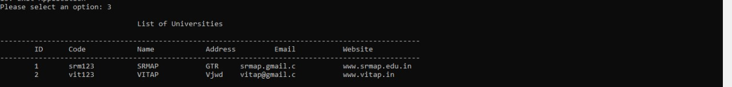
Displaying University Details
Deleting A Selected University

Slide 38
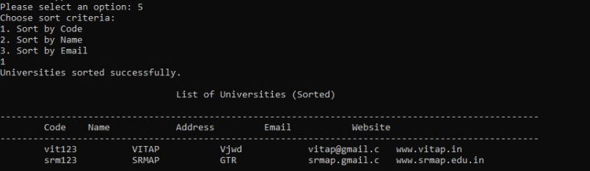

Sorting University Details
Searching University Details

Slide 39
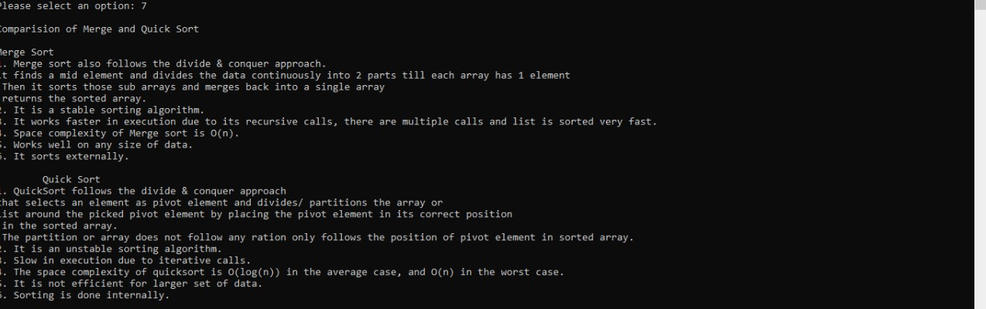
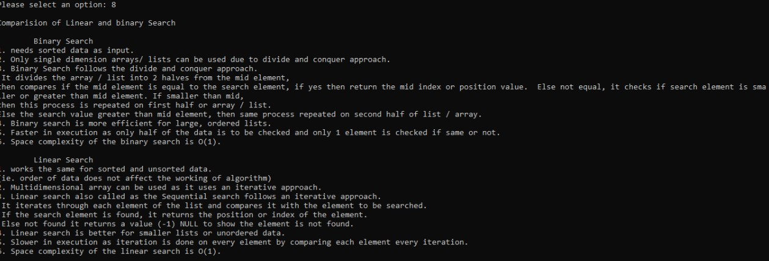
Comparison Of Sorting Algorithms
Comparison Of Searching Algorithms

Slide 40
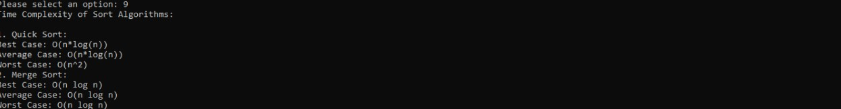
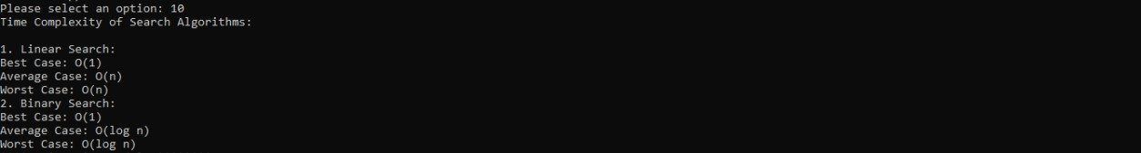
Time Complexities Of Sorting Algorithms
Time Complexities Of Searching Algorithms

Slide 41
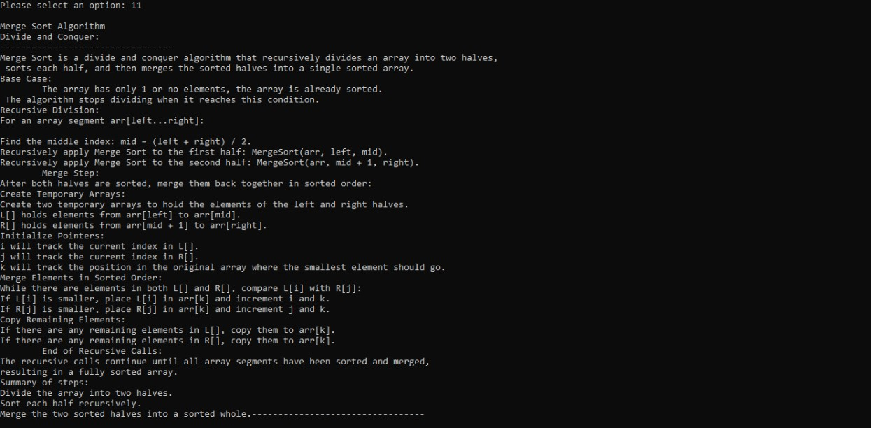
Sorting Algorithm Details

Slide 42
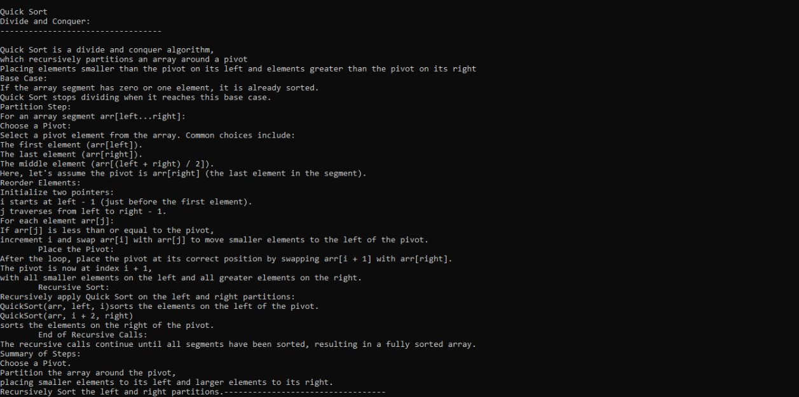
Sorting Algorithm Details

Slide 43
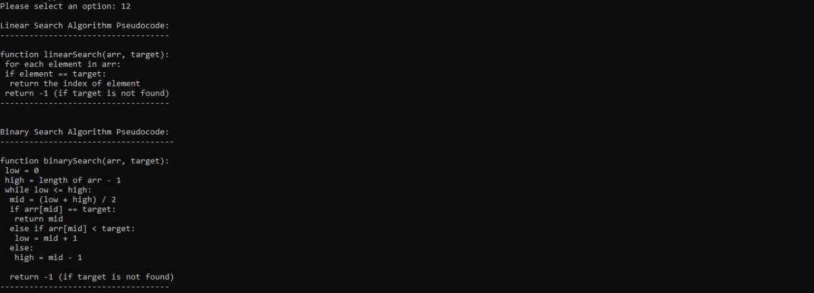
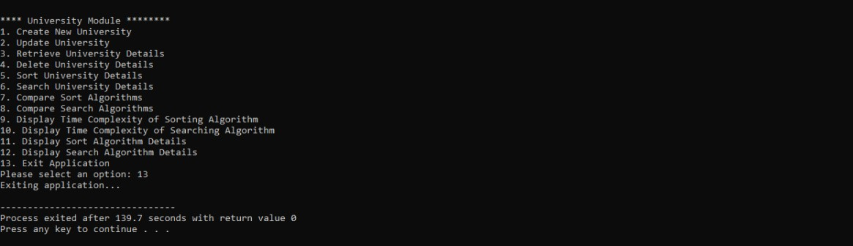
Searching Algorithm Details
Exiting The Menu

Slide 44
Conclusion
This module effectively manages CRUD operations utilizing Merge Sort for sorting and Linear Search for searching. Merge Sort having time complexity of O(n log n) provides stable and efficient sorting,making it suitable for large data sets. For searching, Linear Search having time complexity of O(n) is used as it performs well on both dynamic and unsorted data set. The program also employes functions to display comparsion pseudocode and time complexities of searching and sorting algorithms. The combination of Merge Sort and Linear Search in this module balances simplicity with efficient data handling, making it versatile for moderate data sets.

Slide 45
Thank You

