Slide 1
Onboarding Code Companion: A Vectorized AI Assistant for Private Repositories
Presented By :- Renduchintala Phani Teja (2023DA04339)
Presented To :- Selvaraj K

Slide 2
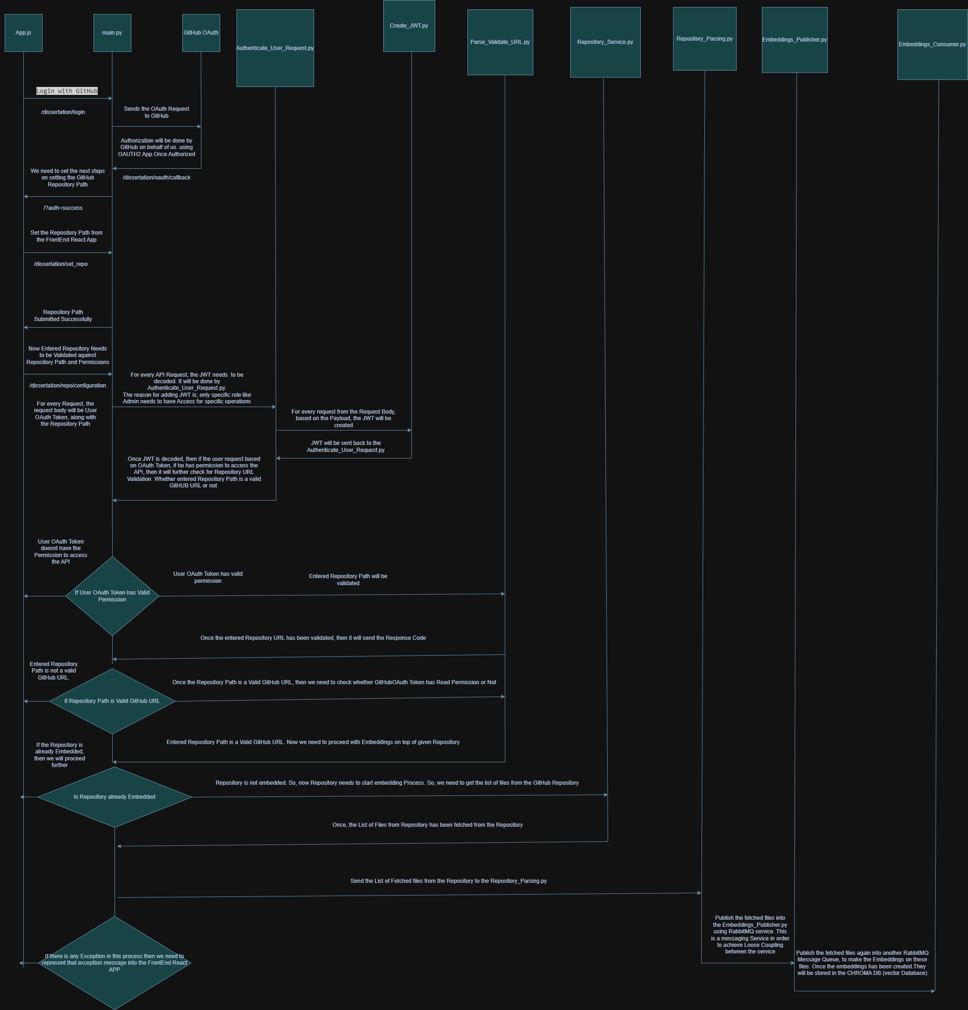
Sequence DIAGRAM

Slide 3
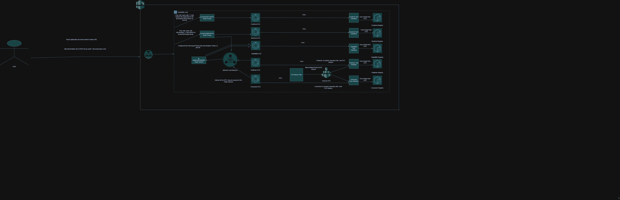
AWS Cloud Deployment

