Slide 1
Cost Minimization in cloud computing with Deadline constraint
Team Details
P Phanindra Varshith(20EG105430)
P Siddartha(20EG105436)
T Abhinav Reddy(20EG105444)
Project Supervisor
Name : E Radha Krishnaiah
Designation: Assistant Professor

Slide 2
Introduction
Cloud computing has emerged as a pivotal paradigm, revolutionizing the way businesses and individuals access and utilize computing resources. In cloud computing environments utilizing a multistage server architecture, a prevalent challenge arises when tasks are queued, and their execution is contingent upon the completion of the initial task in the queue.
In this context, the project titled "Cost Minimization in Cloud Computing with Deadline Constraint," , addresses the crucial challenge of optimizing costs while adhering to specified deadline constraints. DCCM offers security by encrypting data before storing it in the cloud and decrypting it when downloading. The flexibility, scalability, and cost-effectiveness of cloud services make them attractive for a wide range of use cases across industries.

Slide 3
Problem Statement
The resources and services are not provided for free. Cloud computing has attracted more and more attention for its flexibility and economic benefits. To maintain the supply-demand relationship among different participants in cloud computing environment, the exchange of value is the inner drive. From the perspective of cloud service provider, its primary concern is to earn the profit, which can be obtained by finishing the tasks published from customers. In the context of scientific workflows in cloud computing, efficient resource scheduling is crucial for optimizing workflow execution within a budget constrain.

Slide 4
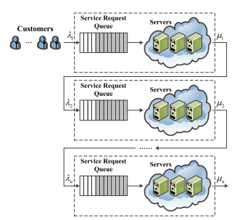
Problem Illustration
Practical swarm optimization is a computational technique inspired by the collective behavior of swarms in nature, such as the movement of bird flocks or ant colonies. However, it has limitations when applied to cloud computing scenarios. PSO does not typically incorporate deadlines into its optimization process. This means that it may not be suitable for applications where tasks must be completed within specific time frames. Practical swarm optimization may not always be cost-effective in cloud computing environments. It may not be able to efficiently allocate resources or minimize costs when compared to other optimization techniques. However, the use of multistage servers in practical swarm optimization can lead to traffic congestion in the server queue, which can result in incomplete tasks or delays in processing. Practical swarm optimization does not inherently provide security measures for data stored in the cloud. This means that additional security measures may be required to protect sensitive information from unauthorized access or data breaches.

Slide 5
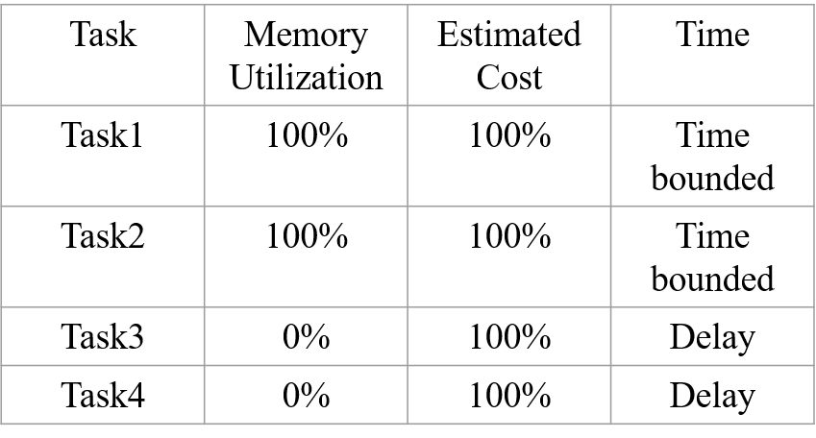
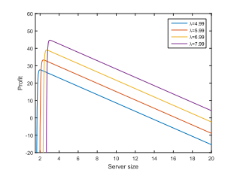
Problem Illustration

Slide 6
Proposed Method
We propose a method for Deadline Constraint Cost Minimization (DCCM) in cloud computing, where users select files for cloud storage and specify task deadlines. These tasks are queued with relevant information such as file size and required computation power. A scheduling algorithm then selects the most suitable virtual machine (VM) based on workload, resource availability, and task requirements, aiming to minimize costs while meeting deadlines. The chosen VM dynamically allocates resources to process tasks efficiently. Prior to storage, files undergo AES encryption for data security, with decryption keys securely generated and delivered to authorized users. This approach ensures effective task management, cost optimization, and robust data security in cloud-based storage systems.

Slide 7
Proposed Method Illustration
User Input: The user selects a file they want to store in the cloud and specifies a deadline for the task.
Task Queuing: The task enters a queue where it awaits processing. Along with the file, the task includes information such as the deadline, size of the file, and the computation power required for processing.
VM Selection: A scheduling algorithm processes tasks from the queue. To minimize costs and meet the deadline constraint, the algorithm evaluates available virtual machines (VMs) based on factors like their current workload, available resources, and compatibility with the task's requirements. The algorithm selects the most suitable VM for the task.

Slide 8


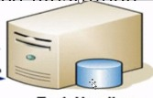

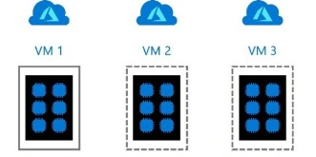



Proposed Method Illustration
Cloud user
Task Queuing
Cloud
Virtual machines
File Download

Slide 9
Proposed Method Illustration
Cost Reduction: The chosen VM helps reduce costs by efficiently utilizing resources. It dynamically allocates CPU, memory, and storage resources as needed to process the task within the specified deadline. Additionally, the algorithm may consider factors like pricing models of cloud providers and resource usage optimization techniques to further minimize costs.
Security Measures: Before storing the file in the cloud, it undergoes AES encryption to ensure data security. AES (Advanced Encryption Standard) is a widely used encryption algorithm known for its strength and efficiency. The file is encrypted using a secret key, which ensures that even if unauthorized parties gain access to the stored data, they cannot decipher it without the key.
Key Generation and Delivery: After encryption, a unique decryption key is generated. This key is necessary to decrypt the content of the file. The key is securely stored and sent to the user via email or another secure communication channel. This ensures that only authorized users with access to the decryption key can retrieve and decrypt the stored file.

Slide 10
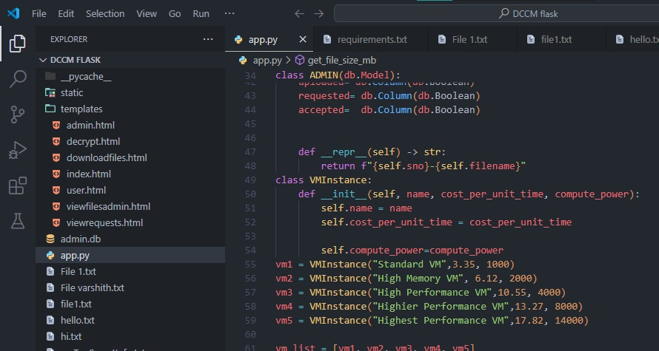
Experiment Environment
In our experimental environment, we utilized Visual Studio Code as our primary development tool. To implement the cloud storage system with enhanced security features, we leveraged Python libraries such as Pyrebase and Cryptography.
Cryptography facilitated AES encryption for securing the stored data.

Slide 11
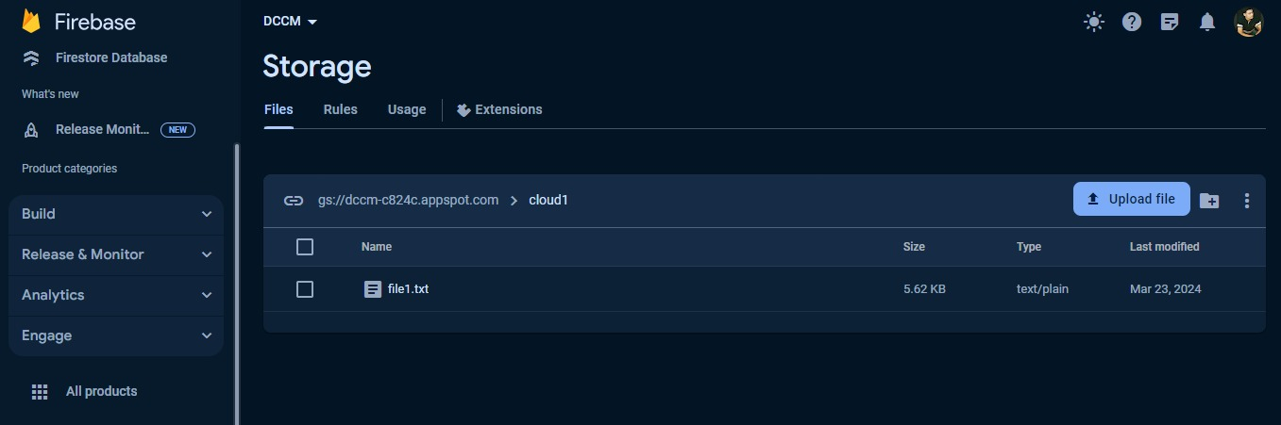
Experiment Environment
Pyrebase provided us with the necessary functionalities for interacting with the Firebase cloud storage service
This combination of tools and libraries enabled us to develop and test a robust cloud storage solution with encryption capabilities within the familiar environment of Visual Studio Code

Slide 12
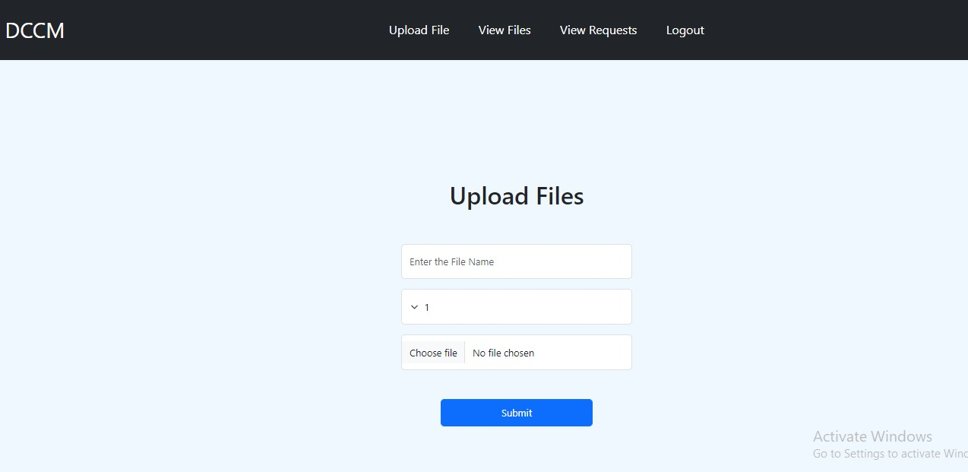
Experiment Screenshots
You have the flexibility to select both the file you wish to upload and the deadline by which it needs to be uploaded.

Slide 13
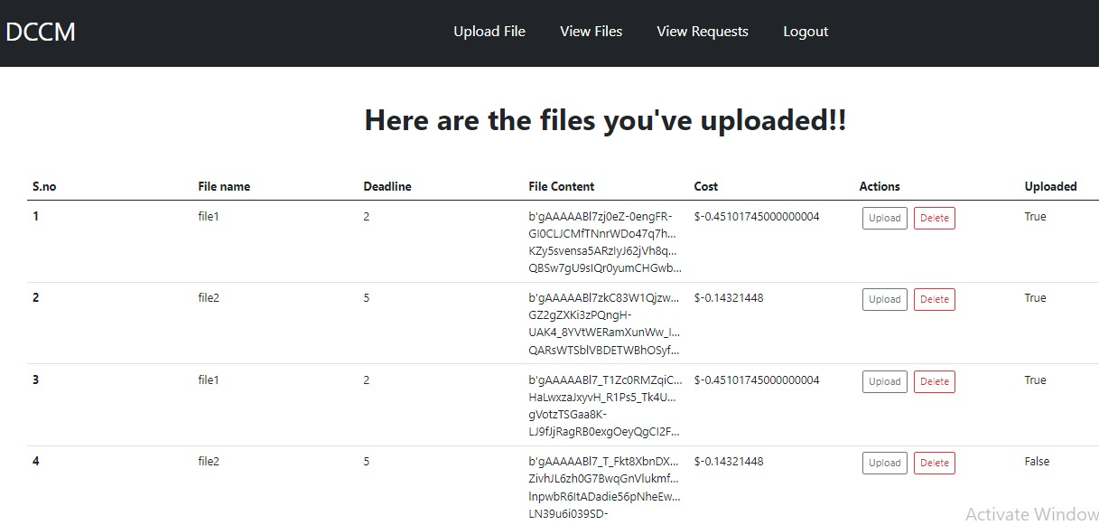
Experiment Screenshots

Slide 14
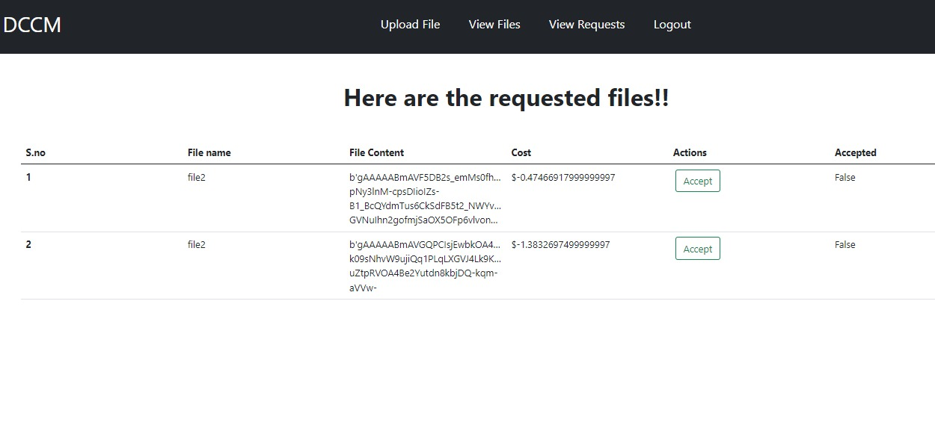
Experiment Screenshots

Slide 15
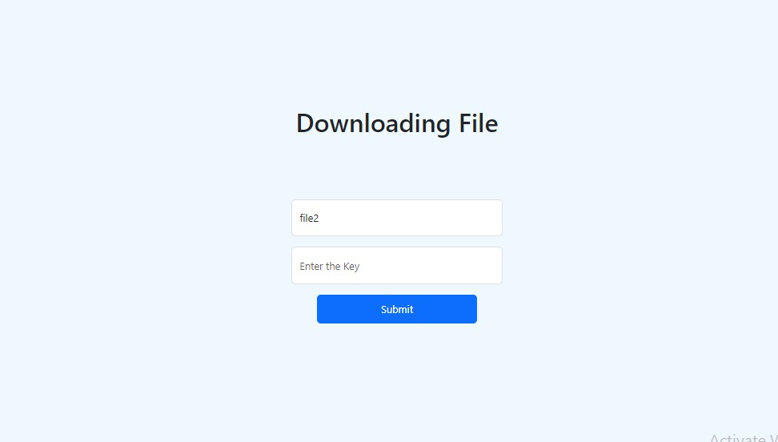
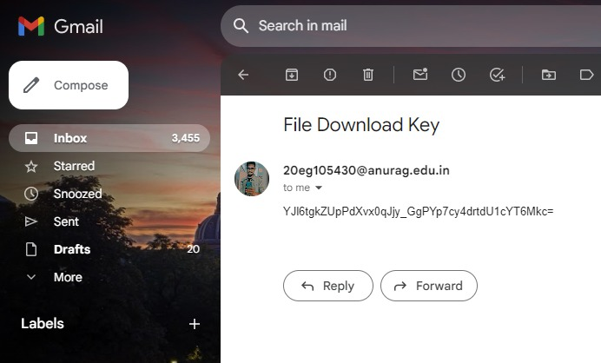
Experiment Screenshots

Slide 16
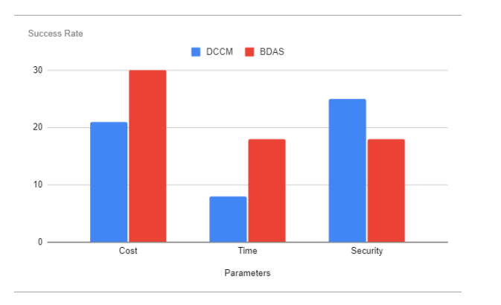
Experiment Results
Experiment Analysis:
File Name: File_1
Deadline: 2
Size of the document: 5kb
Parameters | Existing Method | Proposed Method
Cost | 0.98$ | 0.45$
Time | 12 sec | 2 sec

Slide 17
Experiment Results
The cost of storing files of the same size can vary based on the specified deadlines because the Deadline Constraint Cost Minimization (DCCM) approach selects the most optimal virtual machine (VM) for each file. By choosing a suitable VM, DCCM aims to minimize costs while meeting the specified deadlines. Therefore, different deadlines may result in different VM selections, leading to varying costs for file storage.
Tasks | Deadline | Memory Utilization | Estimated Cost | Time
Task1 | 1 | 100% | 0.56$ | On Time
Task1 | 3 | 100% | 0.26$ | On Time
Task2 | 5 | 100% | 0.47$ | On Time
Task2 | 2 | 100% | 1.38$ | On Time

Slide 18
Finding
Users benefit from the proposed method by being able to securely store their valuable data at a reduced cost. Through the implementation of robust security measures and optimized resource allocation, users can trust that their data remains protected while enjoying cost savings.
The project excels in expediting both the upload and download processes for files. Users experience minimal delays when transferring data to and from the cloud storage system, enhancing overall efficiency and user satisfaction.
The proposed method autonomously selects the most suitable virtual machine for each task. This strategic VM selection not only ensures timely task completion but also contributes to cost reduction by maximizing resource utilization.
In comparison to existing methods, the proposed approach stands out for its ability to deliver cost savings without compromising on security. Users benefit from a cost-effective solution that offers enhanced data protection, positioning the proposed method as a superior alternative in the realm of cloud storage solutions.

Slide 19
Justification
Parameters
Cost Minimization (reducing cost) and Time consumption(data transfer time)
Formulas
Cost = (file_size * vm_cost) + 1 / (deadline * 0.99)
Time Consumption = DTij = Mti / βvm
Where Mti is the data size of ti and βvm is the available band width of the VM.
In what way the parameters are improved
1.Cost Ratio: Cost ratio is defined as the total monetary cost and the cost of the cheapest
workflow schedule.
2.Time Consumption: Deadlines are assigned to a selected document which consumes
the time to store it in the cloud.

