Slide 1


Stock Price Prediction
Group 1
Name: Phan Lam Thanh Du
Student ID: 21522832

Slide 2
1. Introduction
2. Data Preprocessing
Content
3. Model Architecture
4. Performance Evaluation
5. Conclusion

Slide 3

01
Introduction

Slide 4

1. Introduction
Stock price prediction is a field at the intersection of finance and data science. It involves the use of historical market data and analytical techniques to predict the future movement of stock prices.

Slide 5

1. Introduction
Dataset: Amazon Stock Price (All Time) from 1997 to 2021

Slide 6
1. Introduction
Model:
Long Short Term Memory(LSTM)
Optimizer: Adam(SGD)
Loss Function: Mean Squared Error(MSE)

Slide 7
02
Data Preprocessing

Slide 8
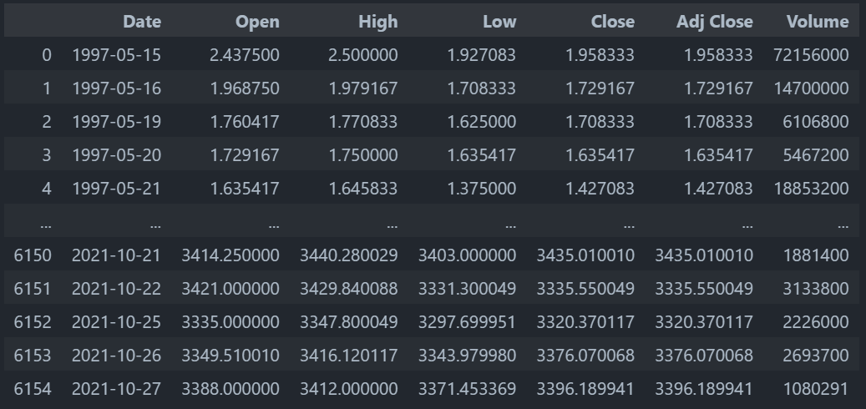
2. Data Preprocessing
Original dataset:

Slide 9
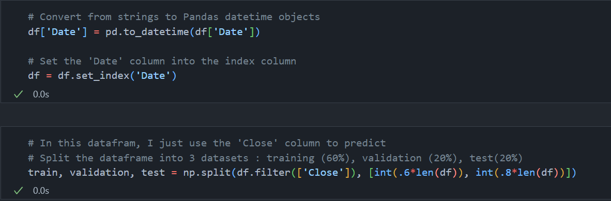
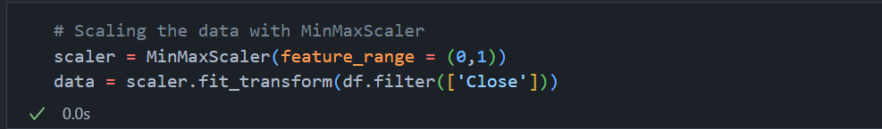
2. Data Preprocessing
Modify the dataset:
Normalize the dataset:

Slide 10
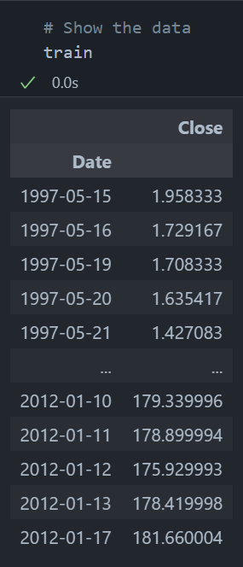
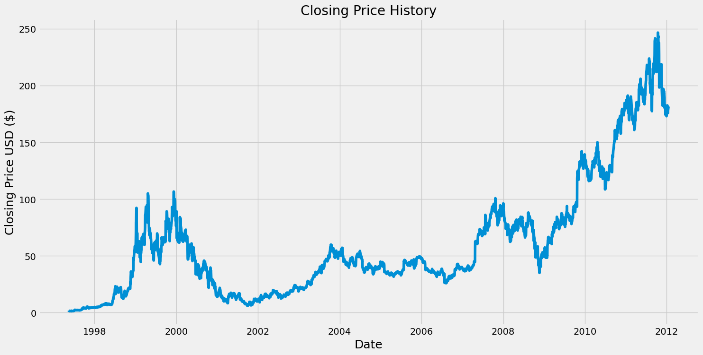
2. Data Preprocessing

Slide 11
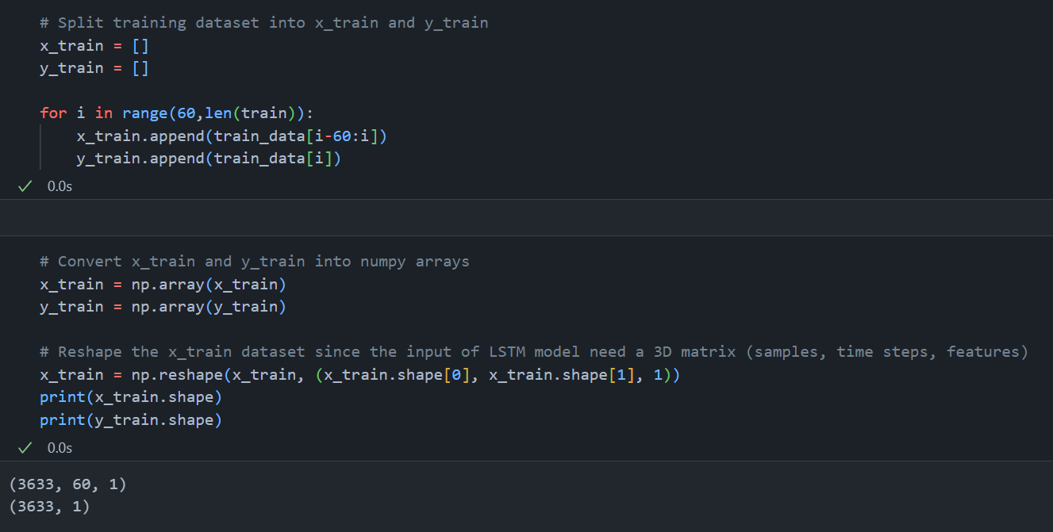
2. Data Preprocessing

Slide 12
2. Data Preprocessing
Predict the stock price of the 61st day
60 days

Slide 13
03
Model Architecture

Slide 14
3. Model Architecture
LSTM Layer
LSTM Layer
Dense Layer
Dense Layer
Input
Output
(Tanh, Sigmoid)
(Tanh, Sigmoid)
(Linear)
(Linear)
Model

Slide 15
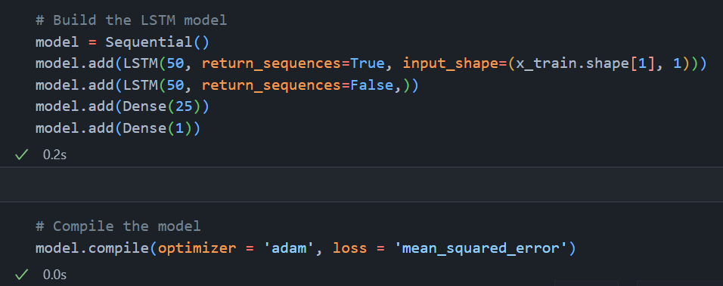
3. Model Architecture
Build the model:

Slide 16
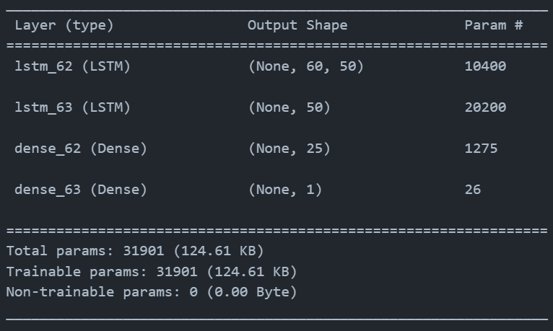
3. Model Architecture
Summary of the model:

Slide 17
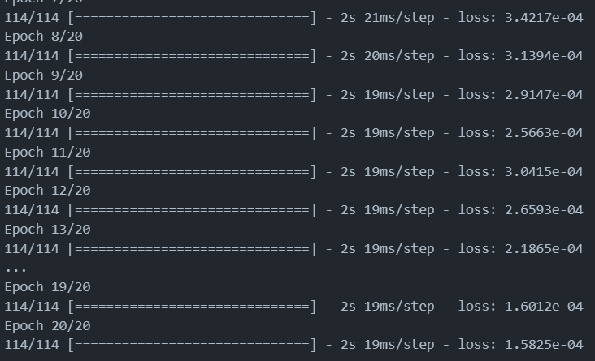
3. Model Architecture
Training the model:
Batch_size = 32
Epoch = 20

Slide 18
04
Performance Evaluation

Slide 19
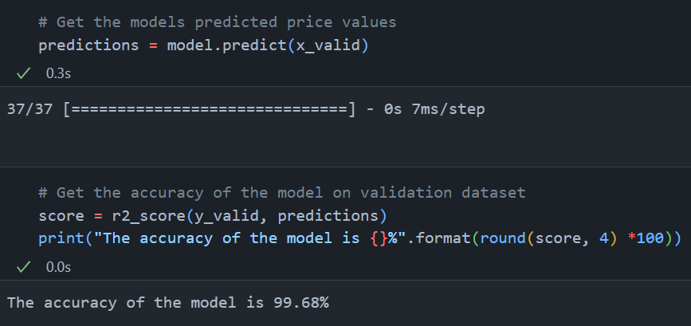
4. Performance Evaluation
Validate the model:

Slide 20
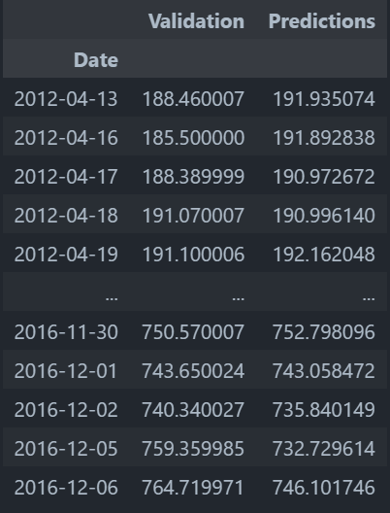
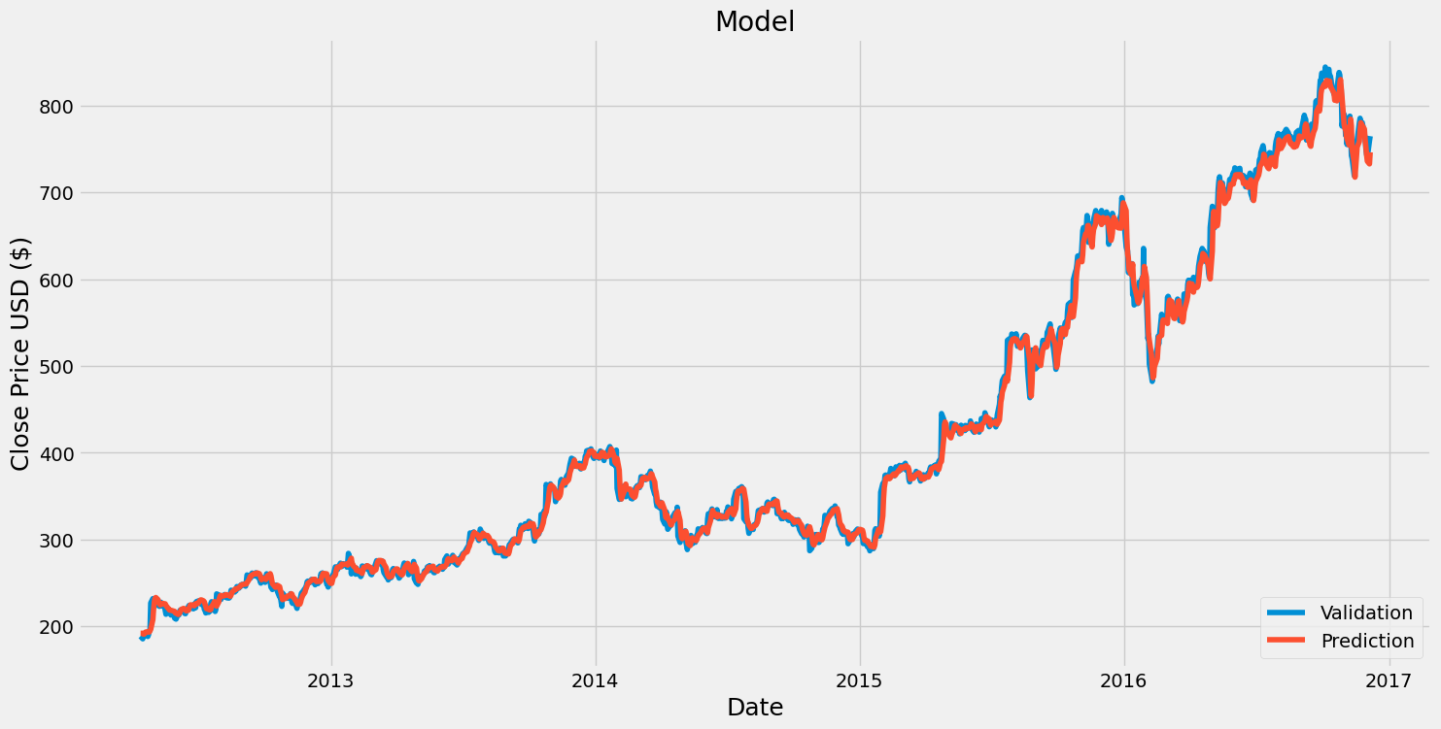
4. Performance Evaluation
Validate the model:

Slide 21
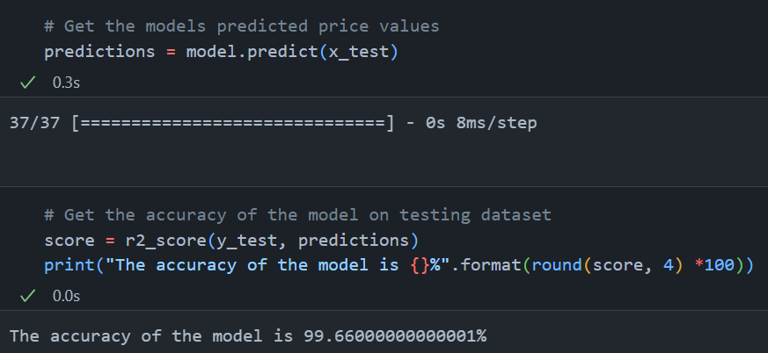
4. Performance Evaluation
Test the model:

Slide 22
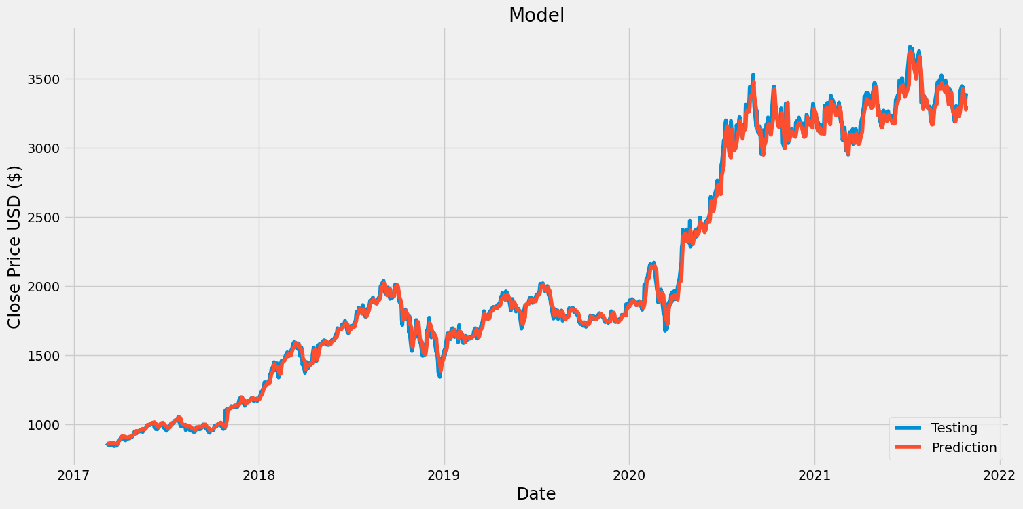
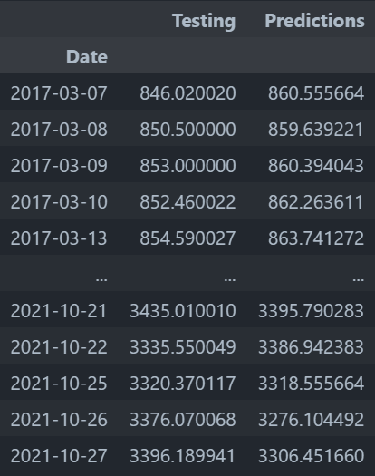
4. Performance Evaluation
Test the model:

Slide 23
05
Conclusion

Slide 24
5. Conclusion
The LSTM model predicting the close stock price Amazon has:
4 layers (2 LSTM, 2 Dense)
31901 parameters
Testing loss : 99.66%
The model could apply effectively on the financial field.

Slide 25
Thanks for listening

