Slide 1
Software testing
Software testing
Ton Duc Thang University

Slide 2
Group member
Xuan Son
Duy Khanh
ThanhTrung
Truc Quyen
Group member
Xuan Son
Duy Khanh
ThanhTrung
Truc Quyen

Slide 3
Table Of Contents
01
Test case & test requirement
02
Group work
03
Pre - condition
Table Of Contents
01
Test case & test requirement
Test case and test requirement for 3 apps : Facebook, CellphoneS and Vietjets
02
Group work
Describe the specific mission each team member
03
Pre - condition
Some prerequisites to run automated script

Slide 4
01
Test case & Test requirement
01
Test case & Test
requirement

Slide 5
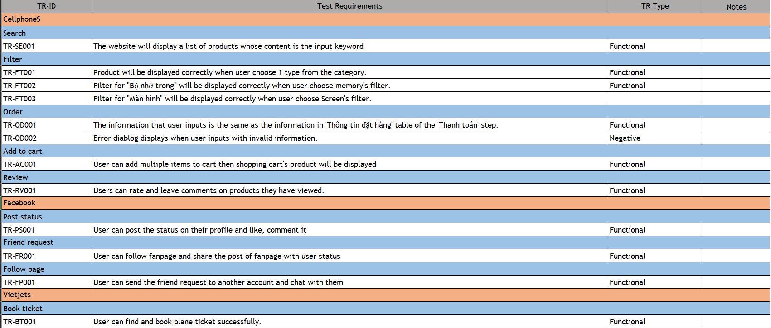
Test case & test requirement
Test case & test requirement

Slide 6
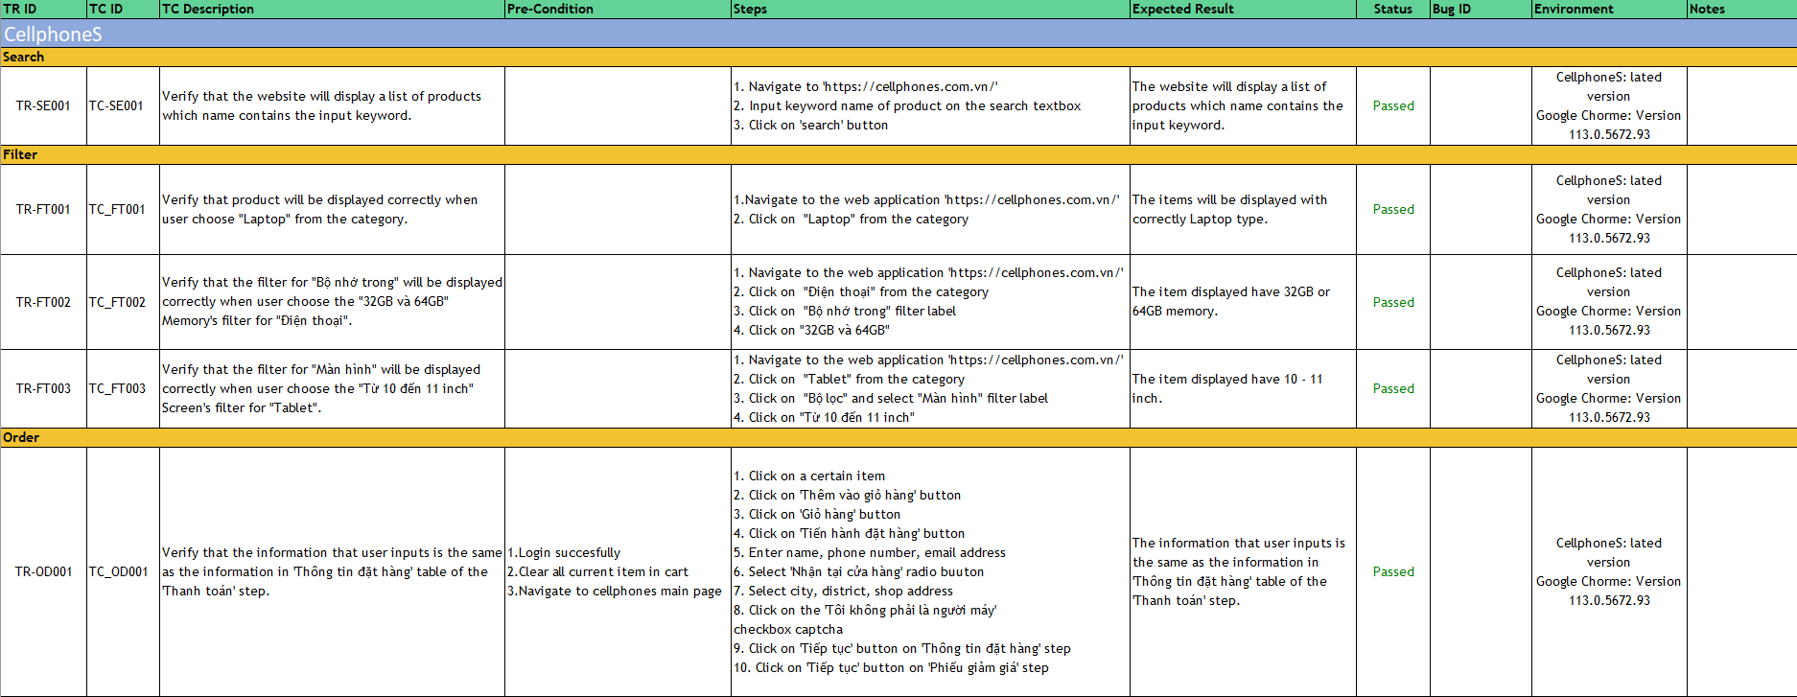
Test case & test requirement
Test case & test requirement

Slide 7
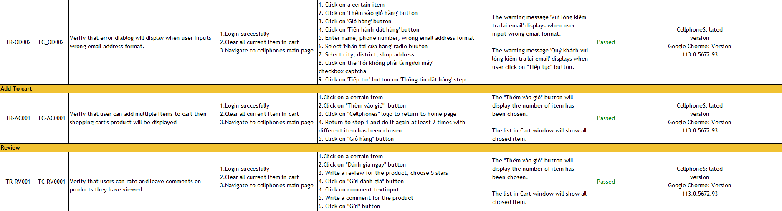
Test case & test requirement
Test case & test requirement

Slide 8
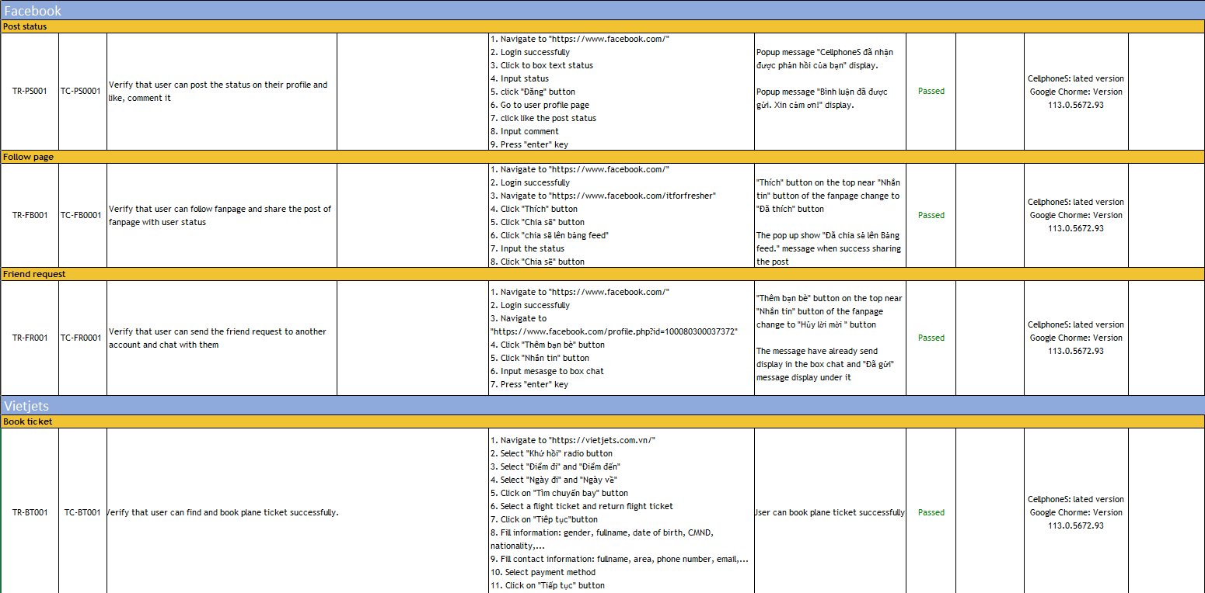
Test case & test requirement
Test case & test requirement

Slide 9
02
Group work
02
Group work

Slide 10
Group work
Group work
Xuan Son
Duy Khanh
Xuan Son
Duy Khanh
StudentID: 519H0228 Task: - Test case “Add to Cart” (CellphoneS) - Test case “Review” (CellphoneS)
- Merge Project
StudentID: 519H0178 Task: - Test case “Search” (CellphoneS) - Test case “Post status”, “Follow page”, “Friend request” (Facebook)
ThanhTrung
Truc Quyen
ThanhTrung
Truc Quyen
StudentID: 519H0249 Task: - Test case “Filter” for Category, Memory, Screen (CellphoneS)
StudentID: 519H0224 Task: -Test case “Order” (CellphoneS) -Test case “Book ticket” (Vietjets)

Slide 11
03
Pre - Condition
03
Pre - Condition

Slide 12
Pre - Condition
Pre - Condition
Before running the project, we must follow the setting below:
We must set up your display scale 100%.
We must open the browser full screen.
We must navigate to https://cellphones.com.vn/ for the first time to surf running.
If you see a captcha (order, login), please click it manually. We just have 12s to verify it.

Slide 13
Thanks!
Thanks!

