Slide 1
BI8 STUDENT MANAGEMENT
Basic Database
Dr.Tran Hoang Ha
Group 4
Phan Mạnh Tùng
Trương Quốc Khánh
Phạm Việt Minh Đức
Nguyễn Trí Huân

Slide 2
Problem statement & Requirements
Tables & Examples
Table Diagram
Demo
Q&A

Slide 3
Problem statement
Student’s information
Performance on examination
Requirements
Student attributes
Classes
Examination information
Absences
Scores

Slide 4
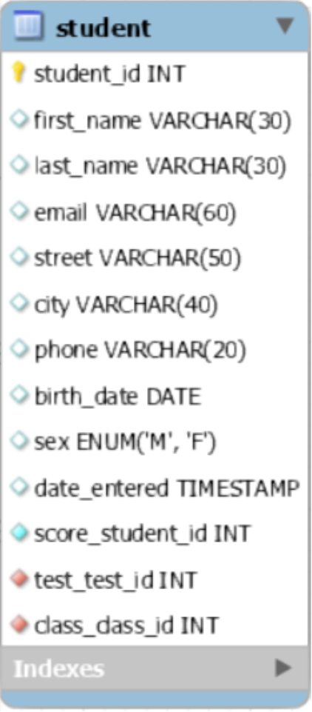
Table: Student
Student ID
Student name
Email address
Date of birth
Sex
...

Slide 5
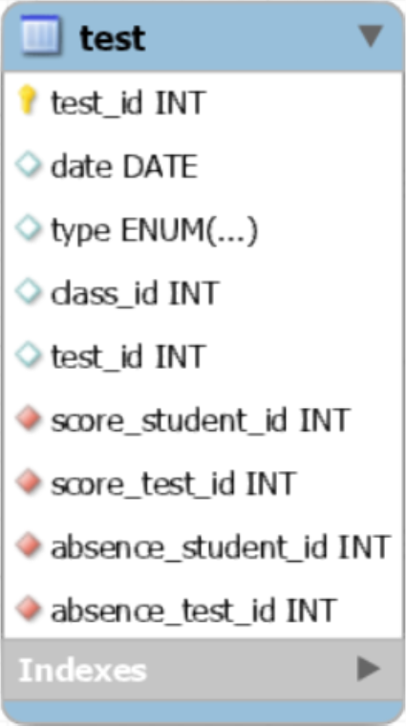
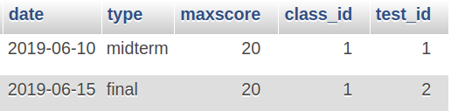
Table: Test
Date
Type (midterm, final)
Test ID
Class ID

Slide 6
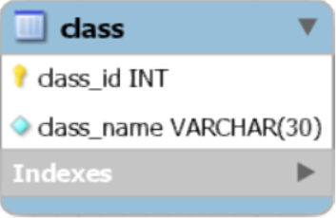
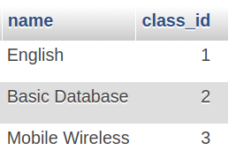
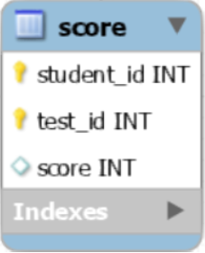
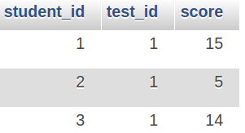
Table: Class & Score

Slide 7
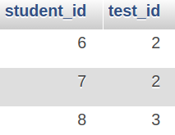
Table: Absence
Record the absence of students in certain examinations

Slide 8
Table Diagram

Slide 9
Demo
List all attributes of students were born in 1999
List all students come from Hanoi
List full name and test score of Moblie Wireless Communication examination, order by score descendingly
List all tests and calculations on scores
List absent students on certain tests
Count number of class
Count number of absences for tests
Count how many people absent for each individual test
Count number of tests students have already taken
Illustrate the performance of Le Nhu Chu Hiep

Slide 10
Thank you for listening! Any question???

