Slide 1

CODE SEARCH
Written by Alexander Neubeck and Ben St. John
Group 9____Presenter Trần Quốc Lập
Nguyễn Hoàng Long
Nguyễn Duy Minh
Phạm Quang Minh

Slide 2
CONTENTS
DIRECTORY
The Code
Search UI
Why a Separate Web Tool?
Impact of Scale on Design
Google’s Implementation
Trade-offs: Codebase size VS Responsiveness

Slide 3
The Code Search UI

Slide 4
The Code Search UI
Code Search is a tool for browsing and searching code at Google that consists of a frontend UI and various backend elements.
Like many of the development tools at Google, it arose directly out of a need to scale to the size of the codebase.
Googlers use it as part of their developer workflows
We chose to develop a separate web tool for code searching, and examine how it addresses the challenges of searching and browsing code at Google repository scale.

Slide 5
The Code Search UI
A tool for searching code at Google
Like the Unix Grep command with relevance ranking and some code-specific enhancements s like proper syntax highlighting, scope awareness, and awareness of comments and string literals.
The search box is a central element of the Code Search UI and like Web search.

✴
When viewing a single file :
+ quickly navigate to related information: người viết, lỗi ID, các phiên bản của đoạn code, xem code ngay cả khi đã xóa,…
Search is also available from the command line and can be incorporated into other tools via a Remote Procedure Call (RPC) API.

Slide 6
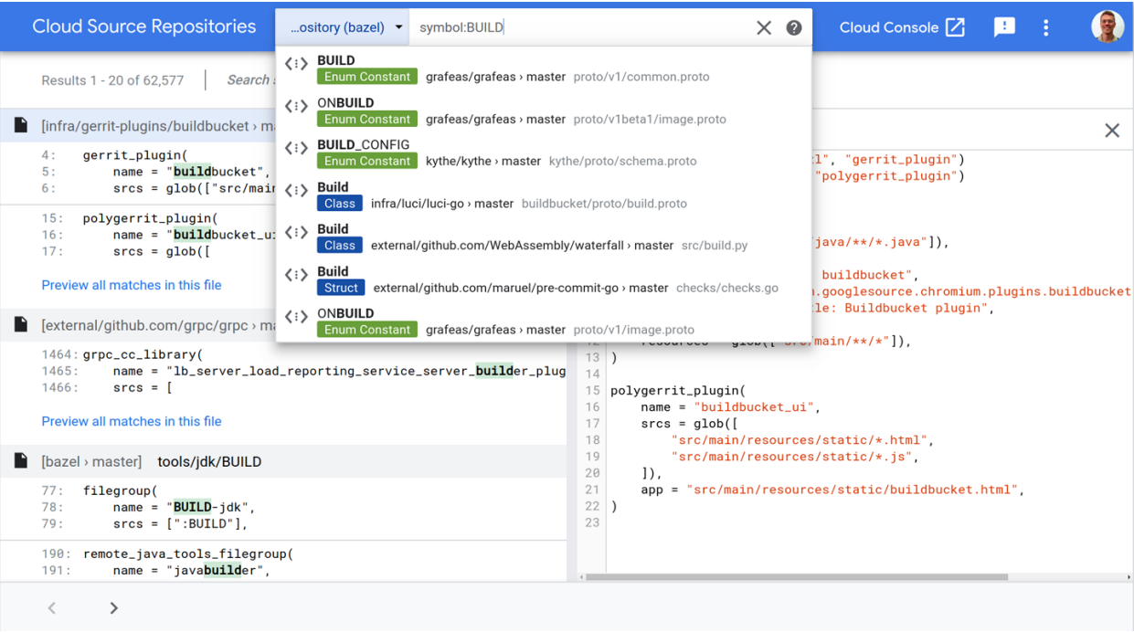
The Code Search UI

Slide 7
Why use Code Search?
Something similar have already been done somewhere
Prevent duplicate code productivity loss for developers
Using Code Search to read the source, to better understand code before
making a change, or to be able to understand someone else’s change.
Precisely answered with either search queries or by following semantic links

Slide 8
Why use Code Search?
How others have done something: see how the API should be applied to a particular problem, ..
Used to find the proper library for specific problems in the first place
Try to answer the question of why a certain piece of code was added, or why it behaves in a certain way. Such questions often arise during debugging.
Same history panel can also be very useful in finding the best person to ask about the code

Slide 9
Why a Separate Web Tool?
Impact of Scale on Design

Slide 10
TEACHING GOAL
Scale
The cost of building local search and cross-reference indices for each developer is too expensive. So one-off searcher can become painfully slow.
01
The GG codebase is so large that a local copy of the full codebase doesn’t fit on a single machine.
02
03
When a code change is submitted, only the actual files touched need to be reindexed, which allows parallel and independent updates to the global index.
The discrepancy between the instant search index and the daily cross-reference index is a source of rare but recurring issues for users.
04

Slide 11
Why a Separate Web Tool?
30%
13%
21%
11%
8%



⇩

Zero Setup Global Code View
It is very easy to find relevant libraries to reuse, and good examples to copy.
It is also very easy and fast to learn about code, wherever it occurs, which improves developer efficiency

Slide 12
Why a Separate Web Tool?
Specialization
The user experience (UX) can be optimized for browsing and understanding code, rather than editing it.
Code Search is not an IDE.
$7.8 M
$ 3.5 M
vs
45,678
45,678
45,678
45,678
45,678
45,678

Slide 13
Impact of Scale on Design
The biggest scaling challenge for searching code is the corpus size.
Search Query Latency

PROFESSIONAL
Conveniently procrastinate
With about 100,000 queries per day (corresponding to less than 5,000 developers), just the one-second latency argument is something of a break-even point.

The engineers of GG process much more than one million search queries from developers within Code Search perday.
✴

CREATIVE
Conveniently procrastinate
PROTIVE
Convenientlyprocrastinate
To make search this effective, additional information about the search context can be provided to the search backend.
A UI is considered responsive if latencies are below 200ms

Slide 14
TEACHING PREPARATION
Index Latency
Most of the time, developers wont notice when indices are out of date.
When new files, functions, or classes are added, not being able to find them is frustrating, and breaks the normal workflow for developers used to perfect cross-referencing.
During an incident, a discrepancy between the index and the running code can be especially problematic because it can hide real causes or introduce irrelevant distractions.

Slide 15
Google’s Implementation

Slide 16


Google’s Implementation
Search Index
Search Index
02. ORGANIC
n-gram solution
more than 500 times more efficient than the brute-force solution
With n-gram schemes, both the number of inverse indices and their size can be reduced at the expense of a larger index

Slide 17
Google’s Implementation
Ranking
find the correct one
the higher the score
the better the result

Slide 18
Google’s Implementation
QUERY INDEPENDENT SIGNALS
Some of the most important query independent signals are the number of file views and the amount of references to a file.
File views are important because they indicate which files developers consider important and are therefore more likely to want to find.

Slide 19
Google’s Implementation
QUERY DEPENDENT SIGNALS
Query independent signals can be computed offline, so computational cost isn't a major concern, although it can be high.

Slide 20
Google’s Implementation
RETRIEVAL
01
RESULT DIVERSITY
Before a document can be scored, candidates that are likely to match the search query are found. This phase is called retrieval. Because it is not practical to retrieve all documents, but only retrieved documents can be scored, retrieval and scoring must work well together to find the most relevant documents.
Another aspect of search is diversity of results, meaning trying to give the best results in multiple categories.
02
03
04

Slide 21
Trade-offs: Codebase size
VS Responsiveness

Slide 22
Trade-offs: Codebase size VS Responsiveness
Skip some contents in the result?
Large codebase
01
02
03
04
Slower queries
Expensive indexing
More noise result
Slower queries
Expensive indexing
More noise result

Slide 23
Trade-offs: Codebase size VS Responsiveness
Skip some contents in the result?
Yes, but with caution
Skip non-text files
unreadable-by-human files

Slide 24
Trade-offs: Codebase size VS Responsiveness
All vs Most relevant result?
Search Word
Example: Perform a global search and replace?
-> Need all results, but sacrifice with high cost.
Question: Should rank and give top results?
Yes, give top results in typical search
give all results if requested

Slide 25
Trade-offs: Codebase size VS Responsiveness
Head vs Branches vs All history?
Version control: efficiently deal with obsolete code
Perform Code Search on all history
Help even finding deleted code
unsubmitted changes
But increase cost drastically

Slide 26
Trade-offs: Codebase size VS Responsiveness
Token vs Substring vs Regex?
Step 1: Deal with:
function() VS function(x)
NewClass VS new_class VS newclass
searching VS searched
Problem: many use cases are extremely difficult to realize efficiently with token-base index
Step 2: Perform full substring search
Problem: compromise index size VS search latency VS resource consumption
vs

Slide 27
Trade-offs: Codebase size VS Responsiveness
Conclusion
40%
20%
Codesearch are tremendous maintaining and developing code
scaling size of codebase
guaranteeing productivity of developers
50%

Slide 28
THANK YOU
Trần Quốc Lập
Nguyễn Hoàng Long
Nguyễn Duy Minh
Phạm Quang Minh
Presenter

