Slide 1
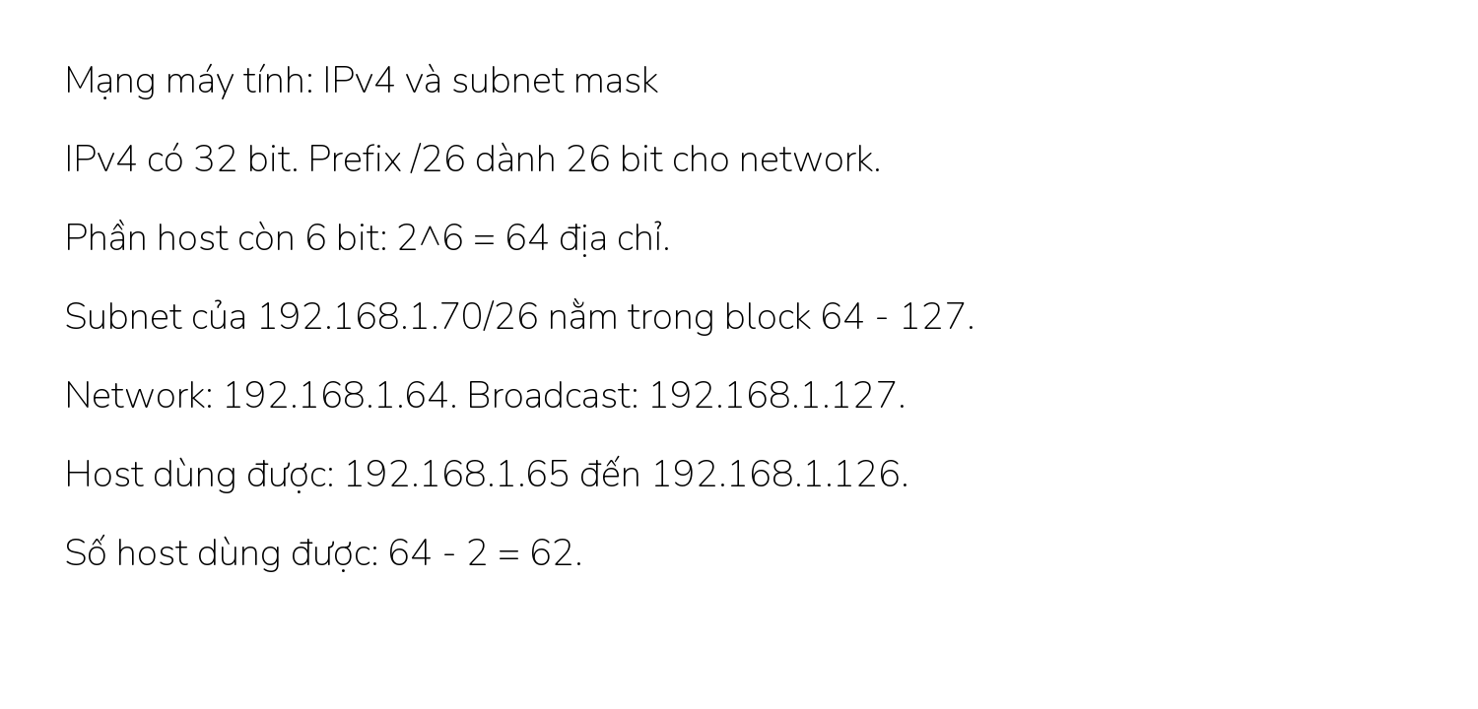
Networking - self-authored parser QA

Slide 2

Calculus - self-authored parser QA

Slide 3

Psychology - self-authored parser QA

