Slide 1
FLAME MEBT lattice
Kei Fukushima
Research Associate

Slide 2
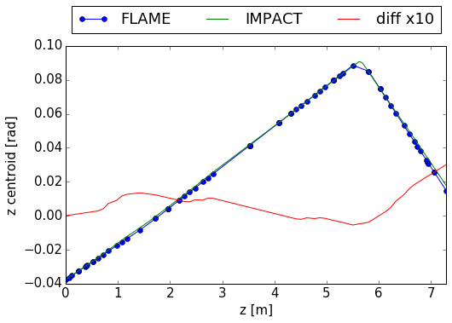
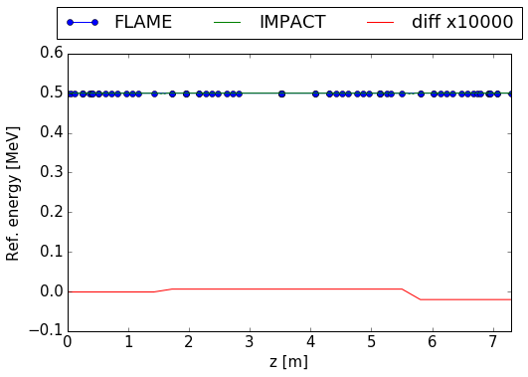
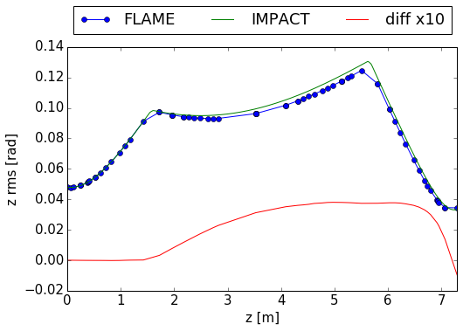
Benchmark: MEBT lattice for FLAME (z)
Std. error = 8e-4 [rad]
Std. error = 1e-6 [MeV]
Std. error = 2e-3 [rad]

Slide 3
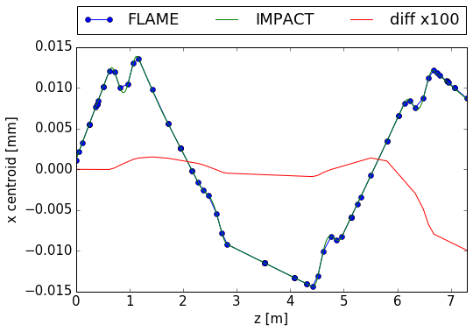
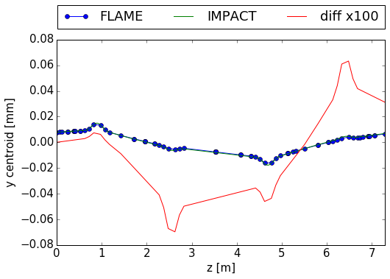
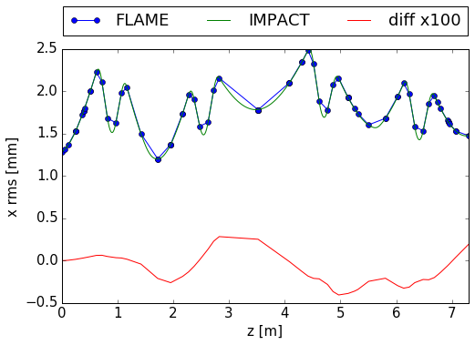
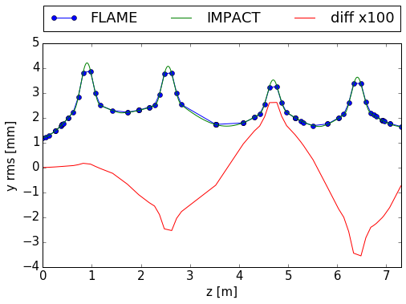
Benchmark: MEBT lattice for FLAME (x,y)
Std. error = 4e-5 [mm]
Std. error = 4e-4 [mm]
Std. error = 2e-3 [mm]
Std. error = 2e-2 [mm]

