Slide 1
Mobility
Prof. Dr. Jimmy Or, PhD
Created By: Dr. (James) Elliott Coleshill

Slide 2
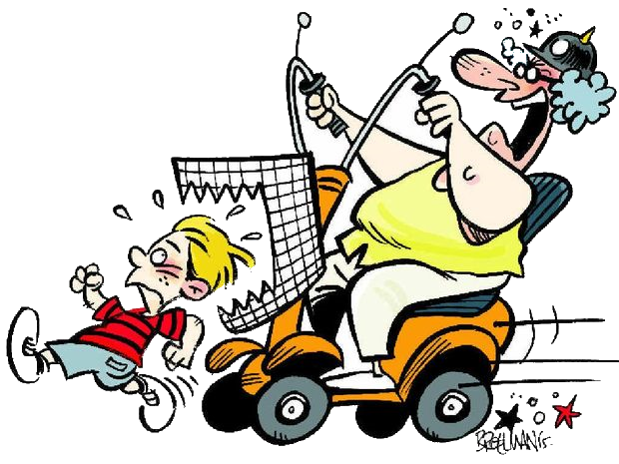
OVERVIEW
What is mobility?
How do I control motors?
How do I steer?
How do I know how far I have gone?
Mobility in RobotC with VEX EDR
Notes:
Mobility in nature does not include wheels. Well, that is not completely true…have a look at your foot some time wearing a shoe and the tread of a car tire…see any similarities?

Slide 3
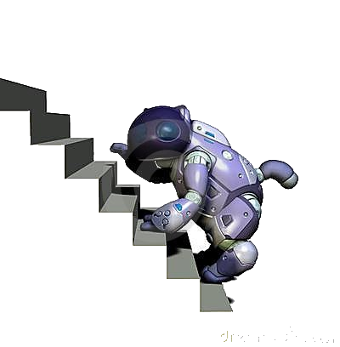

DEFINITIONS
Mobility: Directed movement of an agent
  Characteristics (Land based)
    Maximum height of traversable step
    Maximum width of traversable ditch
    Maximum speed on flat floor
    Maximum traversable slope
    Type of terrain traversable
      Cement, gravel, grass, loose sand, combination, etc…

Slide 4
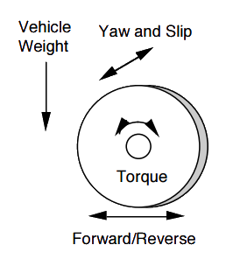
FORCES ON A WHEEL
Vehicle Weight
  Movement causes redistribution
Yaw and Slip
  Yaw caused by turning wheel side ways, slip caused by loss of friction with surface
Torque
  Caused by power to axle
Forward/Reverse
  Caused by turning of the axle due to torque and momentum

Slide 5
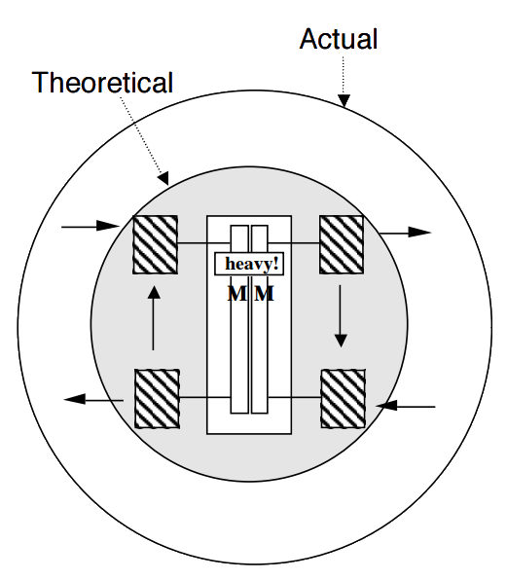
TURNS USING WHEELED DIFFERENTIAL
“Actual” turn footprint depends on weight distribution and slip
Slip will be different on all contacting wheels
“Actual” foot print can be reduced by bringing wheels closer together

Slide 6

MOVEMENT IN ROBOT C
We have played with sample programs
Let’s look at the details of how a Robot C program works using just motor drive

Slide 7
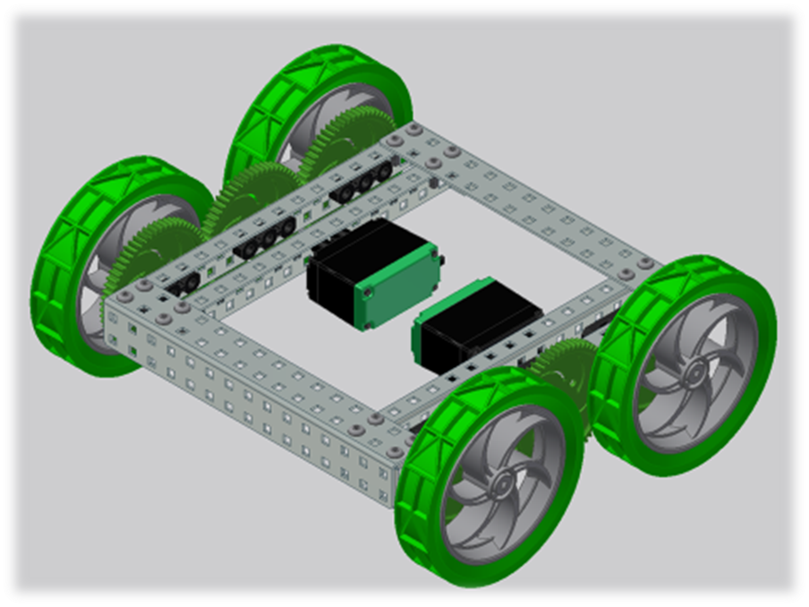
VEX WHEEL DRIVE SYSTEM
4-Wheels / 2-motors
Differential steering
Motors are reversed due to mechanical design

Slide 8
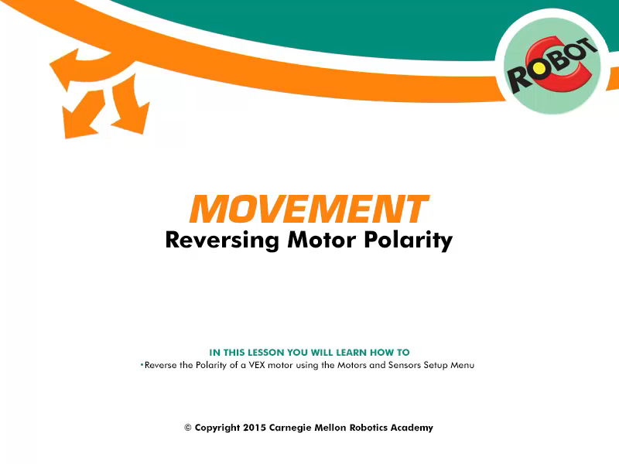
REVERSING MOTOR POLARITY
You could just place a ‘-’ in front of the number
    BAD!! DANGEROUS!!
Design and implement your code to match/mimic the hardware/electrical design

Slide 9
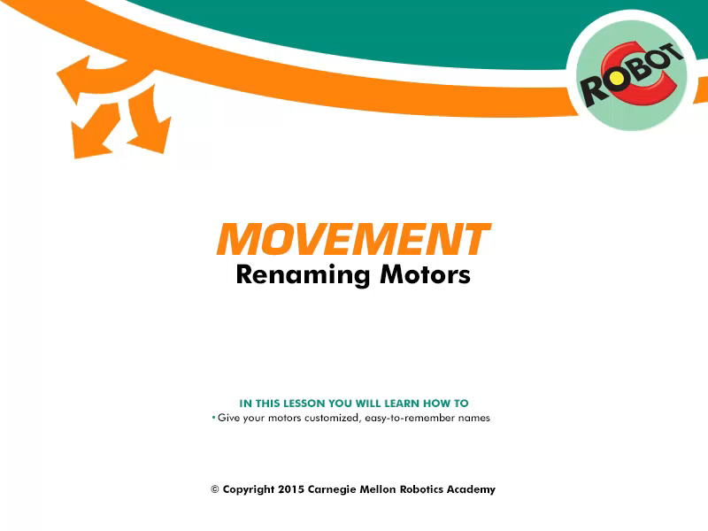
RENAMING MOTORS
Variable names are important
  Port3 = Default by program, easy to understand, but not mapped to hardware design
  X = BAD!
  CheeseBurger = VERY BAD!
  LeftMotor = GOOD!

Slide 10
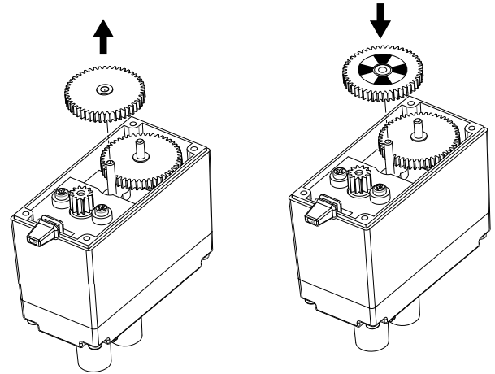
INTEGRATED ENCODER MODULES
White/Black Encoder wheel
Built onto first gear
Optical light counts number of white/black transitions
Provides information on:
  Speed
  Distance travelled
  Direction (forward/backward)

Slide 11
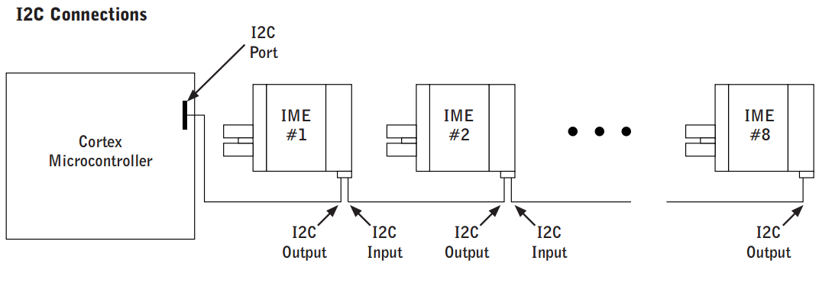
I2C BUS
I2C YouTube Video

Slide 12
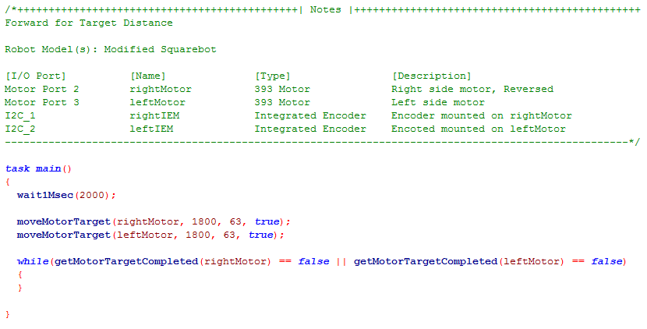
SIMPLE PROGRAM

Slide 13
MOTION PLANNING – FUZZY LOGIC

Slide 14
THE PROBLEM
Autonomous operation of a mobile robot in a real-world unstructured environment poses a series of problems
  knowledge about the environment is usually
    Incomplete
    uncertain, and
    approximate
  Perceptually acquired information is not reliable
    noise introduces uncertainty and imprecision
    limited range and visibility introduces incompleteness
    errors in interpretation

Slide 15
MORE PROBLEMS
Real world environments have complex and largely unpredictable dynamics
  objects can move
  the environment may be modified
  features may change
Vehicle action execution is not reliable
  the results produced by sending a given command to an effector can only be approximately estimated
  action execution may fail entirely

Slide 16
THE FUZZY CONTROLLER
Physical motion based on complex fuzzy controller
  Provides a layer of robust high-level motor skills.
  Basic building block of controller is a “behavior”
    A behavior is defined as implementing an atomic motor skill aimed at achieving or maintaining a give goal situation
    e.g. follow a wall.

Slide 17
IMPLEMENTING BEHAVIORS
Each behavioral skill is represented by means of a “desirability function” that expresses preferences over possible actions with reference to the goal
  e.g. a behavior aimed at following a given wall prefers actions that keep the agent parallel to the wall at a safe distance

Slide 18
FUZZY RULES
Each behavior was implemented by a set of fuzzy rules of the form
  IF A THEN C
    A is composed of fuzzy predicates and connectives, and
    C is a fuzzy set of control vectors
  An example of a “keep off” behavior rule is
    IF obstacle-close-in-front AND NOT obstacle-close-on-left THEN turn-sharp left

Slide 19
REACTIVITY
Purely reactive behaviors,
  intended to provide quick simple reactions to potential dangers
  typically use sensor data that has undergone little or no interpretation.
Since quick response is necessary to avoid disaster, little processing can be done.

Slide 20
BENDING BEHAVIORS
Many behaviors can be simultaneously active
Fuzzy controller selects the controls that best satisfy the active behaviors
Satisfaction is weighted by each behaviors relevance to the current situation.
  e.g. can’t follow a wall if there isn’t one
Context dependent blending of behaviors is implemented by combining the output of all the behaviors using context rules

