Slide 1
Project Management
Key terms and definitions
Presentation

Slide 2
Definitions
System – packaged hardware and software
Platform software – Operating System
Infrastructure software – other servers, middleware, utilities
Application – custom software
Project – a measurable process to build systems

Slide 3
ITIL, SDLC, and Projects
ITIL – Information Technology Infrastructure Library
  Contains a company’s standards required to cover all areas of systems development, deployment, and maintenance
SDLC – System Development Life Cycle
  Standards for the systems development, from requirements to deployment
Project – a process to manage development

Slide 4
Project attributes
Special activity that
  is a temporary organization
  has some particular goal
  the result must be clearly determined in advance
  has a specified time frame
  requires assembled resources
  has a pre-defined approach to how the result may be achieved

Slide 5
Projects Need to be Managed

Slide 6
Benefits from project based approach
Following methodology ensures that no steps are missed
Detailed blueprint makes all the project team members more productive
Identification of specific responsibilities reduces confusion between team members
Definition of constraints increase the likelihood of staying within the project constraints (time, budget)
Having milestones simplifies project monitoring
Early identification of deviations enables early correction

Slide 7
Project is successful when
It is completed in time
It comes in at or below planned expenditures
It meets the specifications and the deliverables are accepted by end users or assigned authority

Slide 8
What Helps Projects Succeed?*
1. Executive support
2. User involvement
3. Experienced project manager
4. Clear business objectives
5. Minimized scope
6. Standard software infrastructure
7. Firm basic requirements
8. Formal methodology
9. Reliable estimates
10. Other criteria, such as small milestones, proper planning, competent staff, and ownership
*The Standish Group, “Extreme CHAOS,” (2001).
Information Technology Project Management, Fifth Edition, Copyright 2007

Slide 9
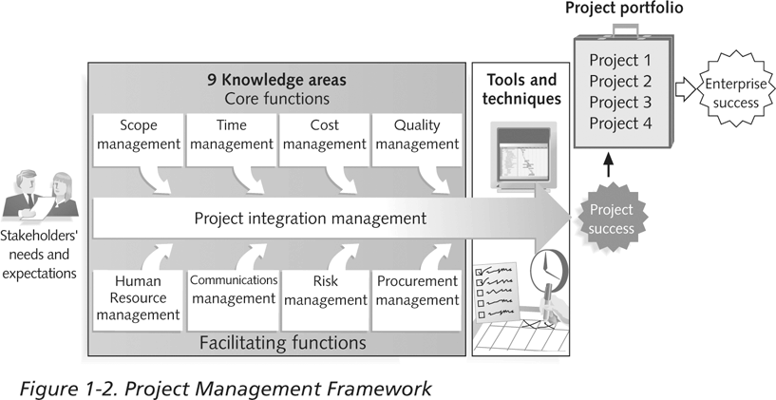
Project Management Framework
Information Technology Project Management, Fifth Edition, Copyright 2007

Slide 10
Project stakeholders
Stakeholder – anyone (individuals, or groups) who is impacted /by or impacts the project development
Example:
Obvious:
  Users
  Developers
Less obvious:
  Legal department
  Information security department
  Customer relationships department

Slide 11
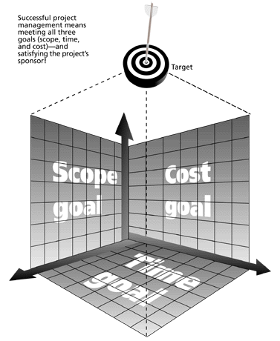
The Project Management Triangle
Successful project management means meeting all three goals (scope, time, and cost) – and satisfying the project’s sponsor!
Information Technology Project Management, Fifth Edition, Copyright 2007

Slide 12
Project Management Job Functions
Define scope of the project
Identify stakeholders, decision makers, and escalation procedures
Develop detailed tasks list (Work Breakdown Structure)
Identify interdependencies
Estimate time requirements
Identify and evaluate risks
Identify and track critical milestones
Report project status

Slide 13
Ten Most Important Skills and Competencies for Project Managers
1. People skills
2. Leadership
3. Listening
4. Integrity, ethical behavior, consistent
5. Strong at building trust
6. Verbal communication
7. Strong at building teams
8. Conflict resolution, conflict management
9. Critical thinking, problem solving
10. Understands, balances priorities
Information Technology Project Management, Fifth Edition, Copyright 2007

Slide 14
Different Skills Needed in Different Situations
Large projects: leadership, relevant prior experience, planning, people skills, verbal communication, and team-building skills are most important
High uncertainty projects: risk management, expectation management, leadership, people skills, and planning skills are most important
Very “novel” projects: leadership, people skills, having vision and goals, self-confidence, expectations management, and listening skills are most important
Information Technology Project Management, Fifth Edition, Copyright 2007

Slide 15
Super Tools
“Super tools” are those tools that have high use and high potential for improving project success, such as:
  Software for task scheduling (such as project management software)
  Scope statements
  Requirements analyses
  Lessons-learned reports
Tools already extensively used that have been found to improve project management include:
  Progress reports
  Kick-off meetings
  Change requests
Information Technology Project Management, Fifth Edition, Copyright 2007

Slide 16
Project Deliverables
Deliverables
  Project Management Documents
  Technical Documents
  Implementation deliverables
  Source code
  Configuration files
  Processes and procedures
Deliverables must be tangible

Slide 17
Project Management Documents
Project Charter, including:
  Stakeholders
  Project scope
  Budget
  Milestones
  Constraints
  Communication Plan
  Risks management
  Issues Management
  Escalation procedures
  Others

Slide 18
Project Management Documents
Other project management documents
  Project Schedule
  Issues Log
  Decisions log
  Reports on progress
  Meeting minutes
  Others

Slide 19
Technical Documents
Business Requirements
Functional Requirements
Non-Functional Requirements
Detailed Technical Requirements
Architectural Solution
Design Solution
Test Plan

Slide 20
The Project Management Institute
The Project Management Institute (PMI) is an international professional society for project managers founded in 1969
PMI has continued to attract and retain members, reporting 500,000+ members worldwide - 2020
There are specific interest groups in many areas like engineering, financial services, health care, IT, etc.
Project management research and certification programs continue to grow
Information Technology Project Management, Fifth Edition, Copyright 2007

Slide 21
Project stages
Initiating
Planning
Executing
Closing

Slide 22
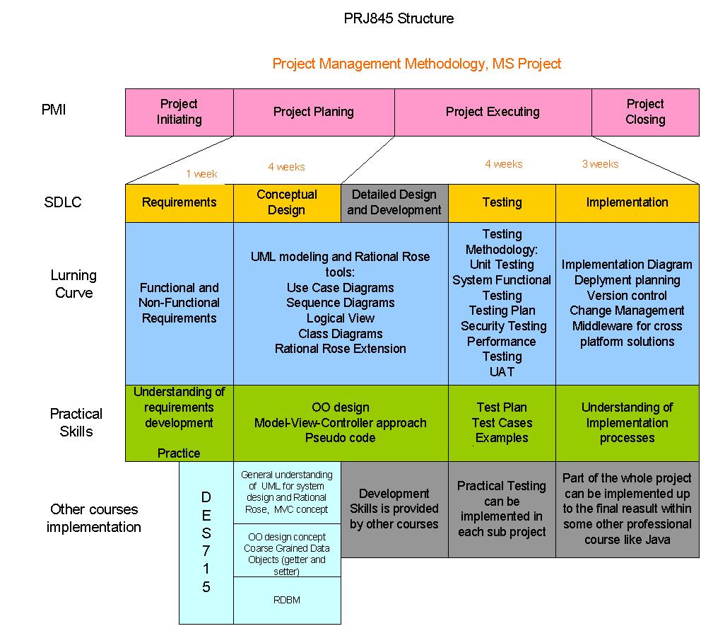
Putting it all together
Go to live

Slide 23
ITIL processes
System/product development lifecycle
Release management
Configuration management
Change management
Quality assurance

Slide 24
System/product development lifecycle
Gates-based approach to monitor system development
Assume review of project deliverables at pre-determined points of time (gates)
Performed by a designated body of professionals
Approval required to proceed with development

Slide 25
Release management
Pre-determined schedule of system upgrade for production
Accumulate upgrades from a certain number of qualified projects
Project schedule must be aligned with Release schedule

Slide 26
Configuration management
Processes required to create production version of the system
For security reasons, separated from any development or testing processes
Performed by a dedicated team
Must be seen as the task required for promoting system to production

Slide 27
Change management
Automated process to control changes to the system
Formal change request must be submitted for any change
Review and approval required to initiate the project
Designated team and tools normally exist

Slide 28
Quality Assurance (QA)
Processes to ensure compliancy with the standards and to perform pre-production testing
QA technology environment must be separated from development and from production environment
QA activities must be considered as a part of the project scope

