Slide 1
Autonomous Mobile Robotics
Dr. Jimmy Or, PhD
Created by: Dr. (James) Elliott Coleshill

Slide 2


OVERVIEW
About the course
  Blackboard Setup
  Lectures/Labs
  Policies & Procedures
Purpose of the course
  What this course is not
  What this course is
Focus of the course
Evaluation of Work

Slide 3
PURPOSE OF THE COURSE
Explore issues in mobile robotics by programming them using the VEX EDR Robotics platform
Develop an understanding of what it means to be autonomous
Learn an appreciation for the extreme difficulty of most autonomy tasks
Introduction to a distributed system and inter-processor communication

Slide 4

WHAT THIS COURSE IS NOT…
Industrial Robotics
Control Theory
Robot Simulation
“Expert Systems”
Big “AI Thingy”
Robot Wars
Hardware Design
Notes:
These topics are typically what are discussed in first courses in robotics. Students tend to end up in one of two states at the end of a traditional course.
The student comes out of the course thinking that the world of robotics is a rather simple one based on mathematics (however complex) and therefore tractable by anyone who sets their minds to work on a problem. Engineers typically approach robotics with this notion, and there have been some very impressive robots purpose-built to solve industrial problems. The car industry is one obvious example where robots have layed an impressive role.
2) The student is turned off by the extremely dry way that control theory is taught and loses interest in the problem.
I hope to avoid both these states.

Slide 5
WHAT THIS COURSE IS …
A course offered at Seneca College
A course in Programming Autonomous Mobile Robotics
The intent of the course is to introduce participants to the:
  Concepts,
  Problems,
  And practical aspects
Associated with the knowledge of robotic systems capable of surviving in an defined environment (without models)
Notes:
We will spend a lot of time talking about environmental considerations, sensory input and data communications. AMRs are typically built to exist in a specific environment. This is not particularly hard to understand since you were built to survive in a particular environment as well (Planet Earth). If you think about it, we would have a hard time if the Sun suddenly went out or gravity stopped working. We claim we are adaptable (and to a certain extent we are) but by and large we are situated and function best in our situation….so do AMRs.

Slide 6

FOCUS!
Understanding Behavior
  Why do things behave as they do
  Why achieving behavior is important
Understanding Autonomy
  What do we mean?
Programming Vehicles
  I tell you what!
  You figure out how!
Introduction to distributed programming & embedded systems
Notes:
The course will concentrate on attempting to give the student an understanding of what autonomy is with respect to mobile robots and provide a certain amount of practical experience in actually programming robots (using the VEX EDR platform) that can achieve defined behaviors. As such, it is a good introduction to various fields including control theory and various behavioral disciplines within psychology and biology

Slide 7

COURSE EVALUATION
You
  Quizzes: 15%
  Term Test: 20%
Robot
  Labs: 45%
  Practical Exam: 20%
If you:
  don’t like to implement things that actually work
  like to be evaluated through written work
  like to be told exactly what to do
Notes:
Evaluation is based on two parts. You will be evaluated based on your understanding of the theory via quizzes and a term test. The rest of your mark is calculated based on what the robot earns for you. These will be through 30 problem-based labs and a final practical exam performed by the robot.

Slide 8
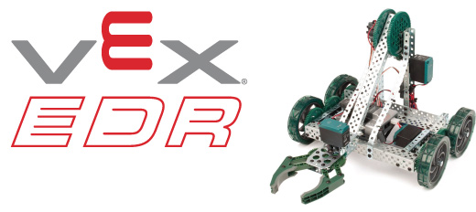
HARDWARE REQUIREMENTS (1/2)
Seneca will provide these
Notes:
Seneca will provide the VEX EDR robot platforms and the RobotC License is available via the lab computers at S@Y. You will not be provided with a personal license for your laptops.
You are responsible to make sure the VEX EDR kits do not get damaged and are returned in good condition at the end of the semester, including all the sensors and assembly hardware.

Slide 9
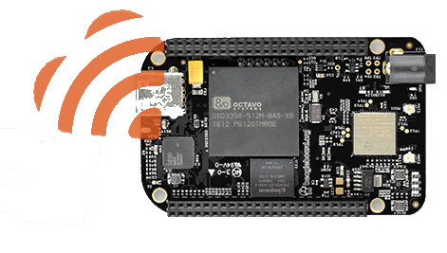
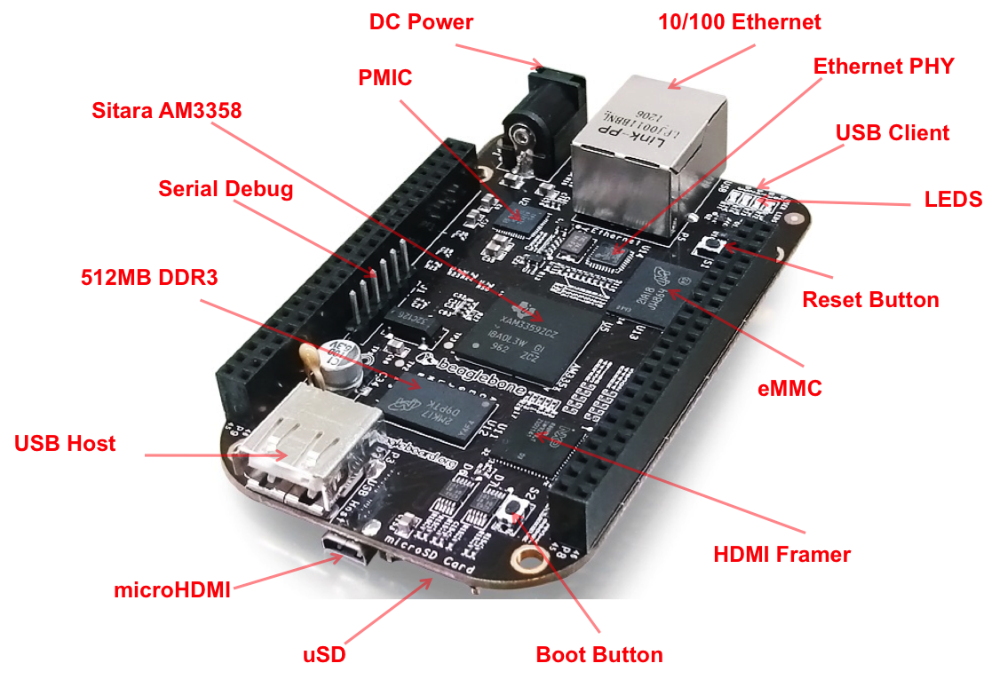

HARDWARE REQUIREMENTS (2/2)
You will need to purchase:
  BeagleBone Black Wifi
    Official Website
    Places to purchase
  Zip-ties
  Electrical Tape
Notes:
All students are required to purchase a BeagleBone Black credit card micro controller for this course. They are ~$100.

Slide 10
Thank You
Dr. Jimmy Or
Jimmy.or1@senecacollege.ca

