Slide 1
What is Autonomy
Dr. Jimmy Or
Created By: Dr. (James) Elliott Coleshill

Slide 2
OVERVIEW
Some Definitions
What is Autonomy?
Autonomy Examples

Slide 3
DEFINITIONS
Sensing: sampling the environment
Effecting: making changes to the environment
System: A group of interacting items which form a unified whole
Agent: Any system which can be viewed as perceiving its environment through sensors and acting upon it through effectors.
Control: The regulation of the behavior of a system to make it perform as desired

Slide 4
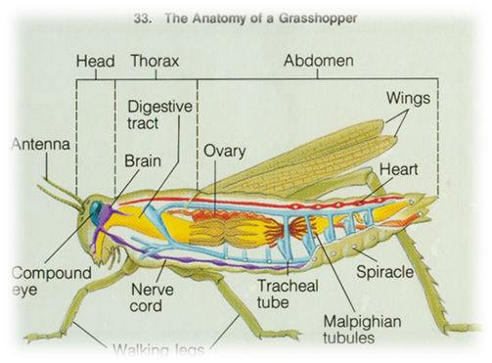


BIOLOGICAL EXAMPLE
Sensors
Agent
Control
System
Effectors

Slide 5

AGENT TERMINOLOGY
Sensors
User Interface
Effectors
Control

Slide 6

WHAT IS AUTONOMY?
I think therefore I am autonomous?
Philosophical Perspective
Psychological Perspective
Biological Perspective

Slide 7
PHILOSOPHICAL PERSPECTIVE
The autonomous man, insofar as he is autonomous, is not subject to the will or another [wolff 70]
A person is “autonomous” to the degree that what he thinks and does cannot be explained without reference to his own activity of mind. [Dearden 72]
I, and I alone, am ultimately responsible for the decisions I make, and am in that sense autonomous. [Lucas 66]
Notes:
Autonomy is equated with dignity, integrity, individuality, independence, responsibility, and self-awareness. It is identified with critical reflection,
freedom from obligation, absence of external influence, determination and execution of self interest. It is related to actions, to beliefs, to reasons for
acting or not acting, to rules, to the will of other persons, to thoughts, and to principles. About the only features held constant from one interpretation to
another is that autonomy is a feature of people, and that autonomy is a desirable quality to have [Dworkin 88].
One definition of autonomy is self-determination. The autonomous person is one who chooses for themselves what to think and what to do. They are selfgoverning
in that their actions are a result of interests and values that they have decided upon. Also, these beliefs are arrived at independently, by
means of critical reasoning. The autonomous individual is guided by their own notion of what is right, best, or at least possible. This has been termed the
Autonomy of judgment or “thinking for oneself.”
In reality we do not directly ascertain the validity of most of our beliefs. A good deal of our autonomy is derived from assessing the behaviour of others-
-we are taught. This requires that we have criteria by which to recognize an authority or when someone’s testimony is dependable.
With the idea of dependence, we come to the matter of constraints or limitations on our autonomy. External constraints typically interfere with the
exercise of autonomy, as with deception or censorship--being lied to or “kept in the dark” can severely limit autonomy. Internal restrictions are due to
some condition suffered by the individual rather than outside interference. Typically, they will consist in deficiencies or “defects” in rationality. For
example, stubbornness or stupidity might restrict autonomy in this way.
While autonomy of judgment is necessary for autonomous thinking and action, it is not sufficient. Because of either external or internal conditions a
person may be incapable of acting or even choosing based on freely made decisions. Threats (external) or the possibility of embarrassment (internal)
might restrict an action.
Efficacy of will indicates the ability to do what one wills. Deliberateness of will refers to the extent to which what it is that one wills is the fruit of
deliberate choice. Efficacy of will might more colloquially be called autonomy of action, since it refers to our ability to act on our decisions or will.
It is easy to see how autonomy of action can be interfered with. Interference can range from physical limitation to coercion or exploitation. The latter
limits the individual by, “attaching costs to certain forms of action that they would not otherwise carry.”--For example the association of a certain action
with pain (pain = wrong).
[Benn 76] example of the psychopath nicely illustrates how someone could have autonomy of judgment but lack of autonomy of action. Psychopaths
cannot carry through projects requiring deferment of gratification. Only immediate consequences of action count as relevant considerations for
decision-making.
The nature of one’s will is relevant to the question of autonomy. Depending on why one wills what one does, or how the will is formed, it may be more
or less autonomous. What one wills may be determined exclusively by the strength of one’s desires and impulses. Such a person then acts in accordance
with their strongest prompting. If you are both hungry and tired you will eat if the hunger is greater than the fatigue and vice versa. This sort of will
consists of the most demanding, urgent force within the individual. Such a will is in some sense less one’s own, hence less autonomous, than it might be.
There is a higher level at which our deliberations may proceed. We can assess and make decisions about who we are and what we wish to become. We
can take up the question of what sort of person to be and what kind of life to lead. This sort of deliberation goes beyond the ordering of priorities

Slide 8

PSYCHOLOGICAL PERSPECTIVE
The chick, which can peck accurately at food shortly after hatching, quickly develops its expertise in behavior because it stems from only a few original tendencies. Its immediate efficiency, however, is “like a railway ticket,...good for one route only.” Whereas, “A being who, in order to use his eyes, ears, hands and legs, has to experiment in making varied combinations of their reactions, achieves a control that is flexible and varied.” [Dewey 63]
Notes:
First-order autonomy is autonomy exercised in the particular decisions
which occupy us in the ordinary course of life: where to live, whom to
marry, what vocation to pursue...These everyday decisions can be made
more or less autonomously, depending, as we have seen, on our
resources, abilities, and freedom from restrictions. [Benn 76]
Autonomy may also be viewed as moral self-governance--the individual
authoring his moral principles, obeying moral laws which are self-imposed.
The autonomous individual does not simply conform to some
conventional standard of conduct. Rather, they rationally ascertain for
themselves what is desireable for any rational individual. This is autonomy
not in the sense of being governed by contingent desires or ambitions,
but governed by the rewards of a dispassionate, disinterested reason.
This is what we will refer to as Second-Order Autonomy.

Slide 9
BIOLOGICAL PERSPECTIVE (1/2)
“Autopoiesis”: defining and describing “living” beings in terms of their mechanical components
biological systems are comprised of physical components
robots are comprised of physical components
a biological life form is defined not by its components but by their interaction
the same is true of a robot
Notes:
•From:Varela, Francisco J. ,Principles of Biological Autonomy, The North Holland series in general systems research:2, 1979,
Elsevier North Holland Inc., ISBN 0-444-00321-5
•Linking Autonomy andRobotics
•there is relevant discourse in biology (Autopoiesis) defining and describing “living” beings in terms of their mechanical
components, their interactions and relationships [Varela 79]. Machines and biology have been, and continue to be, closely
associated. From the zoological figures present in astronomical formations to models of flight to present-day discussions
concerning “thinking computers” and the computing brain, runs the compelling notion that the mechanism of living things is
inextricably bound to what we know as life.
•Often, the mechanical implementation of an entity is used to dismiss any notion of animal life being autonomous. The
assertion is made that because of the mechanical nature of biological systems, there are no purposes in animal nature [Bonner
80]. Its apparent purpose is similar to the purposes of machines--they do what they are designed to do. So, if machines are not
the same as living creatures, why is it that the comparison is so easily made?
•The mechanisms that define a machine like a mobile robot as an entity, and determine the nature of interactions and
transformations it may undergo, we call the organization or architecture of the machine. The actual relationships that hold
between the components that constitute a particular machine is its structure. The organization of a machine (or system) does not
specify what components should be used to construct the machine as a system; it only specifies the processes and behaviours
that these must generate to constitute the machine [Braitenberg 86]. Therefore, the organization of a machine is independent of
the properties of its components, which are essentially arbitrary, and a given machine can be realized in many different ways by
many different kinds of components. [Varela 79]. The validity of this argument can be seen in many places. Few people think of
the individual components of an automobile when they think of the concept of “car” yet they know the functionality that they
associate with being “car-like”.
•Biological systems are also defined by their mechanisms and are therefore machines of a particular class. The argument
commonly made is that a living entity is defined by its organization independent of its structure or the material that physically
embodies it. You are more than what you eat, or more accurately, you are independent of what you eat. In short, a biological life
form is defined not by its components but by their interaction.
•Any biological system can be treated in terms of the properties of its actual components as a physical system. There is no
limitation whatsoever on doing so, except for the number of variables that one might have to consider. But this is only a
complexity problem--all be it a profound one. Eventually, one should be able to have a physical description as accurate as
required of any biological system. Of course, some biological systems are much easier to describe than others--an amoebae
versus a kitten for example. Weather this is, in fact, possible to fully realize is still a matter of some debate and is not
necessarily relevant to this argument.
•Since humans are biological systems, and by extension, physical systems this measure could be applied to humanity as well.
This is a very important link as it at least allows us to argue that autonomy--as a philosophical concept--is applicable to at least
one describable physical system and, by extension, should at least be examined in other physical systems.
•Therefore, it should be possible to examine the autonomy of a mobile robot in terms of the autonomy of a human. While mobile
robots may fail this examination--as animals might, they must still be examined using the same criteria.
•Autopoiesis does not specifically address the concept of autonomy but it creates an essential link between mechanical and
biological systems, at least at the descriptive level. Although machines are not commonly thought of as alive, it is possible to
extend the notion of the autonomy of a human to that of the autonomy of a machine

Slide 10

BIOLOGICAL PERSPECTIVE (2/2)
I think therefore I am autonomous?
Since humans are biological systems, they are defined by their component interactions as well
it should be possible to examine the autonomy of a biological system in terms of human autonomy
This could be applicable to artificial systems as well--like robots!

Slide 11

AUTONOMY IN ROBOTICS
Levels of Autonomy
  First Order
    Degree to which behavioral choices are made independently
  Second Order
    Changing the nature of behavioral choice
Autonomy of Judgment
  Degree to which decisions are made internally
Autonomy of Action
  Degree to which decisions can be acted on
Dependence
  Reduces autonomy
  External and Internal
External
Internal
GOAL
Autonomy of Action
Autonomy of Judgment
First Order
Second Order

Slide 12

APPLYING AUTONOMY TO A ROBOT
- Aspects of first order autonomy, no second order
- Heavy Internal dependence of pre-programmed behavior
- Heavy external dependence of commands from user controls/ground control
- Autonomy of Judgment limited to self collision

Slide 13
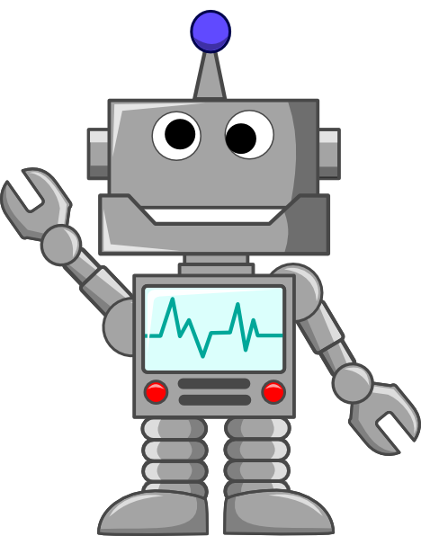
THE AUTONOMY PROBLEM ILLUSTRATED
Goal
How would you build an autonomous robot that can move to the goal and push it out of the circle?
Robot
Circle
Notes:
Break class into groups and give them 10-15 minutes to come up with some solutions

Slide 14

POSSIBLE SOLUTIONS
Solution #1
  Point the robot at the goal and let it go in hopes of pushing the goal out of the circle
Very limited in first order autonomy
Dependence on various factors which limit the robots success
  Friction, Misalignment with target, No correction possible

Slide 15
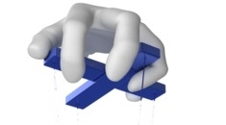
POSSIBLE SOLUTIONS
Solution #2
  Hook the robot to a controller and manipulate the controller to steer the robot to accomplish the goal
Hard to call it autonomous in any sense
Just because it’s tethered doesn’t mean the task is easy!
  Canadarm2 – Dextre are essentially tethered robots
A robot might be tethered because it is not desirable or possible to put the controller on-board
  Size,. Power, safety!

Slide 16

POSSIBLE SOLUTIONS
Solution #3
  Create a robot which you “tell” to “push the goal out of the circle”
  The robot than goes and does that!
Usually proposed by classical AI types
Requires representation of the world by an internal model
  Every object encountered must be in the model
  Decisions are made based on the model
Very slow but very flexible

Slide 17
POSSIBLE SOLUTIONS
Solution #4
  Instill a set of behaviors which allow the robot to use what it senses to make control decisions
  Allow it to reach the goal on its own
I like to collect stars
Sometimes referred to as “behavior based robotics”
No model required as robot uses what it senses to make decisions
Very fast but limited in scope

Slide 18
POSSIBLE SOLUTIONS
Solution #3
  Create a robot which you “tell” to “push the goal out of the circle”
  The robot than goes and does that!
Usually proposed by classical AI types
Requires representation of the world by an internal model
  Every object encountered must be in the model
  Decisions are made based on the model
Very slow but very flexible

