Slide 1
Intelligence
Prof. Dr. Jimmy Or
Created By: Dr. (James) Elliott Coleshill

Slide 2

BRAITENBERG'S VEHICLES
Braitenberg's book, “Vehicles: Experiments in Synthetic Psychology” discusses ideas about the
  evolution of
  intelligence to guide
  interaction with a
  complex world.
Body
  Wheel
  Motor
  Connection
  Sensor
  Type of Activation + -

Slide 3
VEHICLE 1
Configuration
  One sensor and one motor.
Reaction
  The greater the sensor input, the faster the motor goes.
Behavior
  The vehicle will move in the direction in which it happens to be pointing.
  It will speed up and slow down depending on the sensor data.
BUT
  Physical forces, such as friction, will cause it to deviate from its course.
Observation
  Over time, the vehicle will appear to move in a complicated trajectory without apparent reason.
Vehicle 1 is restless!
+

Slide 4
VEHICLE 2
Configuration
  Two sensors (one on each side) and two motors (left and right).
Two types of vehicles:
  each sensor is connected to the motor on the same side
  each sensor is connected to the motor on the opposite side
Reaction
  The greater the sensor input, the faster the motor goes.
+
+
+
+
Type 1
Type 2

Slide 5
VEHICLE 2 – TYPE 1
Behavior
  The vehicle will spend more time in the places where there is less sensor input and will speed up when exposed to higher concentrations.
  If the sensor input source is directly ahead, the vehicle may hit it.
  If the source is to one side, the vehicle will turn away from the source.
+
+
Type 1

Slide 6
VEHICLE 2 – TYPE 2
Behavior
  If the sensor input source is directly ahead, the vehicle may hit it (same as type 1).
  If the source is to one side, the vehicle will turn towards the source and may eventually hit it.
+
+
Type 2

Slide 7
VEHICLE 3 – TYPE 1 & 2
Configuration
  Two sensors (one on each side) and two motors (left and right).
  Two types of vehicles:
    each sensor is connected to the motor on the same side
    each sensor is connected to the motor on the opposite side
  Reaction
    Inhibition:
      The greater the sensor input, the slower the motor goes.
      The weaker the sensor input, the faster the motor goes.
-
-
-
-
Type 1
Type 2

Slide 8
VEHICLE 3 – TYPE 1 & 2
Type 1
  Behavior
    The vehicle will come to rest facing the source.
Type 2
  Behavior
    The vehicle will come to rest facing away from the source.
    It will not stay there long; any slight perturbation will cause it to drift away from the source.
Types 1 and 2
  Observation
    Type 1 vehicles love the source.
    Type 2 vehicles are explorers.

Slide 9


DEFINITION
Anthropomorphism
  the attribution of human characteristics or behavior to a god, animal, or object.
-
-
-
-
Type 1
Type 2

Slide 10
VEHICLE 3 – TYPE 3
Configuration
  Four pairs of sensors (for different environmental factors) and two motors.
  The sensors are connected in the following manner:
    first pair (light) to motors with uncrossed excitatory connections
    second pair (temp) to motors with crossed excitatory connections
    third pair (O2) to motors with crossed inhibitory connections
    fourth pair (organic matter) to motors with uncrossed inhibitory connections

Slide 11
VEHICLE 3 – TYPE 3
Behavior and Observations
  Dislikes light bulbs --> turns towards them and tries to destroy them.
  Dislikes high temperatures --> turns away from hot places.
  Prefers a well-oxygenated environment and one containing many organic
  molecules, since it spends much of its time in such places.
  Moves elsewhere if the supply of O2 or organic matter runs low.
  It would appear that this little creatures has both values and knowledge.

Slide 12
VEHICLE 4
Behavior and Observations
  A vehicle might navigate towards a source and then turn away from it when the sensory input reaches a set point.
  The vehicle may appear to ``circle'' or orbit the source in some fashion.
  This behavior has some of the characteristics of animal instincts.
Configuration
  Similar to Vehicle 3, but the activation of a sensor will make the corresponding motor run faster (slower), but only up to a point at which the speed of the motor reaches a maximum (minimum). Beyond this point, if the sensor is further stimulated (more or less) then the speed will start to decrease (increase).

Slide 13
VEHICLE 4
Configuration
  Similar to Vehicle 3, but the influence of the sensor on the motor is no longer smooth; it has breaks. – Some levels of input do not cause any activity.
  There might be smooth changes of motor activation for certain ranges of sensor input with abrupt changes in between.
  No activation up to a threshold level.
  Increasing activation beyond the threshold starting with a fixed minimum.
Behavior and Observations
  The thresholds of sensory input necessary for motor activation give the appearance of decision-making.

Slide 14
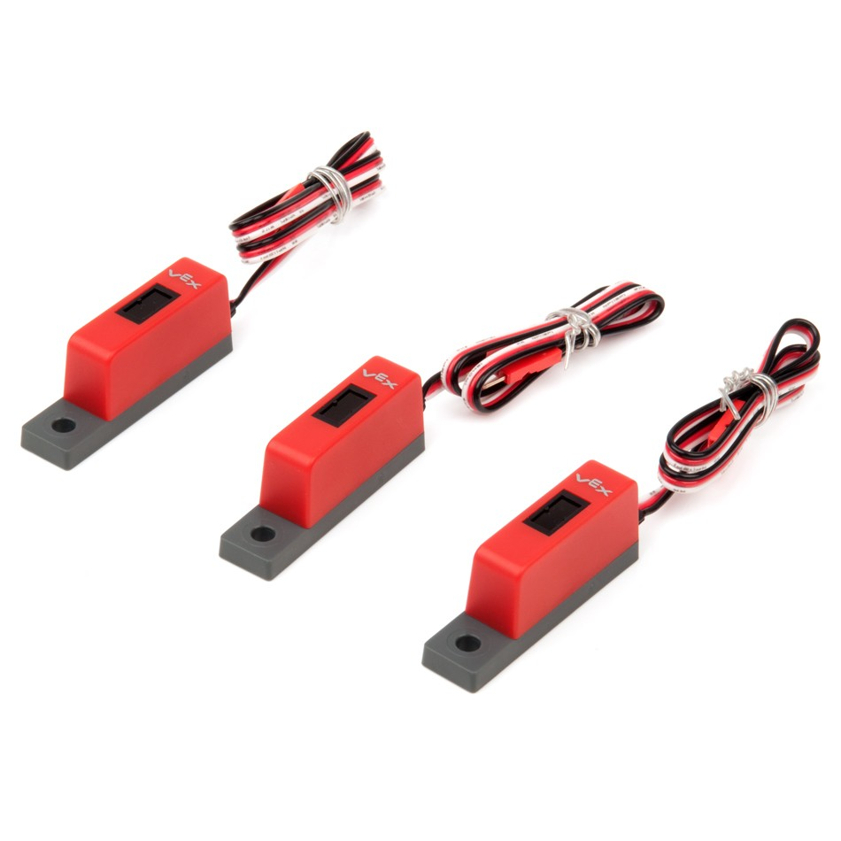
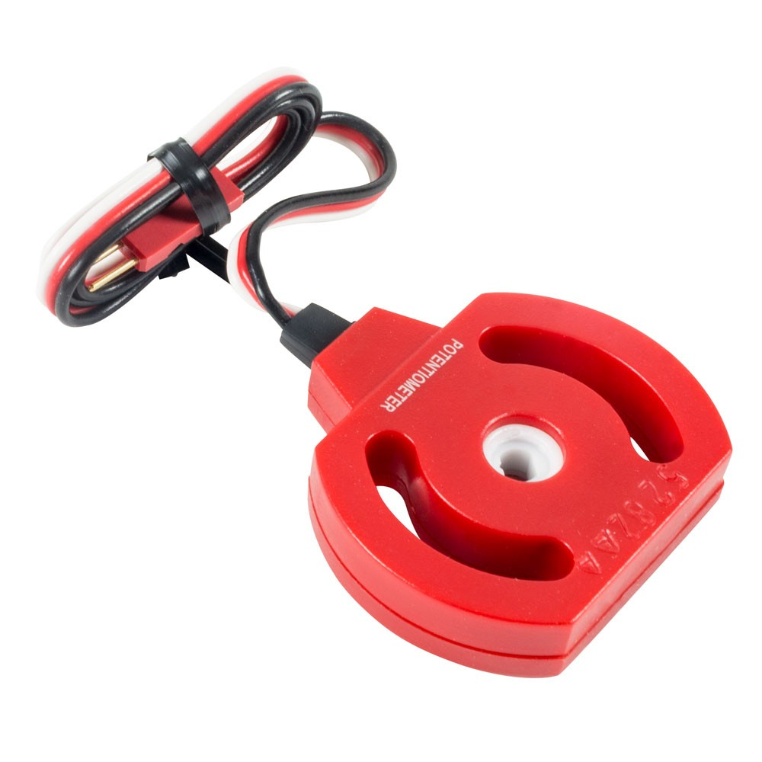
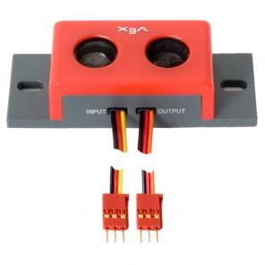
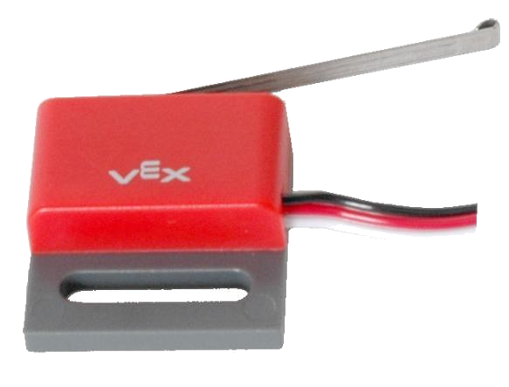
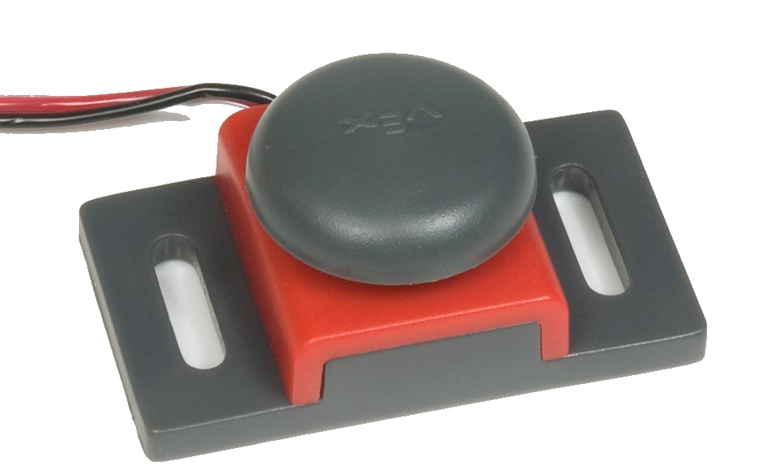
MAP THESE CONCEPTS TO VEX SENSORS
Let’s take a minute and figure out how these theories apply to the VEX EDR Sensors that we have available to us
Notes:
Get a discussion going on how you can program these sensors to control the robot with the type of theory just talked about. How would you design an autonomous explorer robot? How would you design an autonomous affectionate robot (the love bot)

