Slide 1
Animal Behavior and Robotics
Prof. Dr. Jimmy Or
Created By: Dr. (James) Elliott Coleshill

Slide 2
OVERVIEW
Understanding Animal Behavior
  Some Assumptions
  Some Biology
  Observing Animal Behavior
  Ethology, Behavioral Psychology and Physiology – Top down vs.. Bottom up
  The wasp and the lion
Complex Adaptive Behavior
  Design approach
  Requirements for Robots
  Finite State Machines

Slide 3
ROBOT ASSUMPTION
In order for a robot to act autonomously over a wide range of tasks and environments, it must be capable of exhibiting a variety of different behaviors.

Slide 4
BIOLOGICAL SUPPORT
This is supported by ethological observation on the behavior of animals
  D. McFarland (ed) The Oxford Companion to Animal Behavior
Differ from traditional approaches to robot control which have concentrated on the development of a single behavior.

Slide 5
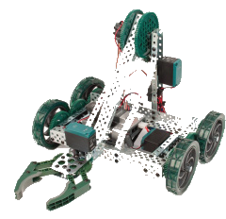
ANIMAL BEHAVIOR
Nature has often been used as a source for the design of man made artifacts. In robotic design,
  grasping,
  manipulation, and
  Locomotion
These biological examples have provided us with a basis for the design of robot hands, flexible and rigid manipulators and various walking machines.

Slide 6
OBSERVING BEHAVIOR
Nature provides many examples of different types of behavior
allow both vertebrates and invertebrates to successfully interact with their environment.
Successful interaction is essential to their survival.
Examples include • attack and escape behaviors, • mating, • feeding, and • nest building behaviors.

Slide 7
DIFFERENT APPROACHES TO STUDY ANIMAL BEHAVIOR
Two basic approaches have been used in the study of animal behavior.
Top down strategy
  attempts to explain the behavior of the animal without complete knowledge of the underlying physical mechanisms.
Bottom up strategy
  taken by physiologists is based on the analytical decomposition of the organism into its various physical subcomponents.
  Shared by ethologists and behavioral psychologists.

Slide 8
TOP DOWN APPROACH
Ethologists
  study the behavior of animals under natural settings
  in addition to the cause of the behavior, they are interested in determining what function it provides the animal and its evolutionary consequences.
  Bottom line belief: Survival of a given species depends not only upon the physical structure but also upon possessing the necessary behavioral characteristics.
behavioral psychologists
  study the behavior of animals in a controlled laboratory environment.
  largely ignore the natural habitat in which the animal exists.
  Bottom line belief: They desire to formulate general laws of learning.
Notes:
belief that behavior is largely a result of the animal's innate response to certain environmental stimuli. It is their belief that types of behavior are specific to certain species. Related species will exhibit similar behaviors while unrelated species will exhibit dissimilar behaviors.
They believe that the response exhibited by an animal to certain stimuli is not an innate response but instead is primarily a learned response. Their aim is to uncover general principles which describe the behavior of an animal in terms of its ability to learn to respond to certain stimuli.

Slide 9
BOTTOM UP APPROACH
Physiologists
  attempt to explain animal behavior in terms of the interactions between the physical components of the animal.
  approach animal behavior from analytical perspective
  Bottom line belief: primarily concerned with the functioning of the animal at the neural level.
Notes:
decomposing the animal into physiological subcomponents, and then focus upon understanding the underlying mechanisms of each the subcomponents.

Slide 10
LACK OF FRAMEWORK
Describing the behavior of an animal presents a serious problem to the observer.
  no common unit of measurement.
    like voltage, current, and force,
  the description of behavior depends upon the behavior being investigated
    is subjective at best.

Slide 11
A THEORY OF ANIMAL BEHAVIOR
The ethological approach to the study of animal behavior began in the late 1930s
mainly through the early work of
  Konrad Lorenz, and
  Niko Tenbergen.
It was Lorenz who introduced a model to explain the predictable behavior of certain animals when exposed to specific stimuli.

Slide 12
THE LORENZO MODEL
Consists of an internal centre based in the central nervous system, receiving sensory information from the environment.
  Called the “innate releasing mechanism”
    causes a specific response from the animal when certain situations in the environment detected
  Stimulus when invoked the response was called a “releaser”
  Pattern of behavior exhibited was called a “fixed action pattern”
    Surprisingly similar to the way we look at our vehicles!

Slide 13
INSTINCT AND LEARNING
How is it that an animal
  possesses the ability to feed itself,
  produce and raise offspring,
  build nests, and
  avoid predators?
The answer is believed to be due to a combination of
  inherited responses to certain situations, and
  the ability to adapt to situations for which no response is available.

Slide 14
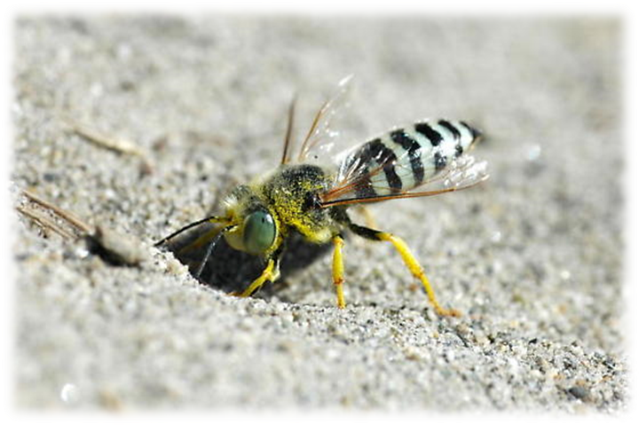
THE DIGGER WASP – INHERITED RESPONSE
“A female digger-wasp emerges from her underground pupa in spring,. Her parents died the previous summer. She has to mate with a male wasp and then perform a whole series of complex patterns connected with digging out a nest hole, constructing cells within it, hunting and killing prey such as caterpillars, provisioning the cells with the prey, laying eggs and finally sealing up the cells. All of this must be completed with a few weeks, after which the wasp dies.” –
    A. Manning, An Introduction to Animal Behavior, 3rd ed., 1979, pg 22

Slide 15
LORENZO EXPLAINS THIS…
This behavior is an aggregation of a series of sequential behaviors.
  result of one behavior triggers the next.
In this example, the releaser would be the presence of a male digger wasp which would evoke a mating behavior, the result of which would evoke a predator behavior, and so on.
Note that under this hypothesis, if the female digger wasp was isolated from the male, then none of the other behaviors should occur.
      This has been experimentally verified.

Slide 16
GENETICALLY PROGRAMMED BEHAVIOR
This is an example of an innate behavior which has been genetically passed on from previous generations.
The wasp is not trying to accomplish a “goal” but acts as it does because that is the way its ancestors acted.
These wasps survive because,
    Each wasp is physically suited to its environment • Its behavior is suited to the environment
This is the main idea behind “ethology”

Slide 17
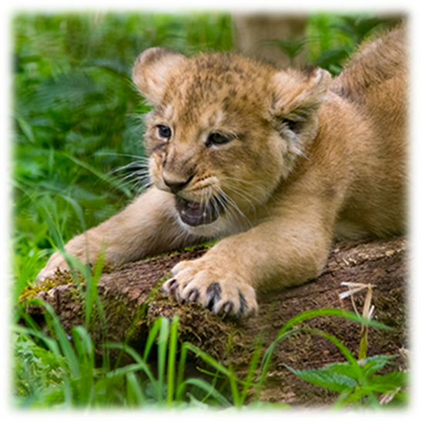
LION CUB – LEARNED RESPONSE
“Born quite helpless, it is sheltered and fed by its mother until it can move around. It is gradually introduced to solid food and gains agility in playing with its litter mates. It has constant opportunities to watch and copy its parents and other members of the group as they stalk and capture prey. It may catch its first small live prey when 6 months old, but it is 2 years or more before it has grown sufficiently to feed itself. Its behaviors, and particularly the methods and stratagems it uses in hunting, may change according to circumstances throughout its life.”
  A. Manning, An Introduction to Animal Behavior,
    3rd ed., 1979, pg 22

Slide 18
INSTINCT AND LEARNING
Adaptation, or learning, has the obvious benefit of allowing the animal to react to new situations.
Innate responses have the benefit of immediacy, since no time is required in order to develop a learned behavior.
Many creatures use both.

Slide 19
COMPLEX ADAPTIVE BEHAVIOR & DESIGNING A ROBOT

Slide 20
INTRODUCTION
Complex adaptive systems
  consist of many parts undergoing simultaneous interactions.
  With time they “evolve” in response to the world
They all share three characteristics:
  evolution
  aggregate behavior
  anticipation
Undergo events that are (or are similar to) Darwinian Evolution

Slide 21
AGGREGATE BEHAVIOR
Aggregate behavior is not simply derived from the actions of the parts.
behavior of a system that we are interested in, such as the control of the brain over the body
Aggregate behavior emerges from the interactions of the parts of a system.

Slide 22
ANTICIPATION
Part of complex behavior can be thought of as the development of rules that anticipate the consequences of certain responses.
This is the most difficult characteristic to understand and model.
Since complex systems are constantly revising their rules to adapt to novel surroundings, the aggregate behavior of the system is usually far from optimal.
Optimality may not even be definable for the system as a whole.
These systems continue to evolve and exhibit new forms of emergent behavior.
An end-point may never be reached.

Slide 23
RODNEY BROOKS AND SUBSUMPTION
Systems should be designed and built incrementally to achieve intelligent capabilities.
These systems should be tested in the real world.
Conclusions Reached Using the Approach
  For very simple levels of intelligence, explicit representations and models of the world are counterproductive.
  The real world should be used as its own model.
  Representation (abstraction) is the wrong unit of abstraction.
  Moving Around, sensing and interacting with the world drives the development of biological systems.
  This should be good enough to drive the development of artificial systems.
  By factoring out real world interactions in artificial systems the systems are ineffective at really moving around in the world.
  We should really work to resolve motor skills problems with the systems first.

Slide 24
DESIGN METHODOLOGY
Cope with a dynamic environment.
Robust in the sense that a change in the environment should not lead to a total and sudden collapse of behavior.
Maintain multiple goals.
It should have some “purpose

Slide 25
DESIGN APPROACH
Design to implement individual functions often leads to a disconnected set of component parts (sensor, control, reasoning) which cannot be integrated to perform a task.
Design by intended activity will result in a design that might be simple but is complete.
Sensing should be directly tied to action.
A layer is an activity producing system where an activity is some pattern of interaction with the world (often called a skill).

Slide 26
DESIGN APPROACH (CONT)
Different layers can exist in parallel, unaware of the existence of others.
A reaction system senses the environment often and acts quickly.
Individual layers extract only those aspects of the world which are relevant.
Different layers have different goals.
The overall “purpose” is implicit.
The complexity of behavior of a system is not necessarily inherent in the complexity of the creature, but perhaps is in the complexity of the environment.

Slide 27
ROBUST CONTROL SYSTEM FOR A ROBOT
Introduction: The Problem: Control for an autonomous robot:
  rapidly changing conditions
  information about environment is collected over noisy channels (sensors)
Traditional approach: functional decomposition.
Non-traditional approach of Brooks: decomposition by task-achieving behavior.

Slide 28
REQUIREMENTS
Multiple goals
  may be conflicting relative importance of goals may be context dependent must be responsive to high priority goals while still servicing necessary low-level goals
Multiple sensors
  often no direct mapping from sensor values to physical quantities inconsistent, noisy information
Robustness
  sensor failure should not cause total loss of function.
  environmental changes, even drastic ones, should elicit a reasonable behavior
Extensibility – sensors and capabilities additions

Slide 29
SUBSUMPTION DESIGN PRINCIPLES
Complex behavior need not be a product of a complex control system reflection of a complex environment
Things should be simple attention to interfaces between components stay away from unstable or ill-conditioned problems
Map making is important for robot independence.
The robot must exist in a 3-D world.
Relative maps are more useful since absolute co-ordinate systems accumulate errors.
Use real environments, not artificial ones.
Sonar data is not rich enough for intelligent interactions -- visual data is necessary.
The robot must function even if some of its sensors fail – self calibration.
Robots must be self-sustaining.

Slide 30
LEVELS OF COMPETENCE
Informal specifications of a desired class of behavior over all environments to be encountered.
Higher level of competence implies a more specific desired class of behaviors.
In a sense, this is a measure of robot “intelligence”

Slide 31
LEVELS
Brooks' levels of competence:
  Avoid contact with objects.
  Wander aimlessly while avoiding objects.
  Explore the environment.
  Build a map of the environment and plan routes.
  Notice changes in the “static” environment.
  Reason about and perform tasks relating to objects.
  Formulate and execute plans that involve changing the state of the world.
  Reason about the world and modify plans accordingly.

Slide 32
LAYERS OF CONTROL (SUBSUMPTION ARCHITECTURE)
Build layers of a control system corresponding to each level of competence.
Layers
  are independently built
  can examine data from lower levels
  can inject data to suppress a lower level
  are unaware of higher levels

Slide 33
STRUCTURE OF LAYERS
Module consist of FSM with some data structures (instance variables)
  send messages over “wires” asynchronous
  no handshaking or acknowledgements
  no shared memory
  no central control
Inputs to modules can be suppressed and outputs inhibited
  subsumption of lower levels by higher levels

Slide 34
FINITE STATE MACHINE
Input lines have single-element buffers (reset signal, start in NIL state).
Four types of states:
  Output: output message sent on output line, then new specified state is entered.
  Side Effect: one of the module's instance variables is set to a new value, then new specified state is entered.
  Conditional Dispatch: a predicate is computed and depending on the outcome, one of two subsequent states is entered.
  Event Dispatch: a sequence of pairs of conditions and states to branch to are monitored until one of the events is true.

