Slide 1

BTH645 - Multimedia Elements for User Interfaces
Shi, Yue (Sunny)
Office: DB2095
sunny.shi@senecacollege.ca
SENECA COLLEGE
Notes:
Good morning and welcome back. I hope you all had a great summer.
This photo is a rendering of our Peterborough Airport campus which is well under way for our January 2014 opening.
And the entire design and build process is exemplary of the entire college community coming together to create a great place for our students to study.

Slide 2
Outline
Importance of text in a multimedia presentation
Understanding fonts and typefaces
Using text elements in a multimedia presentation
Next week
Image
2

Slide 3
Importance of Text in a Multimedia Presentation
Words and symbols in any form, spoken or written, are the most common means of communication.
Text is a vital element of multimedia menus, navigation systems, and content.

Slide 4
Importance of Text in a Multimedia Presentation
The power of meaning
Multimedia developers must use words carefully and accurately.
It’s important to design labels for title screens, menus, and buttons or tabs using words that have the most precise and powerful meanings to express what you need to say.
Which is more powerful?
GO BACK! vs. Previous
Quit vs. Close.

Slide 5
Importance of Text in a Multimedia Presentation
Factors affecting legibility of text:
Size
Font
Style
Leading
Background and foreground color

Slide 6
Typefaces and Fonts
A typeface is a family of graphic characters, often with many type sizes and styles.
A font is a collection of characters of a single size and style belonging to a particular typeface family.
A font describes a subset of that typeface, but each font embodies a particular size and weight.
a font & a typeface : song & an album.
The former makes up the latter.

Slide 7
Typefaces and Fonts
The study of fonts and typefaces includes the following:
Font styles
Font sizes
Cases
Serif versus sans serif

Slide 8
Typefaces and Fonts – (1) Font styles
Font styles include:
Boldface
Italic

Slide 9
Typefaces and Fonts – (1) Font styles
Font styles include:
Boldface
Where to use
title word/phrase of the article, its synonyms,
When not to use:
in article text

Slide 10
Typefaces and Fonts – (1) Font styles
Font styles include:
b) Italic
When to use
names and titles, or abbreviations thereof:
Major works of art and artifice, such as albums, books, video games, films, musical, operas, symphonies, paintings, sculptures, newspapers, journals, magazines, epic poems, plays, television programs, radio shows.
E.g., On an Overgrown Path (Czech: Po zarostlém chodníčku) is a cycle of thirteen piano pieces written by Leoš Janáček ... (named piano composition)

Slide 11
Typefaces and Fonts – (1) Font styles
Font styles include:
b) Italic
When to use (continued)
Court case names: FCC v. Pacifica
Certain scientific names
Named, specific vessels
Emphasis
Words for words: Deuce means "two“
Citations
Variables , E = mc²

Slide 12
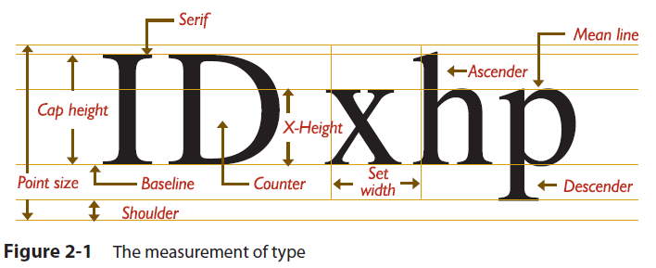
Typefaces and Fonts – (2) Font sizes
Font sizes
Font size is measured in points.
1 point = 1/72 inches
The distance from the top of the capital letters to the bottom of the descenders in letters such as y and g.

Slide 13
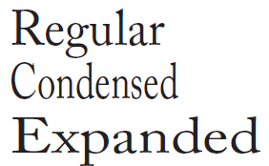
Typefaces and Fonts – (2) Font sizes
Font sizes
Character metrics are the general measurements applied to individual characters.
Kerning is the spacing between character pairs.
Leading is the space between lines.
Traditionally, leading is 20% greater than the font size
Tracking adjusts the spacing throughout the entire word.

Slide 14
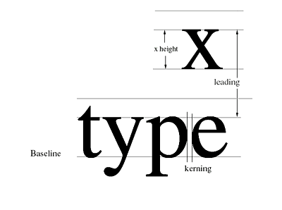
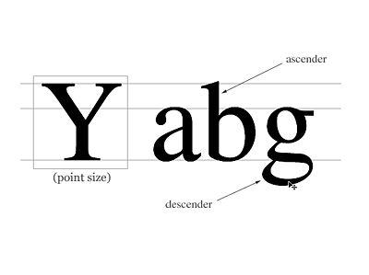
The Measurement of Type
Image from
Internet

Slide 15
Terms
Rasterizing: converts the letter from a mathematical representation to a recognizable symbol displayed on the screen or in printed output
Use tiny square pixels (picture elements), or dots, represent the letter.
High-resolution monitors and printers with more fine little squares or dots per inch (dpi)
can make more attractive-looking and varied characters.

Slide 16
Typefaces and Fonts – (3) Cases
uppercase, a capitalized letter lowercase , a small letter
Intercap, placing an UpperCase letter in the middle of a word.
How are you going to use upper case or lower case?
All upper case?
All lower case?
Mixed?
SHOUTING / YELLING online
Case sensitive

Slide 17

Typefaces and Fonts –
(4) Serif versus sans serif
A serif is the little decoration at the end of a letter stroke.
used for body text.
Sans serif fonts do not have a serif at the end of a letter stroke.
used for headlines and bold statements.
“Sans” is French for “without”

Slide 18
Font Availability
Every single computer has the same set of fonts available. T / F?
-- False
Text may look very different on different computers and/or different OS (windows, Linux). T / F?
-- True

Slide 19
Font Availability
If the desired font is not available, what can you do?
choose the closest font that is available.
E.g., using CSS, in the font-family property, add a generic catch-all, such as “serif” or “sans serif” to cover an instance when your specified fonts are unavailable.

Slide 20
Font Availability
PDF (Portable Document Format): a file format used to present documents in a manner independent of application software, hardware, and operating systems.
Each PDF file encapsulates a complete description of a fixed-layout flat document, including the text, fonts, graphics, and other information needed to display it.

Slide 21
Using Text in Multimedia
The text elements used in multimedia are:
Fields for reading
HTML documents
Menus for navigation
Interactive buttons
Symbols and icons

Slide 22
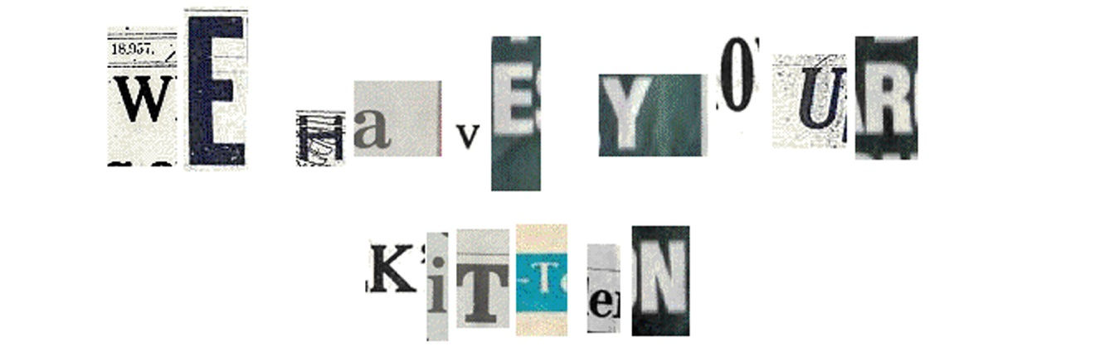
Using Text in Multimedia
Choosing text fonts
Consider legibility and readability.
Avoid too many faces.
Use color purposefully.

Slide 23
Using Text in Multimedia
Choosing text fonts
You need to be a poet, an advertising psychologist, and a graphic designer.
Use the most legible font available (sans serif).
Carefully select different faces, weight, size, bold, italic.
Bold or emphasize text to highlight ideas or concepts, but DO NOT make text look like a link or a button if it is not.
Too many fonts on the same page is called ransom-note typography.

Slide 24
Using Text in Multimedia
Choosing text fonts
You need to be a poet, an advertising psychologist, and a graphic designer.
Vary the size of a font in proportion to the importance of the message.
Adjust leading. Too tight lines are difficult to read.
Animating text to catch a viewer’s attention.
Make type stand out, use different colors, text on various backgrounds.

Slide 25

Symbols and icons
Symbols are concentrated text in the form of stand-alone graphic constructs.
They are used to convey meaningful messages.

Slide 26
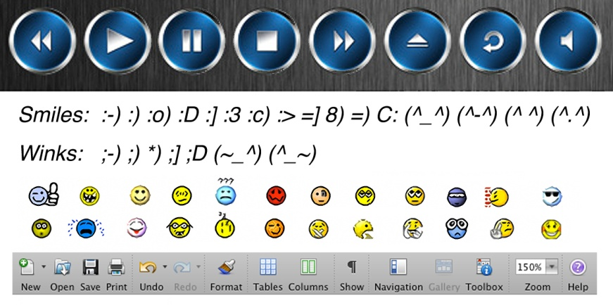
Symbols and icons
Emoticons: Symbols used to convey human emotions.
Icons are symbolic representations of objects and processes.

Slide 27
Menus for navigation
A user navigates through content using a menu.
A simple menu consists of a text list of topics.

Slide 28
Interactive buttons
A button is a clickable object that executes a command when activated.
Users can create their own buttons from bitmaps and graphics.
The design and labeling of the buttons should be treated as an industrial art project, considering….
LEGIBLE
Size
Combinations of font, spacing, colors

Slide 29
Designing with Text
Select font size and the number of headlines depending on the complexity of the message and to its value.
If your messages are part of an interactive project or website where the user is seeking information,
you can pack a great deal of text information onto the screen.

Slide 30
Designing with Text
Balance:
Too much text : overcrowded screen and unpleasant.
too little text: requires annoying page turns and unnecessary mouse clicks and waits;
A lengthy text document read by a web browser may scroll for hundreds of lines without annoying the user because it’s expected.
As a rule of thumb, web pages no longer than one and a half to two screenfuls of text.

Slide 31
Fields for reading
Reading a hard copy is easier and faster than reading from the computer screen.
A document can be printed in one of two orientations: portrait or landscape.
The taller-than-wide orientation used for printing documents is called portrait.
The wider-than-tall orientation that is normal to monitors is called landscape.

Slide 32
Fields for reading
eBooks, E-Readers, and Table Computers
eBooks are books digitized and formatted to be read using an eReader.
eBooks display text, graphics, and multimedia- most using E Ink screens between five and ten inches diagonal, some with touch screens, some with wi-fi and 3G connectivity, and all with varying and sometimes non-standard input formats.
The E Ink screen is a technology for “electronic paper”, designed to imitate the appearance of ordinary ink on paper.

Slide 33
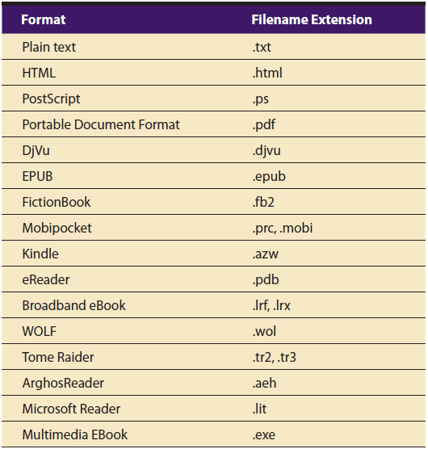
File Formats for E-Readers

Slide 34
HTML Documents
HTML: Hypertext Markup Language
Specify typefaces, sizes, colors, and other properties by “marking up” the text in the document with tags.
CSS: Cascading Style Sheet
A simple mechanism for adding style (e.g., fonts, colors, spacing) to web documents.( http://www.w3.org/Style/CSS/ )

Slide 35
Next Week
Image

Slide 36
Thank you!

