Slide 1

BTH645 - Multimedia Elements for User Interfaces
Shi, Yue (Sunny)
sunny.shi@senecacollege.ca
SENECA COLLEGE
Notes:
Good morning and welcome back. I hope you all had a great summer.
This photo is a rendering of our Peterborough Airport campus which is well under way for our January 2014 opening.
And the entire design and build process is exemplary of the entire college community coming together to create a great place for our students to study.

Slide 2
Outline
P5.js
2

Slide 3
Processing Language
Processing Language:
Created by Ben Fry and Casey Reas at MIT, 2000
To simplify graphics programming
open source programming language and environment
Create images, animations, and interactions
Java based
The programs (called sketches) are deployed as an applet.

Slide 4
Processing.js
Processing.js:
http://processingjs.org/
A sister project of Processing Language
initiated by John Resig, 2008
To use <canvas>
Translate Processing code to JavaScript
Allows Processing sketches to be delivered without plugins to the browser.
Render in <canvas>
Java based processing.
Seneca College started contribution, 2009,
Led by Prof. David Humphrey & students

Slide 5
P5.js
https://p5js.org/
p5.js was created by Lauren McCarthy and is developed by a community of collaborators
Client-side JavaScript library, for creating graphic and interactive experiences, based on the core principles of Processing
to make coding accessible for artists, designers, educators, and beginners—and reinterprets this for today's web.
Not Processing.js
JavaScript based, instead of Java
Use JavaScript syntax rules and conventions
Easy to be used like Processing
extends beyond canvas drawing to allow people to create, access and manipulate other HTML elements.

Slide 6
P5.js Advantages
Simple to create graphics
Easy to add web elements (e.g., buttons, text boxes) with P5.js plugins (e.g., add p5.dom.js)
Easy to implement with regular web development tools.

Slide 7
Demo
Ex: Floating bubble
https://p5js.org/examples/hello-p5-animation.html
References: https://p5js.org/reference/
P5.js Web Editor: https://editor.p5js.org/
testP5.html
sketch_shapes.js
sketch_circles.js
sketch_flowers.js

Slide 8
Steps to Put P5.js Sketch to Web
Download p5.js
https://p5js.org/download/
Complete version, p5.js
<script src = "p5.js"> </script>
2) Minified version p5.min.js
<script src = "p5.min.js"> </script>
CDN (Content Delivery Network):
<script src="https://cdn.jsdelivr.net/npm/p5@1.0.0/lib/p5.js"></script>
or
<script src = "https://cdnjs.cloudflare.com/ajax/libs/p5.js/1.0.0/p5.min.js"> </script>
More available at: https://cdnjs.com/libraries

Slide 9
Steps to Put P5.js Sketch to Web
2. Organize files into one directory (if in different directories, use complete path):
p5.js or p5.min.js (downloaded from https://p5js.org/download/)
mysketch1.js (written by you, the processing sketch)
testP5.html (written by you, the html file with sketches)
You may have css file (optional)

Slide 10
Steps to Put P5.js Sketch to Web
3. Create testP5.html file
<!-- testP5.html -->
<!DOCTYPE html>
<html>
<head>
<title> P5.js </title>
<script src = "p5.js"> </script>
<!-- <script src = "https://cdnjs.cloudflare.com/ajax/libs/p5.js/0.6.0/p5.js"> </script> -->
<script src = "js/mySketch1.js"> </script>
<link rel="stylesheet" href="css/my.css"/>
</head>
<body>
<h1> Have fun with P5.js </h1> </body>
</html>

Slide 11
Steps to Put P5.js Sketch to Web
4. Create sketch file (mySketch1.js)
function setup()
{
createCanvas(600,400)
}
function draw()
{
line(20,30, 50,90);
rect(50,90,100,100);
ellipse(150, 50, 40, 20);
}

Slide 12
function setup()
Called once when the program is started.
Define initial environment properties:
screen size,
background color,
loading images,
frame rate
before the draw() begins executing.
Variables declared within setup() are not accessible within other functions, including draw().
can only be one setup() for each program
should not be called again after its initial execution

Slide 13
function draw()
Called directly after setup()
continuously executes the code until program is stopped or noLoop() is called.
The draw() function is called automatically and should never be called explicitly.
can only be one draw() for each sketch
draw() must exist for continuous run or
events such as mousePressed().
draw() can be empty.

Slide 14
function draw()
Note:
the drawing coordinate system will be reset at the beginning of each draw() call.
If any transformations are performed within draw() (ex: scale, rotate, translate),
their effects will be undone at the beginning of draw(),
so transformations will not accumulate over time.
Styling applied (ex: fill, stroke, etc) will remain in effect.

Slide 15
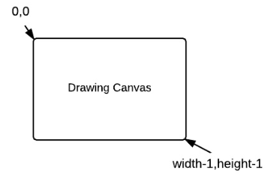
Introduction to P5.js
Coordinate System

Slide 16
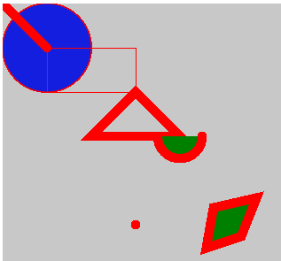
Introduction to P5.js
Reference: https://p5js.org/reference/
Shapes:
strokeWeight(1);
stroke(255,0,0); //red
fill(20,30,222); //blue
//ellipse(x,y,w,h)
ellipse(50,50,100,100); //circle, diameter:100
//fill("green");
noFill();
rect(50,50,100,50);
strokeWeight(10);
line(0,0,50,50);
triangle(150,100,100,150,200,150);
fill("green");
//arc(x,y,w,h,start,stop,
arc(200,150,50,50,0,PI);
point(150,250);
//quad(x1,y1,x2,y2,x3,y3,x4,y4);
quad(238, 231, 286, 220, 269, 263, 230, 276);
Example: sketch_shapes.js

Slide 17
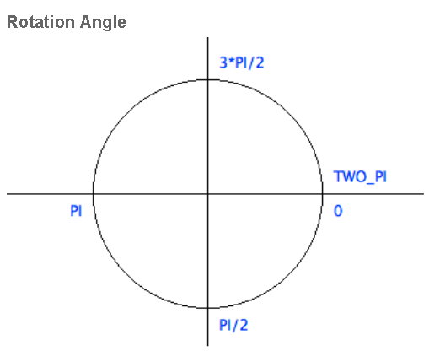

Slide 18
Vertex
sketch_vertex.js
beginShape(MODE);
MODE: POINTS, LINES, TRIANGLES, TRIANGLE_FAN, TRIANGLE_STRIP, QUADS, QUAD_STRIP
endShape();
endShape(CLOSE);
beginShape(TRIANGLES);
vertex(30, 75);
vertex(40, 20);
vertex(50, 75);
vertex(60, 20);
vertex(70, 75);
vertex(80, 20);
endShape();

Slide 19
text
text(): Draws text to the screen.
//sketch_text.js
textSize(32);
textFont("Arial");
text("word1", 50, 30);
//fill color (r,g,b)
fill(200, 102, 13);
text('word2', 50, 60);
sketch_text.js

Slide 20
Print
sketch_math_print.js
print(contents)
contents: Any: any combination of Number, String, Object, Boolean, Array to print
writes to the console area of your browser.
helpful for looking at the data a program is producing.
creates a new line of text for each call to the function.
Individual elements can be separated with quotes ("") and joined with the addition operator (+).
To print a blank line to console you can write print('\n').
Note:
calling print() without any arguments invokes the window.print() function which opens the browser's print dialog.

Slide 21
Math Functions
abs( )
ceil( )
exp( )
floor( )
log( )
max( )
min( )
pow(n, e)
round( )
sq( )
sqrt( )
sketch_math_print.js

Slide 22
3D
sketch_3D.js
3D Box
/* sketch_rotateX.js */
function setup() {
createCanvas(100, 100, WEBGL);
}
function draw() {
background(255);
/*rotateX(angle);
the angle of rotation, specified in radians or degrees,
depending on current angleMode */
rotateX(millis() / 1000);
/* system variable frameCount contains the number of frames that have been displayed
since the program started. Inside setup() the value is 0,
after the first iteration of draw it is 1, etc. */
rotateY(frameCount * 0.01);
/* box([width], [Height], [depth])
Draw a box with given width, height and depth */
box(50);
}

Slide 23
Color
Color:
Greyscale: single value - 0: black, 255: white
e.g., background(23);
Opaque Colors: 3 values for amount of Red, Green, Blue
e.g., fill(255, 0, 0)
http://cloford.com/resources/colours/500col.htm
Colours with alpha: same as opaque colours, except –
include a 4th value for transparency.
0 – completely transparent,
255 – completely opaque
e.g., fill(222,0,0, 120)

Slide 24
Images
Video: p5.js_6_images.mp4
sketch_image.js
function preload() {
img = loadImage('image/pic1.jpg');
}
function setup() {
createCanvas(600,400);
}
function draw()
{
// Top-left corner of the img is at (0, 0)
/* Width and height are the img's original width and height, 100 x 100 */
//image(img,0,0); // not work
image(img, 0, 0, 400,400);
}

Slide 25
"cross-origin" errors
Test the previous code locally,
Image not showing,
you may see errors on web console (next page)
https://github.com/processing/p5.js/wiki/Local-server

Slide 26
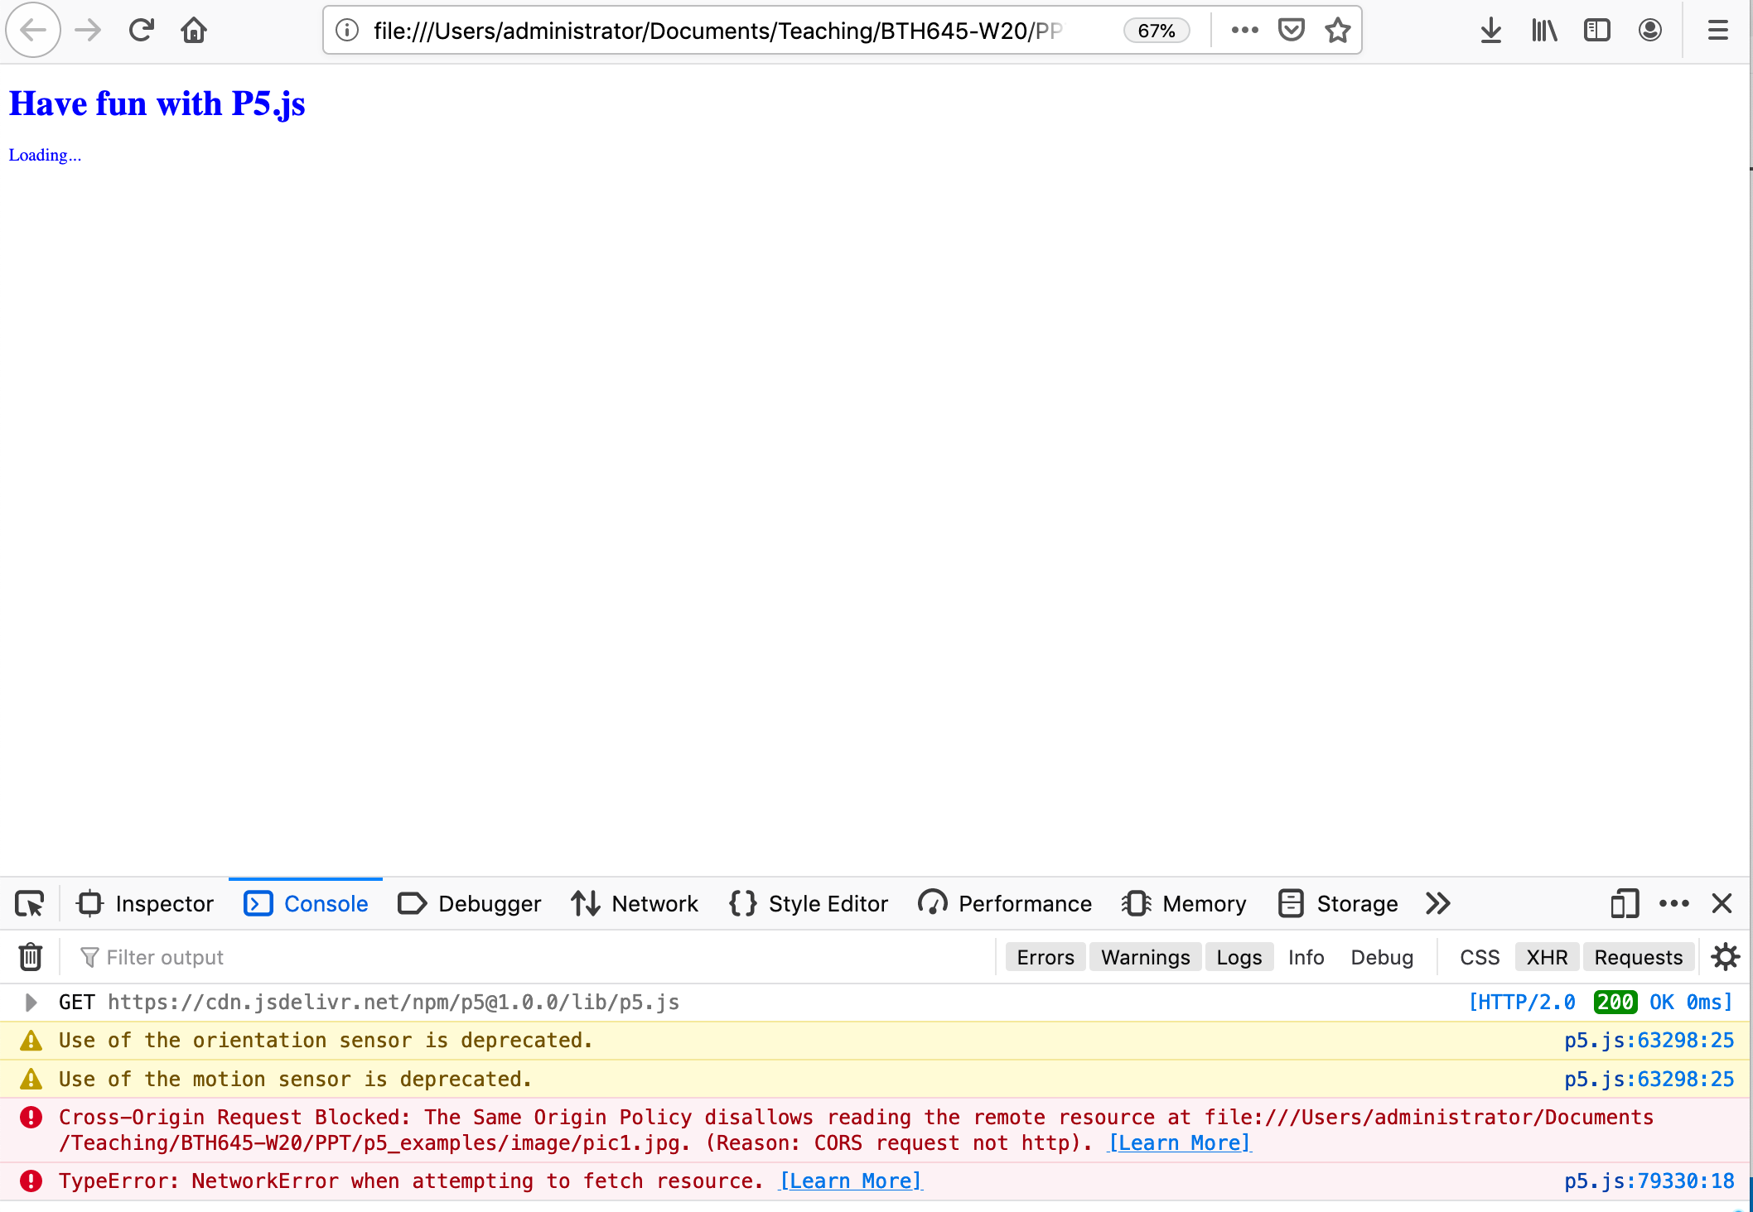
Image cannot load locally. CORS error.

Slide 27
"cross-origin" errors
Reason:
Some functionality (loading external files, for example) works as expected when the files are placed online via FTP or SSH.
However, if you try to view them locally (e.g., display images), you see some kind of "cross-origin" errors in console.
Solution: view them using a web server. E.g.,
1) Upload the project and view it via our matrix account:
https://matrix.senecacollege.ca/~bth645_201b40/testP5.html
2) Local server: refer to the following link
https://github.com/processing/p5.js/wiki/Local-server
https://github.com/processing/p5.js/wiki/Local-server

Slide 28
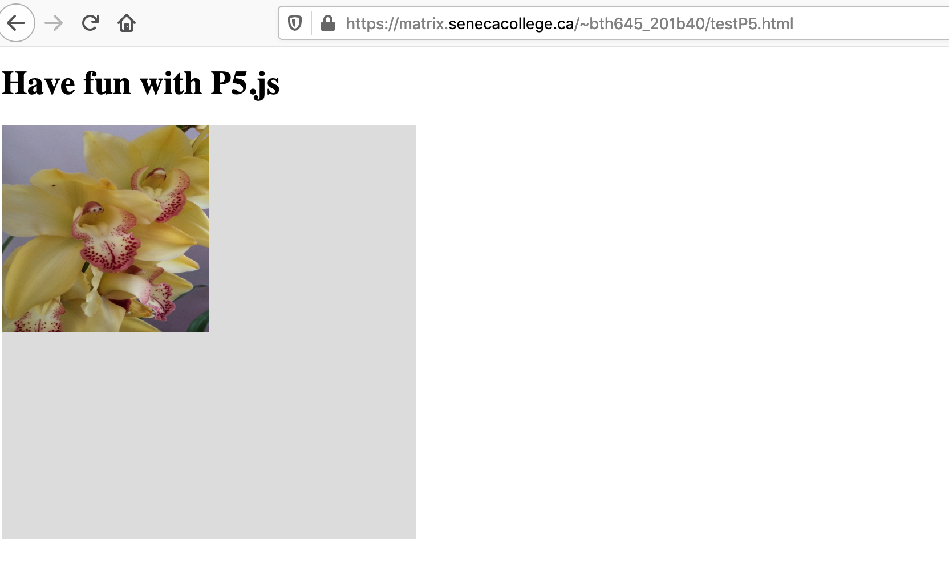
Image is loaded successfully on matrix.

Slide 29
Next Class
More on p5.js
Animation

Slide 30
Thank you!

