Slide 1

Responsive coding of PC and SmartPhone
2014.02

Slide 2
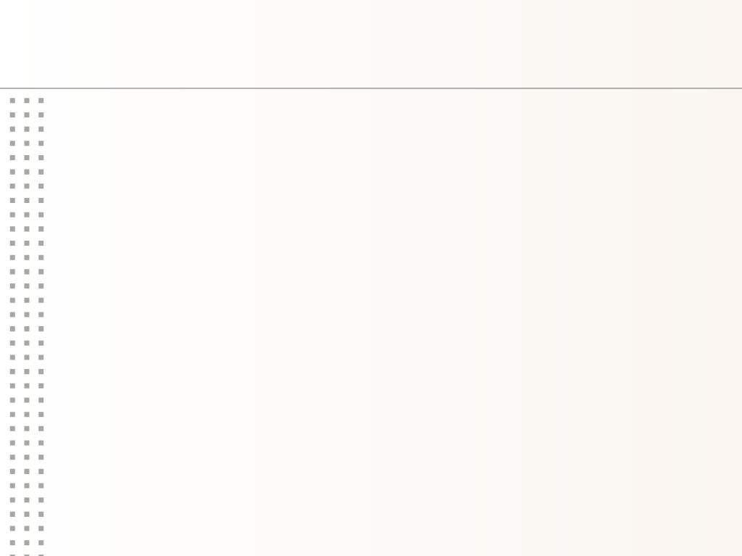
Coding Rule
doctype : html5
charset : utf-8
newline character : CR+LF
enabled browser : each latest
background-image : fixed
device font : no anti-aliasing in PSD
P-01

Slide 3
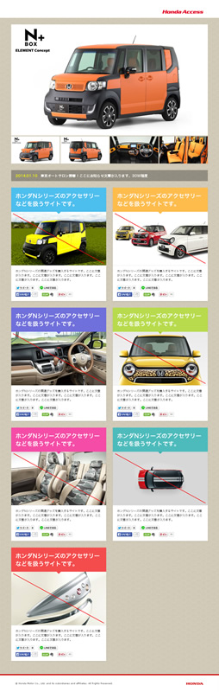
Responsive Rule
PC layout : 641px or more
SP layout : 640px below
index_PC.psd →
index_SP.psd →
P-02

Slide 4
About Material
Text : inex_SP.psd
Image : index_SP.psd
other parts : index_SP.psd
※ use inex_PC.psd only "top-visual"
P-03

Slide 5

Social Button
do not use the official widget
use the slice image
P-04

Slide 6
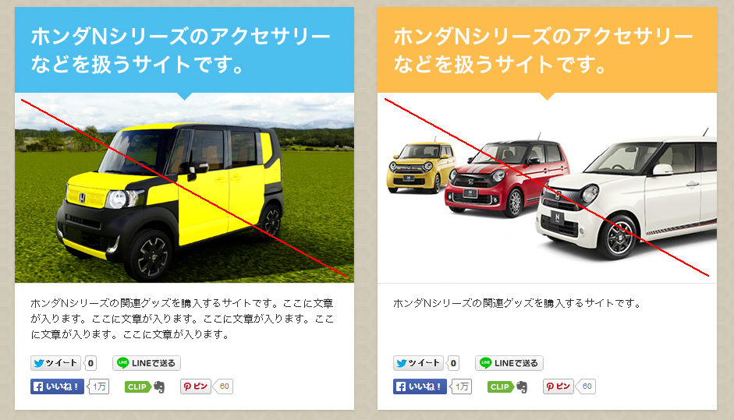
JS Program
adjust the height of the left and right panels in PC layout
P-05

Slide 7

Notes
▼ do not contained in the image below
P-06

Slide 8
Let's do our best!
End

