Slide 1
System Analysis and Design Chapter 1: Introduction
Trương Quốc Định
Faculty of Information Systems – CICT– Can Tho University

Slide 2
General Course Information

Slide 3
General course information
Course
System Analysis and Design
Code: CT112H
Credits
03 (30 theory hours; 30 practice hours)
Assessment
Group project or Mid-term exam, weights: 40%
Final exam, weights: 60%

Slide 4
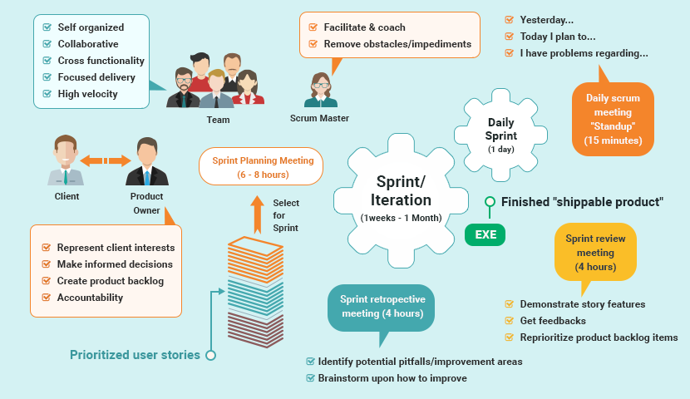
Objectives
General course information
Knowledge about:
System Development Environment,
User requirements analysis,
Data component of a system,
Processing component of a system,
Human computer interaction.

Slide 5

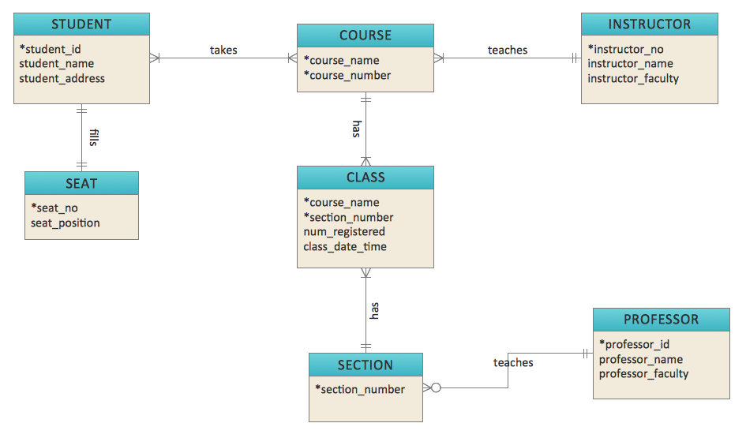
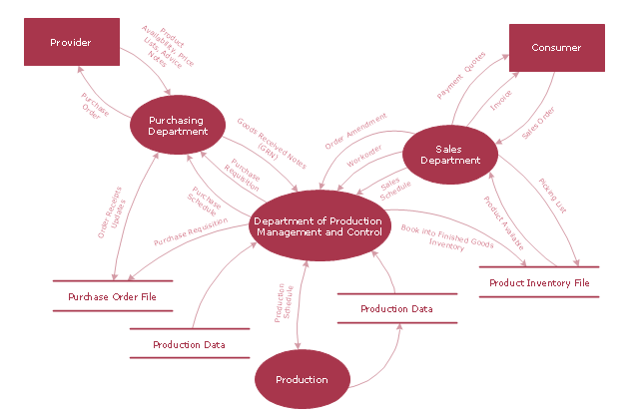
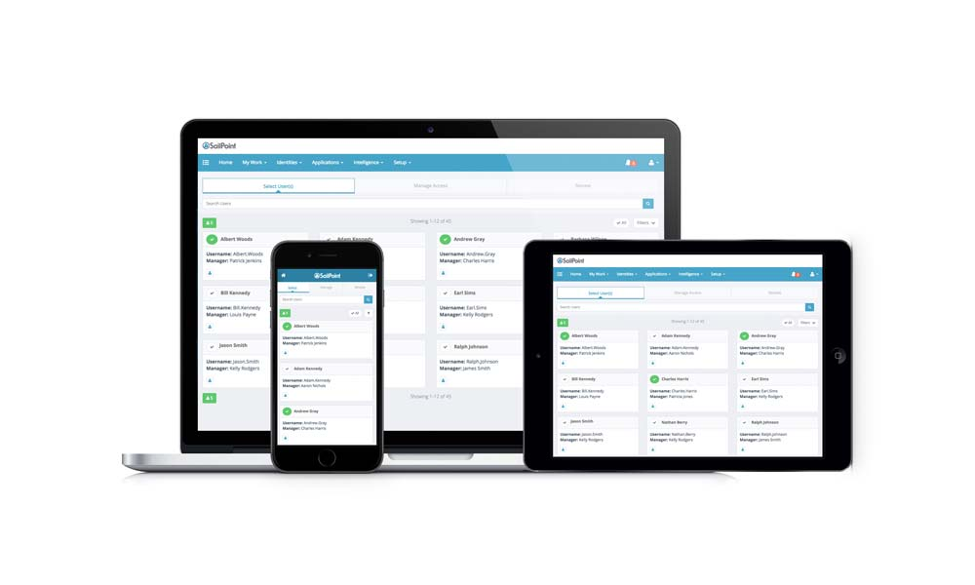
Objectives
General course information
Have ability to:
define accurate user requirements,
design data models,
design Data Flow Diagram,
work in a group and present a
substantial technical report.

Slide 6

Duties of student
General course information
Pay attention in class,
Actively and enthusiastically complete class assignments,
Cross-check against the lecturer’s solution in order to:
identify inconsistencies in the analysis phrase,
identify poorly constructed design elements.
Develop critical thinking and problem identification through practical experience.

Slide 7
Materials
General course information
Course slides.
Text book of System Analysis and Design, Trương Quốc Định, Phan Tấn Tài, 2018.
Modern System Analysis and Design, Jeffrey A. Hoffer, Joey F. George, Joseph S. Valacich, 2002.
Understanding your users- A practical guide to user requirements- Methods, Tools & Techniques, Catherine Courage, Kathy Baxter, 2005.
Business Process Model and Notation, https://www.bpmn.org/

Slide 8
Basic concepts

Slide 9
Definition of system
Basic concepts
According to the Merriam-Webster dictionary, a system is a group of interacting or interdependent items that regularly form a unified whole.
In other words, a system is a set of related things that work together toward a goal or exist together to form a complete entity.
Solar system
Public transport system
Computer system
Information system

Slide 10
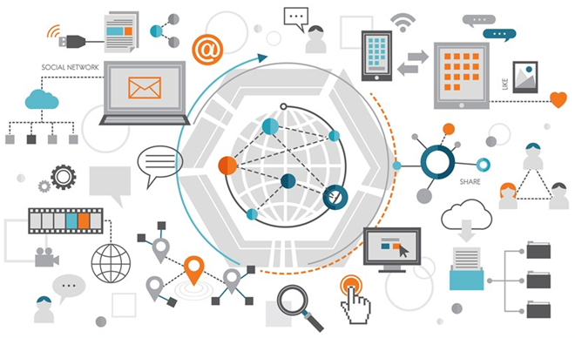
Definition of Information Systems
Basic concepts
Data: refers to raw, unorganized facts that need to be processed. Data is simple, sometimes random, and often meaningless until it is arranged or structured.
Information: is data that has been processed, organized, or presented within a specific context to become meaningful and useful.
Final course grade of a student, Grade distribution for a course
According to Merriam-Webster, an information system is defined as a computer system for collecting, creating, storing, processing, and distributing data/information.

Slide 11
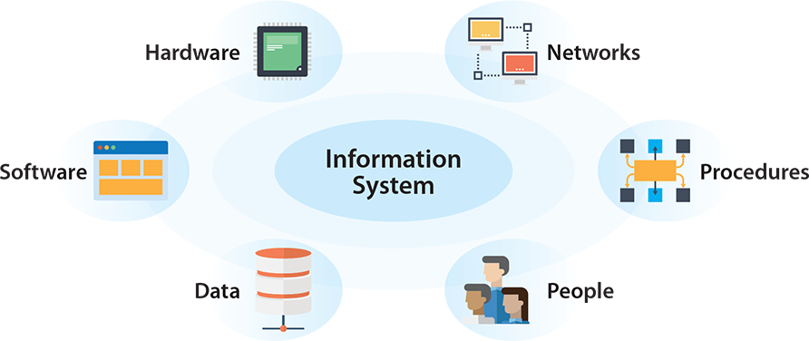
Components of an Information system
Basic concepts

Slide 12
Types of Information system

Slide 13
Types of Information system
Transaction Processing Systems
Management Information Systems
Office Automation Systems
Knowledge Management Systems
Decision Support Systems
Executive Support System

Slide 14
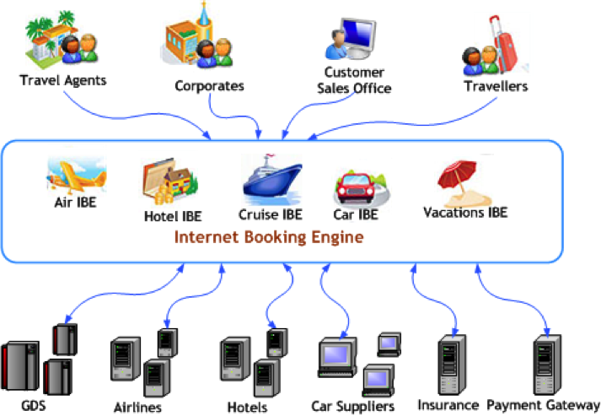

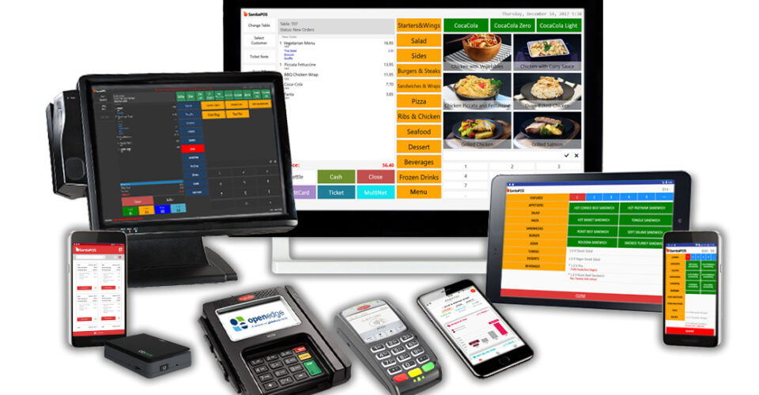
Transaction Processing Systems
Types of Information system
Carry out the collection, storage, modification, and retrieval of a business’s transaction data.
Only predefined and structured transactions are allowed.
The response time is short, though not considered real-time.

Slide 15


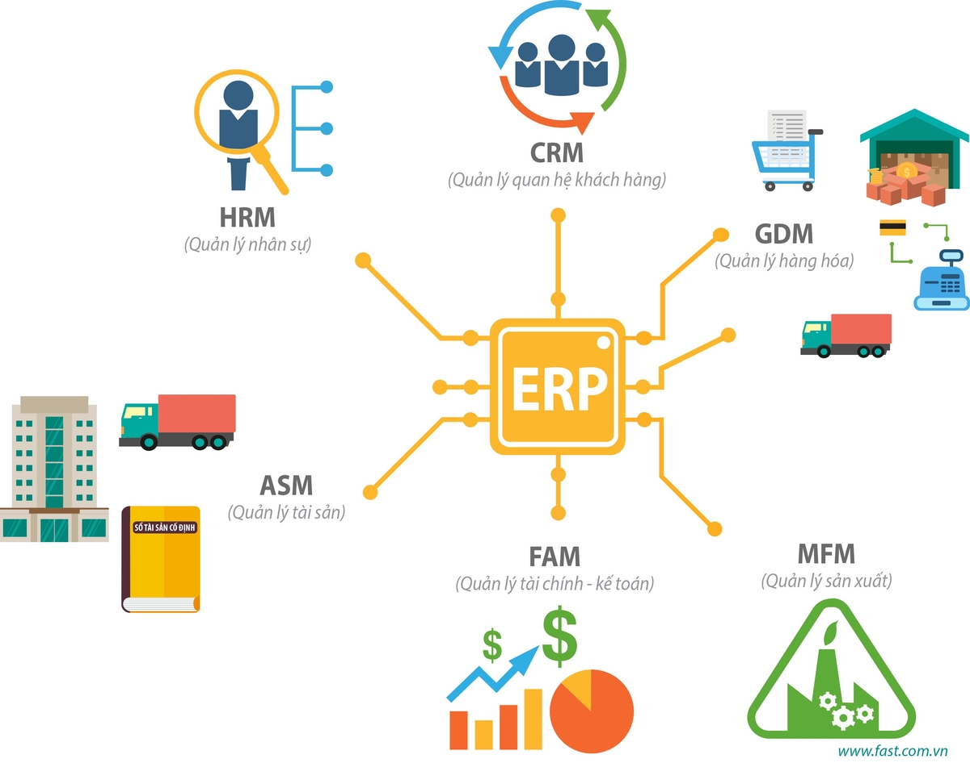
Management Information Systems
Types of Information system
Used to support decision-making, facilitate coordination, maintain control, and present information throughout the organization.
The ultimate goal is to enhance the organization's value and profitability by providing managers with timely and relevant information.

Slide 16
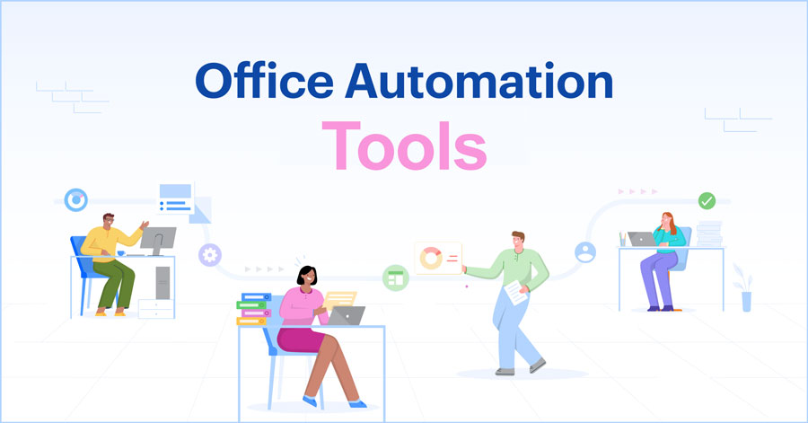
Office Automation Systems
Types of Information system
Hardware and software solutions that enable data transmission between organization components, simplify processes, and automate various administrative tasks.

Slide 17
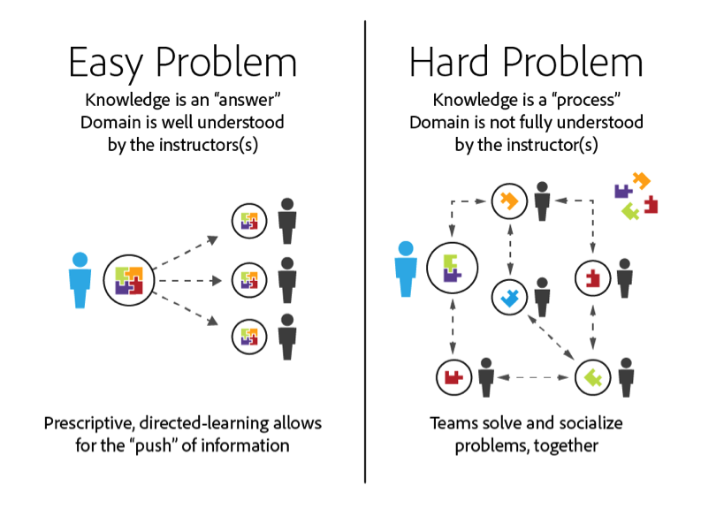
Knowledge Management Systems
Types of Information system
Enables the creation, sharing, preservation, and development of knowledge resources, ensuring their optimal use within the organization to support decision-making and innovation.
Increase productivity
Improve management efficiency
Enhance customer satisfaction
Attract and leverage talent
Encourage learning and knowledge sharing

Slide 18
Decision Support Systems
Types of Information system
Combines data and sophisticated analytical models or data analysis tools to support semi-structured and unstructured decision making.
Analyzing large volumes of unstructured data and accumulating information can help solve problems.

Slide 19

Executive Support System
Types of Information system
The system enables quick and easy access to critical data that supports strategic decision-making by focusing on key performance indicators and organizational priorities.

Slide 20
Why is it necessary to perform system design & analysis?

Slide 21
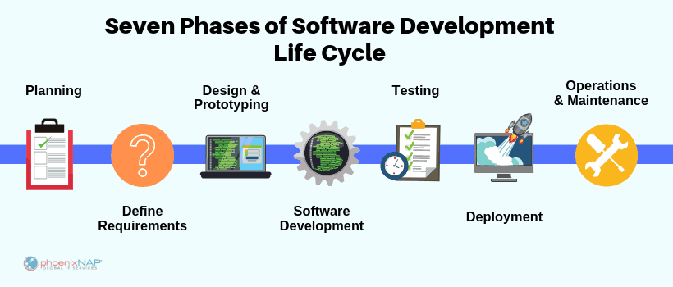
Software development life cycle

Slide 22
What is the purpose of system analysis?
Understand the system that needs to be built.
Collect and interpret data, identify problems, and break down the system into its components.
It is a problem-solving technique aimed at improving the system and ensuring that all its components function effectively.
It answers the questions:
“What should the system do?
Why should it do that?
Is it feasible?”

Slide 23
What is the purpose of designing a system?
Identify approaches for system construction.
Evaluate various solution options
Select the most effective implementation strategy
Address the question: “How should this requirement or function be carried out?”

Slide 24
To become a systems analyst

