Slide 1
System Analysis and Design Chapter 2: User requirements analysis
Trương Quốc Định
Faculty of Information Systems – CICT– Can Tho University

Slide 2
Basic concepts

Slide 3
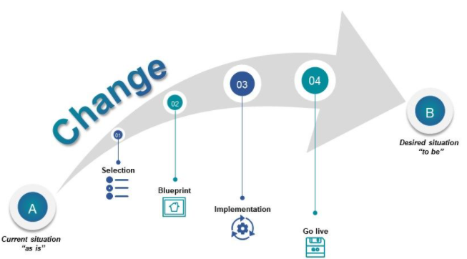
Basic concepts
The As-Is system is the current system and may or may not be computerized.
The To-Be system is the new system that is based on updated requirements.
The System Proposal is the key deliverable from the Analysis Phase.

Slide 4
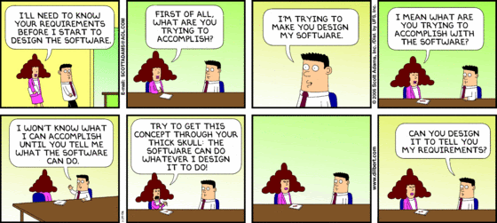
Basic concepts

Slide 5
Requirement Types
Basic concepts
User requirement
Expressed in natural language
May include diagrams and visual models
Specifies system services and operational constraints
Intended for the end user
System requirement
A detailed specification document
Describes functions, services, and constraints of the system
Defines implementation requirements
Serves as a contractual basis for system development

Slide 6
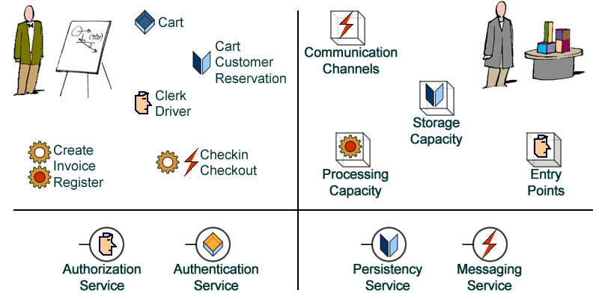
Requirement Types
Basic concepts
Functional Requirements
A process the system has to perform
Information the system must contain
Nonfunctional Requirements
Behavioral properties the system must have
Operational
Performance
Security
Cultural and political
…

Slide 7
Requirements Management Process

Slide 8
Requirements Management Process
Feasibility studies
Requirements elicitation and analysis
Requirements validation
Requirements management

Slide 9

Feasibility studies
Requirements Management Process
Value Proposition
Determine whether the proposed system delivers tangible benefits.
Goal Alignment
Assess if the system supports the organization in achieving strategic objectives.
Technical & Financial Viability
Evaluate whether the system can be implemented using current technologies and within budget constraints.
Integration Capability
Confirm the system’s compatibility with existing operational systems.

Slide 10
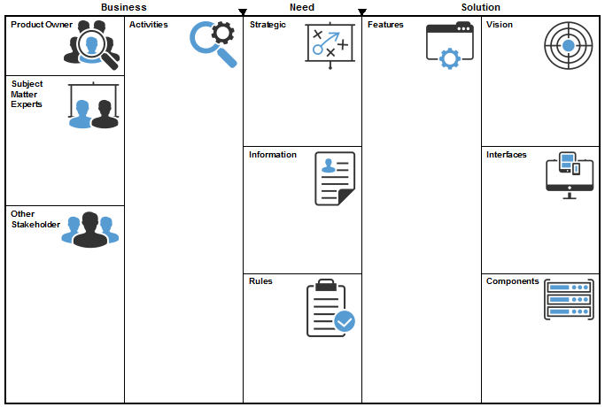
Requirements elicitation and analysis
Requirements Management Process
Collect requirements
Gather data on both the proposed and existing systems.
Requirements Analysis
Identify and refine user and system requirements based on collected information.
Information Sources
Documentation
Stakeholders
Technical specifications of similar systems

Slide 11
Requirements validation
Requirements Management Process
Validity
Does the system provide functionalities that best meet customer requirements?
Consistency
Are there any conflicting or contradictory requirements?
Completeness
Have all required functionalities been included according to customer expectations?
Realism
Can the requirements be implemented within the available budget and technology?
Verifiability
Can each requirement be validated through testing or other means?

Slide 12

Requirements management
Requirements Management Process
Change Management
Oversee adjustments to requirements during system analysis and development.
Dynamic Nature of Requirements
Requirements are often incomplete and inconsistent—continuous refinement is necessary.

Slide 13
Activities preparation

Slide 14
Gain an understanding of the system
Activities preparation
Analysis of Similar Systems
Unique Functionalities: Document the distinct features offered by each system.
Design Limitations: Evaluate weaknesses or drawbacks in system architecture or interface.
User Community: Assess the size, activity level, and supportiveness of the system's user base.
User Ratings: Compile feedback, reviews, and expert evaluations.
Operating Environment: Identify the platforms, technical conditions, and system requirements for optimal operation.
Core Functionalities: Summarize the essential features commonly adopted and valued in practice.

Slide 15
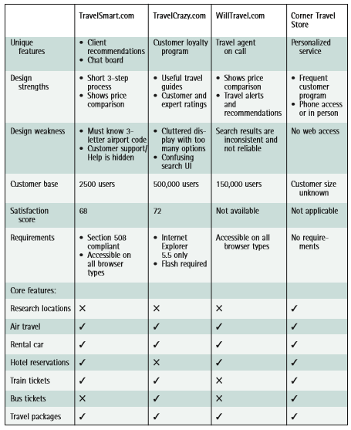
Gain an understanding of the system
Activities preparation

Slide 16
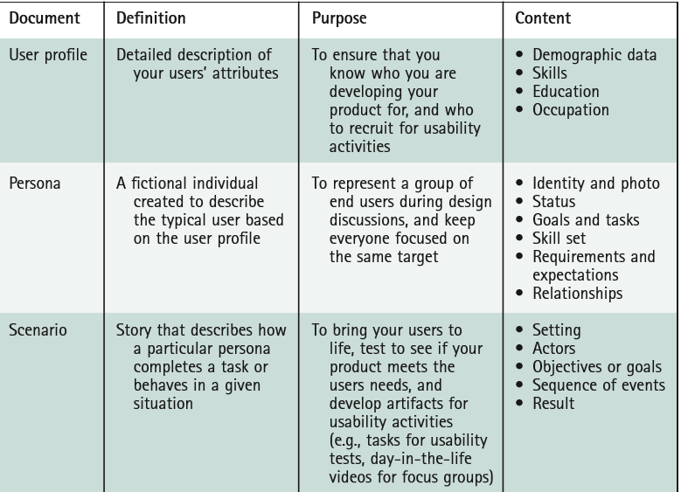
Gain an understanding of the system’s users
Activities preparation

Slide 17
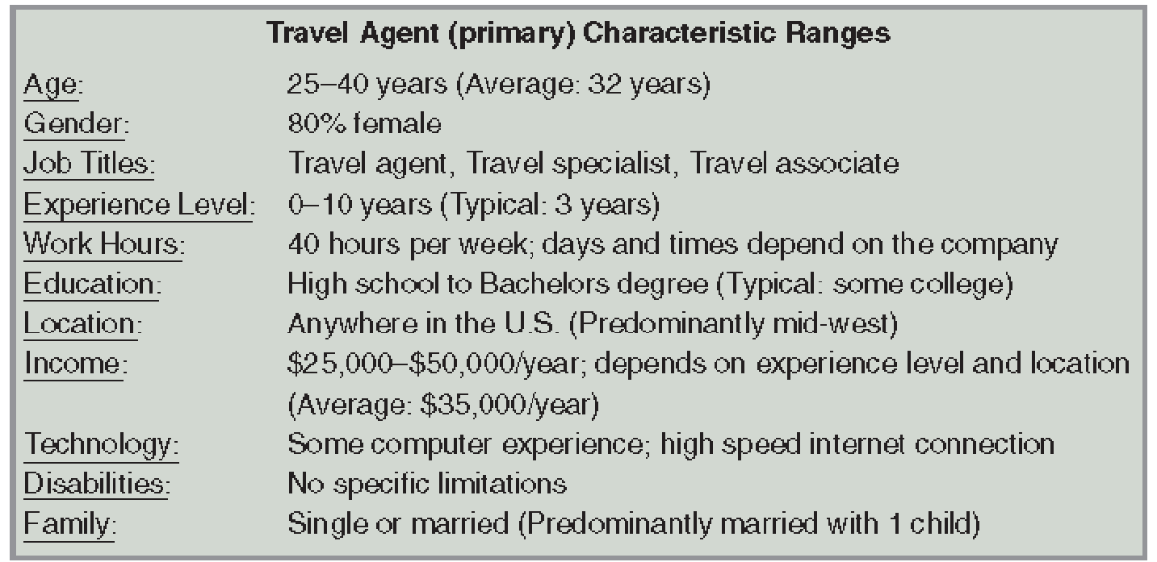
Gain an understanding of the system’s users
Activities preparation

Slide 18
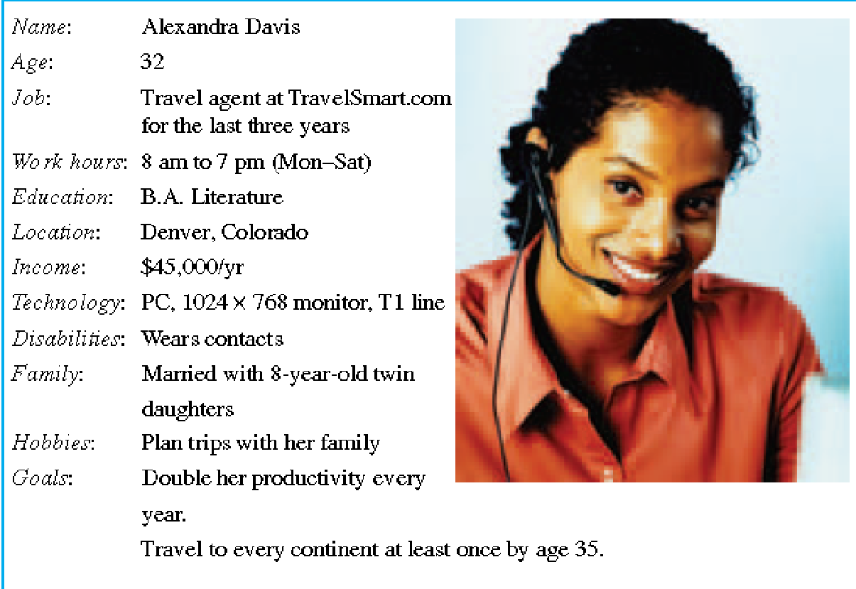
Gain an understanding of the system’s users
Activities preparation

Slide 19
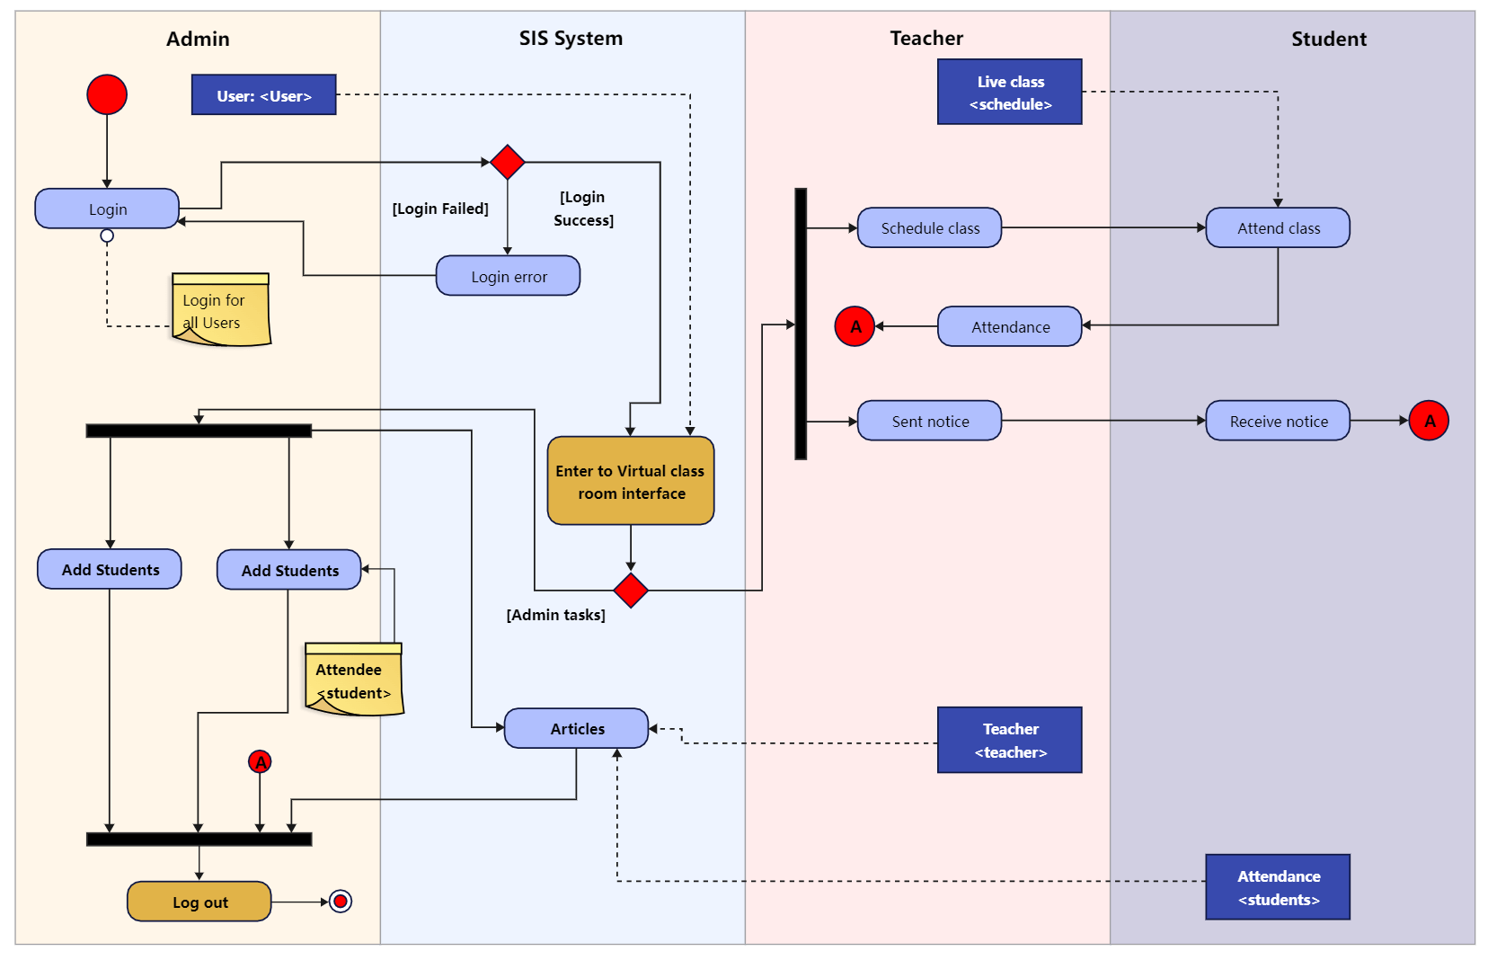
Gain an understanding of the system’s users
Activities preparation

Slide 20
Requirements gathering methods

Slide 21
Requirements gathering methods
Interview
The most widely used method.
Can be combined with other techniques.
Group Interview
Gathers requirements from a group of similar users.
Survey / Questionnaire
Helps collect structured information for system design.
Suitable for gathering requirements from a large user group.

Slide 22
Interview
Requirements gathering methods
Define the objective of the interview.
Select appropriate interviewees.
Choose between in-person or phone interviews.
Pay attention to the phrasing of questions:
Each question should be no longer than 20 words.
Avoid addressing multiple topics in a single question.
Do not use double negatives.
Avoid asking for future predictions.
Do not suggest answers within the question.

Slide 23
Survey / Questionnaire
Requirements gathering methods
Select appropriate survey participants.
Pay attention to response rate (typically between 20% and 60%).
Determine the methods for distributing and collecting the survey.
Choose suitable question types (open-ended or closed).
Define how to analyse response tables.
Ensure anonymity:
Do not collect personal information.
If personal information is collected, do not link it to individual responses.

Slide 24
Activities summary

Slide 25
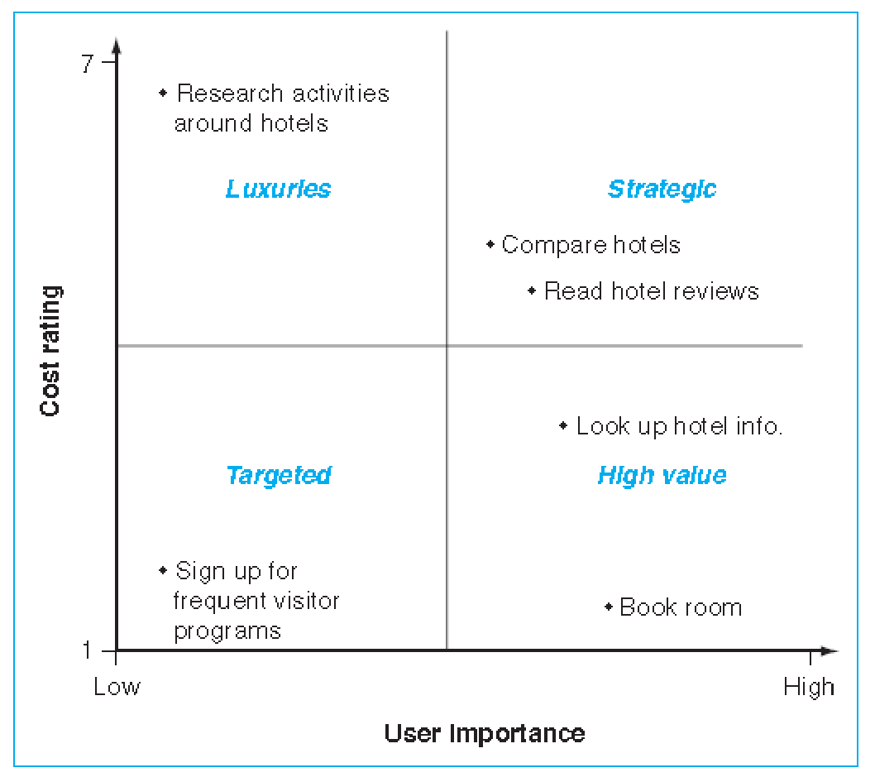
Consolidation and Prioritization of Requirements
Activities summary
Consolidate collected requirements
Organize and categorize all gathered input from users and stakeholders.
Prioritize requirements
Evaluate and rank the requirements.

Slide 26
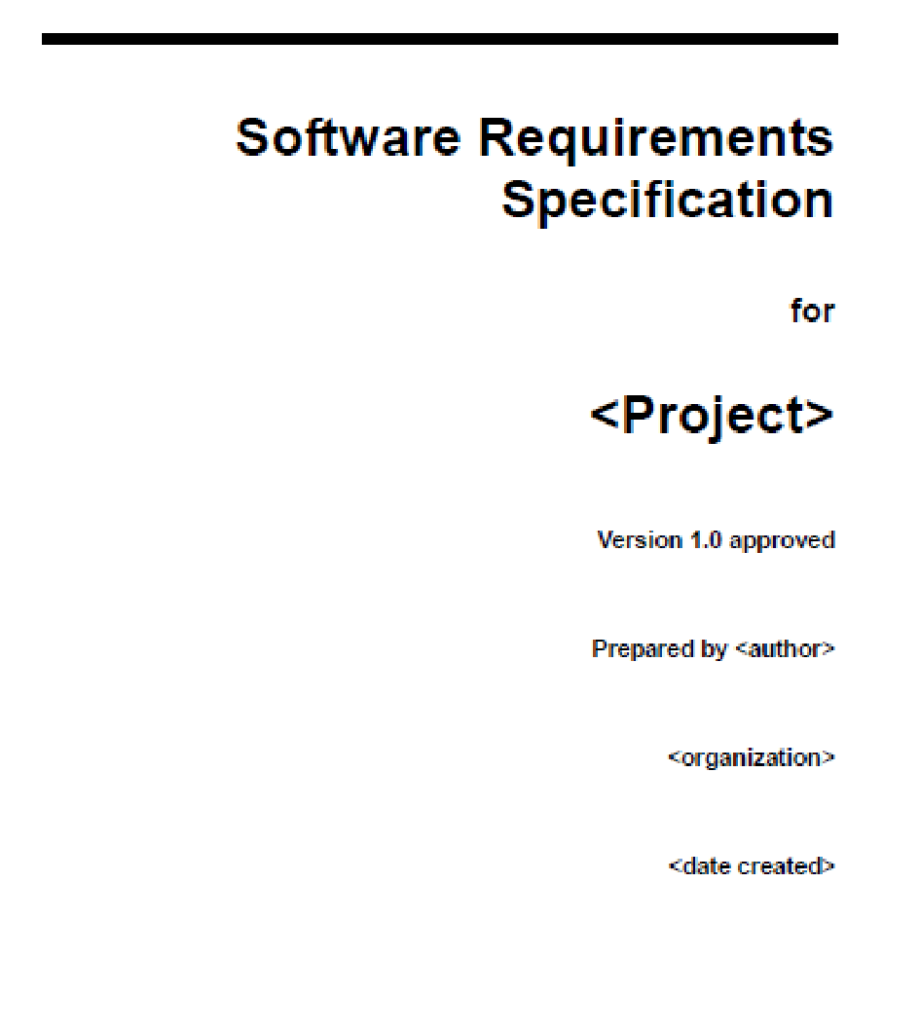
System Requirements Specification
Activities summary

