Slide 1
System Analysis and Design Chapter 3: Business Process Modelling
Trương Quốc Định
Faculty of Information Systems – CICT– Can Tho University

Slide 2
Basic concepts

Slide 3
Basic concepts
A business process is a set of structured activities or tasks performed by people or systems to achieve a specific organizational goal.
It involves the coordination of resources, roles, and workflows to deliver value to customers or stakeholders.
An inter-organizational business process is a workflow that is triggered by one organization but involves collaboration, communication, or data exchange with external parties such as suppliers, partners, clients, or other institutions.

Slide 4
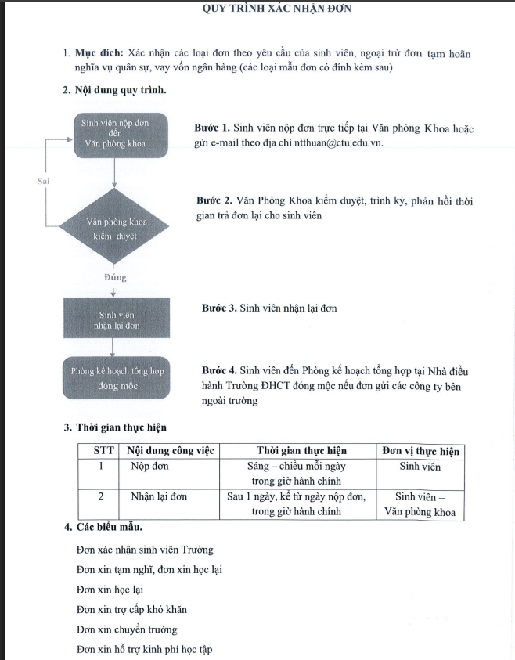
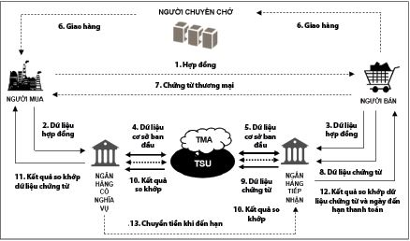
Basic concepts

Slide 5
Working with Business process
Basic concepts
We cannot evaluate, install, or deploy a business process because it only exists in thought.
We can only work with a business process indirectly.
We need to model the business process.

Slide 6
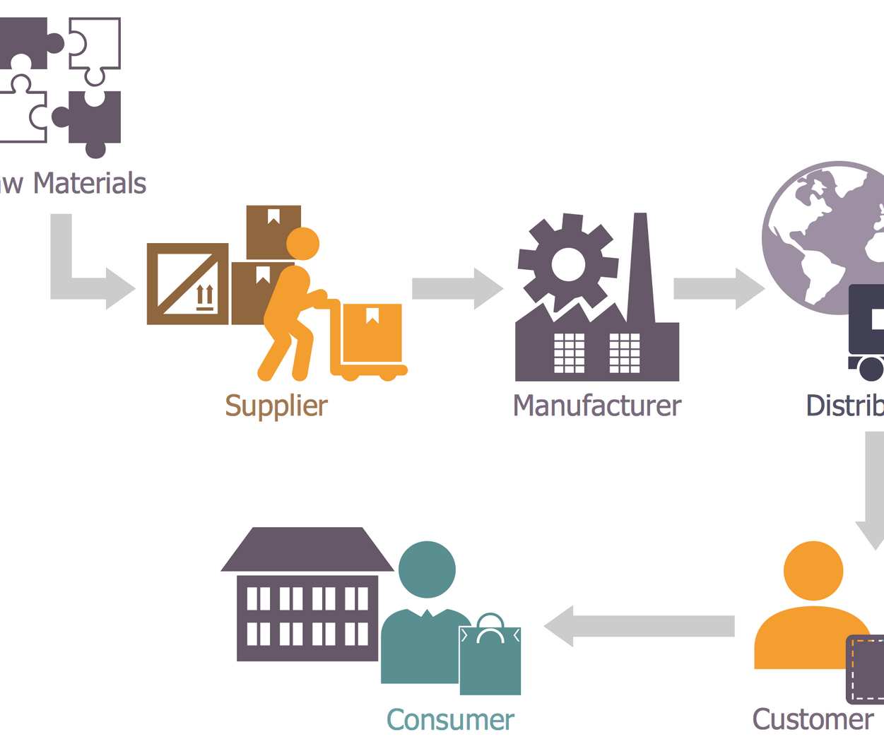

Basic concepts
Modelling is the abstraction of objects and phenomena from the real world.
It represents one or more aspects of a system while omitting unnecessary details.

Slide 7
Business process modelling
Basic concept
Clearly describing the business domain eliminates ambiguity or confusion.
It facilitates easier collection of customer feedback.
It serves as a tool to communicate domain knowledge and business requirements to the development team without misinterpretation.

Slide 8
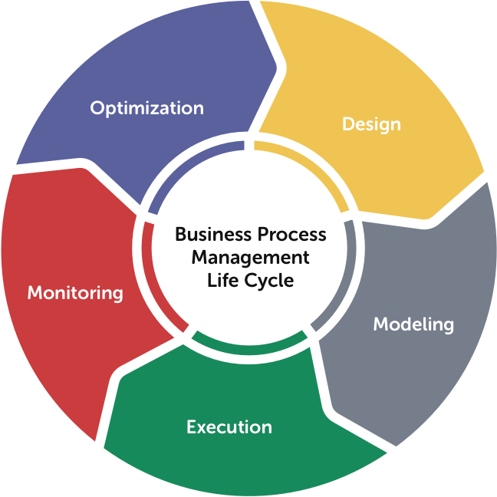
Business process management life circle
Basic concept
Process Design
Process Modelling
Process Execution
Process Monitoring
Process Optimization
....

Slide 9
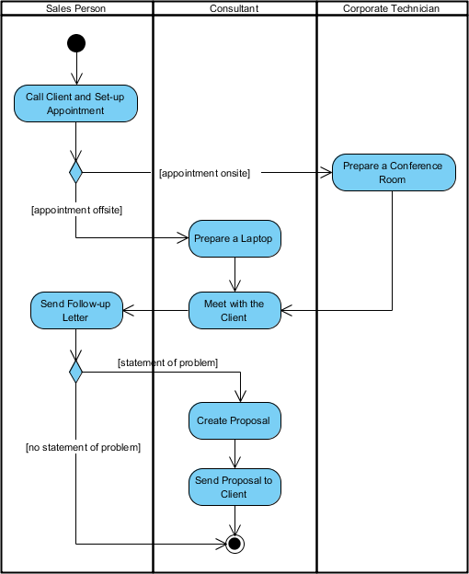
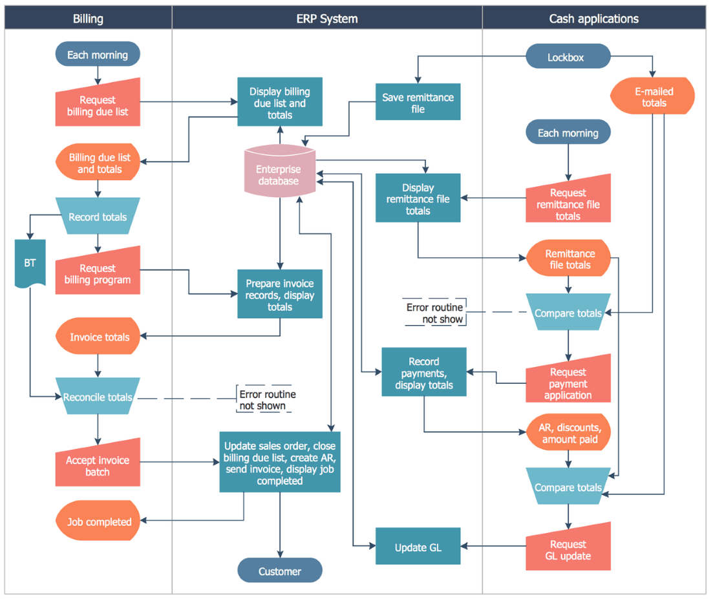
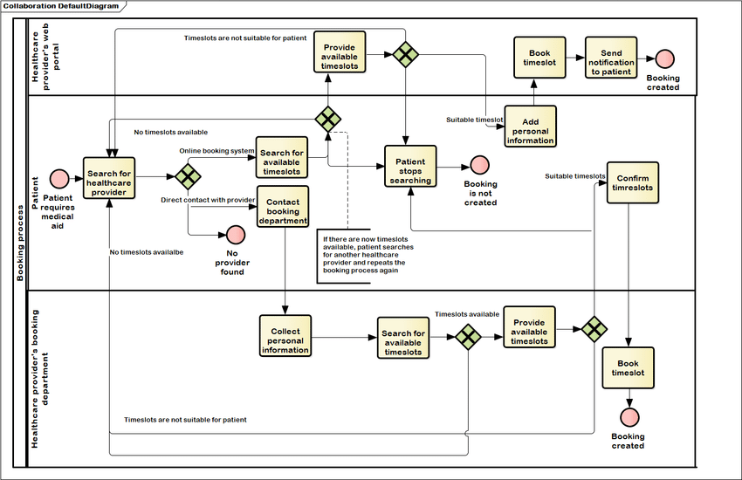
Tools
Basic concept
Flowchart.
UML Activity.
BPMN.

Slide 10
BPMN - Business Process Model and Notation

Slide 11
Why use BPMN?
Business Process Model and Notation
BPMN is a standard specifically used for modelling business processes.
It is governed by OMG (The Object Management Group®), an international, open-membership, non-profit technology standards consortium.
BPMN also draws from previous approaches to business process modelling including EPC, UML activity diagrams, and Petri nets.
It is supported by numerous tools and organizations.

Slide 12
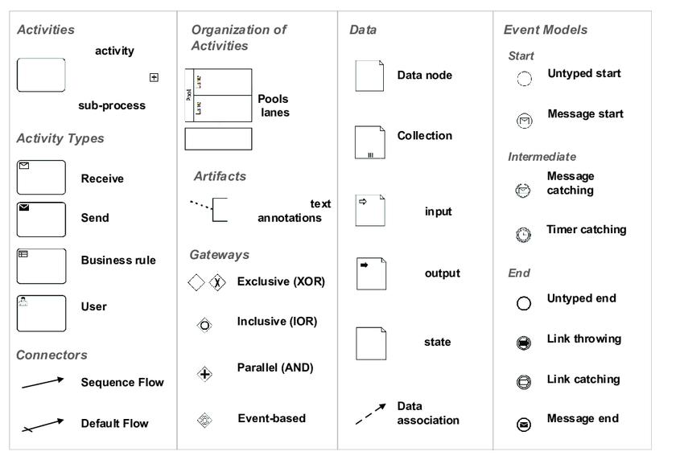
BPMN
Business Process Model and Notation
BPMN – Business Process Model and Notation

Slide 13
Basis elements
Business Process Model and Notation
Swimlanes –visual elements used to organize and categorize activities and tasks within a process diagram, typically representing different participants. It includes two basic components: pool & lane.
Flow Elements – define the behavior of a process. It includes three basic components: event, activity, gateway.
Connecting Objects - are elements that establish relationships between different process components, facilitating the flow of information and control. There are three types: Sequence flows, message flows, associations.
Data – represents information used or produced by activities within a BPMN process.

Slide 14
Describe a business process using BPMN
Business Process Model and Notation
Activity
Flows
A business process is a sequential chain of activities or tasks. Each activity is identified by a name. When describing an activity, it should include:
By which entity (who, component, or process) it is performed.
Performed manually/semi-automatically/automatically.
What is the triggering condition?
How is it integrated with other activities once completed?
Whether it uses or generates data.
Swimlanes
Activity types
Event
Gateway
Data

Slide 15
Swimlane & Message flow
Business Process Model and Notation
Swimlane includes pool and lane.
Pool represents a participant in a business process.
Lane is a sub-partition within a pool that further organizes activities.
Communication between pools occurs through message flows.

Slide 16
Activity & Sequence flow
Business Process Model and Notation
Activity represents tasks or work that is performed within the process.
An activity can be:
An atomic (indivisible) task.
A collection of tasks (process, sub-process)
The ordered sequence of activities is represented by sequence flows.

Slide 17

Basic types of Activity
Business Process Model and Notation
Task
Manual task
User task
Service task
Expanded sub-process
Collapsed sub-process
Call activity
to be performed without the aid of any business process execution engine

Slide 18
Event
Business Process Model and Notation
An Event is something that “happens” during the course of a Process.
These events affect the flow of the Process.
The start of an Activity, the end of an Activity, the change of state of a document, a Message that arrives, etc., all could be considered Events.
Icons within the circle shape of an event can indicate the type of triggering.

Slide 19
Basic types of Event
Business Process Model and Notation
Generic start event
Generic end event
Message start event
Message end event
Timer start event
Terminate event

Slide 20
Gateway
Business Process Model and Notation
Gateways are used to control how Sequence Flows interact as they converge and diverge within a Process.
Tokens arrive at a Gateway, they can be merged together on input and/or split apart on output as the Gateway mechanisms are invoked
Icons within the diamond shape can indicate the type of flow control behavior.

Slide 21
Basic types of Gateway
Business Process Model and Notation
Exclusive (XOR) gateway is used to create alternative paths within a Process flow.
For a given instance of the Process, only one of the paths can be taken.
Use a marker that is shaped like an “X”
Parallel (AND) is used to synchronize (combine) parallel flows.
Use a marker that is shaped like an “+”

Slide 22
Data & Data association
Business Process Model and Notation
Data store is used to retrieve or update stored information that will persist beyond the scope of the Process.
Data object is use to model data within the Process flow.
Data objects and Data stores are connected to other components of the process through data associations.

Slide 23
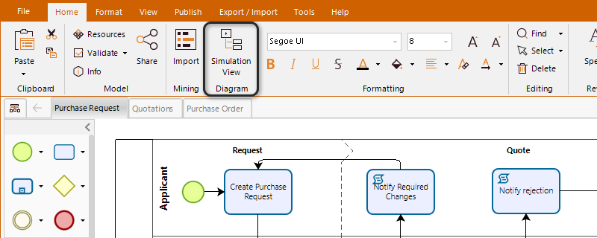
Tools for BPMN modelling
Business Process Model and Notation
Bizagi Modeler

Slide 24
Tools for BPMN modelling
Business Process Model and Notation
bpmn.io

Slide 25
Example – Opening a bank account
Business Process Model and Notation
The process begins when a request to open an account is received from the customer.
The staff reviews the submitted documents; if any are missing or incomplete, the request is rejected.
If the customer provides all the required paperwork, the staff checks the validity of the documents.
If everything is valid, the system automatically creates an account.
The staff then sends the account information and the ATM card linked to the account to the customer

Slide 26
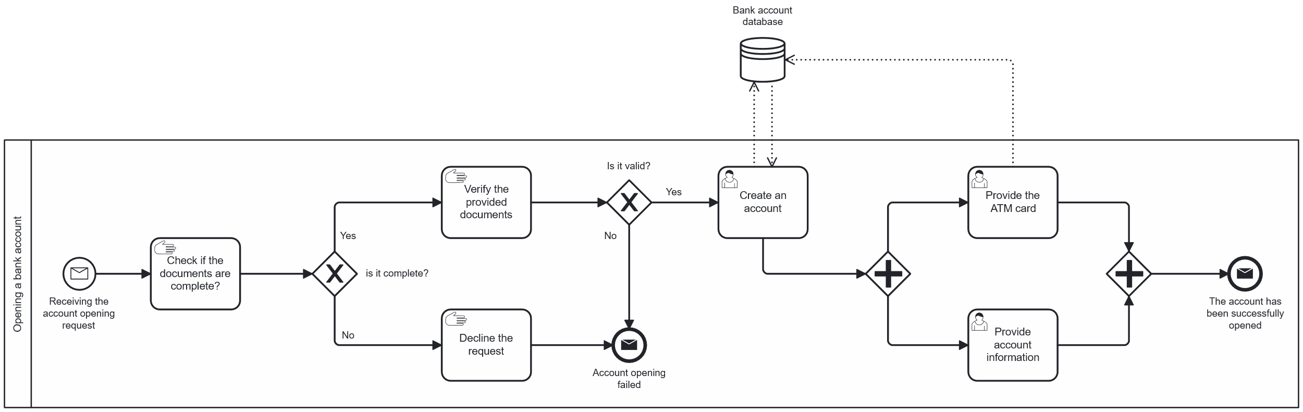
Example – Opening a bank account
Business Process Model and Notation
Suggestion diagram

Slide 27









Types of Event
Business Process Model and Notation
Event | Description
Message Event | They are used to wait until a proper message is received.
Timer Event | Timer events are events which are triggered by a defined timer.
Error Event | Error events are elements in the process referring to defined errors.
Escalation Event | Used to communicate to a higher flow scope. Unlike an error, an escalation event is non-critical and execution continues at the location of throwing.
Signal Event | Used if you want to communicate with multiple listeners.
Cancel Event | The cancel end event can only be used in combination with a transaction subprocess.
Conditional Event | The conditional event defines an event which is triggered if a given condition is evaluated to true.
Link Events | It has no special execution semantics but serves as a “GoTo” to another point in the same process model.
Terminate Event | Signify the immediate and complete termination of a process or subprocess, including all active paths within that scope.
See details at https://docs.camunda.org/manual/7.15/reference/bpmn20/events/

Slide 28
Business Process Model and Notation
Example

Slide 29
Business Process Model and Notation
Example

Slide 30
Business Process Model and Notation
Example

Slide 31
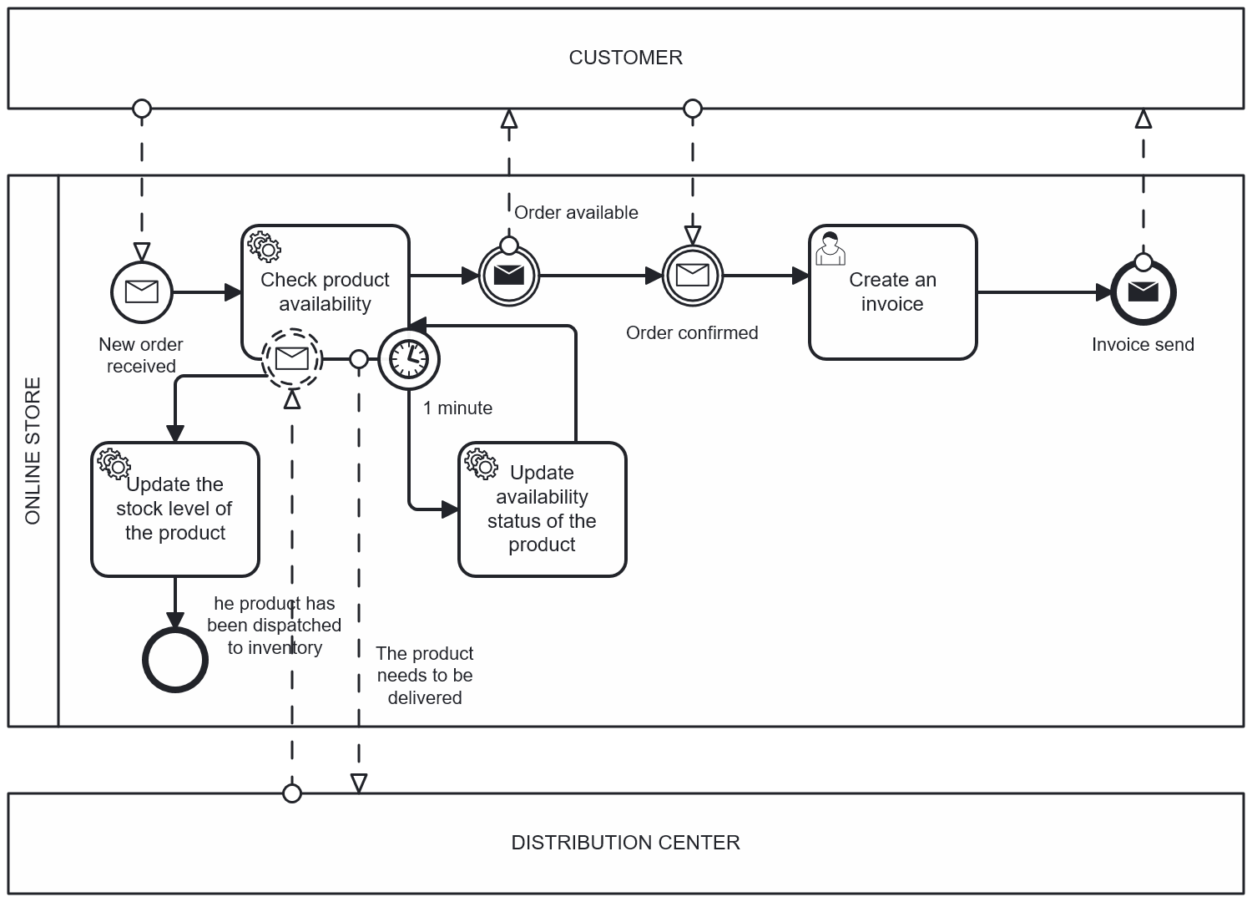
Business Process Model and Notation

Slide 32
Types of Activity
Business Process Model and Notation
Sub-process
View: collapsed/expanded
Type: Loop, multiple instance (sequential, parallel), ad-hoc.
Task
Manual, user, service, send, receive, rule, script.
Activity
Call activity.

Slide 33










Types of Activity
Business Process Model and Notation
Activity | Description
Loop | A Sub-Process indicates that the sub-process repeats itself in sequence.
Multi-instance | The sub-process can run with other identical sub-processes simultaneously.
Ad-hoc | A Sub-Process represents a collection of tasks that exist solely for handling a specific case.
Manual task | A Task is performed without the aid of any business process execution engine.
User task | A Task represents that a human performer performs the task with the use of a software application.
Service task | A Task that uses an automated application, or other kinds of service in completing the task.
Send task | A task that sends a message to another pool, the task is completed once the message has been sent.
Receive task | A Task indicates that the process has to wait for a message to arrive in order to continue.
Rule task | It provides a mechanism for a process to provide input to a Business Rules Engine and then obtain the output provided by the Business Rules Engine.
Script task | A Task is executed by a Business process engine.
Call | Used to create a reusable process definition that can be reused in other process definitions.
See details at https://www.visual-paradigm.com/guide/bpmn/bpmn-activity-types-explained/#bpmn-script-task

Slide 34
Business Process Model and Notation

Slide 35
Business Process Model and Notation

Slide 36
Business Process Model and Notation

Slide 37
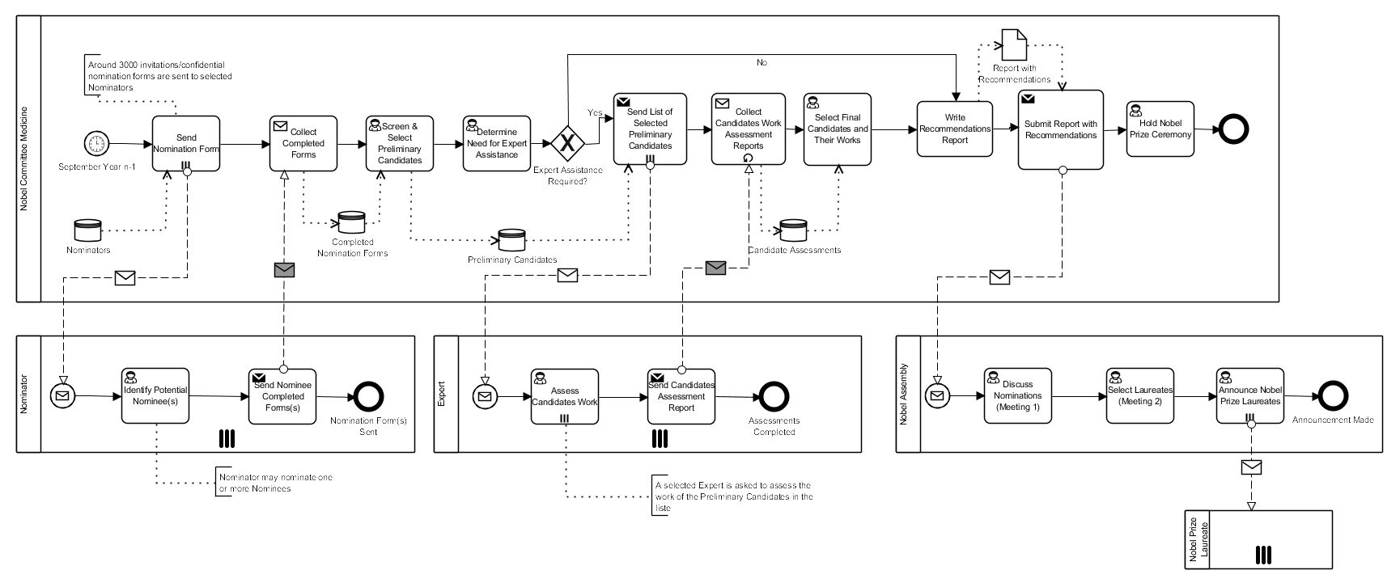
Business Process Model and Notation

Slide 38






Types of Gateway
Business Process Model and Notation
Gateway | Description
Exclusive (XOR) | Used to create alternative paths within a Process flow.
Parallel | A Fork into multiple paths of execution, or A Join of multiple incoming paths of execution.
Inclusive (OR) | One or more of the available paths will be taken.
Exclusive event based | Used to branch a process when alternative paths are determined by events (various messages or signals) rather than by conditional flows.
Parallel event based | A Parallel Event-Based gateway is similar to a parallel gateway. It does not wait for all of the events to arrive.
Complete | Multiple factors, rules, and analyses can all combine to yield results. The analysis should result in at least one path always being taken.
See details at https://www.visual-paradigm.com/guide/bpmn/bpmn-gateway-types/

Slide 39
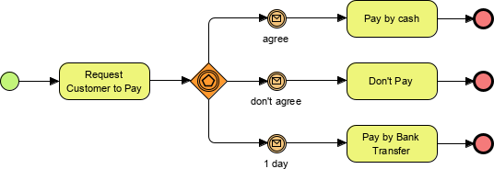
Business Process Model and Notation

Slide 40
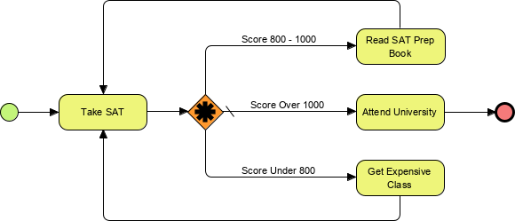
Business Process Model and Notation

Slide 41
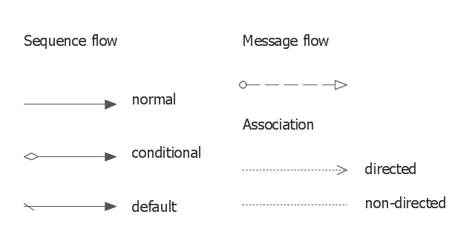
Connecting Object
Business Process Model and Notation

Slide 42
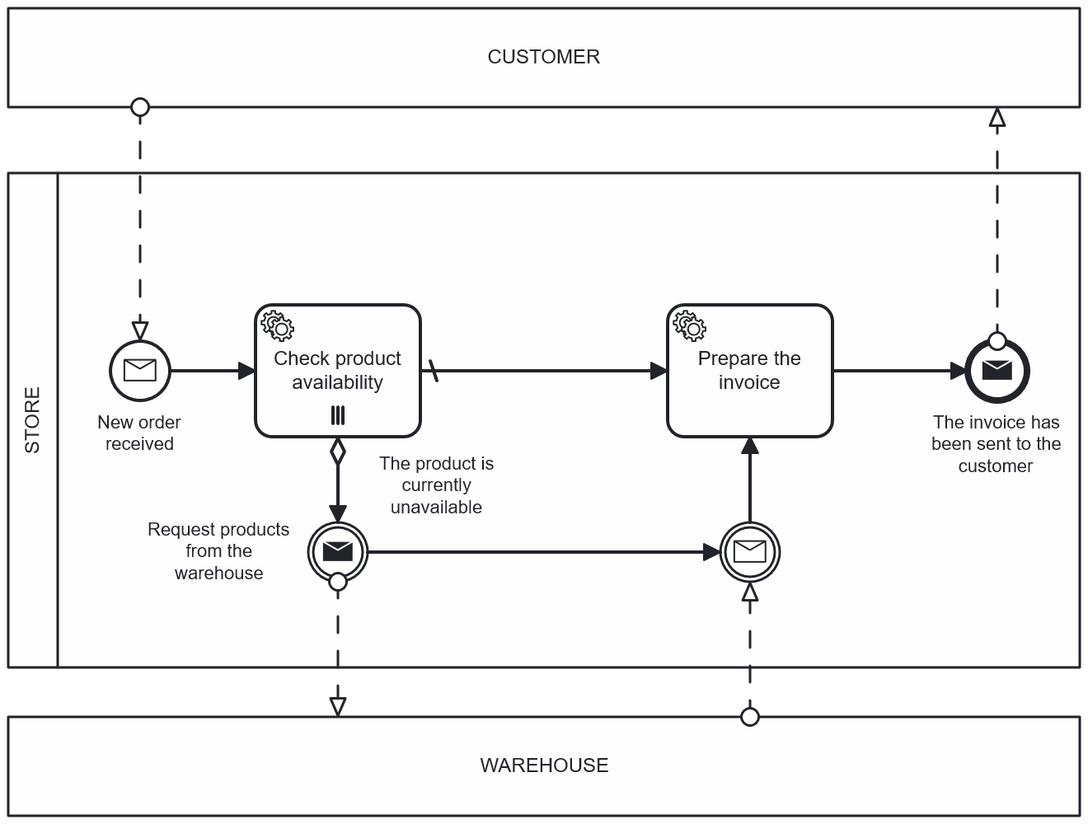
Business Process Model and Notation

