Slide 1
SYSTEM ANALYSIS and DESIGN Chapter 4: Data modelling
Trương Quốc Định
Faculty of Information Systems – CICT – Can Tho University

Slide 2
Basic concepts

Slide 3
Basic concepts
Data modeling is the process of creating a model (structure) for the data that will be stored in a database.
A data model is a conceptual representation of data entities, the relationships between those entities, and business rules.
Data modeling helps visualize data and business rules intuitively.
A data model needs to ensure consistency in naming conventions, default values, semantics, and security while still maintaining the quality of the data.

Slide 4
Basic concepts
Data modeling focuses on identifying what data is essential and how it should be structured, rather than detailing the operations that will be performed on it.

Slide 5
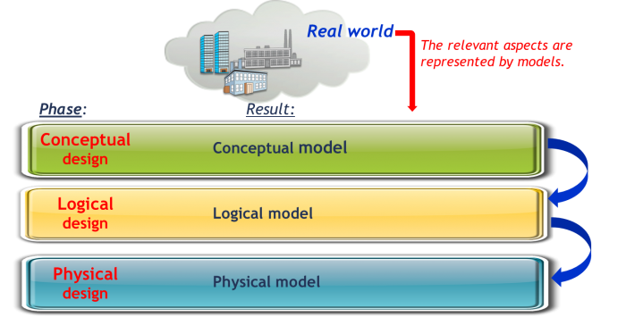
Levels of data model abstraction
Basic concepts
CDM - Conceptual Data Model,
LDM – Logical Data Model,
PDM – Physical Data Model

Slide 6

Conceptual Data Model
Basic concepts
ENTITIES???
ATTRIBUTES ???
RELATIONSHIPS???
A conceptual data model is a high-level, abstract representation of the data, independent of any specific technology or implementation.
It focuses on defining key business entities, their attributes, and the relationships between them, providing a shared understanding of the data within a business context.

Slide 7
Logical Data Model
Basic concepts
STRUCTURE OF DATA ELEMENTS???
HOW IS DATA MANAGED???
It defines what data is needed, how it's organized, and how different data elements relate to each other.
Think of it as a blueprint for how data should be structured and managed, focusing on the logical aspects rather than the physical implementation details.

Slide 8
Physical Data Model
Basic concepts
DATABASE IMPLEMENTATION???
A physical data model is a detailed, database-specific blueprint that defines how data will be physically stored and accessed within a database management system (DBMS).

Slide 9
ENTITY – RELATIONSHIP DIAGRAM

Slide 10
Roles of ERD
ENTITY – RELATIONSHIP DIAGRAM
Often used to represent Conceptual Data Model.
It provides a comprehensive view illustrating how a business system creates, stores, and uses data/information.
It supports the representation of business rules at a high level of abstraction.
It depicts the relationships among sets of entities.

Slide 11
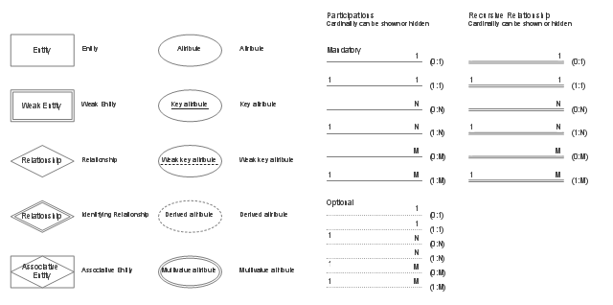
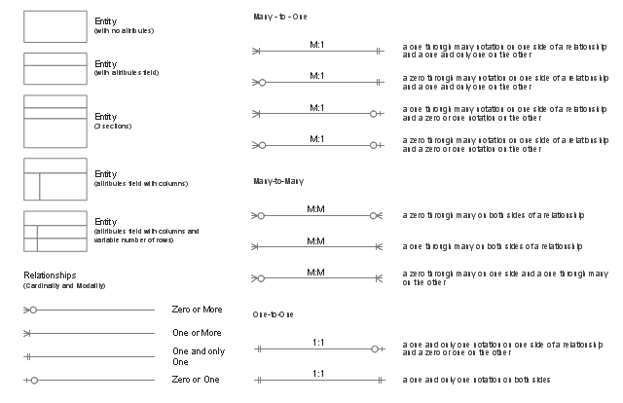
ERD notation
ENTITY – RELATIONSHIP DIAGRAM
This notation will be used.
Common ERD notations: Chen, Crow’s foot.
Crow’s foot

Slide 12
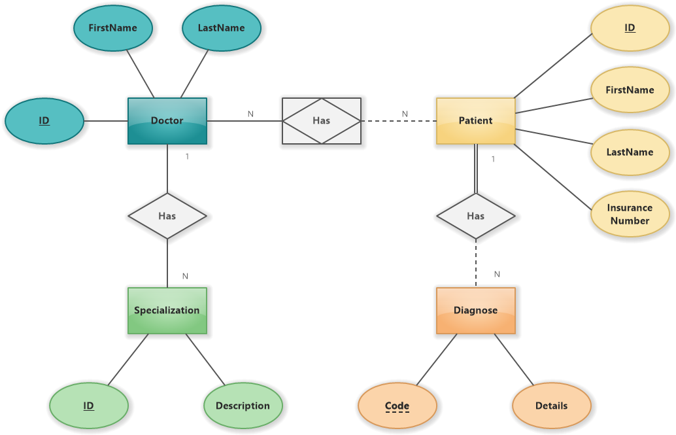
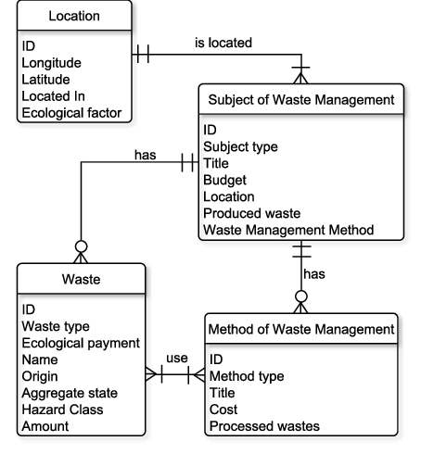
ERD notation
ENTITY – RELATIONSHIP DIAGRAM
This notation will be used.
Crow’s foot

Slide 13
Entity
ENTITY – RELATIONSHIP DIAGRAM
An entity is an element in the model that corresponds to a class of objects belonging to the organization being modeled.
It may be a person (e.g., Student), a location (e.g., District), an event (e.g., Conference) … all sharing common characteristics.
It is identified by a name and is typically expressed as a noun.
An entity must have multiple instances.

Slide 14
Attribute of an entity
ENTITY – RELATIONSHIP DIAGRAM
An Attribute is an element of the model that corresponds to a characteristic of an Entity that needs to be represented.
It is identified by a name, typically a noun.
Different attributes must have distinct names.
Each attribute has a specific data type (conceptual).
Attributes take on values from an appropriate set of valid values.
Attributes are written inside, below the name of the entity.

Slide 15
Attribute of an entity
ENTITY – RELATIONSHIP DIAGRAM
Example
📝 Full Name: variable-length character string
📅 Year of Birth: integer, with valid range [1965, 2007]
⚧️ Gender: Yes/No type, also represented as a string

Slide 16
Entity instances
ENTITY – RELATIONSHIP DIAGRAM
An instance of an entity is an element belonging to a class of objects of the modeled organization.
An instance of an entity is a logical combination of the values of that entity's attributes.
Instance: SV_MaSV = ‘1960547’, SV_HoTen = ‘Nguyễn Văn A’

Slide 17
Identifiers
ENTITY – RELATIONSHIP DIAGRAM
It is an attribute such that a value of this attribute uniquely identifies an instance of an entity.
In many cases, an identifier may be ‘artificial’, such as creating an ID number.
The identifier of an entity must be underlined and is typically placed in the first position.

Slide 18
Generalization - Specialization
ENTITY – RELATIONSHIP DIAGRAM
Generalization
Two or more entities can be generalized into a higher-level entity if they share some common attributes.
Specialization
An entity can be specialized into two or more lower-level entities if the lower-level entities have different attributes.
A higher-level entity is a generalized entity, while lower-level entities are specialized entities.
Specialized entities must differ either in attributes or in relationships (to be discussed later) with other entities.

Slide 19
Generalization - Specialization
ENTITY – RELATIONSHIP DIAGRAM

Slide 20
Relationships
ENTITY – RELATIONSHIP DIAGRAM
It is the association between the instances of two entities.
Relationships should have active verb names.
Cardinality is an indispensable part of a relationship.

Slide 21
Cardinality
ENTITY – RELATIONSHIP DIAGRAM
Refers to the number of times instances in one entity can be related to instances in another entity.
Cardinality consists of two components:
Minimum cardinality: 0 or 1 – the minimum number of instances of an entity that can be associated with one instance of another entity.
Indicates whether participation in the relationship is optional (0) or mandatory (1).
Maximum cardinality: 1 or n – the maximum number of instances of an entity that can be associated with one instance of another entity.
Indicates the upper limit of entity instances that may participate (either 1 or many (n)).

Slide 22
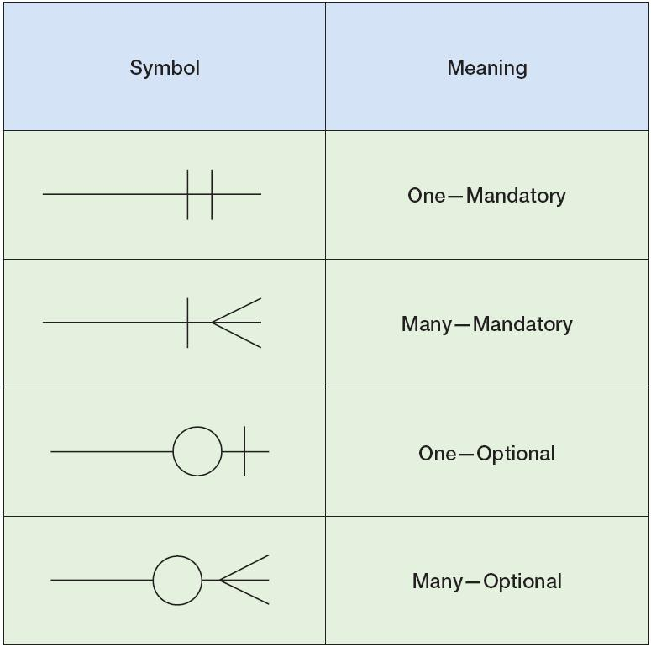
Cardinality symbols
ENTITY – RELATIONSHIP DIAGRAM

Slide 23
Cardinality - Example
ENTITY – RELATIONSHIP DIAGRAM
Is there anything that doesn’t make sense?

Slide 24
Cardinality - Example
ENTITY – RELATIONSHIP DIAGRAM
Adjustments will need to be made at the logical model level

Slide 25
Recursive Relationship
ENTITY – RELATIONSHIP DIAGRAM
Express the significance of the relationship
It’s a relationship with the same entity.
Exercise: Design a data model to represent a genealogical hierarchies, focus solely on father–child relational links.

Slide 26
Weak entity
ENTITY – RELATIONSHIP DIAGRAM
The value of the identifier of a weak entity is insufficient to uniquely identify its instances (meaning that identifier values may be duplicated).
A weak entity must depend on other entities.
Its identifier is formed by combining with the identifiers of related entities.

Slide 27
Weak entity
ENTITY – RELATIONSHIP DIAGRAM
Cardinality: (1, n), depend on

Slide 28
Attribute relationship
ENTITY – RELATIONSHIP DIAGRAM
A data model that captures which products are recorded in purchase invoices (e.g., rice, milk, salt).

Slide 29
Attribute relationship
ENTITY – RELATIONSHIP DIAGRAM
A data model that represents purchase invoices along with the corresponding quantities of products.
Invoice HD00012654 includes the purchase of 2kg of ST25 rice, 1kg of sugar, and 1 bottle of cooking oil.
Invoice HD00012666 includes 3kg of ST25 rice and 2 bottles of cooking oil.
Each invoice may contain multiple products, with varying quantities for each product.
Similarly, a product can be purchased in different invoices with different quantities.
👉 Therefore, quantity is an attribute dependent on both the product and the invoice, and should be modelled as an attribute of the relationship between invoice and product.

Slide 30
Attribute relationship
ENTITY – RELATIONSHIP DIAGRAM
The Crow's Foot notation does not support representing relationships with attributes.
Relationships that have attributes must be converted:
A weak entity with the attribute (the attribute of the relationship).
The weak entity depends on the two entities involved in the examined relationship.

Slide 31
Attribute relationship
ENTITY – RELATIONSHIP DIAGRAM

Slide 32
N-ary relationship
ENTITY – RELATIONSHIP DIAGRAM
Suppose we need to manage student grade data. The management requirement is to identify which student enrolled in which course, in which semester and academic year.
Student
Course
Student
Course
Semester
Semester

Slide 33
N-ary relationship
ENTITY – RELATIONSHIP DIAGRAM
A N-ary relationship is converted:
A weak entity without attributes,
This weak entity depends on all the entities involved in the relationship being modelled.

Slide 34
Exercise
ENTITY – RELATIONSHIP DIAGRAM
Identify the inconsistencies in the following diagrams
Design the ERD for the following system
https://drive.google.com/file/d/1snXsFAsUfBQBhHP2fyuZtOBkq7hk1aMQ/view?usp=sharing

Slide 35
LOGICAL DATA MODEL

Slide 36
Design a Logical Data Model
LOGICAL DATA MODEL
Within the scope of the course, the relational data model is used to represent data at the logical level.
➡️ Convert the Entity-Relationship model to the Relational data model.

Slide 37
Rule 1: Mapping regular entity
LOGICAL DATA MODEL
For each regular entity, create a new relational independent table that includes all attributes as column.
⇨ SINH_VIEN (SV_MaSV, SV_HoTen)

Slide 38
Rule 2: Converting Generalization Hierarchies
LOGICAL DATA MODEL
Convert each entity of a generalization hierarchy into a table.
The only column appearing that are different from attributes in the associated ERD is the inherited Identifier.
NHAN_VIEN (NV_MaNV, NV_HoTen, NV_GioiTinh, NV_NgaySinh, NV_CMND)
HANH_CHINH (NV_MaNV)
TAI_XE (NV_MaNV, TX_SoHieuBangLai)

Slide 39
Rule 3: Mapping weak entity
LOGICAL DATA MODEL
Convert every weak entity set into a table where:
we take the discrimination attribute of the weak entity set and takes the identifier of the strong entity set as a foreign key,
and then declared the combination of discriminator attribute and foreign key as a primary key.
BUILDING (BUILDING_No, BUILDING_Address, BUILDING_Name)
APARTMENT (APARTMENT_No, BUILDING_No, APARTMENT_Floor)

Slide 40
Rule 4: Mapping Strong Dependency
LOGICAL DATA MODEL
Strong Dependency (one cardinality of the relationship is {1, 1})
Represents a relationship where the source entity completely depends on the target entity for its existence.
The target entity is transformed into a table using Rule 1.
The source entity becomes a table, including:
All attributes from the source entity.
The identifier of the target entity, which becomes a foreign key in the source table.
THUEBAO_DIENTHOAI (TB_SoThueBao, CD_CMND)
CONGDAN (CD_CMND, CD_HoTen, CD_NgaySinh, CD_GioiTinh)

Slide 41
Rule 4
LOGICAL DATA MODEL
Is something wrong?
SINH_VIEN (SV_MSSV, SV_HoTen, SV_NgaySinh, SV_GioiTinh, TK_TenNguoiDung)
TAIKHOAN_MAYTINH (TK_TenNguoiDung, TK_MatKhau, SV_MSSV)

Slide 42
Rule 5: Mapping Weak Dependency
LOGICAL DATA MODEL
Weak Dependency (one cardinality of the relationship is {0, 1}):
Create a new table (table name is the name of the weak dependency), consisting of two attributes which are the identifiers of the two corresponding entities.
The primary key of the new table is these two attributes.
KHOA (KHOA_Ma, KHOA_Ten)
BO_MON (BM_Ma, BM_Ten)
BAO_GOM (KHOA_Ma, BM_Ma)

Slide 43
Rule 6: Mapping N, N Relationship
LOGICAL DATA MODEL
Create a new table include in the new relation:
The primary key of the table will be the combination of identifiers of participating entities.
HOC_PHAN (HP_MaHP, HP_TenHP, HP_SoTC, HP_SoTC_LyThuyet, HP_SoTC_ThucHanh)
CO_MON_TIEN_QUYET (HP_MaHP, HP_MaHP_TienQuyet)

Slide 44
Exercise 2
LOGICAL DATA MODEL
Design the ERD for the following system
https://docs.google.com/document/d/1NgaewywHymvjP1whUVoQCosxB7W7z-zE/edit?usp=sharing&ouid=107300846974611878794&rtpof=true&sd=true
Convert the designing ERD to Relation Data model.

Slide 45
PHYSICAL DATA MODEL

Slide 46
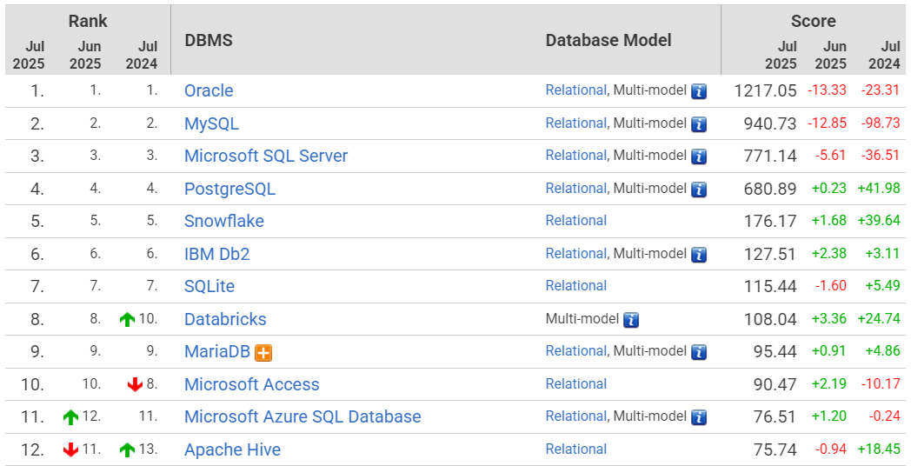
Design a Physical Data Model
PHYSICAL DATA MODEL
The database structure is based on the relational schema obtained during the logical-level data model design phase.
Choosing a suitable database management system (DBMS)
https://db-engines.com/en/ranking/relational+dbms

Slide 47

Design a Physical Data Model
PHYSICAL DATA MODEL
Select the storage format for each attribute in the physical database model:
data type, minimum and maximum storage space, length, number of decimal digits, minimum value, maximum value …

Slide 48
Types of data
PHYSICAL DATA MODEL
Reference Data (persistence data)
Transactional Data
Temporal Data

Slide 49
Reference Data
PHYSICAL DATA MODEL
Reference data is a set of standardized, fixed values used to classify, categorize, or provide context to other data across systems and processes.
Typically static or slow-changing over time.
Used for validation, classification, and data consistency.
Often stored in lookup tables or controlled vocabularies.
Examples include: country codes, currency codes, product categories, …

Slide 50
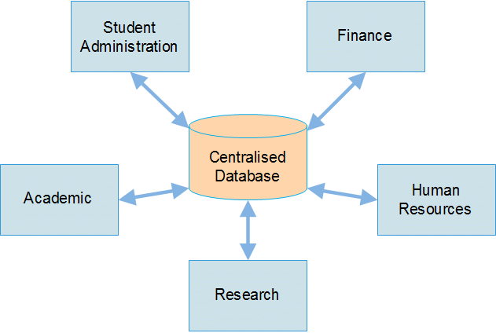
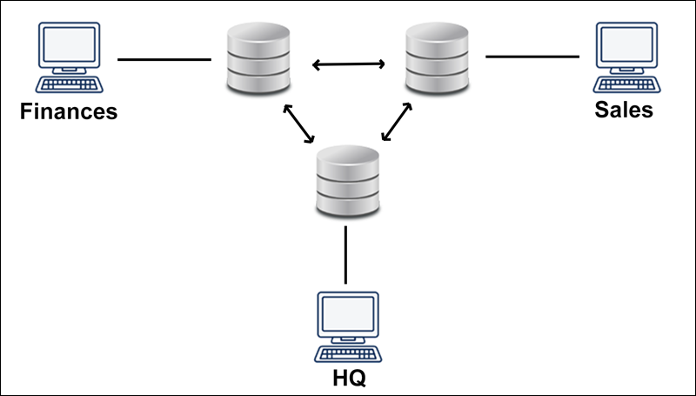
Transactional Data
PHYSICAL DATA MODEL
Transactional data refers to the data generated during business operations, capturing specific events such as purchases, payments, orders, or system interactions …
Dynamic and time-sensitive, constantly updated as transactions occur.
Storage method: Centralized or distributed?

Slide 51
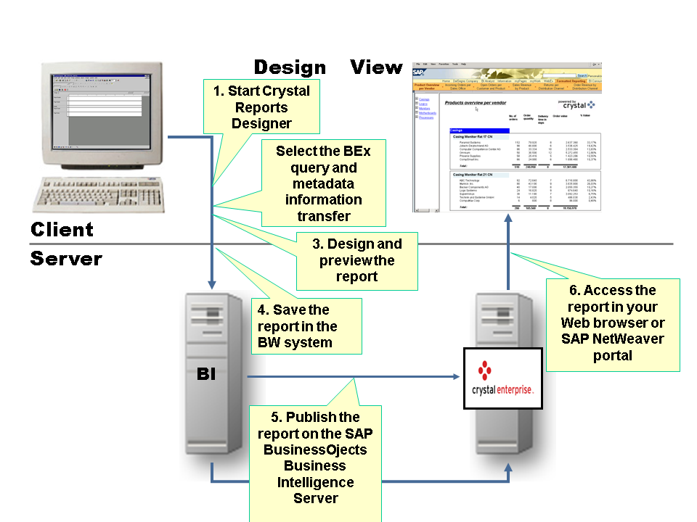
Temporal data
PHYSICAL DATA MODEL
Used only for a certain period of time; can be deleted when no longer needed.

Slide 52
Table description template
PHYSICAL DATA MODEL
TT | Tên | Kiểu | Kích thước | Số số lẻ | Miền giá trị | Trị mặc nhiên | MIN | MAX | Khóa chính | Duy nhất | NOT NULL | RB TV Luận Lý | RBTV Khóa ngoại | Diễn giải
1 | CD_STT | Int |  |  | [1, ∞) |  | 1 |  | X |  | X |  |  | Kiểu số tự tăng dùng làm khóa chính
2 | CD_CMND | Varchar | 13 |  |  |  |  |  |  | X | X |  |  | Số chứng minh nhân dân
3 | CD_HoTen | Varchar | 30 |  |  |  |  |  |  |  | X |  |  | Họ tên công dân
4 | CD_GioiTinh | Varchar | 10 |  |  |  |  |  |  |  | X |  |  | Giới tính, lưu nam hoặc nữ
5 | CD_NgaySinh | Date |  |  |  |  |  |  |  |  | X | > 18 tuổi |  | Ngày sinh
6 | CD_SoDienThoai | Varchar | 11 |  |  |  |  |  |  |  |  |  |  | Số điện thoại di động
7 | CD_TrinhDoVanHoa | Int |  |  | [1, 12] |  |  |  |  |  | X |  |  | Trình độ văn hóa

