Slide 1
SYSTEM ANALYSIS and DESIGN Chapter 5: System Processing Modelling
Trương Quốc Định
Faculty of Information Systems – CICT – Can Tho University

Slide 2
Basic concepts

Slide 3
Basic concepts
Types of system processing
Data input/output,
Processing input and persisted data to yield computed outputs or derived information.
Processing design is:
Outline processing components and detail system activities.

Slide 4
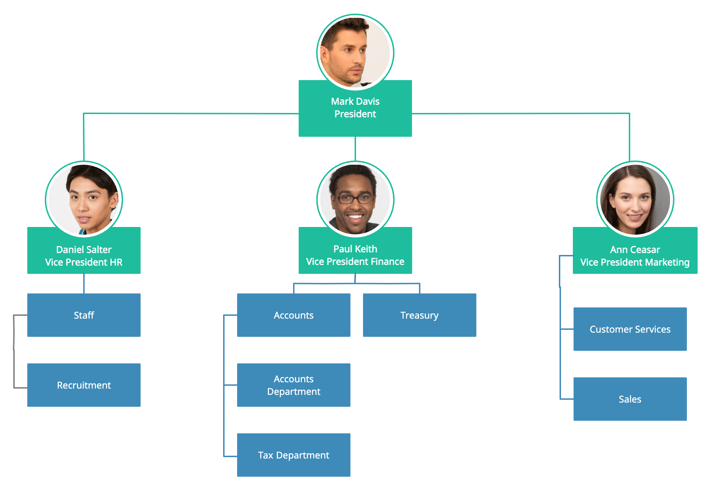
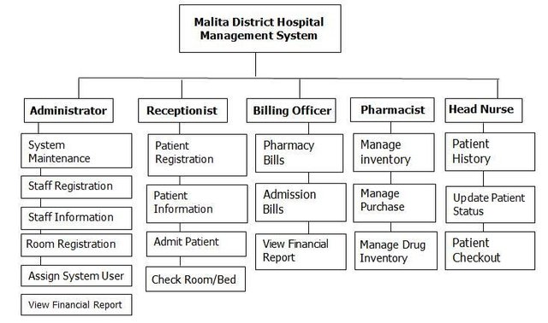
Processing design approach
Basic concepts
Classical Approach
A static design methodology that does not consider the interrelationships or coordination between processing units.
Utilizes organizational hierarchy charts and functional decomposition diagrams.

Slide 5
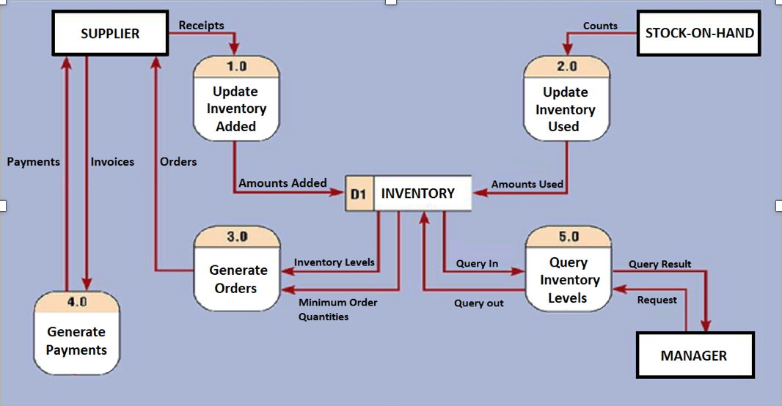
Processing design approach
Chương 5: Thiết kế thành phần xử lý
Modern Approach
When to initiate processing, what processes to combine, what data is required, and how the result is produced.
Use data flow diagrams (DFD).

Slide 6
DATA FLOW DIAGRAM - DFD

Slide 7
DATA FLOW DIAGRAM - DFD
Data Flow Diagram (DFD) illustrates the interconnection between system processes through the exchange of data during system operation.
A DFD should clearly show:
Which processes depend on others,
The data required for each process,
The output produced by each process.

Slide 8
Components of DFD

Slide 9
Process
Components of DFD
Work or action performed on data (inside the system).
Labels should be verb phrases.
Receives input data and produces output.
Process ID
Process Name

Slide 10
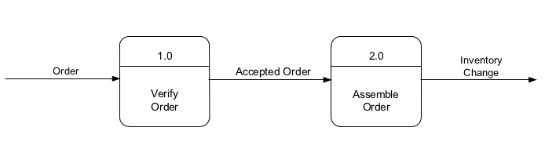
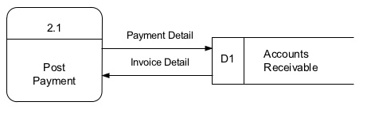
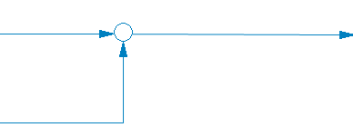
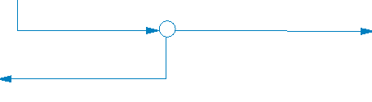
Data Flow
Components of DFD
Is a path for data move from one part of the information system to another.
Arrows depicting movement of data.
Can represent flow between process and data store by two separate arrows.
Labels should be noun phrases.
Input: Required data for carrying out the process.
Output: It represents the outcome of a real-world processing activity, typically materialized as physical evidence—such as a checklist, invoice, or other documentation.

Slide 11
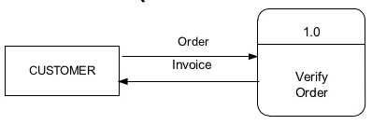
External Entity
Components of DFD
Is origin or destination of data (outside the system).
Source – Entity that supplies data to the system.
Sink – Entity that receives data from the system
Is the singular form of:
a department, outside organization;
other information system;
or person.
Labels should be noun phrases.

Slide 12
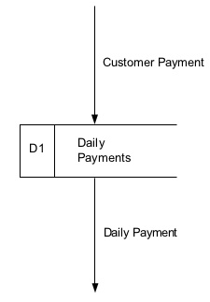

Data store
Components of DFD
Is use in a DFD to represent data that the system stores.
Labels should be noun phrases.
Must have at least one incoming data flow and one outgoing data flow.

Slide 13
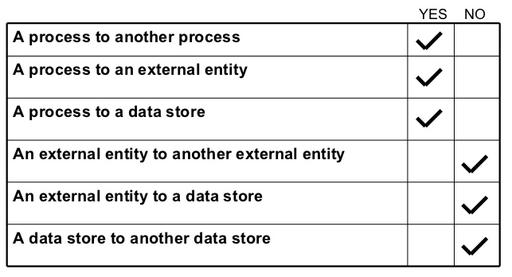
Data flow that connects
Components of DFD

Slide 14
Example
Components of DFD
If we want to reprint an already-issued receipt, is it possible to do so with this design?

Slide 15
Process description
Components of DFD
Process name
Version: Creator: |  | Created date:
Precondition
Postcondition
Input data: | Processing steps: | Output data:

Slide 16
DFD design method

Slide 17
DFD design method
Break down activities progressively into detailed steps until they can be handed off to programmers for implementation.
This is a top-down analysis method, starting from a general overview and narrowing down to specifics.

Slide 18
DFD levels
DFD design method
Context Diagram – Level 0
First DFD in every business process, shows the context into which the business process fits.
Shows the overall business process as just one process (process 0, Label should be noun phrase).
Shows all the external entities that receive information from or contribute information to the system.
Exclude data stores from the diagram.

Slide 19
Context Diagram – Level 0
DFD design method
Example

Slide 20
Lower - Level Diagrams
DFD design method
Functional/Process Decomposition
An iterative process of breaking a system description down into finer and finer detail.
Uses a series of increasingly detailed DFDs to describe an IS.
Balancing
The conservation of inputs and outputs to a data flow process when that process is decomposed to a lower level.
Ensures that the input and output data flows of the parent DFD are maintained on the child DFD.

Slide 21
Suggestions on how to design a DFD
DFD design method
Step 1 – Design the Functional Decomposition Diagram (FDD)
This is considered the tree that represents the decomposition process of the DFD.
It illustrates the individual components of the processing system along with the hierarchical relationships between them.
The diagram is displayed in a tree format, where elements closer to the root are more general.

Slide 22
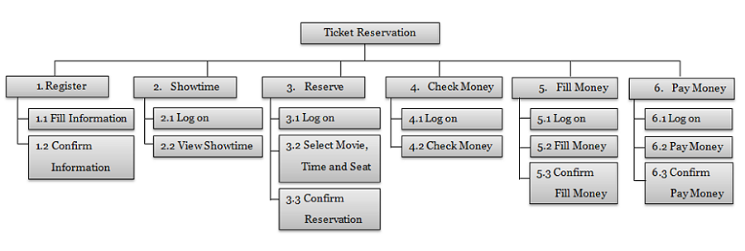
DFD design method

Slide 23
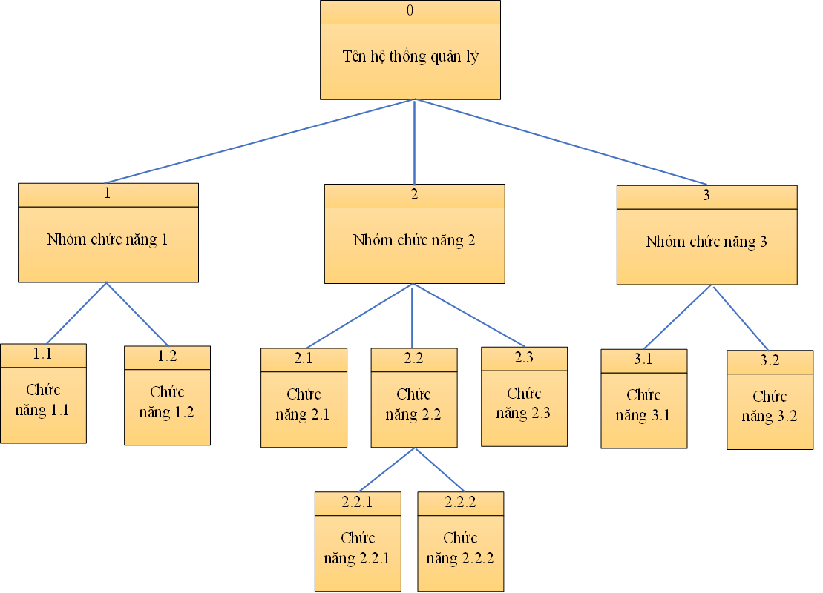
DFD design method

Slide 24
Suggestions on how to design a DFD
DFD design method
Step 2 – Fill in the Event Table
Only fill in the table for the processes at the most detailed level of the FDD.
ID (STT ) | Process (Ô xử lý) | External Entity (Tác nhân) |  | Data store (Kho dữ liệu)
 |  | Source (Nguồn) | Sink (Đích) | Retrieving (Truy xuất) | Updating (Cập nhật)
1 | Lập phiếu tính tiền bán hàng | KHÁCH HÀNG - Mã khách hàng - Thông tin sản phẩm mua NHÂN VIÊN - Mã nhân viên | KHÁCH HÀNG - Phiếu tính tiền | SẢN PHẨM - Thông tin sản phẩm KHÁCH HÀNG - Thông tin khách hàng NHÂN VIÊN - Thông tin nhân viên | SẢN PHẨM - Số lượng tồn được cập nhật KHÁCH HÀNG - Điểm tích lũy được cập nhật PHIẾU TÍNH TIỀN - Phiếu tính tiền mới được lưu

Slide 25
Suggestions on how to design a DFD
DFD design method
Step 3 – Draw the DFD
Use the FDD, the Event table and the Balancing rule.
Start with Level 0, then gradually detail lower levels.
Refer to the FDD to identify which processes appear at each DFD level.
Refer to the Event Table to determine for each process:
Which external entities (sources and sinks) are involved,
What input data is received and what output results are returned,
Which data stores are used or updated.

Slide 26
Exercise
DFD design method
Design a DFD for the system described in https://drive.google.com/file/d/1NgaewywHymvjP1whUVoQCosxB7W7z-zE/view?usp=sharing
Steps to Perform
Design the Functional Decomposition Diagram.
Fill in the Event table.
Draw the Data Flow Diagram for all levels

