Slide 1
Todo App Full Stack Development With Docker
2021-12
Franke Chen

Slide 2
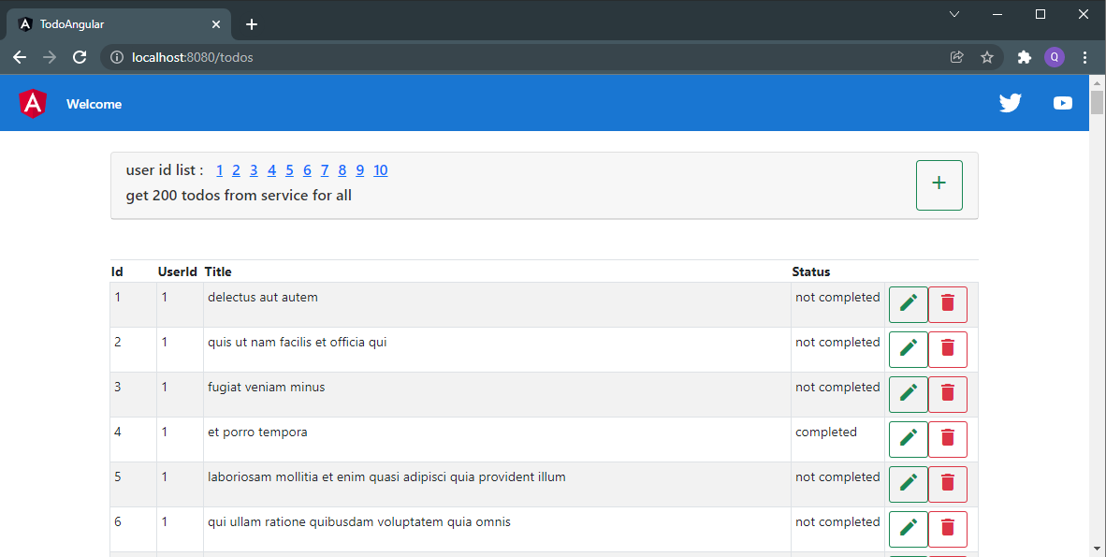
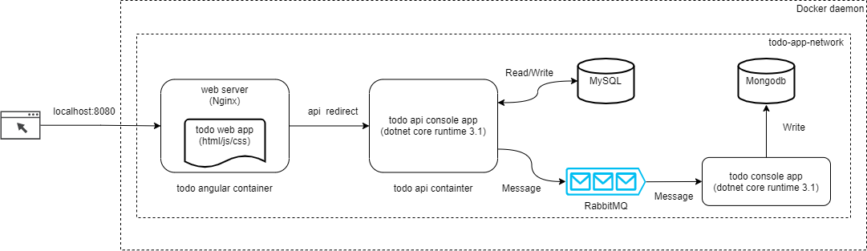
Workshop Agenda
Docker Overview
TODO App Overview
TODO Angular (html/js/css)
TODO Api (.Net core)
TODO Console (.Net core)
Deploy
Q & A

Slide 3
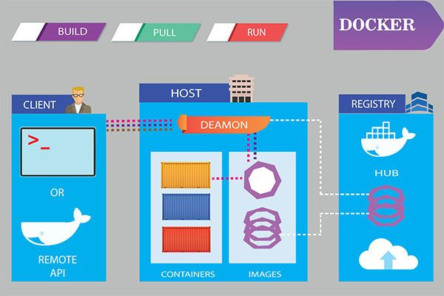
Docker Overview
1.Background
2.What is Docker
3.Docker vs VM
4.Why Docker
5.Docker architecture
6.Samples
Hello world
Docker/getting-started
Nginx
7.Docker-compose
sample: MySQL, Mongodb, Redis, RabbitMQ
8.Dockerfile

Slide 4

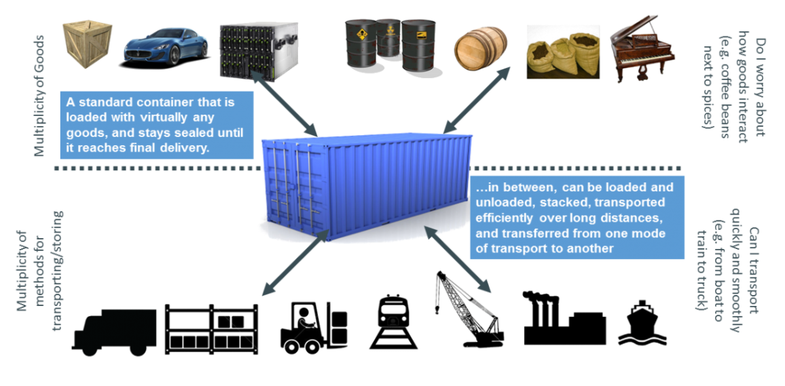
Docker Overview - Shipment and Container

Slide 5
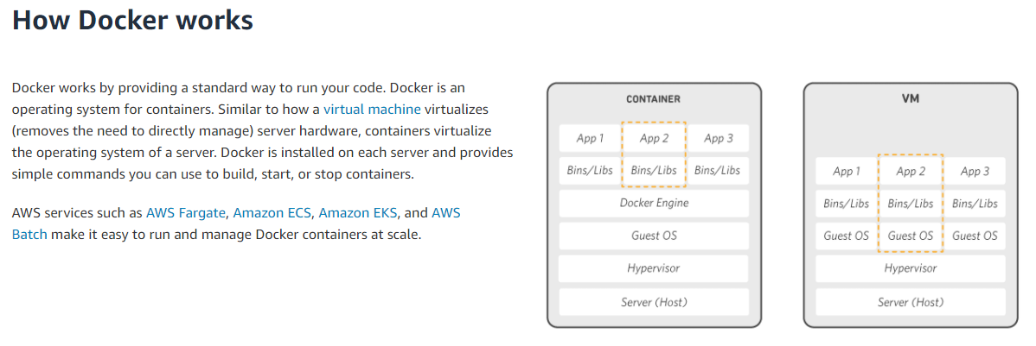
Docker Overview – What is docker
A Beginner-Friendly Introduction to Containers, VMs and Docker (freecodecamp.org) What is Docker? | IBM

Slide 6
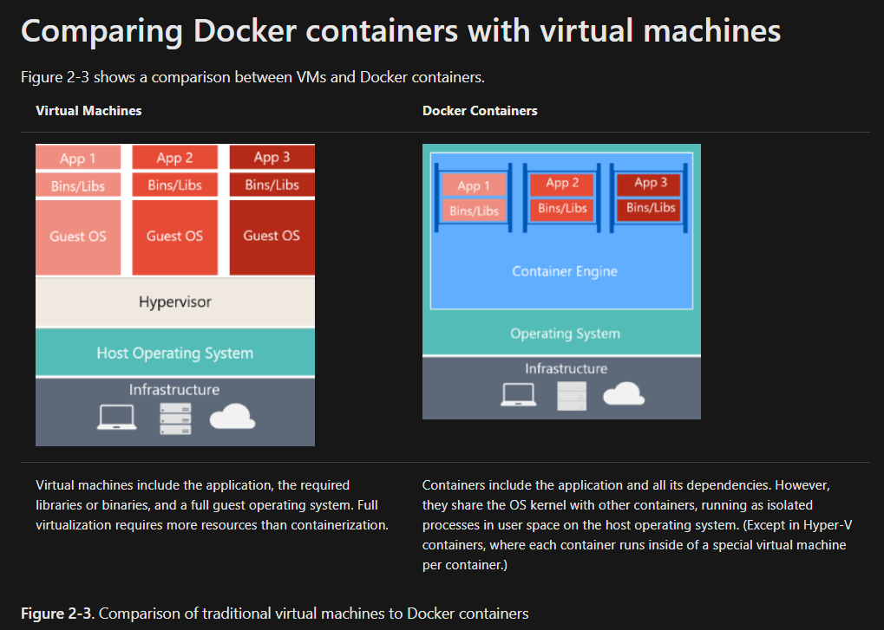
Docker Overview - Docker vs VM

Slide 7
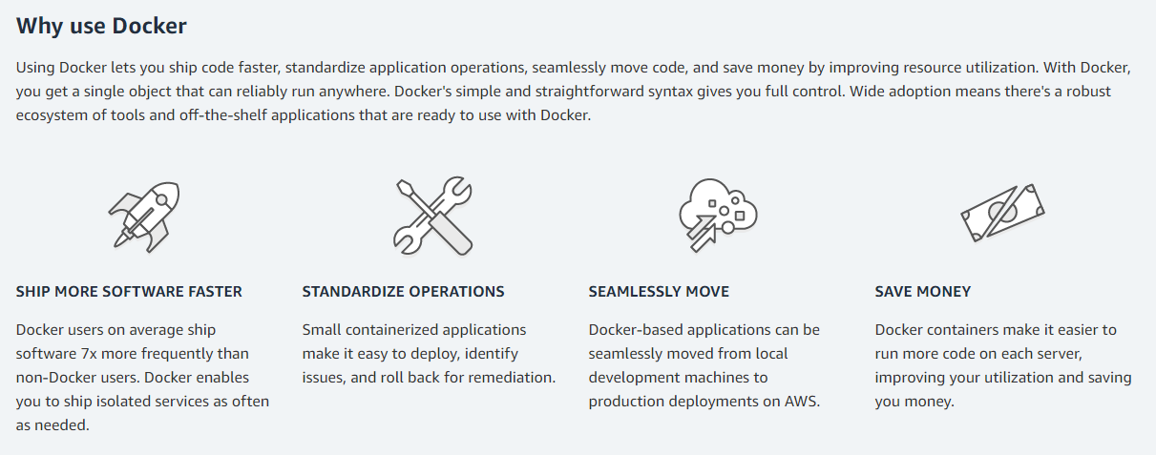
Docker Overview - Why docker
build, ship, run anywhere

Slide 8
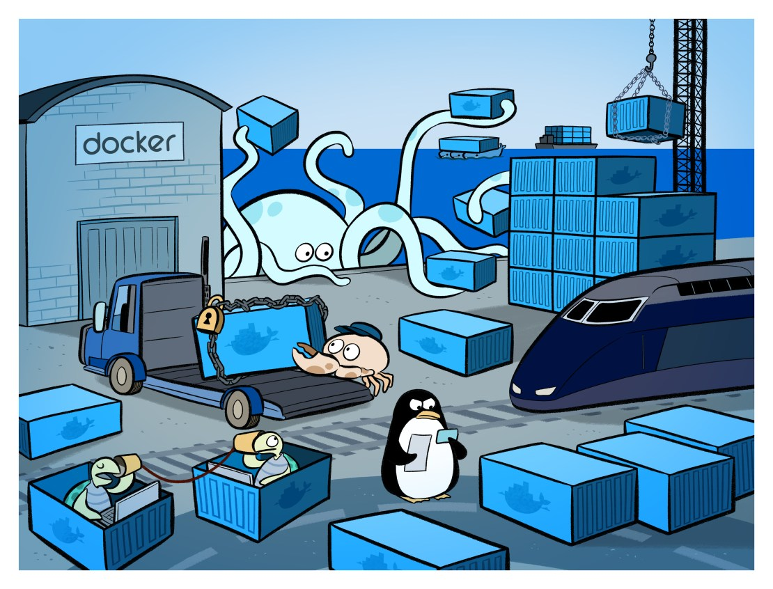
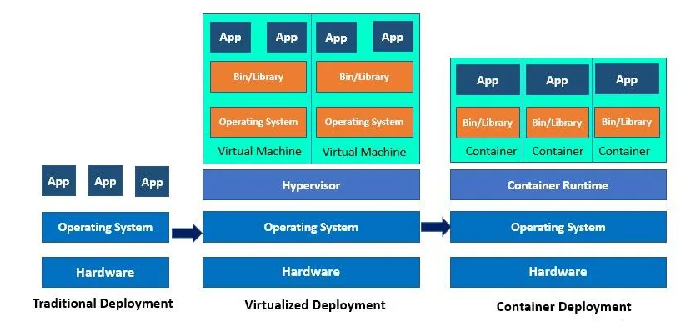
Docker Overview - Deployment

Slide 9
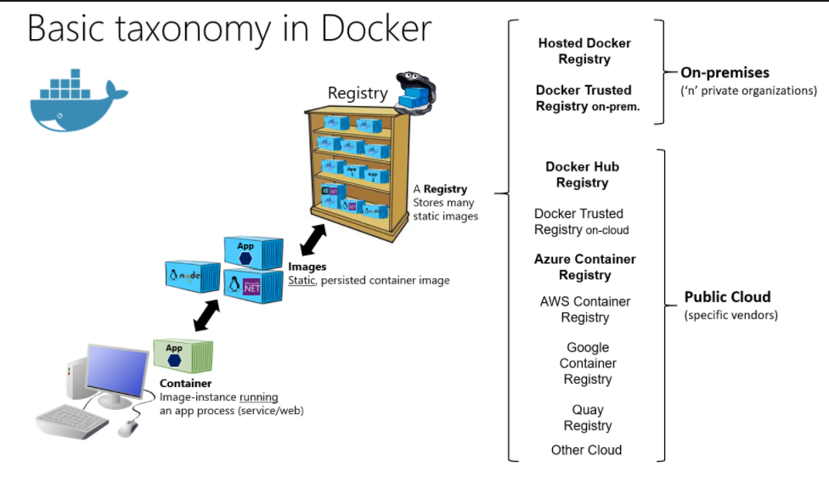
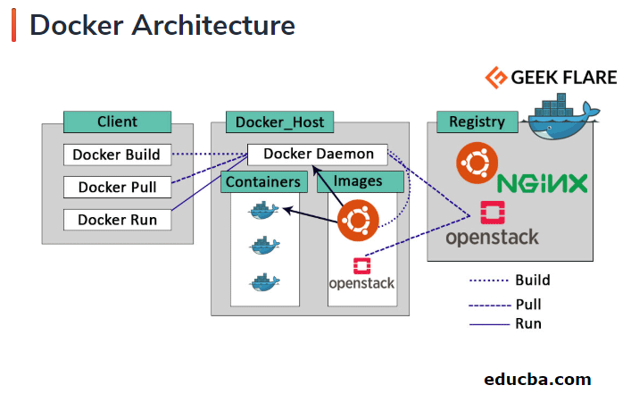
Docker Overview - Docker Architecture

Slide 10
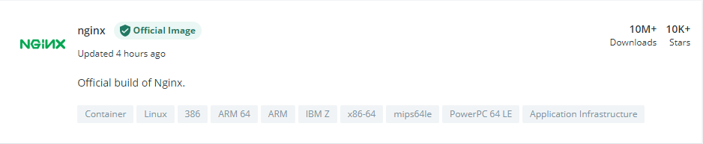
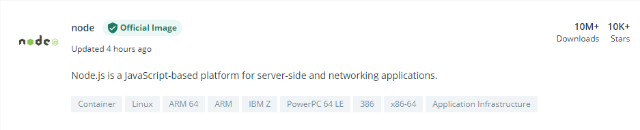
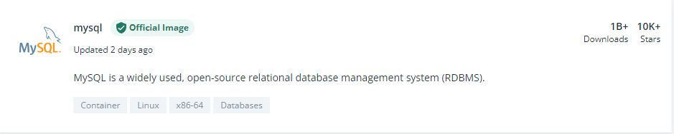
Docker Overview - Registry: Docker hub

Slide 11
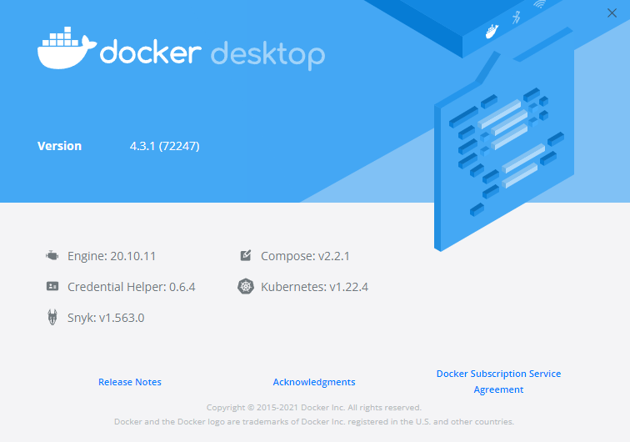
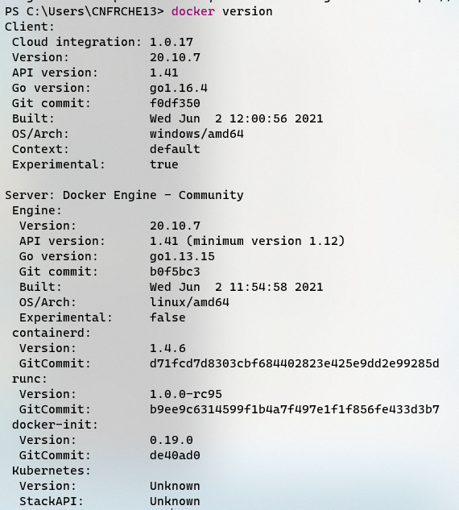
Docker Overview - Docker desktop

Slide 12
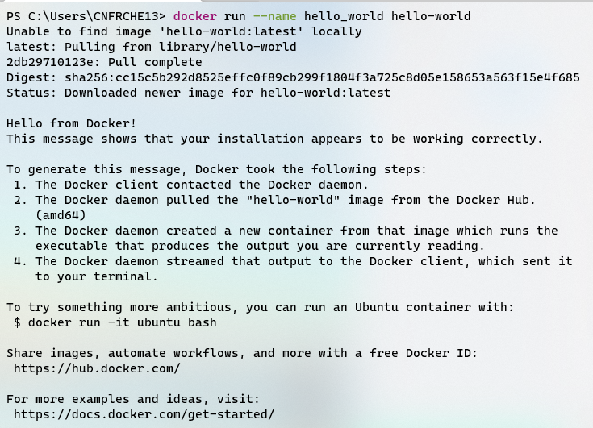
Docker Overview – Sample: Hello world
Used commands
Docker run
Docker restart
Docker inspect
Docker ls
Docker rm

Slide 13

Docker Overview – Sample: Hello World

Slide 14
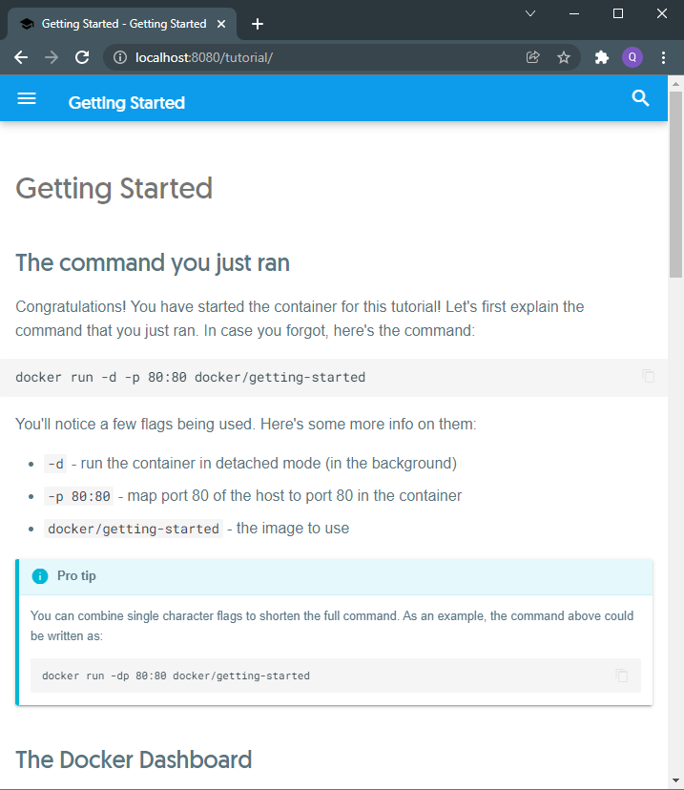
Docker Overview – Sample: Docker/getting-started
Used commands
Docker run
Docker ps
Docker exec

Slide 15
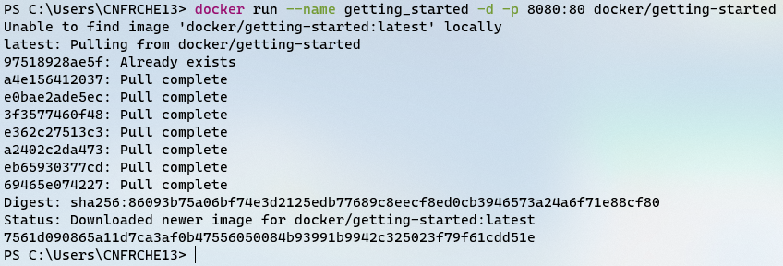
Docker Overview – Sample: Docker/getting-started

Slide 16
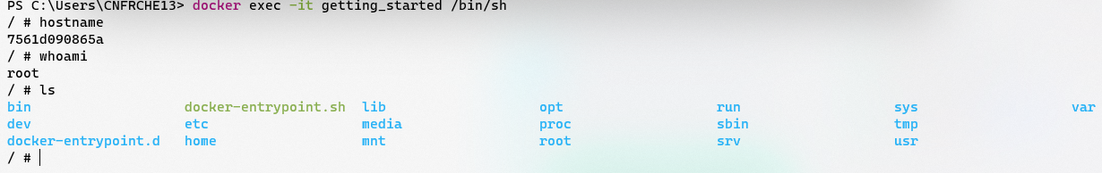
Docker Overview – Sample: docker/getting-started

Slide 17
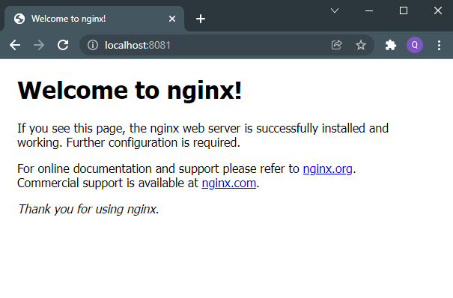
Docker Overview – Sample: Nginx
Used commands
Docker run
Docker ps
Docker logs
Docker exec
Docker cp

Slide 18

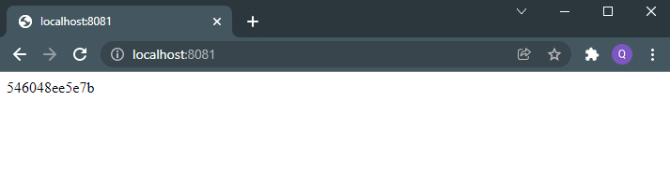
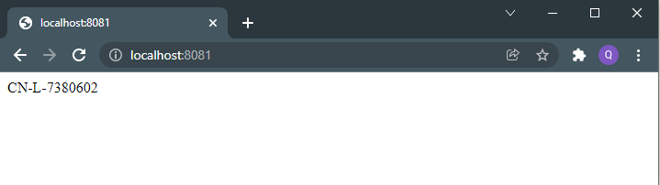
Docker Overview – Sample: Nginx

Slide 19
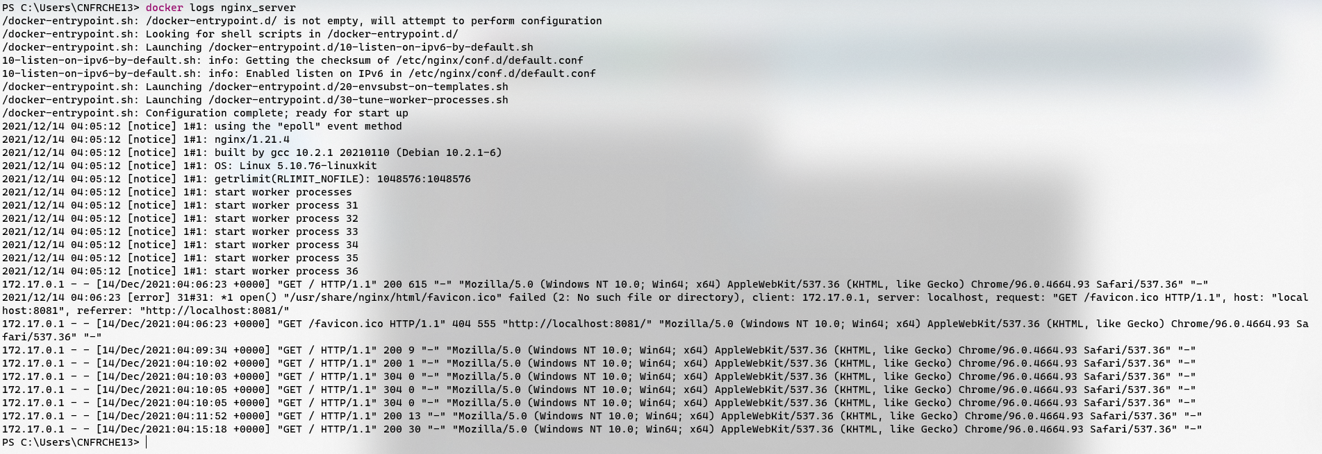
Docker Overview – Sample: Nginx

Slide 20
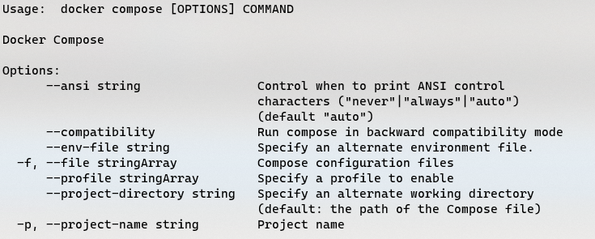
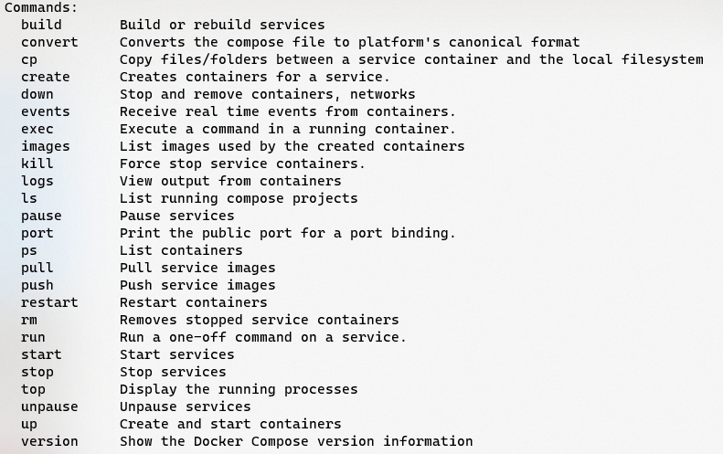
Docker Overview – Docker compose

Slide 21
Docker Overview – Docker compose(MySQL, Mongodb, RabbitMQ)
version: '3.3'
services:
todo_mysql:
image: mysql
volumes:
- ./db/:/docker-entrypoint-initdb.d/
environment:
- "MYSQL_ROOT_PASSWORD=123456"
ports:
- "3306:3306"
todo_mongodb:
image: mongo
ports:
- "27017:27017"
todo_rabbitmq:
hostname: todo_rabbitmq_host
image: rabbitmq:management
environment:
- RABBITMQ_DEFAULT_USER=admin
- RABBITMQ_DEFAULT_PASS=123456
ports:
- "5672:5672"
- "15672:15672"
# networks:
# default:
# external: true
# name: todo-app-test
Yml
Service name
Image name
Container name
Volumes
Environment variables
Ports
Expose
Network (bridge, overlay, etc..)

Slide 22
Docker Overview – Dockerfile
FROM nginx
COPY dist/todo-angular/ /usr/share/nginx/html/
COPY nginx.conf /etc/nginx/nginx.conf
RUN echo "complete building image"
FROM mcr.microsoft.com/dotnet/aspnet:3.1 AS base
WORKDIR /app
EXPOSE 80
FROM mcr.microsoft.com/dotnet/sdk:3.1 AS build
WORKDIR /src
COPY ["todo-api/todo-api.csproj", "todo-api/"]
RUN dotnet restore "todo-api/todo-api.csproj"
COPY . .
WORKDIR "/src/todo-api"
RUN dotnet build "todo-api.csproj" -c Release -r linux-x64 -f netcoreapp3.1 -o /app/build
FROM build AS publish
RUN dotnet publish "todo-api.csproj" -c Release --self-contained false -r linux-x64 -f netcoreapp3.1 -o /app/publish
FROM base AS final
WORKDIR /app
COPY --from=publish /app/publish .
ENTRYPOINT ["dotnet", "todo-api.dll"]

Slide 23
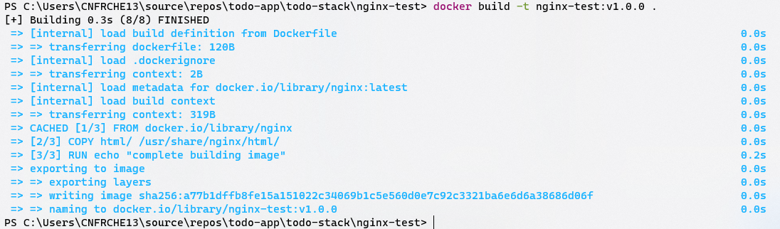
Docker Overview – Build image
<!doctype html>
<html lang="en">
<head>
<meta charset="utf-8">
<title>Nginx Test</title>
<base href="/">
<meta name="viewport" content="width=device-width, initial-scale=1">
</head>
<body>
<h1>nginx test</h1>
</body>
</html>
FROM nginx
COPY html/ /usr/share/nginx/html/
RUN echo "complete building image"

Slide 24
Docker Overview – Build image

Slide 25
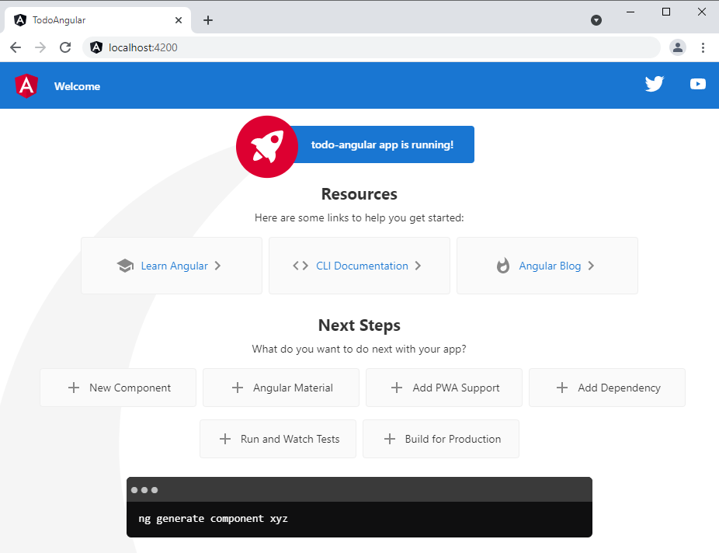
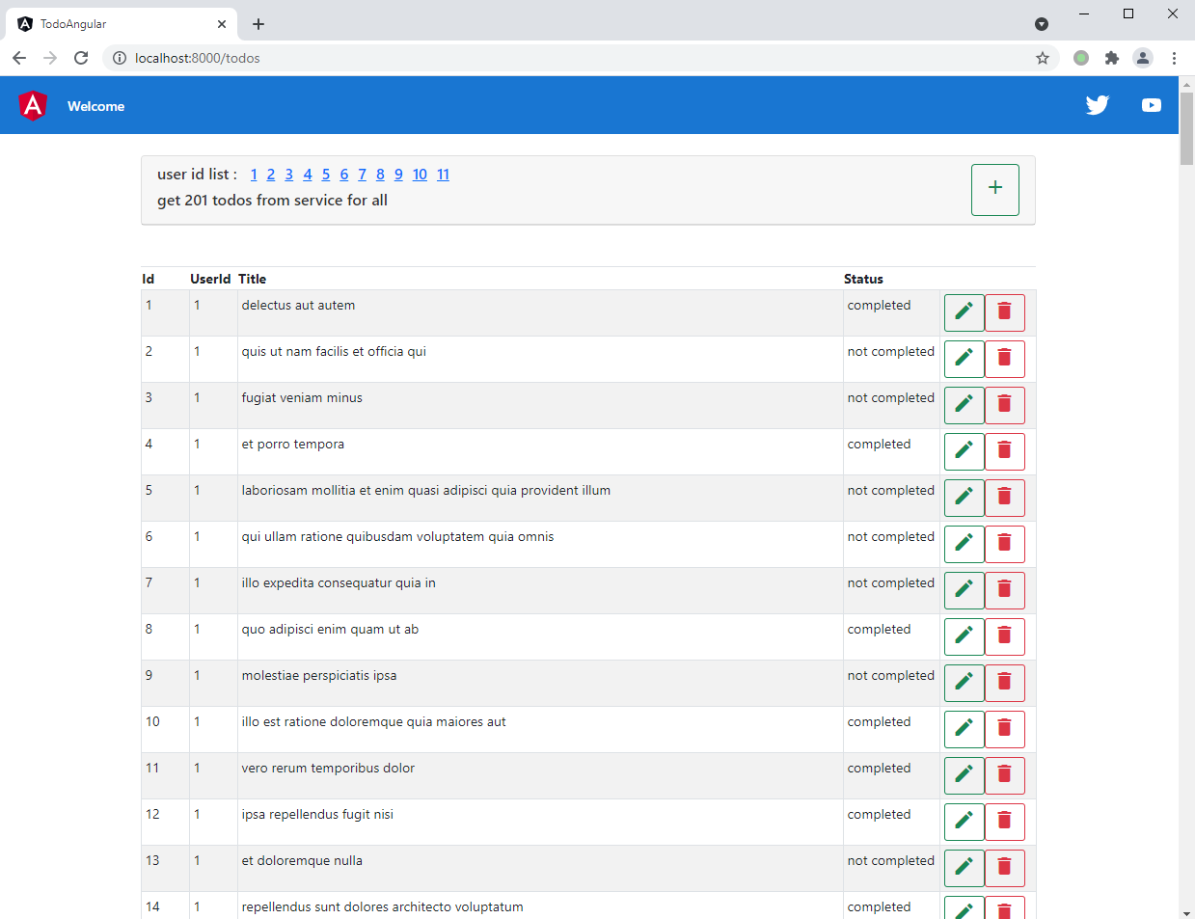
TODO App Overview

Slide 26
TODO App Overview - Architecture
Main stacks
MySQL
Mongodb
RabbitMQ
Nginx
Angular
Asp Net Core Web API
Docker
Docker Compose

Slide 27
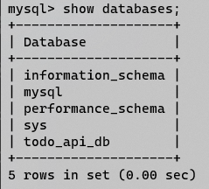
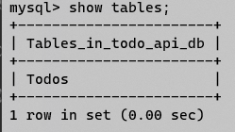
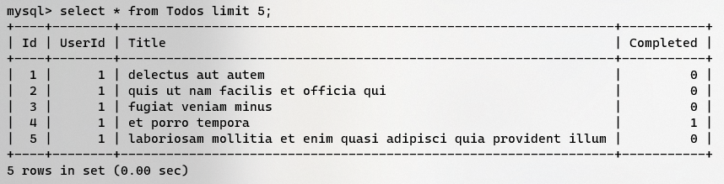
TODO App Overview - Data source
Data source: https://jsonplaceholder.typicode.com/todos
CREATE TABLE `Todos` (
`Id` int unsigned NOT NULL AUTO_INCREMENT,
`UserId` int unsigned DEFAULT NULL,
`Title` varchar(100) DEFAULT NULL,
`Completed` tinyint DEFAULT NULL,
PRIMARY KEY (`Id`)
) ENGINE=InnoDB AUTO_INCREMENT=0 DEFAULT CHARSET=utf8mb3;
Sample: [
{
"userId": 1,
"id": 1,
"title": "delectus aut autem",
"completed": false
},
{
"userId": 1,
"id": 2,
"title": "quis ut nam facilis et officia qui",
"completed": false
}
]

Slide 28
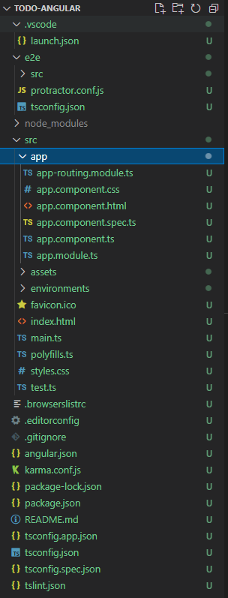
TODO Angular
{
"/api": {
"target": "http://localhost:5000",
"secure": true
}
}
Ng new
Ng serve
Ng test
Ng lint
Ng build
Proxy
Dockerfile
Nginx.conf
Docker build
FROM nginx
COPY dist/todo-angular/ /usr/share/nginx/html/
COPY nginx.conf /etc/nginx/nginx.conf
RUN echo "complete building image"
server {
listen 80;
server_name localhost; # dmmain name
location / {
root /usr/share/nginx/html;
index index.html;
try_files $uri $uri/ /index.html;
}
location /api {
proxy_pass http://todo_api:80; # gateway port
}
}

Slide 29
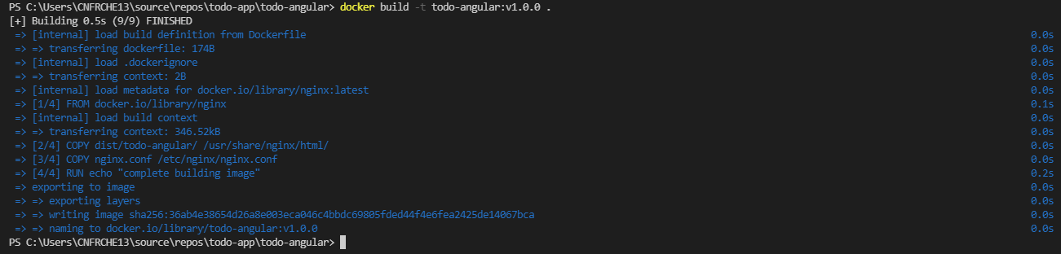
TODO Angular – Build image

Slide 30
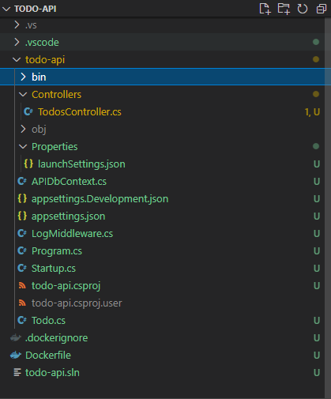
TODO API
Dotnet new
Appsettings.json
EFCore, dbcontext
Todo controller
RabbitMQ client
Log middleware
Dotnet run
Dotnet build

Slide 31
TODO API – App settings.json
{
"Mysql": "server=localhost;database=todo_api_db;user=root;password=123456",
"Rabbitmq": {
"HostName": "localhost",
"UserName": "admin",
"Password": "123456"
},
"Logging": {
"LogLevel": {
"Default": "Information",
"Microsoft": "Warning",
"Microsoft.Hosting.Lifetime": "Information"
}
},
"AllowedHosts": "*"
}

Slide 32
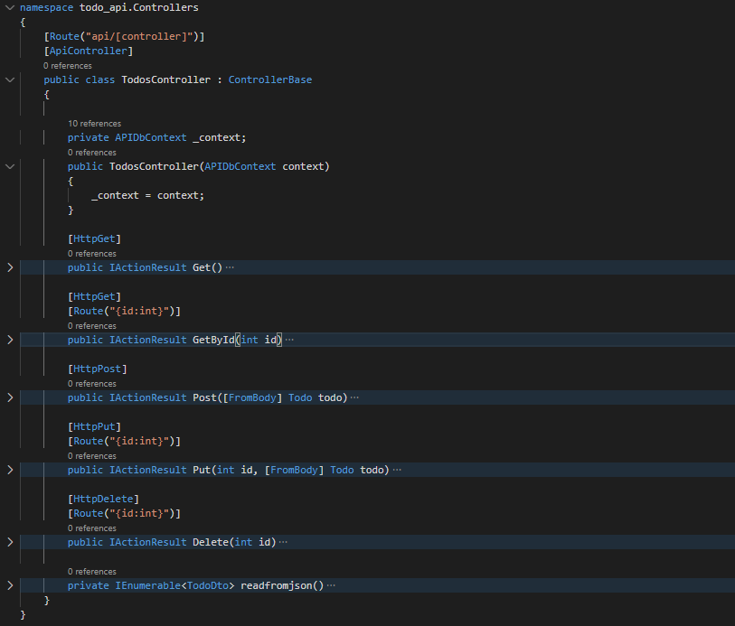
TODO API – Todos controller

Slide 33
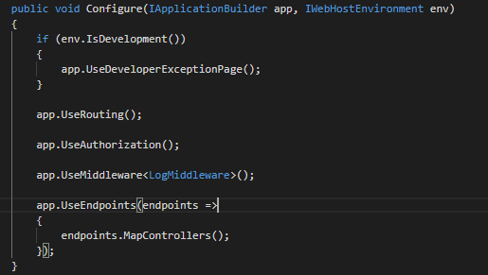
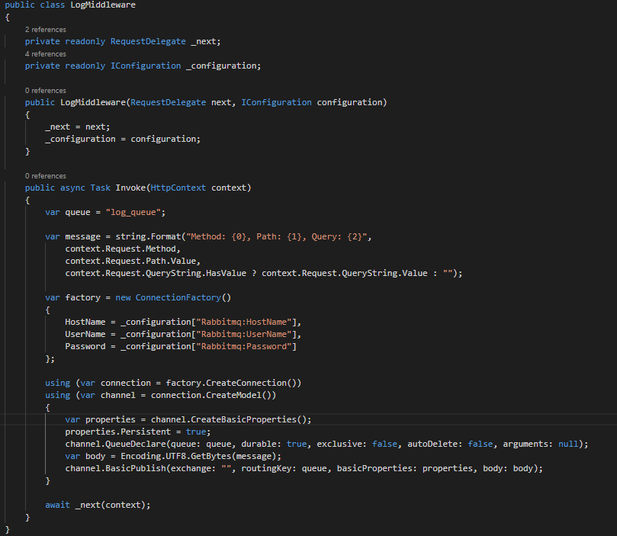
TODO API – Log middleware and rabbit client

Slide 34
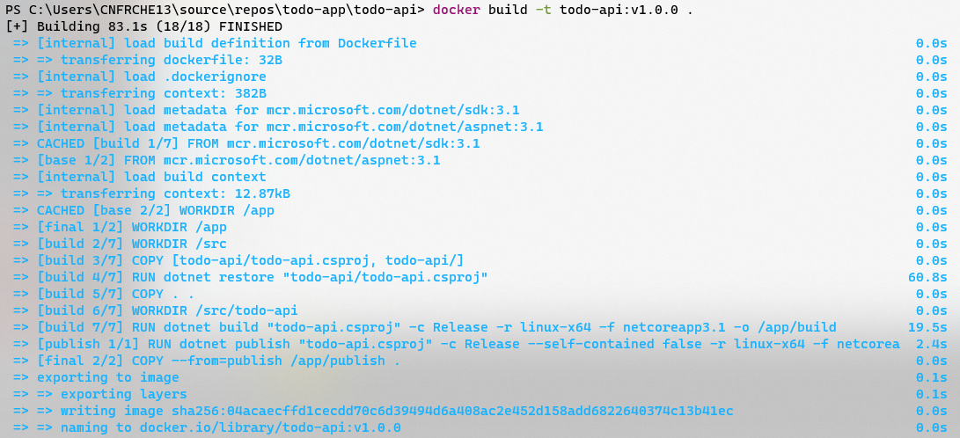
TODO API – Build image

Slide 35
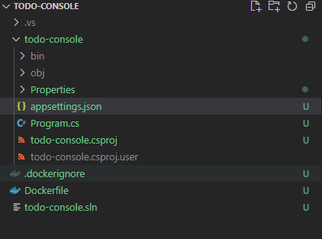
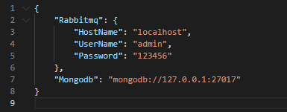
TODO Console
app-settings.json
Mongodb
Rabbit client
Dockerfile
Build image

Slide 36
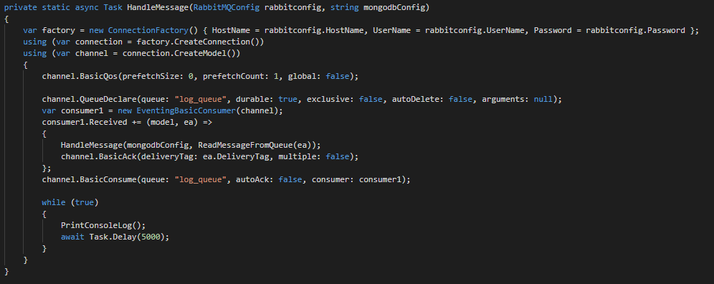
TODO Console – Rabbit client

Slide 37
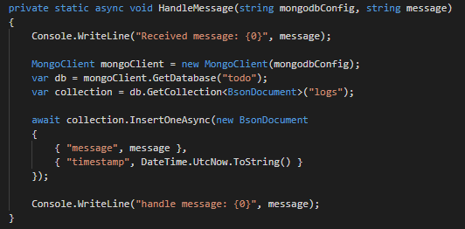
TODO Console – Mongodb

Slide 38
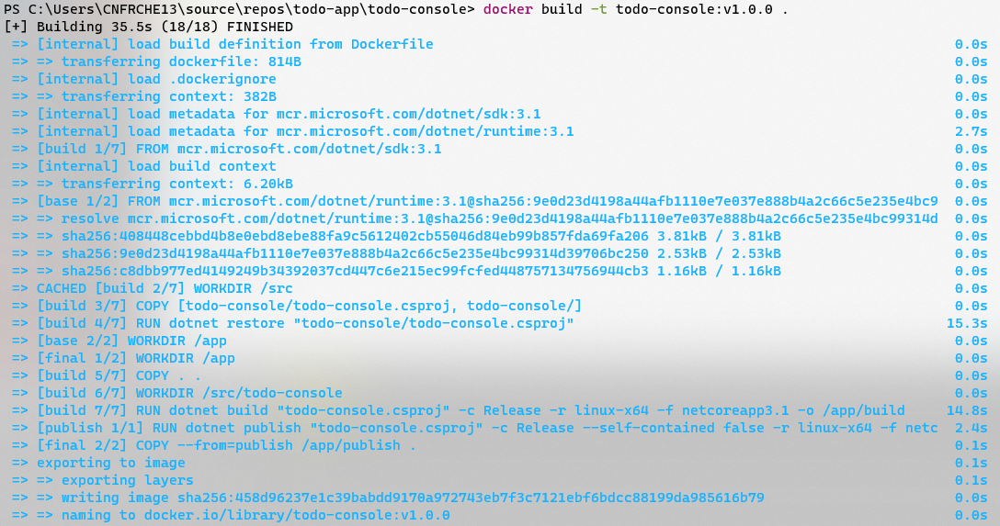
TODO Console – Build image

Slide 39
Deploy
version: '3.3'
services:
todo_api:
image: todo-api:v1.0.0
expose:
- "80"
volumes:
- ./todo-api.appsettings.json:/app/appsettings.json
depends_on:
- todo_mysql
- todo_rabbitmq
todo_console:
image: todo-console:v1.0.0
depends_on:
- todo_api
volumes:
- ./todo-console.appsettings.json:/app/appsettings.json
todo_angular:
image: todo-angular:v1.0.0
ports:
- "8080:80"
depends_on:
- todo_console
- todo_api_db
volumes:
- ./nginx.conf:/etc/nginx/nginx.conf
networks:
default:
external: true
name: todo-app-staging
version: '3.3'
services:
todo_mysql:
image: mysql
volumes:
- ../db/:/docker-entrypoint-initdb.d/
environment:
- "MYSQL_ROOT_PASSWORD=123456"
expose:
- "3306"
todo_mongodb:
image: mongo
expose:
- "27017"
todo_rabbitmq:
hostname: todo_rabbitmq_host
image: rabbitmq:management
environment:
- RABBITMQ_DEFAULT_USER=admin
- RABBITMQ_DEFAULT_PASS=123456
expose:
- "5672"
- "15672"
networks:
default:
external: true
name: todo-app-staging

Slide 40
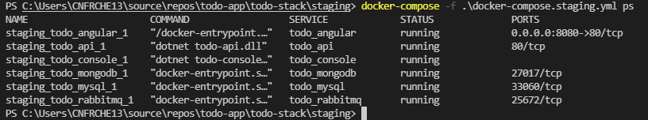
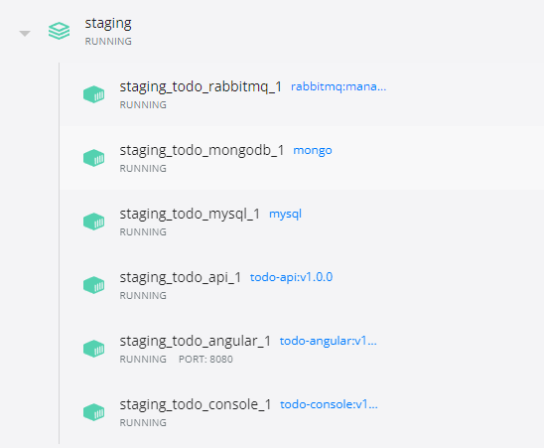
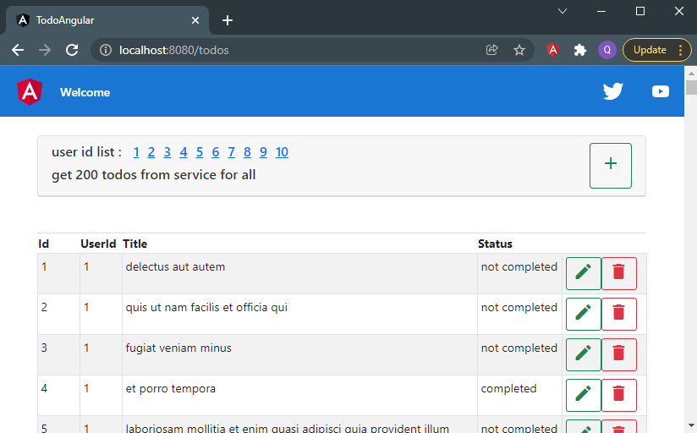
Deploy in staging
docker-compose -f .\docker-compose.infra.yml up -d
docker-compose -f .\docker-compose.staging.yml up -d

Slide 41
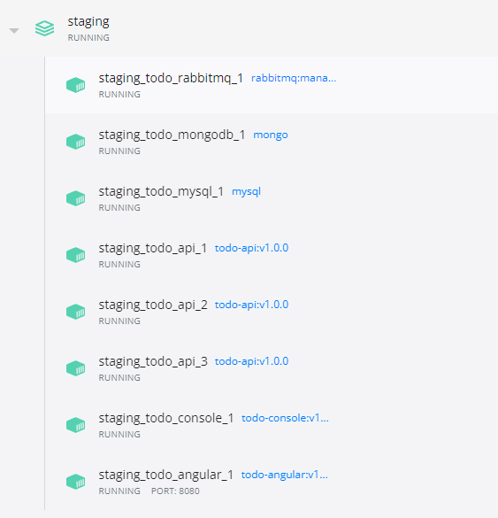
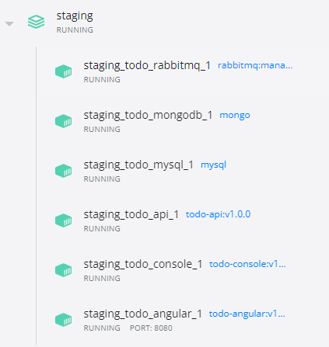
Deploy - Scale up/down
docker-compose -f .\docker-compose.staging.yml up -d --scale todo_api=3
docker-compose -f .\docker-compose.staging.yml up -d --scale todo_api=1

Slide 42
Q&A

