Slide 1
Sequences of given length where every element is more than or equal to twice of previous
Group No 23
Sumit Kumar (IIT2019069)
Adelik Om Tyagi (IIT2019070)
Subham Kumar (IIT2019093)

Slide 2
INTRODUCTION
For ﬁnding the number of possible sequences of length n such that each of the next element is greater than or equal to twice of the previous element but less than or equal to m can be solved using recursion. Recursion is the process of repeating items in a self-similar way. In programming languages, if a program allows you to call a function inside the same function, then it is called a recursive call of the function.

Slide 3
As we know wherever we see a recursive solution that has repeated calls for the same inputs, we can optimize it using Dynamic Programming. The idea is to simply store the results of sub-problems, so that we do not have to re-compute them when needed later. This simple optimization reduces time complexities from exponential to polynomial. As per the given condition the n-th value of the sequence can be at most m. There can be two cases for n-th element.
1) If it is m, then the (n-1)th element is at most m/2. We recur for m/2 and n-1.
2) If it is not m, then it is at most m-1. We recur for (m-1) and n.
The total number of sequences is the sum of the number of sequences including m and the number of sequences where m is not included. Thus the original problem of ﬁnding number of sequences of length n with max value m can be subdivided into independent sub-problems of ﬁnding number of sequences of length n with max value m-1 and number of sequences of length n-1 with max value m/2.

Slide 4
ALGORITHM DESIGN (Algo 1)
1) Take input of integers n and m in variables n and m respectively.
2) Call for the solve function with parameters as n and m which will give the answer.
3) Solve function is using a recursive approach to ﬁnd the answer.
4) Base cases for this function is when m becomes zero then we will return zero and also when n will become one then we will return m.
5) Create a new variable ret initialized with zero and looping from 1 to m and adding answers from 1 to m in ret by recursively calling the solve function for smaller input.
6) Return the value of ret which has the ﬁnal answer.

Slide 5
ALGORITHM DESIGN (Algo 2)
1) Take input of integers n and m in variables n and m respectively.
2) Call for the isZero function with parameters as n and m which will check whether the answer exists or not.
3) If n >= 60 then return true as our algorithm works till long long int.Also if m is less 2 to the power n-1 then we cannot have the sequence of length n having max value upto m so return true. And if the return value is true or it does not exist then we exit after printing 0.
4) Else using we create a vector of vectors mem of n+1 rows and m+1 columns and initializing it to -1.
5) Call the solve function with parameters n,m,mem which uses recursion with memoization (Dynamic Programming) to ﬁnd the answer.

Slide 6
6) Base cases for this function is when the isZero function with n,m as parameters return true then return zero and also when n will become one then we will return m.
7) Check if the value at n,m in the mem vector is not -1 then we return mem[n][m] as answer for this n,m is stored in the previous call of the solve function on n,m.
8) As per the given condition the n-th value of the sequence can be at most m. There can be two cases for n-th element.
(i) If it is m, then the (n-1)th element is at most m/2. We recur for m/2 and n-1.
(ii) If it is not m, then it is at most m-1. We recur for (m-1) and n. So we recursive call for the solve function with parameters n,m-1,mem and n-1,m/2,mem and add the return values from both and store it in mem[n][m] so if further this n,m is called then we can return its value without computation as we have stored.
9) Final answer is returned from the solve function and displayed.

Slide 7
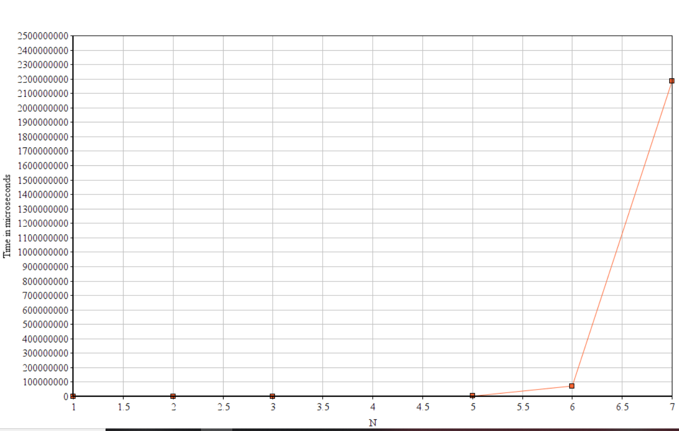
APRIORI ANALYSIS ALGO 1
- fix m=30 and vary n as

Slide 8
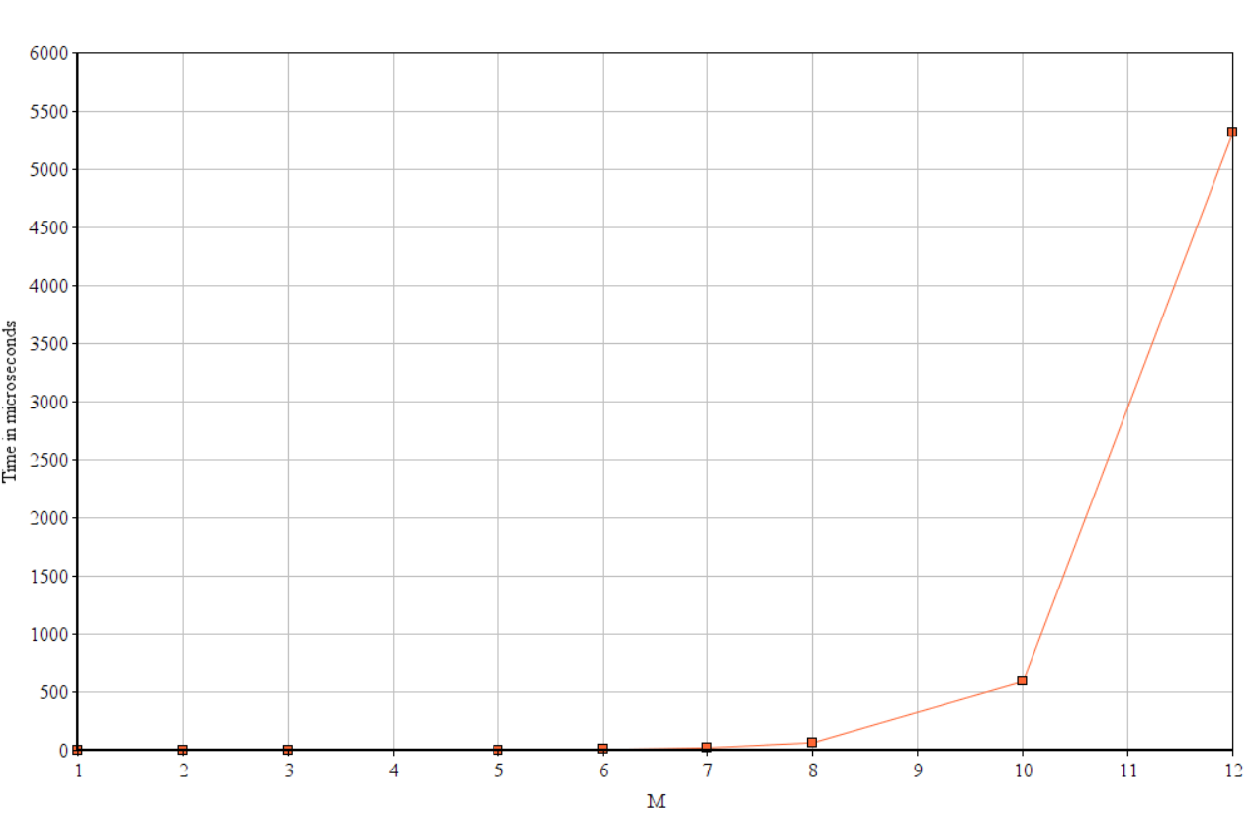
Fix n=3 and vary m as
From these two graphs we can conclude that complexity is exponential in ’n’ and polynomial in ’m’

Slide 9
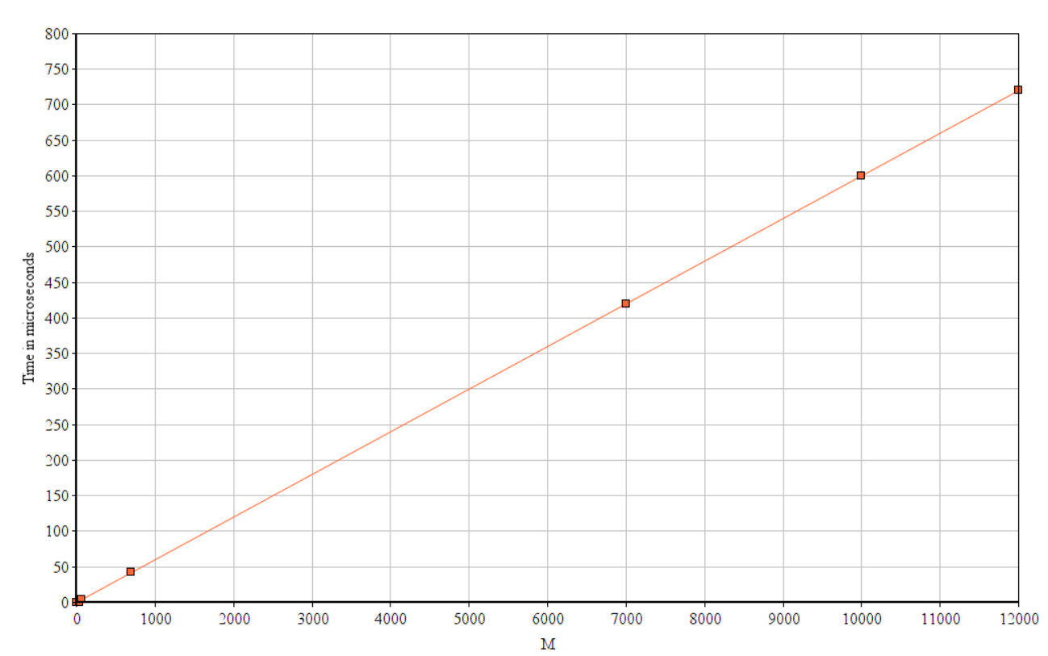
APRIORI ANALYSIS ALGO 2
Fix n=6 and vary m
From above graph we can conclude that complexity is linear
in ’m’.

Slide 10
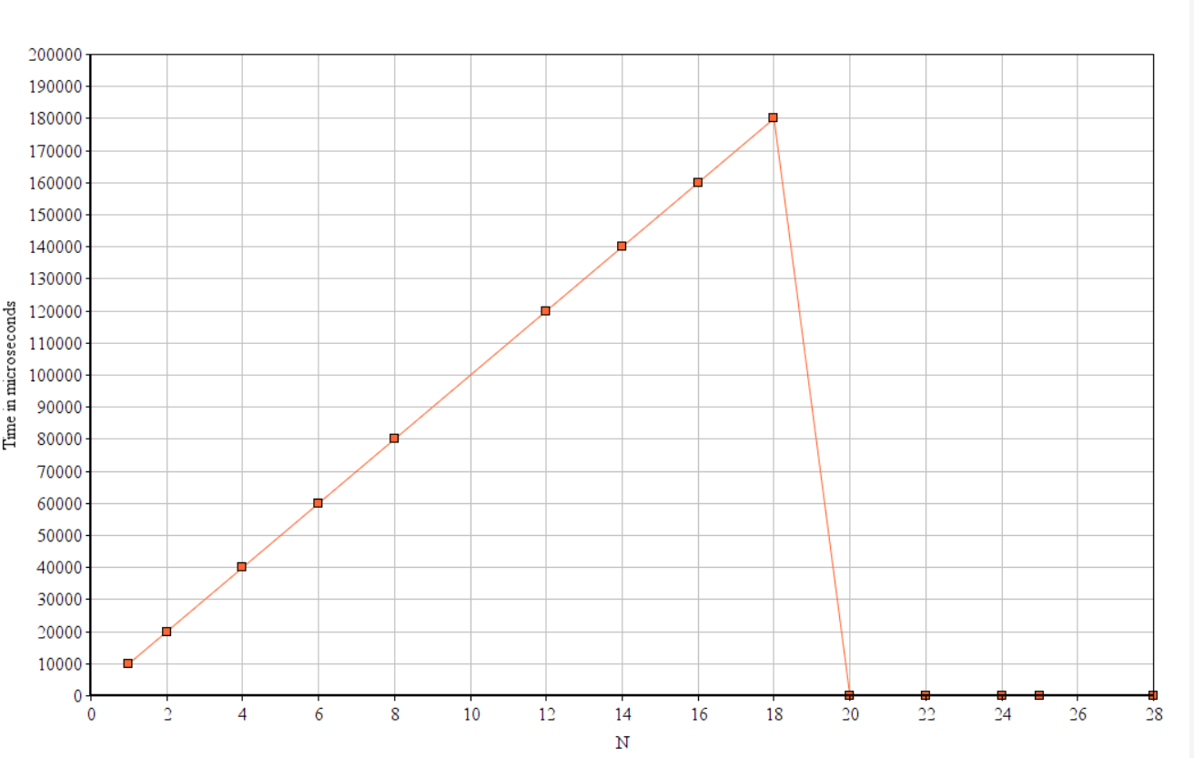
Fix m=1000000 and vary n
In above graph complexity increases linearly with ’n’
But once n becomes greater or equal to log2(m) then decreases and remains constant

Slide 11
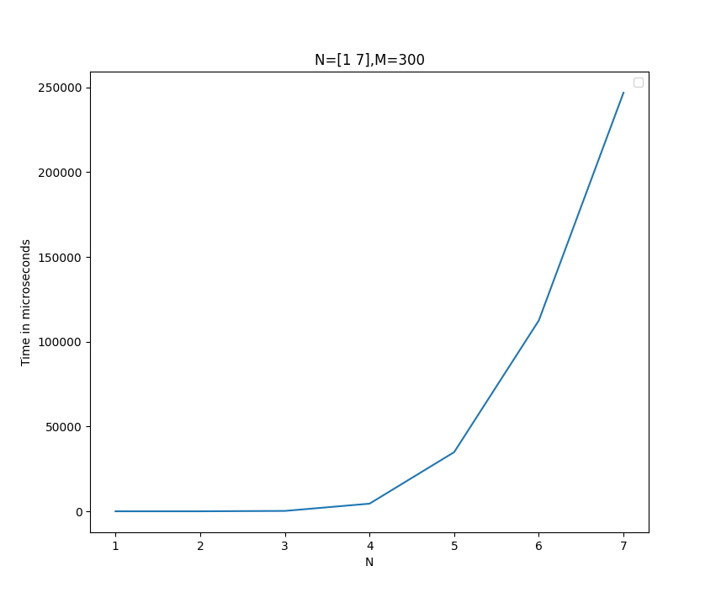
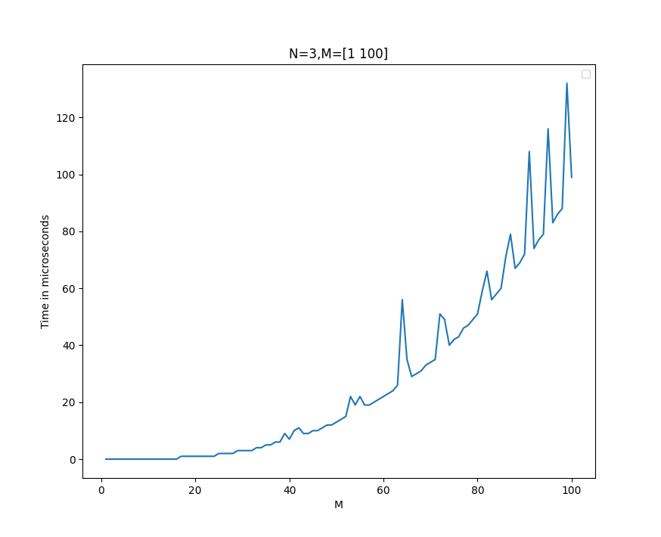
A POSTERIORI Analysis (Algo 1)
Fix M=300 and vary N from 1 to 7
Fix n=4 and vary M from 1 to 100
From these two graphs we can conclude that complexity is exponential in ’n’ and polynomial in ’m’

Slide 12
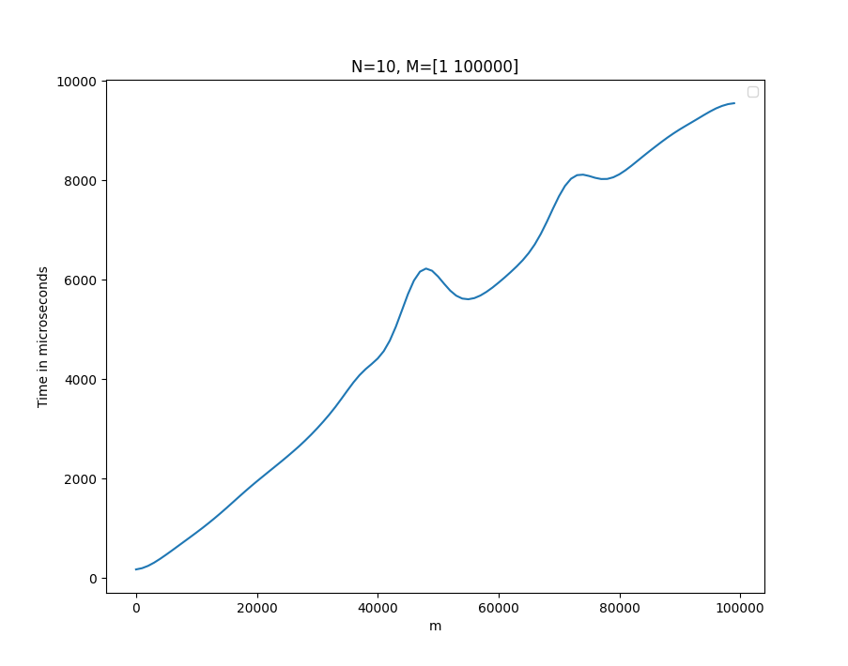
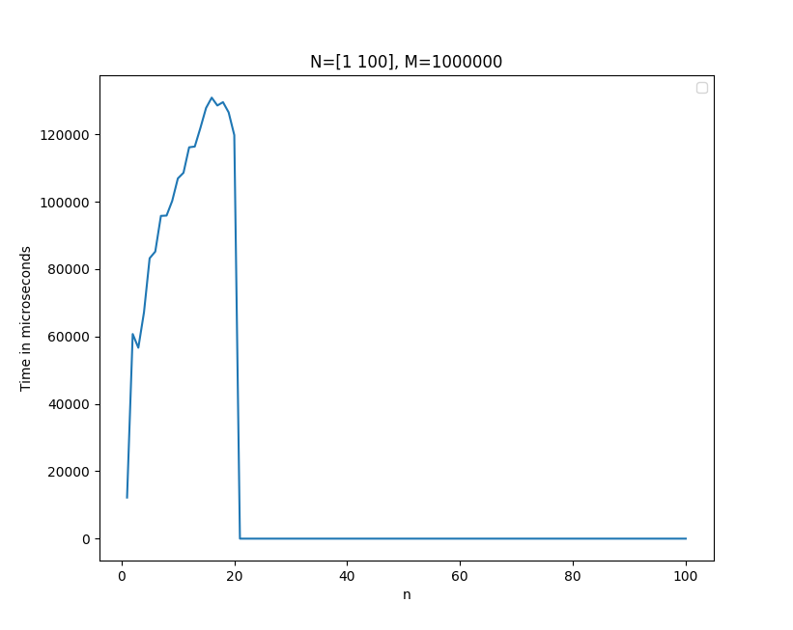
A POSTERIORI Analysis (Algo 2)
Fix N=10 and vary M from 1 to 100000
Fix m=1000000 and vary n from 1 to 100
From above graph we can conclude that complexity is linear
in ’m’.
In above graph complexity increases linearly with ’n’

Slide 13
CONCLUSION
Our second algorithm which we solved by divide and conquer is more efficient because unlike recursive solution it is storing the result of every function call and hence is not making same function calls multiple times. It has a time complexity and space complexity of O(min(n,log2(M))*m).

