Slide 1
Metamorphic Testing:
A Simple Methodology for Testing Non-Testable Programs
Tsong Yueh Chen (陳宗岳)
tychen@swin.edu.au
Swinburne University of Technology
Australia

Slide 2
Example
To solve the following system of linear equations
3x + 2y – z = 5
x – 2y – 2z = 3
2x + y + z = 7
Suppose the solutions x=1, y=2 and z=3

Slide 3
Example
To find the values of x such that
x**67 + 3*(x**46) – x**37 +4.5 =0
Suppose the solutions for x are: 2.17, 6.5, ..

Slide 4
Example
sin function
  sin(0º )=0
  sin(30º)=0.5
Suppose the program returns:
sin(29.8º )=0.51234 incorrect
sin(29.8º )=0.49876 correct?

Slide 5
Example
Shortest path problem SP(G, a, b)

Slide 6
Test Oracle
A mechanism or procedure against which the computed outputs could be verified

Slide 7
Oracle Problem
Absence of test oracle
Too expensive to apply test oracle

Slide 8
Non-Testable Programs

Slide 9
Intuition
Though we do not know the correctness of the output of any individual input
we may know the relation between some related inputs and their outputs

Slide 10
Example
Suppose sin(29.8º ) returns 0.49876
sin function has the following properties
  sin(x)= sin(x+360)
Compute 29.8º + 360^{o =} 389.8º
Execute the program with 389.8º as input
Check whether sin(29.8º ) = sin(389.8º )

Slide 11
Example
Shortest path problem SP(G, a, b)
Suppose the program returns:
  |SP(G, a, b)| = 1,000,001 correct or incorrect?

Slide 12
Example
Shortest Path Problem has the following properties:
  |SP(G, a, b)| = |SP(G, a, c)| +|SP(G, c, b)| where c is a node in SP(G, a, b)
  |SP(G, a, b)| = |SP(G, b, a)|
Execute SP(G, a, c), SP(G, c, b) and SP(G, b, a)

Slide 13
Metamorphic Testing (A Simplified Form)
Define source (initial) test cases using some test case selection strategies
Identify some properties of the problem (referred to as the metamorphic relations)
Construct follow-up test cases from the source test cases with reference to the identified metamorphic relations
Verify the metamorphic relations using the computed outputs

Slide 14
Categories of Research in MT
Applications of MT to specific application domains with oracle problem
Integration of MT with other software analysis and testing methods
Theory for MT

Slide 15
Applications of MT

Slide 16
Cases of Successful Applications of MT
Bioinformatics programs
Embedded systems
Machine learning software
Optimization systems
Compilers
……
…….

Slide 17
Interesting Results
Reveal undetected faults
Siemens suite
  print_token, schedule, and schedule_2
Compiler
Machine learning tool – Weka
…….

Slide 18
A Recent Paper
Compiler Validation via Equivalence Modulo Inputs, V. Le, M. Afshari and Z. Su, Proceedings of 35th ACM SIGPLAN Conference on Programming Language Design & Implementation (PLDI ’14), 216–226, 2014.
Best Paper Award

Slide 19
Testing Compilers
Their testing method is a MT method
Its MR is:
If programs P and P’ are equivalent with respect to input I,
then their object codes are equivalent with respect to I.
http://blog.regehr.org.archives/1161

Slide 20
a new test case selection method!

Slide 21
Integration with Other Methods

Slide 22
Successful Integrations
Debugging with program slicing
Spectrum Based Fault Localization (SBFL)
…..
…..
…..
…..

Slide 23
Debugging
a test case leading to a failure
a relevant program slice
Intuition:
the relevant faulty statement is within the program slice

Slide 24
Debugging with MT
a test case leading to a failure –
a metamorphic test group leading to a violation
a relevant program slice –
a relevant metamorphic program slice
Intuition: …………….

Slide 25
Metamorphic Slices
Slicing is one of the most important concepts in software analysis
Slices are data-based
Metamorphic slices are property-based
Many applications of slicing assume the oracle

Slide 26
Spectrum Based Fault Localization (SBFL)
A statistical approach to predict how likely a program entity is faulty
Intuition
  More likely to be faulty if executed by more failed test cases
  More likely to be faulty if executed by less passed test cases

Slide 27
SBFL
Use a set of test cases with
  testing results of pass or fail
  coverage information whether a program entity is executed or not
Use a formula to predict how likely a program entity is faulty

Slide 28
SBFL assumes test oracle exist

Slide 29
SBFL
An Open Problem
How to apply SBFL on programs with oracle problem?

Slide 30

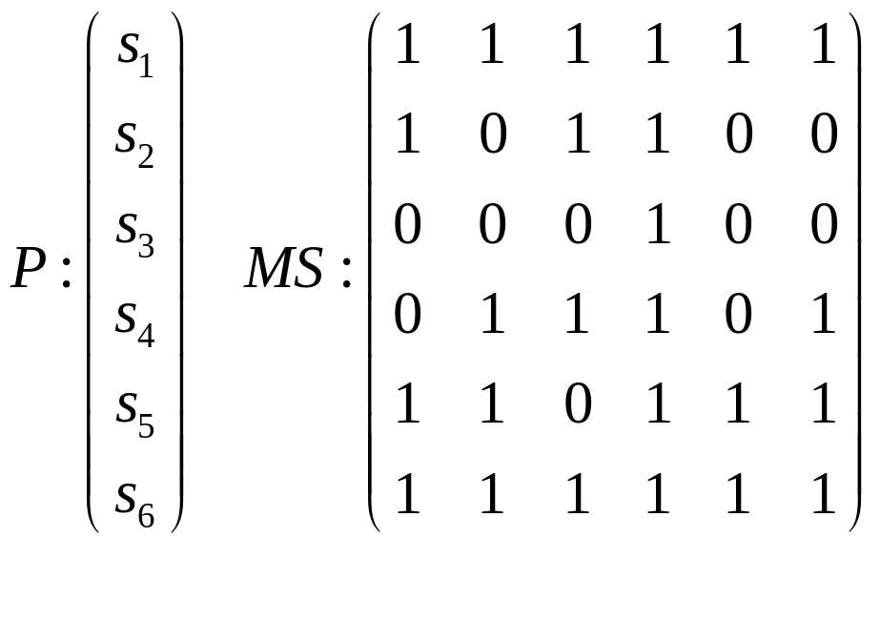

Example

Slide 31
Existing SBFL
Each statement has the following information
  Number of test cases which execute it with the test outcome of pass
  Number of test cases which execute it with the test outcome of fail
  Number of test cases which do not execute it with the test outcome of pass
  Number of test cases which do not execute it with the test outcome of fail

Slide 32
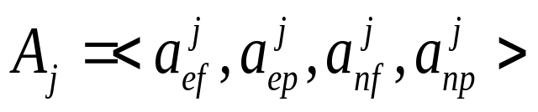
Existing SBFL
For each statement s_{j}, we have
  ‘e’ : ‘executed’
  ‘n’ : ‘not executed’
  ‘f’ : ‘fail’
  ‘p’ : ‘pass’

Slide 33

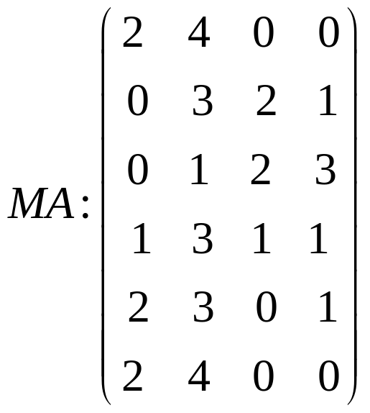
Example

Slide 34
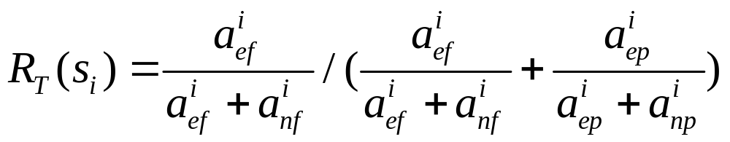

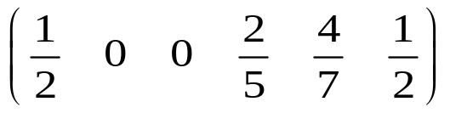

Tarantula
Risk values
Ranking list

Slide 35
Integration of SBFL with MT
A one-to-one correspondence
test case – metamorphic test group
pass or failure of a test case – satisfaction or violation of a metamorphic test group
coverage by a test case – coverage by a metamorphic test group

Slide 36
Integration of SBFL with MT
Corresponding intuition
  More likely to be faulty if executed by more violated metamorphic test groups
  More likely to be faulty if executed by less non-violated metamorphic test groups

Slide 37

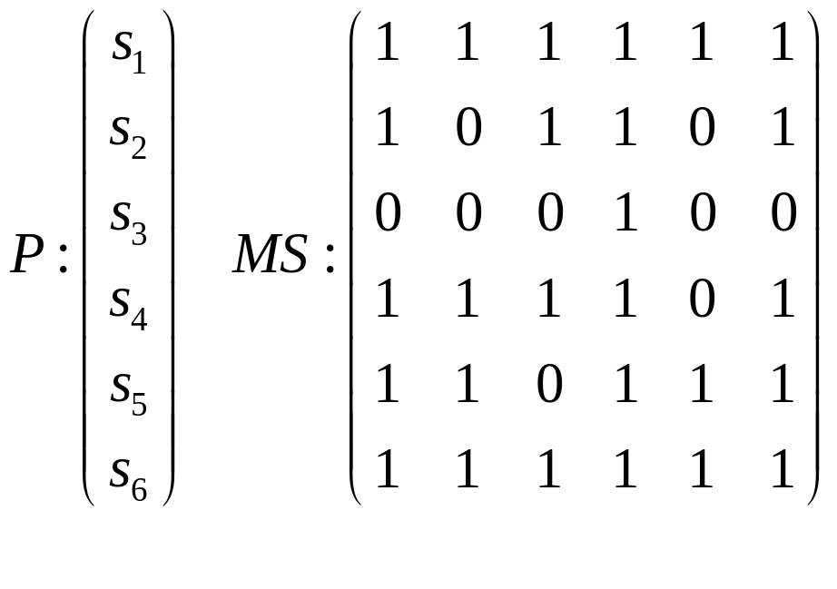

Example

Slide 38
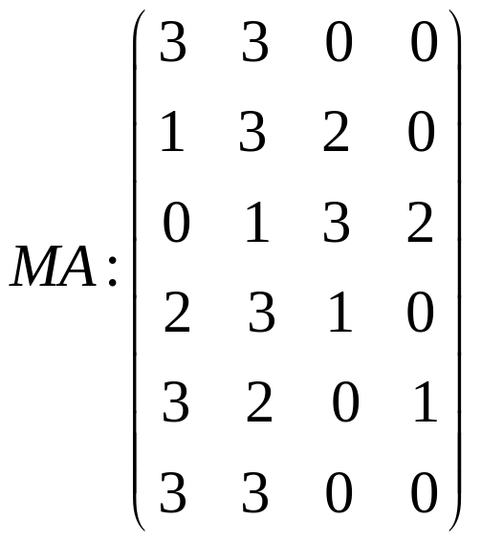
Example

Slide 39
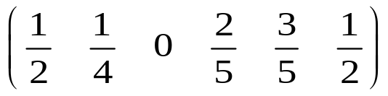

Tarantula
Risk values
Ranking list

Slide 40
Theory for Metamorphic Testing

Slide 41
Metamorphic Testing
Some reminders
  MRs not restricted to identity relations and numeric relations
  Multiple executions
  Follow-up test cases may depend on the outputs of the source test cases
  MT is applicable even if test oracle exists

Slide 42
Metamorphic Relations

Slide 43
Metamorphic Relations
Identification of MRs
Prioritization of MRs
Fault Detection Effectiveness of MRs

Slide 44
Identification of MRs
Is it feasible to identify or generate MRs?

Slide 45
A Popular and Intuitive Approach
Select an input
Modify it, hopefully that the relevant change of output will be somehow predictable.
If yes, any generalisation?
If yes, then identify an MR

Slide 46
Identification of MRs
Various approaches
Machine learning (Kanewala and Bieman)
Data mutation (H. Zhu)
Coding (Zhang Chen Hao Xiong…)
Composition (Liu et al.)
Category-choice framework (Chen et al.)
………… (Columbia University)
……..

Slide 47
Generation by Composition
Generation of new MRs from existing MRs by composition

Slide 48
Example
Shortest path: SP(G, a, b)
Suppose we have the following MRs
  MRA: |SP(G, a, b)| = |SP(G, b, a)|.
  MRB: |SP(G, a, b)| = |SP(G’, a’, b’)|.
By composition, a new MR is defined as
  MRAB: |SP(G, a, b)| = |SP(G’, b’, a’)|.

Slide 49
Prioritization of MRs
Consider sin(x)
  MR1: sin(x) = sin(x + 2 π)
  MR2: sin(x) = -sin(x + π)
  MR3: sin(-x)= -sin(x)
  MR4: sin(x) = sin(π-x)
  MR5: sin(x) = -sin(2 π - x)
  …

Slide 50
Priorization Approaches
Usage profile
Algorithm

Slide 51
Usage Profile
Restricted use of programs – interested in a subset of properties

Slide 52
Usage Profile
sin(x)
  Electrical engineers
    sin(x) = sin(x + 2 π)
  Surveyors
    sin(-x)= -sin(x)
    sin(x) = sin(π-x)

Slide 53
Fault-Detection Effectiveness
How many MRs are required?

Slide 54
Empirical Observation:
a few diverse MRs

Slide 55
f(x)
f(x) = ax^{n} + bx^{n-1} + …
x

Slide 56
f(x)
x

Slide 57
Conclusion
Simplicity

Slide 58
Thanks!

