Slide 1
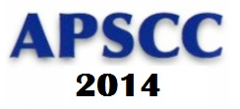
APSCC Special Track
The 2014 Asia-Pacific Services Computing Conference
Zibin Zheng and Shangguang Wang
December 4, 2014, Fuzhou, China

Slide 2
Introduction
APSCC2014 special tracks focus on various emerging topics related to services computing
Accepted papers will be published by IEEE
Best papers will be invited to Journal of Web Services Research (SCI Indexed)
5 special tracks
  cloud services, mobile services, big data, service discovery, development, dependability, testing, etc.

Slide 3
Acceptance ratio of the special tracks
The overall acceptance ratio of the special tracks is 39.3%
Accept 34 papers，including：
SCI papers: 4, Journal of Web Services Research (JWSR)
IEEE papers: 30

Slide 4

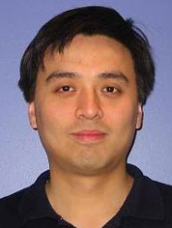
Track: Reliability Technologies and Tools for Services-Based Systems
(泉州厅, 10:30 am - 12:30 pm)
Chairs:
Prof. Chang-ai Sun
University of Science and Technology Beijing, China
Email: casun@ustb.edu.cn
Dr. Huai Liu
RMIT University, Australia
Email: huai.liu@rmit.edu.au
Website: http://scce.ustb.edu.cn/show/mxfwxt/RTTSBS2014.html

Slide 5
Session : Reliability Technologies and Tools for Services-Based Systems
Towards Logical Architecture and Formal Analysis of Dependencies Between Services
Maria Spichkova (RMIT University), Heinrich Schmidt (RMIT University)
Finding Optimized Deployment Strategy for Multi-tenant Services by Iterative Staging
Jizun Liu (Shandong University), Zeyu Di (Shandong University), Shijun Liu (Shandong University), Calton Pu (Georgia Institute of Technology), Lei Wu (Shandong University), Li Pan (Shandong University)
False Logic Attacks on SCADA Control System
Weize Li (University of Science and Technology Beijing), LunXie (University of Science and Technology Beijing), Daqian Liu (University of Science and Technology Beijing), Zhiliang Wang (University of Science and Technology Beijing)
Group Key Agreement in Multimedia Service for Machine Type Communication
Jieying Li (Xidian University), Yueyu Zhang (Xidian University), Jie Chen (Xidian University), Hui Li (Xidian University), Wujun Zhang (Xidian University)
A Multiple Watermarking Scheme with Embedding-Order Identifying Feature
Zhu-wei Jin (Nankai University), Ming Su (Nankai University), Gang Wang (Nankai University)
Analysis and Application of Secondary Code in BDS
Deng-ao Li (Taiyuan University of Technology), Wen-hui Niu (Taiyuan University of Technology), Ju-min Zhao (Taiyuan University of Technology), Shuai Li (Taiyuan University of Technology), Jin-qiang Liu (Taiyuan University of Technology)

Slide 6
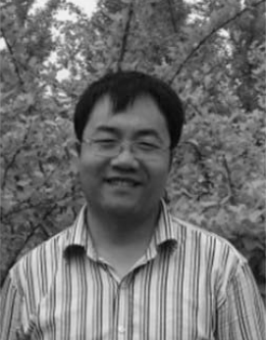
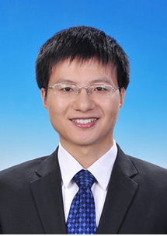
Track: IoT services and Mobile Services
(厦门厅, 14: 00 - 16:00 pm)
Chairs:
Bo Cheng
State Key Laboratory of Networking and Switching Technology Beijing University of Posts and Telecommunications
Email: chengbo@bupt.edu.cn
Shangguang Wang
State Key Laboratory of Networking and Switching Technology
Beijing University of Posts and Telecommunications, Email: sgwang@bupt.edu.cn
Website: http://www.sguangwang.com/IoTMS/

Slide 7
Session : IoT Services and Mobile Services
POC: An optimization strategy of EV efficient travelling
Jiayuan Li (Beijing University of Posts and Telecommunications), Jinglin Li (Beijing University of Posts and Telecommunications), Zhihan Liu (Beijing University of Posts and Telecommunications)
A Spatio-temporal Parallel Processing System for Traffic Sensory Data
Zhuofeng Zhao (North China University of Technology), Weilong Ding (North China University of Technology), Yanbo Han (North China University of Technology), Jianwu Wang (University of California, San Diego)
Context-aware Web Services Recommendation based on User Preference
Xiaoliang Fan (Lanzhou University), Yakun Hu (Lanzhou University), Ruisheng Zhang (Lanzhou University)
Design and Implementation of Capability Opening Engine in PaaS for Internet of Vehicles
Hongman Wang (Beijing University of Posts and Telecommunications), Xiaohan Xia (Beijing University of Posts and Telecommunications), Yueming Gao (Shanghai CINTel Intelligent Telecom System Co., Ltd), Hongmin Zhou (Shanghai CINTel Intelligent Telecom System Co., Ltd)
An Event-driven Service-oriented Architecture for the Internet of Things
Lina Lan (Beijing University of Posts and Telecommunications), Fei Li (Vienna University of Technology), Bai Wang (Beijing University of Posts and Telecommunications), Lei Zhang (Beijing University of Posts and Telecommunications), Ruisheng Shi (Beijing University of Posts and Telecommunications)
Network Traffic Analysis for Mobile Terminal Based Multi-scale Entropy
Xiaoming Chen (Harbin Engineering University), Huiqiang Wang (Harbin Engineering University), Junyu Lin (Harbin Engineering University), Guangsheng Feng (Harbin Engineering University), Chao Zhao (Harbin Engineering University)

Slide 8
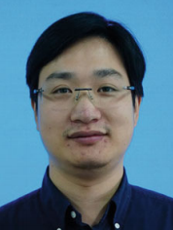

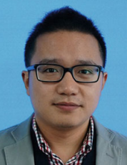
Track: BigData and Service Discovery
(泉州厅, 14:00 - 16:00 pm)
Chairs:
Prof. Jian Wu
Zhejiang University, China
Email:wujian2000@zju.edu.cn
Prof. Qi Yu
Rochester Institute of Technology, USA
Email: qi.yu@rit.edu
Dr. Liang Chen (Zhejiang University, China) Email: cliang@zju.edu.cn
Website: http://bigdatasd.com/apscc/

Slide 9
Session : Big Data and Service Discovery
A Twig Join algorithm for a Query with ID References
Dong Li (South China University of Technology), Lin Zhao (South China University of Technology), Jing Li (South China University of Technology)
Topic Detection from Microblog Based on Text Clustering and Topic Model Analysis
Siqi Huang (Nanjing University of Posts and Telecommunications), Yitao Yang (Nanjing University of Posts and Telecommunications), Huakang Li (Nanjing University of Posts and Telecommunications), Guozi Sun (Nanjing University of Posts and Telecommunications)
A Rule-Based Recommendation for Personalization in Social Networks
Rui Zhang (Wuhan University of Technology), Yueqi Zhou (Wuhan University of Technology), Lin Li (Wuhan University of Technology), Chengming Zou (Wuhan University of Technology)
Function Level Web Service Discovery Based on Category Function Tree
Jipeng Cui (University of Jinan), Bingxian Ma (University of Jinan)
Correlation Search of Web Services
Fenfang Xie (Hunan University of Science and Technology), Jianxun Liu (Hunan University of Science and Technology), Mingdong Tang (Hunan University of Science and Technology), Buqing Cao (Hunan University of Science and Technology), Saixia Lyu (Hunan University of Science and Technology)
An Approach to the Location-based Services Collaboration Evaluation Algorithm Oriented to Mobile Internet Environment
Manli Lu (Shanghai University), Mingjun Xin (Shanghai University), Weimin Li (Shanghai University)

Slide 10
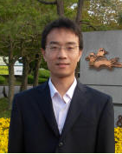
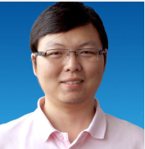
Track: Development, Testing and Maintenance of Cloud Services
(泉州厅, 16:10 - 18:10 pm)
Yutao Ma
Wuhan University,China
Email: ytma@whu.edu.cn
Bo Hu
Kingdee International Software Group Company Limited, China
Email: bob_hu@kingdee.com
Website: http://www.nerc-eis.org/apscc/

Slide 11
Session : Development, Testing and Maintenance of Cloud Services
Data Organization Patterns for Cloud Enterprise Applications
Yi Wei (Shandong University), Lei Wu (Shandong University), Shijun Liu (Shandong University), Li Pan (Shandong University), Xiangxu Meng (Shandong University)
Consistent Testing Framework for Continuous Service Development
Chaiwat Sathawornwichit (Bank of Thailand), Shigeru Hosono (NEC Corporation)
A Petri net-based Approach to Service Composition and Monitoring in the IOT
Rong Yang (Hubei University of Science and Technology), Bing Li (Wuhan University), Can Cheng (Wuhan University)
A Communication Latency Predict-based Method for Deploying Applications on Cloud
Pei Fan (China HuaYi Broadcasting Corporation)
Adaptive Web Services Composition for Multi-user
Yu Lei (Inner Mongolia University), Zhou Jiantao (Inner Mongolia University)
A Coupling-based approach for Class Integration and Test Order
Hao Liu (Wuhan University of Science and Technology), Jianxun Chen (Wuhan University of Science and Technology)

Slide 12
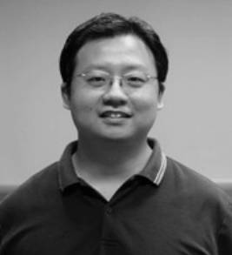
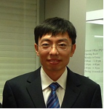
Track: Dependability in Cloud Computing
(厦门厅, 16:10 - 18:10 pm)
Chairs:
Xiapu Luo
The Hong Kong Polytechnic University
Email: csxluo@comp.polyu.edu.hk
Weigang Wu
Sun Yat-sen University
Email: wuweig@mail.sysu.edu.cn
Website: http://ndc.sysu.edu.cn/depcc/

Slide 13
Session : Dependability in Cloud Computing
Congestion Control Algorithm for Data Center
Xiue Gao (Dalian University of Technology), Xin Zhao (Dalian University), Keqiu Li (Dalian University of Technology)
Joint Subcarrier Pairing and Power Allocation in OFDMA Cooperative Relay Networks
Songtao Guo (Southwest University), Jianji Hu (Southwest University), Chunrong He (Southwest University)
Identifying Users’ Interest Similarity Based On Clustering Hot Vertices in Social Networks
Tianchi Mo (Central South University), Hongxiao Fei (Central South University), Li Kuang (Central South University), Qifei Qin (Central South University)
iConCube: A Location-based Mobile Cloud System for Meeting Organizers and Participants
Guo Chi (Wuhan University), Liu Xuan (Wuhan University), Fang Yuan (Wuhan University), Cui Jingsong (Wuhan University)
Tree-structured Network Based Hierarchical Complex Event Processing in Wireless Sensor Networks
Mengyuan Xu (Beijing University of Posts and Telecommunications), Zhihan Liu (Beijing University of Posts and Telecommunications), Jinglin Li (Beijing University of Posts and Telecommunications)
Scheduling Parallel Virtual Machine in Xen based on Credit
Xiaobo Ding (Harbin Engineering University), Zhong Ma (Wuhan Digital engineering Research Institution), Xingfa Dai (Wuhan Digital engineering Research Institution), Alin Zhong (China Three Gorges University)

Slide 14
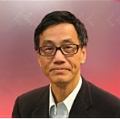
Invited Talk:
Testing the Non-Testable Systems Using a Simple Method
Tsong Yueh Chen
Professor
Swinburne University of Technology
Email:tchen@it.swim.edu.au
Tsong Yueh Chen is a Professor of Software Engineering at the Department of Computer Science and Software Engineering, Swinburne University of Technology, Australia. He received his BSc. and MPhil. from The University of Hong Kong; MSc and DIC from Imperial College of Science and Technology; and PhD degree from The University of Melbourne.
He has published over 250 papers in internationally renowned journals and conferences, such as IEEE Transactions on Software Engineering, ACM Transactions on Software Engineering and Methodology, IEEE Transactions on Reliability, Communication of ACM. He is a leading scholar in software testing recognized for his work in “Adaptive Random Testing” and “Metamorphic Testing”. He is also one of top productive researchers in the area of Software and Systems.

Slide 15
Thanks!

