Slide 1

Final Project
Sajjad Ranjbar
ML, winter semester 1403-1404

Slide 2


Repository
https://github.com/phantomf4321/A-fun-game-with-a-huge-dataset-of-movies
Notes:
Notes to presenter:
What steps will you be taking as a result of this learning experience?
Did you learn from any failed experiences? How will you do things differently?
What advice will you give to others so they can learn from your experiences?
How can you share what you learned with a real-world audience?
Some examples of next steps might be:
After delivering my first persuasive presentation, I am thinking about joining the debate team.
After making my first film, I’m considering entering it in our school film festival or local film festival.
After connecting with this career expert, I’d like to do some research on that career field because it sounds interesting to me.
This SmartArt allows you add images and text to help outline your process. If a picture is worth a thousand words, then pictures and words should help you communicate this reflection on learning perfectly! You can always click on Insert>SmartArt to change this graphic or select the graphic and click on the Design contextual menu to change the colors.
Feel free to use more than one slide to share your next steps. It also helps to add some video content to explain your message.

Slide 3
EDA
Notes:
Notes to presenter:
What steps will you be taking as a result of this learning experience?
Did you learn from any failed experiences? How will you do things differently?
What advice will you give to others so they can learn from your experiences?
How can you share what you learned with a real-world audience?
Some examples of next steps might be:
After delivering my first persuasive presentation, I am thinking about joining the debate team.
After making my first film, I’m considering entering it in our school film festival or local film festival.
After connecting with this career expert, I’d like to do some research on that career field because it sounds interesting to me.
This SmartArt allows you add images and text to help outline your process. If a picture is worth a thousand words, then pictures and words should help you communicate this reflection on learning perfectly! You can always click on Insert>SmartArt to change this graphic or select the graphic and click on the Design contextual menu to change the colors.
Feel free to use more than one slide to share your next steps. It also helps to add some video content to explain your message.

Slide 4

Cleaning
Save plots
Save csv
Convert data frames to numeric
Drop Null rows
Join ratings → links → metadata
eda_rowcount_audit
eda_user_activity_counts
eda_movie_popularity_counts
eda_genre_counts
eda_language_counts
eda_country_counts
eda_temporal_monthly
Notes:
Notes to presenter:
What was important about this learning experience?
How is it relevant to your course, yourself, or your society or community?
Why is this significant?
This SmartArt allows you add images and text to help outline your process. If a picture is worth a thousand words, then pictures and words should help you communicate this reflection on learning perfectly! You can always click on Insert>SmartArt to change this graphic or select the graphic and click on the Design contextual menu to change the colors.

Slide 5
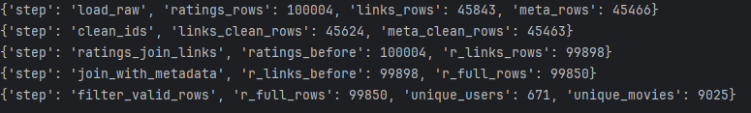
EDA
Notes:
Notes to presenter:
What steps will you be taking as a result of this learning experience?
Did you learn from any failed experiences? How will you do things differently?
What advice will you give to others so they can learn from your experiences?
How can you share what you learned with a real-world audience?
Some examples of next steps might be:
After delivering my first persuasive presentation, I am thinking about joining the debate team.
After making my first film, I’m considering entering it in our school film festival or local film festival.
After connecting with this career expert, I’d like to do some research on that career field because it sounds interesting to me.
This SmartArt allows you add images and text to help outline your process. If a picture is worth a thousand words, then pictures and words should help you communicate this reflection on learning perfectly! You can always click on Insert>SmartArt to change this graphic or select the graphic and click on the Design contextual menu to change the colors.
Feel free to use more than one slide to share your next steps. It also helps to add some video content to explain your message.

Slide 6
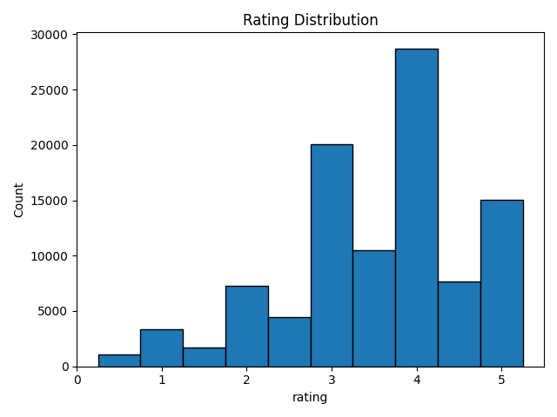
Dataset
Notes:
Notes to presenter:
What steps will you be taking as a result of this learning experience?
Did you learn from any failed experiences? How will you do things differently?
What advice will you give to others so they can learn from your experiences?
How can you share what you learned with a real-world audience?
Some examples of next steps might be:
After delivering my first persuasive presentation, I am thinking about joining the debate team.
After making my first film, I’m considering entering it in our school film festival or local film festival.
After connecting with this career expert, I’d like to do some research on that career field because it sounds interesting to me.
This SmartArt allows you add images and text to help outline your process. If a picture is worth a thousand words, then pictures and words should help you communicate this reflection on learning perfectly! You can always click on Insert>SmartArt to change this graphic or select the graphic and click on the Design contextual menu to change the colors.
Feel free to use more than one slide to share your next steps. It also helps to add some video content to explain your message.

Slide 7
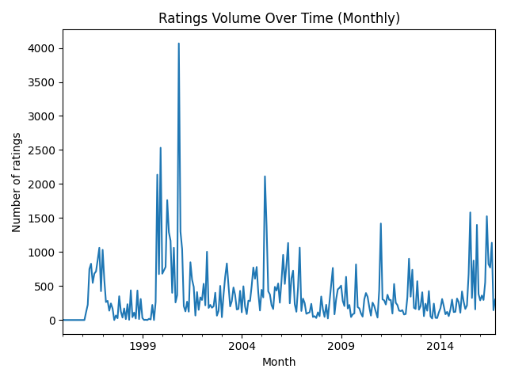
Dataset
Notes:
Notes to presenter:
What steps will you be taking as a result of this learning experience?
Did you learn from any failed experiences? How will you do things differently?
What advice will you give to others so they can learn from your experiences?
How can you share what you learned with a real-world audience?
Some examples of next steps might be:
After delivering my first persuasive presentation, I am thinking about joining the debate team.
After making my first film, I’m considering entering it in our school film festival or local film festival.
After connecting with this career expert, I’d like to do some research on that career field because it sounds interesting to me.
This SmartArt allows you add images and text to help outline your process. If a picture is worth a thousand words, then pictures and words should help you communicate this reflection on learning perfectly! You can always click on Insert>SmartArt to change this graphic or select the graphic and click on the Design contextual menu to change the colors.
Feel free to use more than one slide to share your next steps. It also helps to add some video content to explain your message.

Slide 8
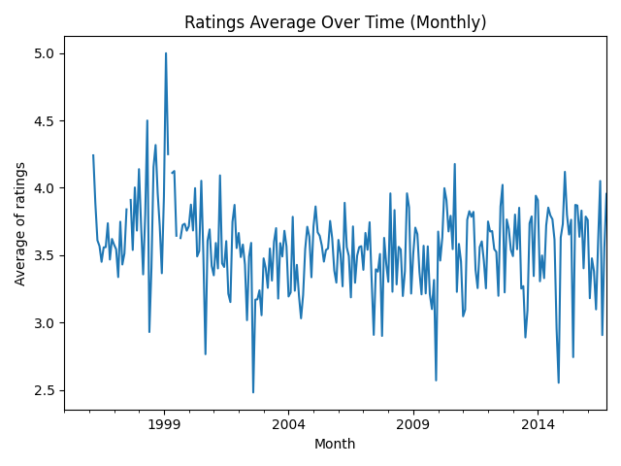
Dataset
Notes:
Notes to presenter:
What steps will you be taking as a result of this learning experience?
Did you learn from any failed experiences? How will you do things differently?
What advice will you give to others so they can learn from your experiences?
How can you share what you learned with a real-world audience?
Some examples of next steps might be:
After delivering my first persuasive presentation, I am thinking about joining the debate team.
After making my first film, I’m considering entering it in our school film festival or local film festival.
After connecting with this career expert, I’d like to do some research on that career field because it sounds interesting to me.
This SmartArt allows you add images and text to help outline your process. If a picture is worth a thousand words, then pictures and words should help you communicate this reflection on learning perfectly! You can always click on Insert>SmartArt to change this graphic or select the graphic and click on the Design contextual menu to change the colors.
Feel free to use more than one slide to share your next steps. It also helps to add some video content to explain your message.

Slide 9
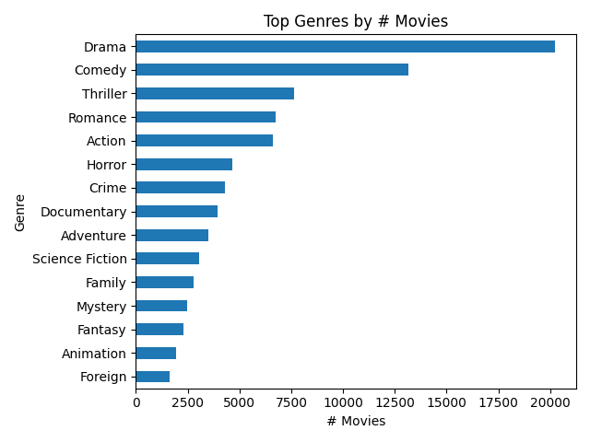
Dataset
Notes:
Notes to presenter:
What steps will you be taking as a result of this learning experience?
Did you learn from any failed experiences? How will you do things differently?
What advice will you give to others so they can learn from your experiences?
How can you share what you learned with a real-world audience?
Some examples of next steps might be:
After delivering my first persuasive presentation, I am thinking about joining the debate team.
After making my first film, I’m considering entering it in our school film festival or local film festival.
After connecting with this career expert, I’d like to do some research on that career field because it sounds interesting to me.
This SmartArt allows you add images and text to help outline your process. If a picture is worth a thousand words, then pictures and words should help you communicate this reflection on learning perfectly! You can always click on Insert>SmartArt to change this graphic or select the graphic and click on the Design contextual menu to change the colors.
Feel free to use more than one slide to share your next steps. It also helps to add some video content to explain your message.

Slide 10
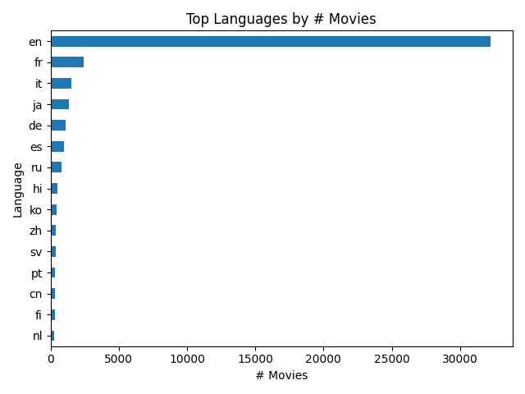
Dataset
Notes:
Notes to presenter:
What steps will you be taking as a result of this learning experience?
Did you learn from any failed experiences? How will you do things differently?
What advice will you give to others so they can learn from your experiences?
How can you share what you learned with a real-world audience?
Some examples of next steps might be:
After delivering my first persuasive presentation, I am thinking about joining the debate team.
After making my first film, I’m considering entering it in our school film festival or local film festival.
After connecting with this career expert, I’d like to do some research on that career field because it sounds interesting to me.
This SmartArt allows you add images and text to help outline your process. If a picture is worth a thousand words, then pictures and words should help you communicate this reflection on learning perfectly! You can always click on Insert>SmartArt to change this graphic or select the graphic and click on the Design contextual menu to change the colors.
Feel free to use more than one slide to share your next steps. It also helps to add some video content to explain your message.

Slide 11
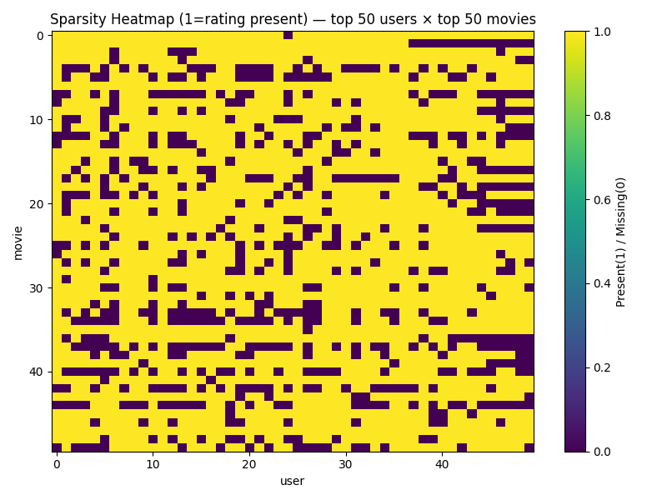
Dataset
Notes:
Notes to presenter:
What steps will you be taking as a result of this learning experience?
Did you learn from any failed experiences? How will you do things differently?
What advice will you give to others so they can learn from your experiences?
How can you share what you learned with a real-world audience?
Some examples of next steps might be:
After delivering my first persuasive presentation, I am thinking about joining the debate team.
After making my first film, I’m considering entering it in our school film festival or local film festival.
After connecting with this career expert, I’d like to do some research on that career field because it sounds interesting to me.
This SmartArt allows you add images and text to help outline your process. If a picture is worth a thousand words, then pictures and words should help you communicate this reflection on learning perfectly! You can always click on Insert>SmartArt to change this graphic or select the graphic and click on the Design contextual menu to change the colors.
Feel free to use more than one slide to share your next steps. It also helps to add some video content to explain your message.

Slide 12
Base Line(construction)
4
r_full is grouped by tmdbId and title
Ri: mean rating
3
Vi: vote count
2
Attach genres list
1
Notes:
Notes to presenter:
What steps will you be taking as a result of this learning experience?
Did you learn from any failed experiences? How will you do things differently?
What advice will you give to others so they can learn from your experiences?
How can you share what you learned with a real-world audience?
Some examples of next steps might be:
After delivering my first persuasive presentation, I am thinking about joining the debate team.
After making my first film, I’m considering entering it in our school film festival or local film festival.
After connecting with this career expert, I’d like to do some research on that career field because it sounds interesting to me.
This SmartArt allows you add images and text to help outline your process. If a picture is worth a thousand words, then pictures and words should help you communicate this reflection on learning perfectly! You can always click on Insert>SmartArt to change this graphic or select the graphic and click on the Design contextual menu to change the colors.
Feel free to use more than one slide to share your next steps. It also helps to add some video content to explain your message.

Slide 13

What does it return?
C: weighted mean of all ratings.
m: 80% of the vote counts.
WR: global weighted ratings.
Notes:
Notes to presenter:
What is your purpose for sharing this reflection?
Is it at the end of a unit or project?
Are you sharing this reflection, at the attainment of a learning goal you set for yourself?
Is it at the end of a course?
State your purpose for the reflection or even the purpose of the learning experience or learning goal. Be clear and be specific in stating your purpose.

Slide 14

We have two main approaches!
Calculate weighted rating for a genre group.
Calculating per-genre weighted ratings.
CG
genre_wr(self, Cg):
Per_genre
Per_genre(self):
Notes:
Notes to presenter:
Description of what you learned in your own words on one side.
Include information about the topic
Details about the topic will also be helpful here.
Tell the story of your learning experience. Just like a story there should always be a beginning, middle and an end.
On the other side, you can add a graphic that provides evidence of what you learned.
Feel free to use more than one slide to reflect upon your process. It also helps to add some video of your process.

Slide 15
Global WR parameters:
{C: np.float64(3.543), m: 13, m_quantile: 0.8}
Notes:
Notes to presenter:
What steps will you be taking as a result of this learning experience?
Did you learn from any failed experiences? How will you do things differently?
What advice will you give to others so they can learn from your experiences?
How can you share what you learned with a real-world audience?
Some examples of next steps might be:
After delivering my first persuasive presentation, I am thinking about joining the debate team.
After making my first film, I’m considering entering it in our school film festival or local film festival.
After connecting with this career expert, I’d like to do some research on that career field because it sounds interesting to me.
This SmartArt allows you add images and text to help outline your process. If a picture is worth a thousand words, then pictures and words should help you communicate this reflection on learning perfectly! You can always click on Insert>SmartArt to change this graphic or select the graphic and click on the Design contextual menu to change the colors.
Feel free to use more than one slide to share your next steps. It also helps to add some video content to explain your message.

Slide 16
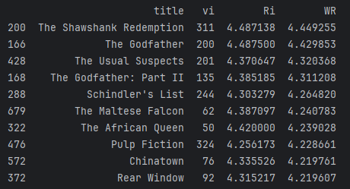
Top 10 globally popular movies (WR):
Notes:
Notes to presenter:
What steps will you be taking as a result of this learning experience?
Did you learn from any failed experiences? How will you do things differently?
What advice will you give to others so they can learn from your experiences?
How can you share what you learned with a real-world audience?
Some examples of next steps might be:
After delivering my first persuasive presentation, I am thinking about joining the debate team.
After making my first film, I’m considering entering it in our school film festival or local film festival.
After connecting with this career expert, I’d like to do some research on that career field because it sounds interesting to me.
This SmartArt allows you add images and text to help outline your process. If a picture is worth a thousand words, then pictures and words should help you communicate this reflection on learning perfectly! You can always click on Insert>SmartArt to change this graphic or select the graphic and click on the Design contextual menu to change the colors.
Feel free to use more than one slide to share your next steps. It also helps to add some video content to explain your message.

Slide 17
Final outputs
We have two csv files as below:
data/baseline/baseline_global_wr.csv
data/baseline/baseline_per_genre_wr.csv
Notes:
Notes to presenter:
What is your purpose for sharing this reflection?
Is it at the end of a unit or project?
Are you sharing this reflection, at the attainment of a learning goal you set for yourself?
Is it at the end of a course?
State your purpose for the reflection or even the purpose of the learning experience or learning goal. Be clear and be specific in stating your purpose.

Slide 18
Make a user profile and recommendations
Notes:
Notes to presenter:
What is your purpose for sharing this reflection?
Is it at the end of a unit or project?
Are you sharing this reflection, at the attainment of a learning goal you set for yourself?
Is it at the end of a course?
State your purpose for the reflection or even the purpose of the learning experience or learning goal. Be clear and be specific in stating your purpose.

Slide 19
Make a user profile and recommendations
Text Features:
Combines overview and tagline into a single text field.
Applies TF-IDF vectorization with English stop words removal.
Notes:
Notes to presenter:
What steps will you be taking as a result of this learning experience?
Did you learn from any failed experiences? How will you do things differently?
What advice will you give to others so they can learn from your experiences?
How can you share what you learned with a real-world audience?
Some examples of next steps might be:
After delivering my first persuasive presentation, I am thinking about joining the debate team.
After making my first film, I’m considering entering it in our school film festival or local film festival.
After connecting with this career expert, I’d like to do some research on that career field because it sounds interesting to me.
This SmartArt allows you add images and text to help outline your process. If a picture is worth a thousand words, then pictures and words should help you communicate this reflection on learning perfectly! You can always click on Insert>SmartArt to change this graphic or select the graphic and click on the Design contextual menu to change the colors.
Feel free to use more than one slide to share your next steps. It also helps to add some video content to explain your message.

Slide 20
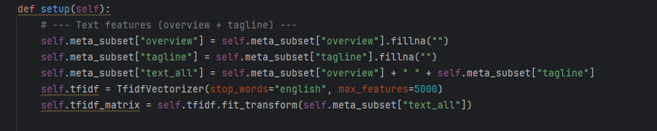
Make a user profile and recommendations
Text Features:
Combines overview and tagline into a single text field.
Applies TF-IDF vectorization with English stop words removal.
Notes:
Notes to presenter:
What steps will you be taking as a result of this learning experience?
Did you learn from any failed experiences? How will you do things differently?
What advice will you give to others so they can learn from your experiences?
How can you share what you learned with a real-world audience?
Some examples of next steps might be:
After delivering my first persuasive presentation, I am thinking about joining the debate team.
After making my first film, I’m considering entering it in our school film festival or local film festival.
After connecting with this career expert, I’d like to do some research on that career field because it sounds interesting to me.
This SmartArt allows you add images and text to help outline your process. If a picture is worth a thousand words, then pictures and words should help you communicate this reflection on learning perfectly! You can always click on Insert>SmartArt to change this graphic or select the graphic and click on the Design contextual menu to change the colors.
Feel free to use more than one slide to share your next steps. It also helps to add some video content to explain your message.

Slide 21
Make a user profile and recommendations
Categorical Features:
Genres: Multi-label binarization of genre lists.
Keywords: Multi-label binarization of keyword lists.
Cast & Crew: Multi-label binarization of top cast and crew members.
Notes:
Notes to presenter:
What steps will you be taking as a result of this learning experience?
Did you learn from any failed experiences? How will you do things differently?
What advice will you give to others so they can learn from your experiences?
How can you share what you learned with a real-world audience?
Some examples of next steps might be:
After delivering my first persuasive presentation, I am thinking about joining the debate team.
After making my first film, I’m considering entering it in our school film festival or local film festival.
After connecting with this career expert, I’d like to do some research on that career field because it sounds interesting to me.
This SmartArt allows you add images and text to help outline your process. If a picture is worth a thousand words, then pictures and words should help you communicate this reflection on learning perfectly! You can always click on Insert>SmartArt to change this graphic or select the graphic and click on the Design contextual menu to change the colors.
Feel free to use more than one slide to share your next steps. It also helps to add some video content to explain your message.

Slide 22
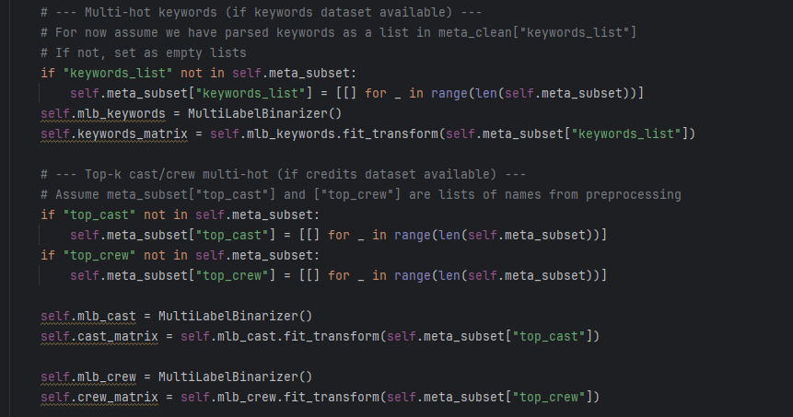
Make a user profile and recommendations
Categorical Features:
Notes:
Notes to presenter:
What steps will you be taking as a result of this learning experience?
Did you learn from any failed experiences? How will you do things differently?
What advice will you give to others so they can learn from your experiences?
How can you share what you learned with a real-world audience?
Some examples of next steps might be:
After delivering my first persuasive presentation, I am thinking about joining the debate team.
After making my first film, I’m considering entering it in our school film festival or local film festival.
After connecting with this career expert, I’d like to do some research on that career field because it sounds interesting to me.
This SmartArt allows you add images and text to help outline your process. If a picture is worth a thousand words, then pictures and words should help you communicate this reflection on learning perfectly! You can always click on Insert>SmartArt to change this graphic or select the graphic and click on the Design contextual menu to change the colors.
Feel free to use more than one slide to share your next steps. It also helps to add some video content to explain your message.

Slide 23
Make a user profile and recommendations
Feature Integration:
Horizontally stacks all feature matrices using hstack()
Creates comprehensive item feature representations.
Notes:
Notes to presenter:
What steps will you be taking as a result of this learning experience?
Did you learn from any failed experiences? How will you do things differently?
What advice will you give to others so they can learn from your experiences?
How can you share what you learned with a real-world audience?
Some examples of next steps might be:
After delivering my first persuasive presentation, I am thinking about joining the debate team.
After making my first film, I’m considering entering it in our school film festival or local film festival.
After connecting with this career expert, I’d like to do some research on that career field because it sounds interesting to me.
This SmartArt allows you add images and text to help outline your process. If a picture is worth a thousand words, then pictures and words should help you communicate this reflection on learning perfectly! You can always click on Insert>SmartArt to change this graphic or select the graphic and click on the Design contextual menu to change the colors.
Feel free to use more than one slide to share your next steps. It also helps to add some video content to explain your message.

Slide 24
Make a user profile and recommendations
Feature Integration:
Notes:
Notes to presenter:
What steps will you be taking as a result of this learning experience?
Did you learn from any failed experiences? How will you do things differently?
What advice will you give to others so they can learn from your experiences?
How can you share what you learned with a real-world audience?
Some examples of next steps might be:
After delivering my first persuasive presentation, I am thinking about joining the debate team.
After making my first film, I’m considering entering it in our school film festival or local film festival.
After connecting with this career expert, I’d like to do some research on that career field because it sounds interesting to me.
This SmartArt allows you add images and text to help outline your process. If a picture is worth a thousand words, then pictures and words should help you communicate this reflection on learning perfectly! You can always click on Insert>SmartArt to change this graphic or select the graphic and click on the Design contextual menu to change the colors.
Feel free to use more than one slide to share your next steps. It also helps to add some video content to explain your message.

Slide 25
Make a user profile and recommendations
2. dimensionality_reduction()
Applies Truncated SVD with 300 components for dimensionality reduction.
Creates efficient item vectors indexed by tmdbId.
Reduces computational complexity while preserving essential patterns.
Notes:
Notes to presenter:
What steps will you be taking as a result of this learning experience?
Did you learn from any failed experiences? How will you do things differently?
What advice will you give to others so they can learn from your experiences?
How can you share what you learned with a real-world audience?
Some examples of next steps might be:
After delivering my first persuasive presentation, I am thinking about joining the debate team.
After making my first film, I’m considering entering it in our school film festival or local film festival.
After connecting with this career expert, I’d like to do some research on that career field because it sounds interesting to me.
This SmartArt allows you add images and text to help outline your process. If a picture is worth a thousand words, then pictures and words should help you communicate this reflection on learning perfectly! You can always click on Insert>SmartArt to change this graphic or select the graphic and click on the Design contextual menu to change the colors.
Feel free to use more than one slide to share your next steps. It also helps to add some video content to explain your message.

Slide 26
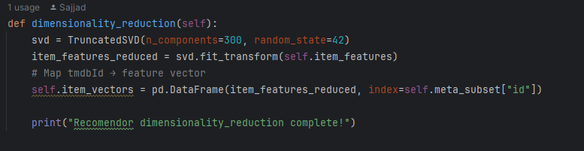
Make a user profile and recommendations
2. dimensionality_reduction()
Applies Truncated SVD with 300 components for dimensionality reduction.
Creates efficient item vectors indexed by tmdbId.
Reduces computational complexity while preserving essential patterns.
Notes:
Notes to presenter:
What steps will you be taking as a result of this learning experience?
Did you learn from any failed experiences? How will you do things differently?
What advice will you give to others so they can learn from your experiences?
How can you share what you learned with a real-world audience?
Some examples of next steps might be:
After delivering my first persuasive presentation, I am thinking about joining the debate team.
After making my first film, I’m considering entering it in our school film festival or local film festival.
After connecting with this career expert, I’d like to do some research on that career field because it sounds interesting to me.
This SmartArt allows you add images and text to help outline your process. If a picture is worth a thousand words, then pictures and words should help you communicate this reflection on learning perfectly! You can always click on Insert>SmartArt to change this graphic or select the graphic and click on the Design contextual menu to change the colors.
Feel free to use more than one slide to share your next steps. It also helps to add some video content to explain your message.

Slide 27
Make a user profile and recommendations
build_user_profile(user_id, ratings_df, item_vecs)
User Preference Modeling:
Extracts the user's rating history.
Applies mean-centering to adjust ratings.
Creates a weighted average profile vector based on user preferences.
Returns None for new users (cold start scenario)
Notes:
Notes to presenter:
What steps will you be taking as a result of this learning experience?
Did you learn from any failed experiences? How will you do things differently?
What advice will you give to others so they can learn from your experiences?
How can you share what you learned with a real-world audience?
Some examples of next steps might be:
After delivering my first persuasive presentation, I am thinking about joining the debate team.
After making my first film, I’m considering entering it in our school film festival or local film festival.
After connecting with this career expert, I’d like to do some research on that career field because it sounds interesting to me.
This SmartArt allows you add images and text to help outline your process. If a picture is worth a thousand words, then pictures and words should help you communicate this reflection on learning perfectly! You can always click on Insert>SmartArt to change this graphic or select the graphic and click on the Design contextual menu to change the colors.
Feel free to use more than one slide to share your next steps. It also helps to add some video content to explain your message.

Slide 28
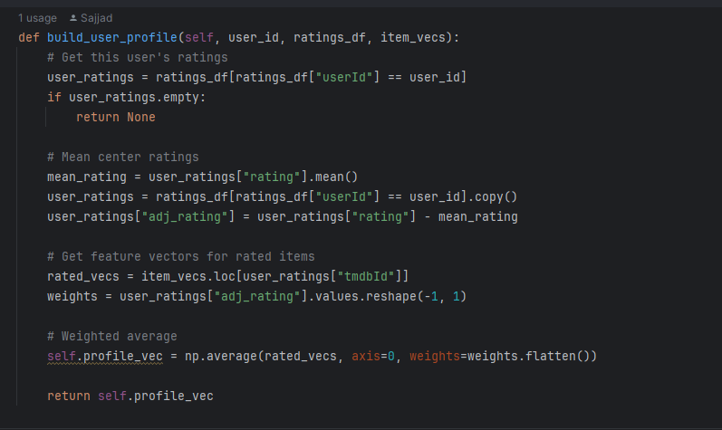
Make a user profile and recommendations
Notes:
Notes to presenter:
What steps will you be taking as a result of this learning experience?
Did you learn from any failed experiences? How will you do things differently?
What advice will you give to others so they can learn from your experiences?
How can you share what you learned with a real-world audience?
Some examples of next steps might be:
After delivering my first persuasive presentation, I am thinking about joining the debate team.
After making my first film, I’m considering entering it in our school film festival or local film festival.
After connecting with this career expert, I’d like to do some research on that career field because it sounds interesting to me.
This SmartArt allows you add images and text to help outline your process. If a picture is worth a thousand words, then pictures and words should help you communicate this reflection on learning perfectly! You can always click on Insert>SmartArt to change this graphic or select the graphic and click on the Design contextual menu to change the colors.
Feel free to use more than one slide to share your next steps. It also helps to add some video content to explain your message.

Slide 29
Make a user profile and recommendations
4. recommend_content(user_id, ratings_df, item_vecs, top_n=10)
Builds user profile or uses global ratings for cold start
Computes cosine similarity between user profile and all items
Filters out previously rated items
Returns top-N recommendations with titles and similarity scores
Notes:
Notes to presenter:
What steps will you be taking as a result of this learning experience?
Did you learn from any failed experiences? How will you do things differently?
What advice will you give to others so they can learn from your experiences?
How can you share what you learned with a real-world audience?
Some examples of next steps might be:
After delivering my first persuasive presentation, I am thinking about joining the debate team.
After making my first film, I’m considering entering it in our school film festival or local film festival.
After connecting with this career expert, I’d like to do some research on that career field because it sounds interesting to me.
This SmartArt allows you add images and text to help outline your process. If a picture is worth a thousand words, then pictures and words should help you communicate this reflection on learning perfectly! You can always click on Insert>SmartArt to change this graphic or select the graphic and click on the Design contextual menu to change the colors.
Feel free to use more than one slide to share your next steps. It also helps to add some video content to explain your message.

Slide 30
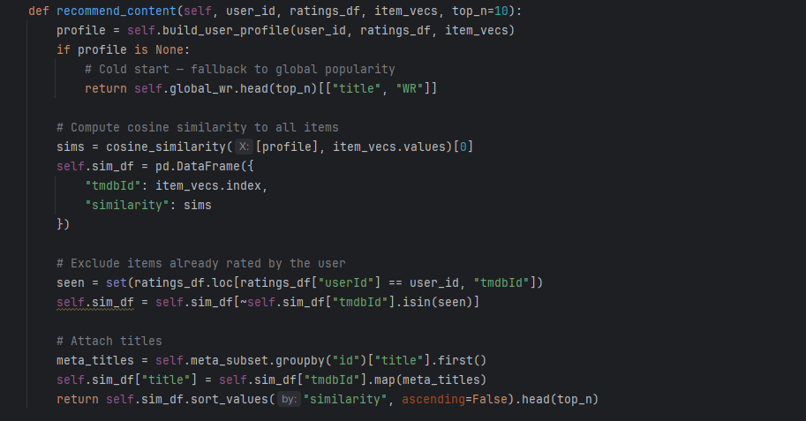
Make a user profile and recommendations
Notes:
Notes to presenter:
What steps will you be taking as a result of this learning experience?
Did you learn from any failed experiences? How will you do things differently?
What advice will you give to others so they can learn from your experiences?
How can you share what you learned with a real-world audience?
Some examples of next steps might be:
After delivering my first persuasive presentation, I am thinking about joining the debate team.
After making my first film, I’m considering entering it in our school film festival or local film festival.
After connecting with this career expert, I’d like to do some research on that career field because it sounds interesting to me.
This SmartArt allows you add images and text to help outline your process. If a picture is worth a thousand words, then pictures and words should help you communicate this reflection on learning perfectly! You can always click on Insert>SmartArt to change this graphic or select the graphic and click on the Design contextual menu to change the colors.
Feel free to use more than one slide to share your next steps. It also helps to add some video content to explain your message.

Slide 31
Make a user profile and recommendations
5. explain_recommendation(tmdbId, user_id, ratings_df, meta_df)
Identifies genre and cast overlaps between recommended item and user's liked items.
Generates human-readable explanations based on common features.
Falls back to "matches your taste profile" when no obvious overlaps exist.
Notes:
Notes to presenter:
What steps will you be taking as a result of this learning experience?
Did you learn from any failed experiences? How will you do things differently?
What advice will you give to others so they can learn from your experiences?
How can you share what you learned with a real-world audience?
Some examples of next steps might be:
After delivering my first persuasive presentation, I am thinking about joining the debate team.
After making my first film, I’m considering entering it in our school film festival or local film festival.
After connecting with this career expert, I’d like to do some research on that career field because it sounds interesting to me.
This SmartArt allows you add images and text to help outline your process. If a picture is worth a thousand words, then pictures and words should help you communicate this reflection on learning perfectly! You can always click on Insert>SmartArt to change this graphic or select the graphic and click on the Design contextual menu to change the colors.
Feel free to use more than one slide to share your next steps. It also helps to add some video content to explain your message.

Slide 32
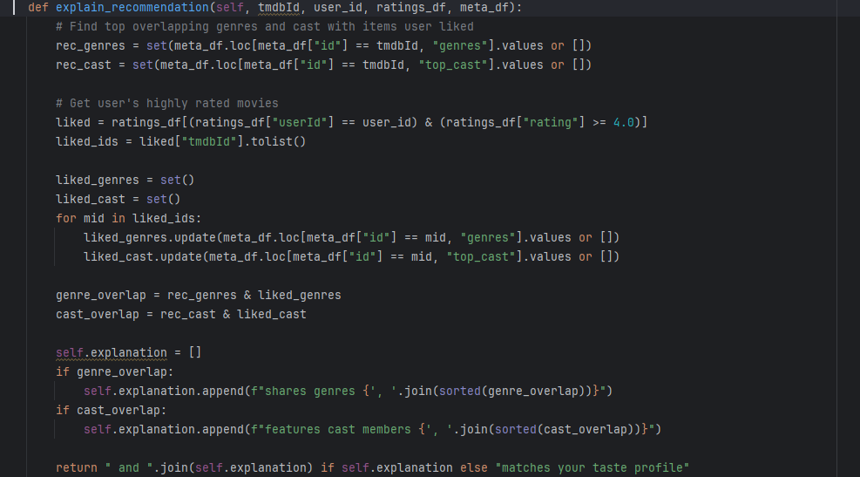
Make a user profile and recommendations
Notes:
Notes to presenter:
What steps will you be taking as a result of this learning experience?
Did you learn from any failed experiences? How will you do things differently?
What advice will you give to others so they can learn from your experiences?
How can you share what you learned with a real-world audience?
Some examples of next steps might be:
After delivering my first persuasive presentation, I am thinking about joining the debate team.
After making my first film, I’m considering entering it in our school film festival or local film festival.
After connecting with this career expert, I’d like to do some research on that career field because it sounds interesting to me.
This SmartArt allows you add images and text to help outline your process. If a picture is worth a thousand words, then pictures and words should help you communicate this reflection on learning perfectly! You can always click on Insert>SmartArt to change this graphic or select the graphic and click on the Design contextual menu to change the colors.
Feel free to use more than one slide to share your next steps. It also helps to add some video content to explain your message.

Slide 33
Make a user profile and recommendations
For example, I test this recommendation for ser 123!
Notes:
Notes to presenter:
What steps will you be taking as a result of this learning experience?
Did you learn from any failed experiences? How will you do things differently?
What advice will you give to others so they can learn from your experiences?
How can you share what you learned with a real-world audience?
Some examples of next steps might be:
After delivering my first persuasive presentation, I am thinking about joining the debate team.
After making my first film, I’m considering entering it in our school film festival or local film festival.
After connecting with this career expert, I’d like to do some research on that career field because it sounds interesting to me.
This SmartArt allows you add images and text to help outline your process. If a picture is worth a thousand words, then pictures and words should help you communicate this reflection on learning perfectly! You can always click on Insert>SmartArt to change this graphic or select the graphic and click on the Design contextual menu to change the colors.
Feel free to use more than one slide to share your next steps. It also helps to add some video content to explain your message.

Slide 34
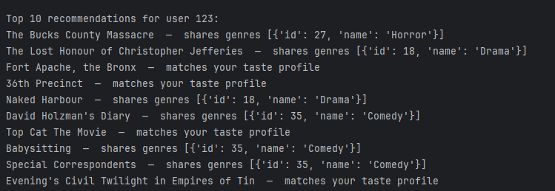
Make a user profile and recommendations
For example, I test this recommendation for ser 123!
Notes:
Notes to presenter:
What steps will you be taking as a result of this learning experience?
Did you learn from any failed experiences? How will you do things differently?
What advice will you give to others so they can learn from your experiences?
How can you share what you learned with a real-world audience?
Some examples of next steps might be:
After delivering my first persuasive presentation, I am thinking about joining the debate team.
After making my first film, I’m considering entering it in our school film festival or local film festival.
After connecting with this career expert, I’d like to do some research on that career field because it sounds interesting to me.
This SmartArt allows you add images and text to help outline your process. If a picture is worth a thousand words, then pictures and words should help you communicate this reflection on learning perfectly! You can always click on Insert>SmartArt to change this graphic or select the graphic and click on the Design contextual menu to change the colors.
Feel free to use more than one slide to share your next steps. It also helps to add some video content to explain your message.

Slide 35
KNN recommendations
Notes:
Notes to presenter:
What is your purpose for sharing this reflection?
Is it at the end of a unit or project?
Are you sharing this reflection, at the attainment of a learning goal you set for yourself?
Is it at the end of a course?
State your purpose for the reflection or even the purpose of the learning experience or learning goal. Be clear and be specific in stating your purpose.

Slide 36
KNN recommendations
Key Components:
Data Ingestion: The constructor takes a DataFrame r_full containing user-item interactions (columns: userId, tmdbId, rating).
Index Mapping: Efficiently maps raw user and item IDs to internal matrix indices using pandas' category data type. This creates four dictionaries:
uid_map, iid_map: Map internal index → original ID.
uid_inv, iid_inv: Map original ID → internal index (crucial for fast lookups).
Notes:
Notes to presenter:
What steps will you be taking as a result of this learning experience?
Did you learn from any failed experiences? How will you do things differently?
What advice will you give to others so they can learn from your experiences?
How can you share what you learned with a real-world audience?
Some examples of next steps might be:
After delivering my first persuasive presentation, I am thinking about joining the debate team.
After making my first film, I’m considering entering it in our school film festival or local film festival.
After connecting with this career expert, I’d like to do some research on that career field because it sounds interesting to me.
This SmartArt allows you add images and text to help outline your process. If a picture is worth a thousand words, then pictures and words should help you communicate this reflection on learning perfectly! You can always click on Insert>SmartArt to change this graphic or select the graphic and click on the Design contextual menu to change the colors.
Feel free to use more than one slide to share your next steps. It also helps to add some video content to explain your message.

Slide 37
KNN recommendations
Key Components:
Sparse Matrix Construction: Constructs a Compressed Sparse Row (csr_matrix) matrix R from the rating data. This is a memory-efficient representation for the user-item interaction matrix, especially since most users have not rated most items.
Notes:
Notes to presenter:
What steps will you be taking as a result of this learning experience?
Did you learn from any failed experiences? How will you do things differently?
What advice will you give to others so they can learn from your experiences?
How can you share what you learned with a real-world audience?
Some examples of next steps might be:
After delivering my first persuasive presentation, I am thinking about joining the debate team.
After making my first film, I’m considering entering it in our school film festival or local film festival.
After connecting with this career expert, I’d like to do some research on that career field because it sounds interesting to me.
This SmartArt allows you add images and text to help outline your process. If a picture is worth a thousand words, then pictures and words should help you communicate this reflection on learning perfectly! You can always click on Insert>SmartArt to change this graphic or select the graphic and click on the Design contextual menu to change the colors.
Feel free to use more than one slide to share your next steps. It also helps to add some video content to explain your message.

Slide 38
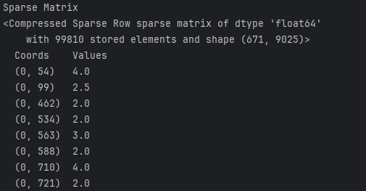
Key Components:
KNN recommendations
tmdbId
Rate
Notes:
Notes to presenter:
What steps will you be taking as a result of this learning experience?
Did you learn from any failed experiences? How will you do things differently?
What advice will you give to others so they can learn from your experiences?
How can you share what you learned with a real-world audience?
Some examples of next steps might be:
After delivering my first persuasive presentation, I am thinking about joining the debate team.
After making my first film, I’m considering entering it in our school film festival or local film festival.
After connecting with this career expert, I’d like to do some research on that career field because it sounds interesting to me.
This SmartArt allows you add images and text to help outline your process. If a picture is worth a thousand words, then pictures and words should help you communicate this reflection on learning perfectly! You can always click on Insert>SmartArt to change this graphic or select the graphic and click on the Design contextual menu to change the colors.
Feel free to use more than one slide to share your next steps. It also helps to add some video content to explain your message.

Slide 39
KNN Core Recommendation Algorithms
Item-Item KNN (item_item_knn)
Principle: "Users who liked this item also liked..."
Methodology:
Identifies items a target user has already rated (seen_items).
Computes the cosine similarity between every seen_item and every other item in the catalog.
Generates a prediction score for each item by calculating a weighted average of the user's ratings, where the weights are the similarities.
Masks items the user has already seen by setting their scores to -inf, ensuring they are not recommended.
Notes:
Notes to presenter:
What steps will you be taking as a result of this learning experience?
Did you learn from any failed experiences? How will you do things differently?
What advice will you give to others so they can learn from your experiences?
How can you share what you learned with a real-world audience?
Some examples of next steps might be:
After delivering my first persuasive presentation, I am thinking about joining the debate team.
After making my first film, I’m considering entering it in our school film festival or local film festival.
After connecting with this career expert, I’d like to do some research on that career field because it sounds interesting to me.
This SmartArt allows you add images and text to help outline your process. If a picture is worth a thousand words, then pictures and words should help you communicate this reflection on learning perfectly! You can always click on Insert>SmartArt to change this graphic or select the graphic and click on the Design contextual menu to change the colors.
Feel free to use more than one slide to share your next steps. It also helps to add some video content to explain your message.

Slide 40
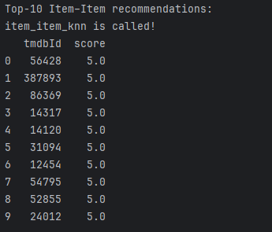
KNN Core Recommendation Algorithms
Item-Item KNN
The recommendations are often intuitive and justifiable.
Notes:
Notes to presenter:
What steps will you be taking as a result of this learning experience?
Did you learn from any failed experiences? How will you do things differently?
What advice will you give to others so they can learn from your experiences?
How can you share what you learned with a real-world audience?
Some examples of next steps might be:
After delivering my first persuasive presentation, I am thinking about joining the debate team.
After making my first film, I’m considering entering it in our school film festival or local film festival.
After connecting with this career expert, I’d like to do some research on that career field because it sounds interesting to me.
This SmartArt allows you add images and text to help outline your process. If a picture is worth a thousand words, then pictures and words should help you communicate this reflection on learning perfectly! You can always click on Insert>SmartArt to change this graphic or select the graphic and click on the Design contextual menu to change the colors.
Feel free to use more than one slide to share your next steps. It also helps to add some video content to explain your message.

Slide 41
KNN Core Recommendation Algorithms
User-User KNN (user_user_knn)
Principle: "Users like you also liked..."
Methodology:
Converts the sparse matrix to a dense array. (Note: This is a significant limitation for large datasets and should be replaced with sparse-aware computations for production use.)
Mean-centers the user ratings to account for user bias (a harsh rater vs. a generous rater).
Computes the cosine similarity between the target user's rating vector and all other users.
Generates a prediction score by taking a weighted average of the ratings from the most similar users (neighbors).
Adds the target user's mean rating back to the centered predictions.
Masks already seen items.
Notes:
Notes to presenter:
What steps will you be taking as a result of this learning experience?
Did you learn from any failed experiences? How will you do things differently?
What advice will you give to others so they can learn from your experiences?
How can you share what you learned with a real-world audience?
Some examples of next steps might be:
After delivering my first persuasive presentation, I am thinking about joining the debate team.
After making my first film, I’m considering entering it in our school film festival or local film festival.
After connecting with this career expert, I’d like to do some research on that career field because it sounds interesting to me.
This SmartArt allows you add images and text to help outline your process. If a picture is worth a thousand words, then pictures and words should help you communicate this reflection on learning perfectly! You can always click on Insert>SmartArt to change this graphic or select the graphic and click on the Design contextual menu to change the colors.
Feel free to use more than one slide to share your next steps. It also helps to add some video content to explain your message.

Slide 42
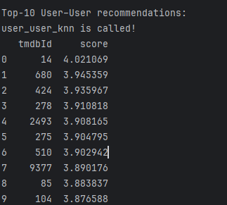
KNN Core Recommendation Algorithms
User-User KNN (user_user_knn)
Directly leverages the wisdom of a user's nearest neighbors.
Notes:
Notes to presenter:
What steps will you be taking as a result of this learning experience?
Did you learn from any failed experiences? How will you do things differently?
What advice will you give to others so they can learn from your experiences?
How can you share what you learned with a real-world audience?
Some examples of next steps might be:
After delivering my first persuasive presentation, I am thinking about joining the debate team.
After making my first film, I’m considering entering it in our school film festival or local film festival.
After connecting with this career expert, I’d like to do some research on that career field because it sounds interesting to me.
This SmartArt allows you add images and text to help outline your process. If a picture is worth a thousand words, then pictures and words should help you communicate this reflection on learning perfectly! You can always click on Insert>SmartArt to change this graphic or select the graphic and click on the Design contextual menu to change the colors.
Feel free to use more than one slide to share your next steps. It also helps to add some video content to explain your message.

Slide 43
KNN Core Recommendation Algorithms
Matrix Factorization (train_mf and mf_scores)
Principle: Discovers latent features (e.g., genre, director, themes) that describe users and items.
Methodology (Biased SGD):
Model: The rating prediction is decomposed into a global mean (mu), user bias (bu), item bias (bi), and the dot product of user and item latent factor vectors (P and Q).
Training: Uses Stochastic Gradient Descent (SGD) to minimize the prediction error on known ratings. The algorithm iteratively updates the biases and latent factors over multiple epochs.
Prediction: After training, scores for all items for a user are calculated using the learned parameters.
Strengths: Generally offers higher accuracy and can capture complex, non-linear relationships that KNN methods might miss. It is more scalable to very large datasets.
Notes:
Notes to presenter:
What steps will you be taking as a result of this learning experience?
Did you learn from any failed experiences? How will you do things differently?
What advice will you give to others so they can learn from your experiences?
How can you share what you learned with a real-world audience?
Some examples of next steps might be:
After delivering my first persuasive presentation, I am thinking about joining the debate team.
After making my first film, I’m considering entering it in our school film festival or local film festival.
After connecting with this career expert, I’d like to do some research on that career field because it sounds interesting to me.
This SmartArt allows you add images and text to help outline your process. If a picture is worth a thousand words, then pictures and words should help you communicate this reflection on learning perfectly! You can always click on Insert>SmartArt to change this graphic or select the graphic and click on the Design contextual menu to change the colors.
Feel free to use more than one slide to share your next steps. It also helps to add some video content to explain your message.

Slide 44
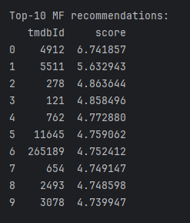
KNN Core Recommendation Algorithms
Matrix Factorization (train_mf and mf_scores)
Generally offers higher accuracy and can capture complex, non-linear relationships that KNN methods might miss. It is more scalable to very large datasets.
Notes:
Notes to presenter:
What steps will you be taking as a result of this learning experience?
Did you learn from any failed experiences? How will you do things differently?
What advice will you give to others so they can learn from your experiences?
How can you share what you learned with a real-world audience?
Some examples of next steps might be:
After delivering my first persuasive presentation, I am thinking about joining the debate team.
After making my first film, I’m considering entering it in our school film festival or local film festival.
After connecting with this career expert, I’d like to do some research on that career field because it sounds interesting to me.
This SmartArt allows you add images and text to help outline your process. If a picture is worth a thousand words, then pictures and words should help you communicate this reflection on learning perfectly! You can always click on Insert>SmartArt to change this graphic or select the graphic and click on the Design contextual menu to change the colors.
Feel free to use more than one slide to share your next steps. It also helps to add some video content to explain your message.

Slide 45
Thanks for your attention

