Slide 1
EIGELBERGER ARCHITECTURE & DESIGN
Office Hub
Every page, in the proposed design.
Built in Google Sites · files live in Drive · no page edits to keep it current

Slide 2
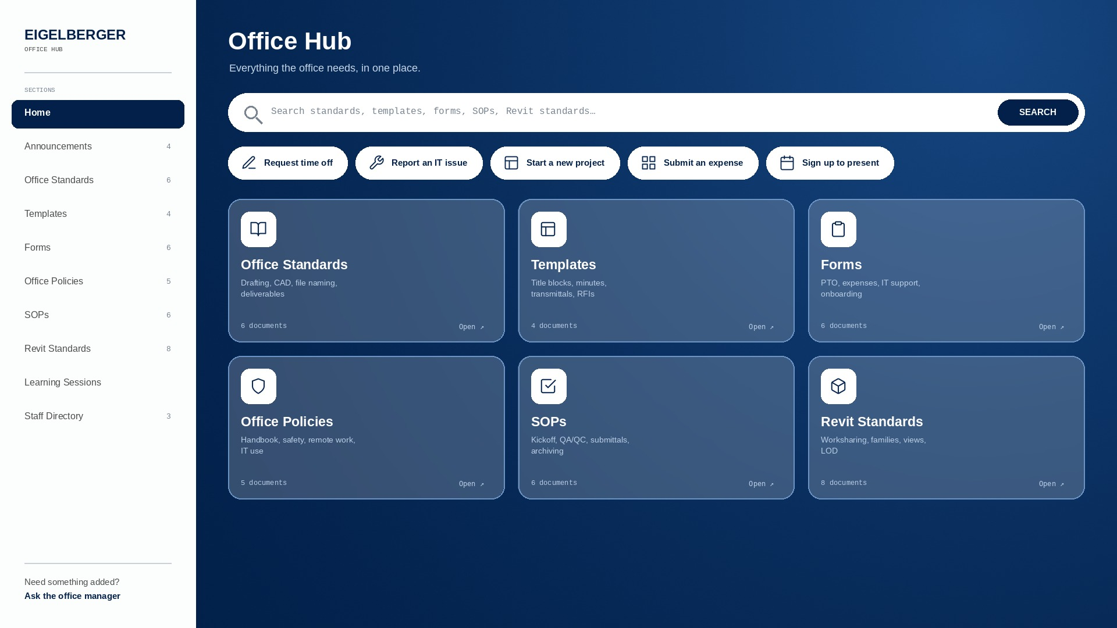
Notes:
Home — The landing page. Search, five one-click actions, and the six sections the office uses most.

Slide 3
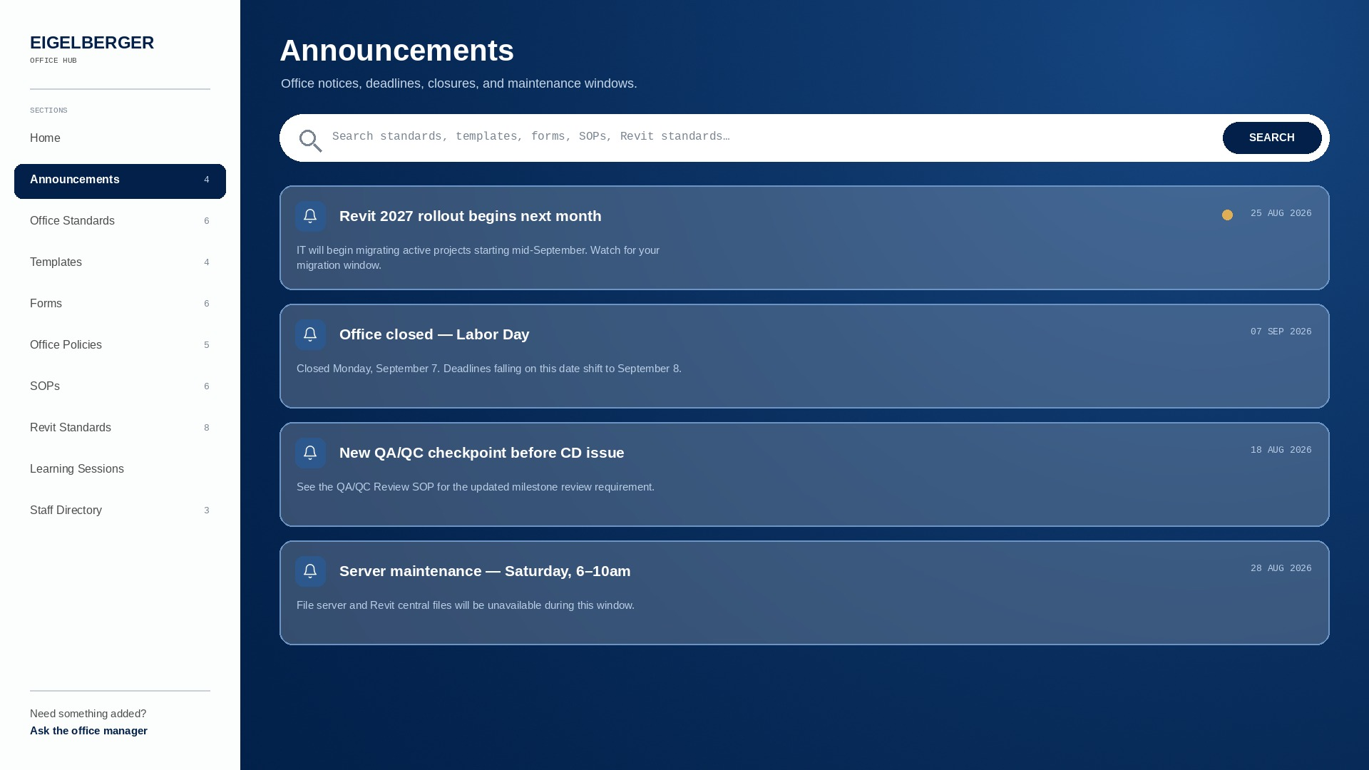
Notes:
Announcements — Office reminders and notices. Newest first, each one dated and tagged.

Slide 4
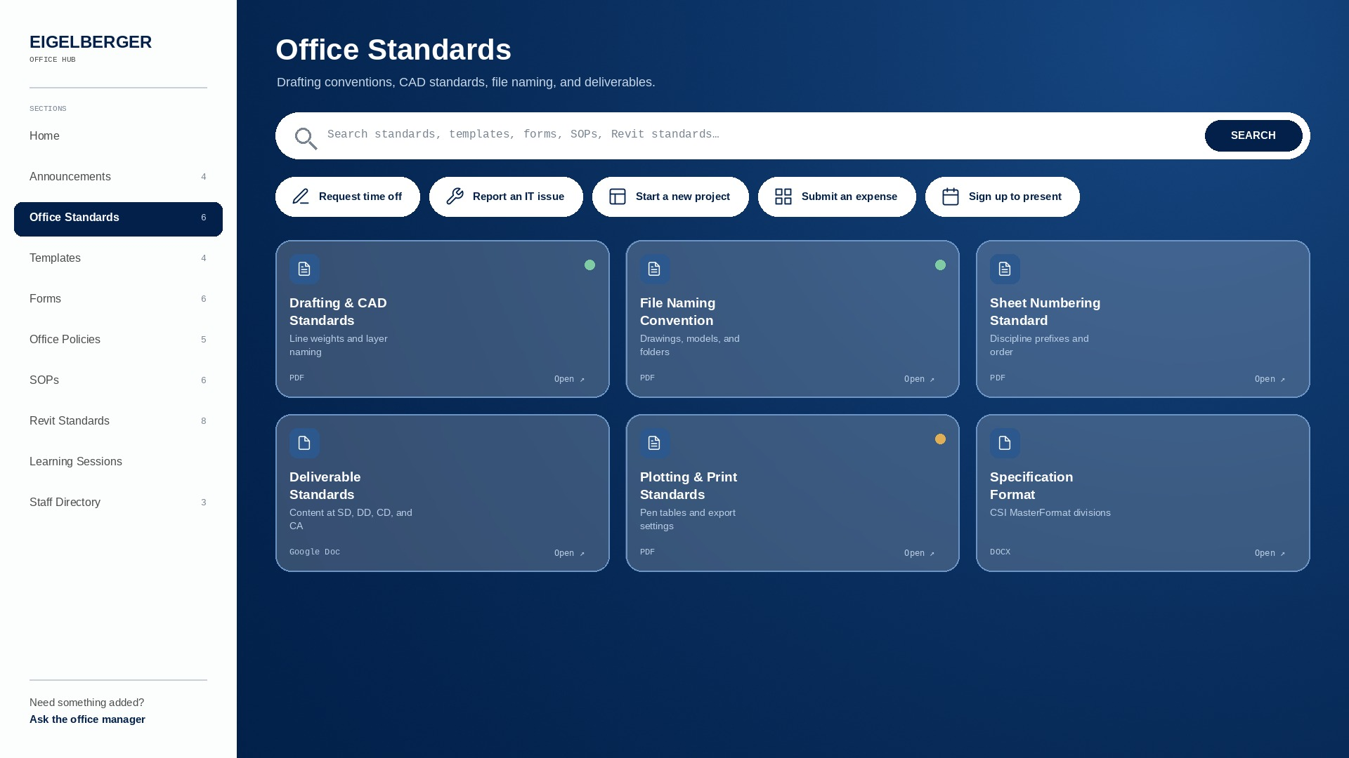
Notes:
Office Standards — Drafting conventions, file naming, sheet setup — the Office Standards Manual and everything under it.

Slide 5
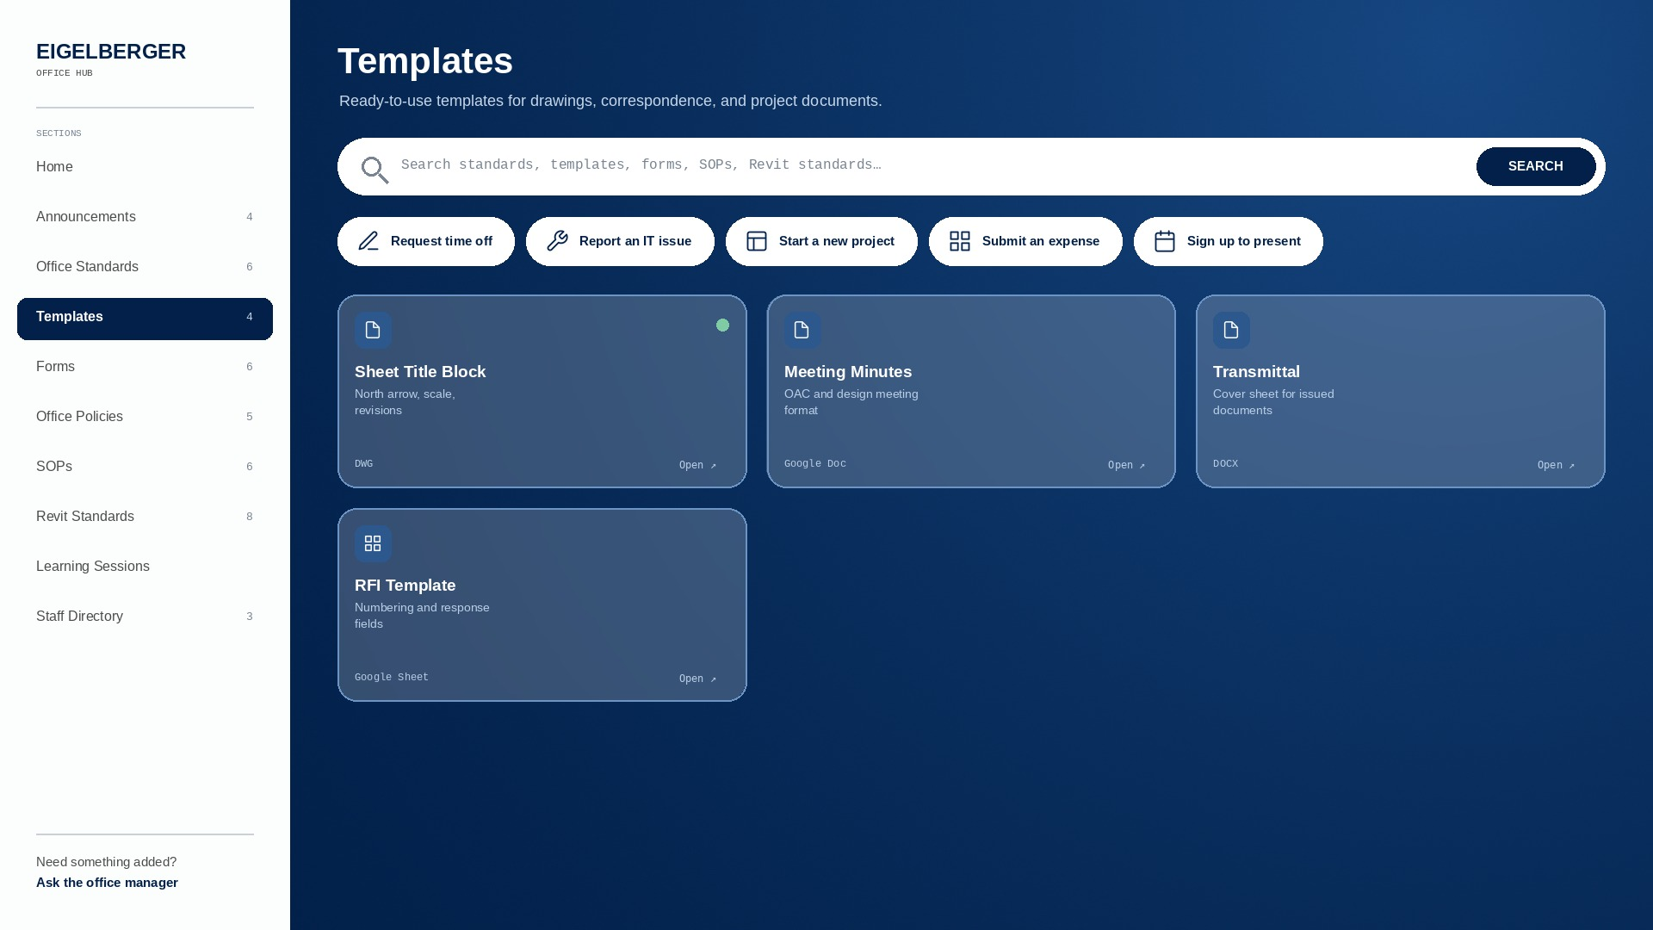
Notes:
Templates — Start-here files: sheet sets, letterhead, proposals, presentation decks.

Slide 6
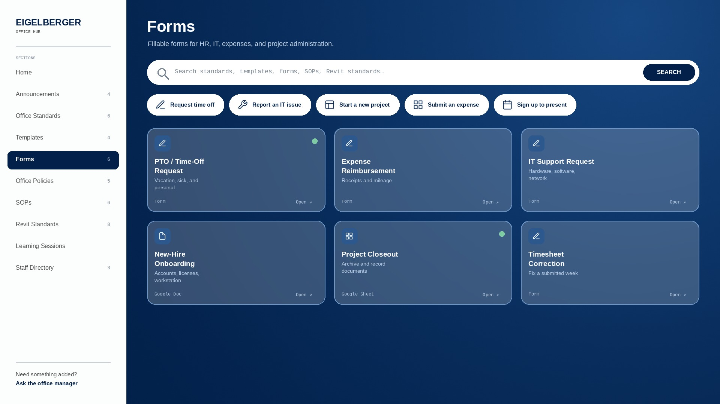
Notes:
Forms — Time off, expenses, IT requests — every form the office fills out, in one list.

Slide 7
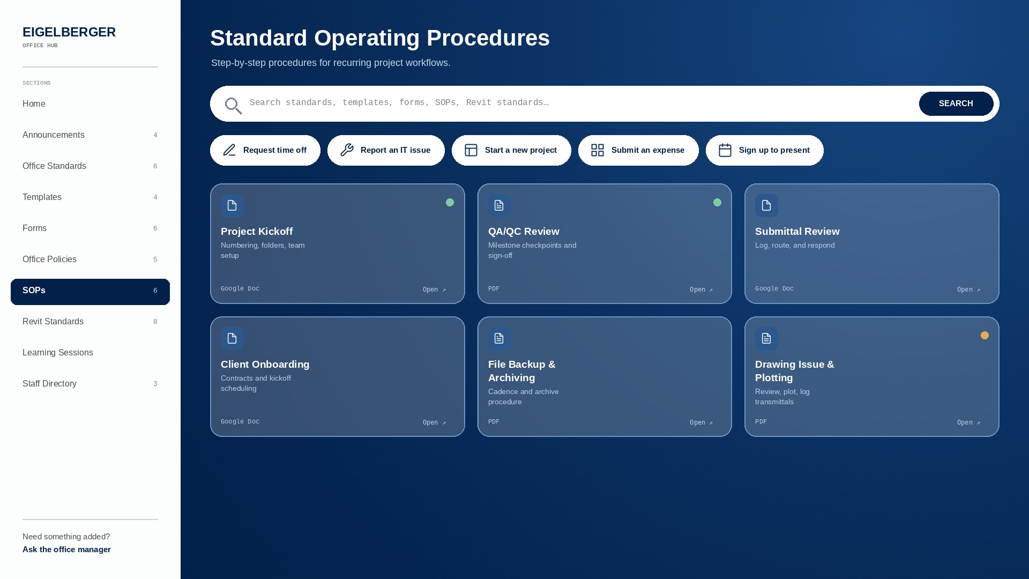
Notes:
SOPs — Step-by-step procedures for how the office runs a project from kickoff to closeout.

Slide 8
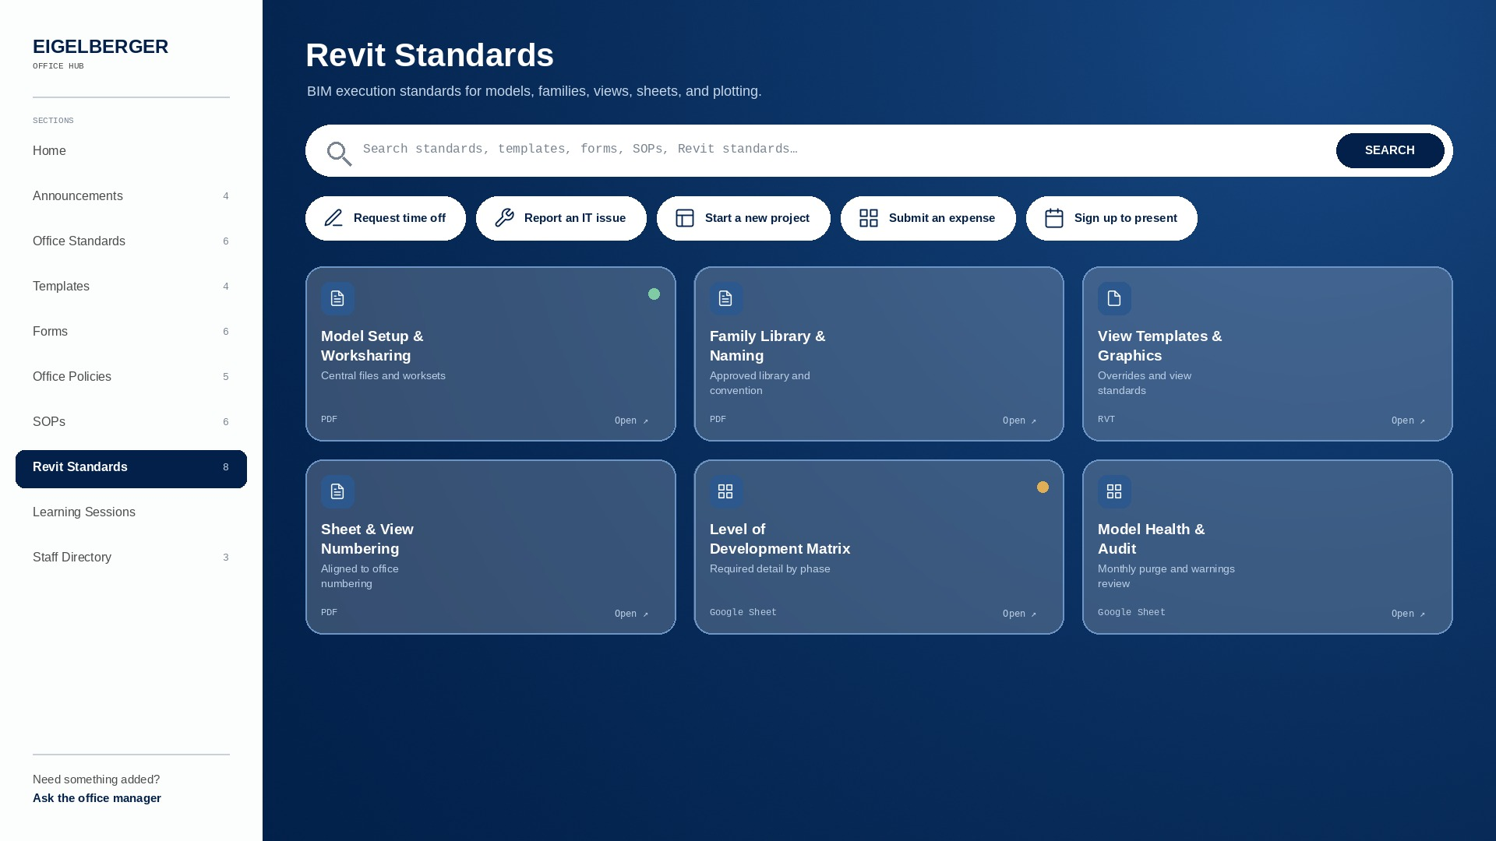
Notes:
Revit Standards — Model setup, worksharing, families, view templates, annotation.

Slide 9
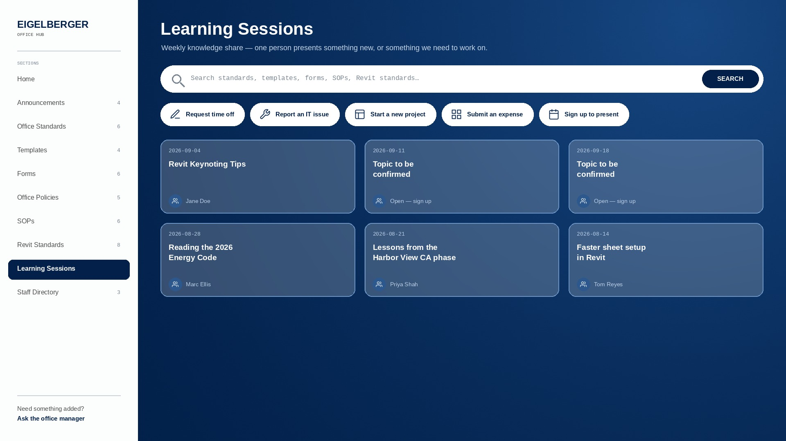
Notes:
Learning Sessions — The weekly presentation program. Upcoming sessions, the sign-up, and the full archive by month.

