Slide 1
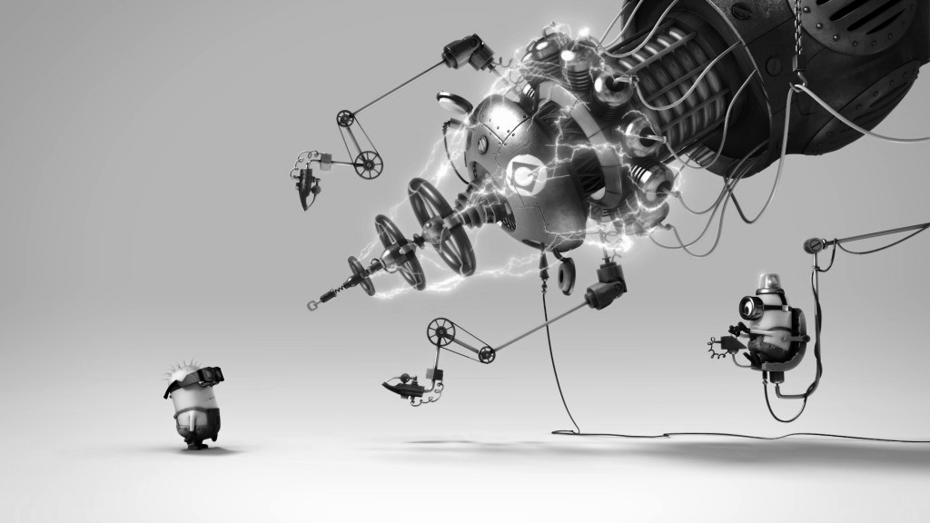
Test

Slide 2
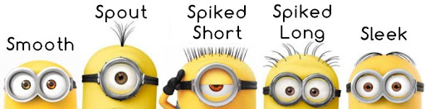
Test Categories
Broad Stack Test (E to E Test)
Subcutaneous Test
Business Facing Test (Acceptance Test)
Contract Test (Testing external services)
Story Test
User Journey Test
Threshold Test
Integration Test
Component Test
Unit Test
Read Martin Fowlers blog about test categories Read Jimmy Bogard’s blog where subcutaneous test is discussed clearly Visualizing Test Terminology

Slide 3
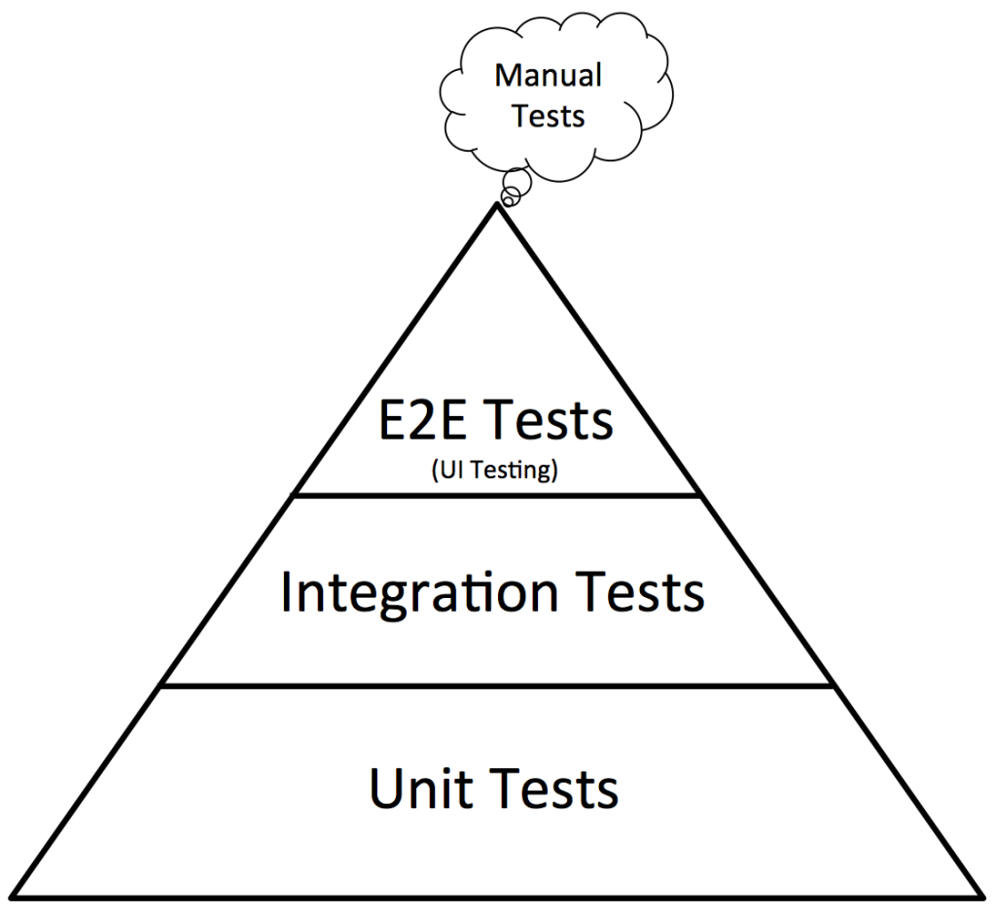
Test Pyramid
Manual Test
Automated UI Test
Cost
Speed & Reliability
Automated Integration Test
Automated Unit Test
Number of tests
Read about Practical Test Pyramid

Slide 4
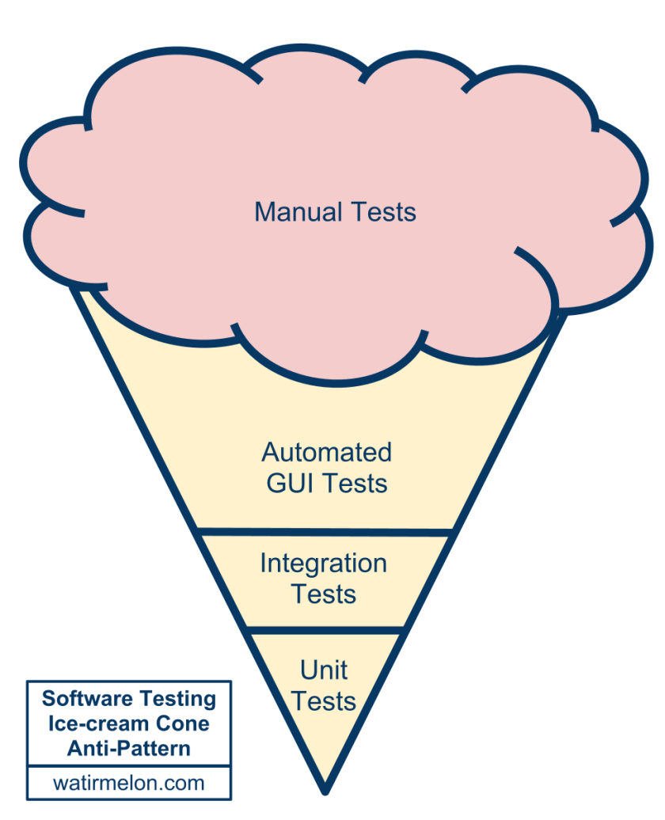
Regression test become more burdensome as more features are added
The ice-cream cone anti-pattern

Slide 5

Some statistics from real life project
Hi my name is Jimmy Bogard, thanks for inviting me here today.
Our ratio of unit:subcutaneous:full-system tests hovered around something like 10:2:1.
We ended the project with something around 5000 unit tests, 1000 subcutaneous tests, and 500 full-system tests that used WatiN and Gallio to drive a browser.
The 6000 unit/subcutaneous tests executed in about 10 minutes, while the 500 UI tests completed in about 50 minutes.
Read more here
Jimmy Bogard

Slide 6
Unit Testing

Slide 7

What we want to achieve
Catch bugs early
Self testing code
Fearless refactoring
Confidence
Enjoy the weekend
Good night sleep

Slide 8

What are the possible challenges
How to overcome
Lots of codes to be written and maintained
Can slow down development (for a while)
Broken tests
It’s very easy to write bad tests
We have to be fast
Learn how to write test that doesn’t break
Learn how to write good unit tests

Slide 9
What is a Unit?
It’s a small subset of functionality that can be tested independently
It can be a method/function
Can be a class
Even a bunch of classes together
Practically speaking it’s a situational thing

Slide 10
Unit Testing Approaches
Based on Six Dimension of Testing
How, What, When, Who, Where and Why
Read more about it

Slide 11
What ?
How ?
When ?
Where ?
Who ?
Functional vs Integration vs Acceptance etc
Before or After writing the code
Low Level vs Broad Stack Level
Automated vs Manual
Programmer vs Tester vs Business Analyst etc
1
2
3
4
5
Why ?
Is the test driving your development or you are just making sure your code is functional
6

Slide 12
TDD (Test Driven Development)
BDD (Behaviour Driven Development)
TFD (Test First Development)
Read about BDD
TDD, By Example
Growing Object Oriented Software Guided By Test

Slide 13
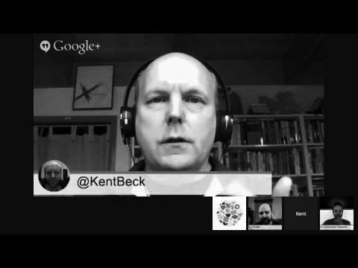
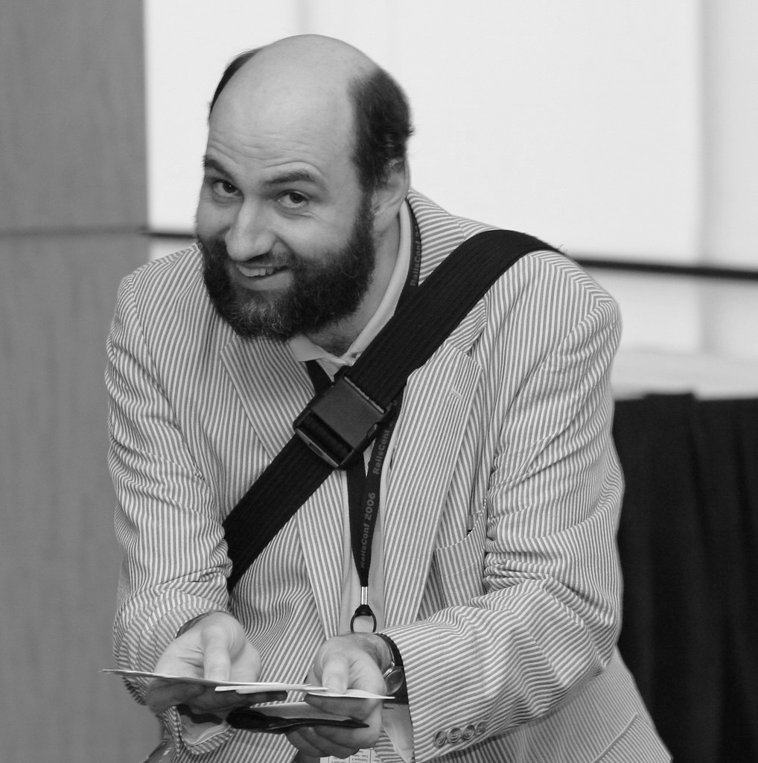
What is TDD
Test-driven development (TDD) is a way of managing fear during programming.
Fear in the legitimate, this-is-a-hard-problem-and-I-can’t-see-the-end-from-the-beginning sense - TDD, by Example
Test-Driven Development (TDD) is a technique for building software that guides software development by writing tests.

Slide 14
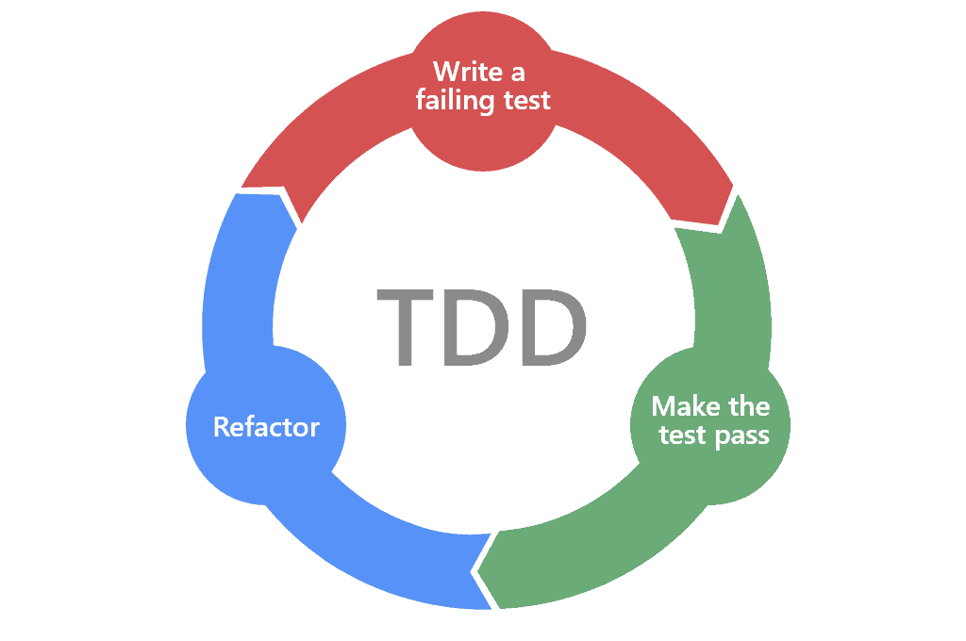
How it works
Red
Write a failing test
Green
Make the test pass as quickly as possible
Refactor
Cleanup the code

Slide 15
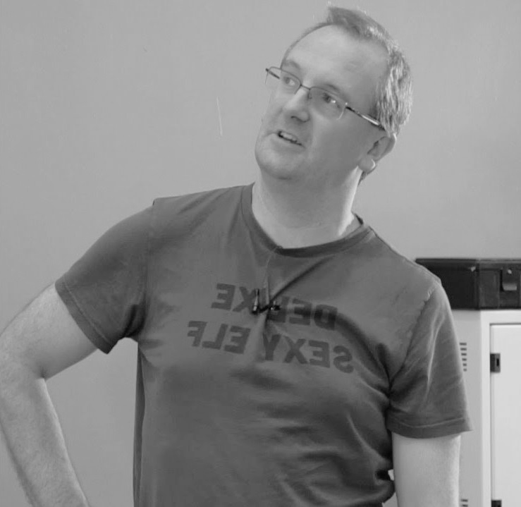
TDD vs TFD
There's a difference in terms of what the driving factor is.
Do you have a vague idea of what the class (or system - this can happen at different scales, of course) should look like, then think up tests which give it the actual shape? That's TDD.
Do you know exactly what the public API of the class should be, and just write the tests before the implementation? That's test-first development.
To put it another way, TDD starts with "What questions do I want to ask?" whereas non-TDD (whether test first or not) starts with "What answer do I want to give?"
Jon Skeet
Read at stack overflow

Slide 16
BDD

Slide 17

What is Behavior
Daniel Terhorst North AKA Dan North
Customer requirement

Slide 18
How it works
Where to start?
What to test and what not to test?
How much to test in one go?
What to call the tests?
How to understand why a test fails?
What’s the next most important thing the system doesn’t do?
Test Behavior not classes or methods
Unit
Test method names should be sentences including business domain terms, start the method name with should/will/shall
An expressive test name is helpful to identify why test fails
I had introduced a bug. Bad me. Solution: Fix the bug.
The intended behaviour was still relevant but had moved elsewhere. Solution: Move the test and maybe change it.
The behaviour was no longer correct – the premise of the system had changed. Solution: Delete the test.
Daniel Terhorst North AKA Dan North
Introduction to BDD

Slide 19
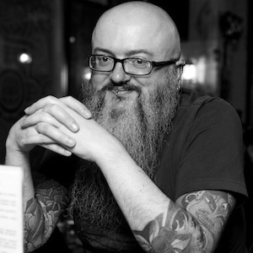
What to test and what not to
Do not test implementation detail test behavior
The SUT(Systems Under Test) is not classes, it’s the module facade i.e exports
In the Unit test ‘Unit’ means modules not classes, a class may be a facade but many
classes are just implementation details of the module.
Don’t write test for implementation details, write tests for stable public contracts of the API
You can write tests for implementation detail only when it’s difficult to understand,
refactor then delete the tests afterwards.
Unit of isolation is the test, not the class, not the SUT.
Do not write new Tests when refactoring.
Avoid heavy mocking.
Don’t test internals, don’t make everything public in order to test it.
Go green as quickly as possible, commit whatever sin you have to to go there
Ian Cooper
TDD, where did it all go wrong

Slide 20
When to refactor
Do not attempt to solve the problem and write your best code at the same time. Write your best code at the best time, when you understand the solution.
Refactor when ?
It’s when you remove duplication. [Beck]
It’s when you sanitize the code smells. [Fowler]
It’s when you apply patterns. [Kerievsky]

Slide 21
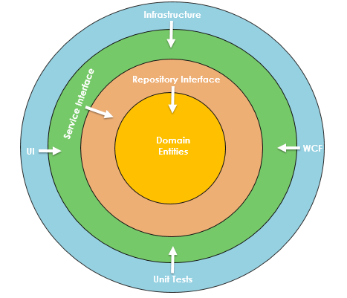
Where are my tests
Onion architecture

Slide 22
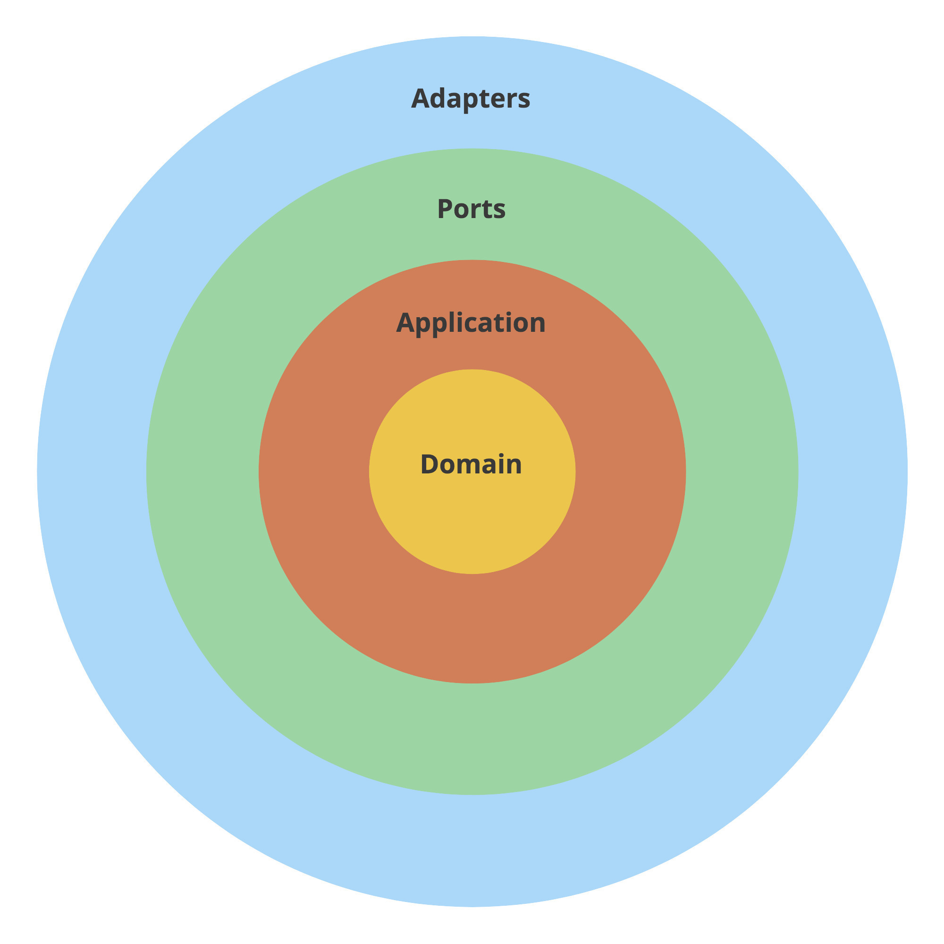
Where are my tests
Ports are interfaces
Adapters are concrete implementations of the interfaces
Test the ports not adapters
Ports and Adapters
Recommended reading

Slide 23
In a Nutshell
[Test Class ]
Class attribute
[Test Method]
Method attribute
Naming convention : MethodName_Scenario_ExpectedBehavior
Here scenario is number of ways execution can exit a method
Eg: GetUserById_WhenIdIsGreatherThanZero_ReturnsUser
GetUserById_WhenUserNotFound_ThrowsException
Or
GetUserById_WhenUserNofFound_ReturnsNull
DeleteGroup_WhenGroupHasUsersAssigned_ThrowsException
DeleteGroup_WhenGroupNotFound_ThrowsException
DeleteGroup_WhenSatisfiesBusiness_DeletesGroup

Slide 24
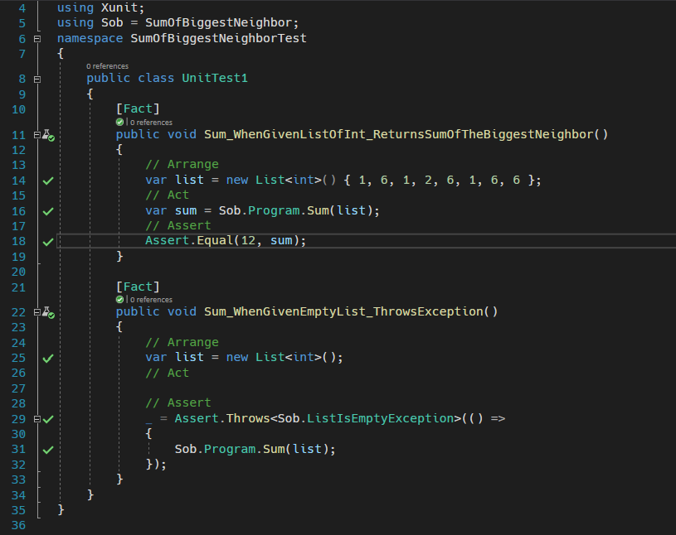
In a Nutshell
Triple A rule :
Arrange
Setup all the variables and initialization
Act
Call the method to generate result
Assert
Assert the result to true/false/equality etc

Slide 25
In a Nutshell
What makes a unit test good :
ATRIP
Automatic
A unit test should be automatic, running and testing the results.
Thorough
Coverage of the test should be 100%
Repeatable
Tests should generate same result every time.
Independent
Tests should not rely on other tests, it should run in isolation, ensure clean slate before each test
Professional
Follow good design principles, good naming standards, well factored methods, SOLID, GRASP, DRY

Slide 26
DEMO

Slide 27
What else do we need
Practice, Practice, Practice, Practice, Practice, Practice, Practice, Practice, Practice, Practice, Practice, Practice, Practice, Practice, Practice, Practice, Practice, Practice, Practice, Practice, Practice, Practice, Practice, Practice, Practice, Practice, Practice, Practice, Practice, Practice, Practice, Practice, Practice, Practice, Practice, Practice, Practice, Practice, Practice, Practice, Practice, Practice, Practice, Practice, Practice, Practice, Practice, Practice, Practice, Practice, Practice, Practice, Practice, Practice, Practice, Practice, Practice, Practice, Practice, Practice, Practice, Practice, Practice, Practice, Practice, Practice, Practice, Practice, Practice, Practice, Practice, Practice, Practice, Practice, Practice, Practice, Practice, Practice, Practice, Practice, Practice, Practice, Practice, Practice, Practice, Practice, Practice, Practice, Practice, Practice, Practice, Practice, Practice, Practice, Practice, Practice, Practice, Practice, Practice, Practice, Practice, Practice, Practice, Practice, Practice, Practice, Practice, Practice, Practice, Practice, Practice, Practice, Practice, Practice, Practice, Practice, Practice, Practice, Practice, Practice, Practice, Practice, Practice, Practice, Practice, Practice, Practice, Practice, Practice, Practice, Practice, Practice, Practice, Practice, Practice, Practice, Practice, Practice, Practice, Practice, Practice, Practice, Practice, Practice, Practice, Practice, Practice, Practice, Practice, Practice, Practice, Practice, Practice, Practice, Practice, Practice, Practice, Practice, Practice, Practice, Practice, Practice, Practice, Practice, Practice, Practice, Practice, Practice, Practice, Practice, Practice, Practice, Practice, Practice, Practice, Practice, Practice, Practice, Practice, Practice, Practice, Practice, Practice, Practice, Practice, Practice, Practice, Practice, Practice, Practice, Practice, Practice, Practice, Practice, Practice, Practice, Practice, Practice, Practice, Practice, Practice, Practice, Practice, Practice, Practice, Practice, Practice, Practice, Practice, Practice, Practice, Practice, Practice, Practice, Practice, Practice, Practice, Practice, Practice, Practice, Practice, Practice, Practice, Practice, Practice, Practice, Practice, Practice, Practice, Practice, Practice, Practice, Practice, Practice, Practice, Practice, Practice, Practice, Practice, Practice, Practice, Practice, Practice, Practice, Practice, Practice, Practice, Practice, Practice, Practice, Practice, Practice, Practice, Practice, Practice, Practice, Practice, Practice, Practice, Practice, Practice, Practice, Practice, Practice, Practice, Practice, Practice, Practice, Practice, Practice, Practice, Practice, Practice, Practice, Practice, Practice, Practice, Practice, Practice, Practice, Practice, Practice, Practice, Practice, Practice, Practice, Practice, Practice, Practice, Practice, Practice, Practice, Practice, Practice, Practice, Practice, Practice, Practice, Practice, Practice, Practice, Practice, Practice, Practice, Practice, Practice, Practice, Practice, Practice, Practice, Practice, Practice, Practice, Practice, Practice, Practice, Practice, Practice, Practice, Practice, Practice, Practice, Practice, Practice, Practice, Practice, Practice, Practice, Practice, Practice, Practice, Practice, Practice, Practice, Practice, Practice, Practice, Practice, Practice, Practice, Practice, Practice, Practice, Practice, Practice, Practice, Practice, Practice, Practice, Practice, Practice, Practice, Practice, Practice, Practice, Practice, Practice, Practice, Practice, Practice, Practice, Practice, Practice, Practice, Practice, Practice, Practice, Practice, Practice, Practice, Practice, Practice, Practice, Practice, Practice, Practice, Practice, Practice, Practice, Practice, Practice, Practice, Practice, Practice, Practice, Practice, Practice, Practice, Practice, Practice, Practice, Practice, Practice, Practice, Practice, Practice, Practice, Practice, Practice, Practice, Practice, Practice, Practice, Practice, Practice, Practice, Practice, Practice, Practice, Practice, Practice, Practice, Practice, Practice, Practice, Practice, Practice, Practice, Practice, Practice, Practice, Practice, Practice, Practice, Practice, Practice, Practice, Practice, Practice, Practice, Practice, Practice, Practice, Practice, Practice, Practice, Practice, Practice, Practice, Practice, Practice, Practice, Practice, Practice, Practice, Practice, Practice, Practice, Practice, Practice, Practice, Practice, Practice, Practice, Practice, Practice, Practice, Practice, Practice, Practice, Practice, Practice, Practice, Practice, Practice, Practice, Practice, Practice, Practice, Practice, Practice, Practice, Practice, Practice, Practice, Practice, Practice, Practice, Practice, Practice, Practice, Practice, Practice, Practice, Practice, Practice, Practice, Practice, Practice, Practice, Practice, Practice, Practice, Practice, Practice, Practice, Practice, Practice, Practice, Practice, Practice, Practice, Practice, Practice, Practice, Practice, Practice, Practice, Practice, Practice, Practice, Practice, Practice, Practice, Practice, Practice, Practice, Practice, Practice, Practice, Practice, Practice, Practice, Practice, Practice, Practice, Practice, Practice, Practice, Practice, Practice, Practice, Practice, Practice, Practice, Practice, Practice, Practice, Practice, Practice, Practice, Practice, Practice, Practice, Practice, Practice, Practice, Practice, Practice, Practice, Practice, Practice, Practice, Practice, Practice, Practice, Practice, Practice, Practice, Practice, Practice, Practice, Practice, Practice, Practice, Practice, Practice, Practice, Practice, Practice, Practice, Practice, Practice, Practice, Practice, Practice, Practice, Practice, Practice, Practice, Practice, Practice, Practice, Practice, Practice, Practice, Practice, Practice, Practice, Practice, Practice, Practice, Practice, Practice, Practice, Practice, Practice, Practice, Practice, Practice, Practice, Practice, Practice, Practice, Practice, Practice, Practice, Practice, Practice, Practice, Practice, Practice, Practice, Practice, Practice, Practice, Practice, Practice, Practice, Practice, Practice, Practice, Practice, Practice, Practice, Practice, Practice, Practice, Practice, Practice, Practice, Practice, Practice, Practice, Practice, Practice, Practice, Practice, Practice, Practice, Practice, Practice, Practice, Practice, Practice, Practice, Practice, Practice, Practice, Practice, Practice, Practice, Practice, Practice, Practice, Practice, Practice, Practice, Practice, Practice, Practice, Practice, Practice, Practice, Practice, Practice, Practice, Practice, Practice, Practice, Practice, Practice, Practice, Practice, Practice, Practice, Practice, Practice, Practice, Practice, Practice, Practice, Practice, Practice, Practice, Practice, Practice, Practice, Practice, Practice, Practice, Practice, Practice, Practice, Practice, Practice, Practice, Practice, Practice, Practice, Practice, Practice, Practice, Practice, Practice, Practice, Practice, Practice, Practice, Practice, Practice, Practice, Practice, Practice, Practice, Practice, Practice, Practice, Practice, Practice, Practice, Practice, Practice, Practice, Practice, Practice, Practice, Practice, Practice, Practice, Practice, Practice, Practice, Practice, Practice, Practice, Practice, Practice, Practice, Practice, Practice, Practice, Practice, Practice, Practice, Practice, Practice, Practice, Practice, Practice, Practice, Practice, Practice, Practice, Practice, Practice, Practice, Practice, Practice, Practice, Practice, Practice, Practice, Practice, Practice, Practice, Practice, Practice, Practice, Practice, Practice, Practice, Practice, Practice, Practice, Practice, Practice, Practice, Practice, Practice, Practice, Practice, Practice, Practice, Practice, Practice, Practice, Practice, Practice, Practice, Practice, Practice, Practice, Practice, Practice, Practice, Practice, Practice, Practice, Practice, Practice, Practice, Practice, Practice, Practice, Practice, Practice, Practice, Practice, Practice, Practice, Practice, Practice, Practice, Practice, Practice, Practice, Practice, Practice, Practice, Practice, Practice, Practice, Practice, Practice, Practice, Practice, Practice, Practice, Practice, Practice, Practice, Practice, Practice, Practice, Practice, Practice, Practice, Practice, Practice, Practice, Practice, Practice, Practice, Practice, Practice, Practice, Practice, Practice, Practice, Practice, Practice, Practice, Practice, Practice, Practice, Practice, Practice, Practice, Practice, Practice, Practice, Practice, Practice, Practice, Practice, Practice, Practice, Practice, Practice, Practice, Practice, Practice, Practice, Practice, Practice, Practice, Practice, Practice, Practice, Practice, Practice, Practice, Practice, Practice, Practice, Practice, Practice, Practice, Practice, Practice, Practice, Practice, Practice, Practice, Practice, Practice, Practice, Practice, Practice, Practice, Practice, Practice, Practice, Practice, Practice, Practice, Practice, Practice, Practice, Practice, Practice, Practice, Practice, Practice, Practice, Practice, Practice, Practice, Practice, Practice, Practice, Practice, Practice, Practice, Practice, Practice, Practice, Practice, Practice, Practice, Practice, Practice, Practice, Practice, Practice, Practice, Practice, Practice, Practice, Practice, Practice, Practice, Practice, Practice, Practice, Practice, Practice, Practice, Practice, Practice, Practice, Practice, Practice, Practice, Practice, Practice, Practice, Practice, Practice, Practice, Practice, Practice, Practice, Practice, Practice, Practice, Practice, Practice, Practice, Practice, Practice, Practice, Practice, Practice, Practice, Practice, Practice, Practice, Practice, Practice, Practice, Practice, Practice, Practice, Practice, Practice, Practice, Practice, Practice, Practice, Practice, Practice, Practice, Practice, Practice, Practice, Practice, Practice, Practice, Practice, Practice, Practice, Practice, Practice, Practice, Practice, Practice, Practice, Practice, Practice, Practice, Practice, Practice, Practice, Practice, Practice, Practice, Practice, Practice, Practice, Practice, Practice, Practice, Practice, Practice, Practice, Practice, Practice, Practice, Practice, Practice, Practice, Practice, Practice, Practice, Practice, Practice, Practice, Practice, Practice, Practice, Practice, Practice, Practice, Practice, Practice, Practice, Practice, Practice, Practice, Practice, Practice, Practice, Practice, Practice, Practice, Practice, Practice, Practice, Practice, Practice, Practice, Practice, Practice, Practice, Practice, Practice, Practice, Practice, Practice, Practice, Practice, Practice, Practice, Practice, Practice, Practice, Practice, Practice, Practice, Practice, Practice, Practice, Practice, Practice, Practice, Practice, Practice, Practice, Practice, Practice, Practice, Practice, Practice, Practice, Practice, Practice, Practice, Practice, Practice, Practice, Practice, Practice, Practice, Practice, Practice, Practice, Practice, Practice, Practice, Practice, Practice, Practice, Practice, Practice, Practice, Practice, Practice, Practice, Practice, Practice, Practice, Practice, Practice, Practice, Practice, Practice, Practice, Practice, Practice, Practice, Practice, Practice, Practice, Practice, Practice, Practice, Practice, Practice, Practice, Practice, Practice, Practice, Practice, Practice, Practice, Practice, Practice, Practice, Practice, Practice, Practice, Practice, Practice, Practice, Practice, Practice, Practice, Practice, Practice, Practice, Practice, Practice, Practice, Practice, Practice, Practice, Practice, Practice, Practice, Practice, Practice, Practice, Practice, Practice, Practice, Practice, Practice, Practice, Practice, Practice, Practice, Practice, Practice, Practice, Practice, Practice, Practice, Practice, Practice, Practice, Practice, Practice, Practice, Practice, Practice, Practice, Practice, Practice, Practice, Practice, Practice, Practice, Practice, Practice, Practice, Practice, Practice, Practice, Practice, Practice, Practice, Practice, Practice, Practice, Practice, Practice, Practice, Practice, Practice, Practice, Practice, Practice, Practice, Practice, Practice, Practice, Practice, Practice, Practice, Practice, Practice, Practice, Practice, Practice, Practice, Practice, Practice, Practice, Practice, Practice, Practice, Practice, Practice, Practice, Practice, Practice, Practice, Practice, Practice, Practice, Practice, Practice, Practice, Practice, Practice, Practice, Practice, Practice, Practice, Practice, Practice, Practice, Practice, Practice, Practice, Practice, Practice, Practice, Practice, Practice, Practice, Practice, Practice, Practice, Practice, Practice, Practice, Practice, Practice, Practice, Practice, Practice, Practice, Practice, Practice, Practice, Practice, Practice, Practice, Practice, Practice, Practice, Practice, Practice, Practice, Practice, Practice, Practice, Practice, Practice, Practice, Practice, Practice, Practice, Practice, Practice, Practice, Practice, Practice, Practice, Practice, Practice, Practice, Practice, Practice, Practice, Practice, Practice, Practice, Practice, Practice, Practice, Practice, Practice, Practice, Practice more Practice...

Slide 28
Is TDD feasible

Slide 29
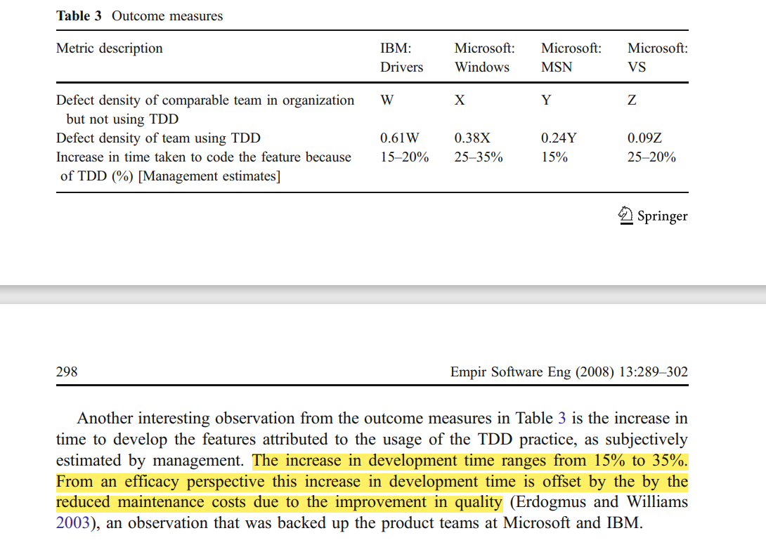
How much development time increases
Microsoft published paper in 2008
Read the paper here

Slide 30
What case studies show
Long lasting regression test (self testing code is very powerful)
Test coverage is very high (in 90% range)
Cost reduction in long term
Find the mistakes while you are in the context
Gain development speed over time
Not all bugs can be removed
Read full length case studies here

Slide 31
A word on development cost
Catching bug late also increases development cost (angry customer is a bonus)
Manual testing surely increases development cost
Manual Regression testing surely increases development cost
The fear of change(add/change features later) also increases development cost
Any amount of change is triggers regression test
Quality product makes customer happy, this has enormous value
Read full length case studies here

Slide 32
Thank God It’s over

