Slide 1
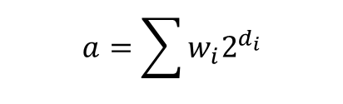




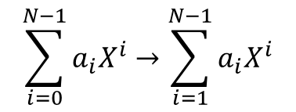




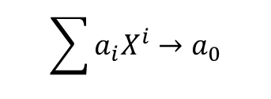



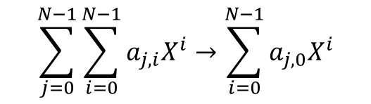





$$a=\sum{w_{i}2^{d_{i}}}$$
DCP
$$a→X^{a}$$
ADDRESS
RAM
READ
TOEXP
$$X^{a}→a$$
$$X^{i}=\prod{X^{w_{i}}X^{N^{i}}}$$
$$\sum{\sum_{i=0}^{N−1}{a_{j,i}X^{i}}}$$
ADDRESS
RAM
TOINT
$$\sum_{j=0}^{N−1}{\sum_{i=0}^{N−1}{a_{j,i}X^{i}}}→\sum_{i=0}^{N−1}{a_{j,0}X^{i}}$$
$$…$$
$$…$$
PACK
$$\sum{a_{i}X^{i}}→a_{0}$$
TRACE
$$\sum_{i=0}^{N−1}{a_{i}X^{i}}→\sum_{i=1}^{N−1}{a_{i}X^{i}}$$
ITRACE
pc
imm
rs2
rs1
rd
rdw
pcw
mw
: Convolution
PACK
: Addition
$$φ$$
:${ X}^{i}→X^{−i}$
Monomial: $X^{i}$
TRACE
Polynomial: $∑a_{i}X^{i}$
Integer: $a$
imm
rs2
rs1
rd
rdw
pcw
mw
WRITE
ITRACE
SE
SE
SE
SE
SE
SE
SE
imm
rs2
rs1
rd
rdw
pcw
mw
CBT
CBT
CBT
CBT
CBT
CBT
CBT
$$φ$$
$$X$$
$$X^{2}$$
$$X^{3}$$
R
imm
rs2
rs1
rd
rdw
pcw
mw
TRACE
ITRACE
TRACE
TRACE
ITRACE
ITRACE
MUL
TRACE
ITRACE
SE
SE
SE
SE
pc
imm
rs2
rs1
M
$$φ$$
PCUPDATE
ARITHMETIC
LOAD
rd
pc
SE
rd
SE
WRITE
WRITE
pc
CBT
pc

